Slide 1
Practice on 7. Mapmaking
Miliaritiana Robjhon, Ehsan Bhuiyan, and Grace Dines
NOAA/Climate Prediction Center, ERT INC., UCAR
PREPARE Forecaster’s Training Workshop
Port of Spain, 4 – 10 December 2024

Slide 2
Continental Heat Hazard Map
Create a Heat Hazard map over Africa
You can extract Africa from your original shape file
Use separate polygon for Moderately Severe, Severe, and Extremely Severe Heat levels using RGB color settings
Your map should have clear and easy to read title, legend, data source, etc.
Heat level | R | G | B
Moderately severe | 255 | 150 | 0
Severe | 255 | 0 | 0
Extremely severe | 130 | 0 | 0

Slide 3
Sub-regional Forecast Map
Create a sub-regional (e.g., West Africa or Eastern Africa or Southern Africa) production level seasonal forecast map(find “subregion” from attribute table)
Your map should have clear and easy to read title, legend, data source, etc.

Slide 4
Country-level Forecast Map
Similar to previous exercises, generate a map but for your home country this time(find “name” from attribute table)
Extract your country from the admin0 data
Create a map with easy to read and understand title, legend, data source, etc.

Slide 5
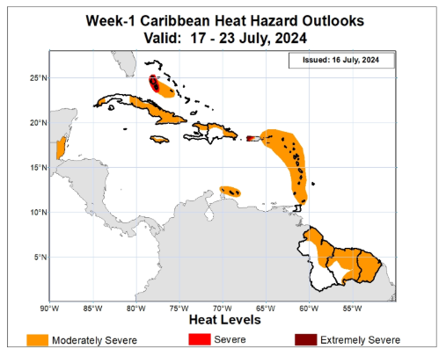

Slide 6
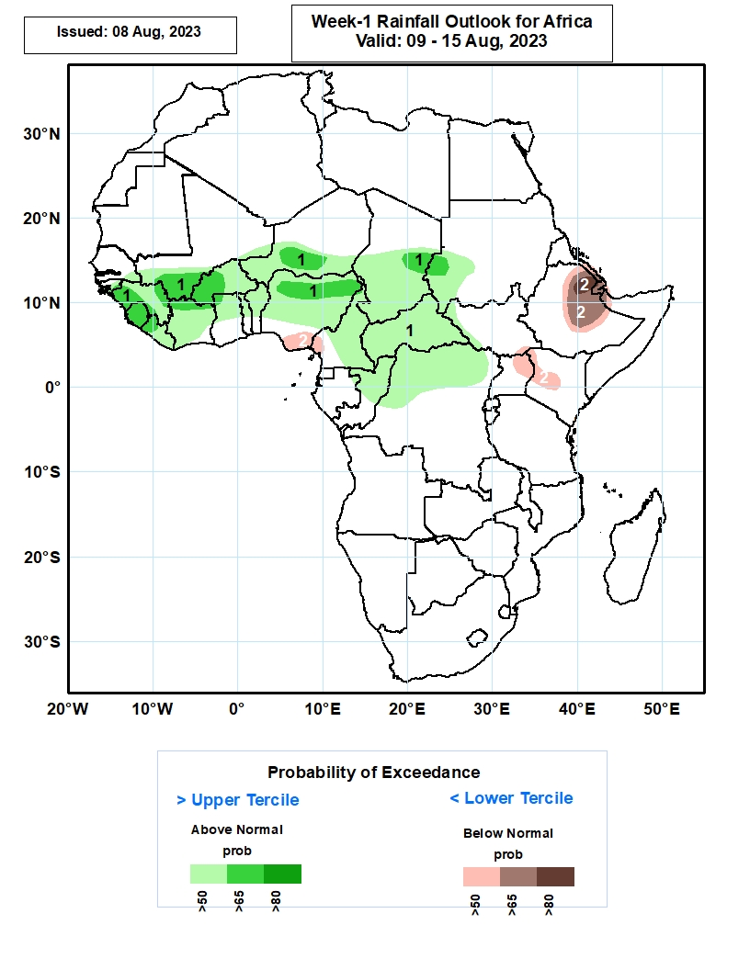

Slide 7
