Slide 1
Practice on 1. Introduction
Miliaritiana Robjhon, Ehsan Bhuiyan, and Grace Dines
NOAA/Climate Prediction Center, ERT INC., UCAR
PREPARE Forecaster’s Training Workshop
Port of Spain, 4 – 10 December 2024

Slide 2
Exercise 1: Familiarization With QGIS
Try to find these tools and identify their purposes
1
2.
3
4
5
Locate and hold your mouse over each toolbar for a while

Slide 3
Exercise 2: Loading Vector Data
Navigate to the workshop data and load countries shapefile
Identify the CRS for project
Drag data to the map canvas
CRS

Slide 4
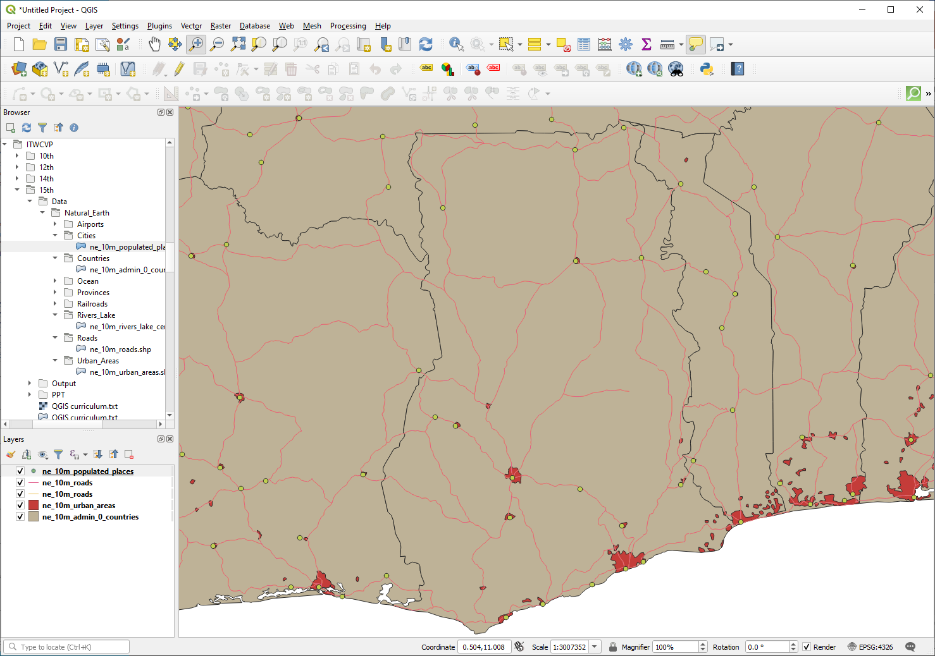
Exercise 2: Loading Vector Data (Cont’d.)
Load urban areas, roads, rivers lake, and cities shapefiles
Use the toolbar and draw a rectangle to zoom in over any country
Identify the geometry for each vector data

Slide 5
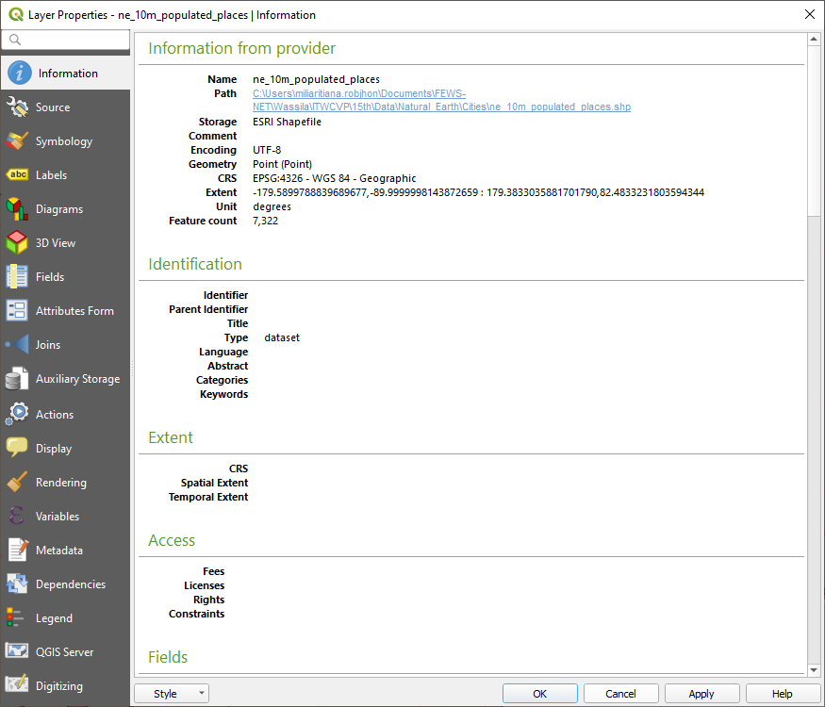
Exercise 3: Properties and Classification
Identify the CRS for each data (layer) by hovering the mouse over
Explore populated places properties by double clicking the data and selecting information in the left tab
Repeat the above for each data

Slide 6
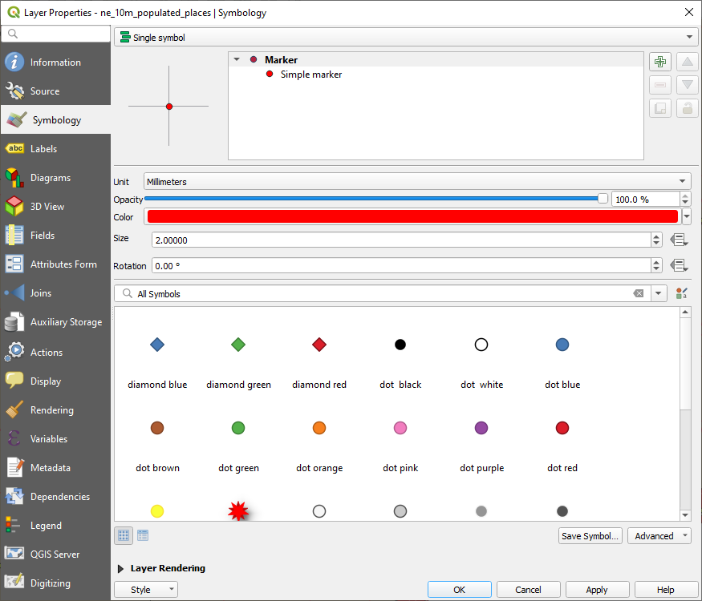
Exercise 3: Properties and Classification
Change the color of populated places to red by opening its properties and selecting Symbology in the left tab
Change also the properties for the remaining data to your likings

Slide 7
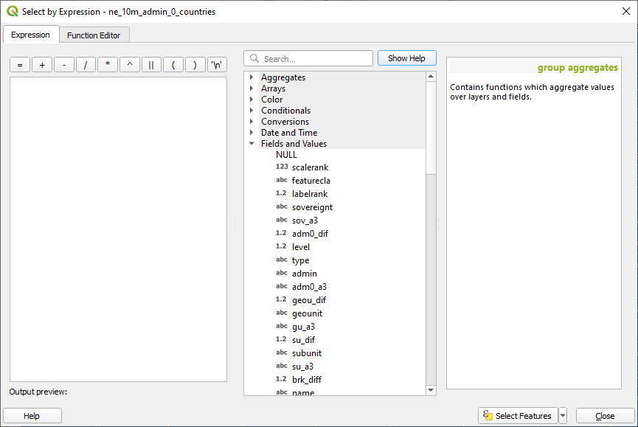
Exercise 4: Querying Attribute Table
Objective: Find countries in Africa with a population >= 10M
Right click on admin0 and open its Attribute Table
Expand Fields and Values, find and double click pop_est

Slide 8
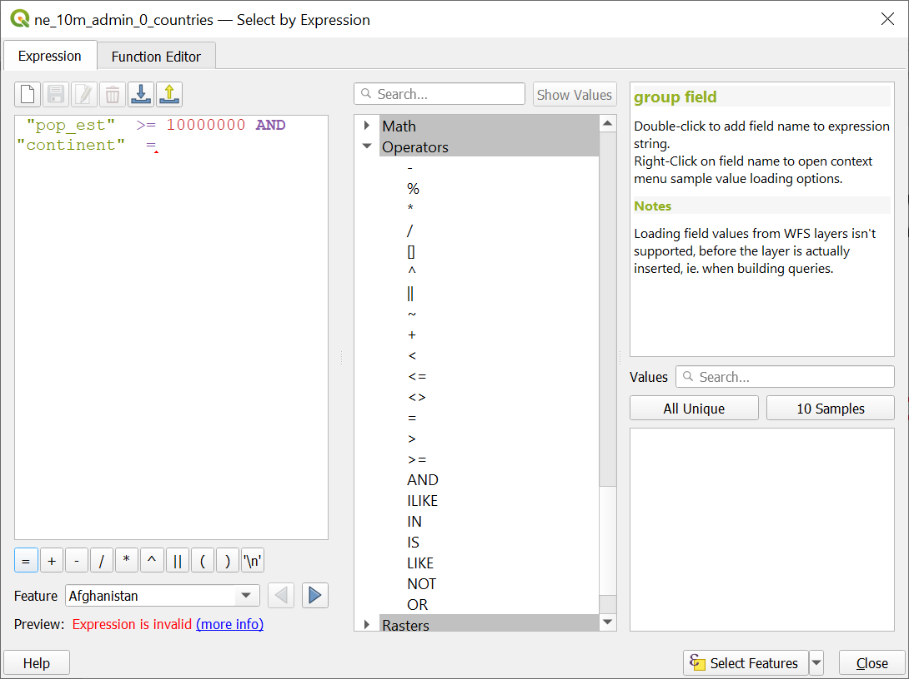
Exercise 4: Querying Attribute Table (Cont.)
Scroll down to Operators, double click >=, and type 10000000 in the Expression field
In Operators, double click AND, scroll up to Fields and Values, find, and double click continent
Click on = , click All Unique, and double click Africa
1
4
2
3

Slide 9
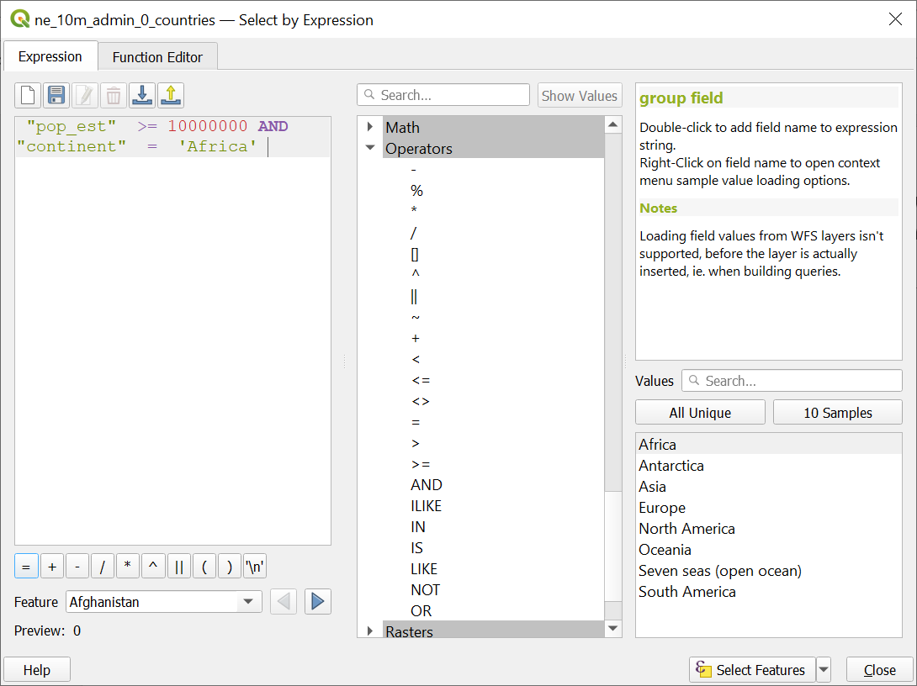
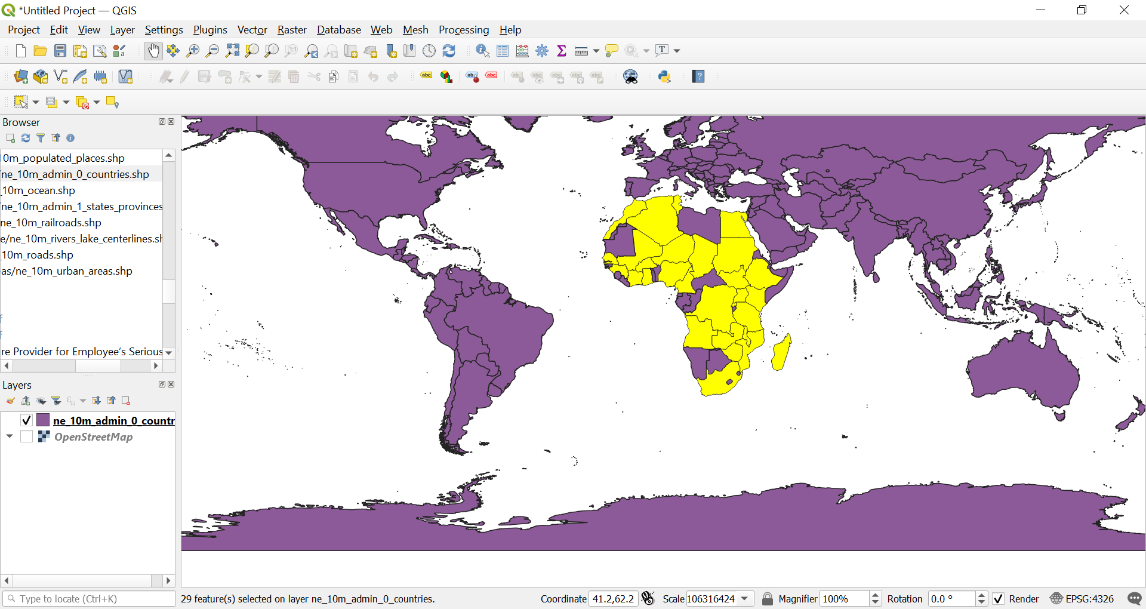
Exercise 4: Querying Attribute Table (Cont.)
Click Select Features. Save as a new data by right clicking on admin0, then Export > Save Selected Featured As

