Slide 1
Introduction to GIS
Miliaritiana Robjhon, Ehsan Bhuiyan, and Grace Dines
NOAA/Climate Prediction Center, ERT INC., UCAR
PREPARE Forecaster’s Training Workshop
Port of Spain, 4 – 10 December 2024

Slide 2
Definition of GIS
GIS is an acronym for Geographic Information Systems. It is a computer-based tool that stores, analyzes, and visualizes data for geographic positions on the Earth’s surface
It needs data to work with, computer hardware to store the data, and software for analysis
Choices between proprietary and open source software
Proprietary software requires purchase of license – example ArcGIS
Open source is free to download and use – example QGIS

Slide 3
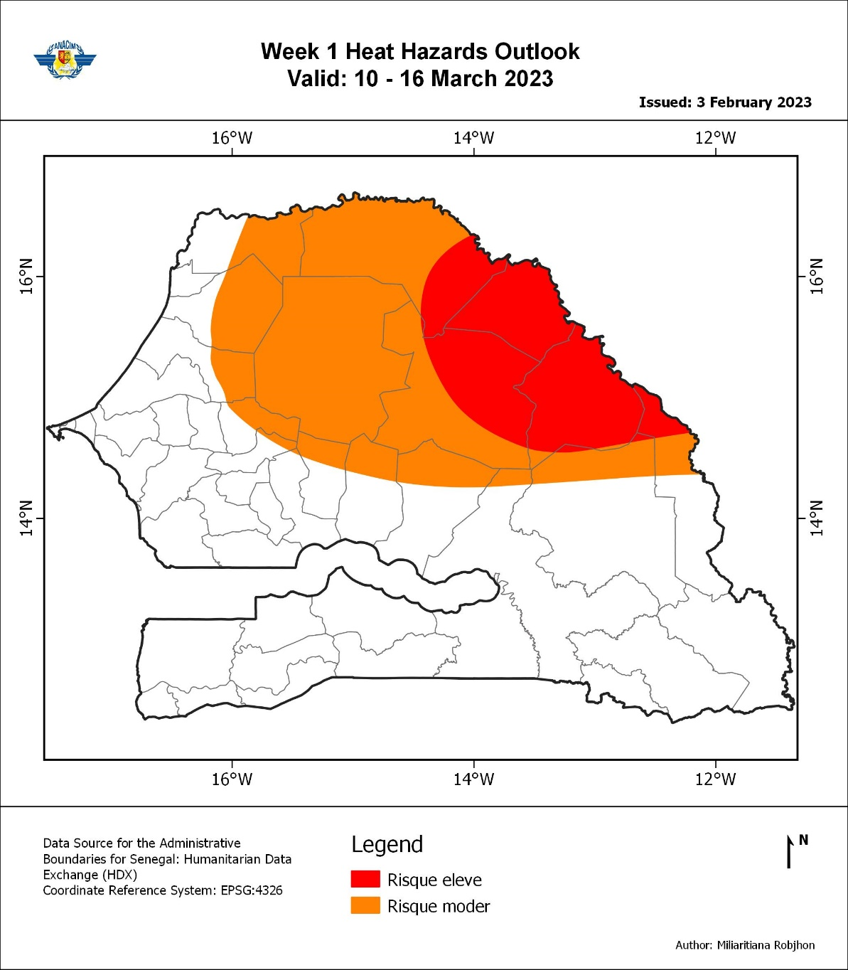
GIS Process
The goal is to answer real world problem – example locating flood prone areas, etc.
Takes geographic/non geographic data and turn into new geospatial information
Presents results in a form of maps, statistics, or reports

Slide 4
QGIS Background
Developed by Gary Sherman in early 2002
Quantum GIS version 1 officially released in 2009
The name was officially changed to QGIS in 2013

Slide 5
GIS Data
Two groups of data
Vector
Raster

Slide 6
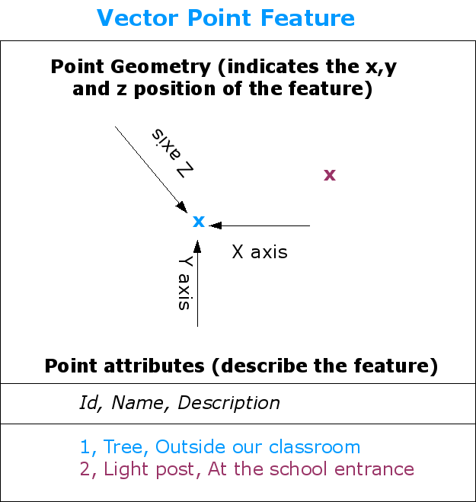
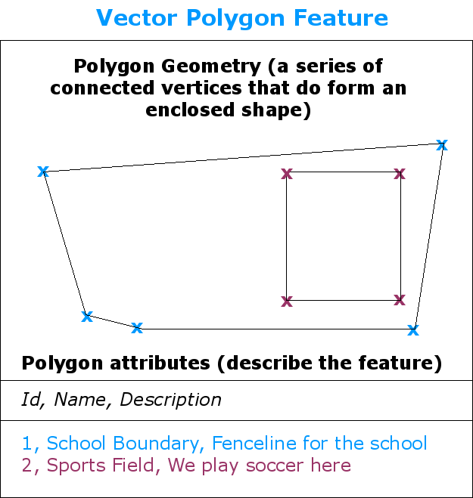
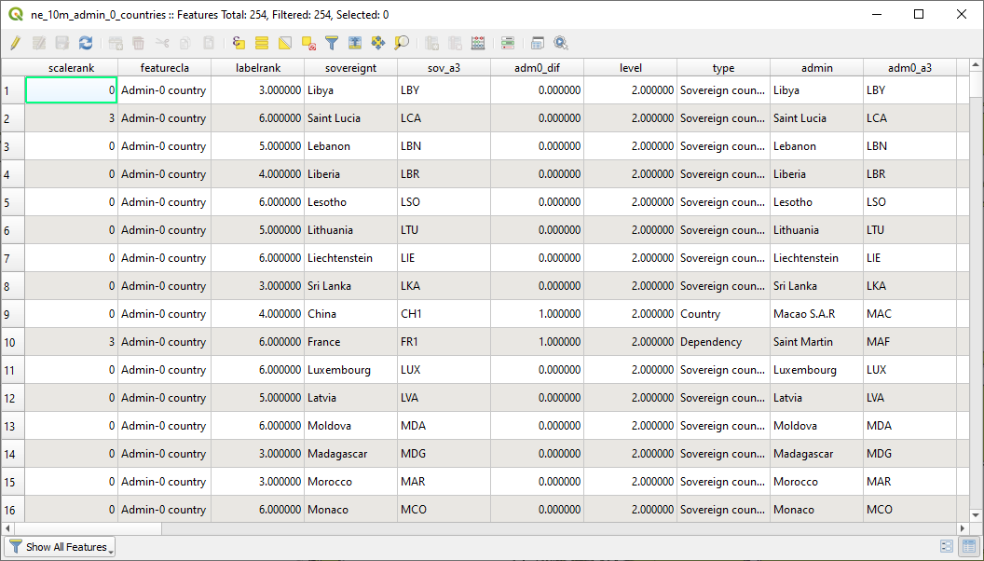
Vector Data
Vector data are representation of features in real world in maps
Characterized by geometry or shapes and attributes
Will primarily focus on vector data today

Slide 7
Geometry and Attributes
Geometry | Real World | Map
Points | Cities, towns, rain gauge stations, … | Points
Lines | Roads, rivers, cyclone track, ITCZ, … | Lines
Polygons | Continents, countries, floods, droughts, … | Polygons
Attributes
Text or numerical information that describe the features, often organized in a table form, called Attribute Table

Slide 8
Coordinate Reference System (CRS)
Defines how spatial dimensions on the projected map relate to the real world
Datum
Projection

Slide 9
Datum
Physical reference systems
Model of the Earth that is used in mapping
Series of numbers that define the shape and size of the ellipsoid and orientation
Chosen to give the best possible fit to the true shape of the Earth
Datum examples: WGS84, NAD27, NAD83
The coordinates of the Christchurch cathedral in New Zealand are
172.63658°E; 43.53103°S in WGS84 but
172.36344°E; 43.53270°S in Geodetic 1949

Slide 10
Projection
A mathematical process of flattening out the Earth onto a flat plane (paper or screen)
Convert the 3-Dimensional Earth’s spherical shape to 2-Dimensional map
Distort some elements of the map:
Conformality
Distance
Area
Direction

Slide 11
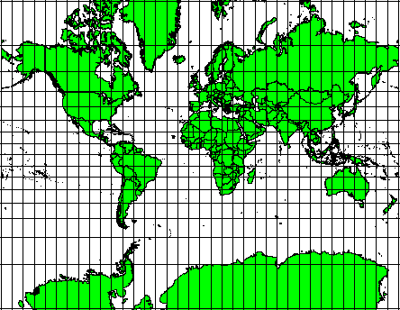
Conformality
Map projection always distorts some or all elements of angular conformity, distance, and areas
The Mercator projection preserves the angular conformity; but distorts areas
The Mercator projection
(qgis.org)

Slide 12
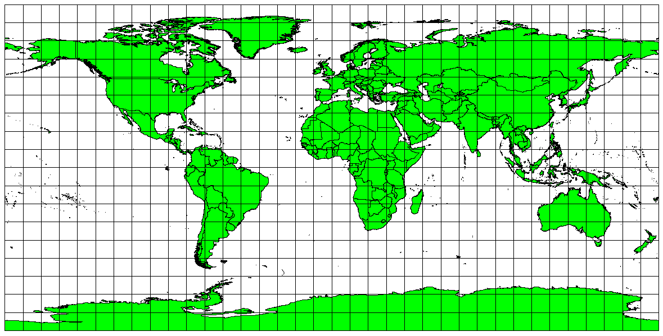
Distance
Equidistant projections represent distance from the center of the map to any place on the map accurately.
Scale is kept constant
The Plate Carree Equidistant Cylindrical projection
(qgis.org)

Slide 13
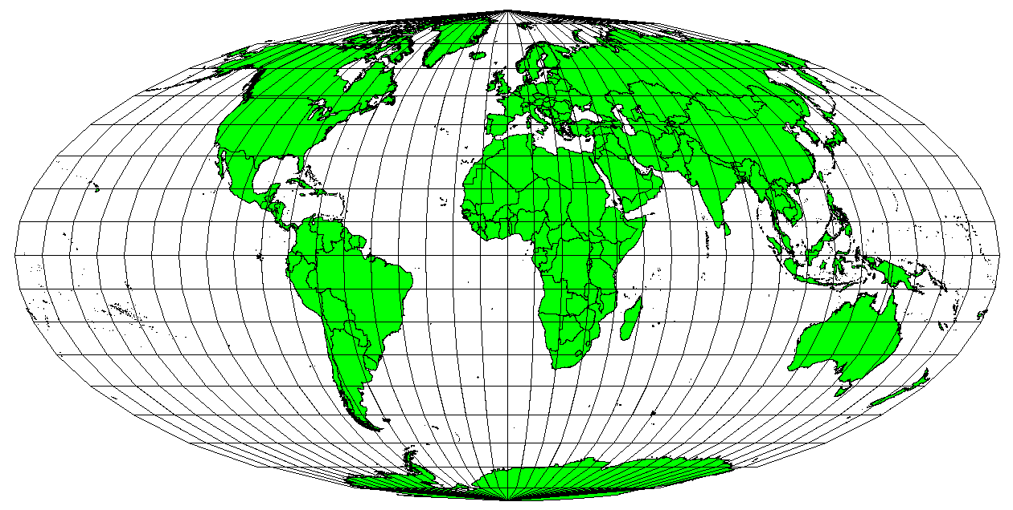
Area
Equal area map projections preserve the area, with the same proportional relationship to the areas on the Earth; but distort angular conformity
The Mollweide Equal Area Cylindrical projection
(qgis.org)

Slide 14
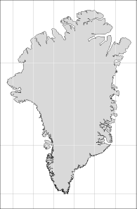
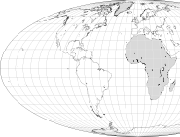
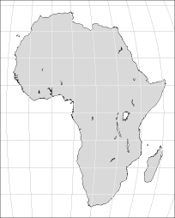
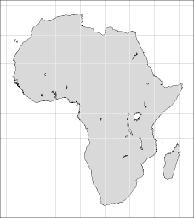
Projections (Cont’d.)
The area of Greenland is preserved but its shape is distorted
Greenland almost as big as Africa
Equal area
Conformal

Slide 15
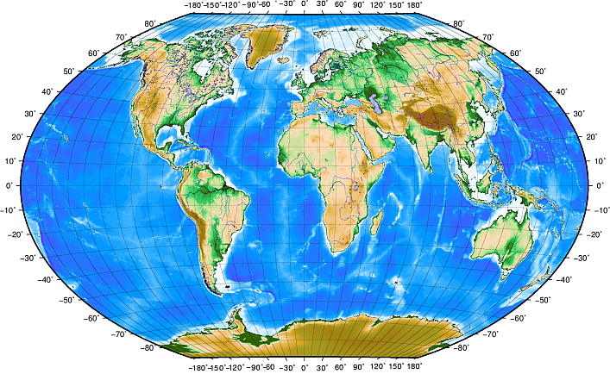
Geographic Coordinate Systems (GCS)
There are two main CRSs:
Geographic coordinate reference systems (GCS)
Projected coordinate reference systems (PCS) (also called Cartesian or rectangular)
GCS use degrees of latitude and longitude to locate a point on the Earth’s surface
The most popular is WGS 84
Geographic Coordinate System with latitudes and longitudes
(qgis.org)

Slide 16
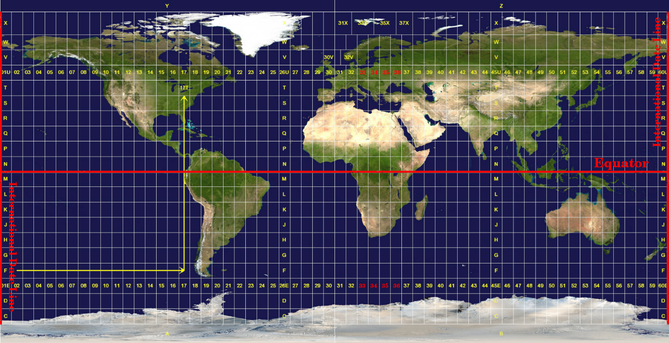
Projected Coordinate Systems (PCS)
The UTM CRS is a global map with 60 equal zones that are six degrees wide in longitude from east to west.
Zone 1 is at 180W longitude and progresses eastward
Unit is meters
PCS are commonly defined by two axes at right angle to each other.
Often used PCS is the Universal Transverse Mercator (UTM)
The Universal Transverse Mercator zones
(qgis.org)

Slide 17
Caution
All data have to be in the same CRS before analysis or processing
QGIS has on-the-fly projection, which transforms automatically data with different projections to a specific projection

Slide 18
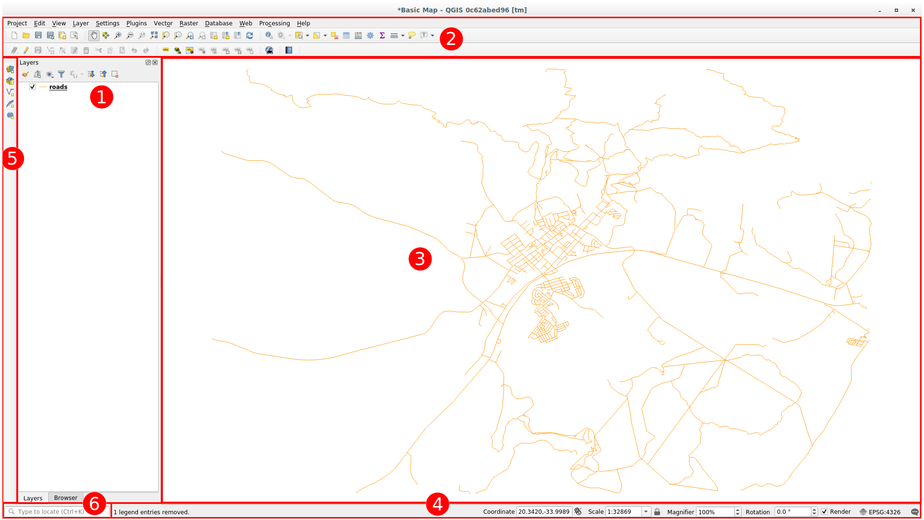
QGIS
1. Layers list/Browser Panel
2. Toolbars
3. Map Canvas
4. Status Bar
5. Side Toolbar
6. Locator Bar

Slide 19
Practice
Familiarization with QGIS
Loading vector data
Understanding CRS and reprojection
Filtering attributes

