Slide 1
Demonstration on Subseasonal Model Precip Calibration PREPARE Drought and Flood Early Warning for Central Pacific Islands Training Workshop Nadi, Fiji, 15-20 July 2024
Endalkachew Bekele
NOAA/CPC/International Desks

Slide 2
Model Forecast Post-Processing
Forecast Calibration in simple terms:
Build a relationship between forecast and observation in the hindcast period.
Use this historical forecast/observation relationship to correct biases in real-time forecasts
Why do we need to calibrate?
Because NWP models are not perfect >> forecast error grows with lead time.
Calibration methods:
From a simple “mean bias removal” method to a very complicated Machine Learning Techniques.

Slide 3
Model Forecast Post-Processing Methods
CPCID post-processing techniques:
Linear Regression (e.g. to calibrate rainfall onset/cessation forecast)
Ensemble Regression: Special form of Linear Regression applied to ensemble forecasts (e.g. precip/T2m week-1/2 and week 3-4 forecasts)
Skill Weighted Ensemble Forecast Consolidation: Consolidate forecasts from different ensemble prediction systems. Higher weight is given to a model with higher prediction skill in the past (e.g. week-1/2, and week 3-4 consolidated precip forecasts): (https://ftp.cpc.ncep.noaa.gov/International/PREPARE_Pacific/subseasonal/multi_cons/ )

Slide 4
Model Forecast Post-Processing Methods (cont.)
XCast-based Calibration Methods (statistical tools to calibrate dynamical forecasts):
Canonical Correlation Analysis (CCA): Pattern based linear regression.
Logistic Regression: The probability of a binary outcome (eg. Probability of above or below average) based on one or more predictor variables.
Extended Logistic Regression (ELR): Non-linear ensemble calibration method. It is an extended form of logistic regression by allowing more complex relationships between predictors and outcomes.
Probabilistic Output Extreme Learning Machine (POELM): Non-linear advanced machine learning approach (a single-hidden-layer feed-forward neural network).
Extended Probability Output Extreme Learning Machine (EPOELM): A combination of ELR and POELM approaches, to do non-exceedance forecasts for any threshold value after fitting.
These techniques are put together in a user-friendly Python-based toolkit - Xcast:
For more information, see https://xcast-lib.github.io/ (Hall and Acharya 2022).

Slide 5
Data and Calibration Period
Hindcast Data
GEFS Reforecast (ensemble mean of 5 members), 2000 – 2019.
CMORPH Observation Data, 2000 – 2019
Sample size increased by using 3-week window (three consecutive forecasts initialized on Wednesdays) for each year, 20 years X 3 Wednesdays = 60
Horizontal resolution of observation data: 0.25 deg
Real-time forecast data
Ensemble mean of 30 members of GEFS forecast
Horizontal resolution is 0.5 deg
Preprocess the data and convert them to netCDF format

Slide 6
Jupyter Notebook Demo
Download the demo file (Windows users):
Download file from:
https://ftp.cpc.ncep.noaa.gov/International/PREPARE_Pacific/subseasonal/subseasonal.zip
Save compressed file into your working directory (e.g. C:\Users\“your user name“)
Right click and unzip subseasonal.zip
Download the demo file (Linux & Mac users):
Using your Ubuntu terminal change your directory to your home folder, replace ‘home_folder_name’ with name of your directory (e.g. C:/Users/USERNAME)
$ cd home_folder_name
Download file using ‘wget’ command in terminal:
$ wget --no-check-certificate https://ftp.cpc.ncep.noaa.gov/International/PREPARE_Pacific/subseasonal/subseasonal.zip
Unzip file using:
$ unzip subseasonal.zip

Slide 7
Jupyter Notebook Demo (cont.)
Change directory to subseasonal using:
$ cd subseasonal
Launch Jupyter Notebook
Activate the intdesk_train environment
$ conda activate intdesk_train
If using a Mac or Linux Machine: ensure wget is correctly installed
$ pip install wget
Launch Jupyter Notebook, using the command below:
$ jupyter notebook
The notebook should launch automatically via your default Internet browser.

Slide 8
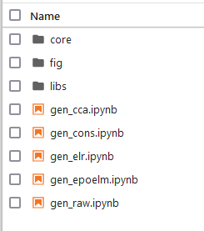
Jupyter Notebook Demo (cont.)
Click gen_cca.ipynb to open the Canonical Correlation analysis (CCA) code

Slide 9
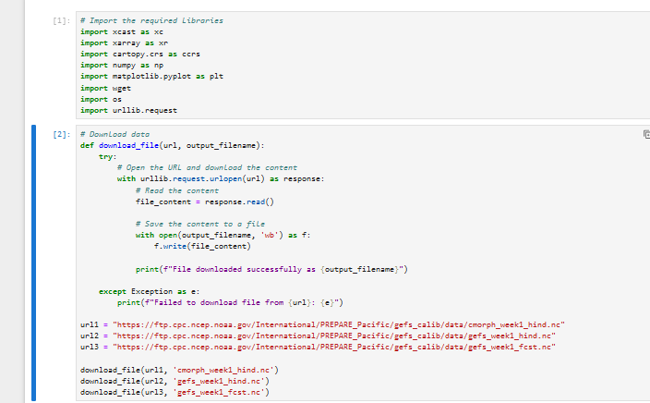
Jupyter Notebook Demo (cont.)
Import the required python libraries
Download model and observation data to train the model

Slide 10
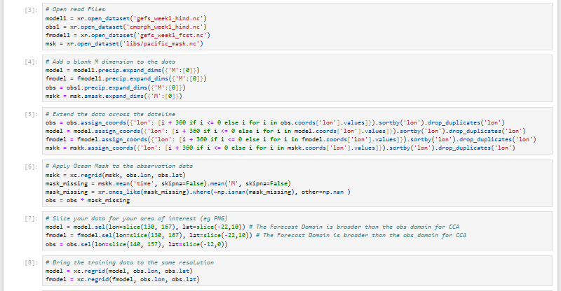
Jupyter Notebook Demo (cont.)
Open and Read model and observation data
Extend the domain across the dateline
Apply “ocean mask” to the data
Slice data for the your area of interest (PNG)
Bring model and observation data to same resolution (0.25deg)

Slide 11
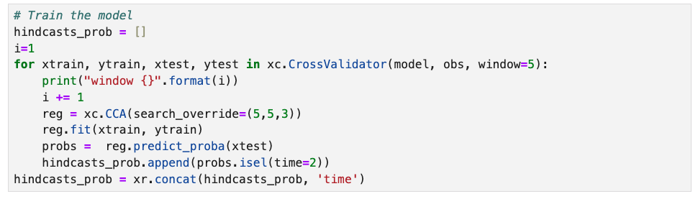
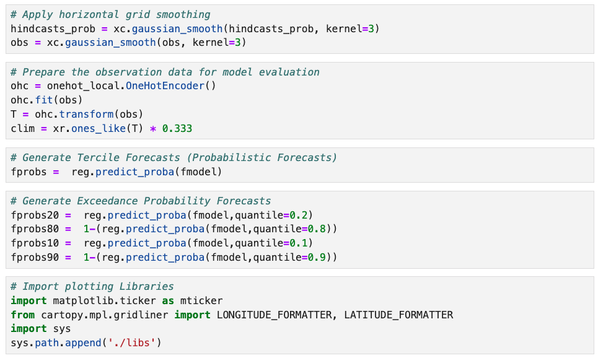
Jupyter Notebook Demo (cont.)
Train the model
Apply horizontal grid smoothing
Prepare the observation data for model evaluation
Generate Tercile Forecasts (Probabilistic Forecasts)
Generate Exceedance Probability Forecasts
Import plotting Libraries

Slide 12
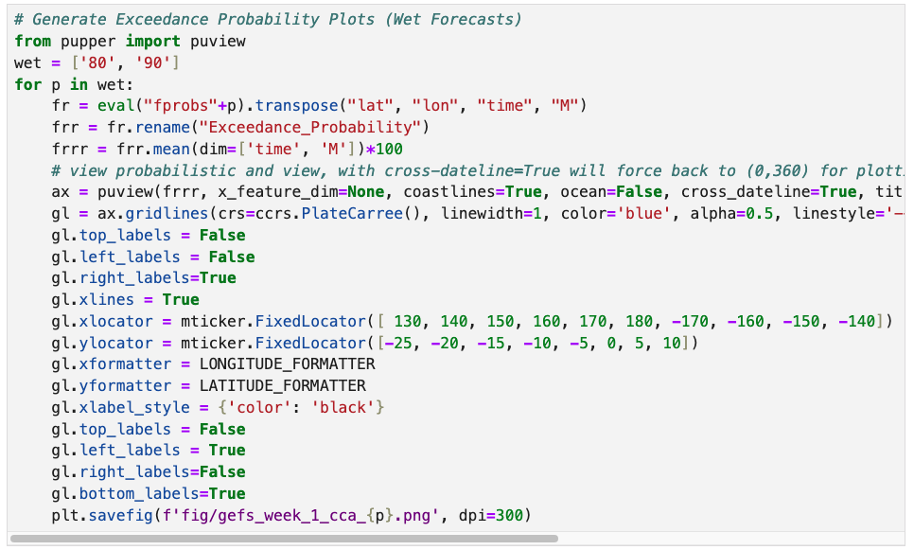
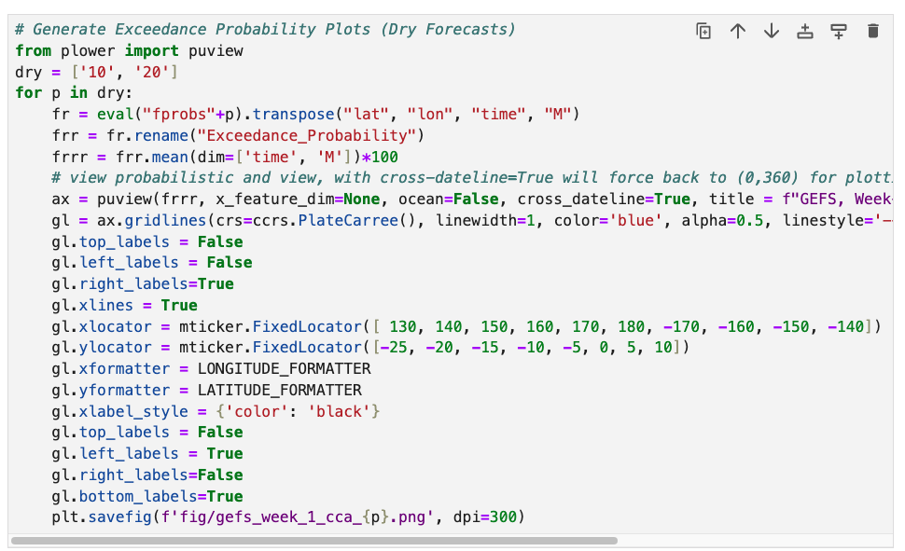
Jupyter Notebook Demo (cont.)
Generate Exceedance Probability Plots (Wet Forecasts)
Generate Exceedance Probability Plots (Dry Forecasts)

Slide 13
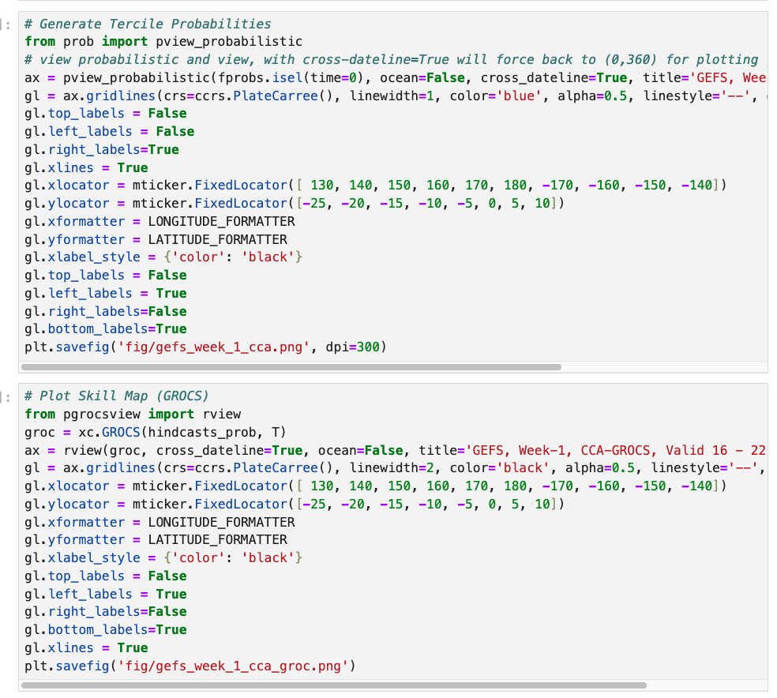
Jupyter Notebook Demo (cont.)
Generate Tercile Probability
Generate Skill Map (GROCS)

Slide 14
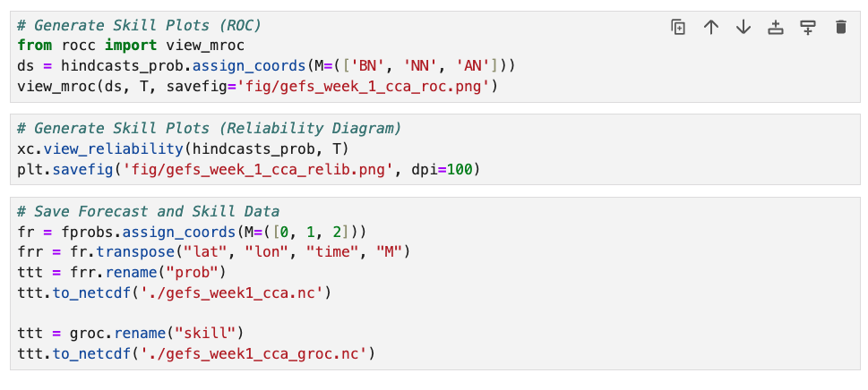
Jupyter Notebook Demo (cont.)
Generate ROC Curve
Generate Reliability Diagram
Save Tercile Forecast Data for later use in Skill Weighted Consolidation
Save Forecast Skill Data for later use in Skill Weighted Consolidation

Slide 15
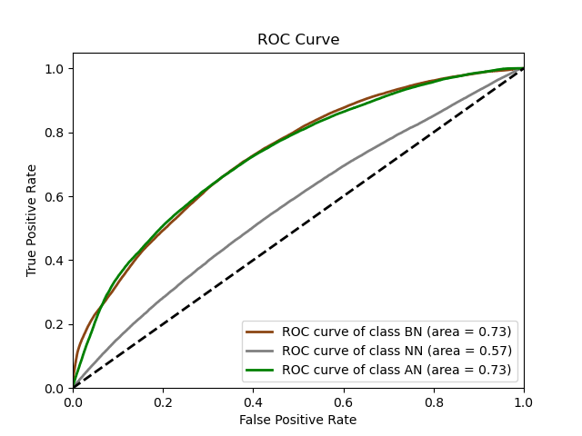
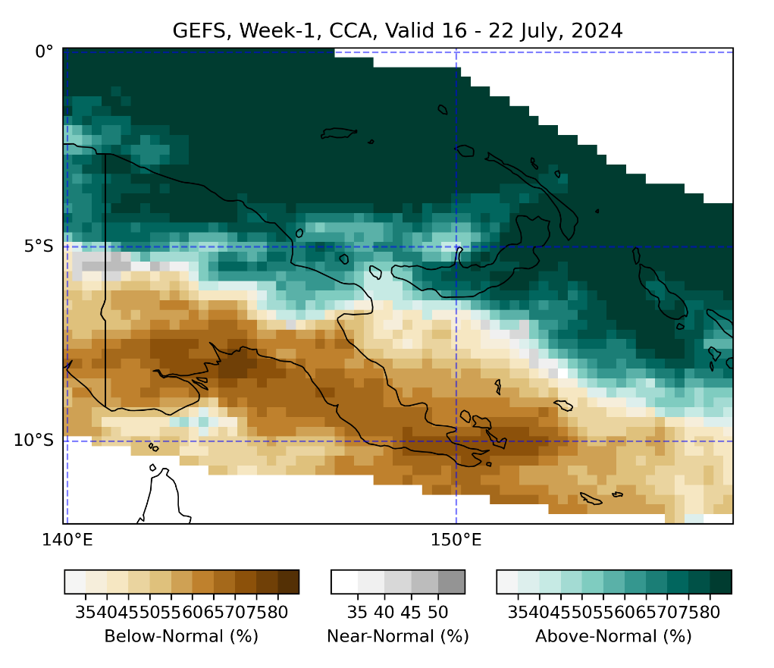
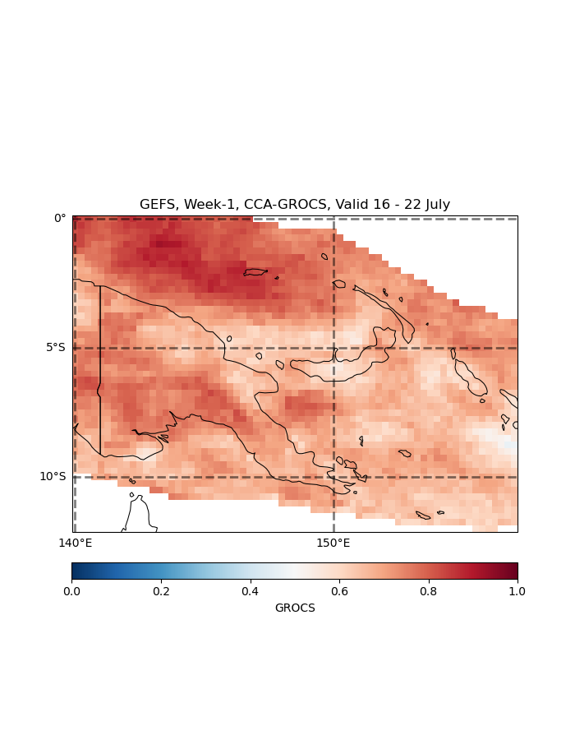
Calibrated Tercile Fcst & Hindcast Evaluation
Tercile Forecast
ROC
GROC-AUC

Slide 16
Exercise, Calibrated Forecasts
Use Jupyter Notebooks under subseasonal directory to generate GEFS Week-1: (please run CCA before ELR and EPOELM, and then run the consolidated forecast script after CCA, ELR and EPOELM )
Raw
CCA
ELR
EPOELM
And Consolidated Forecasts
Test domain of your interest. Avoid using a very small domain as resolution of the data is not good enough for very small areas.
Identify areas with:
Above and below normal rainfall
Extreme rainfall (eg. >80th and <20th)
Assess the skill of the calibration methods for your area of interest

