Slide 1
Maximum Temperature and Heat Index Calibration over Selected Stations
President Emergency Plan for Adaptation and Resilience (PREPARE)
Forecasters’ Training Workshop Hazardous Heat Forecasts
Endalkachew Bekele
NOAA/CPC/International Desks
Port of Spain, Trinidad and Tobago
4 – 10 December 2024

Slide 2
1. Model Forecast Post-Processing
Forecast Calibration in simple terms:
  Build a relationship between forecast and observation in the historical period.
  Use this historical forecast/observation relationship to correct biases in real-time forecasts.
Why do we need to calibrate?
  Because NWP models are not perfect >> forecast error grows with lead time.
Calibration methods:
  From a simple “mean bias removal” method to a very complicated Machine Learning Techniques.

Slide 3
2. Model Forecast Post-Processing Methods
XCast-based Calibration Methods (statistical tools to calibrate dynamical forecasts):
  Canonical Correlation Analysis (CCA): Pattern based linear regression.
  Logistic Regression: The probability of a binary outcome (eg. Probability of above or below average) based on one or more predictor variables.
  Extended Logistic Regression (ELR): Non-linear ensemble calibration method. It is an extended form of logistic regression by allowing more complex relationships between predictors and outcomes.
  Probabilistic Output Extreme Learning Machine (POELM): Non-linear advanced machine learning approach (a single-hidden-layer feed-forward neural network).
  Extended Probability Output Extreme Learning Machine (EPOELM): A combination of ELR and POELM approaches, to do non-exceedance forecasts for any threshold value after fitting.
These techniques are put together in a user-friendly Python-based toolkit - XCast:
For more information, see https://xcast-lib.github.io / (Hall and Acharya 2022).

Slide 4
2. Model Forecast Post-Processing Methods (cont.)
Historical Observation (X)
Plus
Calibrated Deterministic Forecasts
Realtime Model Forecasts
(Raw )
Model Hindcast data (Y)
Acharya and Hall (2024), https://www.weather.gov/media/climateservices/CPASW/2024/Wednesday/4-Wed-Session5-Acharya.pdf

Slide 5
3. Extended Probability Output Extreme Learning Machine (EPOELM)
Systematic errors can sometimes be reduced by using linear models, especially when the error is known and can be modeled.
Random errors are difficult to eliminate but can be reduced by:
  Increasing the sample size.
  Using non-linear machine learning models to capture complex relationships in the data.
EPOELM is a non-linear machine learning approach based on a single-hidden-layer feed-forward neural network.
The EPOELM model can be applied to both gridded and station data.
In this training, we will use EPOELM to correct model forecast biases for selected cities in the Caribbean.

Slide 6
4. Raw and Calibrated Forecasts over Selected Stations
The GEFS Week-1 and Week-2 time series plots for 15 selected cities are available at this link: https://ftp.cpc.ncep.noaa.gov/International/PREPARE_Caribbean/heat_fcst/city_fcst
The plots include:
  Raw and calibrated Tmax deterministic forecasts
  Raw and calibrated Tmax probability of exceedance forecasts
  Raw and calibrated HImax deterministic forecasts (above the 80th percentile)
  Raw and calibrated HImax probability of exceedance forecasts (above the 80th percentile)

Slide 7
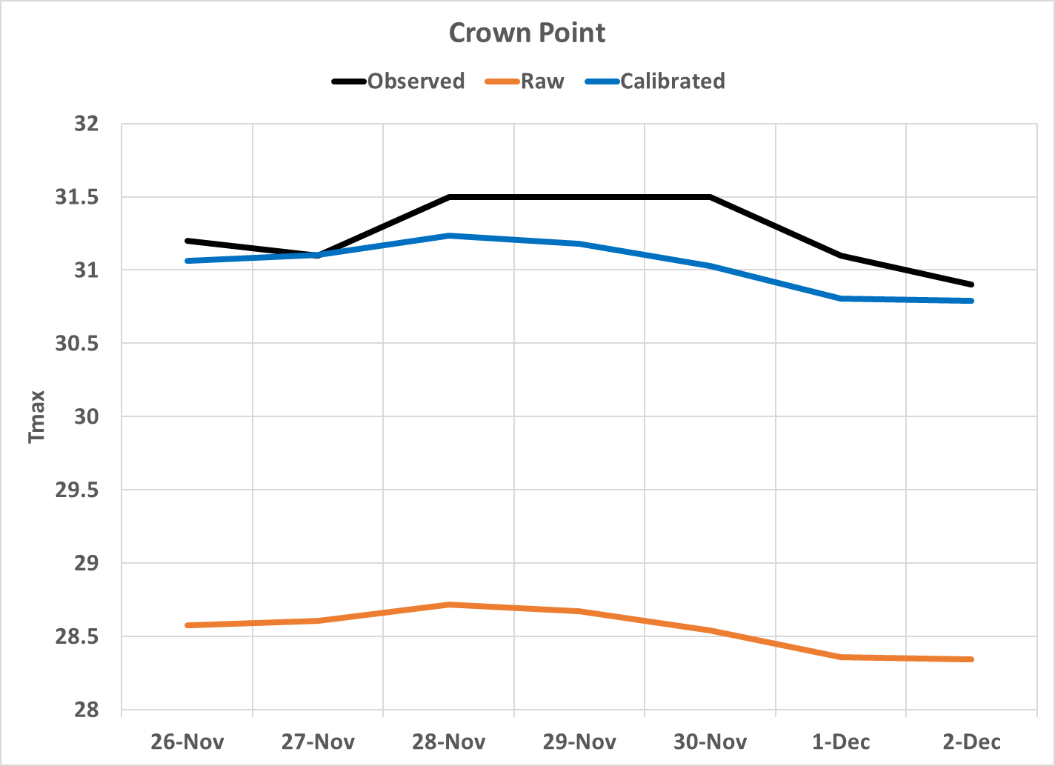
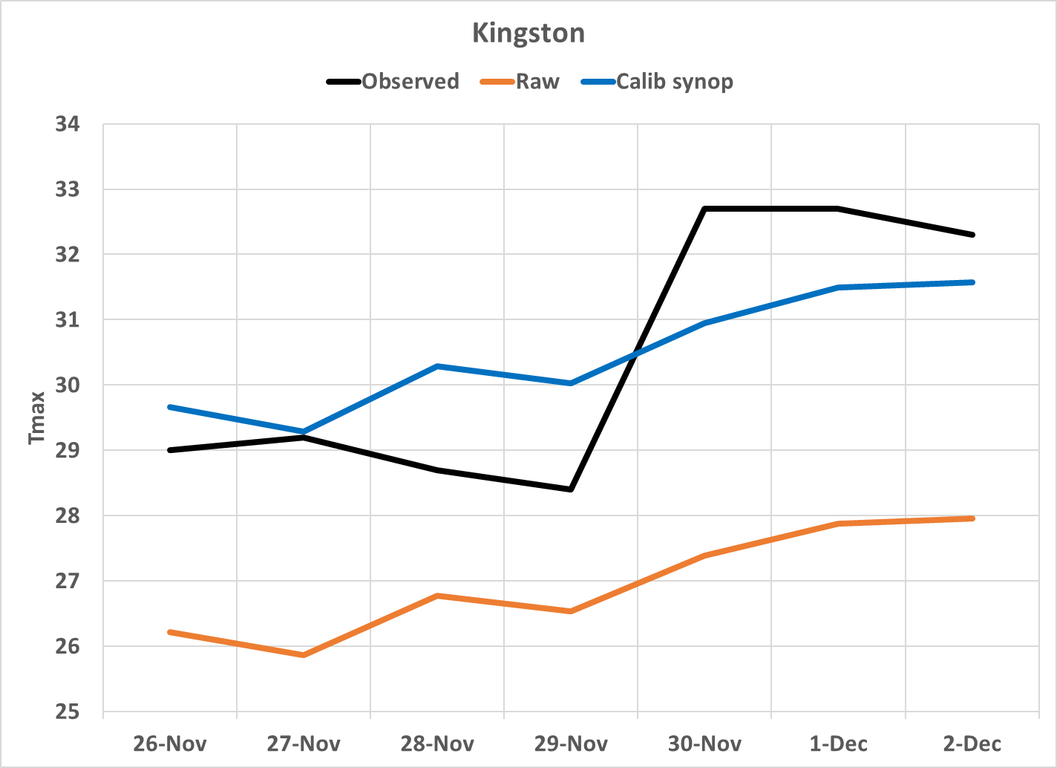
5. Verification of Calibrated and Raw Forecasts VS Recent Observations
Crown Point, Trinidad and Tobago
Kingston, Jamaica
Observation
Week-1
Valid: 26 Nov – 02 Dec 2024
Calibrated
Raw

Slide 8
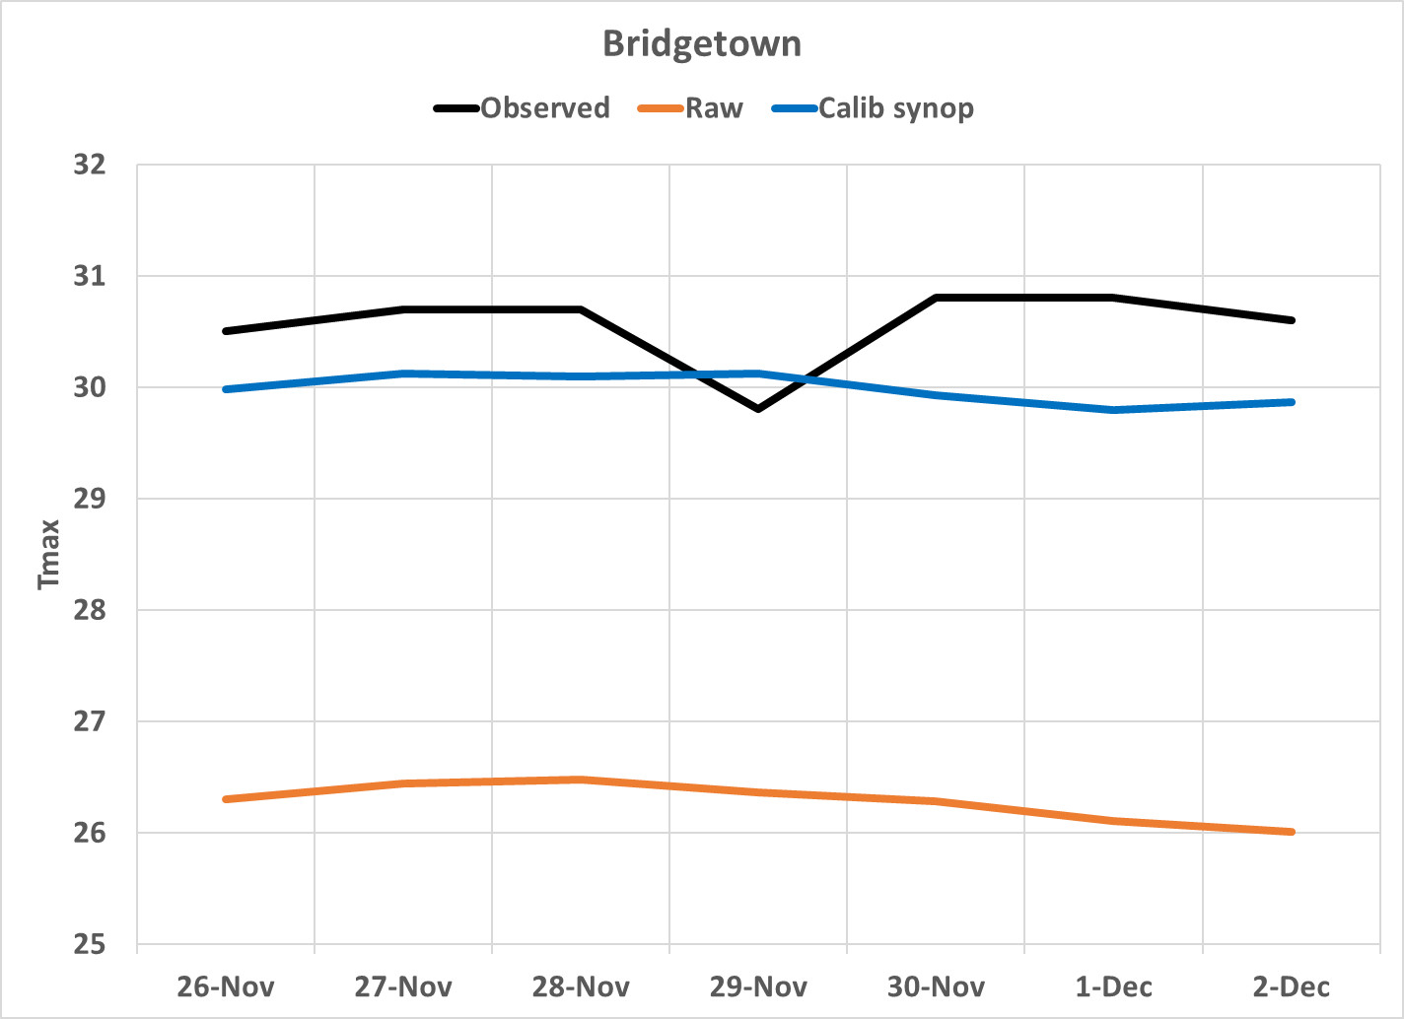
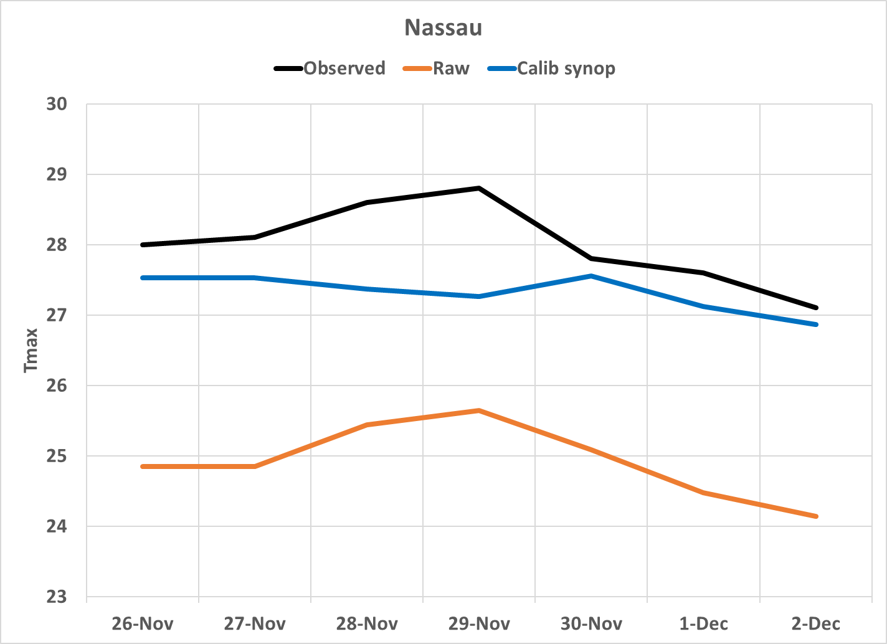
5. Verification of Calibrated and Raw Forecasts VS Recent Observations (cont.)
Bridgetown, Barbados
Nassau, The Bahamas
Observation
Week-1
Valid: 26 Nov – 02 Dec 2024
Calibrated
Raw

Slide 9
6. Data Preprocessing
For each station, extract historical daily maximum temperature and heat index observation data for the 2000 – 2019 period (x array data).
Similarly, extract historical daily maximum temperature and heat index GEFS forecast data for the 2000 – 2019 period (y array data).
Extract realtime daily maximum temperature and heat index GEFS forecast data for the current target period (realtime raw forecast).
Convert the x, y and raw forecast data to the netCDF format.
The pre-processed data is already available for use, so you don’t need to worry about going through this step.

Slide 10
7. Hyperparameter Tuning
Hyperparameter tuning is the process of selecting the best set of hyperparameters in order to optimize the performance of a ML model.
The hyperparameters could be region- and season-dependent, and tuning needs to be done for each station and period.
One of the best from each category is selected during the tuning process.
EPOELM hyperparameters: (For more details, please refer to: https://xcast-lib.github.io/extreme_learning_machine/ )
regularization: [i for i in range(-20, 20) ],
hidden_layer_size: [i for i in range(3, 16)],#, 80, 160, 320, 640],
activation: ['relu', 'sigm', 'tanh', 'lin', 'leaky', 'elu', 'softplus'],
preprocessing: ['minmax', 'std', 'none' ],
encoding: [ 'nonexceedance', 'binary'],
quantiles: [ [1/3,2/3], [0.0001, 0.5, 0.9999], [0.2, 0.4, 0.6, 0.8], [0.1,0.2,0.3,0.4,0.5,0.6,0.7,0.8,0.9] ],
standardize_y: [True, False],
n_estimators: [5],
initialization: ['uniform', 'normal', 'xavier']

Slide 11
8. EPOELM Model Fitting and Running the Calibration Code
Once the hyperparameter tuning step is complete, we will use the selected parameters (eg parameters2) to fit the EPOELM model:
reg = xc.EPOELM(params=params2)
reg.fit(xtrain, ytrain)
We will go through the detailed process in the next slides, using a Jupyter Notebook demonstration.
Launch your Ubuntu terminal
Change directory to the heat_notebooks folder:
cd heat_notebooks

Slide 12
9. Running the Calibration Code
List the files in the folder
ls
You should be able to see two folders listed in the current directory (heat_cities_notebooks and heat_spatial_notebooks)
For this exercise, we change directory to the heat_cities_notebooks folder
cd heat_cities_notebooks
List the files in the new sub-directory:
ls
You should be able to see the following list of jupyter notebook files (black) and subdirectories (blue):
  fcst_data gefs_week1_rawNcalibrated_himax.ipynb, gefs_week1_rawNcalibrated_tmax.ipynb, himax_fig and tmax_fig

Slide 13
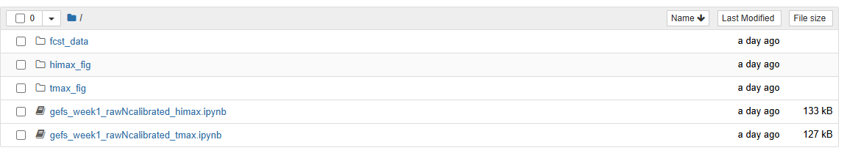
9. Running the Calibration Code (cont.)
Activate the XCast conda environment:
conda activate xcast_env
Launch jupyter notebook:
jupyter notebook
This should automatically launch the notebook environment. If it doesn't, copy one of the links provided on the screen into your web browser, and you should be able to see something that looks like this:

Slide 14
9. Running the Calibration Code (cont.)
Select the tmax calibration notebook and DoubleClick to open it:

Slide 15
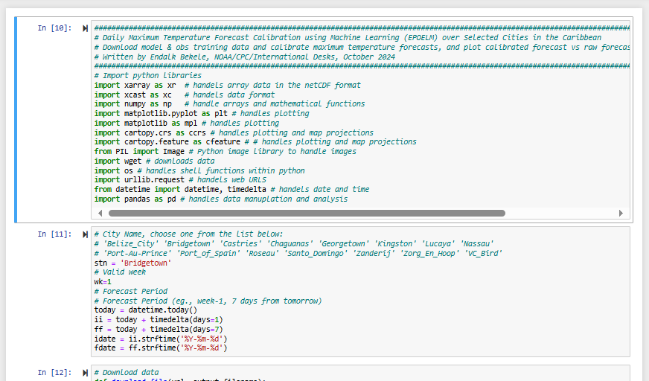
9. Running the Calibration Code (cont.)
Scroll through the notebook to see the code descriptions provided in each cell:
You may select the city of your interest from the list:

Slide 16
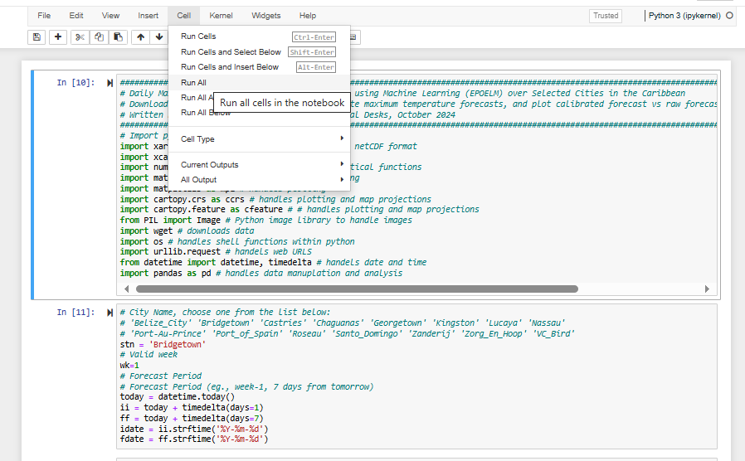
9. Running the Calibration Code (cont.)
Under the 'Cell' menu, select 'Run All' to execute the entire code:

Slide 17
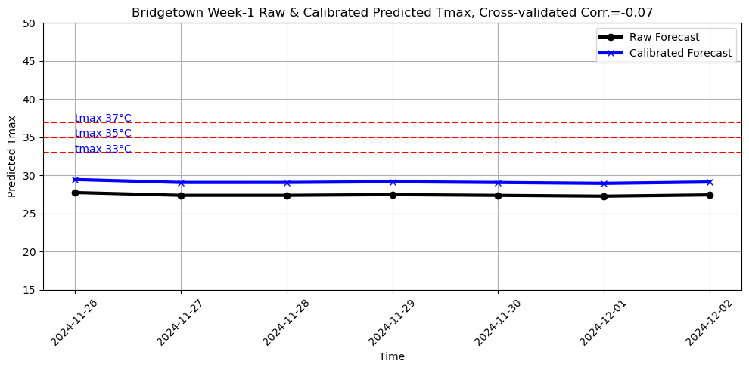
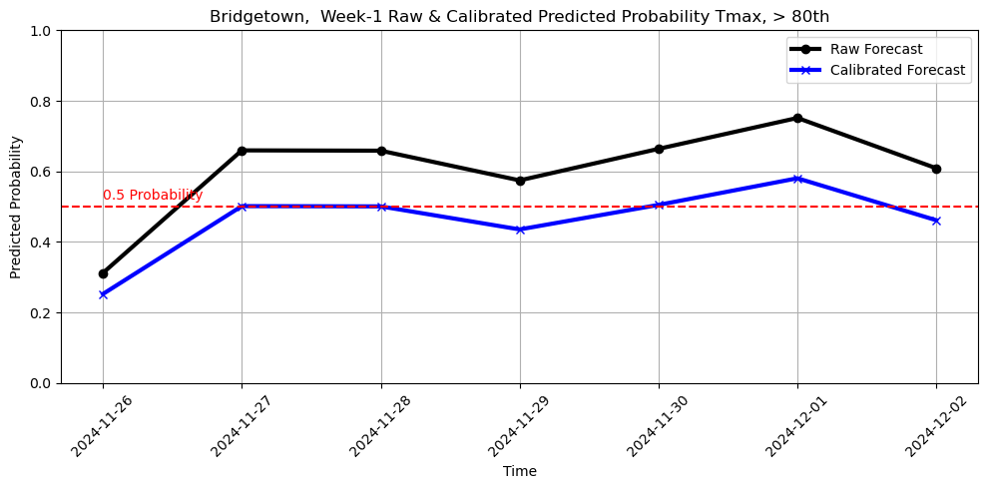
10. Sample Output Tmax Raw Vs Calibrated Forecasts
Daily Tmax Forecasts (Deterministic)
Daily Tmax Probability of Exceedance Forecasts (> 80th)

Slide 18
11. Maximum Heat Index Forecast (exercise)
Follow similar steps to run notebooks that generate maximum heat index forecast tools.
Try running the code for different cities in the list.
Prepare PowerPoint slides with sample output plots.

