Slide 1
Excessive Heat Forecasting Tools
President Emergency Plan for Adaptation and Resilience (PREPARE)
Forecasters’ Training Workshop Hazardous Heat Forecasts
Endalkachew Bekele
NOAA/CPC/International Desks
Port of Spain, Trinidad and Tobago
4 – 10 December 2024

Slide 2
1. Large Scale Atmospheric Circulation
GEFS Predicted Atmospheric Circulation Patterns:
Mean Sea Level Pressure Anomalies.
925-hPa Wind Anomalies (speed and direction).
500-hPa Height Anomalies.
200-hPa Wind Anomalies (divergence/convergence and direction).
Weekly averaged anomalies, valid for Week 1 and Week 2.
Anomalies are generated by removing the hindcast climatology (2000–2019).

Slide 3
2. Primary Temperature Tools
Maximum Temperature Exceedance Probabilities:
Tmax > 33ºC, 35ºC and 37ºC for at least 3 consecutive days.
Tmax > 80th, 90th and 95th percentiles for at least 3 consecutive days.
Maximum Heat Index Exceedance Probabilities:
HImax > 33ºC, 35ºC and 37ºC for at least 3 consecutive days.
HImax > 80th, 90th and 95th percentiles for at least 3 consecutive days.
Tmax or Himax Hybrid Exceedance Probabilities:
Hybmax > 33ºC, 35ºC and 37ºC for at least 3 consecutive days.
Hybmax > 80th, 90th and 95th percentiles for at least 3 consecutive days.

Slide 4
3. Supplementary Temperature Tools
To monitor likelihood of morning heat, minimum temperature and minimum heat index based tools are useful.
Mnimum Temperature Exceedance Probabilities:
Tmin > 27ºC, 29ºC and 31ºC for at least 3 consecutive days.
Tmin > 80th, 90th and 95th percentiles for at least 3 consecutive days.
Maximum Heat Index Exceedance Probabilities:
HImin > 27ºC, 29ºC and 31ºC for at least 3 consecutive days.
HImin > 80th, 90th and 95th percentiles for at least 3 consecutive days.
Tmin or Himin Hybrid Exceedance Probabilities:
Hybmin > > 27ºC, 29ºC and 31ºC for at least 3 consecutive days.
Hybmin > 80th, 90th and 95th percentiles for at least 3 consecutive days.

Slide 5
3. Excessive Heat Forecasting Toolkit
We have developed a toolkit that downloads gridded forecast data and plots the excessive heat tools described in the previous slides.
Prerequisite software to run the toolki include:
Linux like environment (eg. Wsl/Ubuntu, Mac terminal)
Anaconda
XCast (https://xcast-lib.github.io/)
Wget
firefox
If you have not done so already, please follow the software instructions shared with you to install the prerequisites.

Slide 6
3. Excessive Heat Forecasting Toolkit (cont.)
There are two ways of running the toolkit:
Use a 1-line command:
The codes run in the background and generates the tools automatically.
Little or no user interactions.
Jupyter Notebook version:
The user can view and modify the code if needed.
It is also easier to demonstrate the contents of the toolkit.

Slide 7
4. Excessive Heat Forecasting Jupyter Notebook Demonstration
Launch your Ubuntu terminal.
Download the demo file using the command below
wget https://ftp.cpc.ncep.noaa.gov/International/PREPARE_Trinidad_Tobago/excessive_heat_toolkit/heat_notebooks.tar.gz
Unzip the file:
tar -xvf heat_notebooks.tar.gz
Change directory to the heat_notebooks folder:
cd heat_notebooks
List the files in the folder
ls
You should be able to see two folders listed in the current directory (heat_cities_notebooks and heat_spatial_notebooks)

Slide 8
4. Excessive Heat Forecasting Jupyter Notebook Demonstration (cont.)
For this exercise, we change directory to the heat_spatial_notebooks folder
cd heat_spatial_notebooks
List the files in the new sub-directory:
ls
You should be able to see the following list of jupyter notebook files (black) and subdirectories (blue):
fcst_data, gen_gefs_week1_circulation_plots.ipynb, gen_gefs_week1_tmax_himax_hybrid_percentile_thresholds.ipynb, gen_gefs_week1_tmin_himin_hybrid_percentile_thresholds.ipynb,
fig_dir , gen_gefs_week1_tmax_himax_hybrid_fixed_threshold.ipynb, gen_gefs_week1_tmin_himin_hybrid_fixed_threshold.ipynb , and lib
fcst_data is used to store downloaded forecast data, fig_dir is used to store output graphics, and the lib directory contains libraries required to plot the forecast graphics

Slide 9
5. Run Large-Scale Circulation Anomaly Scripts
Activate the XCast conda environment:
conda activate xcast_env
Launch jupyter notebook:
jupyter notebook
This should automatically launch the notebook environment. If it doesn't, copy one of the links provided on the screen into your web browser, and you should be able to see something that looks like this:

Slide 10
5. Run Large-Scale Circulation Anomaly Scripts (cont.)
Select the circulation plot notebook and DoubleClick to open it:

Slide 11
5. Run Large-Scale Circulation Anomaly Scripts (cont.)
Scroll through the notebook to see the code descriptions provided in each cell:
You may change the domain to an area of your interest (by changing the wlon, elon, slat and nlat values).

Slide 12
5. Run Large-Scale Circulation Anomaly Scripts (cont.)
Under the 'Cell' menu, select 'Run All' to execute the entire code:

Slide 13
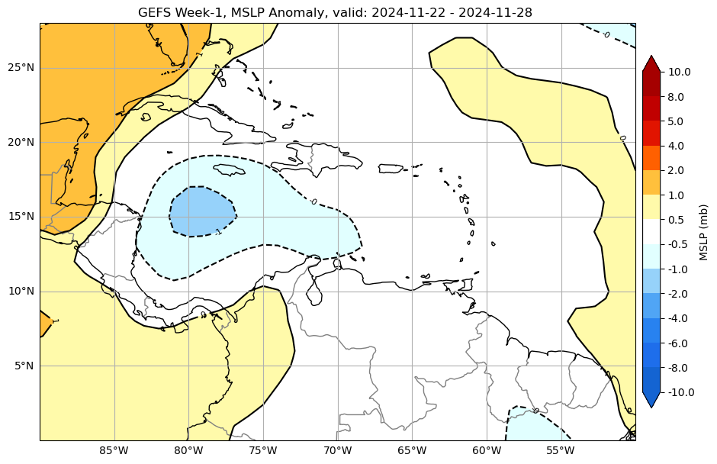
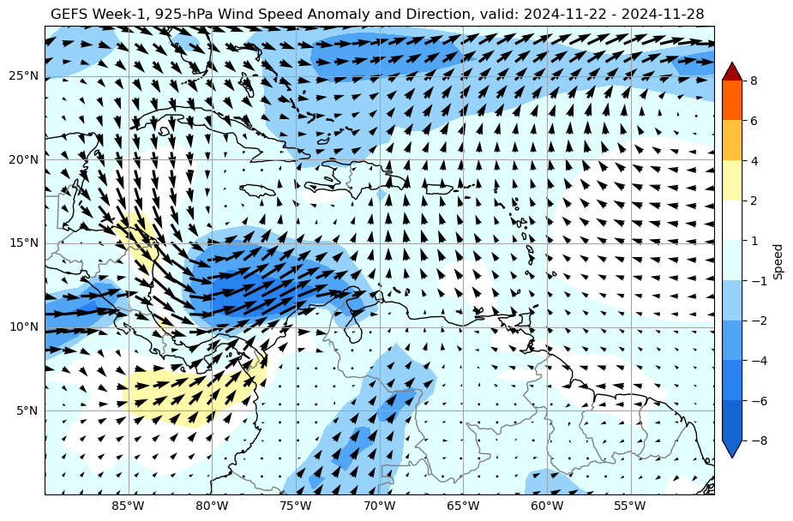
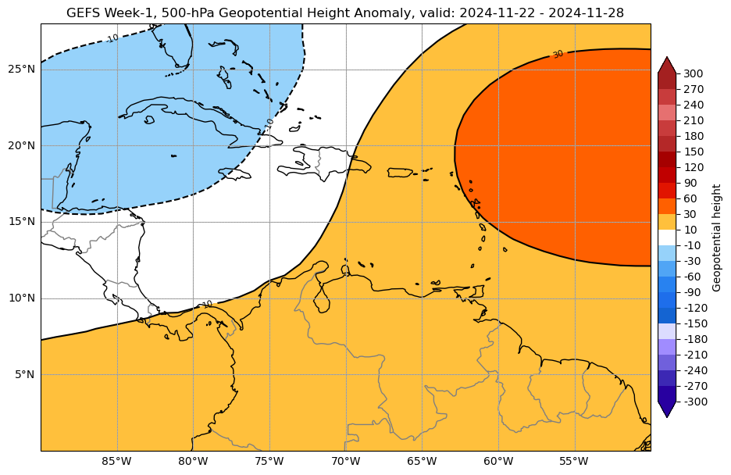
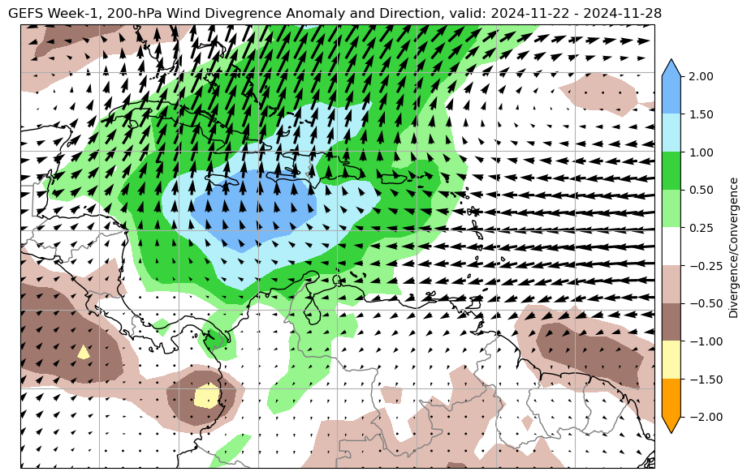
6. Sample Output Circulation Figures
MSLP Anomaly
925-hPa Wind Anomaly
500-hPa Height Anomaly
200-hPa Wind Anomaly

Slide 14
7. Temperature Tools (exercise)
Follow similar steps to run notebooks that generate the following plots:
Exceedance probabilities of tmax, himax, and hybrid tools with respect to fixed thresholds.
Exceedance probabilities of tmax, himax, and hybrid tools with respect to fixed percentile thresholds.
Exceedance probabilities of tmin, himin, and hybrid tools with respect to fixed thresholds.
Exceedance probabilities of tmin, himin, and hybrid tools with respect to fixed percentile thresholds.
The file names are self-explanatory and easy to identify.
For each code, prepare PowerPoint slides with sample output plots.
You may change the domain to an area of your interest by adjusting the wlon, elon, slat, and nlat values.

Slide 15
8. One-line Command Approach
You can also generate week-1 and week-2 circulation and temperature based excessive heat forecasting tools.
Open a new Ubuntu terminal:
Download the compressed file using:
wget https://ftp.cpc.ncep.noaa.gov/International/PREPARE_Trinidad_Tobago/excessive_heat_toolkit/heat_spatial_shell.tar.gz
Unzip the file:
tar -xvf heat_spatial_shell.tar.gz
Change directory to the heat_spatial_shell folder:
cd heat_spatial_shell
Run the script using one-line command
bash run_all.sh wlon elon slat nlat
where wlon, elon, slat and nlat are coordinates of your domain, see the below example:
bash run_all.sh -60 -55 10 28

Slide 16
9. One-line Command Output Page
An offline webpage should launch automatically.
If it doesn’t launch automatically, use your Windows file explorer to locate heat_spatial_shell directory, and DoubleClick index.html to launch the page manually.

