Slide 1
Week-1, valid: 27 Aug – 02 Sep, 2023
Heat Hazard Outlook for Central America, Mexico & the Caribbean
Notes:
https://www.cpc.ncep.noaa.gov/products/international/endalk/climatehealth/heat-health_forecasts_alt.shtml

Slide 2
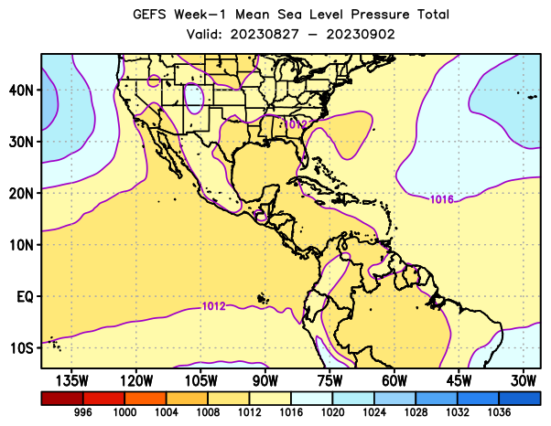
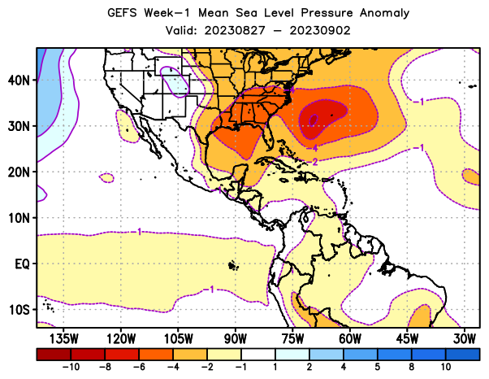
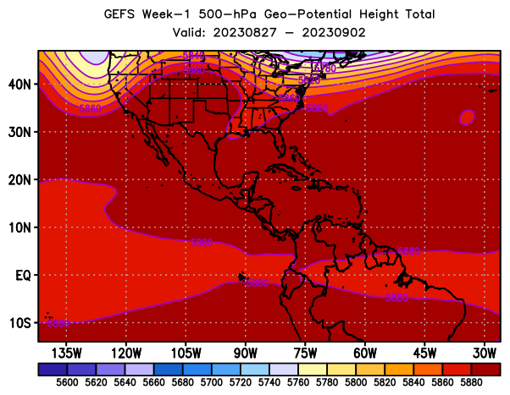
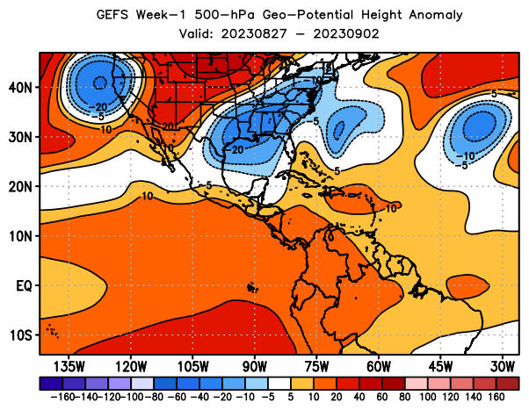
Week-1, Mean Sea Level Pressure & 500-hPa Height
7-day total
7-day anomaly
The 7-day mean sea level pressure is expected to be below-average across eastern US, northwestern Atlantic Ocean, C. America and parts of the Caribbean.
MSLP
The 7-day 500-hPa height is expected to be above-average over Central America and the Caribbean.
500-hPa
Height

Slide 3
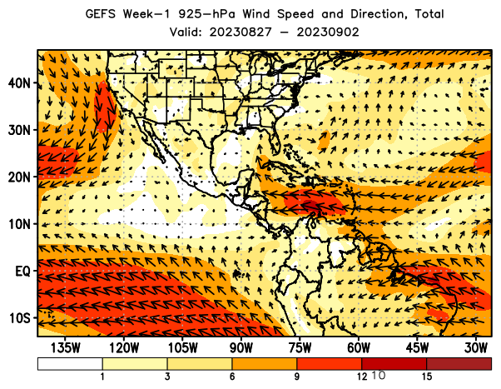
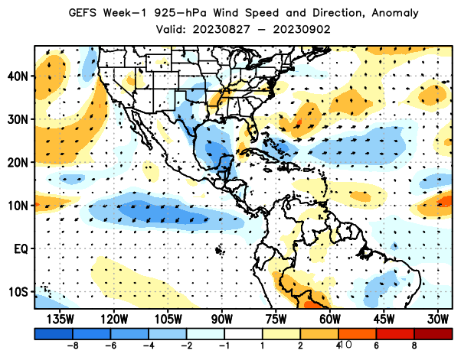
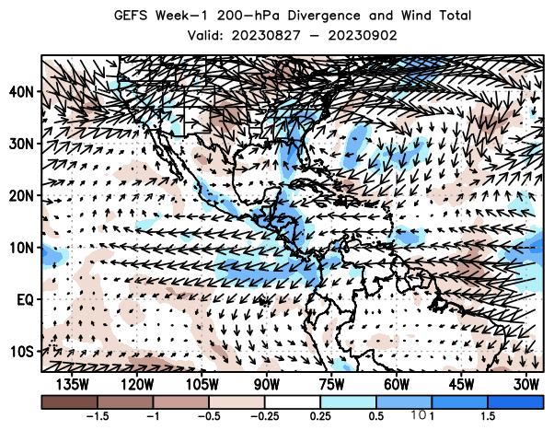
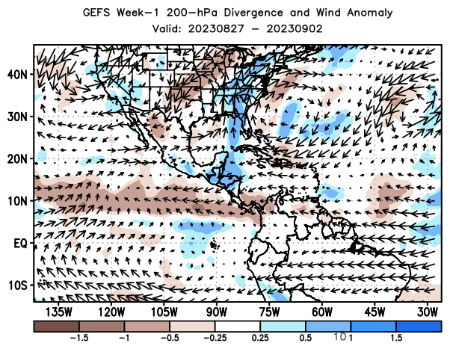
Week-1, 925-hPa and 200-hPa Wind
7-day total
7-day anomaly
925-hpa
wind (speed and direction)
The 7-day wind speed at 925-hPa level is expected to be weaker-than-average across the entire Caribbean region.
200-hpa
wind (diverg. and direction)
Upper-level convergence is expected to persist across the entire Caribbean region.

Slide 4
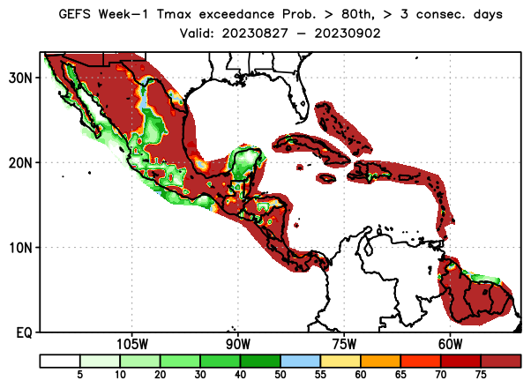
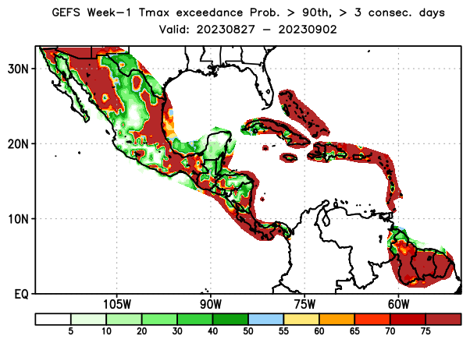
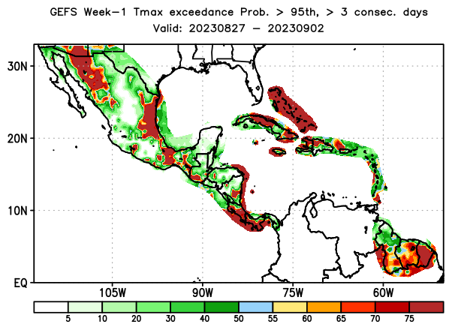
Week-1, Daily Tmax Exceedance Probability, with respect to percentile thresholds
Tmax > 80th percentile, ≥3 consecutive days
Tmax > 90th percentile, ≥3 consecutive days
Tmax > 95th percentile, ≥3 consecutive days
There is a moderate to high chance for daily Tmax to exceed the 80th percentile threshold for at least 3 consecutive days over much of Central America and the Caribbean, and many parts of Mexico. There is also a moderate to high chance for daily Tmax to exceed the 95th percentile threshold for at least 3 consecutive days over the southern portion of Central America, and the northern portion of the Caribbean region, northern and eastern Mexico, and parts of Guyana, Suriname and French Guiana.

Slide 5
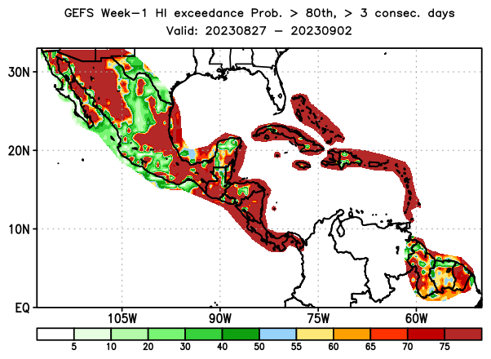
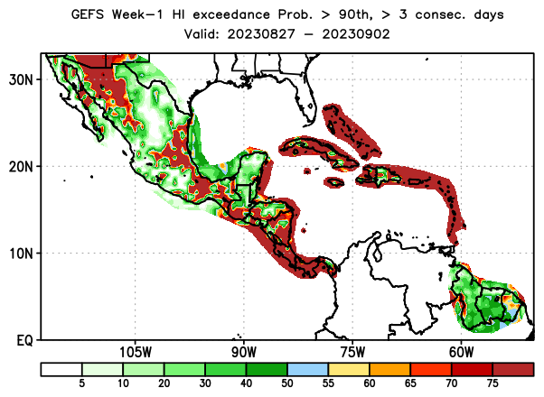
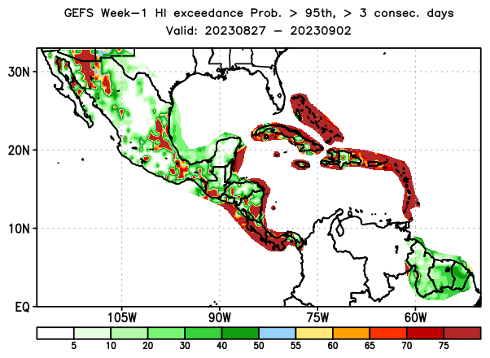
Week-1, Daily HImax Exceedance Probability, with respect to percentile thresholds
HImax > 80th percentile, ≥3 consecutive days
HImax > 90th percentile, ≥3 consecutive days
HImax > 95th percentile, ≥3 consecutive days
There is a moderate to high chance for daily HImax to exceed the 80th percentile threshold for at least 3 consecutive days over much of Central America and the Caribbean, and many parts of Mexico. There is also a moderate to high chance for daily HImax to exceed the 95th percentile threshold for at least 3 consecutive days over pockets of Mexico, the southern portion of Central America and much of the Caribbean.

Slide 6
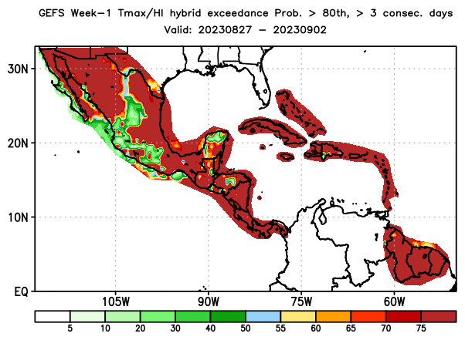
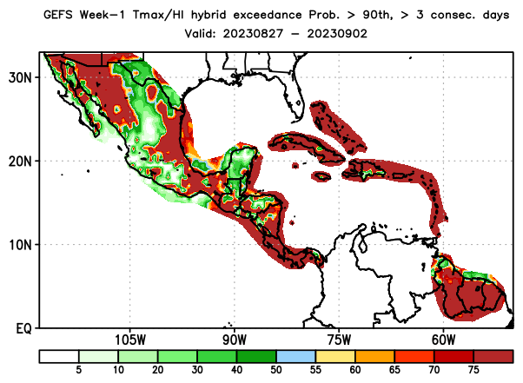
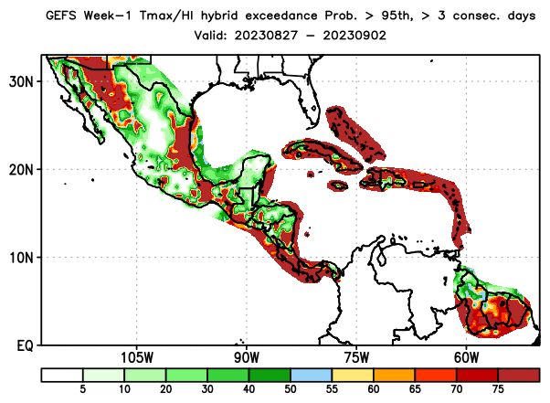
Week-1, Daily Tmax/HI Hybrid Index (hybrid) Exceedance Probability, with respect to percentile thresholds
hybrid > 80th percentile, ≥3 consecutive days
hybrid > 90th percentile, ≥3 consecutive days
hybrid > 95th percentile, ≥3 consecutive days
There is a moderate to high chance for daily HImax to exceed the 80th percentile threshold for at least 3 consecutive days over much of Mexico, Central America and the Caribbean. There is also a moderate to high chance for daily HImax to exceed the 95th percentile threshold for at least 3 consecutive days over parts of Mexico and Central America and the Caribbean, including, parts of Guyana, Suriname and French Guiana.

Slide 7
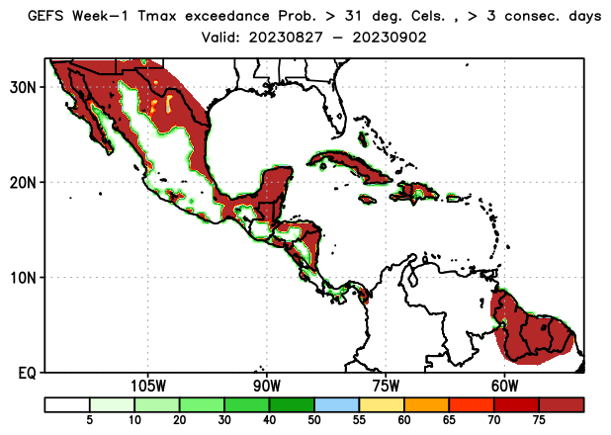
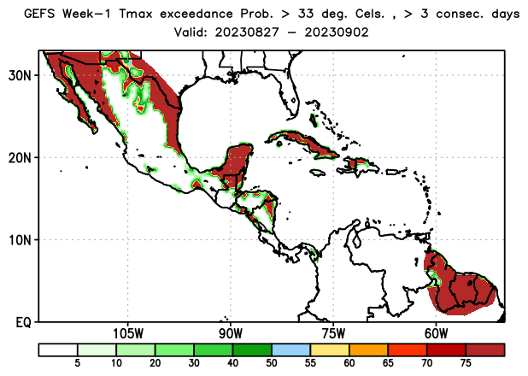
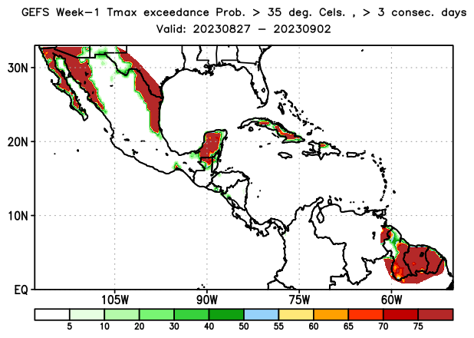
Week-1, Daily Tmax Exceedance Probability, with respect to fixed thresholds
Tmax > 31ºC , ≥3 consecutive days
Tmax > 33ºC , ≥3 consecutive days
Tmax > 35ºC , ≥3 consecutive days
There is a moderate to high probability for daily Tmax to exceed the 31ºC threshold for at least 3 consecutive days over parts of Mexico and Central America, the Greater Antilles, parts of Hispania, Guyana, Suriname and French Guiana. There is also a moderate to high chance for daily Tmax to exceed the 35ºC threshold over parts of Cuba, pockets of northern Dominican Republic, northern Guatemala, and Guyana, Suriname and French Guiana.

Slide 8
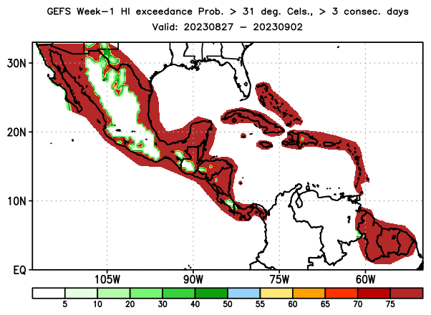
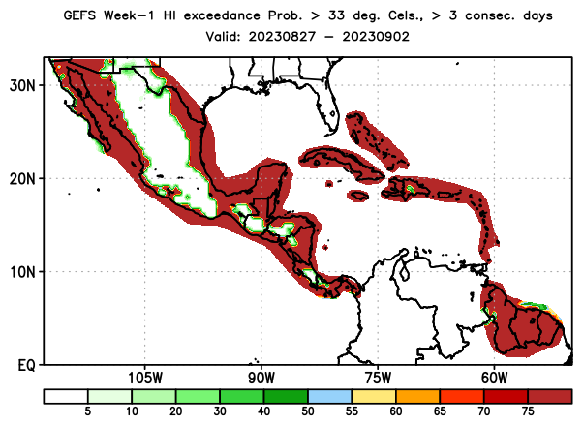
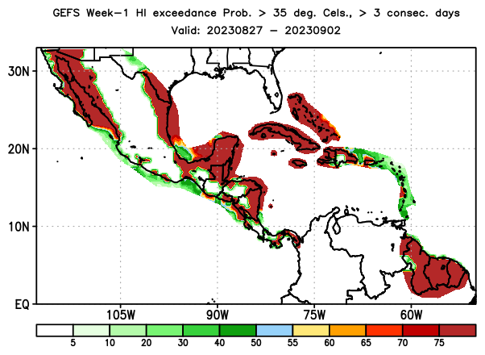
Week-1, Daily HImax Exceedance Probability, with respect to fixed thresholds
HImax > 31ºC , ≥3 consecutive days
HImax > 33ºC , ≥3 consecutive days
HImax > 35ºC , ≥3 consecutive days
There is a moderate to high probability for daily HImax to exceed the 31ºC threshold for at least 3 consecutive days over parts of Mexico, much of Central America and the Caribbean. There is also a moderate to high chance for daily HImax to exceed the 35ºC threshold over parts of Mexico and Central America, the Greater Antilles, the Bahamas, Hispaniola, and Guyana, Suriname and French Guiana.

Slide 9
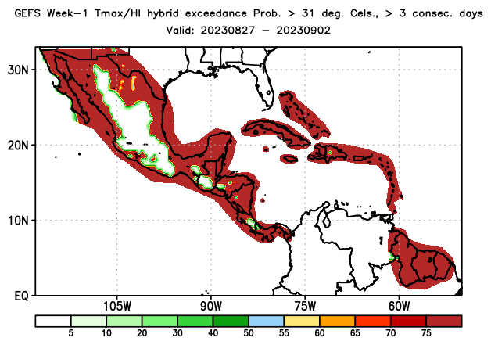
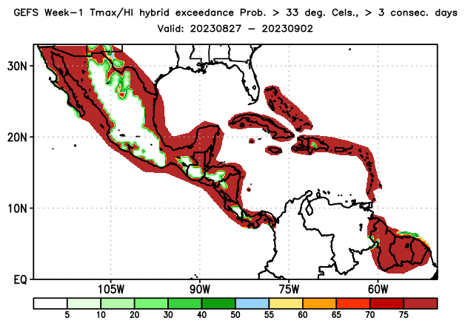
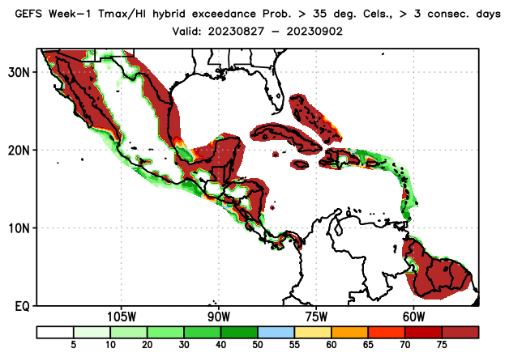
Week-1, Daily Tmax/HI Hybrid Index (hybrid) Exceedance Probability, with respect to fixed thresholds
hybrid > 31ºC , ≥3 consecutive days
hybrid > 33ºC , ≥3 consecutive days
hybrid > 35ºC , ≥3 consecutive days
There is a moderate to high probability for daily Himax/Tmax hybrid index to exceed to exceed 31ºC threshold for at least 3 consecutive days over parts of Mexico, much of Central America and the Caribbean. There is also a moderate to high chance for daily HImax to exceed the 35ºC threshold over parts of Mexico and Central America, the Greater Antilles, the Bahamas, Hispaniola, and Guyana, Suriname and French Guiana.

Slide 10
Convergence of Evidences
MSLP Anom.
Hybrid - 80th
Hybrid - 31ºC
Hybrid - 90th
Hybrid - 33ºC
500-hPa Height
Hybrid - 95th
Hybrid - 35ºC

Slide 11
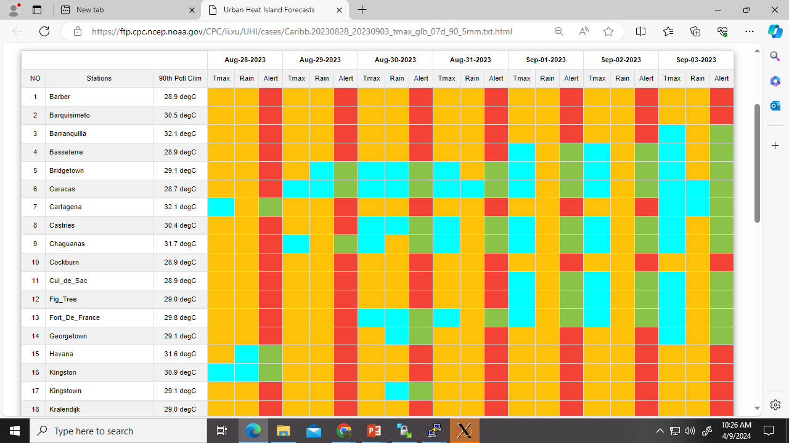
Urban Heat Island Forecasts
https://ftp.cpc.ncep.noaa.gov/CPC/li.xu/UHI/cases/Caribb.20230828_20230903_tmax_glb_07d_90_5mm.txt.html

Slide 12
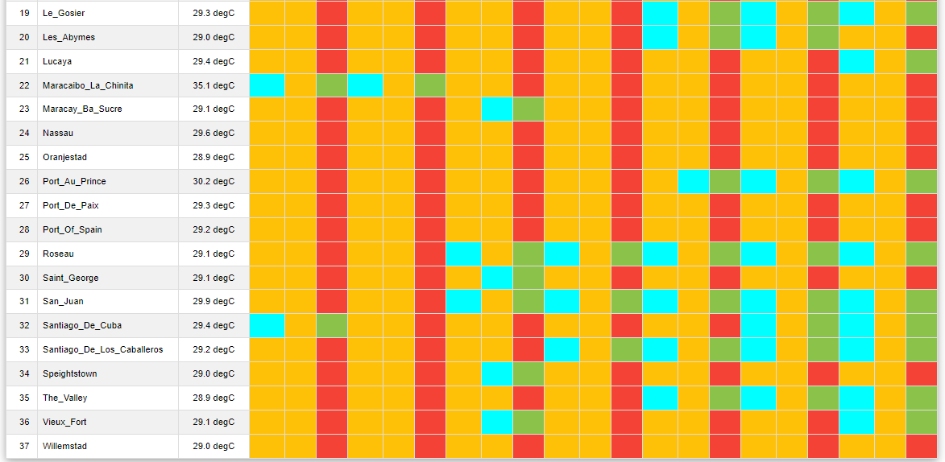
Urban Heat Island Forecasts (cont).
https://ftp.cpc.ncep.noaa.gov/CPC/li.xu/UHI/cases/Caribb.20230828_20230903_tmax_glb_07d_90_5mm.txt.html

Slide 13
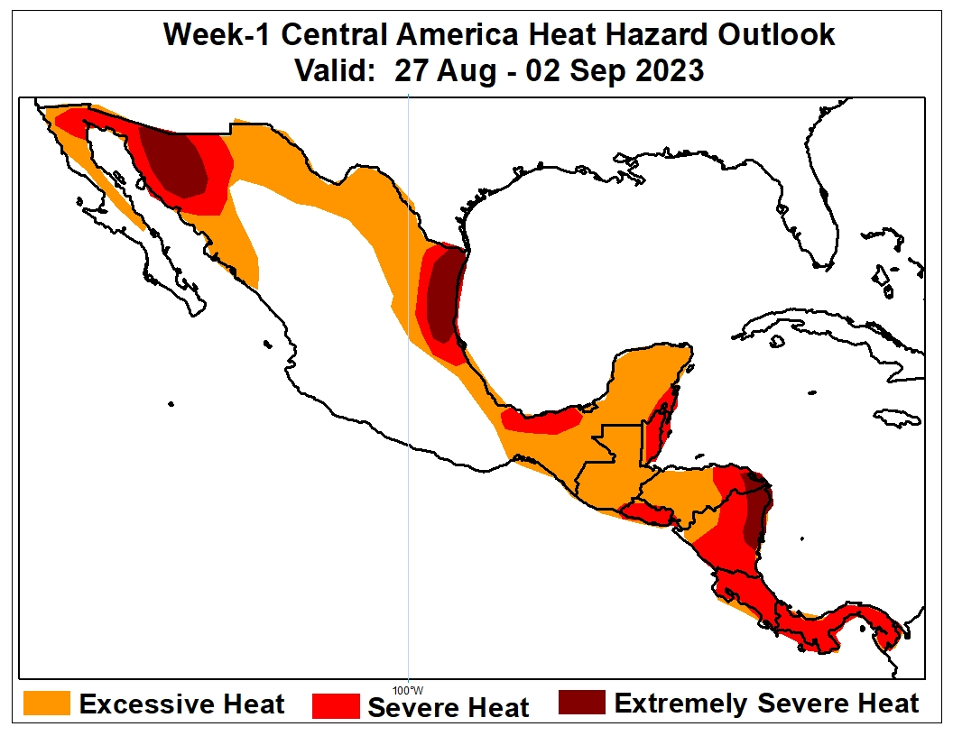
Week-1 Heat Hazards Outlook (C. America)
Valid: 27 August – 02 September, 2023
There is an increased chance for Extremely Severe Heat over parts of northwestern and eastern Mexico, pockets of Belize, the far eastern Honduras and eastern Nicaragua.
There is an increased chance for Excessive to Severe Heat across northern and eastern Mexico, and much of Central America.
Below-average MSLP in Northwest Atlantic, weak low-level winds, and positive height anomaly at mid-tropospheric level are expected to create conducive environment for excessive heat conditions. Hybrid index probability of exceedance forecasts also suggest high chances for persistent excessive heat in the orange and red shaded areas.

Slide 14
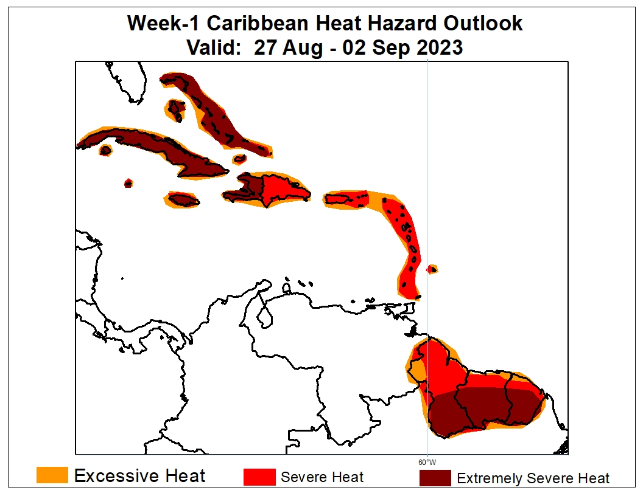
Week-1 Heat Hazards Outlook (Caribbean)
Valid: 27 August – 02 September, 2023
There is an increased chance for Extremely Severe Heat over the Greater Antilles region, the Bahamas, Jamaica, Haiti, and the southern portions of Guyana, Suriname and French Guiana.
There is an increased chance for Excessive to Severe Heat over much of the Caribbean, including Guyana, Suriname and French Guiana.
Below-average MSLP in Northwest Atlantic, weak low-level winds, and positive height anomaly at mid-tropospheric level are expected to create conducive environment for excessive heat conditions. Hybrid index probability of exceedance forecasts also suggest high chances for persistent excessive heat in the orange and red shaded areas.

Slide 15
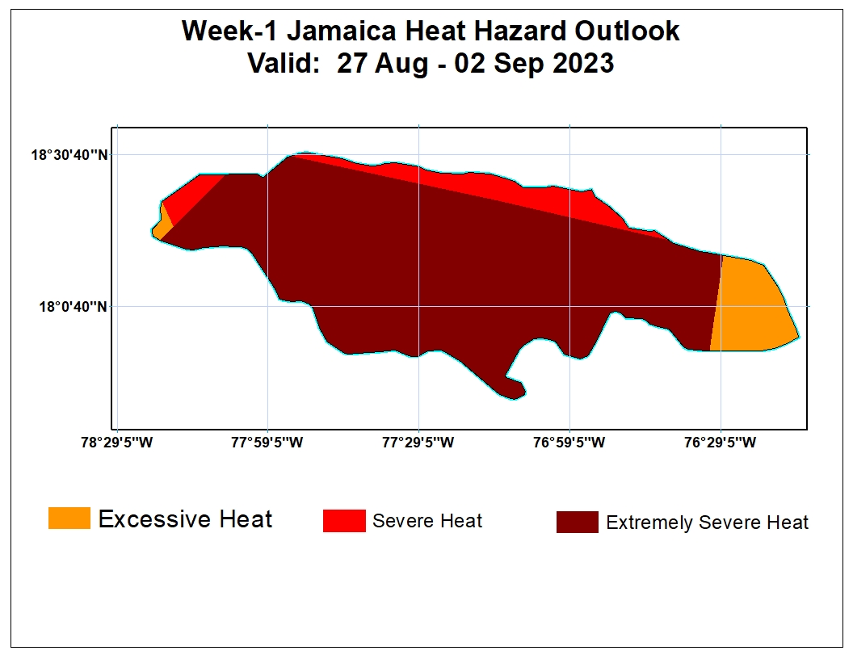
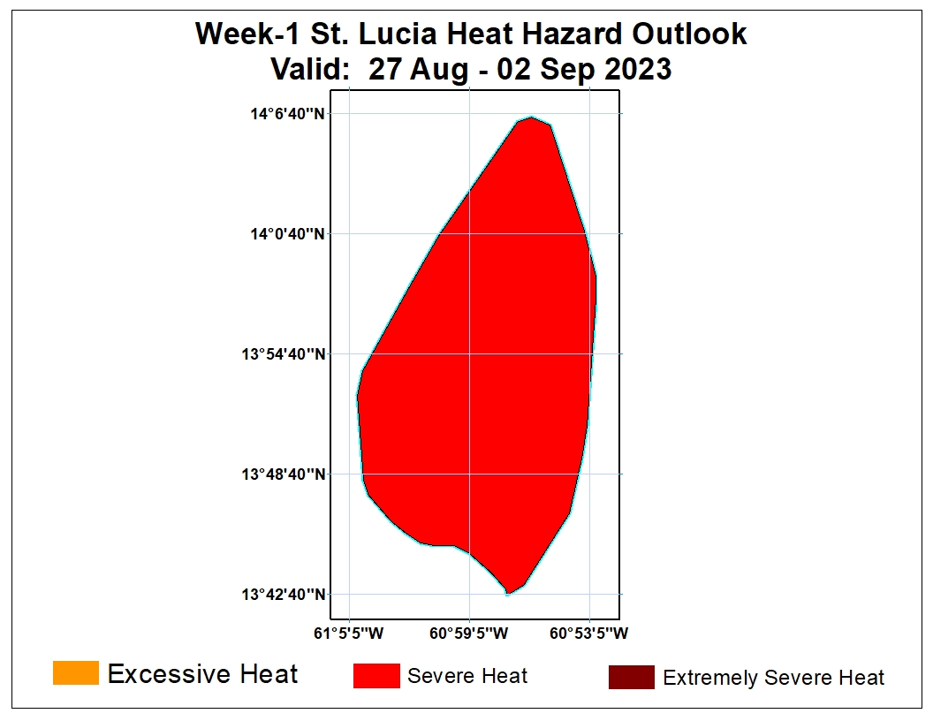
Week-1 Heat Hazards Outlook (Regionalized)
Valid: 27 August – 02 September, 2023
Jamaica
St. Lucia

