Slide 1
Week-1, valid: 27 Sep – 03 Oct, 2023
Heat Hazard Outlook for the Caribbean
Notes:
https://www.cpc.ncep.noaa.gov/products/international/endalk/climatehealth/heat-health_forecasts_alt.shtml

Slide 2
Week-1, Mean Sea Level Pressure & 500-hPa Height
7-day total
7-day anomaly
Add your notes, here
MSLP
Add your notes, here
500-hPa
Height

Slide 3
Week-1, 925-hPa and 200-hPa Wind
7-day total
7-day anomaly
925-hpa
wind (speed and direction)
Add your notes, here
200-hpa
wind (diverg. and direction)
Add your notes, here.

Slide 4
Week-1, Daily Tmax Exceedance Probability, with respect to percentile thresholds
Tmax > 80th percentile, ≥3 consecutive days
Tmax > 90th percentile, ≥3 consecutive days
Tmax > 95th percentile, ≥3 consecutive days
Add your notes, here

Slide 5
Week-1, Daily HImax Exceedance Probability, with respect to percentile thresholds
HImax > 80th percentile, ≥3 consecutive days
HImax > 90th percentile, ≥3 consecutive days
HImax > 95th percentile, ≥3 consecutive days
Add your notes, here

Slide 6
Week-1, Daily Tmax/HI Hybrid Index (hybrid) Exceedance Probability, with respect to percentile thresholds
hybrid > 80th percentile, ≥3 consecutive days
hybrid > 90th percentile, ≥3 consecutive days
hybrid > 95th percentile, ≥3 consecutive days
Add your notes, here

Slide 7
Week-1, Daily Tmax Exceedance Probability, with respect to fixed thresholds
Tmax > 31ºC , ≥3 consecutive days
Tmax > 33ºC , ≥3 consecutive days
Tmax > 35ºC , ≥3 consecutive days
Add your notes, here

Slide 8
Week-1, Daily HImax Exceedance Probability, with respect to fixed thresholds
HImax > 31ºC , ≥3 consecutive days
HImax > 33ºC , ≥3 consecutive days
HImax > 35ºC , ≥3 consecutive days
Add your notes, here

Slide 9
Week-1, Daily Tmax/HI Hybrid Index (hybrid) Exceedance Probability, with respect to fixed thresholds
hybrid > 31ºC , ≥3 consecutive days
hybrid > 33ºC , ≥3 consecutive days
hybrid > 35ºC , ≥3 consecutive days
Add your notes, here

Slide 10
Heat Hazard Outlooks Criteria
Excessive Heat: Hybrid Index > 80th and Hybrid Index > 31ºC thresholds for at least 3 consecutive days.
Severe Heat: Hybrid Index > 90th and Hybrid Index > 33ºC thresholds for at least 3 consecutive days.
Extremely Severe Heat: Hybrid Index > 95th and Hybrid Index > 35ºC thresholds for at least 3 consecutive days.

Slide 11
Convergence of Evidences
MSLP Anom.
Hybrid - 80th
Hybrid - 31ºC
Hybrid - 90th
Hybrid - 33ºC
500-hPa Height
Hybrid - 95th
Hybrid - 35ºC

Slide 12
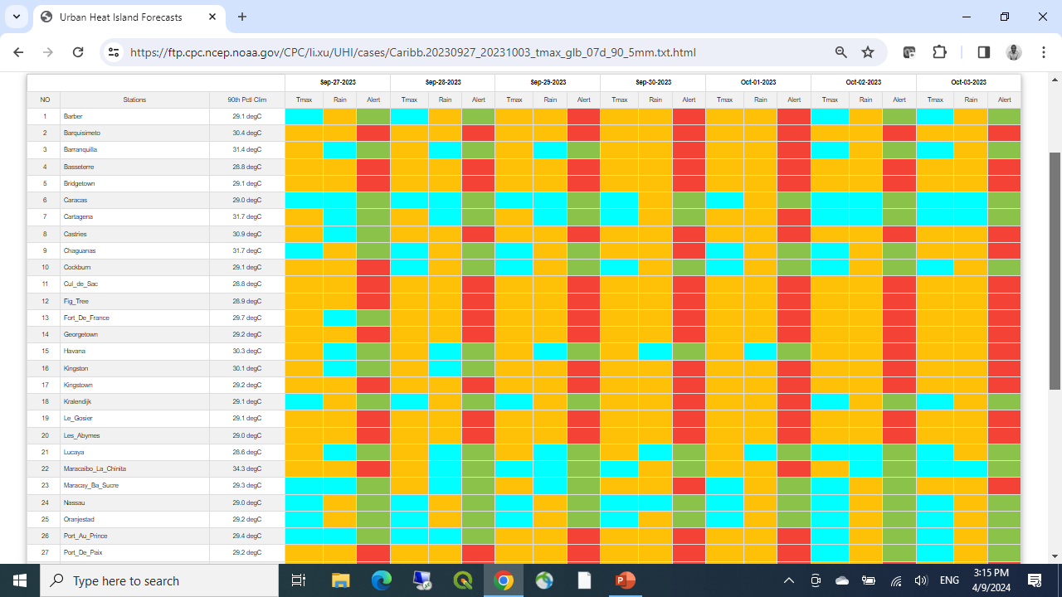
Urban Heat Island Forecasts
https://ftp.cpc.ncep.noaa.gov/CPC/li.xu/UHI/cases/Caribb.20230927_20231003_tmax_glb_07d_90_5mm.txt.html

Slide 13
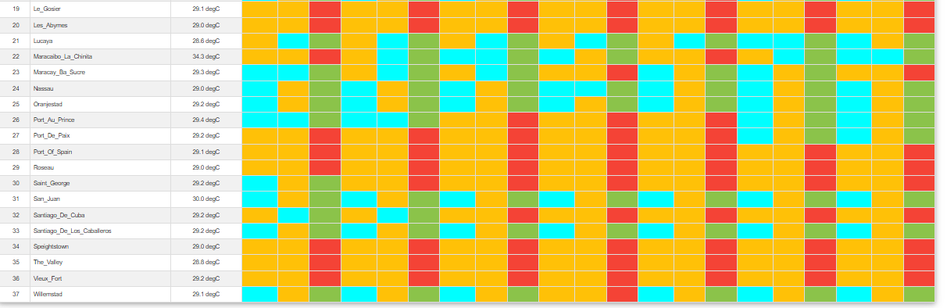
Urban Heat Island Forecasts (cont.)
https://ftp.cpc.ncep.noaa.gov/CPC/li.xu/UHI/cases/Caribb.20230927_20231003_tmax_glb_07d_90_5mm.txt.html

Slide 14
Week-1 Heat Hazards Outlook (Caribbean)
Valid: 27 September – 03 October, 2023
Add your notes, here
Insert QGIS drawn Outlook map, here
Add your notes here

