Slide 1
Climate Services Information System implementation and recent developments
Anahit Hovsepyan
World Climate Applications & Services Division
Climate Prediction and Adaptation Branch
Climate and Water Department
Second Symposium on the Variability and Predictability of the Global Climate System, Ankara, Turkey, 15 – 22 April, 2019

Slide 2
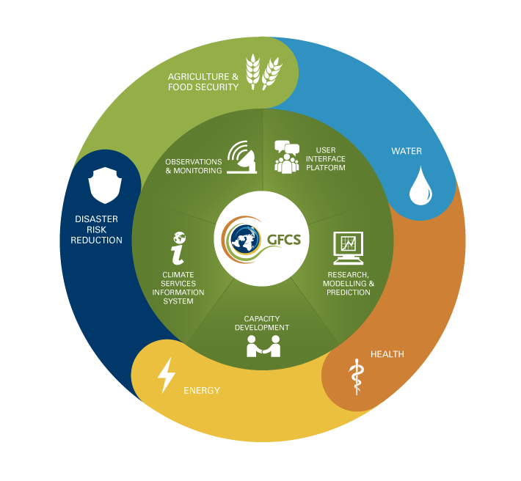
Global Framework for Climate Services
WMO spearheaded international initiative, coordinates efforts by the United Nations, governments and organizations to develop science-based climate information for various climate-sensitive sectors by improving the availability and access to reliable climate information, methods, tools and systems through interdisciplinary activities
Notes:
The five GFCS pillars are as follows:
1. The User Interface Platform — to provide ways for climate service users and providers to interact to identify needs and capacities and improve the effectiveness of the Framework and its climate services;
2. The Climate Services Information System — to produce and distribute climate data, products and information according to the needs of users and to agreed standards;
3. Observations and Monitoring – to generate the necessary data for climate services according to agreed standards;
4.. Research, Modeling and Prediction — to harness science capabilities and results and develop appropriate tools to meet the needs of climate services;
5. Capacity Building — to support the systematic development of the institutions, infrastructure and human resources needed for effective climate services.
To address the entire value chain for the effective production and application of climate services, the above five main functional components or pillars of the GFCS need to be in place.

Slide 3
Climate Services Information System (CSIS)
The CSIS is the component of the GFCS most concerned with the generation and dissemination of climate information.
It is the ‘operational core’ of the GFCS. It deals with climate data, monitoring, prediction (monthly, seasonal, decadal) and projection (centennial) activities.
“CSIS is the system needed to collect, process and distribute climate data and information according to the needs of users and according to the procedures agreed by governments and other data providers.” (High Level Taskforce on GFCS)
GFCS Goal:
Enable better management of the risks of climate variability and change and adaptation to climate change at all levels, through development and incorporation of science-based climate information and prediction into planning, policy and practice.

Slide 4
CSIS Implementation Strategy
Developing and implementing CSIS architecture
Functional descriptions and product development (Data/Monitoring/Prediction/Projection)
Operational infrastructure: GPCs, RCCs, RCOFs, NMHSs, NCOFs/NCFs
Climate Services Toolkit
Capacity Development

Slide 5
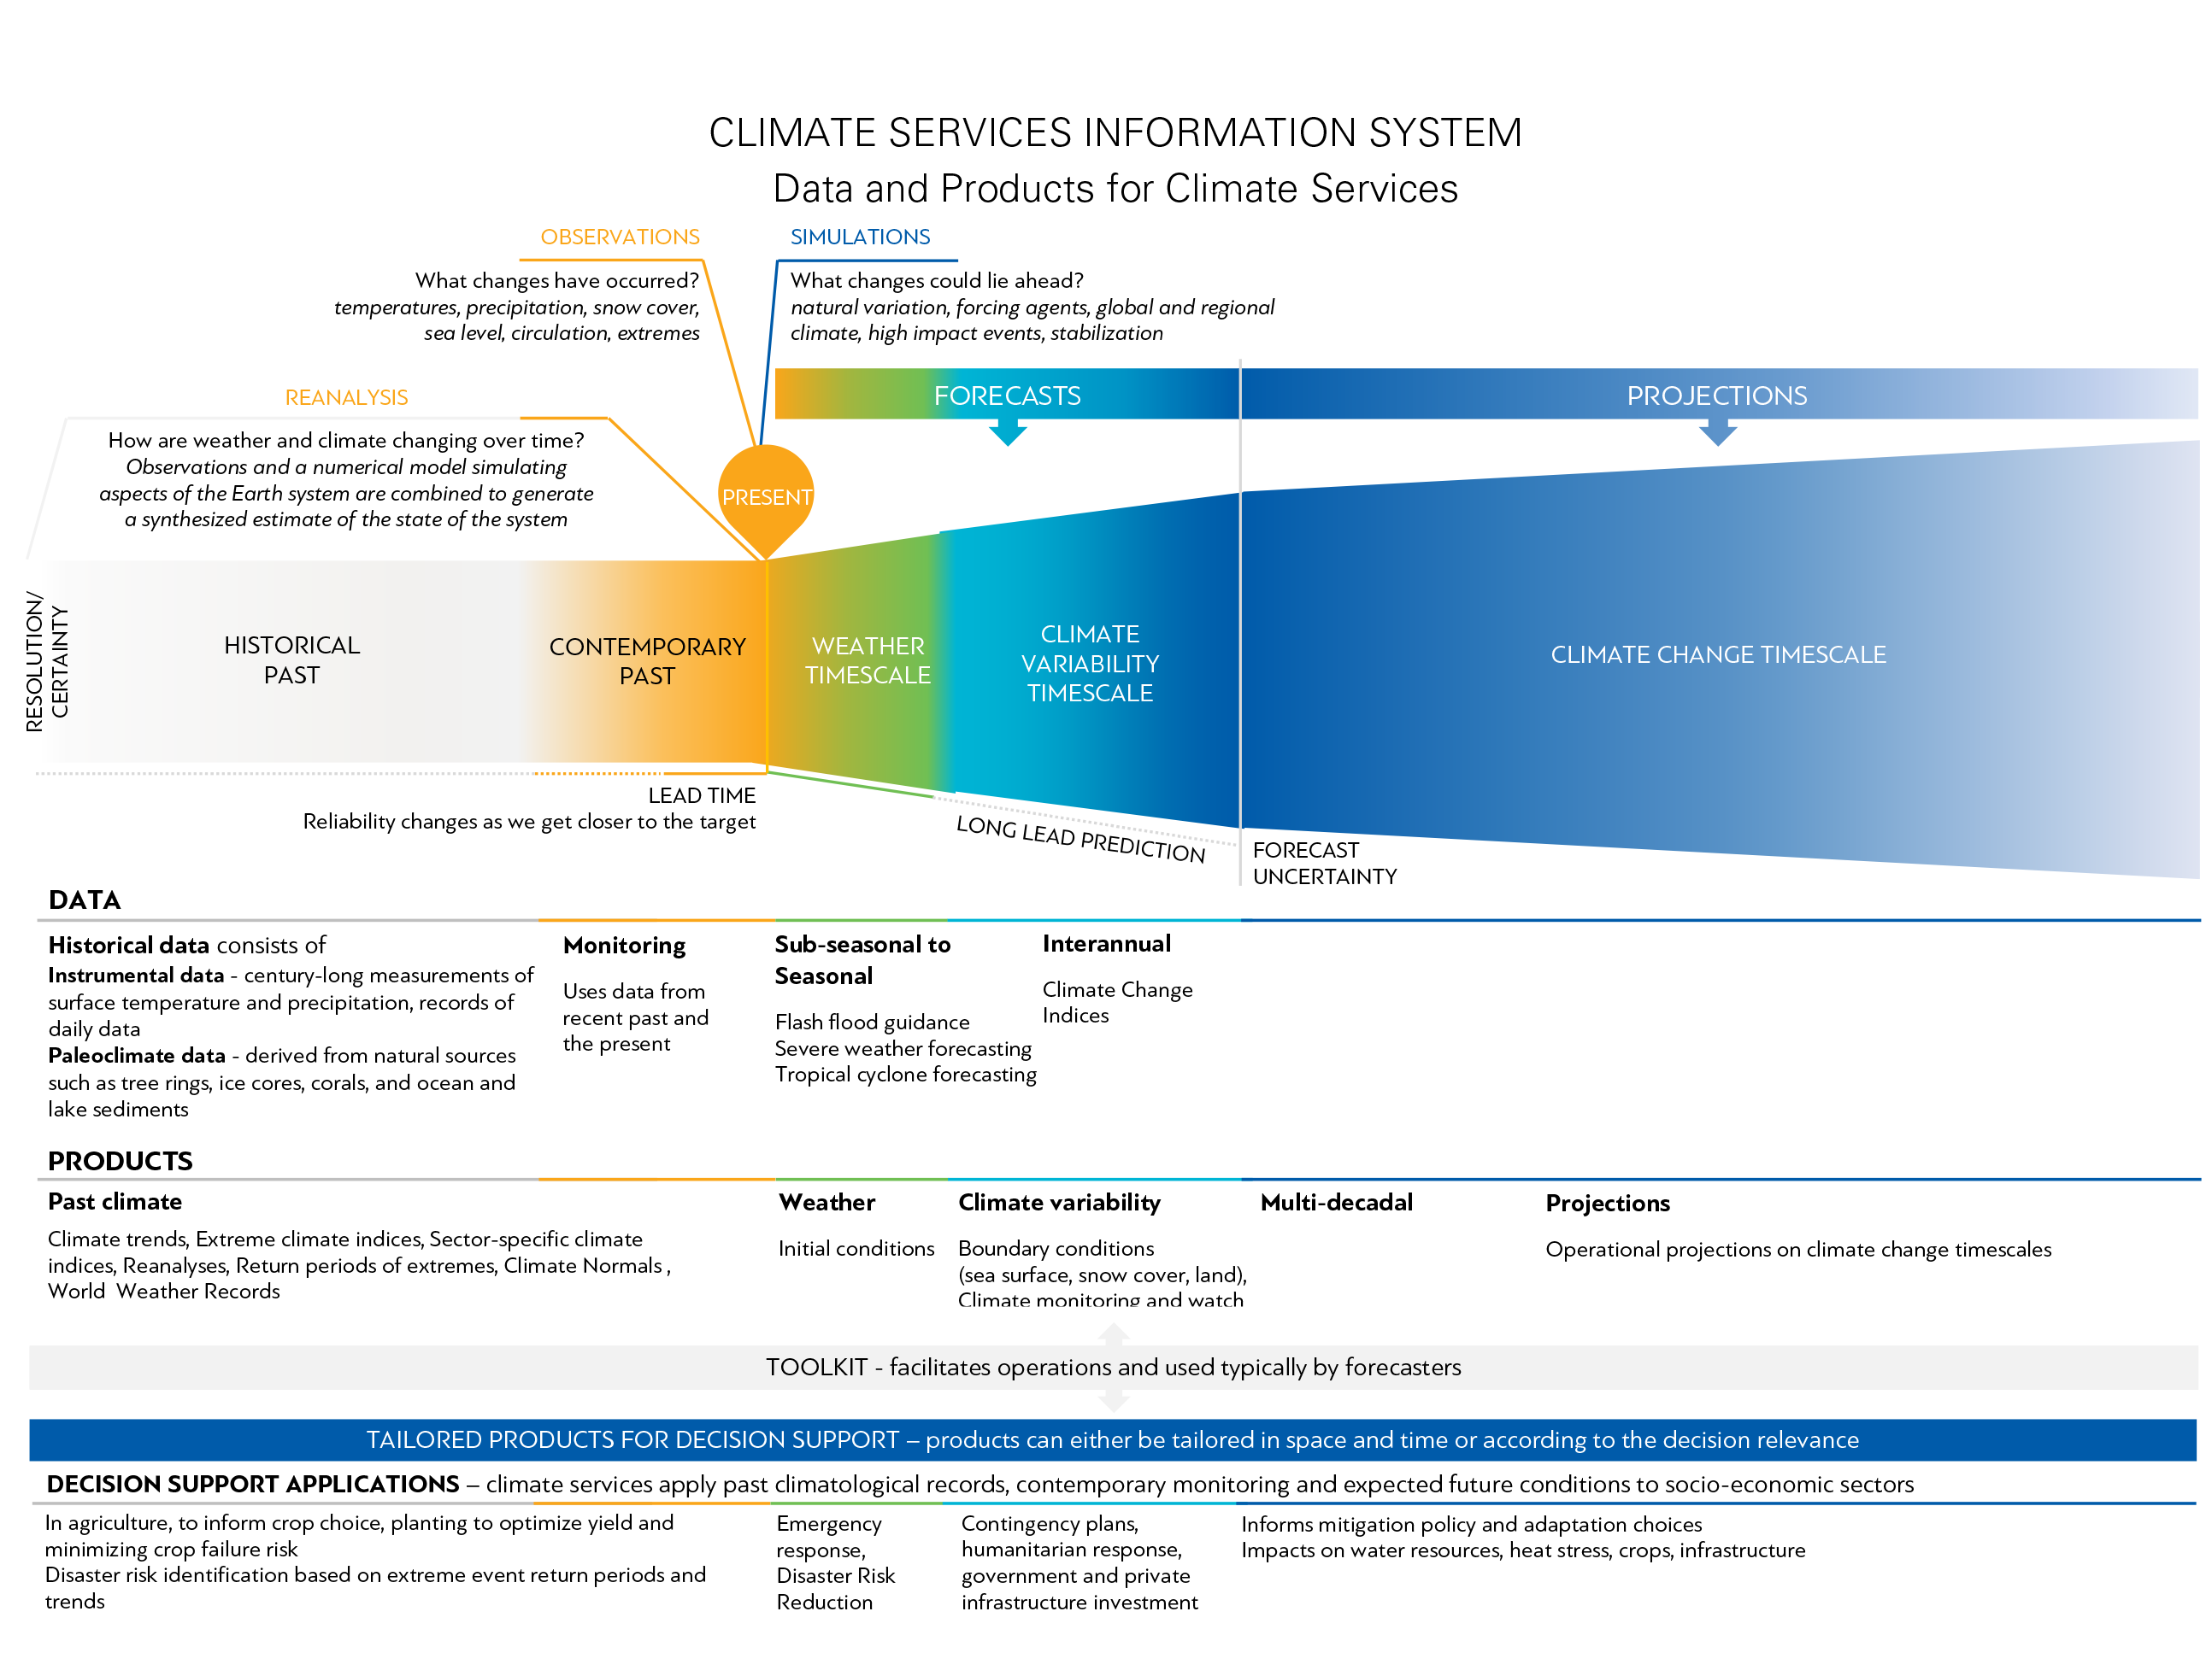
Climate Services Information System
SERVICE DELIVERY AT COUNTRY LEVEL
Notes:
The schematic shows the elements of the CSIS. The top part is the seamless basic system. The bottom part is the conversion of the basic data and products to decision-support services. The horizontal arrow indicates that the CSIS elements are all necessary for a fully functioning system – historical data is used to validate models. The§ down arrows indicate that useable products can be generated from any point in the seamless continuum.

Slide 6
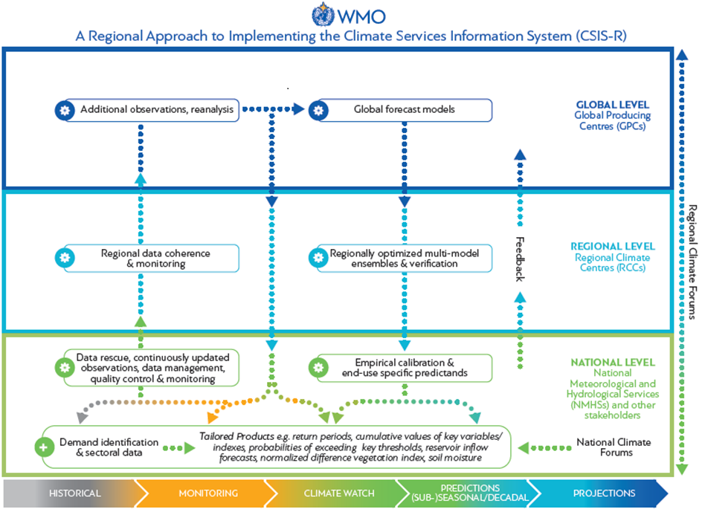
Notes:
The figure illustrates the cascade of functions - from global to regional to national levels – on which CSIS is built, and it identifies the relevant actors at each level – respectively, Global Producing Centres, Regional Climate Centres, and National Meteorological and Hydrological Services. WMO contributes to the present action by supporting CSIS-related capacity strengthening at the regional and national levels.

Slide 7
Global level
CSIS implementation

Slide 8
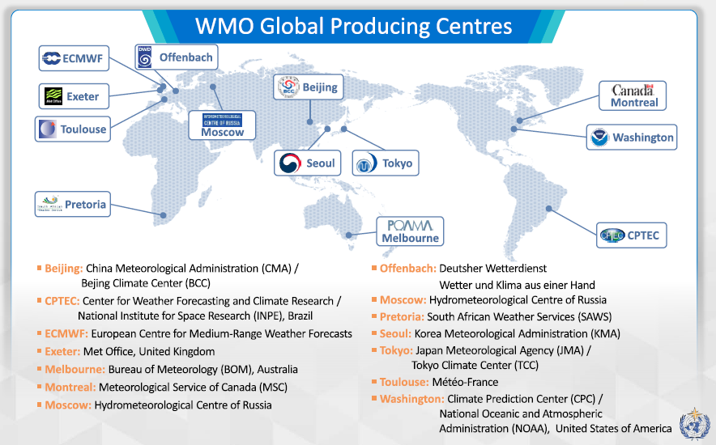
Global Producing Centres
GPCs for Long Range Forecasts (GPCLRFs)
13 GPCLRFs designated so far
Two Lead Centres: LC-LRFMME and LC-SVSLRF
GPCLRFs adhere to commonly defined standards – aiding consistency and usability of output:
a fixed forecast production cycle
a standard set of forecast products
WMO-defined verification standards
GPCs for Near-Term Climate Prediction (GPC-NTCP)
Concept approved in May 2017, LC-NTCP operational
GPCs for Data ? Monitoring ?
Links to GPCLRFs: http://www.wmo.int/pages/prog/wcp/wcasp/clips/producers_forecasts.html

Slide 9
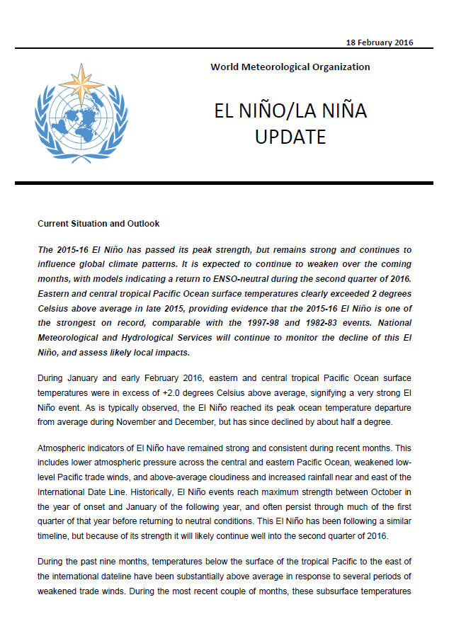
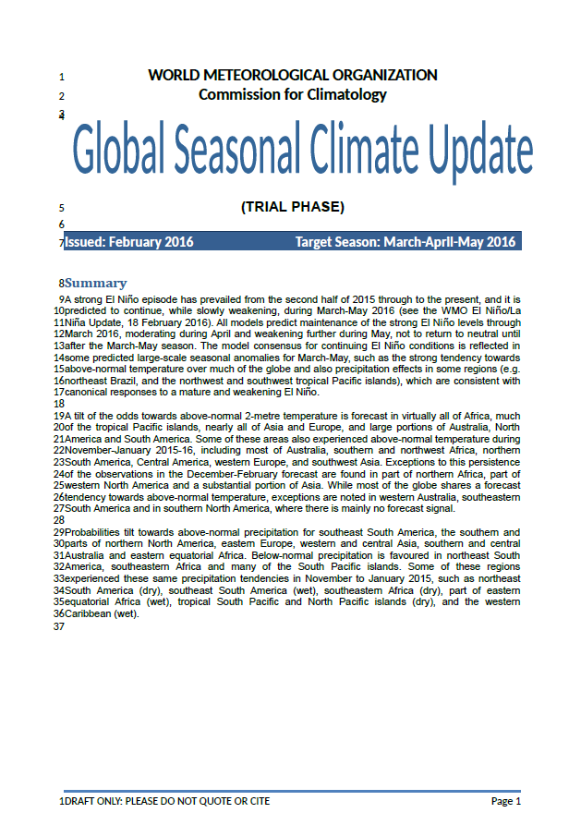
Global Products
WMO El Niño/La Niña Updates – quasi-regular (quarterly)
Global Seasonal Climate Update includes major general circulation features, large-scale oceanic anomalies, and regional impacts around the globe
GSCU – pre-operational issue

Slide 10
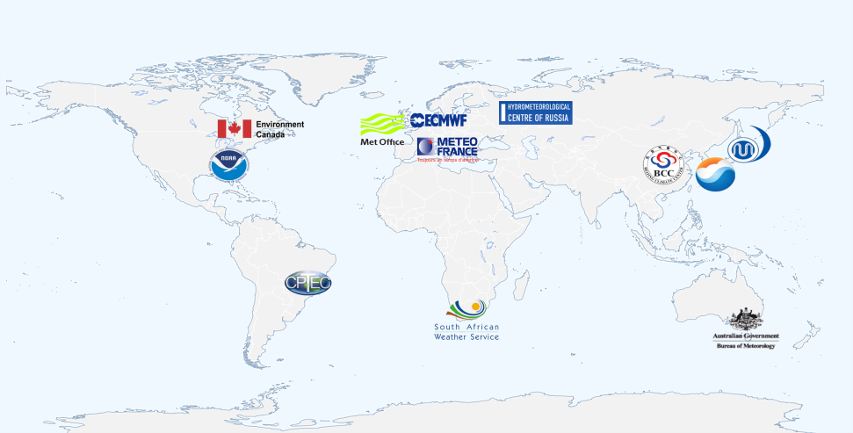
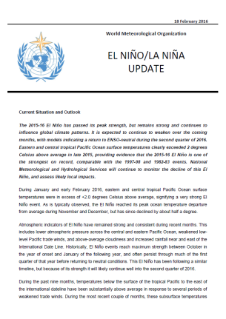
Global infrastructure and products
WMO El Niño/La Niña Updates – quasi-regular (quarterly)
Global Seasonal Climate Update includes major general circulation features, large-scale oceanic anomalies, and regional impacts around the globe
GSCU – pre-operational issue
Global Producing Centres of Long Range Forecasts

Slide 11
Regional level
CSIS implementation

Slide 12
Regional Climate Centres
WMO RCCs are Centres of Excellence that produce regional climate products in support of regional and national climate activities and thereby strengthen capacity of WMO Members in a given region to deliver better climate services to national users
WMO RCC serves primarily the NMHSs in the region!
WMO RCCs do not duplicate or replace national responsibilities, rather complementary to and supportive of NMHSs, who deliver all national-scale warnings, products and services

Slide 13
Regional Climate Centres
Mandatory Functions:
Operational Activities for LRF
Operational Activities for Climate Monitoring
Operational Data Services, to support operational LRF and climate monitoring
Training in the use of operational RCC products and services
Highly Recommended Functions:
Climate prediction and projection
Non-operational data services
Coordination functions
Training and capacity building
Research and development
Two modes of Implementation: fully self-contained RCCs or distributed-function RCC-Networks
http://www.wmo.int/pages/prog/wcp/wcasp/rcc/rcc.php

Slide 14
Regional Climate Outlook Forums
RCOFs provide platforms for Climate experts and climate information users to:
Discuss common climate risks, current climate status
Exchange views on scientific developments in climate prediction
Develop consensus-based regional climate outlooks that can feed into national climate outlooks produced by NMHSs
Establish user-provider dialogue to collect feedback and improve products
An important aspect of RCOFs is the facility to bring together experts in various fields, at regular intervals, operational climate providers and end users of forecasts in an environment that encourages interaction and learning both for climate experts and users

Slide 15
Regional Climate Outlook Forums
Notes:
The Regional Climate Outlook Forums, which have been in continuous operation in most sub-regions worldwide for decades, provide a platform for strengthening the operationalization of the Climate Services Information System on sub-regional scales. In the coming years these forums will move to objective regional forecast schemes whose skill can be verified and communicated to users. This will promote a focus on data coordination and forecast development, and on helping countries to develop and disseminate a wider variety of tailored products for country level decision-support (e.g. in climate-affected sectors) as well as for climate policy applications.

Slide 16
Key Limitations of RCOF outlooks
Format unsuitable for applications in specific decision making
Forecast skills not routinely evaluated/communicated
Lack of opportunities to implement new measures reflecting progress in science
No systematic approach to provide regular updates as the target season evolves
Limited use of RCOF products or value addition at the national level
Lack of user-tailored or targeted product packages/practical constraints to engage users at the regional level
Space-time resolution inadequate for most user level decision support

Slide 17
RCOF review
WMO Executive Council Decision 4.5/2 (EC-69 May 2017) SUB-SEASONAL AND SEASONAL FORECASTING SYSTEMS
``Decides to consider the adoption of objective sub-seasonal and seasonal forecasts as an overarching technical strategy, particularly at regional and national levels, promoted through RCOFs, by adopting suitable operational practices and capacity development efforts, to be facilitated by a global RCOF review``

Slide 18
Global RCOF Review 2017: Objectives
Identify the lessons learnt, and good practices in RCOFs
Identify opportunities and innovative approaches for RCOFs
Explore possibilities to enhance/improve the capacity development benefits of RCOFs
Consider possible expansion of the RCOF product portfolio
Propose ways to make more effective delivery and communication of climate products and services for decision making in a sustainable manner

Slide 19
RCOF review 2017: Next generation
Adoption of objective seasonal climate forecasts to underpin RCOF products
An expanded product portfolio, based on standardized operational practices, including
climate monitoring,
forecast verification,
sub-seasonal products, and
climate change-related products such as observed trends and attribution of extreme events
Follow-up on product use in country-level decision-making processes
Improved Partnership and User Engagement in RCOF process
Training workshops targeting capacities required for RCOF operations
Piloting of development and institutionalization of objective seasonal forecasting schemes in selected regions
Notes:
With the above in mind, and building on over a decade of preceding preparatory work, a process was launched to strengthen the operationalization of full value-chain country-level service delivery, with the Regional Climate Forums as a key vehicle for implementation. A key step in this transition is the operationalization of seasonal climate forecasts to replace the current consensus seasonal outlook products with objective forecasts for which the skill is verified via hindcast analysis and communicated to users, and the further operationalization of tailored seasonal forecasts products (i.e. forecasts of other variables of interest to users not limited only to rainfall). This focus has the additional benefit that it requires consolidation of regional and national historical data, and implementation of operational exchange of a variety of climate data and products. Once objective seasonal timescale forecasts have been fully operationalized, an expanded range of products can be similarly operationalized, guided by priority needs in each sub-region. For example, it is also envisioned that sub-seasonal forecasts could be introduced simultaneously in the process. Some sub-regions are also already taking steps to harmonize regional climate change projections.

Slide 20
National level
CSIS implementation

Slide 21
Potential National Mechanisms
National Framework for Climate Services
Similar to GFCS structure but involves practicalities and specifics for delivery of climate services at the national level.
Guidance on Stepwise approach for establishment of NFCS
Some countries may establish coordination mechanisms appropriate to their national context, largely as integral components of the NMHSs, to support/facilitate GFCS implementation at the national level
National Climate Outlook Forums (NCOFs)
Adapting the Large and Regional scale forecasts to the national context
Tailoring products and translating key messages for users (Multidisciplinary Working Groups)
Evaluating the impact of expected conditions (with existing vulnerabilities)

Slide 22
National Climate Outlook Forum
NCOFs are envisioned as an essential mechanism for promoting inter-agency coordination and regular multi-stakeholder dialogue between information provider and users at the national level, which will support national level implementation of both the CSIS and the UIP pillars of the GFCS.
NCOFs facilitate provision of standardized climate products based on high quality climate information from Global Producing Centers (GPCs), Regional Climate Centers (RCCs) and relevant Climate Outlook Forums (RCOFs) at user-relevant scales

Slide 23
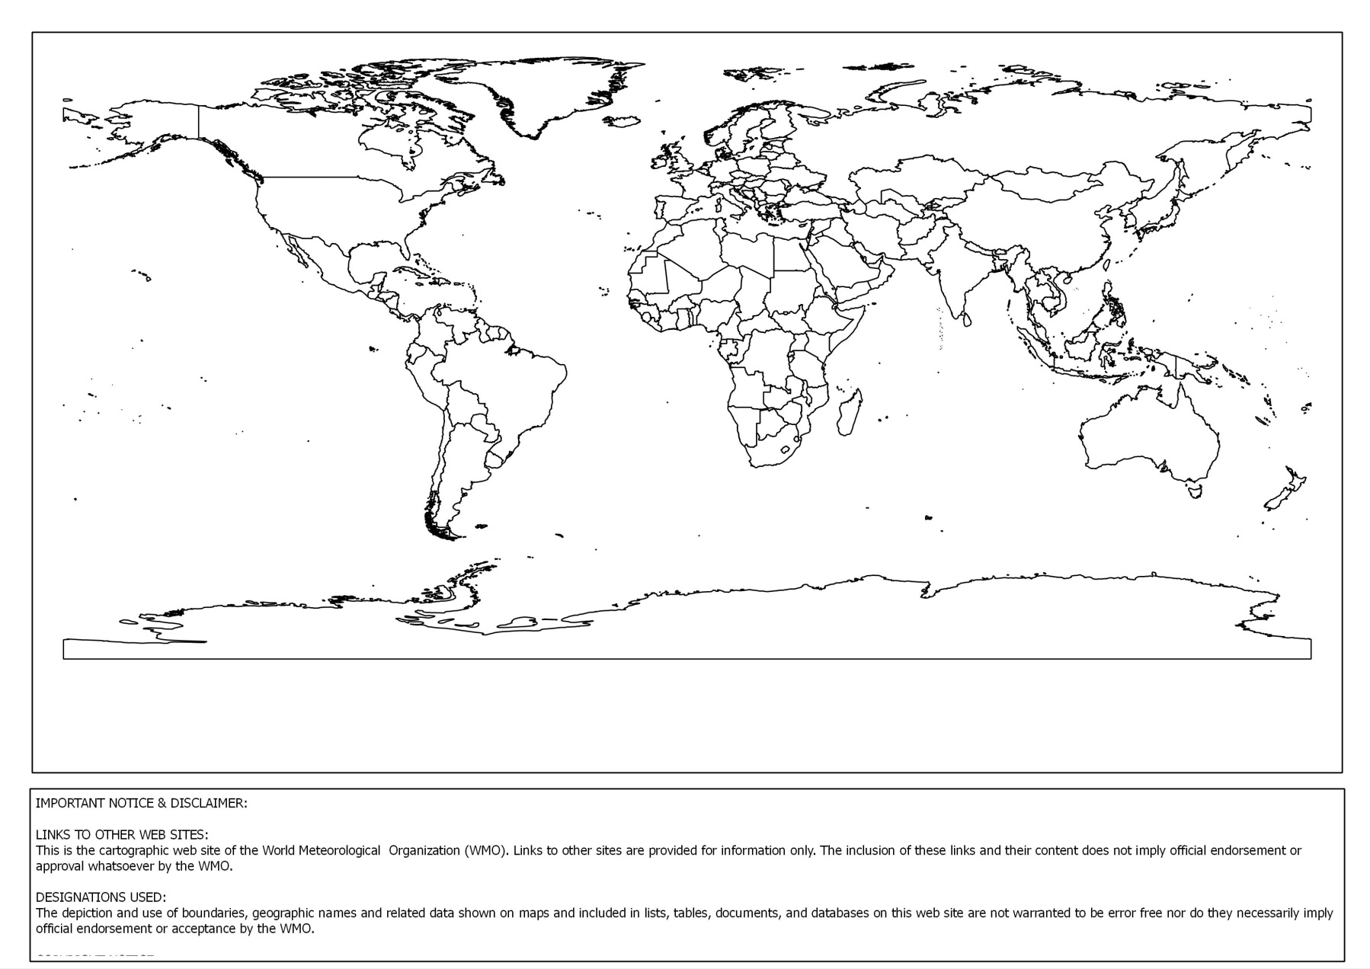
NCOFs worldwide
Maldives
April 2015
Bhutan
Bangladesh
Nepal
Dominica
Focus on Health
March – Sept 2015
PNG
Tonga
Kiribati
Vanuatu
Caribbean
South Asia
Belize
June 2014
Feb 2015
May 2015
Trinidad &Tobago
May 2015
Suriname
July 2015
Sri Lanka
Focus on Water
2015
Myanmar, Bangladesh & Madagascar
Data Rescue
April 2015 – March 2017
Pacific
12 PICTs
Focus on disaster mgmt plans for communities
April 2015 – March 2017
National Climate Outlook Forum
GOAL: provision of standardized climate products based on high quality climate at relevant timescales through multi-stakeholder dialogue process at the national level

Slide 24
Climate Services Toolkit
The Climate Services Toolkit comprises:
Data portal in public domain for access to and analysis of observations
Data management system for quality control and simple management of data
Climate monitoring tools for calculation of anomalies, percentiles, return periods
Software tools for conducting climate analyses, making predictions, and assessing projections
CST is a suite of guidance, procedures and instructions, data, software tools, training resources, and examples for enabling climate services at global, regional, and national levels
Guidance, procedures, and instructions serve as a starting point for climate services development and a reference tool
These products are accompanied by training materials specifically designated to support the generation and use of climate information and prediction products dedicated to user-target

Slide 25
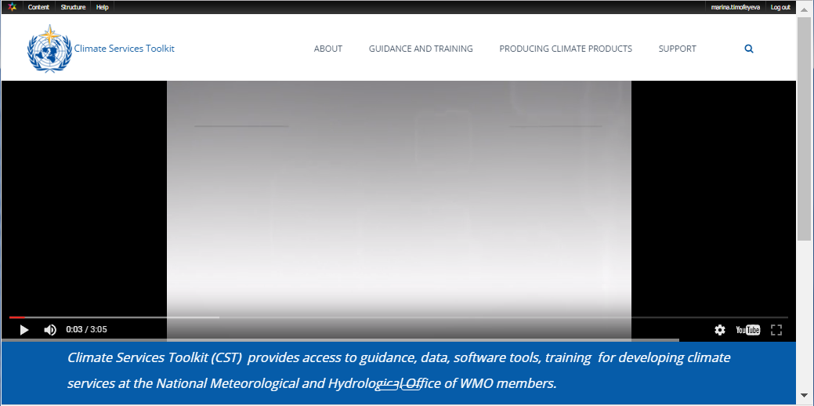
Why CSIS Climate Services Toolkit Prototype?
In support of Climate Services Information System implementation, the operational component of the Global Framework for Climate Services
An online outlet for data, tools, guidance, and training resources
For climate services development at national, regional, and global levels
Recommended by technical experts from WMO Commission of Climatology
Available in public domain at no cost to users

Slide 26
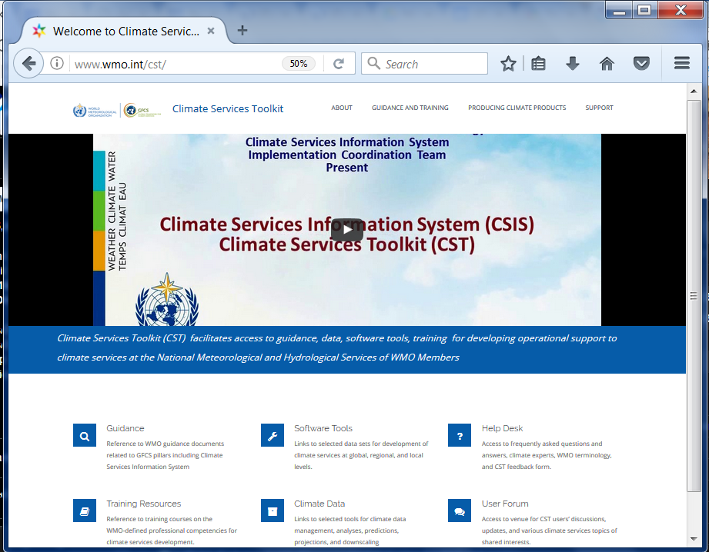
CST Web Portal
www.wmo.int/cst
Notes:
Currently under developed for postage at www.wmo.int/cst/
Will link selected users to tools identified by this meeting
To be used for demonstration of CST initial capabilities for GFCS partners and priority countries

Slide 27
Thank you
AHovsepyan@wmo.int

Slide 28
Three Dimensions for Pilots
Identification of skillful seasonal forecast methodologies for specific regions
Identify the global model which demonstrates the highest skill for a given regional domain
Identification of a Multi-Model Ensemble (MME) of global models that gives the best skill for a given regional domain
Maximize the exploitation of the available predictability in the system
Design innovative products to extract/characterize decision-relevant features
Identifying and accessing the necessary resources for developing and operationalizing such methodologies
WMO is making concerted efforts to attract extra-budgetary resources
Opportunities already opening up with an explicit focus on sub-seasonal and seasonal forecasting (e.g., CREWS regional/national projects, ACP, ACREI, Adaptation Fund, etc.)
Assembling and coordinating the cooperation among the institutions that would be involved in further developing and operationalizing skillful seasonal forecast systems
GPC-LRF and RCC inputs; engagement of other institutions (e.g., IRI, APCC, C3S,…)
Targeting NMHS implementation, strengthening two-way interaction and data exchange
Addressing research needs, particularly at regional/national levels
Co-production with climate-sensitive user sectors – to develop demand driven tailored products

Slide 29
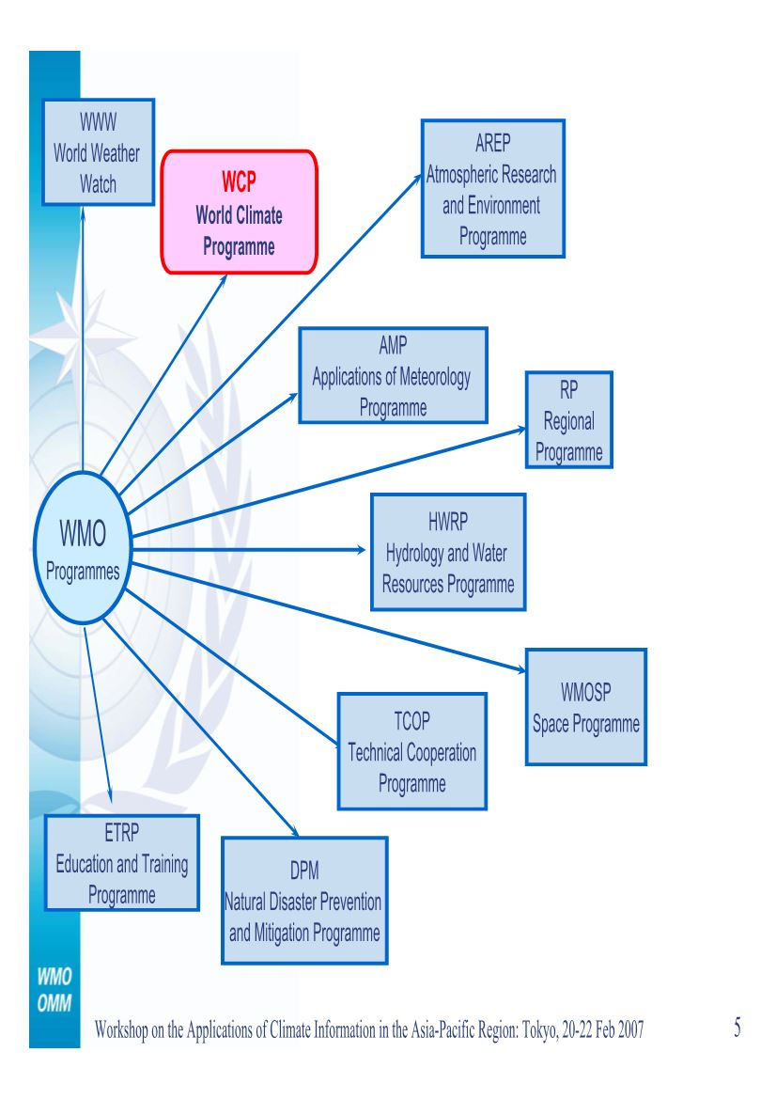
World Meteorological Organization Programmes
Notes:
WMO through its World Climate Programme coordinates and facilitates enhancement of climate services with adequate focus on user interaction, in order to facilitate useful applications of climate information in support of decision making to derive optimal socio-economic benefits, and thereby underpins the Global Framework for Climate Services (GFCS).

Slide 30
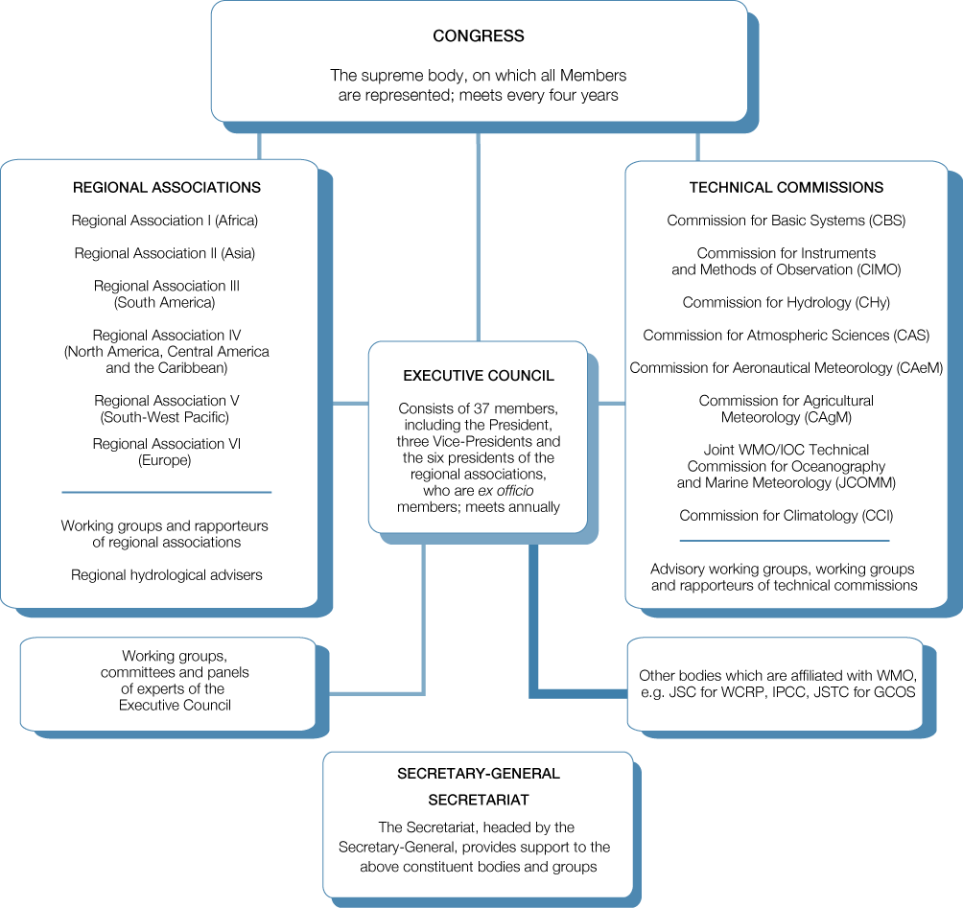
WMO governance structure

