Slide 1



Symposium on the Global Climate System,
Ankara, Turkey, 24 – 26 April, 2019
Advances in climate modeling, assessment and future directions
Carolina Vera
CIMA/Universidad de Buenos Aires-CONICET, UMI-IFAECI/CNRS
Argentina

Slide 2
Actions to advance on intraseasonal to interannual (ISI) predictions:
Improvements to the Building Blocks of ISI Forecast Systems
  Continued development of observations, models, and data assimilation systems.
Best Practices
  Largely focused on the activities of the operational forecast centers (Public Archives, Verification Metrics, etc.)
  Aimed to improve the delivery and dissemination of forecast information for decision makers.
Research for Sources of Predictability
  Efforts mainly by the research community to investigate unexploited sources of predictability
(National Research Council, 2010)

Slide 3
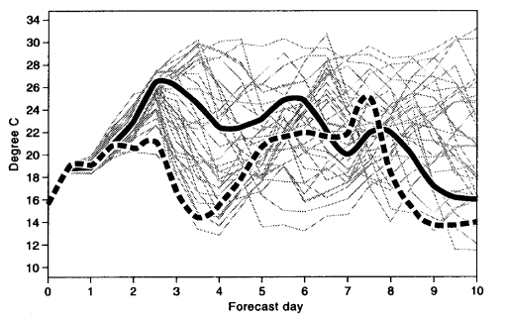
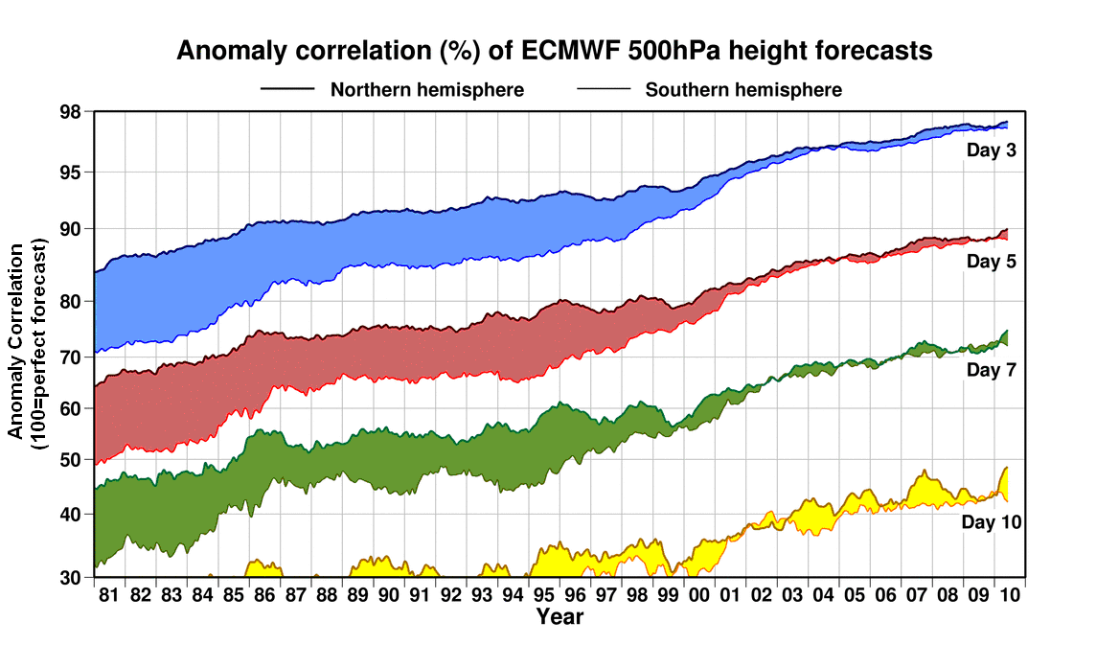
  Predictability of the first kind
    Forecasts are highly sensitive to initial conditions, i.e. predictability depends on the state of the system
The memory of the atmosphere to initial conditions is limited to approximately 10 days
The memory of the oceans to initial conditions can range from months to years
Weather prediction works and improves!

Slide 4
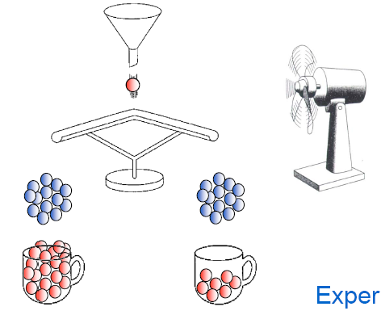
  Predictability of second kind
    Even though individual weather events are not predictable beyond 10 days, “the average weather behavior “ (=climate) may be influenced by boundary conditions for several months and longer.
EXPERIMENT 1: no boundary conditions (coincidence)
EXPERIMENT 2: with boundary conditions
Knutti, ETH
Notes:
Parámetros externos al sistema a pronosticar. En nuestro caso al estar interesados en la circulación atmosférica de gran escala, parámetros externos obvios serían las condiciones del borde inferior de la atmósfera. Pero si estuvieramos interesados en predicciones para todo el sistema climático, tal condicion de borde sería un elemento interno al sistema, cual sería un parámetro externo que su conocimiento imperfecto podría limitar la predictibilidad? Las erupciones volcánicas, los cambios en la composición de la atmósfera a través de las actividades humanas, etc.

Slide 5
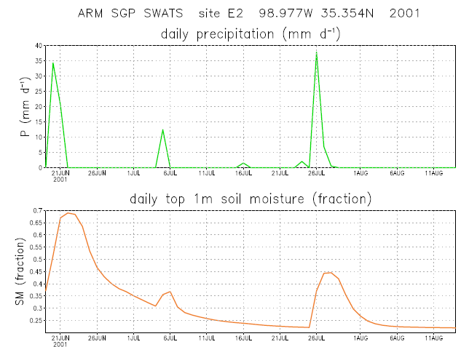
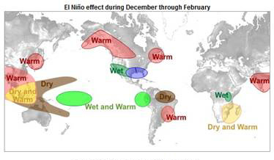
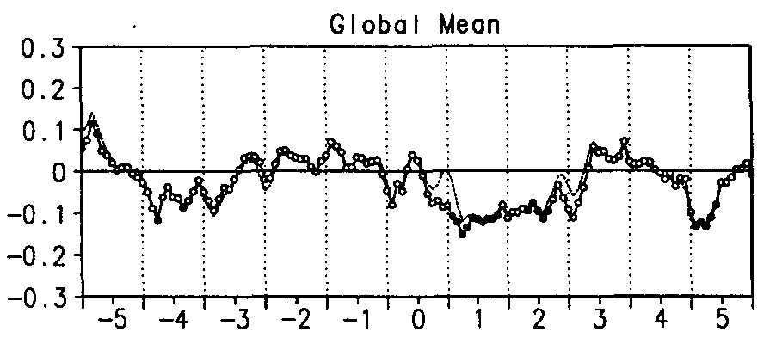
Sources of predictability on ISI timescales
Inertial Memory
Patterns of variability
External forcing
(National Research Council, 2010)

Slide 6
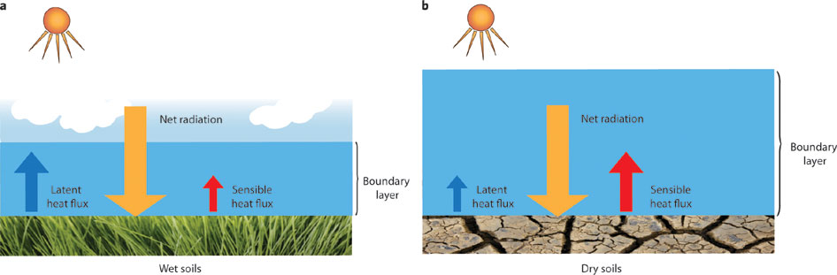
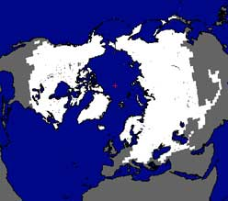
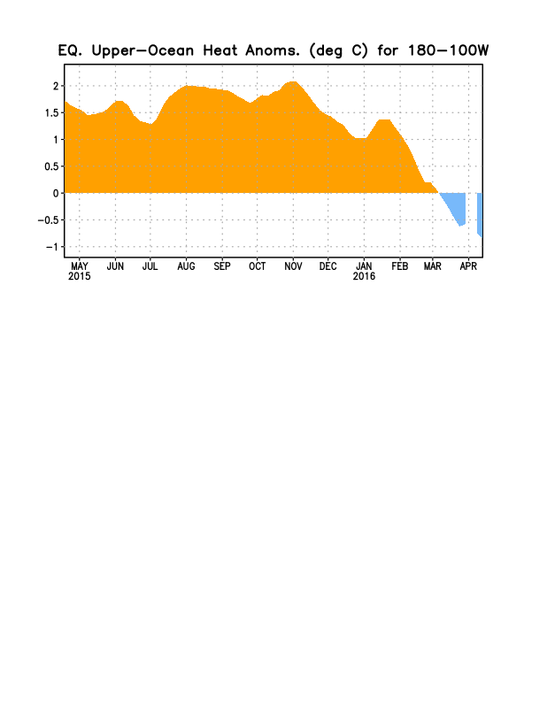
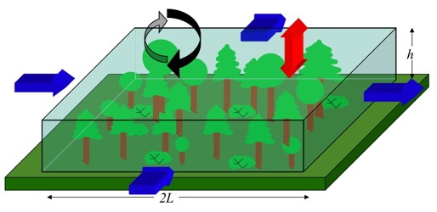
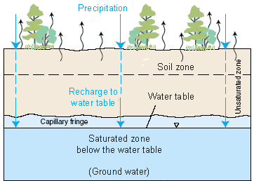
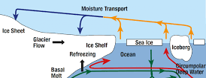
Sources of predictability on ISI timescales: Inertial Memory
Particular variables exhibit inertia or memory in which anomalous conditions can take relatively long periods of time (days to years) to decay:
Upper-Ocean heat content
Soil Moisture
Snow Cover
Vegetation
Water Table Variations
Land Heat Content
Polar Sea Ice
(National Research Council, 2010)
Notes:
Upper ocean heat content: On seasonal-to-interannual time scales upper ocean heat content is a known source of predictability. The ocean can store a tremendous amount of heat. Sunlight penetrates the upper ocean, and much of the energy associated with sunlight can be absorbed directly by the top few meters of the ocean. Mixing processes further distribute heat through the surface mixed layer, which can be tens to hundreds of meters thick. Thus, the atmosphere acts as a “receiver” of any anomalies that have been stored in the ocean, and predictions of the evolution of air temperature over the ocean can be improved by consideration of the ocean state.
Soil Moisture, Soil moisture memory spans intraseasonal time scales. Memory in soil moisture is translated to the atmosphere through the impact of soil moisture on the surface energy budget, mainly through its impact on evaporation. Soil moisture initialization in forecast systems is known to affect the evolution of forecasted precipitation and air temperature in certain areas during certain times of the year on intraseasonal time scales
Snow cover, Snow acts to raise surface albedo and decouple the atmosphere from warmer underlying soil. Large snowpack anomalies during winter also imply large surface runoff and soil moisture anomalies during and following the snowmelt season, anomalies that are of direct relevance to water resources management and that in turn could feed back on the atmosphere, potentially providing some predictability at the seasonal time scale.
Vegetation, Vegetation structure and health respond slowly to climate anomalies, and anomalous vegetation properties may persist for some time (months to perhaps years) after the long-term climate anomaly that spawned them subsides. Vegetation properties such as species type, fractional cover, and leaf area index help control evaporation, radiation exchange, and momentum exchange at the land surface; thus, long-term memory in vegetation anomalies could be translated into the larger Earth system
Water Table variations, Water table properties vary on much longer timescales (years or more for deep water tables) than surface soil moisture. Some useful predictability may stem from these variations,
though the investigation of the connection of these variations to the overall climate system is still in its infancy, in part due to a paucity of relevant observations in time and space.
Land heat content, Thermal energy stored in land is released by molecular diffusion and thus over all time scales, but with a rate of release that decreases with the square root of the time scale. In practice,
there is strong diurnal storage (up to 100 W m-2) of heat energy and a still significant amount over the annual cycle (up to 5 W m-2). This is particularly strong in relatively unvegetated regions where solar radiation is absorbed mostly by the soil, since vegetation has much less thermal inertia, or in higher latitudes where soil water seasonally freezes.
Polar sea ice, Sea ice is an active component of the climate system and is highly coupled with the atmosphere and ocean at time scales ranging from synoptic to decadal. When large anomalies are established in sea ice, they tend to persist due to inertial memory and to positive feedback in the atmosphere-ocean-sea ice system. These characteristics suggest that some aspects of sea ice may be predictable on ISI seasonal time scales. In the Southern Hemisphere, sea ice concentration anomalies can be predicted statistically by a linear Markov model on seasonal time scales (Chen and Yuan, 2004). The best cross-validated skill is at the large climate action centers in the southeast Pacific and Weddell Sea, reaching 0.5 correlation with observed estimates even at 12- month lead time, which is comparable to or even better than that for ENSO prediction. We have
less understanding of how well sea ice impacts the predictability of the overlying atmosphere.

Slide 7
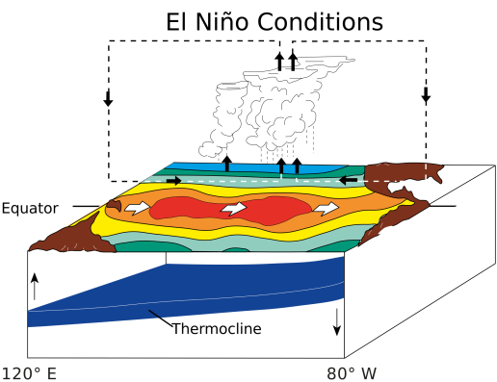
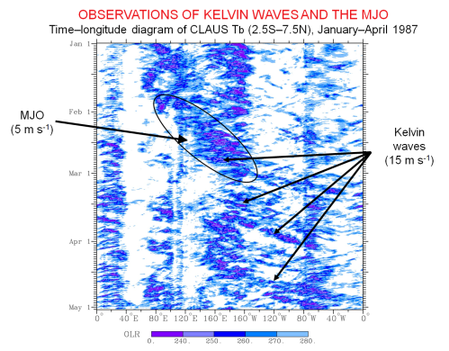
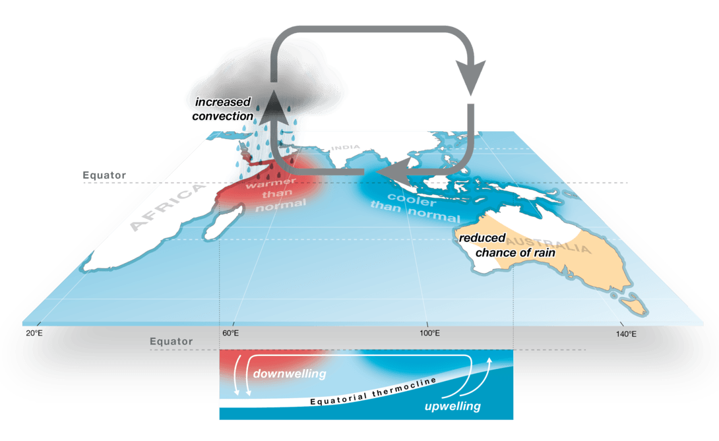
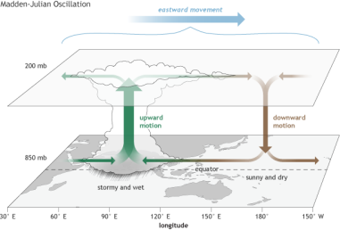
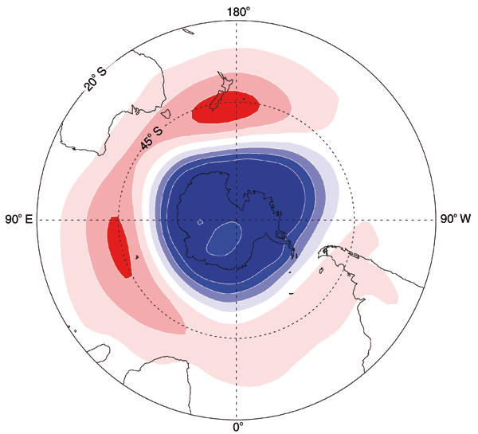
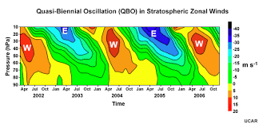
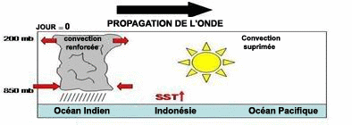
Sources of predictability on ISI timescales: Patterns of variability
Coupling among processes in the climate system can give rise to characteristic patterns that explain some portion of the spatial and temporal variance exhibited by key climate variables
ENSO
IOD
MJO
Low-Frequency Equatorial Waves
Annular Modes (SAM, NAM)
Stratosphere-Troposphere Interaction (QBO)
SST and mixed layer feedbacks on subseasonal timescales
(National Research Council, 2010)
Notes:
ENSO (involving subsurface ocean heat content)
Indian Ocean Dipole (IOD), A coupled mode of interannual variability has been found in the equatorial Indian Ocean in which the normally positive SST gradient is significantly weakened or reversed for a period
on the order of a season. It can result in significant regional climate impacts. The independence of this
mode and its connections to ENSO are still being investigated, but like ENSO, appears to offer an intermittent source of interannual predictability. Similar to ENSO, the IOD involves equatorial SST-wind thermocline/
upwelling feedback; however, in contrast to ENSO, it also involves off-equatorial, SST-convection-atmospheric Rossby wave interaction
Low-frequency equatorial waves in the Atmosphere and Ocean, The equator provides an efficient wave guide by which tropical dynamical energy is organized, propagated, and dissipated. In the atmosphere, equatorial Kelvin and Rossby waves and mixed Rossby-Gravity waves, are observed. these low-frequency waves are often associated with convection and are referred to as convectively-coupled equatorial waves (CCEWs). Although complicated by their coupling to atmospheric convection, the organization and propagation of these low-frequency waves provides an element of predictability for the tropical atmosphere and possibly the extra-tropics via teleconnections. Analogous to the discussion of the atmosphere above, the equatorial ocean supports the presence of equatorial wave modes, such as the Kelvin, Rossby and mixed-Rossby gravity modes. One simplifying aspect for their presence in the ocean is that, in contrast to the atmosphere, no convection or phase changes are involved. Because the equivalent depth of the ocean is considerably smaller than that for the atmosphere, its propagation speeds are much slower, and thus the time scale (and the predictability that arises from it) is much longer (e.g., a Kelvin wave takes about 2–3 months to cross the Pacific Ocean). These waves play a crucial role in the ocean thermocline adjustment and ENSO turnaround.
Madden-Julian Oscillation (MJO), Another fundamental mode of tropical convectively-coupled wave-like variability. MJOs operate on the planetary scale, with most of the convective disturbance and variations occurring in the Indo- Pacific warm pool regions. The typical time scale of these quasi-periodic disturbances is of the order of 40–50 days. They tend to propagate eastward and strongly influence the onsets and breaks of the monsoons with also some influence at extratropical regions
SST and mixed layer feedback on subseasonal timescales, The large/planetary spatial and subseasonal time scales of the CCEWs and MJO discussed above, along with the often strong impact of these phenomena on surface fluxes via wind speed and cloudiness, can result in significant modulation of the ocean surface mixed layer, with variations in depth on the order of tens of meters and in temperature of the order of a
degree. This process can impart a feedback onto the atmospheric wave processes which
influences their subsequent evolution (e.g. amplitude, propagation speed).
Annular Modes (SAM, NAM), The Annular Modes, also refereed to as the Arctic Oscillation in the Northern Hemisphere, or the Antarctic Oscillation in the Southern Hemisphere, are dominant modes of variability outside the tropics. They are established on a weekly time scale due to atmospheric internal dynamics (such as mean flow-wave interaction or stratosphere-troposphere interaction). They offer some predictability on seasonal time scales through longer-timescale persistence of stratospheric winds. The modes can influence
surface temperature and precipitation, especially the frequency of extreme events.
Stratosphere-Troposphere Interaction (QBO), Since the stratosphere can interact with the troposphere, knowledge of the state of the stratosphere can serve almost as a boundary condition when attempting to simulate the troposphere. The stratospheric circulation can be highly variable, with a time scale much longer
than that of the troposphere. The variability of the stratospheric circulation can be characterized mainly by the strength of the polar vortex, or equivalently the high latitude westerly winds. Stratospheric variability peaks during Northern winter and Southern late spring. When the flow just above the tropopause is anomalous, the tropospheric flow tends to be disturbed in the same manner, with the anomalous tropospheric flow lasting up to about two month. Additionally, the Quasi-Biennial Oscillation (QBO) of the stratospheric circulation offers
a source of predictability for the tropospheric climate. The stratospheric QBO in the tropics arises from the interaction of the stratospheric mean flow with eddy fluxes of momentum carried upward by Rossby and gravity waves that are excited by tropical convection. The result is an oscillation in the stratospheric zonal winds having a period of about 26 months. While our weather and climate models do not often resolve or represent the QBO well, it is one of the more predictable features in the atmosphere, and it has been found to exhibit a signature in surface climate

Slide 8
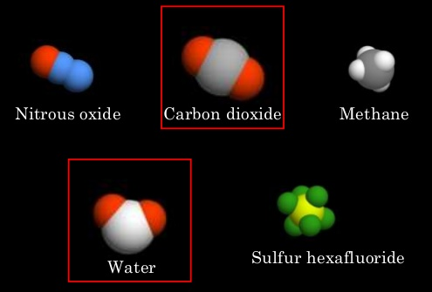
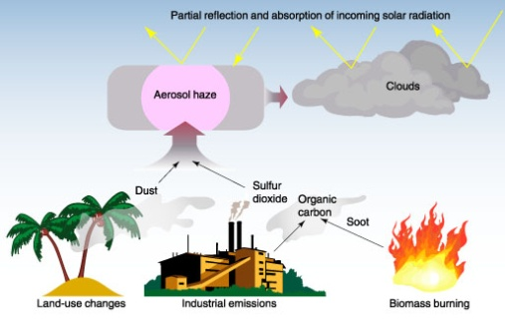
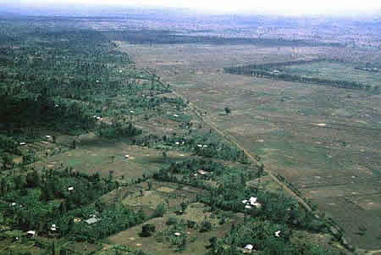
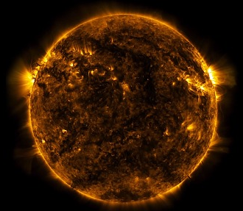
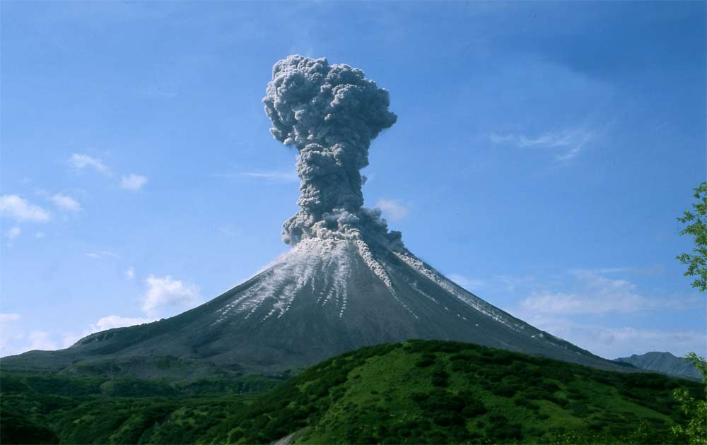
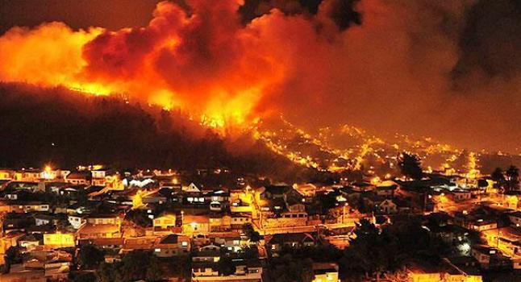
Sources of predictability on ISI timescales: External forcing
Greenhouse gases
Anthropogenic Aerosols
Land use change
Fluctuations in solar output
Volcanoes and other high-impact modifications of atmospheric composition
(National Research Council, 2010)
Notes:
Greenhouse gases, have a direct impact on the radiation balance of the atmosphere: increases in greenhouse gases warm the global climate. The non-stationarity associated with this
climate change is an important component of climate forecasts even on ISI timescales. For example, the NOAA Climate Prediction Center uses optimal climate normals and other empirical
techniques to capture this non-stationarity in climate forecasts (Huang et al., 1996a; Livezey et al., 2007). However, regional details of this climate change are difficult to model numerically
due to the myriad important feedbacks that need to be taken into account. These include feedbacks due to the enhancement of water vapor in the warming atmosphere and the associated
changes in cloudiness and snow/ice amount, all of which can affect the radiation budget. In addition, there are feedbacks from the carbon cycle itself (including the release of additional
greenhouse gases in northern latitudes as permafrost melts), the ocean thermohaline circulation, changes in the biosphere, and so on.
Anthropogenic Aerosols, Atmospheric aerosols, which affect the radiation budget of the Earth, include major human-related components that change with the nature of human activities, and thus which may
be predictable. The human-related components include sulfate aerosols from fossil fuel combustion and organic aerosols from biomass burning and land use change. The effect of changes in aerosols on precipitation at ISI timescales could be important. Bollasina and Nigam (2009) have shown that elevated aerosol concentrations over the Indian subcontinent can accompany periods of reduced cloudiness, increased downward shortwave
radiation, and ultimately a delayed onset of the monsoon. However, the role of aerosols as the “cause” of a decrease or delay in precipitation is not yet confirmed—more research on subseasonal
timescales is required to isolate the effect of aerosols from the influence of the largescale
synoptic flow and associated changes in precipitation.
Land use change, Humans have had a marked impact on the character of the land surface through deforestation, agricultural conversion, and urbanization. This change in surface character can
have a long-term impact on surface energy and water budgets (e.g., deforested land may generate less evapotranspiration than forested land), which in turn can have a long-term impact on the rest
of the climate system.
Fluctuations in solar output, The sun provides the energy that powers the Earth’s climate system. Its output varies slightly with an 11-year cycle that is highly predictable because it is nearly periodic. Larger
changes may occur on longer time scales, but in the absence of measurements, these changes cannot be quantified beyond a statement that they appear to be small compared to the signal seen
from greenhouse gases. it is likely that the mechanism that links solar fluctuations to surface climate involves the communication of anomalies between the stratosphere and troposphere,
Volcanoes and other high-impact modifications of atmospheric composition (e.g. forest fires), There are a number of rare external forcing events that can cause a sudden drastic change
to the atmospheric burden of aerosols, trace gases, and particulates. Volcanoes are one example. Major eruptions are relatively rare (less than one per decade) but can quickly inject large
volumes of material high into the atmosphere. The effects on the climate system can be felt for years afterward, typically as a cooling of the global mean temperature (Robock and Mao, 1995).
The impacts of major eruptions on temperature distributions over the continental United States can be larger than those from internal variations of the climate system discussed earlier in this
section (Bradley, 1988). Shortened growing seasons caused by an overall reduction of solar radiation reaching the ground could have negative impacts on particular crops in some regions.
Forest fires provide another example of relatively rapid changes in atmospheric composition that can affect climate on ISI time scales.

Slide 9
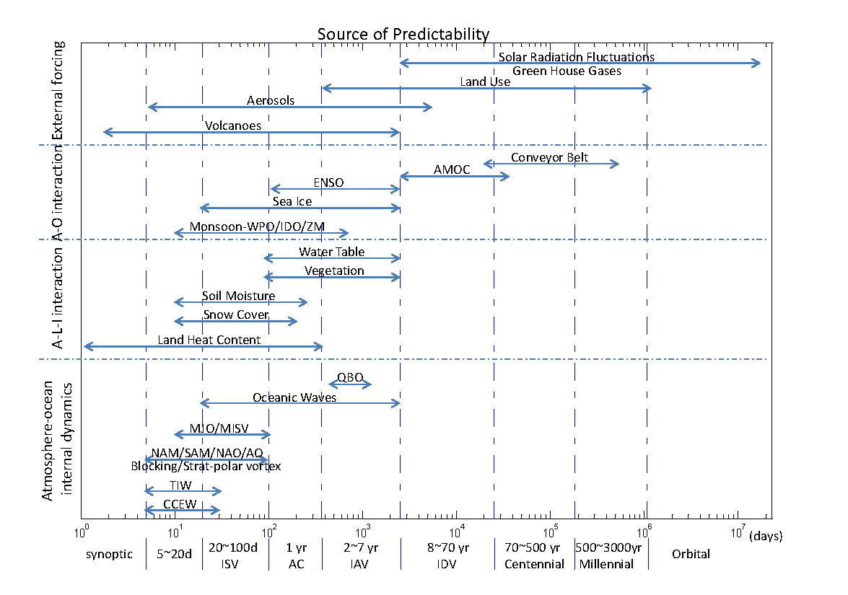
Processes that affect the climate on ISI timescales can themselves operate on a variety of timescales
(National Research Council, 2010)
Notes:
Processes that act as sources of ISI climate predictability extend over a wide range of timescales and involve interactions among the atmosphere, ocean, and land. CCEW: convectively coupled equatorial waves; TIW: tropical instability wave; MJO/MISV: Madden- Julian Oscillation/Monsoon intraseasonal variability; NAM: Northern Hemisphere annular mode; SAM: Southern Hemisphere annular mode; AO: Arctic oscillation; NAO: North Atlantic
oscillation; QBO: quasi-biennial oscillation, IOD/ZM: Indian Ocean dipole/zonal mode; AMOC: Atlantic meridional overturning circulation. For the y-axis, “A” indicates “atmosphere;” “L”indicates “land;” “I” indicates “ice;” and, “O” indicates “ocean.”

Slide 10
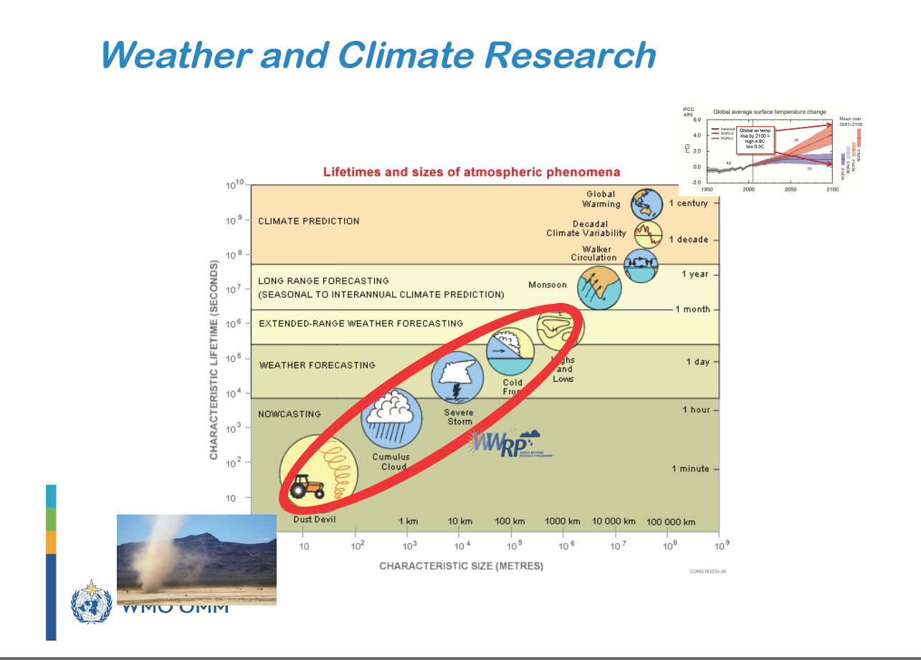
(Kabat, CMIP6 Workshop, March 2019)

Slide 11
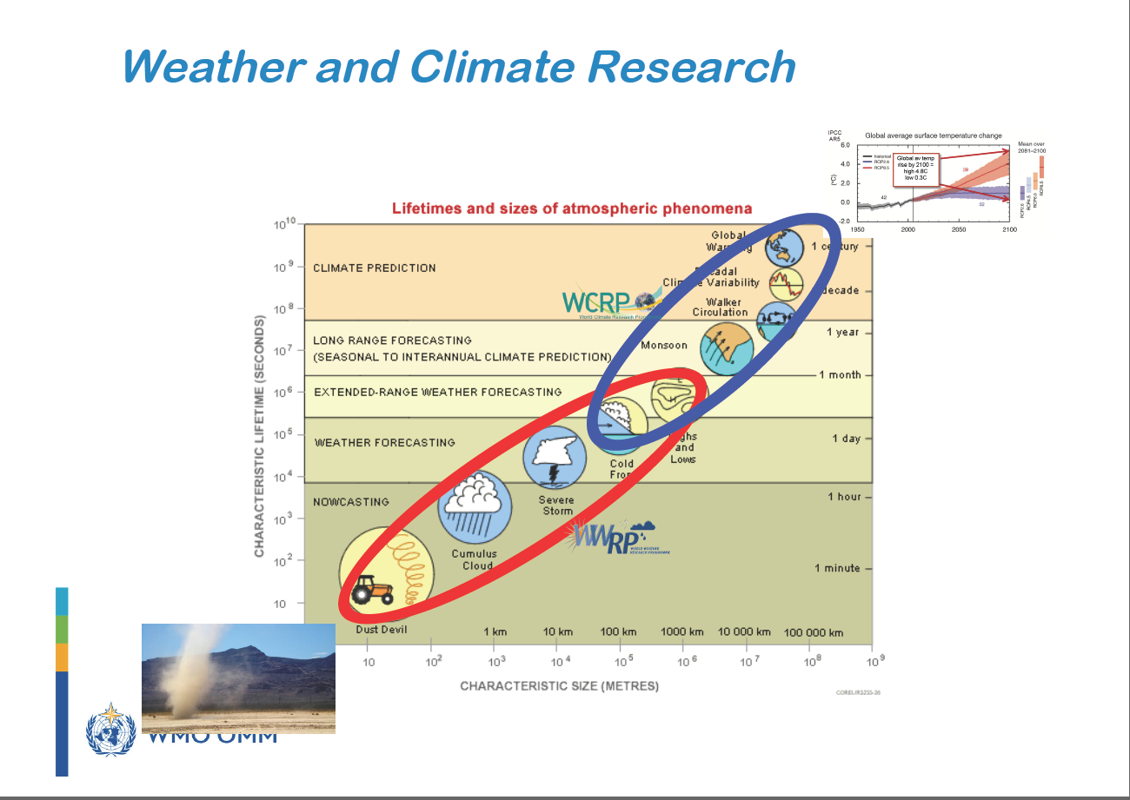
(Kabat, CMIP6 Workshop, March 2019)

Slide 12
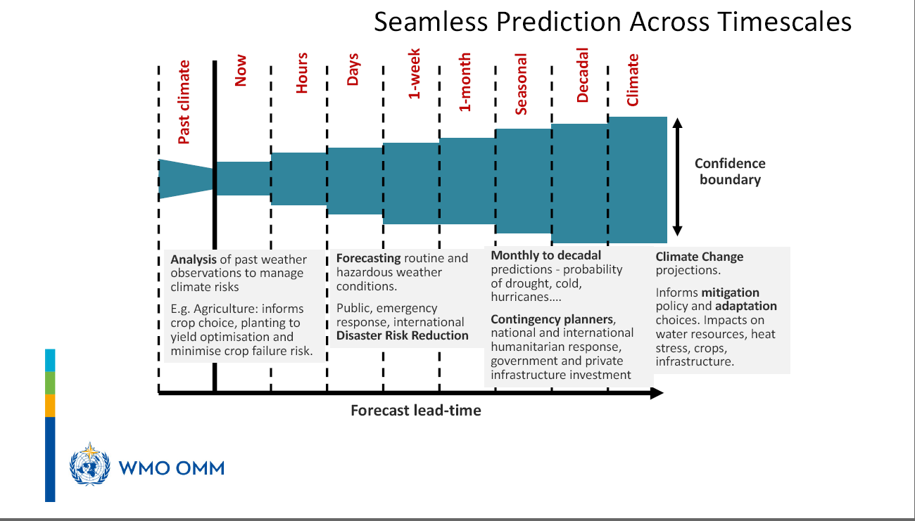
(Kabat, CMIP6 Workshop, March 2019)

Slide 13
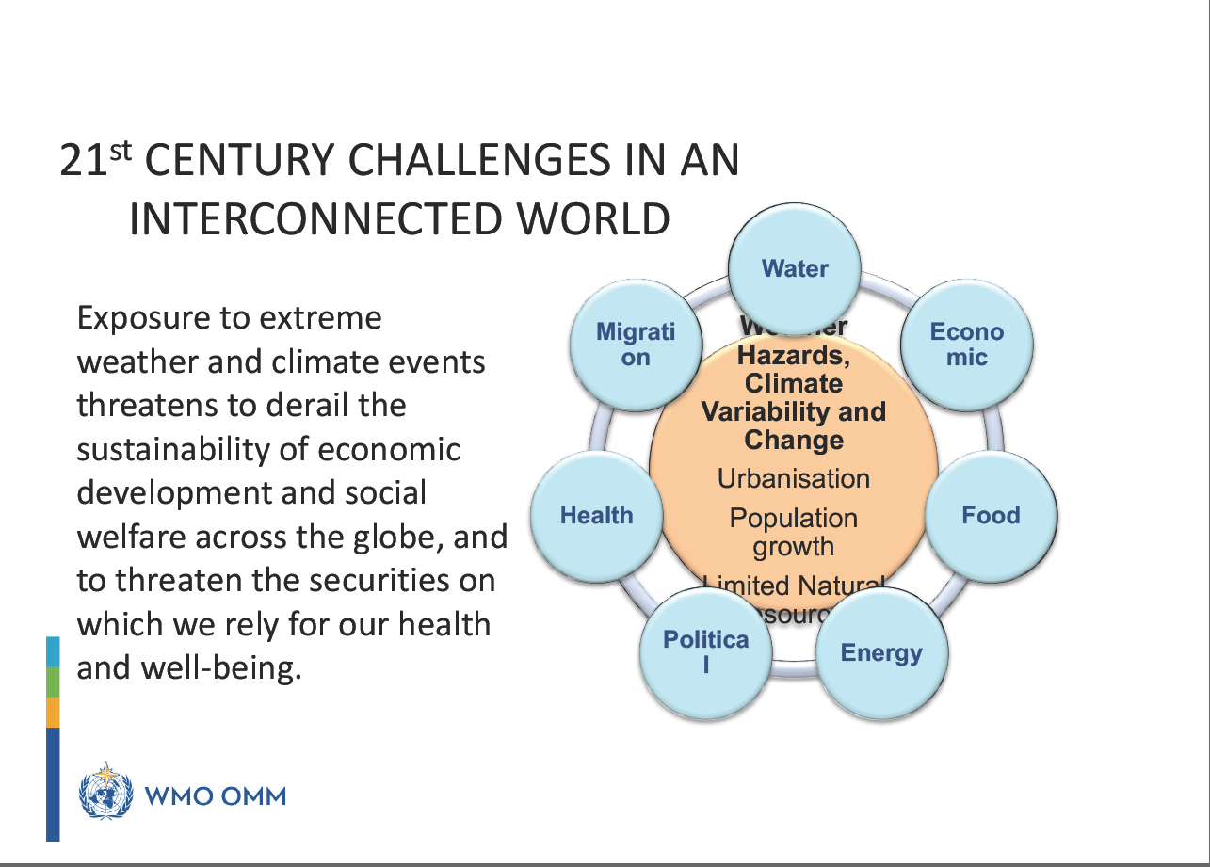
(Kabat, CMIP6 Workshop, March 2019)

Slide 14
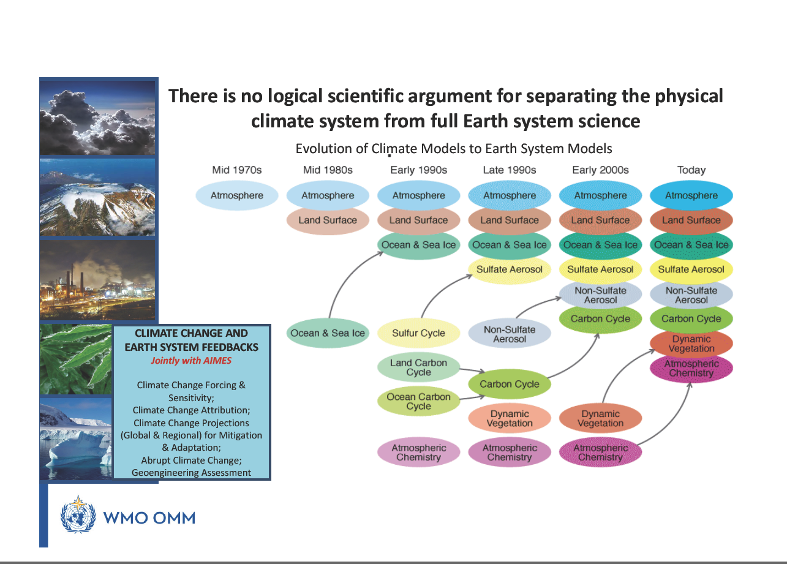
(Kabat, CMIP6 Workshop, March 2019)

Slide 15
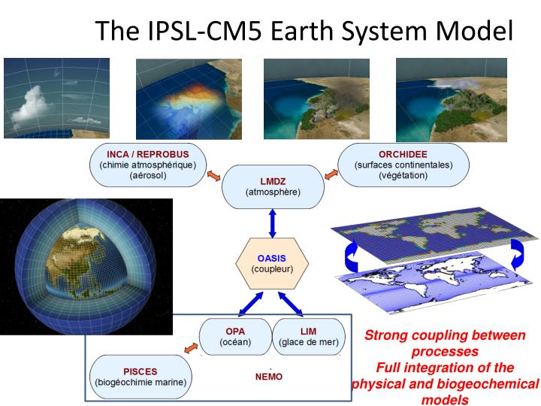

Slide 16
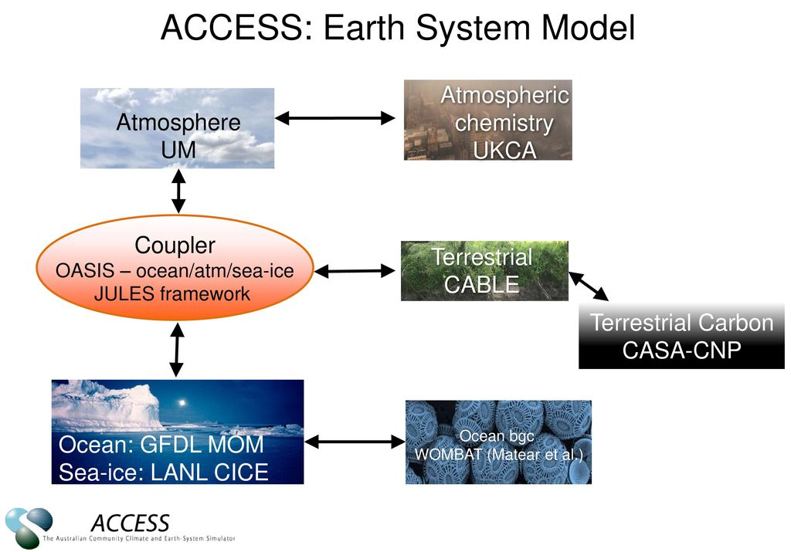

Slide 17
How is the best way to deal with the model limitations?
Multi-Model Multi-Member Ensemble
International collaboration is needed!

Slide 18
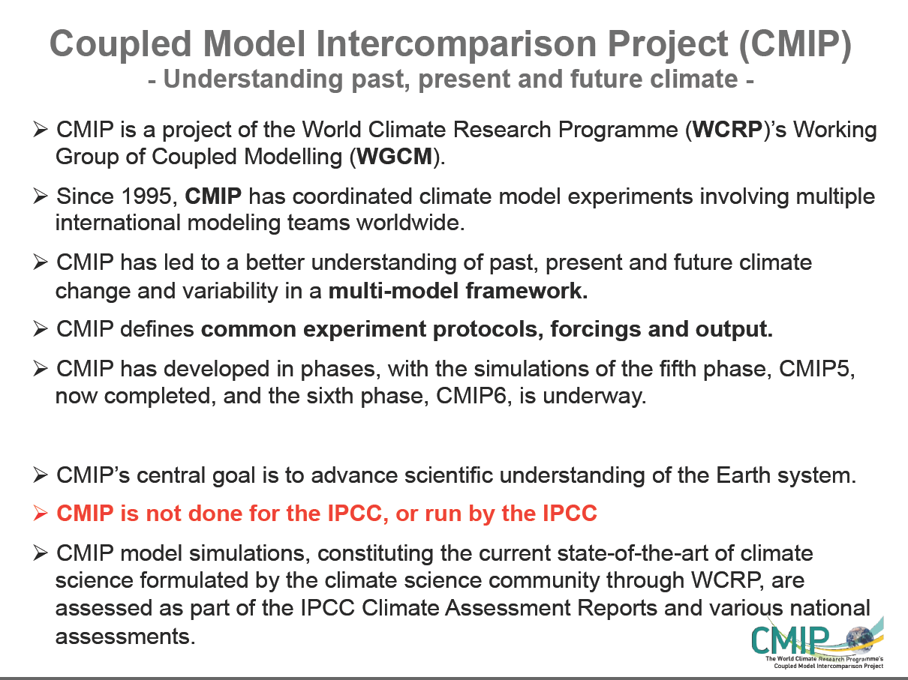
Eyring et al. (2016)

Slide 19
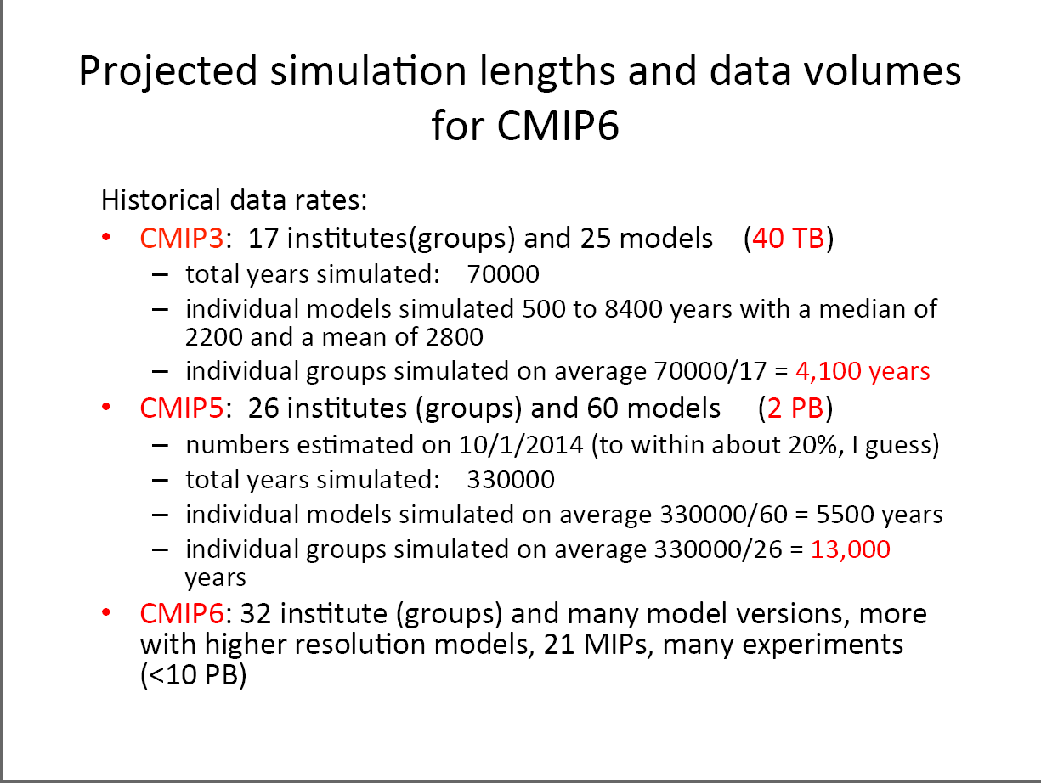
Eyring et al. (2016)

Slide 20
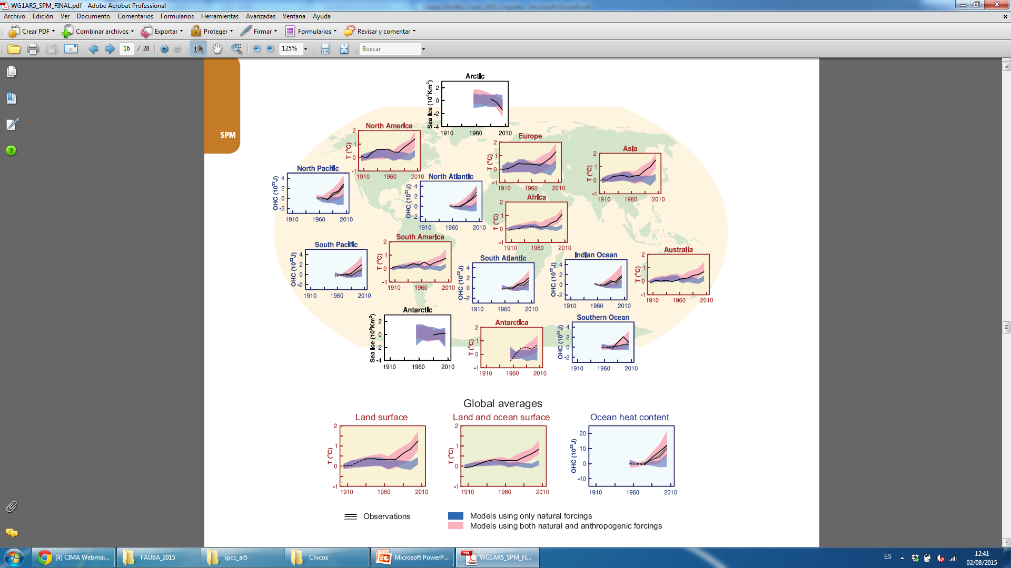
“It is extremely likely that more than half of the observed increase in global average surface temperature from 1951 to 2010 was caused by the anthropogenic increase in greenhouse gas concentrations and other anthropogenic forcings together. The best estimate of the human-induced contribution to warming is similar to the observed warming over this period.”
IPCC-AR5

Slide 21
Schematic of the CMIP/CMIP6 experiment design
The inner ring and surrounding white text involve standardized functions
of all CMIP experiments and the CMIP6 historical
simulation.
The middle ring shows science topics that are addressed by the CMIP6-Endorsed MIPs (21),
Outer ring display MIP topics shown in the outer ring.
Eyring et al. (2016)

Slide 22
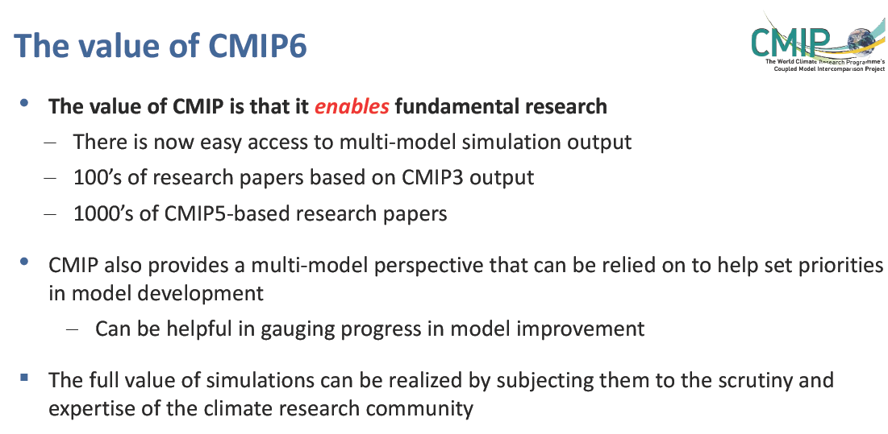
Eyring et al. (2016)

Slide 23
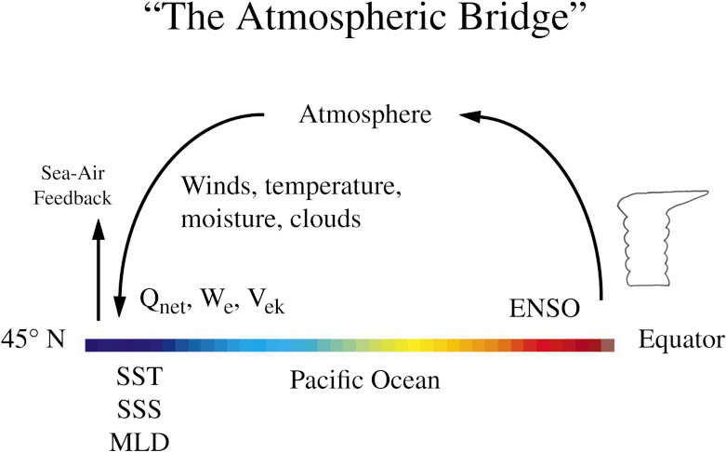
ISI Predictability associated with Teleconnections
Alexander et al. (2003)

Slide 24
How predictable is the tropospheric circulation at both hemispheres on seasonal timescales?
Goal: Assess the ability of coupled models in predicting the leading patterns of circulation variability and quantify its role on determining current levels of predictability.
  Lee et al. (2011, Climate Dynamics) for the Northern Hemisphere
  Osman, and Vera (2019, submitted to J. of Climate) for the Southern Hemisphere

Slide 25
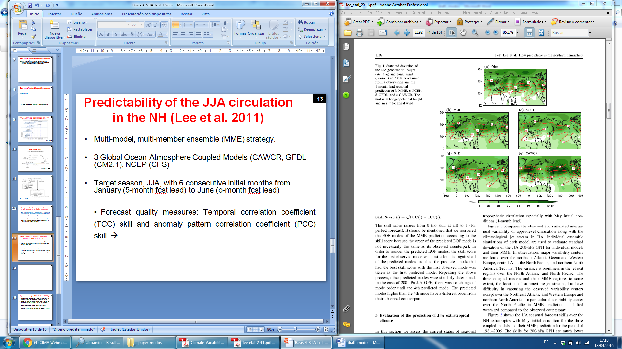
Predictability of the JJA circulation in the NH (Lee et al. 2011)
Multi-model, multi-member ensemble (MME) strategy.
3 Global Ocean-Atmosphere Coupled Models (CAWCR, GFDL (CM2.1), NCEP (CFS) (10 members each)
Target season, JJA, with 6 consecutive initial months from January (5-month fcst lead) to June (o-month fcst lead). (period: 1981-2005)
Forecast quality measures: Temporal correlation coefficient (TCC) skill and anomaly pattern correlation coefficient (PCC) skill. →
(Lee et al., 2011)

Slide 26
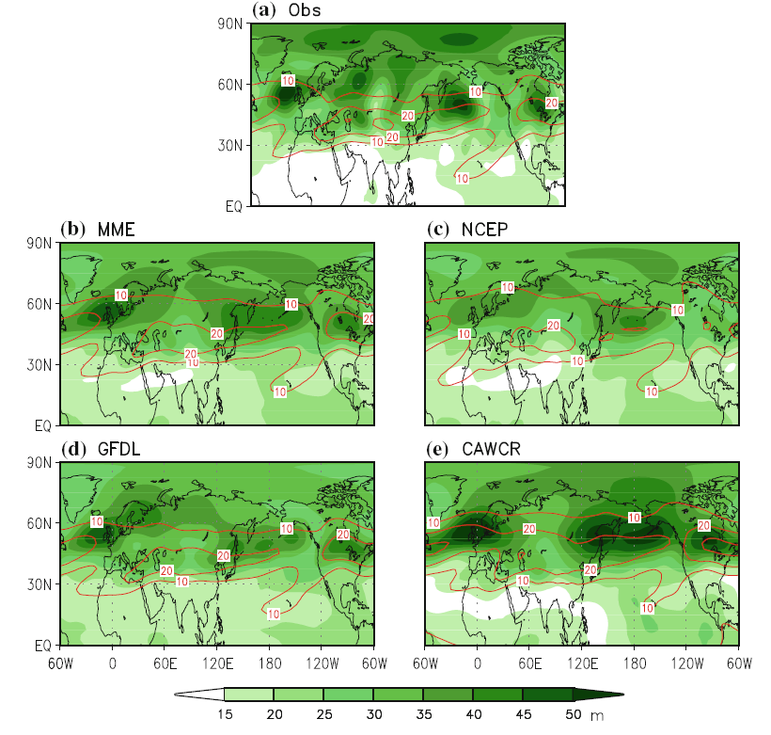
Standard deviation of JJA geopotential height (shading) and zonal wind (contour) at 200 hPa
(Lee et al., 2011)
Notes:
In observation, major variability centers are found over the northeast Atlantic Ocean and Western Europe, central Asia, the North Pacific, and northern North America (Fig. 1a). The variance is prominent in the jet exit regions over the North Atlantic and North Pacific. The three coupled models and their MME capture, to some extent, the location of summertime jet streams, but have difficulty in capturing the observed variability centers
except over the Northeast Atlantic and Western Europe and northern North America. In particular, the variability center over the North Pacific in MME prediction is shifted westward compared to the observed counterpart.

Slide 27
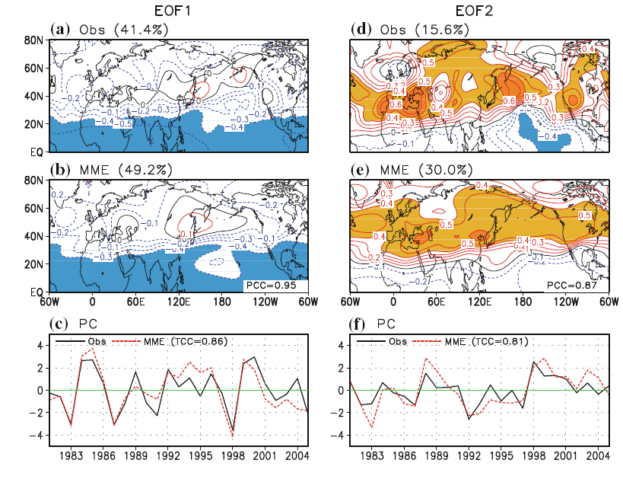
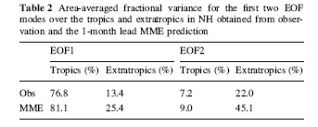
Spatial patterns of the EOF1 and EOF2 of
200-hPa GPH anomalies
obtained from observation
and 4-coupled modes’
MME prediction and the corresponding principal components (PCs)
(Lee et al., 2011)
Notes:
The first observed EOF mode (EOF1), which accounts for 41.4% of total variance, is characterized by an overall zonally oriented mode of variability of negative height anomalies. However, along the latitude circle of
50N, positive height anomalies extend from East Asia across the entire North Pacific to the western US. The associated PC time series (PC1) shows strong interannual variability with a time scale of 3–6 years and indicates that the EOF1 has significant variability associated with the decay of ENSO in JJA, after the mature phase of ENSO, such as JJA 1983, 1987, and 1998.
The second observed EOF mode (EOF2), which accounts for 15.6% of total variance, features both zonally symmetric distribution and a wave-like pattern (Fig. 3d). The zonally symmetric pattern is characterized by positive height over the subtropics and midlatitude and by negative height over the tropics (equatorward of 20N). The wavelike pattern is characterized by strong positive variability over southern Europe and the Mediterranean Sea, the North Pacific, and the western part of North America. The associated PC time series (PC2) shown in Fig. 3f indicates that the mode may have interdecadal as well as interannual variability.
The MME is capable of predicting the spatial and temporal structures of the two leading modes 1-month ahead with a high fidelity. The PCC skill for spatial similarity is 0.95 for the first and 0.87 for the second
eigenvector, respectively. In particular, the MME well predicts the zonal mean component of the first and second observed eigenvectors. However, it has difficulty in capturing the tilted structure over the North Pacific in the observed EOF1 and the aforementioned CGT pattern in the observed EOF2. The MME also well predicts the time variation of the PC1 (PC2) with a TCC skill of 0.86 (0.81). The strong positive and negative years for the PC1, such as 1983, 1987, 1998, and 1999 are especially well predicted. The MME captures not only interannual component but also interdecadal component of the observed PC2.

Slide 28
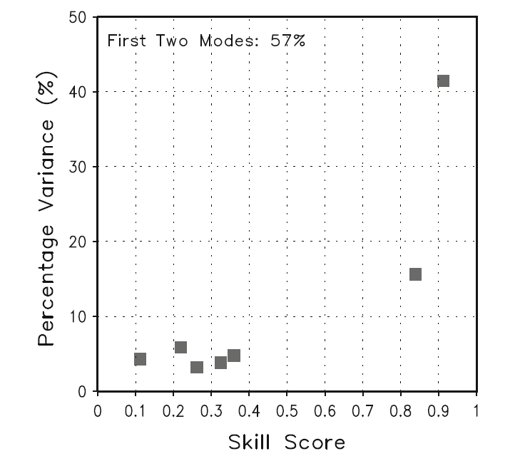
Identification of predictable modes:
In observation, predictable modes should explain a large part of the total variability and be statistically separated from other higher modes. (%of explained variance)
The climate prediction models should be capable of predicting these major modes (skill score)
The leading two modes of observed 200-hPa GPH in JJA capture about 57% of the total interannual variability and 79.2% of predicted total variability with high forecast skill values
(Lee et al., 2011)
Notes:
Over the extratropics only, 35% (70.5%) of the observed (predicted) total variability can be explained by the first two modes.

Slide 29
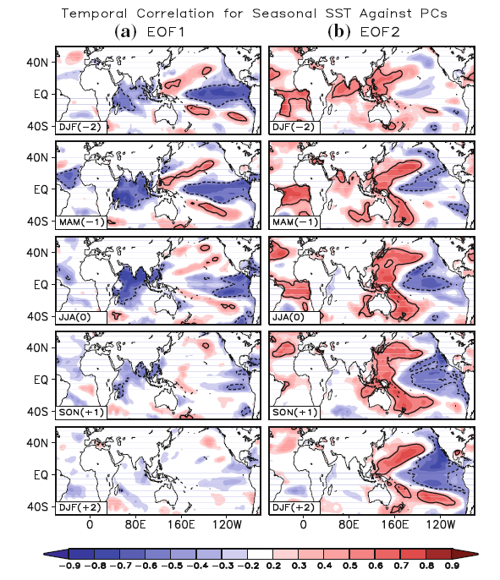
Spatial patterns of the lead-lag correlation coefficients for the seasonal mean SST against the 1st and 2nd PC, obtained from observations.
(Lee et al., 2011)
Notes:
Given the fact that the current coupled models predict the first two EOF modes with a high fidelity even 5 months ahead, one may wonder what the sources of predictability are. Figure 9a shows the lead-lag correlation coefficients for seasonal mean SST against the first PC, which reveals that the climate predictability of the first mode comes mainly from ENSO in observation.

Slide 30
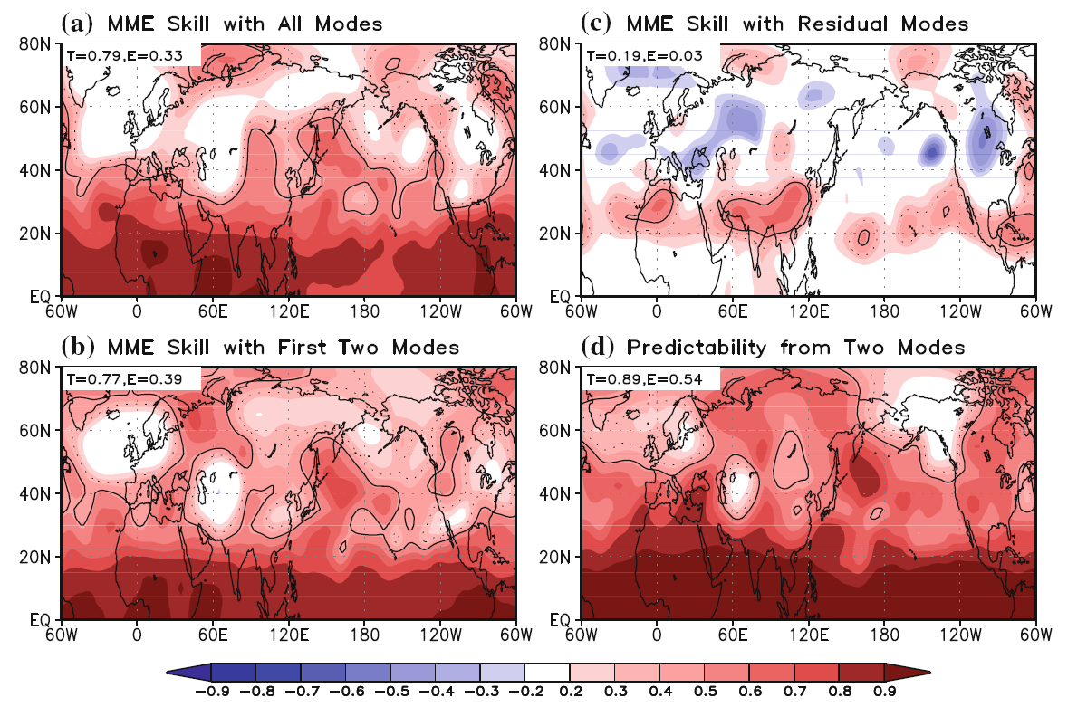
MME prediction skill for 200-hPa JJA GPH
Sacar esto
(Lee et al., 2011)
Notes:
The locations with significant predictability over the NH extratropics include the Northwest Pacific, most of North America, southern Europe and the Mediterranean Sea in which the prominent variability of the observed second eigenvector (Fig. 4d) is observed. Wherever the variability of the second eigenvector is weak, the potential predictability is also low such as over northern Europe, Central and East Asia, and Alaska.
Obviously, the 1-month-lead MME prediction skill shown in Fig. 5a is far below the potential predictability over the extratropics. Nonetheless, the predictable part of the MME prediction (Fig. 5b) better predicts the observed variability where the potential predictability is higher.

Slide 31
Predictability of the DJF circulation in the SH extratropics
(Osman and Vera, submitted)
Multi-model, multi-member ensemble (MME) strategy.
11 Global Ocean-Atmosphere Coupled Models (ECMWF,NCEP, CCCMA, JMA/MRI, METFR, AORI/NIES/JAMSTEC, CCCMA) (7-10 members each)
Target season, DJF, with initial months from Nov (1-month fcst lead) (period: 1982-2005)
Forecast quality measures: Temporal correlation coefficient (TCC) skill and anomaly pattern correlation coefficient (PCC) skill. →

Slide 32
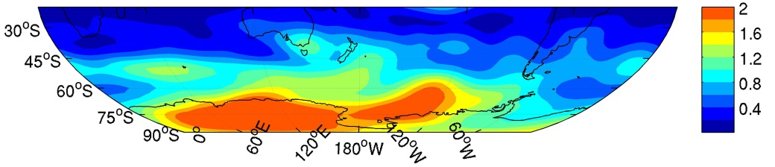
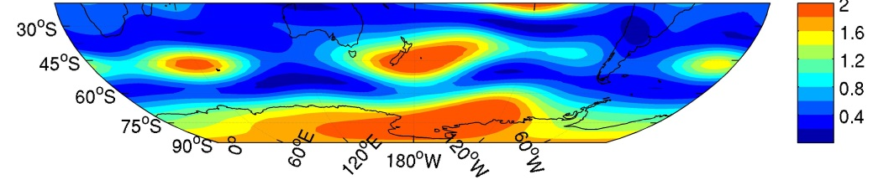
Normalized variance of DJF geopotential height (GPH) at 200 hPa
OBS
MME
(Osman and Vera, submitted)

Slide 33
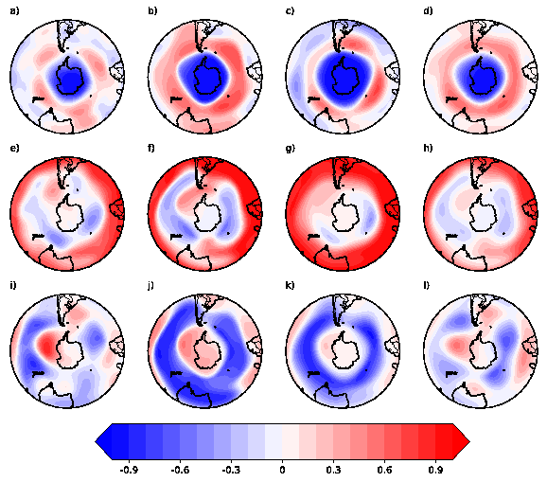
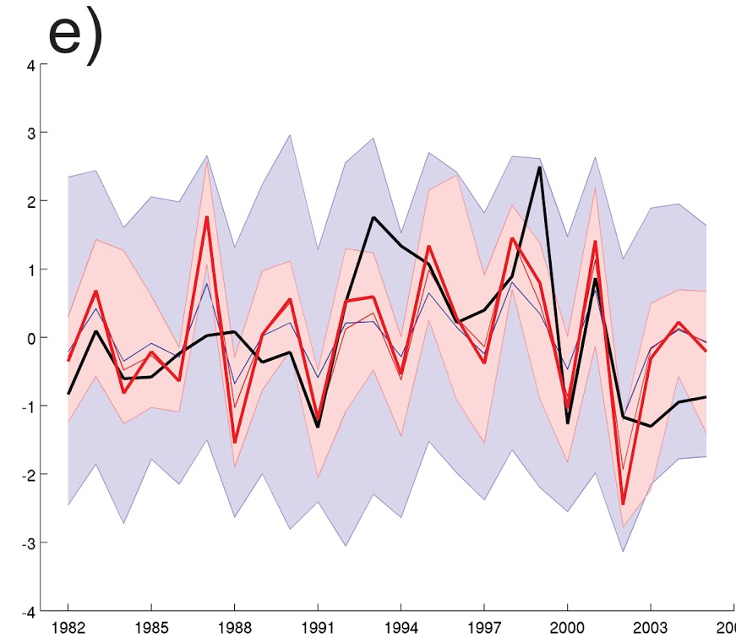
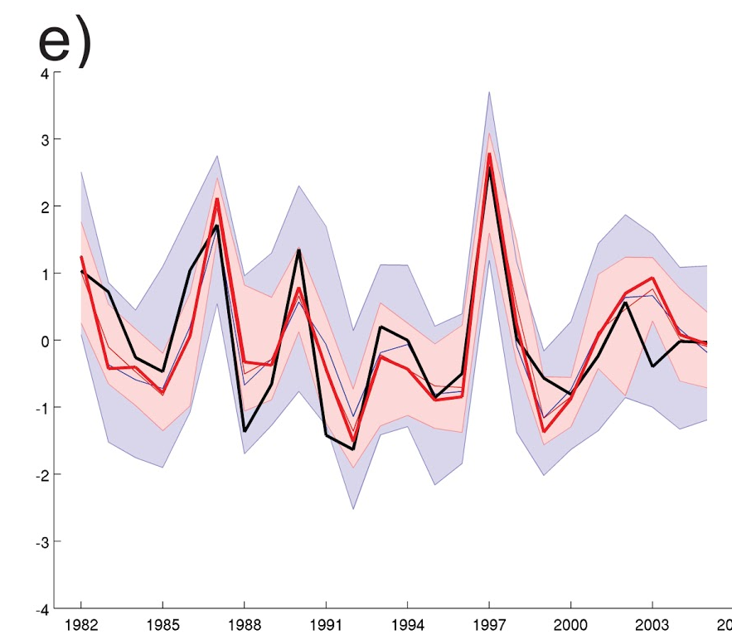

Predictability of the main modes of DJF circulation variability in the SH
HGT 200 hPa DJF
Obs
MMEM
Ensemble
Members
REOF 1
(SAM)
PC 1
PC 2
PC 3
REOF 2
(PSA1)
REOF 3
PSA2
Osman and Vera (submitted)

Slide 34

Identification of predictable modes:
The leading three modes of observed 200-hPa SH GPH in DJF capture about 50% of the total interannual variability and 87% of predicted total variability with moderate to high forecast skill values
(Osman and Vera, submitted)

Slide 35

Spatial patterns of the coefficients for the seasonal mean SST against the 1st, 2nd, and 3rd PC, obtained from observations and MME
EOF1
(SAM)
EOF2
(PSA1)
EOF3
(PSA2)
(Osman and Vera, submitted)

Slide 36


MME prediction skill for 200-hPa SH DJF GPH
MME skill with all modes
MME skill with the 3 modes
(Osman and Vera, submitted)

Slide 37
Gaps in our knowledge of ISI climate predictability that require more research:
We cannot yet claim to have identified all of the sources of predictability in the Earth system.
For many of the predictability sources we have identified, we cannot claim to understand fully the mechanisms that underlie them. The observational record contains many non-stationary trends that may relate to predictability but are not yet adequately explained
The models that have been used to evaluate the known sources of predictability and to make forecasts are known to be deficient in many ways. Many key processes associated with predictability occur at spatial scales that cannot be resolved by current models.
Even if the models used were perfect—even if they included and represented accurately all physical and dynamical processes relevant to predictability at adequate spatial and temporal resolution—they would still be limited in their ability to make accurate forecasts by deficiencies in our ability to initialize prognostic fields.

Slide 38
Important references
Alexander et al. (2002), The Atmospheric Bridge: The Influence of ENSO Teleconnections on Air–Sea Interaction over the Global Oceans. J. of Climate, 15, 2205-2231
Eyring and co-authors (2016): Overview of the Coupled Model Intercomparison Project Phase 6 (CMIP6) experimental design and organization. Geosci. Model Dev., 9, 1937–1958, 2016
Lee et al. 2011: How predictable is the northern hemisphere summer upper-tropospheric circulation?. Climate Dynamics, 37:1189–1203 DOI 10.1007/s00382-010-0909-9
National Research Council, 2010: Assessment of Intraseasonal to Interannual Climate Prediction and Predictability. Washington, DC: The National Academies Press, doi:10.17226/12878.
Osman, M., C. Vera and F. Doblas-Reyes, 2016: Predictability of leading patterns of seasonal variability in the Southern Hemisphere extratropics. To be submitted to J. of Climate.

