Slide 1
NOAA-USAID Second Symposium on the Global Climate System
Ankara, Turkey, 24 – 26 April, 2019
C3S
Copernicus Climate Change Service
Eduardo Penabad Ramos (ECMWF)
with contributions from:
Carlo Buontempo, Anca Brookshaw,
Jean-Noël Thepaut, Dick Dee, Cedric Bergeron
Notes:
Good afternoon,
thanks for the invitation, it is a real pleasure being here with you today.
EPR, seasonal forecast team at the CopClimChService

Slide 2
Contents
Copernicus Programme
  Description, components and role of ECMWF
Copernicus Climate Change Service (C3S)
  Description, components, available products, SIS
  The Climate Data Store (CDS)
C3S seasonal forecast activity description
  Description, current status, products, next steps
C3S seasonal forecast user perspective
  Forecast quality, postprocessing, multi-system
Notes:
User perspective…
… to fit better in a session entitled “Recent Advances in Science, Assessments of Weather and Climate Models”
… but trying to link that with the the focus in the way users interact with the service (as we´ll see… C3S is [intends to be] a remarkably user-driven service)
(disclaimer… my role is more technically-focused than scientifically, but I´ll do my best to introduce you and hopefully answer questions should there would be any)

Slide 3
Contents
Copernicus Programme
  Description, components and role of ECMWF
Copernicus Climate Change Service (C3S)
  Description, components, available products, SIS
  The Climate Data Store (CDS)
C3S seasonal forecast activity description
  Description, current status, products, next steps
C3S seasonal forecast user perspective
  Forecast quality, postprocessing, multi-system

Slide 4

Copernicus Programme - Description
European Union´s Earth Observation Programme
  Managed and coordinated by the European Comission
  Implemented in collaboration with EU member states, ESA, EUMETSAT, Mercator Océan, ECMWF and EU Agencies like EEA
  ~4300 M€ in the current multiannual financial framework (2014-2020)
System based on Earth Observation satellite data and “in-situ” (non spatial) observations
Free, full and open access to data and services for any citizen or organization
  Improve citizens´ life
  Offer (to administrations and businesses) tools for decision-making
Notes:
NOTE… 2014-2020… about to be defined Copernicus 2.0 (EU Space Regulation)

Slide 5
Copernicus Programme - Description
European Union´s Earth Observation Programme
  Managed and coordinated by the European Comission
  Implemented in collaboration with EU member states, ESA, EUMETSAT, Mercator Océan, ECMWF and EU Agencies like EEA
  ~4300 M€ in the current multiannual financial framework (2014-2020)
System based on Earth Observation satellite data and “in-situ” (non spatial) observations
Free, full and open access to data and services for any citizen or organization
  Improve citizens´ life
  Offer (to administrations and businesses) tools for decision-making
Notes:
USER-DRIVEN programme

Slide 6
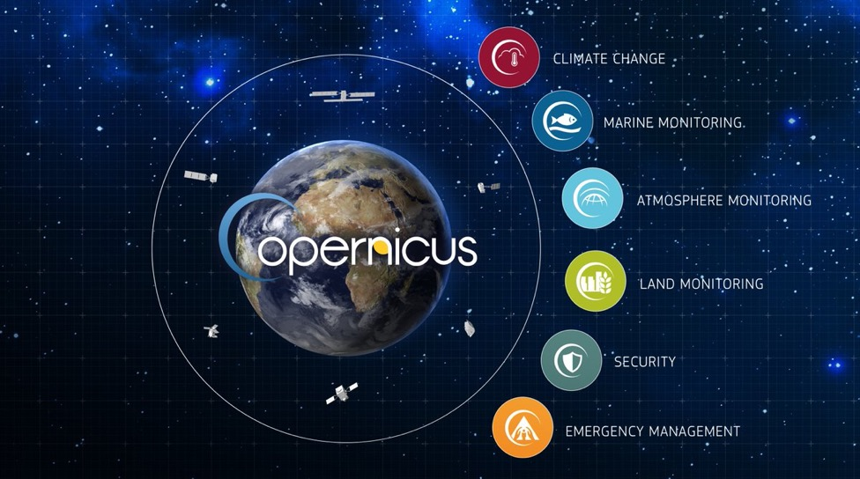


Sentinels
Notes:
Operations
Marine (MERCATOR-OCEAN from 1 May 2015) – ecosistemas físicos océanos (global-regional) – seguridad marina, residuos, meteo-clima,
Land (EEA from 1 April 2012, parte JRC) – uso de suelo, cubierta terrestre, criosfera, biogeofísica
Emergency Mgmt (JRC from 1 April 2012) …. Gestioón de emergencias, catástrofes, peligros meteo/geofísicos. EFAS/GloFAS
Security (FRONTEX, EMSA, EUSatCen) – fronteras, marina, apoyar acción exterior de la UE
CAMS y C3S veremos a continuación con más profundidad. Gestionados por ECMWF (también EFAS-GloFAS)
CAMS at the end of 2015 (ECMWF)
C3S transition from pre-operational to operational
Una frase de cada servicio (incluir quien lo gestiona)
CAMS, calidad del aire a escala europea, composición química de la atmósfera a escala mundial;
Vigilancia marina, ecosistemasfísicos en los océanos y mares para el océano a escala mundial y las zonas marinas regionales europeas, enapoyo de la seguridad marina, de la contribución a la vigilancia de los movimientos de residuos, del medio ambientemarino, de las regiones costeras y polares y de los recursos marinos, así como de la predicción meteorológica y de lavigilancia del clima
vigilancia terrestre, utilización del suelo y la cubierta terrestre,la criosfera, el cambio climático y las variables biogeofísicas, con inclusión de sus dinámicas, en apoyo de la vigilanciamedioambiental, desde la escala mundial hasta la local, de la biodiversidad, el suelo, las aguas interiores y costeras,los bosques y la vegetación y los recursos naturales, así como sobre la aplicación, en general, de las políticas de medioambiente, agricultura, desarrollo, energía, planificación urbana, infraestructura y transporte;
C3S, que facilitará información para aumentar la base de conocimientos con el finde apoyar las políticas de adaptación y mitigación; en particular, contribuirá al suministro de variables climáticas esenciales, análisis, proyecciones e indicadores climáticos a escalas temporales y espaciales pertinentes para las estrategias de adaptación y mitigación en los diversos ámbitos sectoriales y de interés social de la Unión;
gestión de emergencias, catástrofes, incluidos los peligros de índole meteorológica, los peligros geofísicos, los desastres provocados deliberada o accidentalmente por el hombre y otros desastres humanitarios, así como las actividades de prevención, preparación, respuesta y recuperación;
seguridad, retos de seguridad civil de Europa, vigilancia de las fronterasy la vigilancia marítima-, así como a apoyar la acción exterior de la Unión, Centro de Satélites de la Unión Europea.

Slide 7
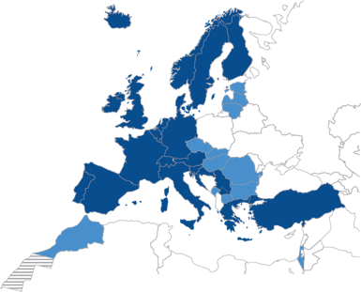
Copernicus Programme - Role of ECMWF
Research institute + 24/7 operational service
Established in 1975, located in Reading, UK
22 member states, 12 co-operating states
350 member of staff, 30 nationalities
Annual Budget ~ 70 M€
MARS: Meteorological data archive (Petabytes)
Commercial catalogue
One of the biggest HPC in Europe

Slide 8
Copernicus Programme - Role of ECMWF
ECMWF is the entity entrusted to operate CAMS and C3S Copernicus Services, by delegation of the European Commision.
The delegation agreement covers the period 2014 to 2020.
ECMWF is also the operational centre in charge of the flooding and forest fire components of the Copernicus Emergency Management Service.
In this service, ECMWF currently participates as a subcontractor of JRC

Slide 9
Contents
Copernicus Programme
  Description, components and role of ECMWF
Copernicus Climate Change Service (C3S)
  Description, components, available products, SIS
  The Climate Data Store (CDS)
C3S seasonal forecast activity description
  Description, current status, products, next steps
C3S seasonal forecast user perspective
  Forecast quality, postprocessing, multi-system

Slide 10
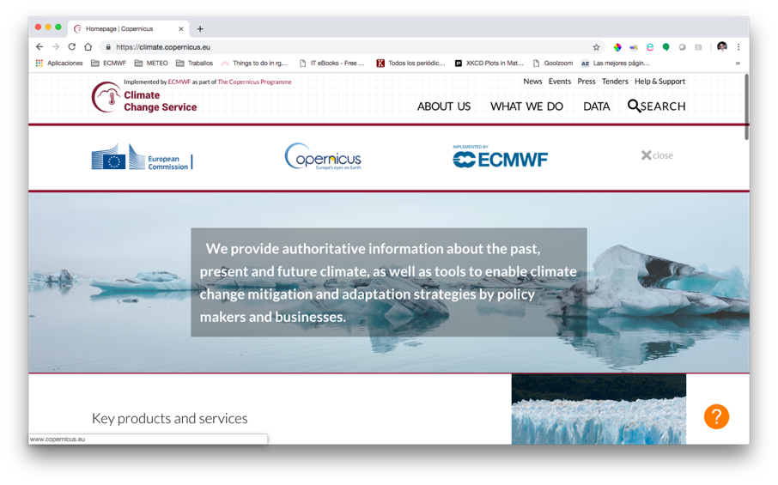
Notes:
Hice el ejercicio... “que pasa si voy a la pagina de entrada de la web del C3S?”
MISIÓN del C3S
Apoyar las políticas Europeas de adaptación y mitigación:
Siendo una fuente autorizada de información climática consistente
Construyendo el servicio en torno a capacidades e infraestructuras existentes
Estimulando el mercado de los servicios climáticos en Europa

Slide 11
C3S - Components
International expert panel
from European commission e.g.,FP7 Space call, H2020
from EU Member States, ESA, EUMETSAT, EEA, WMO..
Climate Data Store
Quality assurance
Integrity of Service
User requirements
Outreach & Dissemination
Evaluation & QC function
Sectoral Information System
Stakeholders & users
Implemented by
Notes:
Overview of C3S components. Non-exhaustive schematic view of the interrelationships, and I won´t get into too much details from all of the components)
Users on the base, how do they feed back into the service? In the current stage, EQC
EQC:
as we will see in a minute, C3S covers different activities, then EQC functions are different projects with an overall shared structure, which on top to integrate the user requirements into the service, are devoted to monitor the quality control procedures for C3S products and services. EQC functions are also in charge of identifying gaps in service provision and ensuring that C3S delivers state-of-the-art climate information to the users.
By the end of this talk we will have a brief look to some of the outcomes related to this workshop´s topic coming from QA4SEAS, the EQC for C3S seasonal
On the core of the service lies the CDS: the infrastructure that catalogues the contents and offers tools to interact with them. I´ll get back to it a couple of times in the rest of this talk.
SIS… let´s briefly introduce it, and come back later to the contents

Slide 12
C3S – service evolution
Delegation Agreement
Signature
March
1st General Assembly
Service
declared operational
2014
2015
2016
2017
2018
2019
2020
2nd G.A.
Stages 0/I
PoC / Pre-operational
Stage II
Operational
CDS
Notes:
Explica cosas buenas y malas (primeras etapas de servicio... Operativo)

Slide 13
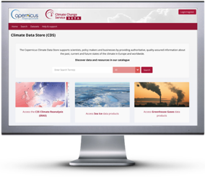
Climate Data Store – Data catalogue
Global reanalysis
Regional reanalyses: Europe, Arctic
ECVs global estimates
Multi-system seasonal forecasts
Climate projections
Sectoral indices (SIS)
Past Climate
Present Climate
Future Climate
Notes:
Explicar “reanálisis”!!!! (non-exhaustive list of catalogue entries… invite to visit it)
CATALOGO
Lista de productos/datos climáticos
Descubrir datos, procesamiento, busqueda con flitros, listado completo
Cualquiera puede navegar por el catálogo, pero el registro es necesario para descargarlos/toolbox
BOLETIN MENSUAL
https://climate.copernicus.eu/climate-bulletins
Publicado mensualmente en la web del C3S (4-6 de cada mes)
Actualmente basado en ERA-Interim
Más ECVs en los próximos meses. Ahora: temp, hidro, hielo marino, etc…
‘Estado del Clima en Europa’ (‘European State of Climate’)

Slide 14
Climate Data Store – Data catalogue
Global reanalysis
Regional reanalyses: Europe, Arctic
ECVs global estimates
Multi-system seasonal forecasts
Climate projections
Sectoral indices (SIS)
Gateway to climate information
Past Climate
Present Climate
Future Climate
Notes:
Explicar “reanálisis”!!!! (non-exhaustive list of catalogue entries… invite to visit it)
CATALOGO
Lista de productos/datos climáticos
Descubrir datos, procesamiento, busqueda con flitros, listado completo
Cualquiera puede navegar por el catálogo, pero el registro es necesario para descargarlos/toolbox
BOLETIN MENSUAL
https://climate.copernicus.eu/climate-bulletins
Publicado mensualmente en la web del C3S (4-6 de cada mes)
Actualmente basado en ERA-Interim
Más ECVs en los próximos meses. Ahora: temp, hidro, hielo marino, etc…
‘Estado del Clima en Europa’ (‘European State of Climate’)

Slide 15
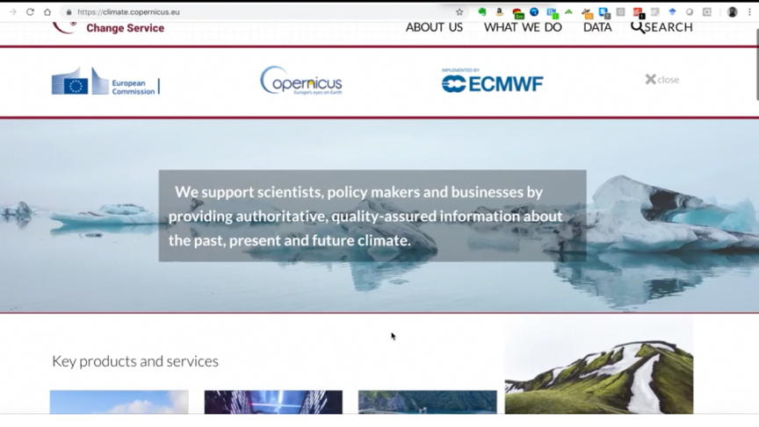


Slide 16
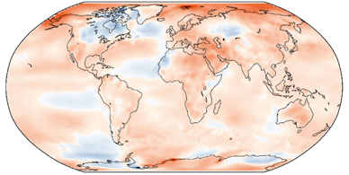
CDS Catalogue – ERA5
ERA5 is now an ECMWF operational product
ERA5 replaces ERA-Interim
During 2015-2018 ERA-Interim had around 40,000 users
Now, ERA5 is publicly available
in the period 1979-2018 (40 years!)
T2m, Feb 2018 - Jan 2019
anomaly relative to 1981-2010
Improvements compared to ERA-Interim:
+10 years of IFS model development
Finer resolution: 31km versus 80km
More and better input data
Outputs with hourly frequency
Uncertainty estimates (at 62km)
Plans for 2019:
Currently: updated 2 months behind real-time
Soon: ERA5T update with just 2-5 days of delay
Next: full acces to ERA5 observations
End of 2019: extension to 1950-1978
Notes:
Ejemplo de uno de los productos insignia del ECMWF incluido en el C3S
NOTA:
“acceso a las observaciones de ERA5” se refiere al acceso a los datos originales de las observaciones utilizadas para producir el reanálisis

Slide 17
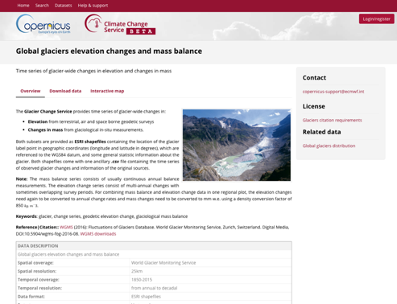
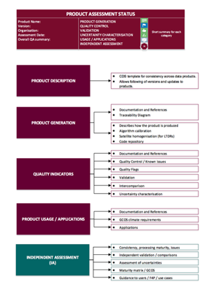
CDS–Evaluation and Quality Control (EQC)
Quality of data
Assessments
User guidance
Gaps and limitations
Quality of tools
Fitness for purpose
Best practices
Quality of service
Speed, responsiveness
System availability, …
Notes:
EQC integrated in the CDS data catalogue

Slide 18
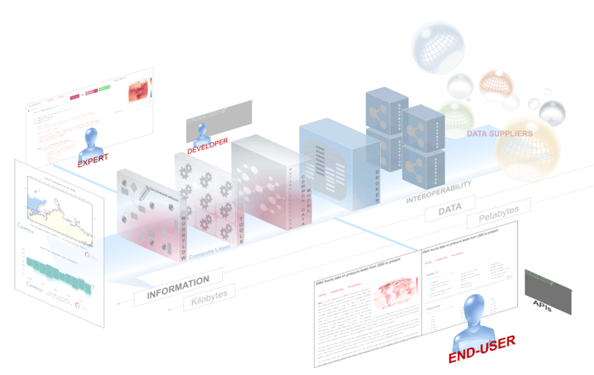
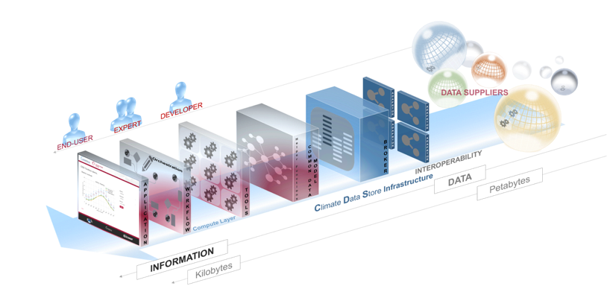
CDS – API, Toolbox and User Types
Notes:
Esquema del Climate Data Store (punto de acceso único para los datos climáticos del C3S).... More than just data
Desde el abundante y variado conjunto de datos a los que da acceso el CDS, hasta los distintos tipos de usuarios del CDS y de la Toolbox:
- Desarrolladores, utilizando la CDS API para incluir datos del C3S en sus productos
- Expertos: programando “workflows” en python, usando la CDS Toolbox, que a partir de los datos del CDS dan lugar a aplicaciones web interactivas
- Usuarios finales interesados en el acceso a datos sin procesar: usando la descarga interactiva con los formularios de acceso al catálogo del CDS, o usando “programáticamente” el acceso mediante la interfaz de programación de aplicaciones (API)
- Usuarios finales: accediendo a aplicaciones web (esencialmente gráficos, pero también posibilidad de descarga de datos procesados) creadas con la CDS Toolbox y disponibles (en el fúturo) en el catálogo del CDS, o creadas esepecíficamente para ellos (por usuarios “expertos”)

Slide 19
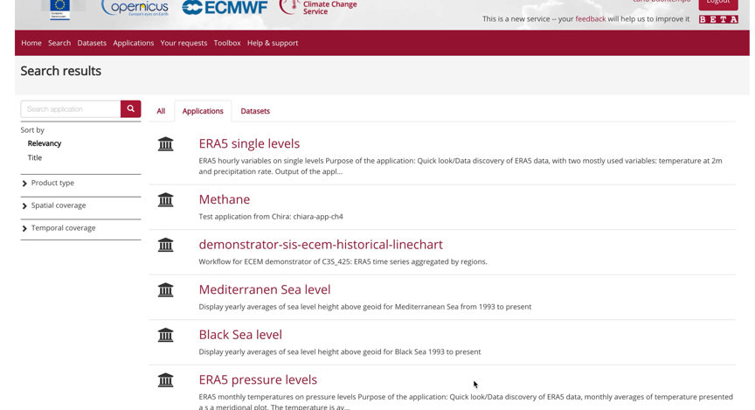

Slide 20













C3S - Sectoral Information System
Examples
Good practices
User needs
FISHERIES
URBAN
BIODIVERSITY
Notes:
El Sistema de Información Sectorial del C3S pretende
Proveer ejemplos prácticos de como el C3S en general, y el CDS y su Toolbox en particular, pueden producir información relevante para sectores de actividad específicos
Proveer ejemplos de buenas prácticas. Los prototipos desarrollados por los SISs deben estar basados en los más altos estándares, para ser fuente de inspiración para los desarrolladores y poder ser considerados como referentes de calidad
Proveer información de las necesidades reales de los usuarios. Los prototipos de los SISs ponen a disposición de los usuarios indicadores y herramientas relevantes para los diferentes sectores de actividad

Slide 21
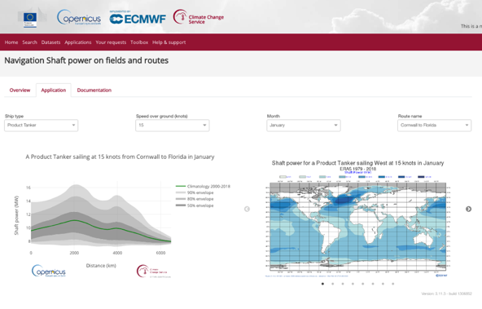
SIS Examples (1/2)

Slide 22
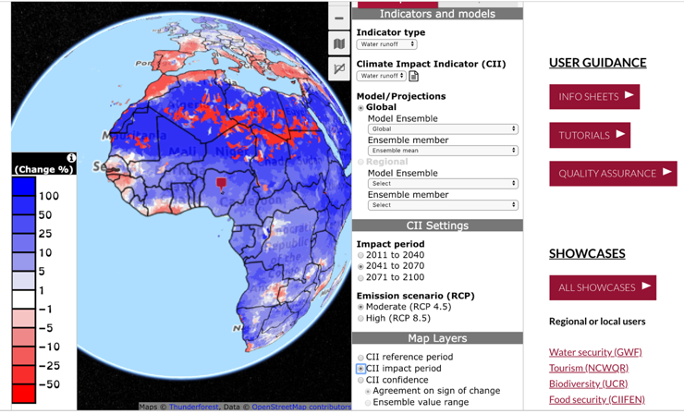
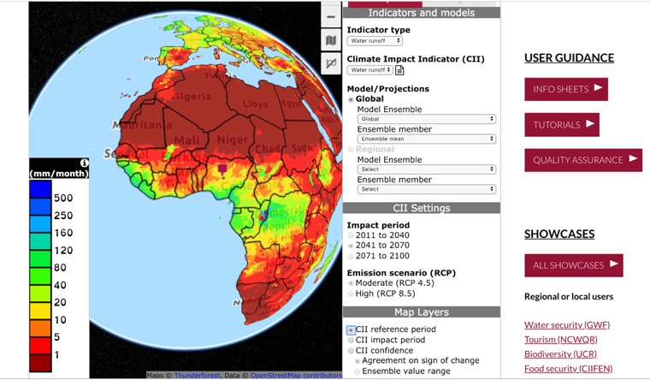
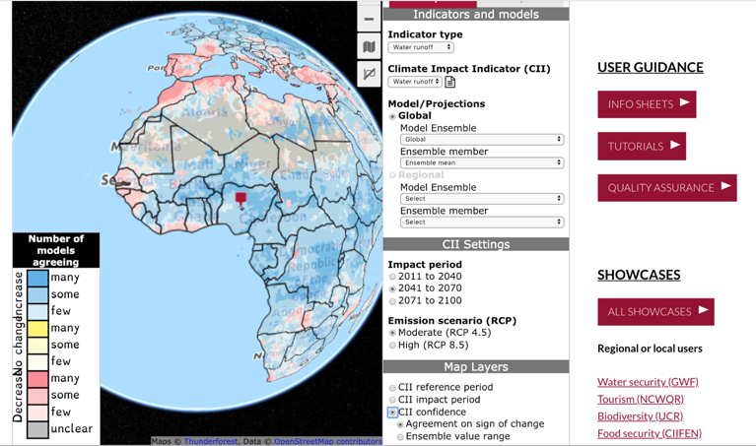
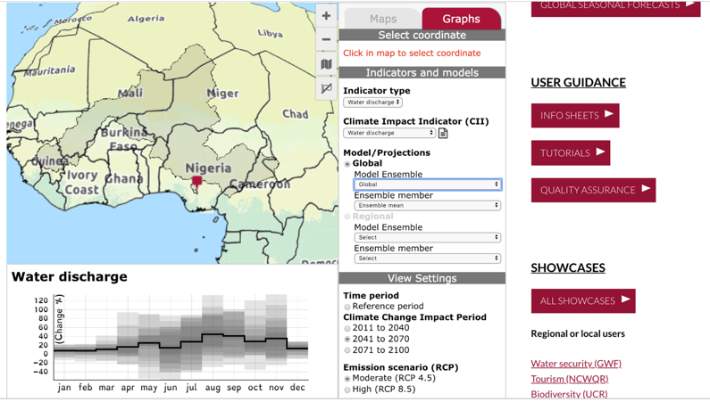
SIS Examples (2/2)

Slide 23


European State of the Climate 2018

Slide 24
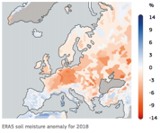

European State of the Climate 2018
Presented 9th April 2019 at EGU meeting
Some highlights…
https://climate.copernicus.eu/ESOTC
Extraordinarily warm spring/summer in Central Europe
2018, third warmest year on record for Europe
2018, lowest soil moisture of the last 40 years
February 2018, first time (in satellite era) winter sea ice pack opens North of Greenland

Slide 25
C3S – Copernicus 2.0 (2021 – 2027)
New service elements
  Decadal climate predictions
  Attribution service
Enhanced reanalysis portfolio
  Regional reanalyses
  Centennial
  Coupled ocean
  Coupled chemistry (joint CAMS/C3S)
CO₂ observatory (with CAMS)
Expanded capabilities of the CDS / CDS Toolbox
Fast track response service

Slide 26
Contents
Copernicus Programme
  Description, components and role of ECMWF
Copernicus Climate Change Service (C3S)
  Description, components, available products, SIS
  The Climate Data Store (CDS)
C3S seasonal forecast activity description
  Description, current status, products, next steps
C3S seasonal forecast user perspective
  Forecast quality, postprocessing, multi-system

Slide 27







C3S Seasonal Forecasts - Introduction
Aim: to generate seasonal forecast products based on the best information available, to an operational schedule, and make them publicly available.
Issued every month on the 13th
(to be moved to the 10th)
Large ensembles
(members: ~50 forecast, ~25 hindcast)
Common reference period (1993-2016)
Common horizontal resolution (1-degree)
~30 single-level variables (every 6h or 24h)
5 variables in pressure levels (every 12h)
(11 levels from 925hPa to 10hPa)
Agreed NetCDF specification C3S-0.1 (based on CF)
Notes:
Introduction to C3S Seasonal
5 contributors
Current: ECMWF, MeteoFrance, Met Office
Soon (May/June?): DWD, CMCC, update MeteoFrance to system6
Non-European partners: (not under contract => tailored bilateral agreements and terms of engagement)
NCEP (NOAA), JMA: end of 2018?. Terms under negotiation
Also likely BoM, ECCC, but negotiation not yet started

Slide 28
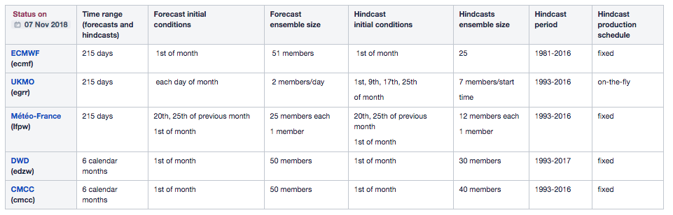
C3S Seasonal Forecasts – Forecast systems

Slide 29
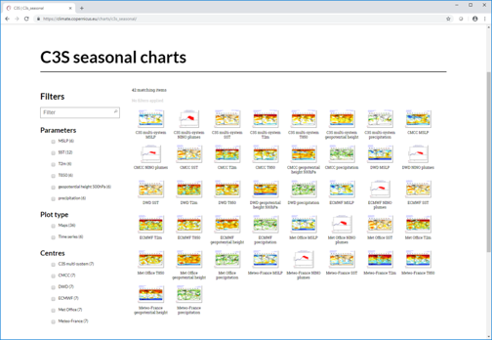
C3S Seasonal Forecasts – Graphical products
Variables:
sea-level pressure
geopotential height
precipitation
air temperature
sea-surface temperature
Type of plots:
maps:
  global
  pre-defined regions
time series
Publication schedule:
monthly updates
on the 13th of each month
  will be on the 10th
http://climate.copernicus.eu/charts/c3s_seasonal/

Slide 30
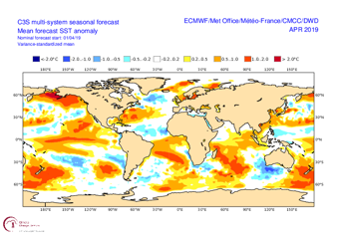
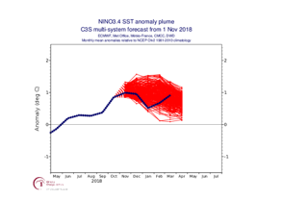
C3S Seasonal Forecasts – Graphical products
Apr. 2019
http://climate.copernicus.eu/charts/c3s_seasonal/

Slide 31
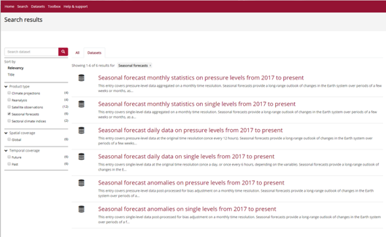
C3S Seasonal Forecasts - Data products
“daily data”
  6h/24h or 12h
“monthly statistics”
  mean,min,max,stdev
“anomalies” (postprocessed)
  just real-time forecasts
NOTE: “from 2017 to present”?
Note about data formats:
GRIB (as archived in MARS)
NetCDF experimental (see CDS docs.)
Notes:
In the CDS

Slide 32
C3S Seasonal Forecasts - Data products
Single level variables:
every 6 hours: 2 metre temperature
2 metre dewpoint temperature
10 metre u wind
10 metre v wind
mean sea level pressure
total cloud cover
soil temperature
sea-surface temperature
sea-ice temperature
every 24 hours: sea-ice concentration
volumetric soil moisture in model (or total soil moisture)
snow depth (water equivalent)
snow density
2 metre Tmax and Tmin
10 metre maximum wind gust
every 24 hours, accumulated:
large scale precipitation & convective precipitation
(or total precipitation)
snow fall
surface sensible heat flux
surface latent heat flux
surface incoming solar radiation
surface incoming thermal radiation
surface net solar radiation
surface net thermal radiation
top of atmosphere net solar radiation
top of atmosphere net thermal radiation
eastward surface stress
northward surface stress
evaporation
surface runoff & sub-surface runoff (or total runoff)
Pressure levels variables:
at 925, 850, 700, 500, 400, 300, 200, 100, 50, 30, 10 hPa
every 12 hours:
geopotential
temperature
specific humidity
u/v wind components
(or vorticity/divergence)
Notes:
In the CDS

Slide 33
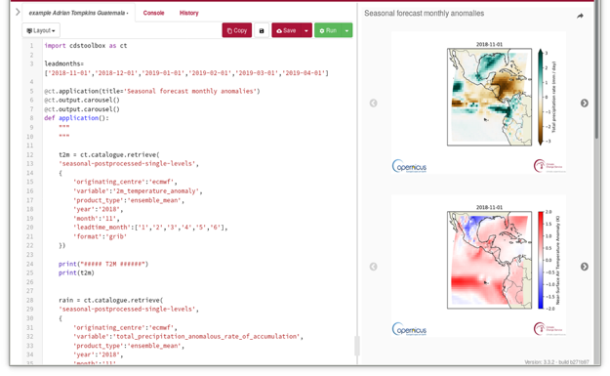
C3S Seasonal Forecasts - CDS Toolbox
EXPERIMENTAL
for SEASONAL DATASETS
Notes:
NOT YET FULLY OPERATIONAL

Slide 34
C3S Seasonal Forecasts – Next steps
Generate and display verification scores for products presented in the graphs
(By Q2 2019)
  Add monthly mean based products to the plots
Add new providers to the multi-system
(By Q3 2019)
  NCEP, JMA, ECCC
Produce example workflows/applications and develop tools in the CDS Toolbox
Introduce new products in the C3S suite of outputs
  probability forecasts for ENSO indices
  indices of atmospheric circulation (NAO, SOI)
  products based on within-season statistics (frequency/length of spells)
  …
Notes:
Not necessarily in the order they will finally happen, but in the order of priority

Slide 35
Contents
Copernicus Programme
  Description, components and role of ECMWF
Copernicus Climate Change Service (C3S)
  Description, components, available products, SIS
  The Climate Data Store (CDS)
C3S seasonal forecast activity description
  Description, current status, products, next steps
C3S seasonal forecast user perspective
  Forecast quality, postprocessing, multi-system

Slide 36
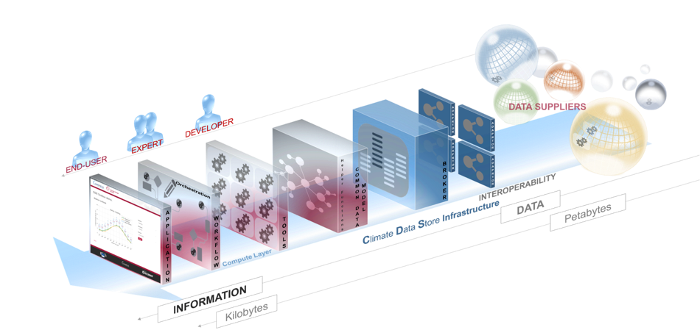
C3S Seasonal Forecasts – User perspective
The CDS and the Toolbox

Slide 37
C3S Seasonal Forecasts – User perspective
Notes:
Maybe obvious things (need of bias corection, etc)

Slide 38
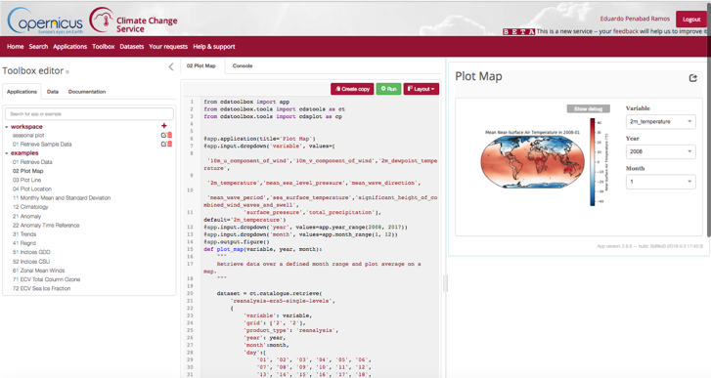
C3S Seasonal Forecasts – User perspective

Slide 39
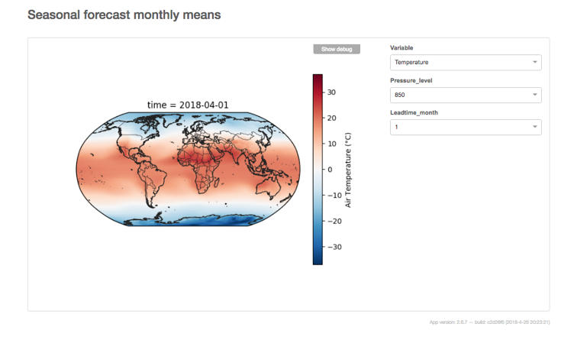
C3S Seasonal Forecasts – User perspective

Slide 40
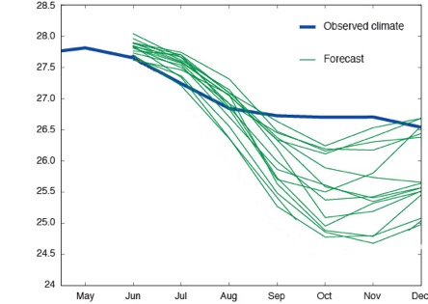
C3S Seasonal Forecasts – Postprocessing
Post-processing of raw model data is needed to produce suitable predictions for climate services.
Notes:
Model errors grow in time => Model is different to real world
The differences could be systematic, and bias adjustment/correction methods can help removing them

Slide 41
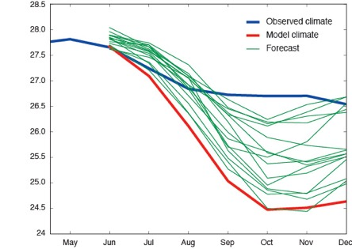
C3S Seasonal Forecasts – Postprocessing
Post-processing of raw model data is needed to produce suitable predictions for climate services.
Notes:
Model errors grow in time => Model is different to real world
The differences could be systematic, and bias adjustmen/correction methods can help removing them

Slide 42
C3S Seasonal Forecasts – Postprocessing
Different seasonal forecast products may require different post-processing
  anomaly - vs percentile-based outlooks
  deterministic vs probabilistic products
  monthly/seasonal-based products vs daily-based products
Quantile mapping (bias adjustment) is rapidly becoming the method of choice for sectoral impact studies.
  However, there are only a few papers on this topic in the context of seasonal forecasting
There are benefits in bias adjustment but also in other postprocessing (e.g. MOS)
Zhao et al. 2017. “How Suitable Is Quantile Mapping For Postprocessing GCM Precipitation Forecasts?” Journal of Climate 30 (9): 3185–96. https://doi.org/10.1175/JCLI-D-16-0652.1.
Manzanas et al. 2017 “Can Bias Correction and Statistical Downscaling Methods Improve the Skill of Seasonal Precipitation Forecasts?” Climate Dynamics 50 (3–4): 1161–76. https://doi.org/10.1007/s00382-017-3668-z.
Bedia et al. 2018. “Seasonal Predictions of Fire Weather Index: Paving the Way for Their Operational Applicability in Mediterranean Europe.” Climate Services 9: 101–10. https://doi.org/https://doi.org/10.1016/j.cliser.2017.04.001.
Notes:
Some of the gaps detected by EQC activity
Benefits of BA (remove systematic errors) but alternative postprocessing (e.g. MOS) can improve other aspects (reliability)

Slide 43
C3S Seasonal Forecasts – Postprocessing
Different seasonal forecast products may require different post-processing
  anomaly - vs percentile-based outlooks
  deterministic vs probabilistic products
  monthly/seasonal-based products vs daily-based products
Quantile mapping (bias adjustment) is rapidly becoming the method of choice for sectoral impact studies.
  However, there are only a few papers on this topic in the context of seasonal forecasting
There are benefits in bias adjustment but also in other postprocessing (e.g. MOS)
DJF
Upper terc. T2m
ECMWF System4
51 members
34 years
raw model
Simple BA (scaling)
EQM
EMOS recalibration
Notes:
Some of the gaps detected by EQC activity
Benefits of BA (remove systematic errors) but alternative postprocessing (e.g. MOS) can improve other aspects (reliability)

Slide 44
C3S Seasonal Forecasts – EQC
QA4SEAS:
Quality Assurance for Multi-Model Seasonal Forecasts
Led by
Partners

Slide 45
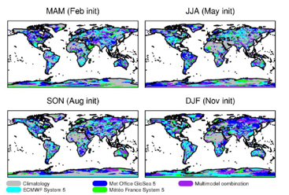
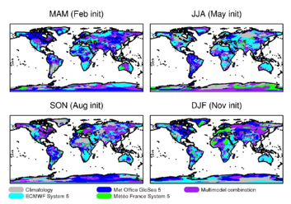
C3S Seasonal Forecasts – EQC / Verification
Verification framework (to be implemented in operations)
Forecast quality
  Is limited
  Varies in space, time (lead time, valid time), parameter, system
  No single model/combination systematically outperforms others
    Multi-model including all systems tends to be the more skilful
    (specially at longer lead times)
lowest
CRPS
(ERA-i)
PRECIPITATION
2m TEMPERATURE

Slide 46
C3S Seasonal Forecasts – EQC/ Postprocessing
User guidelines for postprocessing
Notes:
First some naming…. (note about “overloaded” words like “CAL” for calibrated)

Slide 47
C3S Seasonal Forecasts – EQC/ Postprocessing
User guidelines for postprocessing
Naming
Predictor | Technique | How? | Examples
Target variable, y | Bias adjustment (BA) | y_{CAL} = F([y_{MOD}], [y_{OBS}]) | MVA, EQM, PQM
 | Ensemble re-calibration (RC) | y_{CAL} = F([y_{MOD}, y_{OBS}]_{t}) | CCR (Weigel 2009) RPC (Eade 2014)
Large scale var(s), x_{i} | Model Output Statistics (MOS) | y_{OBS} = f (x_{i,HCST}) y_{CAL} = f (x_{i,MOD}) | Linear Regression
 | Perfect Prognosis (PP) | y_{OBS} = f (x_{i,OBS}) y_{CAL} = f (x_{i,MOD}) | GLM
Notes:
Disclaimer…. Some words overloaded meanings… e.g. “CAL” (for calibrated)
Mention to time scales… monthly-seasonal in general, BA also daily, PP just daily (????)

Slide 48
C3S Seasonal Forecasts – EQC/ Postprocessing
User guidelines for postprocessing
  No single approach outperforms others
  BA/RC successfully remove biases but do not improve other metrics
  (e.g. correlation, ROC, RPS)
  RC sometimes also improve reliability (limited to regions with skill)
  Longer hindcast periods improve reliability (BA/RC)
    Ensemble size seems to matter less
Manzanas et al. 2019, “Bias adjustment and ensemble recalibration methods for seasonal forecasting: A comprehensive intercomparison using the C3S dataset”. Climate Dynamics. DOI: 10.1007/s00382-019-04640-4.
Notes:
RC techniques all perform similar
BA techniques show differences: EQM is worse (and more computational costly) than MVA (Fig. 8, Rodri ClimDyn 2019)
Reliability improvement in RC (remember plot a few slides before)

Slide 49
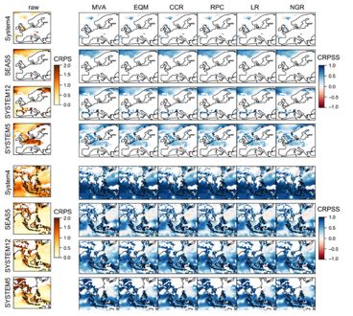
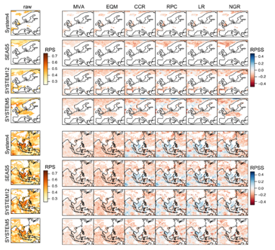
C3S Seasonal Forecasts – EQC/ Postprocessing
User guidelines for postprocessing
  No single approach outperforms others
  BA/RC successfully remove biases but do not improve other metrics
  (e.g. correlation, ROC, RPS)
Notes:
RC techniques all perform similar
BA techniques show differences: EQM is worse (and more computational costly) than MVA (Fig. 8, Rodri ClimDyn 2019)
CRPS (continuous), RPS (discrete, multi-category… equivalent to BS in the 2 category case)
Reliability improvement in RC (remember plot a few slides before)

Slide 50
C3S Seasonal Forecasts – EQC/ Postprocessing
User guidelines for postprocessing
  There are ’windows of opportunity’ where MOS/PP outperform all quality aspects (beyond bias removal)
    When skill of the model is weaker for target variable (e.g. precipitation) than for the predictors used
    “Handle with care!”, reverse situation is also possible (expert advise)
  Observational uncertainty can strongly affect MOS/PP
    Might be relevant in the Tropics (elevated obs. uncertainty)
      BA is recommended as a, in general, more secure alternative over those latitudes
Manzanas et al. 2019, "A comprehensive review of techniques for the post-processing (adjustment/calibration/downscaling) of seasonal forecasts" submitted to Climate Dynamics
Notes:
Observational uncertainty in the tropics…. And also higher skill (so little room for improvement in the models), hence, preferable general recommendation to use BA

Slide 51
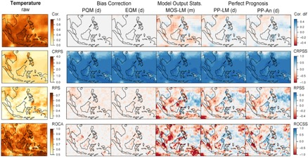
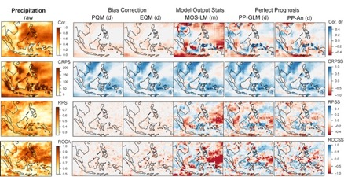
C3S Seasonal Forecasts – EQC/ Postprocessing
User guidelines for postprocessing
  There are ’windows of opportunity’ where MOS/PP outperform all quality aspects (beyond bias removal)
    When skill of the model is weaker for target variable (e.g. precipitation) than for the predictors used
    “Handle with care!”, reverse situation is also possible (expert advise)
Notes:
Temperature
RPS
AUC
Precip
RPS
AUC
NOTE: ECMWF System4 (because longer hindcast and, bigger in size with 51 members, was available… remember importance of hindcast period length)

Slide 52
C3S Seasonal Forecasts – EQC/ Multi-model
Assessment of forecast quality of multi-model seasonal forecasts
  Continuous ensemble forecasts
    Best results with averaged single-model fitted PDFs (after individual recalibration)
    Weights based on RMSE of the individual calibrated ensemble mean offer just a slight improvement, so equal weights are recommended as basic multi-model combination method
  Multi-category forecasts
    Best results with average of single model probabilities
    Weights based on RPS adds a slight improvement
Hemri et al. 2019,
"A practical guide to quality assessment of operational multi-model seasonal forecasts" to be submitted

Slide 53
NOAA-USAID Second Symposium on the Global Climate System
Ankara, Turkey, 24 – 26 April, 2019
C3S
Copernicus Climate Change Service
Eduardo Penabad Ramos (ECMWF)
with contributions from:
Carlo Buontempo, Anca Brookshaw,
Jean-Noël Thepaut, Dick Dee, Cedric Bergeron

Slide 54
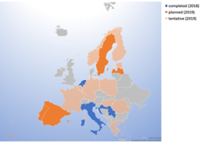

C3S - Bonus track
Free training
https://uls.climate.copernicus.eu
User Support
https://climate.copernicus.eu/help-support

Slide 55
Thank you!
Teşekkür ederim!
Eduardo Penabad Ramos
eduardo.penabad@ecmwf.int
NOAA-USAID Second Symposium on the Global Climate System
Ankara, Turkey, 24 – 26 April, 2019

