Slide 1
NOAA-USAID 11th International Training Workshop Climate Variability and Predictions
Ankara, Turkey, 15 – 23 April, 2019
C3S Climate Data Store CDS catalogue, API and Toolbox: Hands-On practice
Eduardo Penabad Ramos (ECMWF)
with contributions from: Cedric Bergeron, Gionata Biavati, Ángel López-Alos

Slide 2
Contents
Copernicus Programme
The Copernicus Climate Change Service (C3S)
Overview of the CDS
Hands-on
CDS User Registration
CDS Catalogue and Interactive Forms
CDS API
CDS Toolbox
Notes:
Hands-on… very introductory

Slide 3
Contents
Copernicus Programme
The Copernicus Climate Change Service (C3S)
Overview of the CDS
Hands-on
CDS User Registration
CDS Catalogue and Interactive Forms
CDS API
CDS Toolbox
Notes:
Hands-on… very introductory

Slide 4
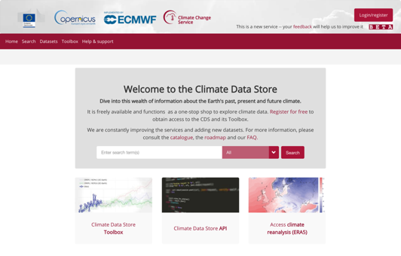
The C3S Climate Data Store (CDS)
The Climate Data Store
also called CDS, is an online open and free service.
It allows users to browse and
access the wide range of climate datasets via a searchable catalogue…
… It allows users to build their own applications, maps and graphs
12000+
registered users
https://cds.climate.copernicus.eu
Notes:
4

Slide 5
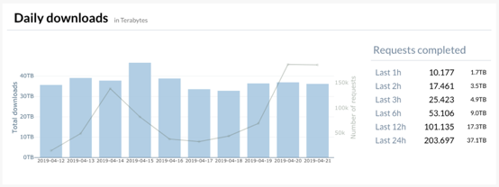
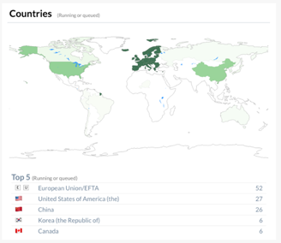
The C3S Climate Data Store (CDS)
12000+
registered users

Slide 6
What is the CDS vision?
Make data discovery/access easy and relevant for users
Provide scalable data access
Provide online capabilities to process the data to users
Provide easy-to-use online applications for users
Enable reproducible research
➤ Spend less time handling the data
Notes:
kkkk

Slide 7
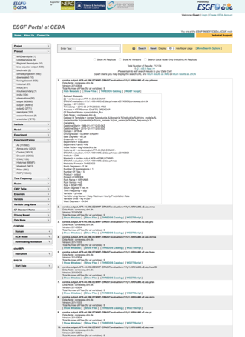
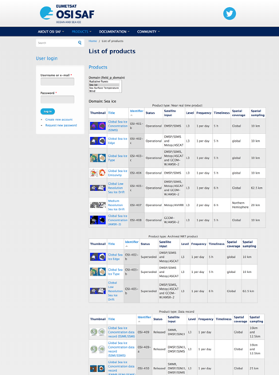
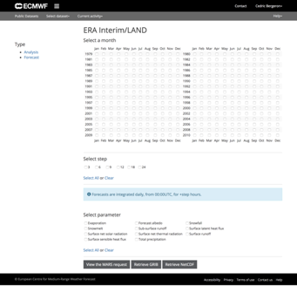
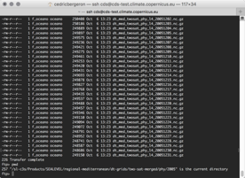
Before…
Finding datasets before the CDS…
?

Slide 8
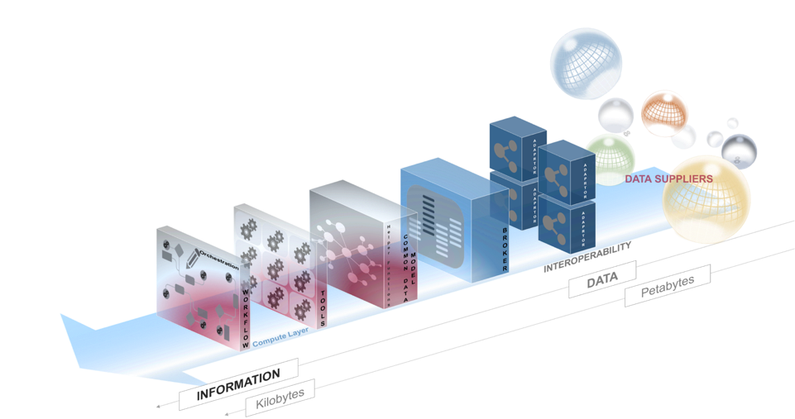
What is the CDS concept?
The CDS is designed as a distributed system, providing improved access to existing datasets through a unified web interfaces

Slide 9
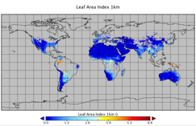
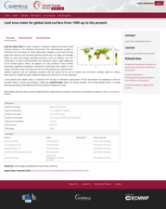
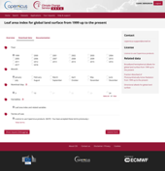
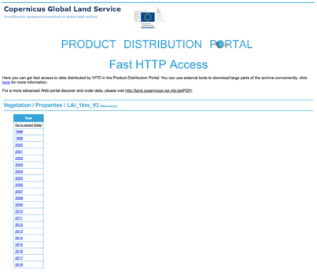
Climate Data Store - Concept
🙂
User
Catalogue
Web Portal
Broker
Adaptor
Adaptor
Adaptor
Adaptor
VITO
http server
ESGF
Website
ftp server
ECMWF
MARS archive

Slide 10
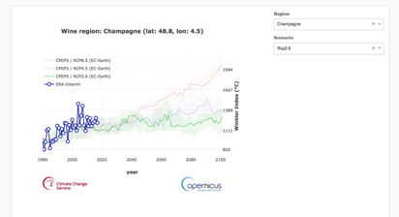
Climate Data Store - Concept
🙂
User
Compute
Catalogue
Toolbox
Broker
Adaptor
Adaptor
Adaptor
ESGF
Website
ftp server
ECMWF
MARS archive

Slide 11
CDS – Overall technical Architecture
End User
Data Supplier
External Information
Systems
CDS EQC
CDS Administrator
Browse
Browse
API
Catalogue
Export
WEB PORTAL
Authentication
Users Management*
Data/Products Catalogue
Discover/View/
Download
Data/Product
Metadata Management*
Tools/Workflow Management*
Data/Products Catalogue
Iso19115 Export
Application Management*
CLIMATE DATA STORE
Applications Use
*Creation Modification Deletion
TOOLBOX INFRASTRUCTURE
BACK END
Monitoring / Metrics
Monitoring / Metrics
Data/Products Catalogue
User Settings
User Requests
Web Pages
Content Management System
Tools/Workflow Inventory
Applications
inventory
Scale out
BROKER / Scheduler
Compute
Queues
Status
Tools/Workflows Repository
Computation Exec.
Staging
Computation Exec.
Results/Cache
Adaptor
Adaptor
Adaptor
Adaptor
Adaptor
Data Elaborated
Data Elaborated
DATA SUPPLIERS
Computation
Computation
DATA
Site n
Tools Repository
Tools Repository
DATA
DATA
Site 1
DATA
Site 2
DATA
Site 3
DATA
Site 4
DATA

Slide 12
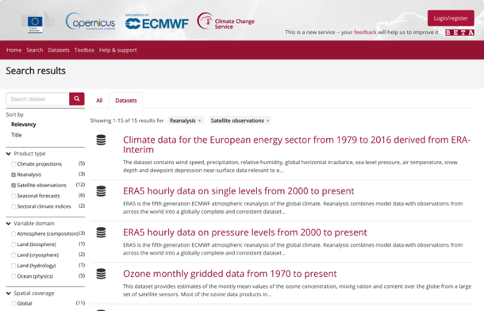
Finding datasets
Metadata ISO 19115

Slide 13
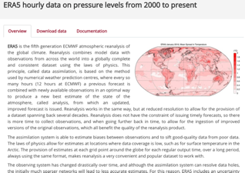
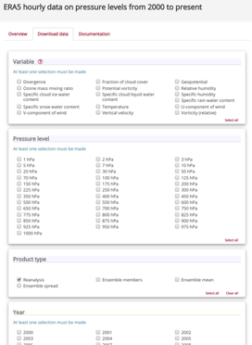
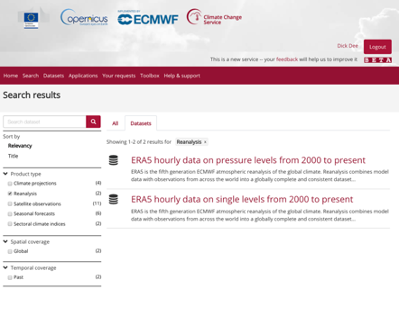
Before…
Accessing datasets: Global reanalysis data
Quality Evaluation will come soon (2019)
Simplicity and consistency are key
Notes:
ERA5 from 1979 before end 2018
ERA5T before

Slide 14
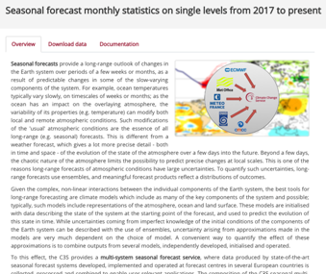
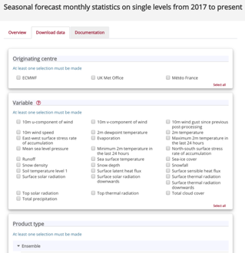
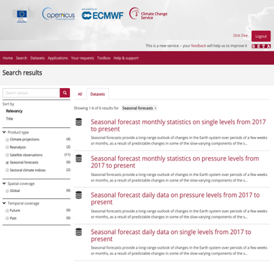
Before…
Accessing datasets: Multi-system seasonal forecasts
Simplicity and consistency are key

Slide 15
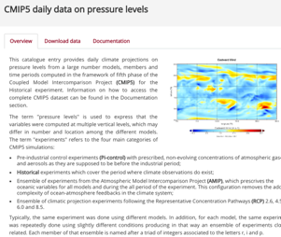
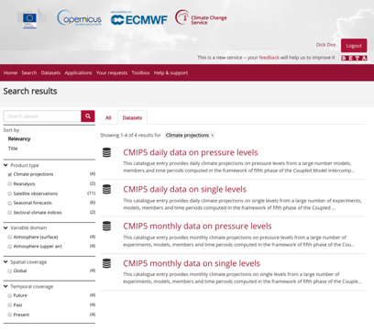
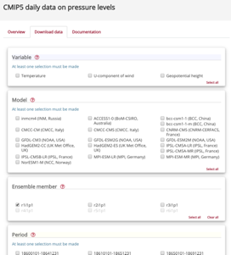
Before…
Accessing datasets: Climate model output via ESGF
Simplicity and consistency are key

Slide 16
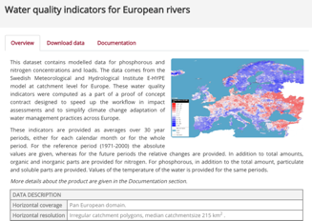
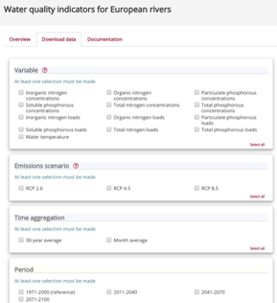
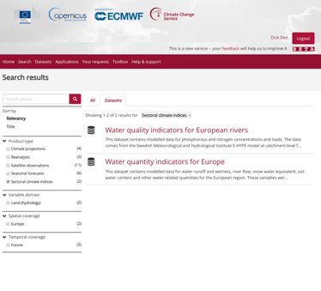
Before…
Accessing datasets: Sectoral impact indicators
Simplicity and consistency are key

Slide 17
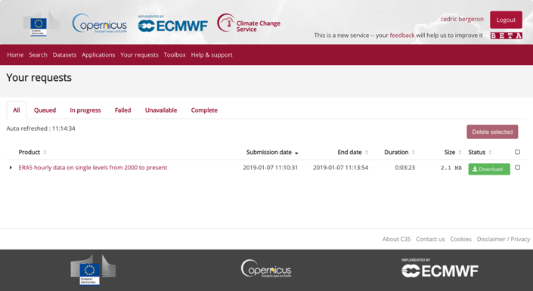
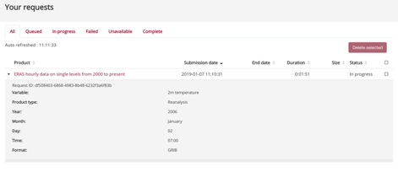
Accessing datasets: a personal space

Slide 18
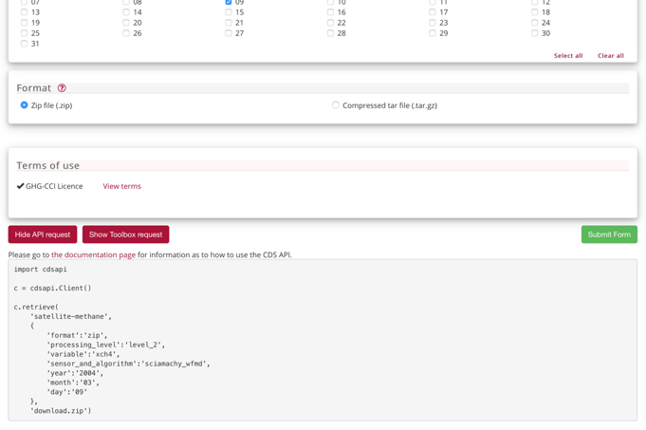
Accessing datasets through the CDS API
API Acess
[Screen shot form + API + Toolbox]
[Screen shot Sublime text]
pip install cdsapi
https://cds.climate.copernicus.eu/api-how-to

Slide 19
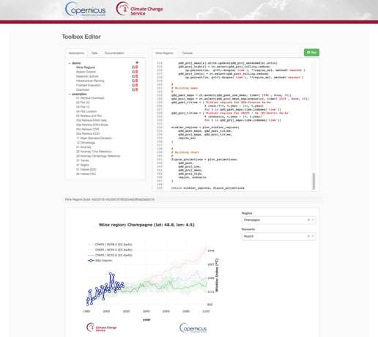
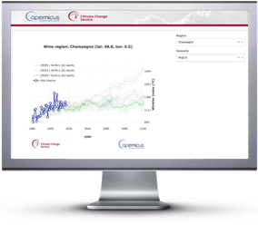
Using the data online: The CDS Toolbox Editor

Slide 20
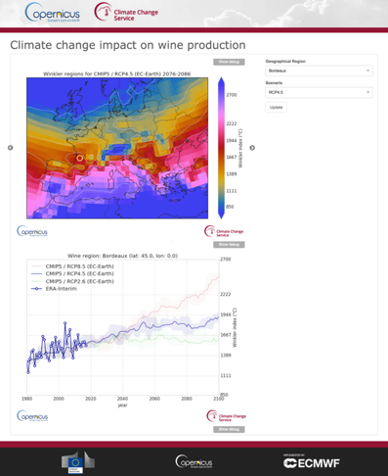
Using the data online: Building Online Applications
Web page/components with possible parameterization from users
Perform specific tasks
Provide one or more of:
Data
Processed results
Plots / Maps

Slide 21
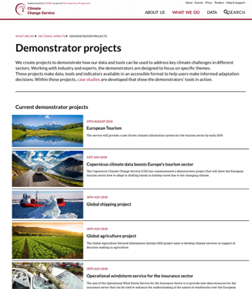
Using the data online: Building Online Applications

Slide 22
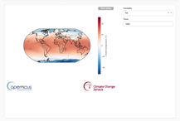
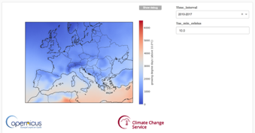
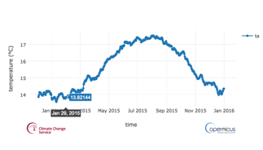
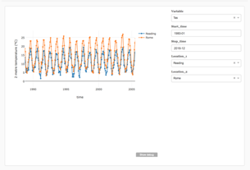
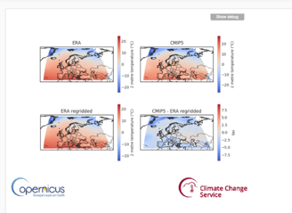
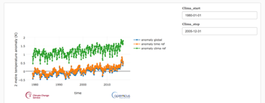
Using the data online: Building Online Applications

Slide 23
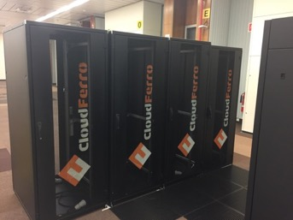
The CDS: An operational system
On-Premises Private Cloud
40+ nodes, 2000+ CPUs, 8TB memory
2.5 PB usable (of which 256 TB SSD)
Automatic deployment using
OpenStack Heat
CloudInit
Puppet
Partners are given VMs to contribute data and tools

Slide 24
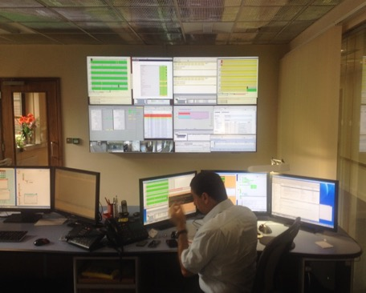
The CDS: An operational system
Monitoring
Reporting
Capacity planning
Usage statistics
Service level agreement
On-call and support
Help desk
High-availability
Backup
Notes:
But still a young system…. (in development)

Slide 25
Hands-On Practice
CDS User Registration

Slide 26
CDS User Registration

Slide 27
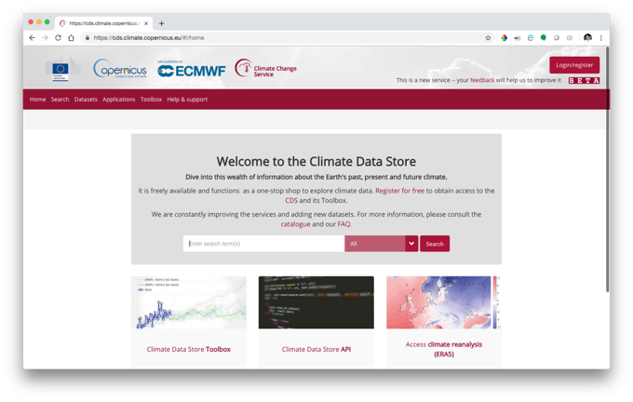
CDS User Registration

Slide 28
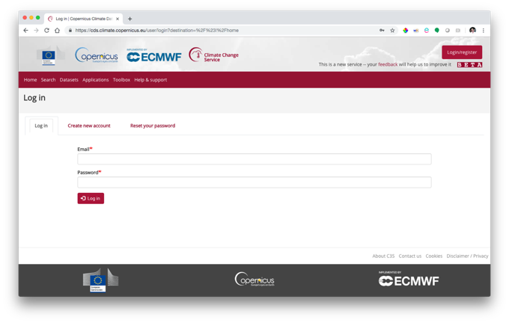
CDS User Registration

Slide 29
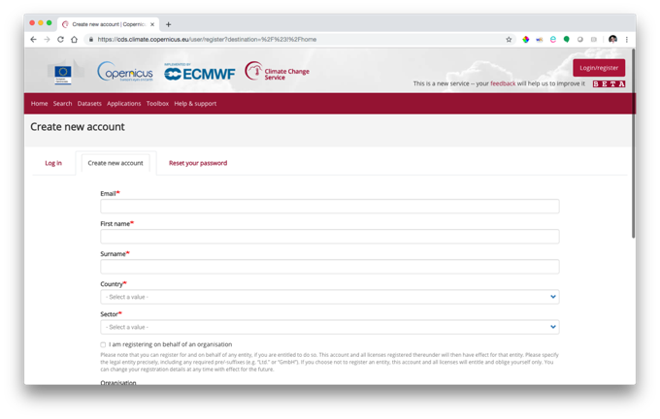
CDS User Registration

Slide 30
CDS User Registration

Slide 31
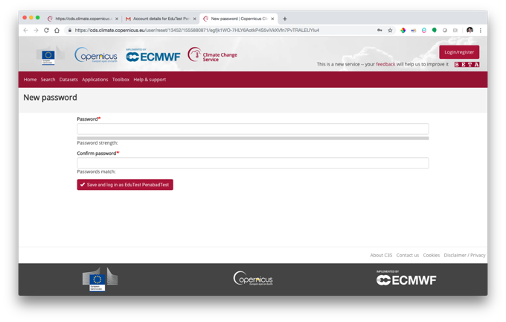
CDS User Registration

Slide 32
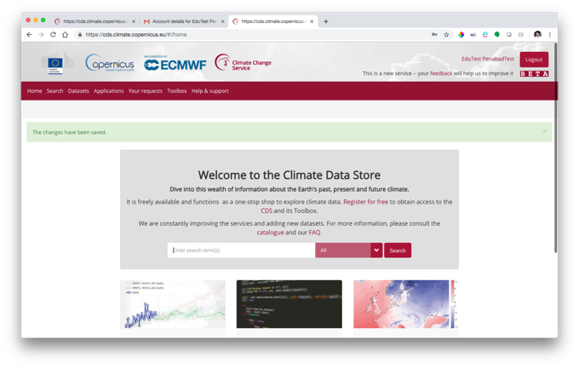
CDS User Registration

Slide 33
Hands-On Practice
CDS Catalogue and Interactive Forms

Slide 34
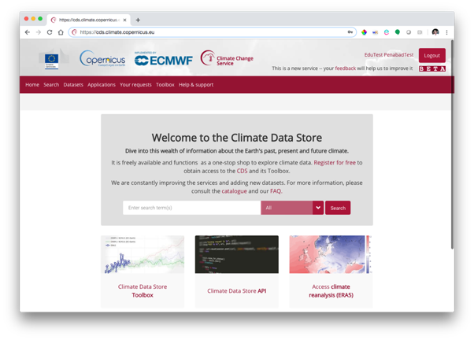
CDS Catalogue and Interactive Forms

Slide 35
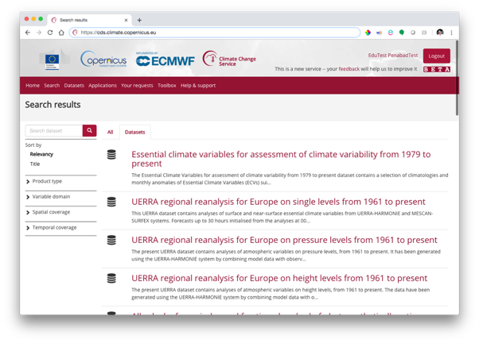
CDS Catalogue and Interactive Forms

Slide 36
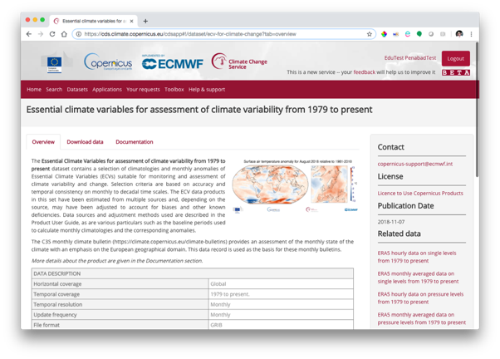
CDS Catalogue and Interactive Forms

Slide 37
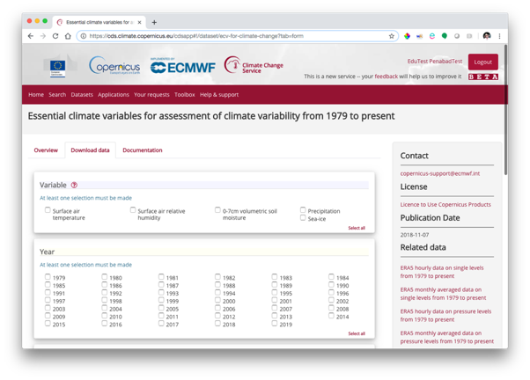
CDS Catalogue and Interactive Forms

Slide 38
CDS Catalogue and Interactive Forms

Slide 39
CDS Catalogue and Interactive Forms

Slide 40
CDS Catalogue and Interactive Forms

Slide 41
CDS Catalogue and Interactive Forms

Slide 42
CDS Catalogue and Interactive Forms

Slide 43
CDS Catalogue and Interactive Forms

Slide 44
Hands-On Practice
CDS API

Slide 45
CDS API
Python package ´cdsapi´
Requirements:
Python
Package ‘cdsapi’
Potentially also package ‘pyopenssl’
Preferable Linux-type OS (linux, MacOS)
But also possible in Windows

Slide 46
CDS API
Install package ‘cdsapi’
Using ‘pip’
> pip install cdsapi
Using ‘conda’
> conda config --add channels conda-forge
> conda install cdsapi

Slide 47
CDS API
Install CDS API key at $HOME/.cdsapirc

Slide 48
CDS API

Slide 49
CDS API

Slide 50
CDS API
Install CDS API key at $HOME/.cdsapirc

Slide 51
CDS API
Install CDS API key at $HOME/.cdsapirc
Test CDS API
import cdsapi c = cdsapi.Client() c.retrieve("dataset-short-name", {... sub-selection request ...},
"target-file")

Slide 52
CDS API

Slide 53
Hands-On Practice
CDS Toolbox

Slide 54
CDS Toolbox

Slide 55
CDS Toolbox

Slide 56
CDS Toolbox

Slide 57
CDS Toolbox

Slide 58
CDS Toolbox

Slide 59
CDS Toolbox

Slide 60
CDS Toolbox

Slide 61
CDS Toolbox

Slide 62
CDS Toolbox

Slide 63
CDS Toolbox

Slide 64
CDS Toolbox

Slide 65
CDS Toolbox

Slide 66
CDS Toolbox

Slide 67
CDS Toolbox

Slide 68
CDS Toolbox

Slide 69
Thank you! Teşekkür ederim!
Eduardo Penabad Ramos
eduardo.penabad@ecmwf.int
NOAA-USAID Second Symposium on the Global Climate System
Ankara, Turkey, 24 – 26 April, 2019

