Slide 1
The North American Multi-Model Ensemble (NMME)
Real time monthly and seasonal forecasts made available to the public to improve climate services.
Dr. Wassila Mamadou Thiaw
Climate Prediction Center
National Center for Environmental Prediction
National Oceanic and Atmospheric Administration

Slide 2
The North America Multi-Model Ensemble (NMME)
The National Research Council (2010) recommended NCEP to implement an NMME system to improve ISI forecasting
NMME Phase-I: Experimental system initiated as a Climate Test Bed (CTB) research project supported by NOAA in 2011
NMME Phase-II: Improved experimental system as a 2012-2013 NOAA/CTB research project with additional support from NSF, DOE and NASA. Includes sub-seasonal timescales
NMME and IMME are considered in the NCEP operational monthly and seasonal forecasting system

Slide 3
NMME Model Overview
Models | Initial Conditions | Members
CFSv2 (NCEP) | 1st to the 8th of month | 32
CCMs (Canada) | 1st of each month | 20
GFDL | 1st of each month | 10
GFDL-FLOR | 1st of each month | 24
NASA | /5dy 4mb / lstdy 7mb | 11
NCAR | 1st of each month | 10
NMME | Combined | 107
Forecasts released by the 8th of each month
All models have the same horizontal resolution 1.0◦ X 1.0◦
Hindcasts are from 1982 - 2010

Slide 4
Regionalized NMME Forecasts
http://www.cpc.ncep.noaa.gov/products/international/nmme/ensm/index.shtml
Acknowledgment: Huug, Emily, Qin, and entire NMME Team

Slide 5
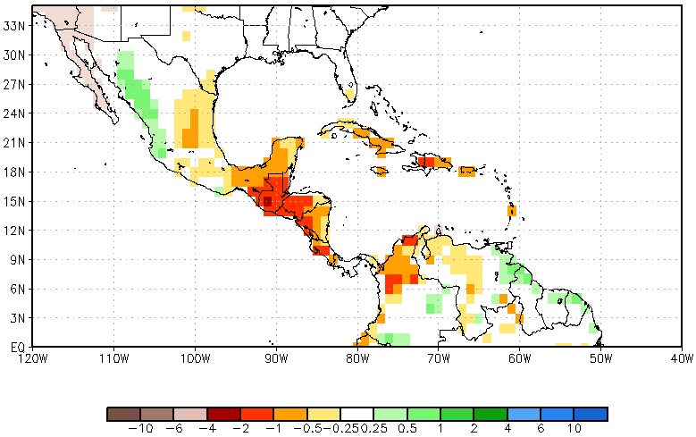
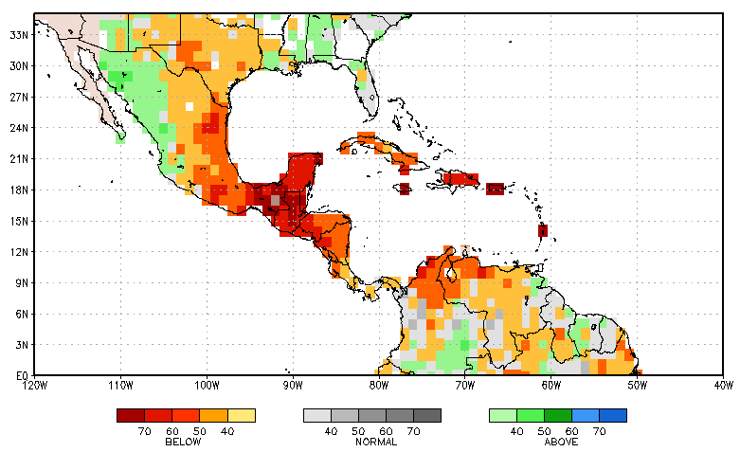
Deterministic vs. Probabilistic Forecast
Deterministic
Probabilistic
Bias-corrected ensemble mean anomalies: anomalies are calculated using model’s climatology
MME uses equal weighting for each model
Skill measures: AC; RMSE
For each year, tercile (A, N, B) thresholds determined from 28 years of the hindcasts of individual models
Forecast mbers assigned to terciles; # of mbers in each class counted
Historical skill used to calibrate probability forecasts.

Slide 6
Probabilistic Forecast
Precipitation (Count Method)
Hindcasts (1982-2010) are ranked
The 66th and 33rd percentiles are taken to determine the upper third, lower third and the middle third of the tercile categories
For a given forecast, number of ensemble members in each model that falls into one of the categories (relative to their own distributions) is counted
This tally gives the raw probability forecasts for each model
The resulting model probabilities are added together and divided by the number of NMME models

Slide 7
Probabilistic Forecast
Precipitation (Calibrated Method)
Probability Anomaly Correlation (PAC) is used
Historical correlation between forecast probability anomaly (PA) and observed PA is calculated
For forecasts, PA_{f} = difference between forecast and 1/3, the climatological frequency (0.33)
E.g.: if forecast for above = 0.5; PA_{f} = 0.5 – 0.33 = 0.17
For observations, PA_{o} = difference between observation and 1/3, the climatological frequency (0.33)
Observed probability = 1, or 0, always.
E.g.: if observation for above = 1; PA_{f} = 1 – 0.33 = 0.66
PAC is multiplied by the ratio between observed and predicted standard deviation (std_{o}/std_{f}) to yield PAC_{adj}
PA_{f} + PAC_{adj} = calibrated probability forecast for each model
Model calibrated forecasts are added and divided by the number of NMME models

Slide 8
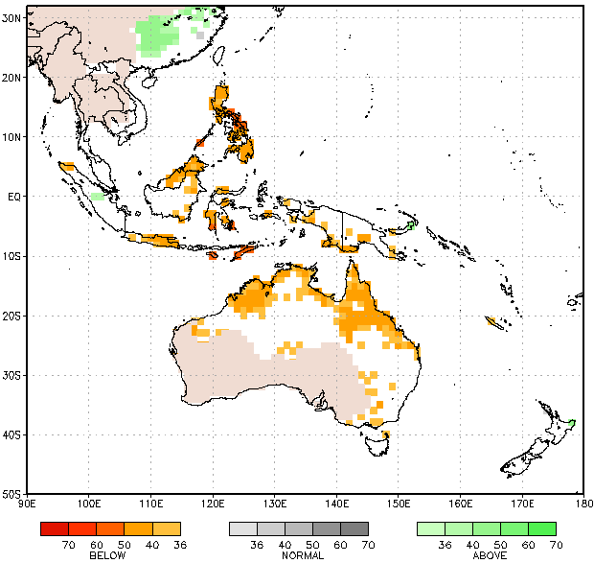
Regionalized
NMME Forecasts
Three category precipitation
probability forecasts, Oct IC
P Fcst NDJ, Maritime Continent

Slide 9
NMME Data Access
ftp://ftp.cpc.ncep.noaa.gov/International/nmme/
binary
Grads ctl file
Forecast data
SST
Precipitation
2-meter temperature
cpt
All NMME model hindcasts & forecasts data are available in cpt format

Slide 10
How good is the NMME in the tropics?
Is the raw NMME forecast good enough?
Can the NMME be used as a tool to improve forecasts (Importance of statistical downscaling)

Slide 11
Downscaling of NMME Models for Indonesia Case of Borneo
CCA predictions of Borneo rainfall, JJA, observed Apr SST
CCA forced with NMME predicted SST JJA, May IC
CCA forced with NMME predicted precipitation JJA, May IC

Slide 12
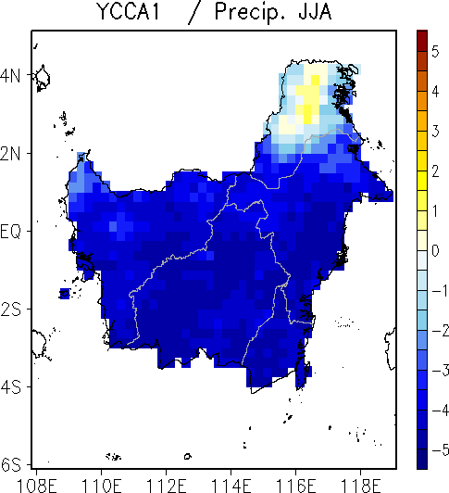
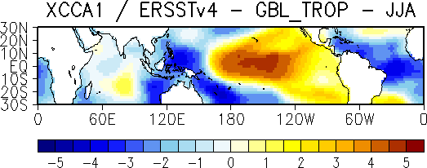
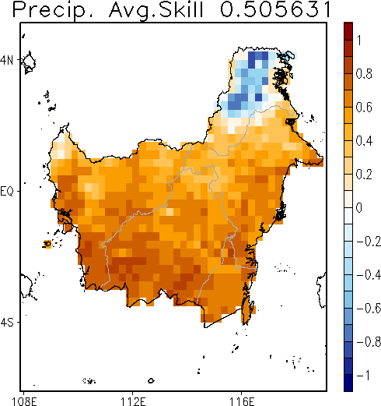
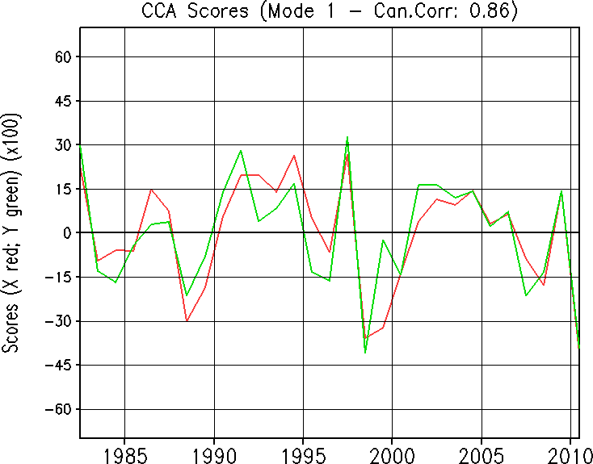
CCA forced with observed June Global tropical SST
Borneo, Indonesia, JJA rainfall

Slide 13
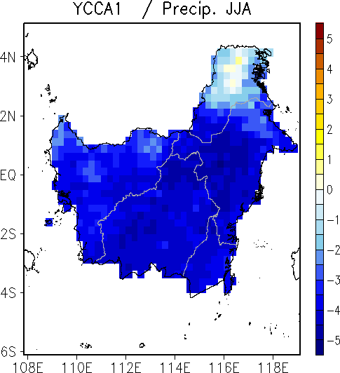
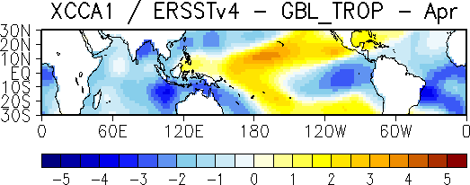
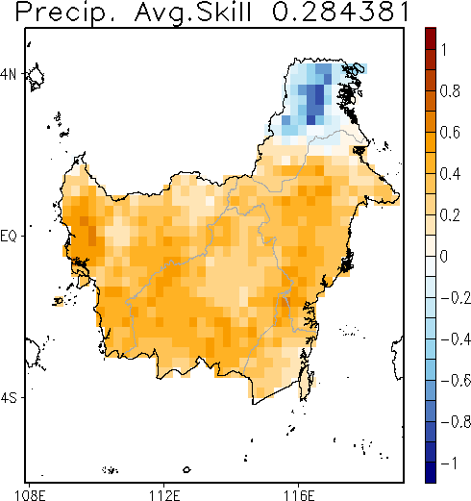
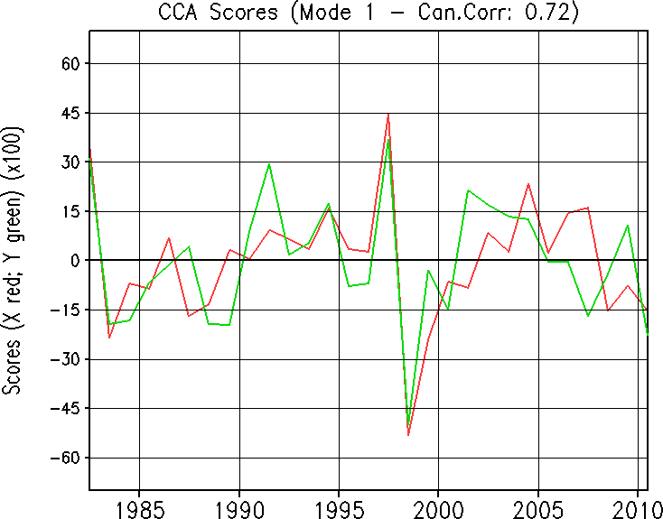
CCA forced with observed Apr Global tropical SST
Borneo, Indonesia, JJA rainfall

Slide 14
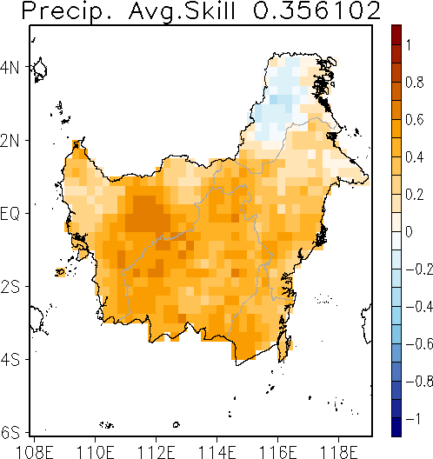
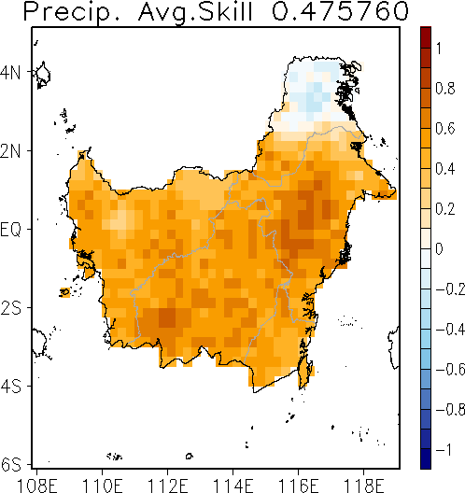
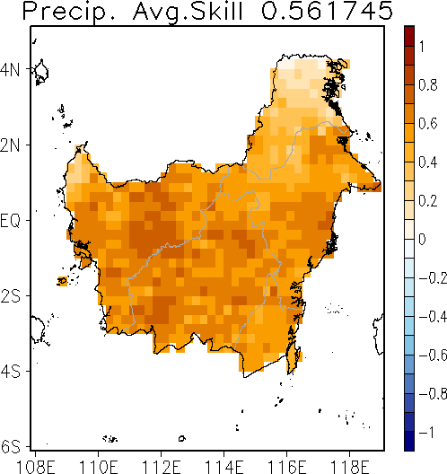
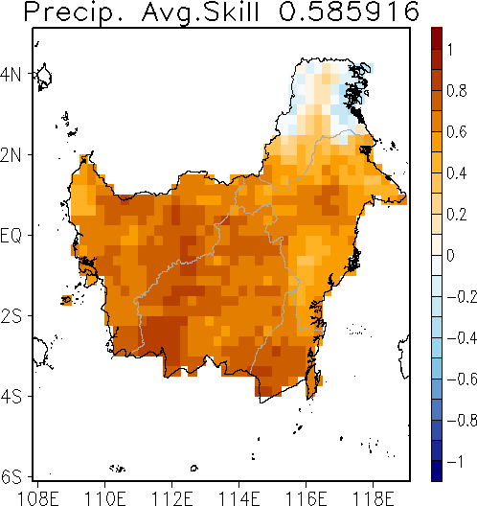
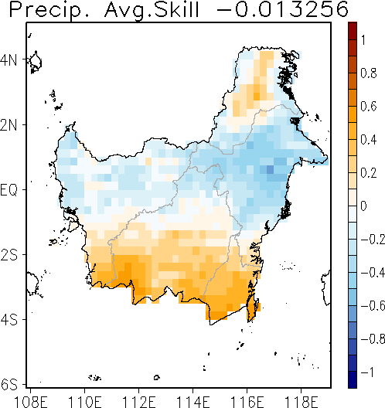
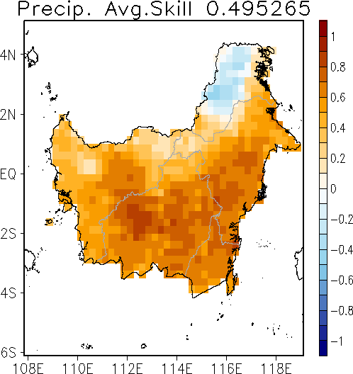
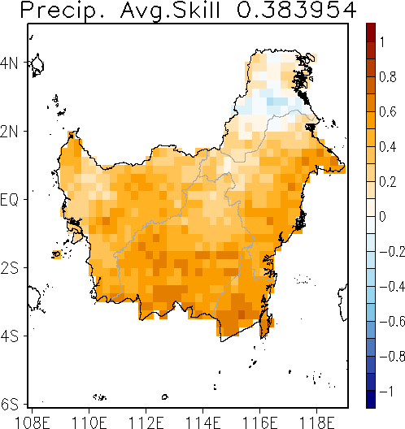
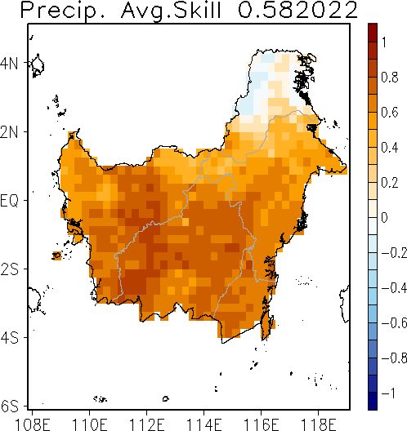
Raw model skill map
Borneo, JJA (May IC) CPCU
CFSv2
CMC1
CMC2
GFDL FLOR
GFDL
NASA
NCAR CCSM4
nmme

Slide 15
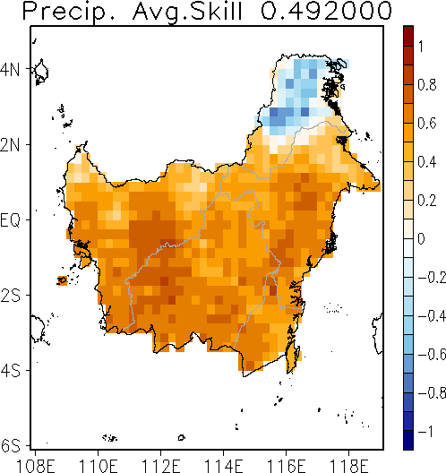
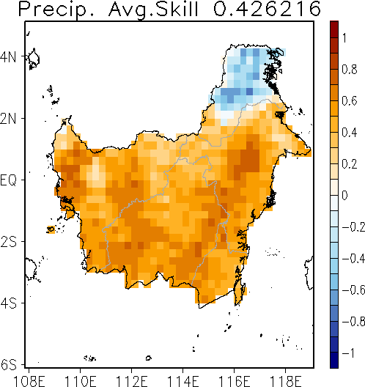
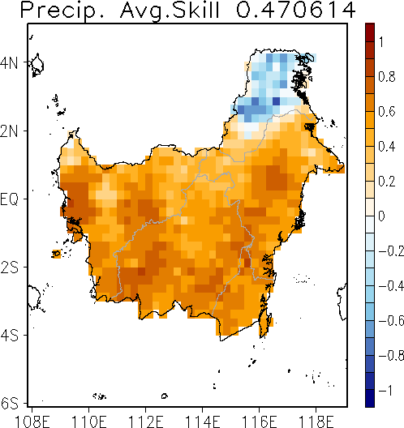
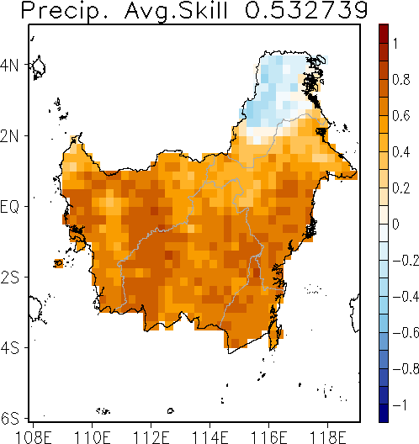
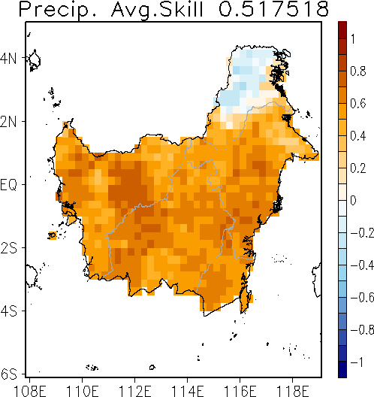
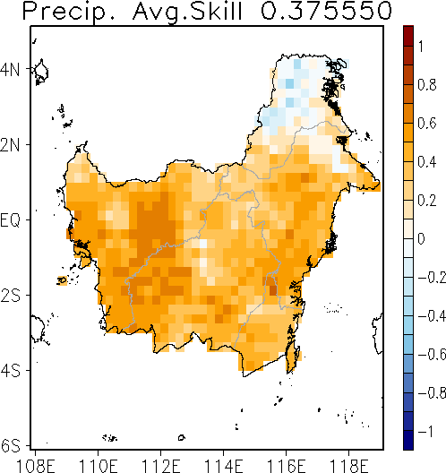
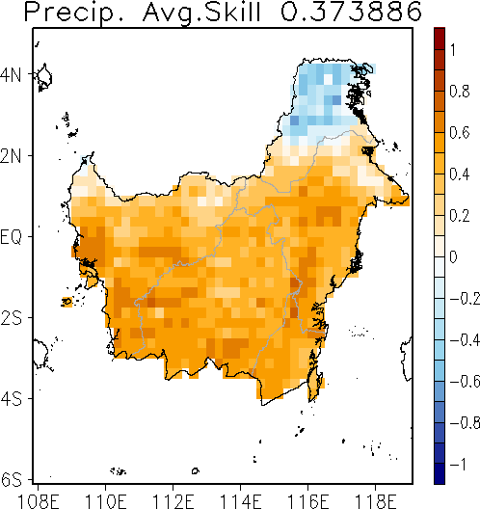
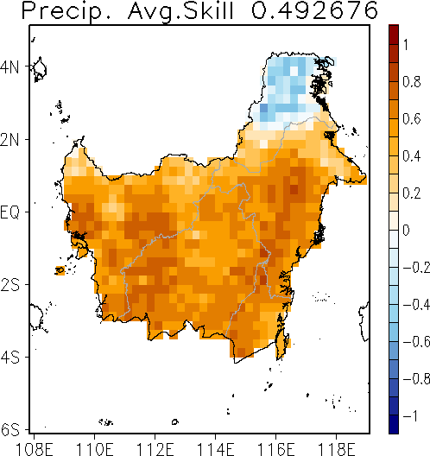
Skill Map : NMME JJA Global Tropical SST
Borneo JJA Rainfall, May IC
CFSv2
CMC1
CMC2
GFDL FLOR
GFDL
NASA
NCAR CCSM4
nmme

Slide 16
Ensemble CCA for Borneo
Predictand: CPCUnified
Predictors
Observed SST
Model predicted SSTs
Model predicted precipitation
Experiments | CFSv2 | CMC1 | CMC2 | GFDL_F | GFDL | NASA | NCAR | nmme
Raw Mod (Mod) | 0.356 | 0.476 | 0.562 | 0.586 | -0.013 | 0.495 | 0.384 | 0.582
CCA Correction | 0.250 | 0.432 | 0.559 | 0.526 | 0.439 | 0.500 | 0.461 | 0.501
T-Pac-SST (TPSST) | 0.476 | 0.449 | 0.471 | 0.537 | 0.499 | 0.403 | 0.383 | 0.461
EM2 (Corr + TPSST) | 0.412 | 0.458 | 0.537 | 0.548 | 0.495 | 0.493 | 0.423 | 0.478
EM3 (EM2 + Mod) | 0.413 | 0.472 | 0.551 | 0.565 | 0.473 | 0.519 | 0.433 | 0.491

Slide 17
For Borneo, from these experiments, seems the model is as good as it gets. Is it true everywhere else?

Slide 18
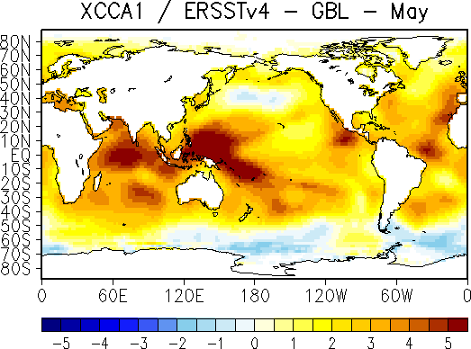
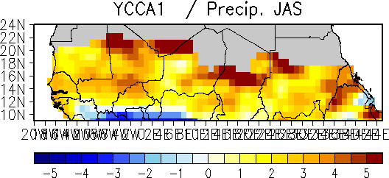
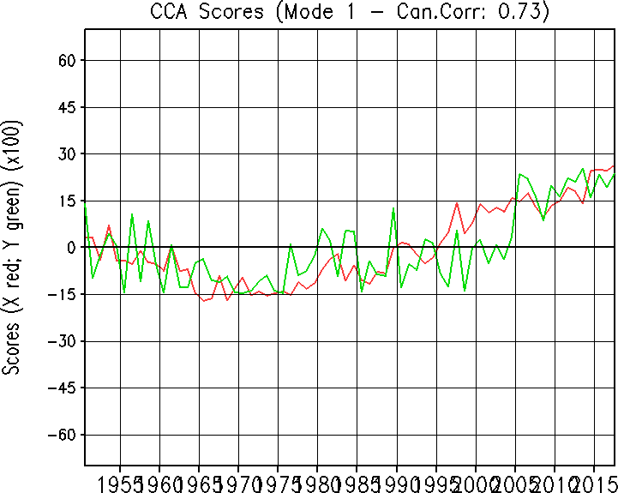
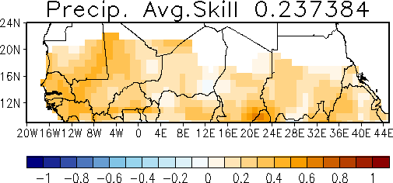
CCA forced with observed May Global SST –
Sahel, JAS rainfall (1951 – 2017)

Slide 19
Ensemble CCA for The Sahel, West Africa
Experiments | CFSv2 | CMC1 | CMC2 | GFDL_F | GFDL | NASA | NCAR | nmme
Raw Model | 0.1371 | 0.2566 | 0.0304 | 0.1780 | 0.0856 | 0.3318 | 0.0436 | 0.1993
After CCA Correction | 0.0119 | 0.1676 | 0.3727 | 0.4308 | 0.0124 | 0.4316 | 0.2787 | 0.2818
CCA Forced Model SST (JunIC - JAS) | 0.3982 | 0.4056 | 0.3677 | 0.3643 | 0.3914 | 0.3827 | 0.3237 | 0.3183
EM3 | 0.3120 | 0.3180 | 0.4112 | 0.4441 | 0.2809 | 0.4294 | 0.3743 | 0.3740
EM4 | 0.3668 | 0.3612 | 0.4123 | 0.4426 | 0.3401 | 0.4330 | 0.3464 | 0.3460
EM3 : obs_sst(May) + obs_PSI(May) + CCA_correction
EM4 : obs_sst(May) + obs_PSI(May) + CCA_correction + CCA_mod_sst + raw model

Slide 20
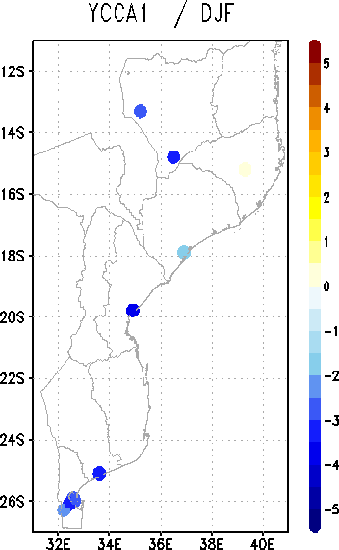
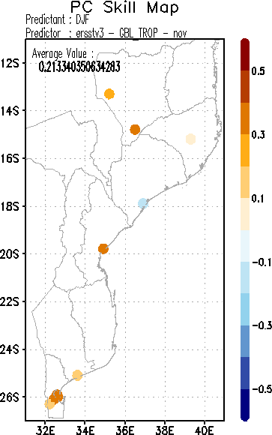
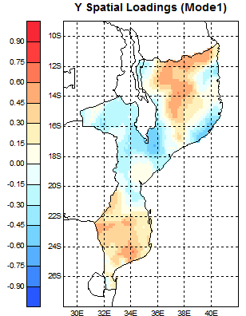
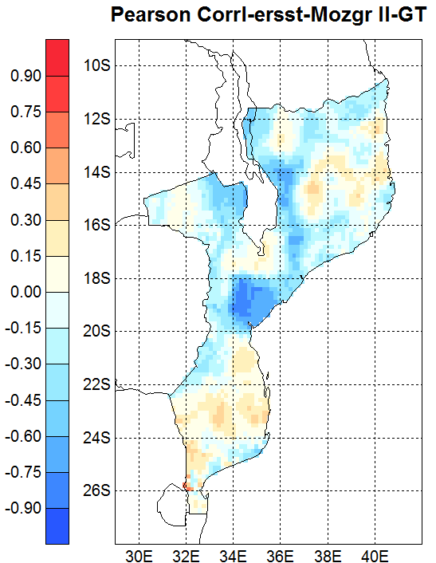
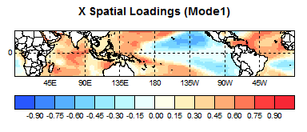
Data and Statistical Downscaling - Mozambique
Exp – Mozambique Station Data
Exp – Mozambique Gridded Data

Slide 21
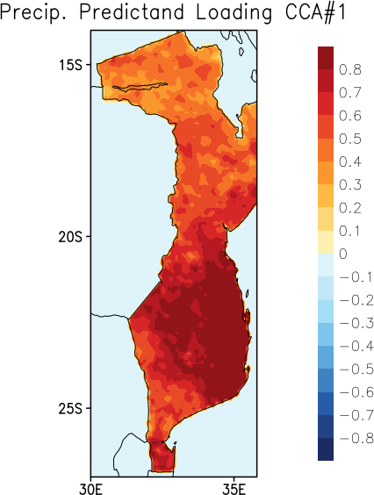
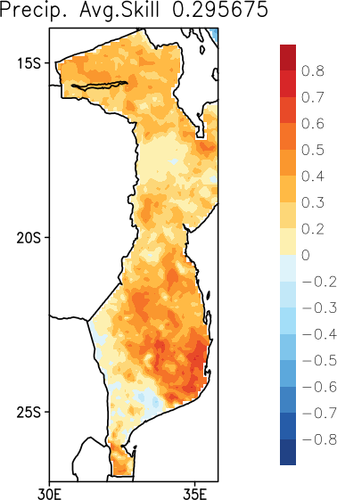
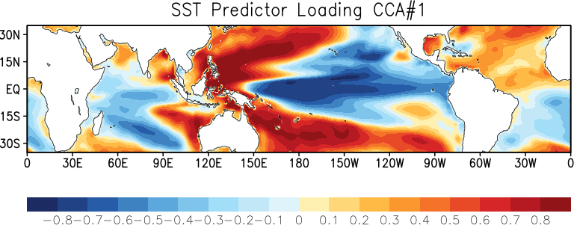
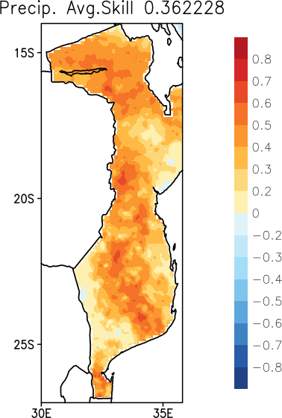
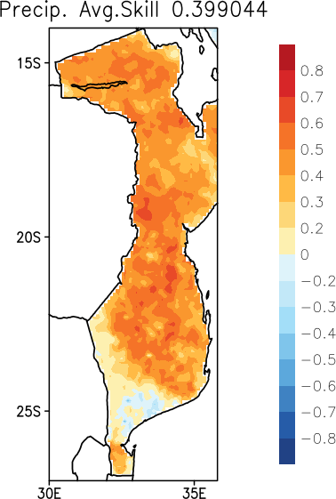
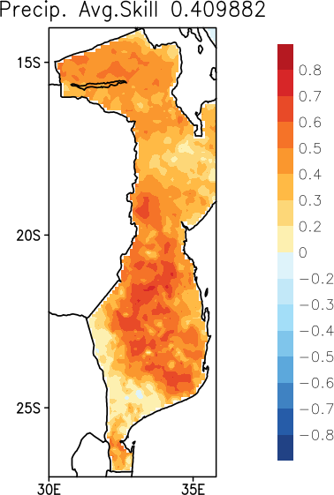
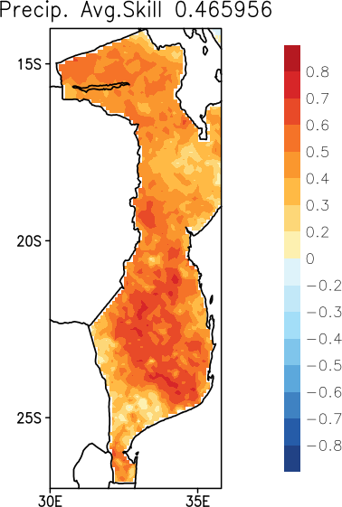
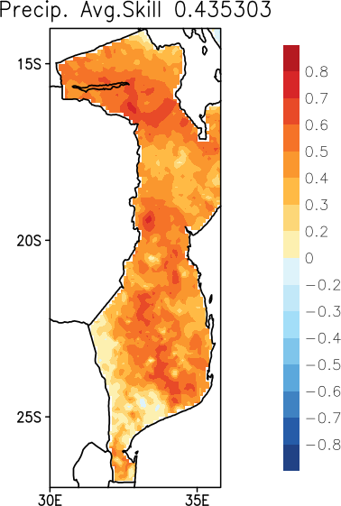
Data and Statistical Downscaling - Mozambique
Exp – Mozambique SRE – Global SST
exp4b_nmme_novic_djf_arc2_djf_prdor_load.txt.cca1
Exp – Mozambique SRE – TP
exp4b_nmme_novic_djf_arc2_djf_prdnd_load.txt.cca1
exp4b_nmme_novic_djf_arc2_djf_skillmap.txt
exp5b_cfsv2_novic_djf_arc2_djf_skillmap.txt
exp5b_cmc2_novic_djf_arc2_djf_skillmap.txt
exp5b_nasa_novic_djf_arc2_djf_skillmap.txt
exp5b_gfdl_flor_novic_djf_arc2_djf_skillmap.txt
exp5b_nmme_novic_djf_arc2_djf_skillmap.txt

Slide 22
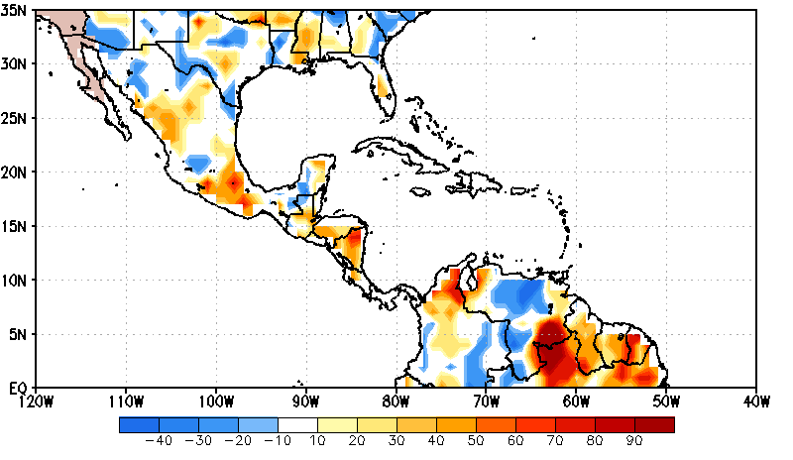
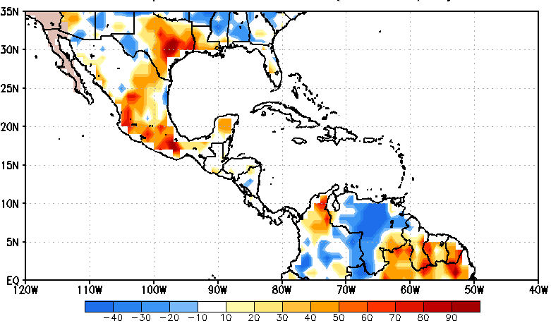
NMME P Heidke Skill Score 2012-17 June IC
Jul-Sep
July
NMME seasonal (JAS) and monthly (July) HSS are reasonable over parts of Mexico during the summer.
Acknowledgement: Peitao Peng

Slide 23
Summary
The NMME data is available real from NCEP/CPC website and can be used for statistical downscaling and to improve seasonal forecasts.
Statistical downscaling needs to be carried out carefully and requires multiple sets of prediction experiments to identify the optimal prediction scheme.
Forecasts needs to be verified to convey model deficiencies and to communicate these limitations to the users.

Slide 24
Teshekurla Ashante Shukran Merci Thank you

