Slide 1
The Madden-Julian Oscillation
Jon Gottschalck and Kyle MacRitchie
Operational Prediction Branch
NOAA / NWS / NCEP / Climate Prediction Center
Presented by Wassila M. Thiaw

Slide 2
Why do we care about the MJO?
The MJO is intellectually important: there’s a lot that we don’t understand about it so it’s a great area to research.
The MJO has direct and indirect sensible weather impacts nearly everywhere around the globe.
The MJO has direct impacts on ENSO, tropical cyclone activity, other tropical waves, etc.

Slide 3
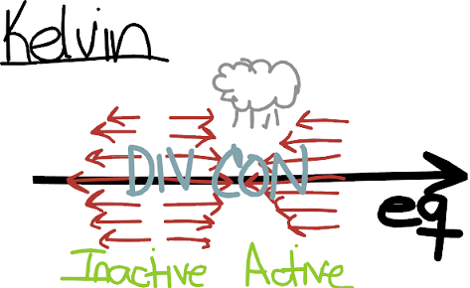
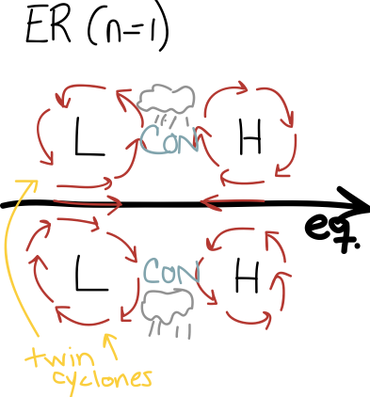
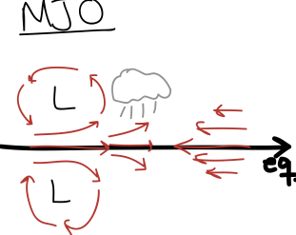
Tropical Waves
There are many kinds of tropical waves. The most important are:

Slide 4
Outline
(1) What are the characteristics, structure, dynamics and theories of the MJO?
(2) How do we monitor and assess the MJO?
(3) How does the MJO impact conditions in the Tropics?
(4) What is the current state of MJO prediction? What forecast tools are available?
(5) What CPC assessments are available to utilize?

Slide 5
Part 1: Characteristics, Structure, Dynamics and Theories of the MJO

Slide 6
MJO Characteristics
The MJO is an intraseasonal wave originating in the Tropics
The MJO results in changes in atmospheric and oceanic conditions
Lower- and upper-level wind
Cloudiness and tropical rainfall
Sea level Pressure
Sea surface temperature (SST)
Ocean surface evaporation
Ocean chlorophyll
Typical period of the MJO cycle is approximately 30-60 days
Acts on a global spatial scale
Coherent eastward propagation (EH 5 m/s and WH 15 m/s)
Madden and Julian, 1971; 1972; Zhang, 2005; Hendon and Salby, 1994

Slide 7
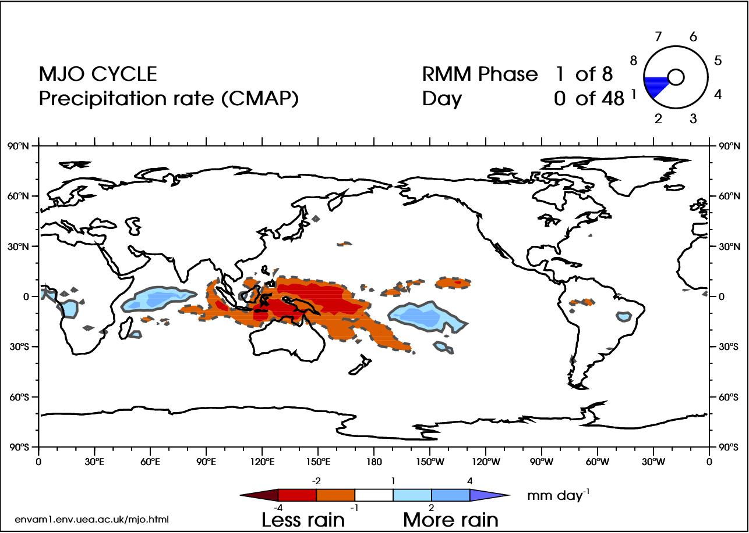
MJO Characteristics
Courtesy: Adrian Matthews, Univ. East Anglia, UK

Slide 8
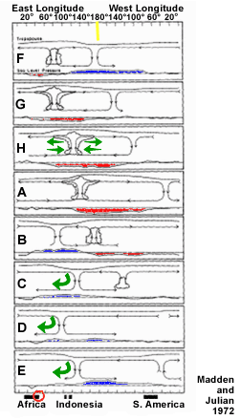
MJO Vertical Structure
8 phases altering patterns of:
Tropical Rainfall (cloud)
Winds (green arrows)
Sea level pressure (red/blue shading)
Convective signal strongest across the Indian Ocean, Indonesia and Western Pacific
Convective signal often weakens as it moves over cooler SSTs in Central & Eastern Pacific
Circulation signal transverses the globe

Slide 9
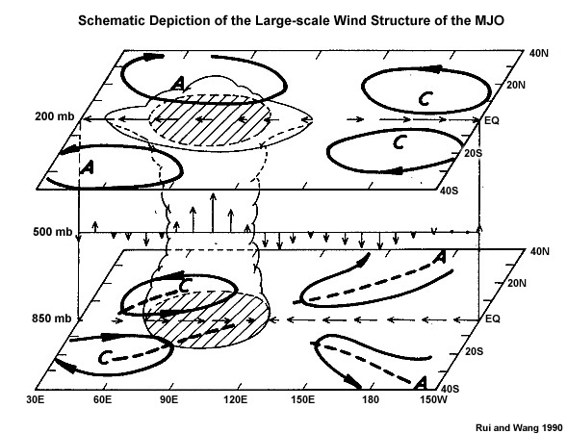
Schematic of Three-Dimensional MJO Structure

Slide 10
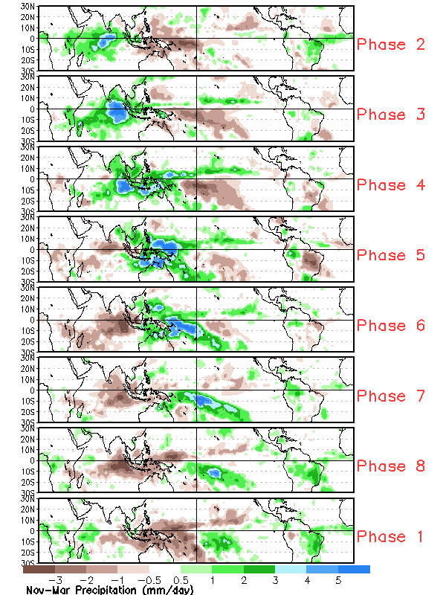
Composite of the MJO Lifecycle
Tropical Rainfall
Green areas
Increased rainfall
Enhanced phase of the MJO
Brown areas
Decreased rainfall
Suppressed phase of the MJO

Slide 11
Which of these items helps create or maintain the MJO?
(a) random or stochastic variability
(b) Asian monsoon rainfall
(c) cold surges from the extratropics
(d) all of the above

Slide 12
MJO Mechanisms
The mechanisms for MJO development, maintenance and decay are not well understood
Initiation is likely a result of complex interactions ……
(1) between atmosphere and ocean
(2) across multiple temporal and spatial scales
(3) across regional boundaries
No one theory completely explains the mechanisms for the period, zonal scale and eastward propagation of the MJO
Two types of theories:
Independent external forcing: Stationary intraseasonal oscillations in Asian monsoon, stochastic forcing, extratropical disturbances
Internal MJO mechanisms driven: Complex air-sea interactions initiate MJO, varying temporal / spatial scales of convection interact and organize MJO
Zhang, 2005

Slide 13
Part 2: Monitoring the MJO

Slide 14
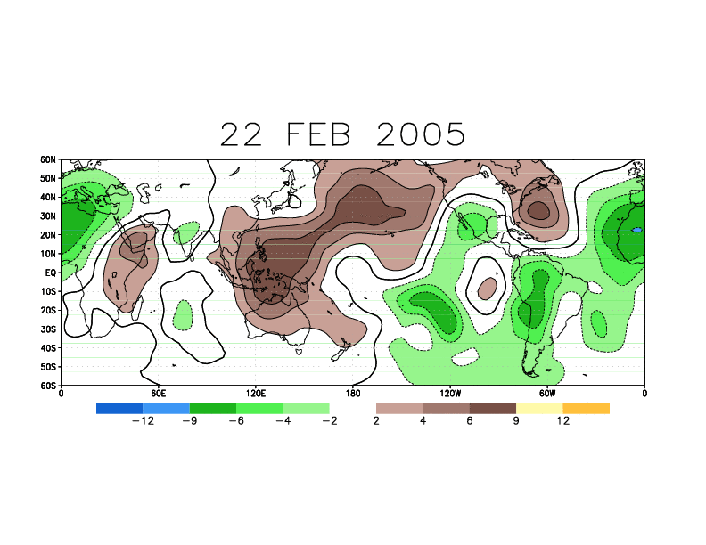
200-hPa Velocity Potential Animation
Spring 2005 MJO Event

Slide 15
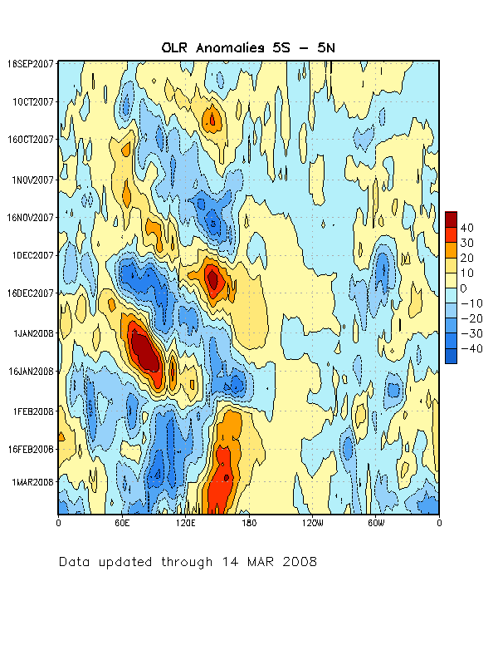
Monitoring the MJO -- Time-Longitude Sections
Eastward
Propagation
Blue shades
Enhanced convection
Increased rainfall Negative anomalies
Red/Yellow shades
Suppressed convection
Decreased rainfall Positive anomalies
Indian
Ocean
Indonesia
Western Pacific

Slide 16
When does the MJO activity end in the preceding figure and in what region is the enhanced convective phase centered?
(a) mid November 2007, western Pacific
(b) early-mid February 2008, Indonesia
(c) mid January 2008, western Pacific
(d) late December 2008, Indonesia
Indian
Ocean
Ind.
Western Pacific

Slide 17
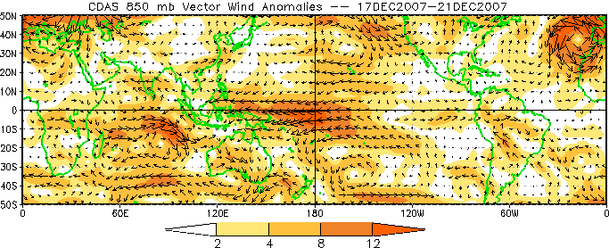
Monitoring the MJO – 850-hPa Zonal Wind
MJO event during late 2007
Boxes indicate enhanced westerly (red) and easterly (blue) anomalies and low-level convergence (black circle) when the enhanced convective phase of the MJO is centered over the eastern Indian Ocean

Slide 18
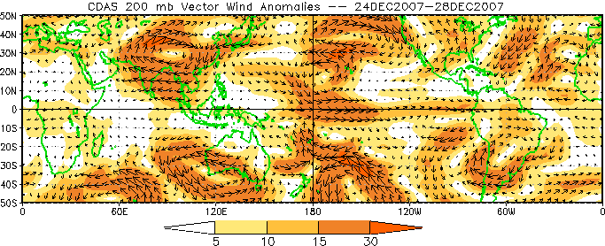
Monitoring the MJO – 200-hPa Zonal Wind
A
C
C
A
Anticyclonic (A) and cyclonic (C) circulations straddling anomalous tropical convection
Westerly anomalies across the eastern equatorial Pacific Ocean
Enhanced phase of the MJO (black circle) centered across Indonesia

Slide 19
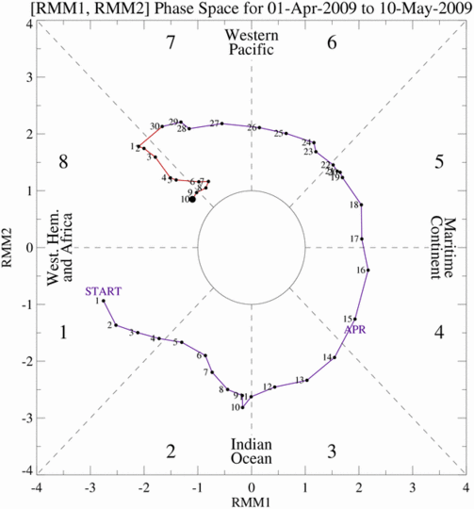
MJO Index
The axes (RMM1 and RMM2) represent daily values of the PCs from two modes
The triangular areas indicate the location of the MJO enhanced convective phase
Counter-clockwise motion is indicative of eastward propagation. Large dot most recent day.
Distance from center proportional to strength
Line colors distinguish different months
Weak
MJO
Strong
MJO
--EOF analysis (OLR, 850 and 200 hPa zonal wind) --Index uses information from first two modes
Wheeler and Hendon, 2004

Slide 20
How many MJO events are there each year?

Slide 21
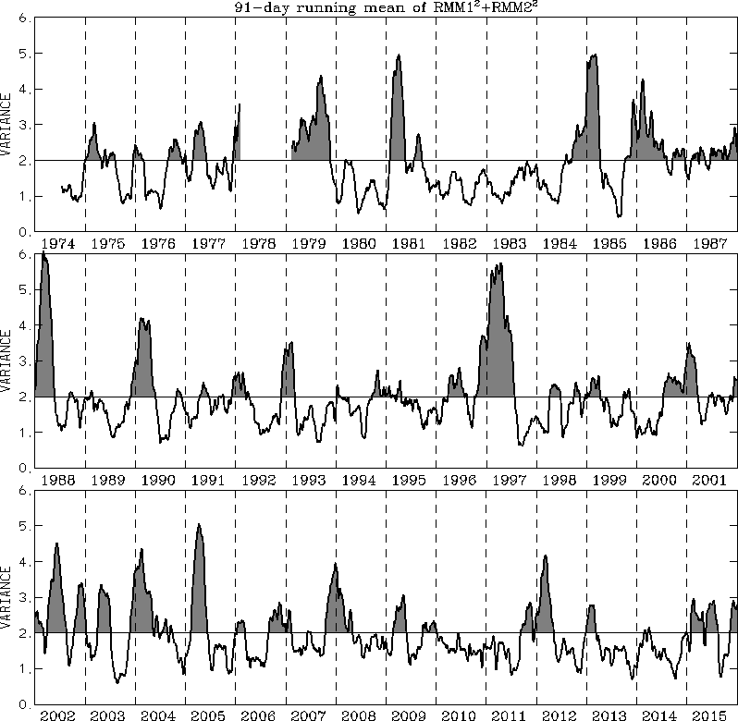
Interannual Variability of the MJO
There is strong year to year variability in MJO activity
This interannual variability is partly linked to the ENSO cycle
Grey areas are “active” MJO periods.
Courtesy:
Australia CAWCR
http://cawcr.gov.au/staff/mwheeler/maproom/RMM/ts.PCvar91drm.gif

Slide 22
Part 3: MJO Impacts in the Tropics

Slide 23
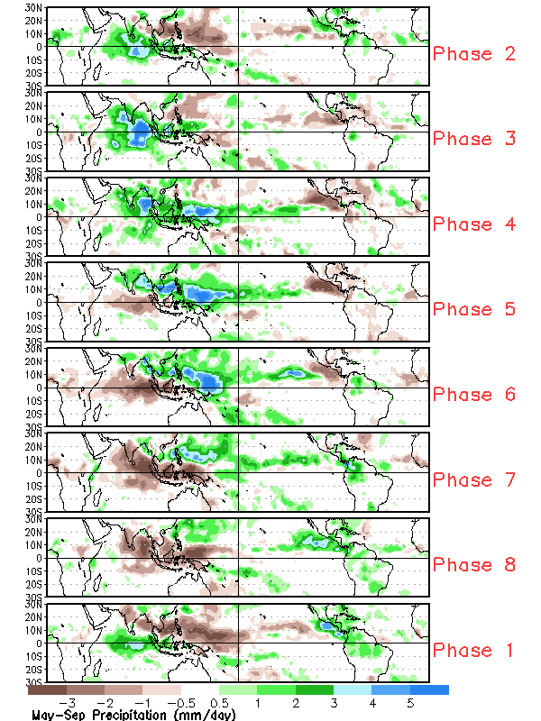
MJO Impacts – Tropical Rainfall Hotspots
Boreal Winter
Boreal Summer
Boreal
Summer

Slide 24
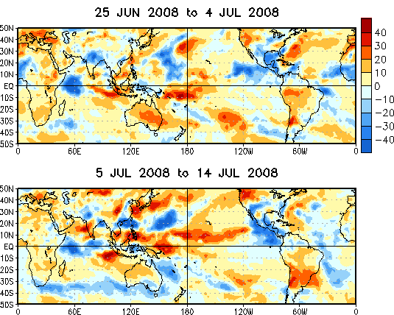
MJO Impacts – Monsoons
The MJO modulates monsoon systems in a number of ways
The MJO can affect monsoon onset and end dates and their intensity
The MJO often leads to “breaks” in the monsoon or periods of especially enhanced rainfall
OLR Anomalies
Enhanced ITCZ,
Tropical cyclone activity
Gulf surge and
SW monsoon modulation
Shi and Higgins, 2001
Notes:
Step through bullets

Slide 25
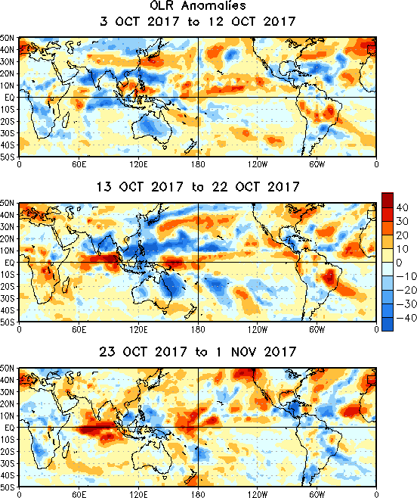
OLR Anomalies – Past 30 days
Drier-than-normal conditions, positive OLR anomalies (yellow/red shading)
Wetter-than-normal conditions, negative OLR anomalies (blue shading)
During early to mid-October, enhanced convection associated with a strengthening MJO developed over the eastern Indian Ocean and western Maritime Continent. Suppressed convection remained entrenched over the central and eastern Pacific.
Enhanced convection, related to a robust MJO shifted east across the Maritime Continent and West Pacific during mid to late October, while suppressed convection developed over Africa and the Indian Ocean.
During late October, the MJO rapidly propagated east across the Western Hemisphere with convection increasing once again across Africa. The low frequency state continued to support suppressed convection across the equatorial central Pacific.

Slide 26
Part 5: MJO Prediction

Slide 27
MJO Prediction -- Overview
Predictability 2-4 weeks in future
Best when the MJO is already in progress.
Hard to predict when MJO will dissipate.
Hardest to predict when an MJO will form out of nothing.
Both statistical and dynamical model predictions are available

Slide 28
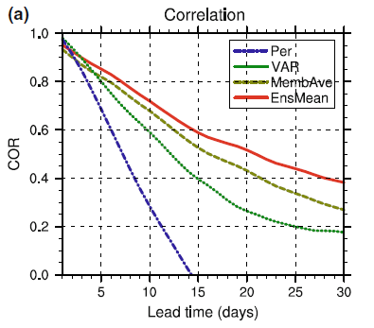
MJO Prediction – Skill Comparison
Comparison of methods:
Useful skill:
Persistence: 7 days
Simple statistical: 12 days
POAMA model: 15-20 days
model
statistical
persistence
Statistical MJO forecasts from several different methods (lagged regression, constructed analog, etc.) are generally comparable
Rashid et al. 2010

Slide 29
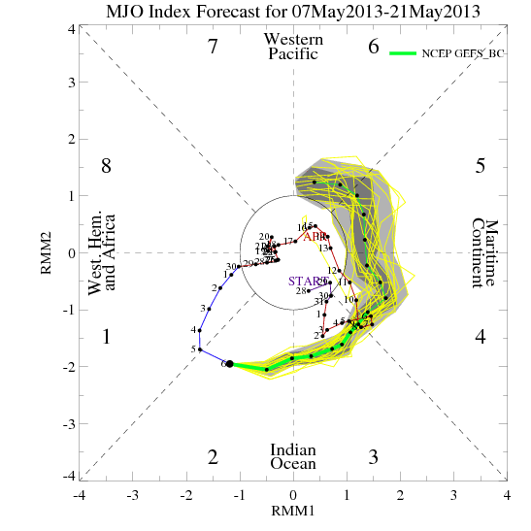
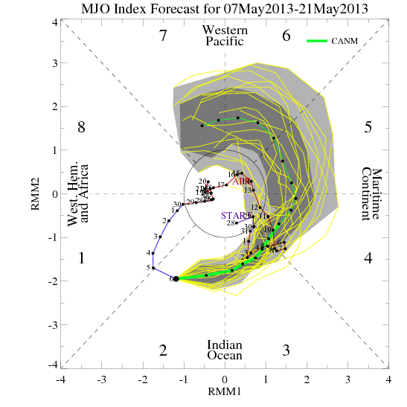
Dynamical Model MJO Forecasts
GEFS
CANM
Application of Wheeler and Hendon (2004) MJO index methodology to dynamical model data from operational international centers
Uniform approach for comparison and skill assessment
Realtime forecasts
Differences in:
(1) Ensemble spread
(2) Propagation speed
(3) Amplitude
Gottschalck et al. 2010
http://www.cpc.ncep.noaa.gov/products/precip/CWlink/MJO/CLIVAR/clivar_wh.shtml

Slide 30
Part 6: MJO Related Assessments

Slide 31
CPC MJO Weekly Update
http://www.cpc.ncep.noaa.gov/products/precip/CWlink/MJO/mjoupdate.pdf
--Review of weekly changes in the MJO
--Includes some of the monitoring and prediction products described here
--Provides an assessment in compact form
--Anticipated evolution and impacts of the MJO during the next 1-2 weeks
--Released every Monday ~ 3 PM ET

Slide 32
Global Tropics Hazards and Benefits Outlook

Slide 33
Weekly CPC Tropical Briefing
--Organized around current MJO status and CPC’s Global Tropics Hazards and Benefits Outlook
--Review of recent weather/climate conditions in the Tropics
--Review of major climate variability including ENSO, MJO, monsoons, TCs, etc.
--Overview of current GTH outlook with potential impacts to the U.S. and Tropics
--GotoWebinar format every week at 2:30 PM Tuesday
--Duration is approximated 15-20 minutes with the opportunity to ask questions after the briefing

Slide 34
Information Sources
CPC MJO webpage (monitoring and predictions): http://www.cpc.ncep.noaa.gov/products/precip/CWlink/MJO/mjo.shtml
CPC weekly MJO update: http://www.cpc.ncep.noaa.gov/products/precip/CWlink/MJO/mjoupdate.pdf
CPC Global Tropics Hazards and Benefits Outlook: http://www.cpc.ncep.noaa.gov/products/precip/CWlink/ghazards/index.php
ESRL MJO webpage:
http://www.esrl.noaa.gov/psd/mjo/
Australian Bureau of Meteorology MJO webpage: http://cawcr.gov.au/staff/mwheeler/maproom

