Slide 1
Sub-seasonal
Real time anomalies of temperature at 2m, wind and precipitation for week1
By Group 5
Ankara, Turkey

Slide 2
200 hPa Velocity Potential Anomaly
Green shade indicates areas of upper level divergence and convection or precipitation at surface. Brown contours indicate areas of upper level convergence or subsidence and suppressed precipitation at surface.

Slide 3
MJO
Statistical

Slide 4
Evolution of MJO-related anomalies
Initial date: 17 April, 2019
Red shade indicate areas
of suppressed convection
Blue shade indicate areas
of enhanced convection
1 - 5 days ave. Forecast
6-10 days ave. Forecast
11-15 days ave. Forecast

Slide 5
Week_1

Slide 6
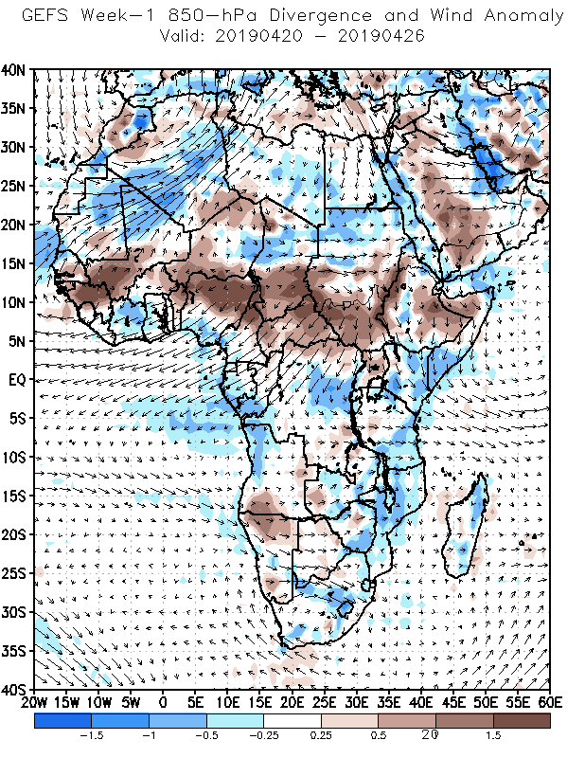
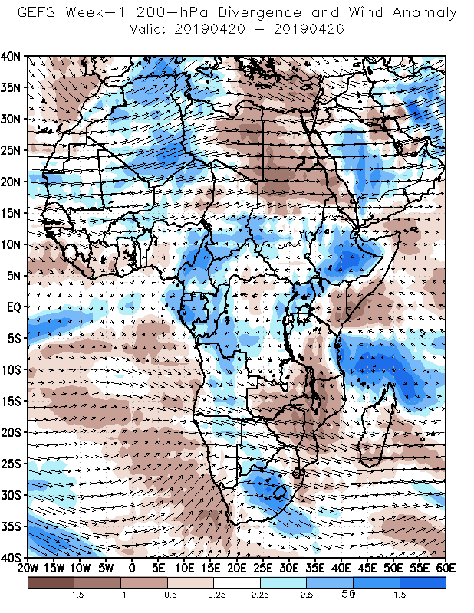

Slide 7
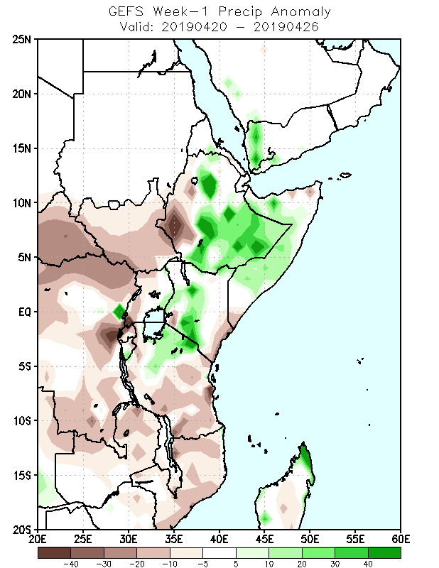

Slide 8
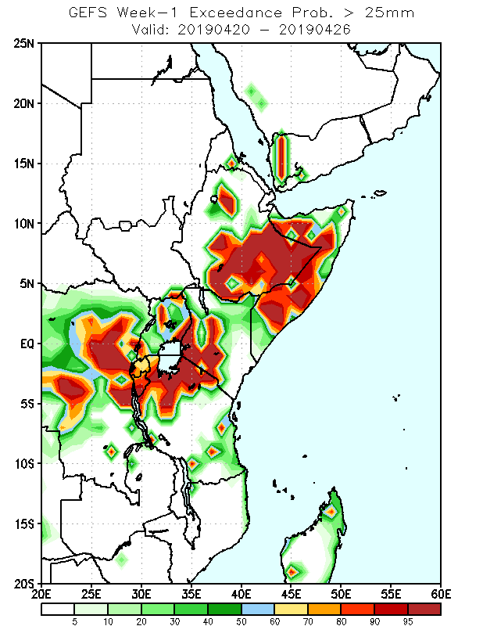
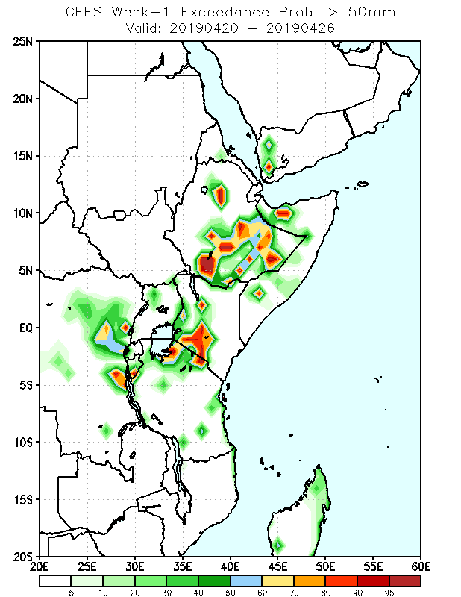

Slide 9
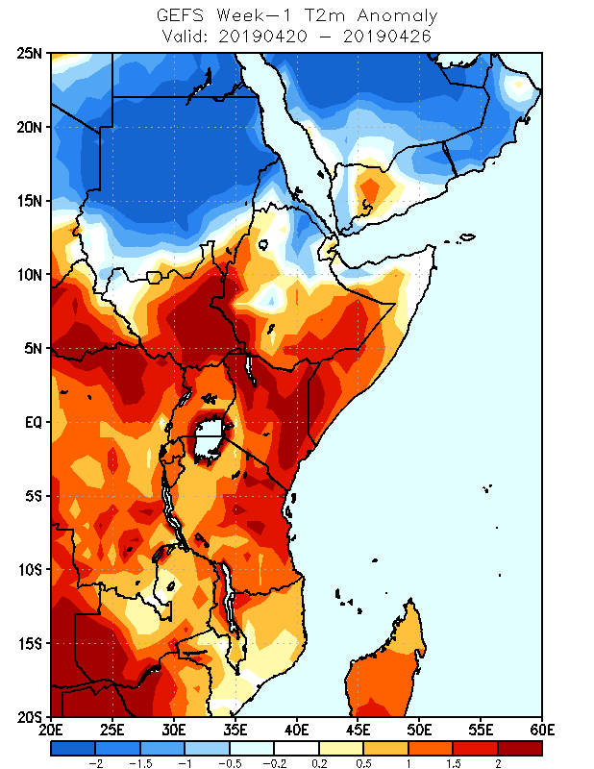

Slide 10
Conclusion
MJO is inactive over the region but active on the Indian Ocean
There is a strong convergence at lower levels and divergence at upper levels in the north- eastern parts of our region.
As a result, Somali, Ethiopia, Kenya, including the northern parts of Tanzania are indicating active rainfall activities by week 1
Probability of getting rainfall above 25mm covers much of Somalia, Rwanda, Burundi, the southern half of Ethiopia, the western half of Kenya, the northern parts of Tanzania and Congo.
The probability of getting 50mm in the region cover a lesser area which includes the southern Parts of Ethiopia, the western parts of Kenya and their surrounding areas.
Temp anomaly @2m indicates that temperature is increasing in most parts of the region by week1

Slide 11
END

Slide 12
Week_2

Slide 13
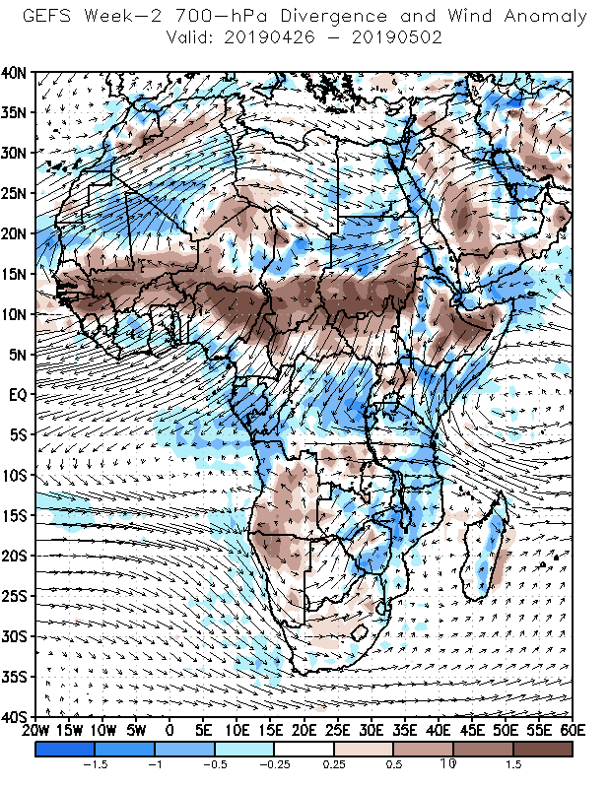
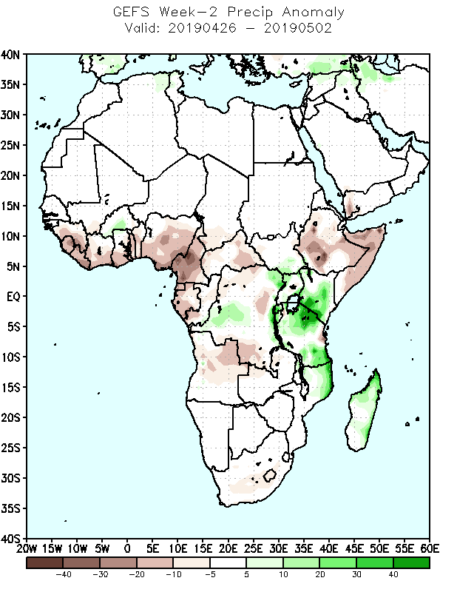

Slide 14
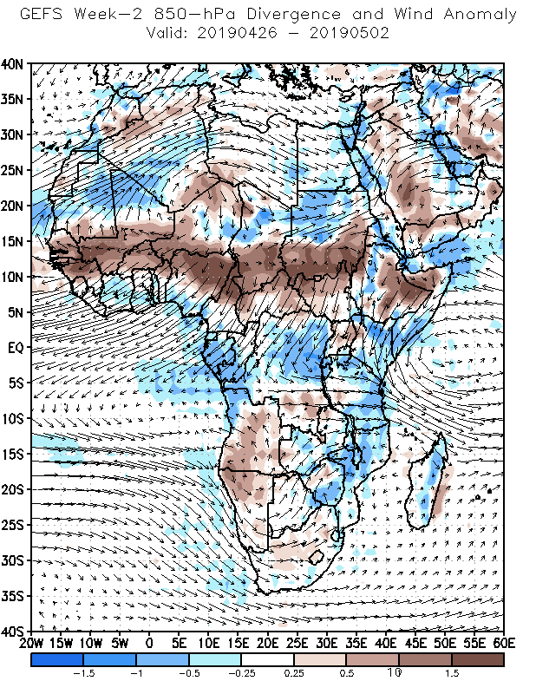
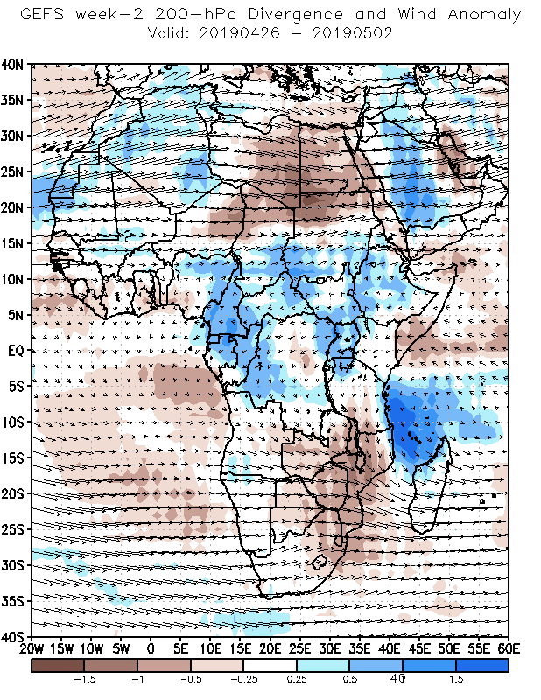

Slide 15
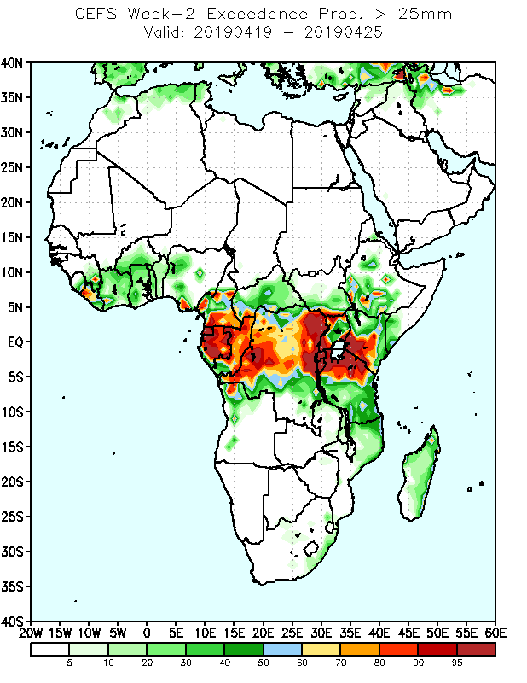
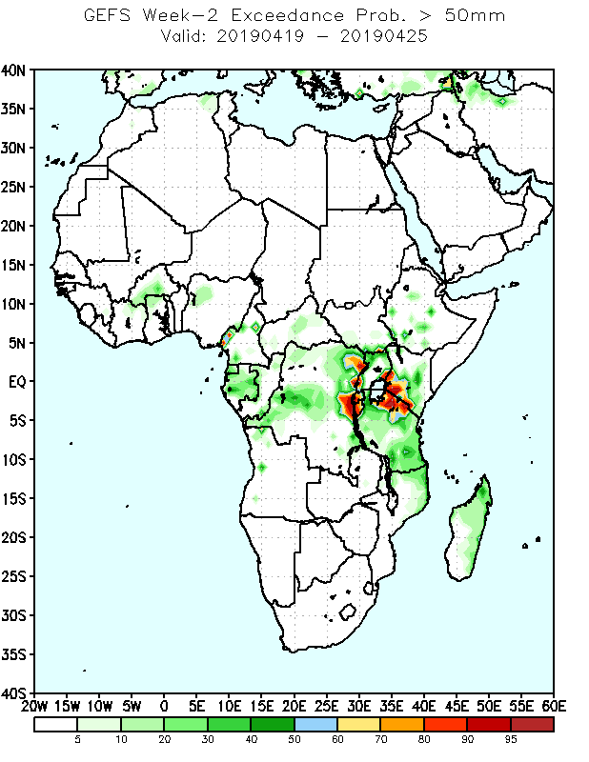

Slide 16
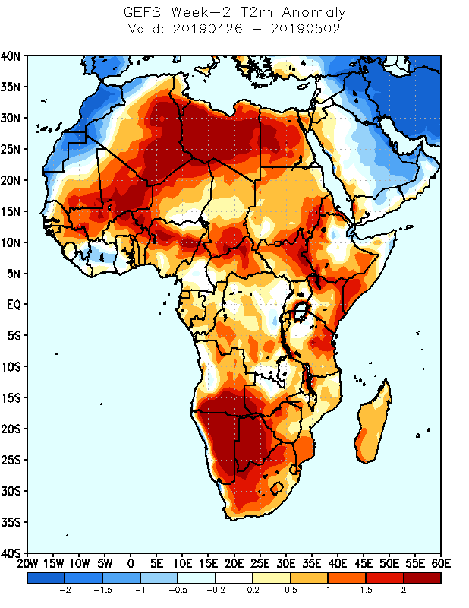

Slide 17
Conclusion
There is a convergence at lower while divergence at upper level
As a result, north eastern, central, eastern, southern, southern high grounds and southeastern parts of the country are anticipated to have above normal precipitation by week1
Probability of getting rainfall above 25mm covers much areas of the country in week1 while getting decrease in receiving above 50mm.
Temp anomaly @2m indicates that lowlands that are adjoining areas of Somali, South Sudan and Kenya will experience above normal temperature during by week1 and week2
Areas like south and southwestern as well as pocket places of eastern parts are expected to have a probability of getting above 25mm Rf and limited areas are anticipated to have a probability of getting above 50mm by week2
MJO is not active as it propagate in the direction that it is not usually propagating.

