Slide 1
Sub-Seasonal Forecasting GEFS Model Guidance Scripts NOAA-USAID Eleventh International Training Workshop Climate Variability and Predictions (11ITWCVP) NOAA’s CPC International Desks Sarah Diouf
Ankara, Turkey, 15 – 23 April 2019

Slide 2
Background NCEP GEFS Model Characteristics
GEFS: Global Ensemble Forecast System
The spatial resolution is 1° x 1°.
The GEFS model is a weather forecast model comprising 21 ensemble members.
It aims to quantify the amount of uncertainty in a forecast by generating multiple forecasts from its 21 ensemble members.
It produces forecasts every six hours (00 UTC, 06 UTC, 12 UTC and 18 UTC) and each day.
Maximum period of forecast = 15 days
21 forecasts
21 forecasts
21 forecasts
21 forecasts
00 UTC
06 UTC
12 UTC
18 UTC
00 UTC
06 UTC
12 UTC
18 UTC
00 UTC
06 UTC
12 UTC
18 UTC
00 UTC
06 UTC
12 UTC
18 UTC
day₀
day₁
day_{n}
day₁₆

Slide 3
Practical Exercise: Generate Sub-seasonal Forecasts Purpose
Purpose: Generate NCEP GEFS deterministic week 1 and week 2 forecasts of precipitation and temperature anomaly.
Week 1 and week 2 forecasts are initiated on 27 March 2019 at 00 UTC.
Valid period of the week 1 forecast: 28 March – 3 April 2019
Valid period of the week 2 forecast: 4 – 10 April 2019
1-day lead-time
Week 1
8-day lead-time
Week 2
27 March 2019
3 April 2019
10 April 2019
28 March 2019
4 April 2019
Initial Conditions

Slide 4
Practical Exercise: Generate Sub-seasonal Forecasts Extract data and scripts
1. Download the folder GEFS_model_guidance.zip from the ftp server:
wget ftp://ftp.cpc.ncep.noaa.gov/International/11ITWCVP_Ankara2019/GEFS_model_guidance.zip
2. Unzip the folder GEFS_model_guidance
unzip GEFS_model_guidance.zip –d GEFS_model_guidance
3. List files/folders
ls
4. Go to the folder GEFS_model_guidance
cd GEFS_model_guidance
5. List files/folders
ls
→ You should see one folder GEFS_model_guidance
→ You should see one folder GEFS_week1_week2_forecasts

Slide 5
Practical Exercise: Generate Sub-seasonal Forecasts Script guidance
6. Go to the folder GEFS_week1_week2_forecasts
cd GEFS_week1_week2_forecast
7. List files/folders
ls
8. Go to the folder data
cd data
9. List files/folders
ls
→ You should see two folders data and scripts
→ You should see 6 control files (.ctl) and 6 binary files (.dat)
gefs_precipitation_climatology.ctl
gefs_precipitation_climatology.dat
gefs_temperature_climatology.ctl
gefs_temperature_climatology.dat
gefs_week1_precipitation.ctl
gefs_week1_precipitation.dat
gefs_week1_temperature.ctl
gefs_week1_temperature.dat
gefs_week2_precipitation.ctl
gefs_week2_precipitation.dat
gefs_week2_temperature.ctl
gefs_week2_temperature.dat

Slide 6
Practical Exercise: Generate Sub-seasonal Forecasts Script guidance
GEFS Climatology (1999 – 2017)
gefs_precipitation_climatology.ctl
gefs_temperature_climatology.ctl
Contain the daily climatology of the week 1 and week 2 precipitation/temperature forecast from the NCEP GEFS model computed over the period 1999 – 2017
10. Open the file gefs_precipitation_climatology.ctl
Linux: gedit gefs_precipitation_climatology.ctl &
Cygwin: npp gefs_precipitation_climatology.ctl &
dset ^gefs_precipitation_climatology.dat
title GEFS Week 1 and Week 2 Precipitation Climatology Data
undef 9.999E+20
xdef 360 linear 0 1
ydef 181 linear -90 1
zdef 1 linear 0 1
tdef 365 linear 01JAN1999 1dy
vars 2
week1precip 0 99 Climatology of the GEFS week 1 precipitation forecast [mm]
week2precip 0 99 Climatology of the GEFS week 2 precipitation forecast [mm]
endvars
binary data file
cover the world
with a spatial resolution of 1° x 1°
daily climatology
2 variables

Slide 7
Practical Exercise: Generate Sub-seasonal Forecasts Script guidance
GEFS Forecasts
gefs_week1_precipitation.ctl
gefs_week1_temperature.ctl
gefs_week2_precipitation.ctl
gefs_week2_temperature.ctl
Contain the ensemble mean precipitation/temperature forecasts for the period:
For week 1 forecast 28 March – 3 April 2019
For week 2 forecast 4 April – 10 April 2019
11. Open the file gefs_week1_precipitation.ctl
Linux: gedit gefs_week1_precipitation.ctl &
Cygwin: npp gefs_week1_precipitation.ctl &
dset ^gefs_week1_precipitation.dat
title GEFS Week 1 Precipitation Forecast Data
undef 9.999E+20
xdef 360 linear 0 1
ydef 181 linear -90 1
tdef 1 linear 28Mar2019 7dy
zdef 1 linear 1 1
vars 1
week1rain 0 99 * GEFS week 1 precipitation forecast [mm]
endvars
binary data file
cover the world
with a spatial resolution of 1° x 1°
Beginning date of the valid period
1 variable

Slide 8
Practical Exercise: Generate Sub-seasonal Forecasts Script guidance
12. Go to the folder scripts
cd ../scripts
13. List files/folders
ls
14. Open the GrADS script plot_gefs_week1_week2_forecasts.gs
Linux: gedit plot_gefs_week1_week2_forecasts.gs &
Cygwin: npp plot_gefs_week1_week2_forecasts.gs &
15. Run the GrADS script plot_gefs_week1_week2_forecasts.gs
grads –lc plot_gefs_week1_week2_forecasts.gs
16. Hit the enter key to see the next plot

Slide 9
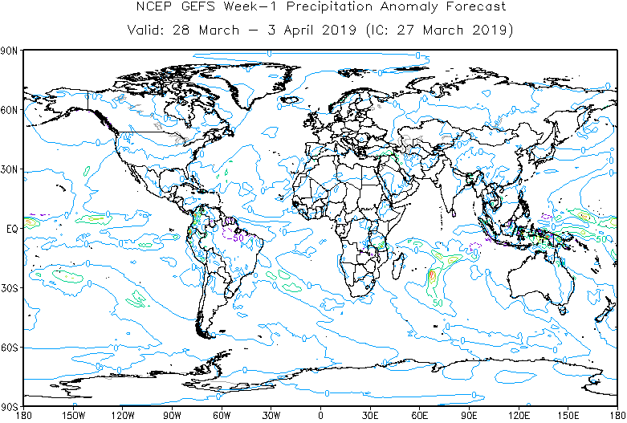
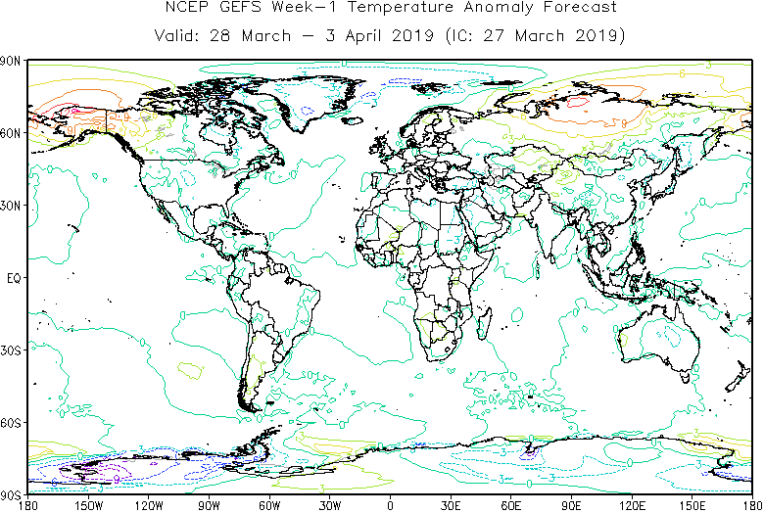
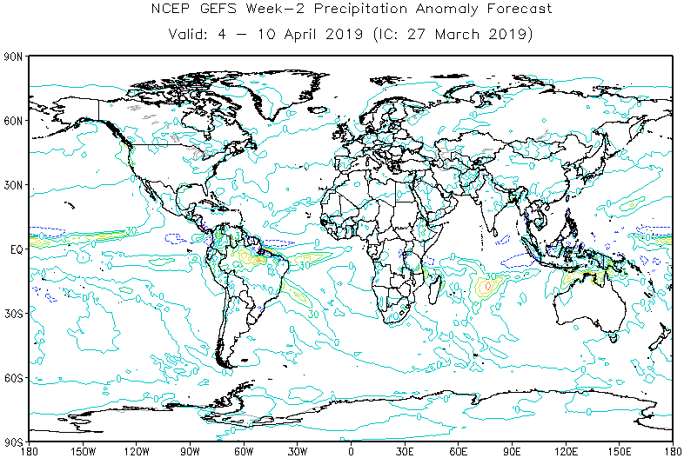
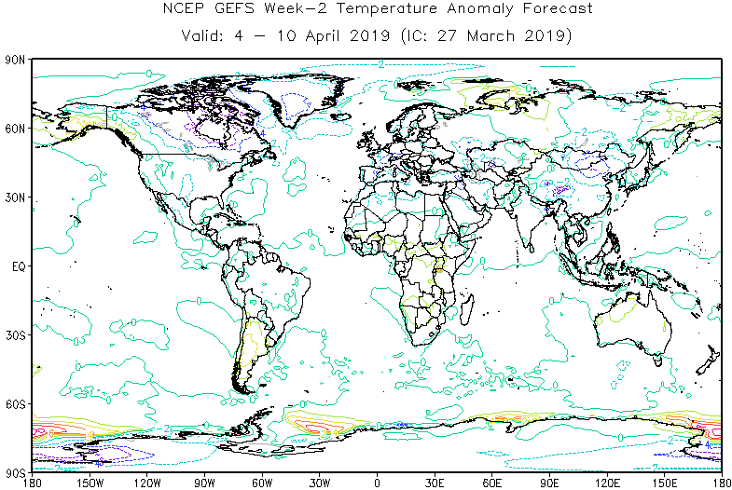
Practical Exercise: Generate Sub-seasonal Forecasts Script guidance
Do you get these maps?
Week 1 precipitation anomaly forecast
Week 1 temperature anomaly forecast
Week 2 precipitation anomaly forecast
Week 2 temperature anomaly forecast

Slide 10
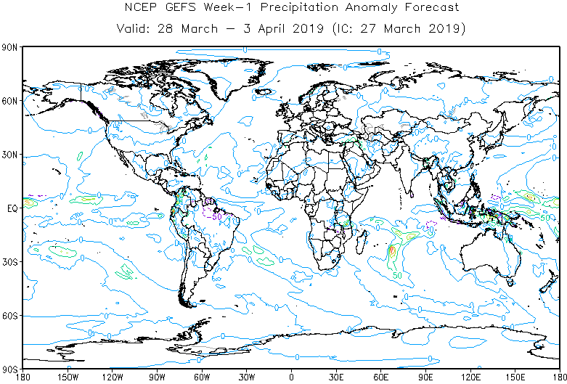
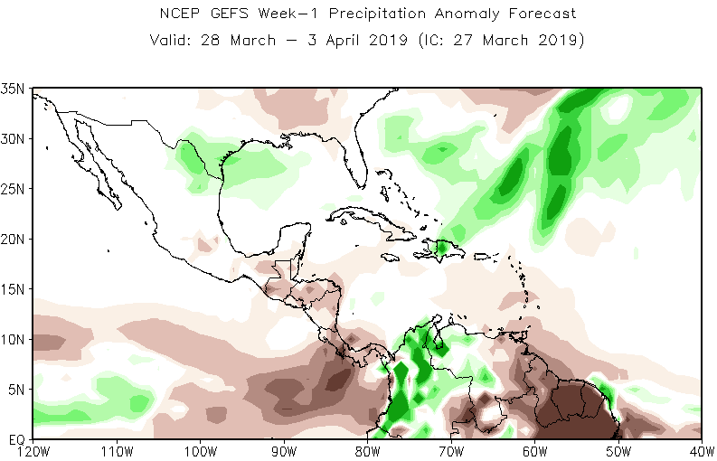
Practical Exercise: Generate Sub-seasonal Forecasts Customize forecast maps
17. Copy the file plot_gefs_week1_week2_forecasts.gs and name it as plot_myforecasts.gs
cp plot_gefs_week1_week2_forecasts.gs plot_myforecasts.gs
18. Open your new script plot_myforecasts.gs
Linux: gedit plot_myforecasts &
Cygwin: npp plot_myforecasts &
19. Edit your new script plot_myforecasts.gs to customize maps

Slide 11
Practical Exercise: Generate Sub-seasonal Forecasts Customize forecast maps
Edit your file plot_myforecasts.gs to generate similar forecasts for your domain of interest
Change the latitudes and longitudes
'set lat LATS LATN'
'set lon LONW LONE'
Adjust the latitude interval (xlint) and longitude interval (ylint)
'set xlint XX'
'set ylint XX'
Change the appearance of x-labels (xlopts) and y-labels (ylopts)
'set xlopts 1 5 0.12 '
'set ylopts 1 5 0.12 '
thickness
color
size

Slide 12
Practical Exercise: Generate Sub-seasonal Forecasts Customize forecast maps
Apply shaded areas instead of contours
'set gxout shaded'
'define_colors'
Define levels and colors for the precipitation anomaly forecast
'set clevs -40 -30 -20 -10 -5 5 10 20 30 40'
'set ccols 79 77 75 73 71 0 31 33 35 37 39'
Define levels and colors for the temperature anomaly forecast
'set clevs -8 -6 -4 -2 -1 1 2 4 6 8'
'set ccols 47 45 44 43 41 0 21 23 24 25 27'
Add the color bar
'cbarmerc2'
Save your maps as .png
'printim gefs_week1_precipitation.png'
'!convert gefs_week1_precipitation.png gefs_week1_precipitation.png'
Check the maps that you have generated
display gefs_week1_precipitation.png
79 77 75 73 71 0 31 33 35 37 39
-40 -30 -20 -10 -5 5 10 20 30 40
47 45 44 43 41 0 21 23 24 25 27
-8 -6 -4 -2 -1 1 2 4 6 8

