Slide 1
Creating Diagnostics for Subseasonal Forecast Week-1/2 Outlook Tools Eleventh International Training Workshop Climate Variability and Predictions (11ITWCVP) Ankara, Turkey, April 2019
Endalkachew Bekele & Wassila Thiaw
NOAA/CPC/International Desks

Slide 2
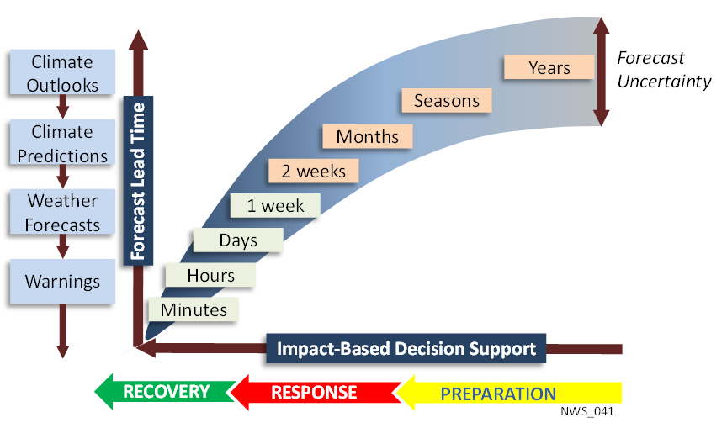
1. NOAA Forecast Continuum
e.g. Disaster management planning and response
e.g. Crop Selection, Water management
e.g. Infrastructure development

Slide 3
2. Tools for Operational Sub-Seasonal Forecasting
Week 1/2
Week 3-4
Madden Julian Oscillation
Numerical Weather and climate models
El Nino Southern Oscillation

Slide 4
3. Week-1 and Week-2 Forecasts
State of the MJO
Much emphasis is given to the state of the MJO and its projected phases on the Wheeler-Hendon diagram at the moment of the forecasts.
Refer to the MJO monitoring and prediction tools to determine if an active MJO is present
http://www.cpc.ncep.noaa.gov/products/precip/CWlink/MJO/CLIVAR/clivar_wh.shtml#

Slide 5
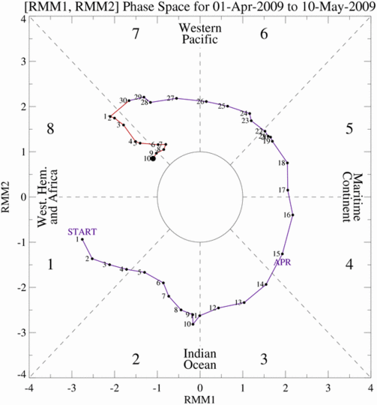
3. Week-1 and Week-2 Forecasts
State of the MJO (The Wheeler-Hendon Diagram)
Each dot/number represents a single day and location of the MJO enhanced rainfall.
Weak
MJO
MJO exists when there is counterclockwise movement on diagram
Strong
MJO

Slide 6
3. Week-1 and Week-2 Forecasts
NWP Guidance
The MJO is present, but projected to weaken considerably during the week-1 and/or week-2 outlook period.
NWP outputs are the primary tools for guiding the week-1 and week-2 forecasts.
NWP output tools include quantitative precipitation forecasts, ensemble bias corrected precipitation forecasts from the GFS, the GEFS, CFS, and ECMWF.
Examine the predicted circulation features associated with the predicted rainfall anomalies.
More weight will be given to the NWP precipitation outlook tools that are more consistent with the predicted rainfall anomalies.
Examine the weekly SST patterns and tendency, as well as tropical cyclone activities

Slide 7
4. Week-1/2 Forecast Process
Active MJO
Phase diagrams and composites
Yes
Consensus Forecast, Polygons and Text Description
No
Circulation Anomalies
Forecast Discussion
Assess its possible Impact
Raw Rainfall Anomalies
No
Active Tropical Cyclone
Yes
Bias Corrected / Reg Calibrated

Slide 8
5. Example, week 1/2 Outlook for Africa
Week 1 Forecast, valid Feb 26– Mar 4, 2019
Week 2 Forecast, valid 5 – 11 March 2019
Tools
MJO
NWP Guidance
Tropical Cyclone?

Slide 9
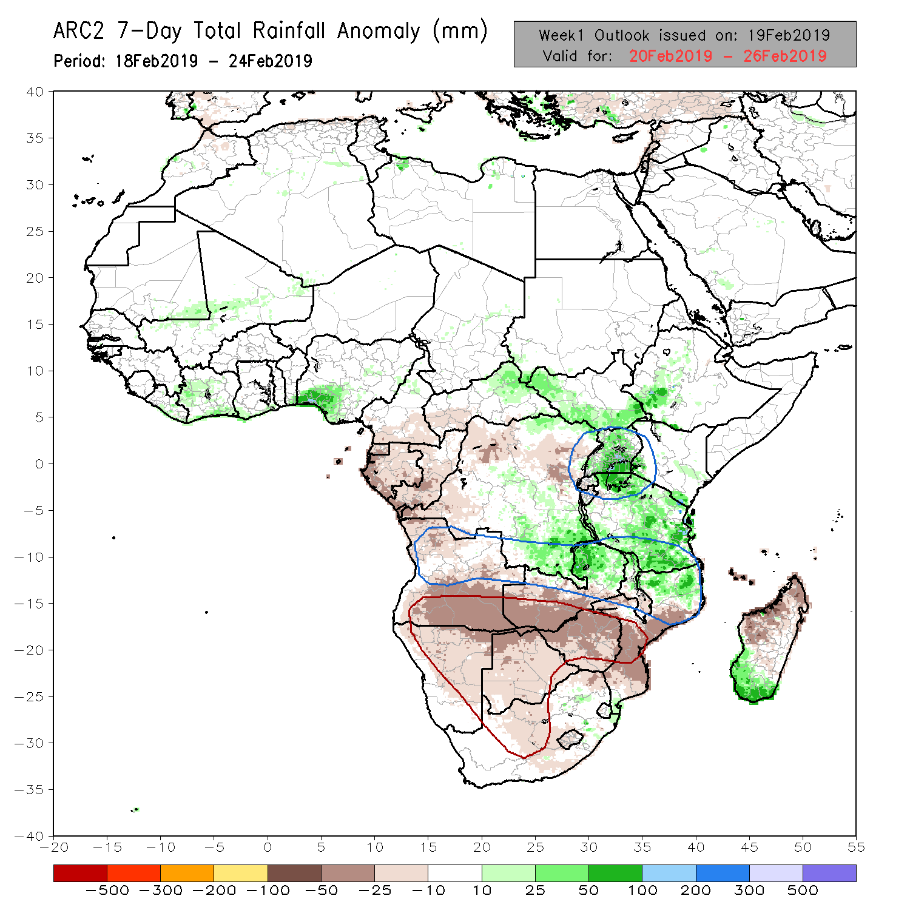
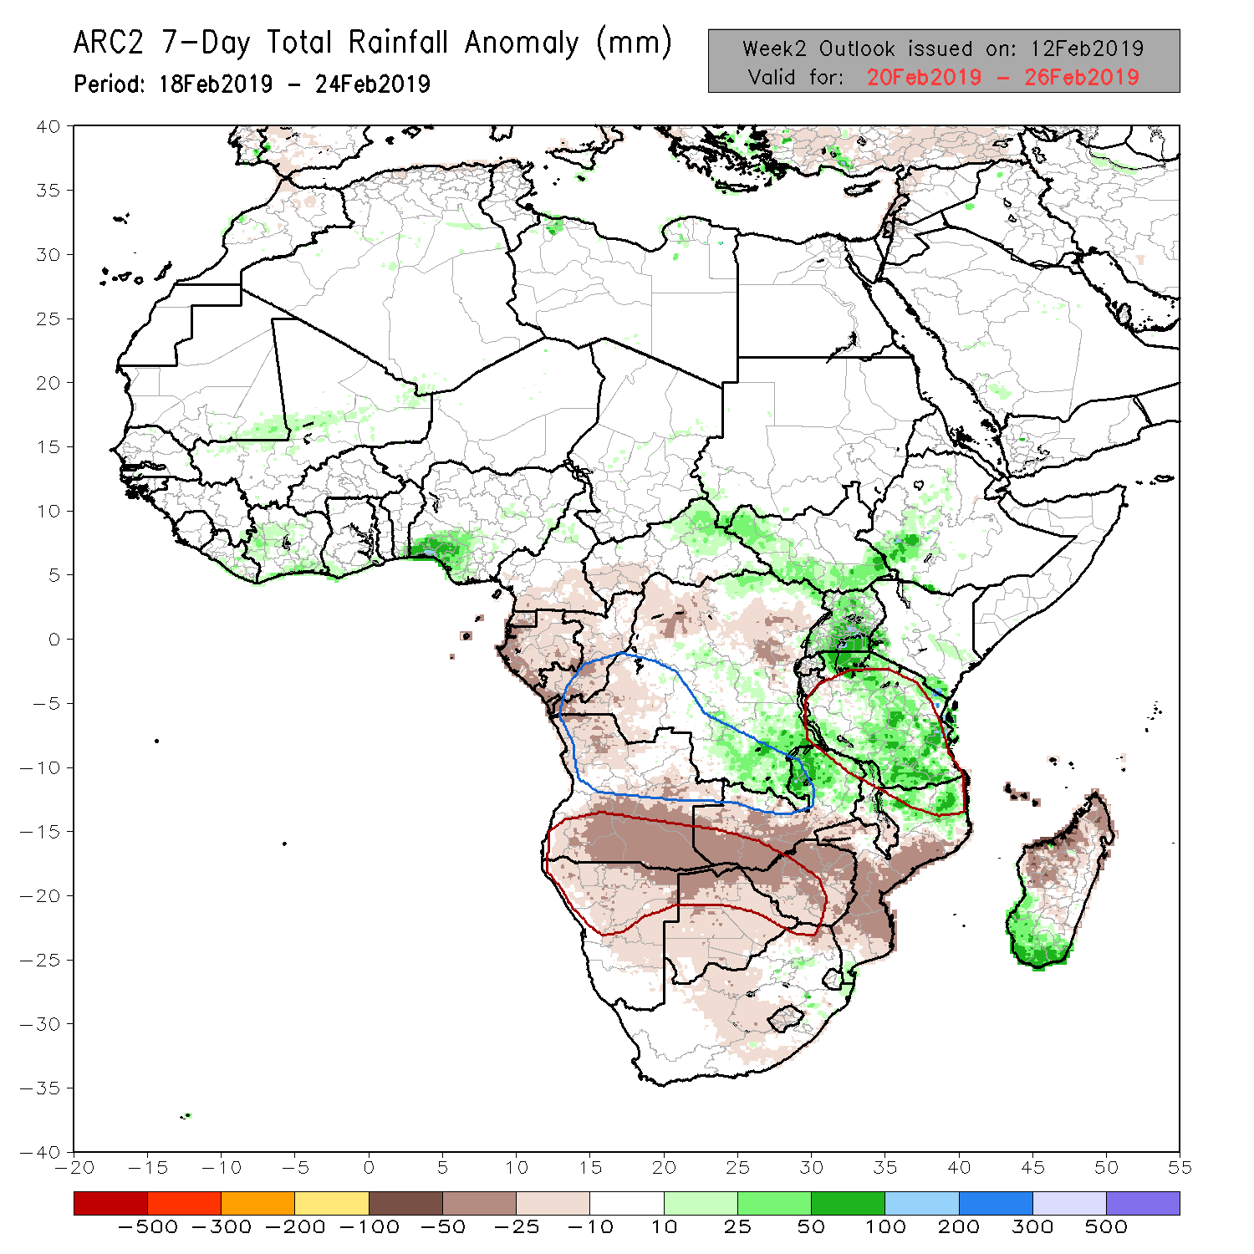
Verification
Evaluate previous week outlooks
Eyeball verification of the previous week-1 and week-2 forecasts

Slide 10
Current State of the Climate
Active MJO?
Active tropical cyclone/typhoon activity?
Significant SST and circulation anomaly patterns?

Slide 11
Current State of the Climate
Active MJO?
http://www.cpc.ncep.noaa.gov/products/precip/CWlink/MJO/mjo.shtml#discussion

Slide 12
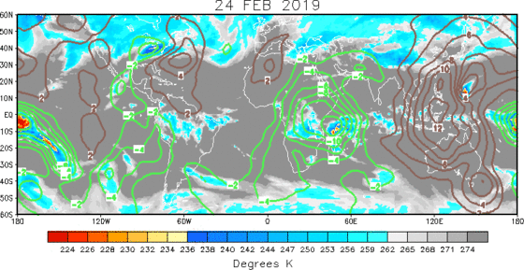
200 hPa Velocity Potential Anomaly
Green shade indicates areas of upper level divergence and convection or precipitation at surface. Brown contours indicate areas of upper level convergence or subsidence and suppressed precipitation at surface.

Slide 13
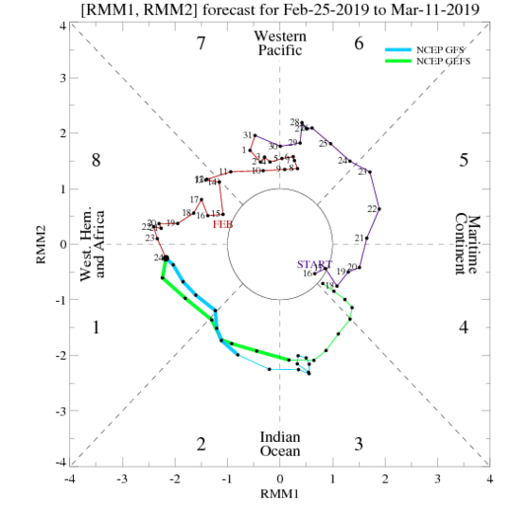
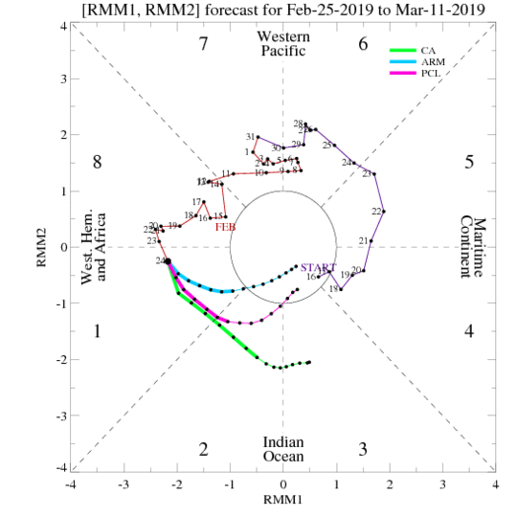
Wheeler-Hendon Index - Forecasts
Dynamical, GFS/GEFS
Statistical

Slide 14
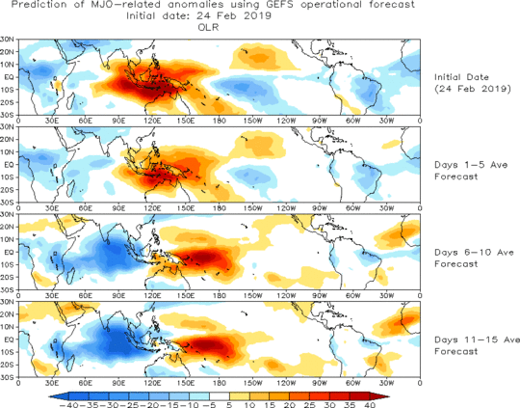
Evolution of MJO-related anomalies
Initial date: 24 February 2019
Red shade indicate areas
of suppressed convection
Blue shade indicate areas
of enhanced convection
1 - 5 days ave. Forecast
6-10 days ave. Forecast
11-15 days ave. Forecast

Slide 15
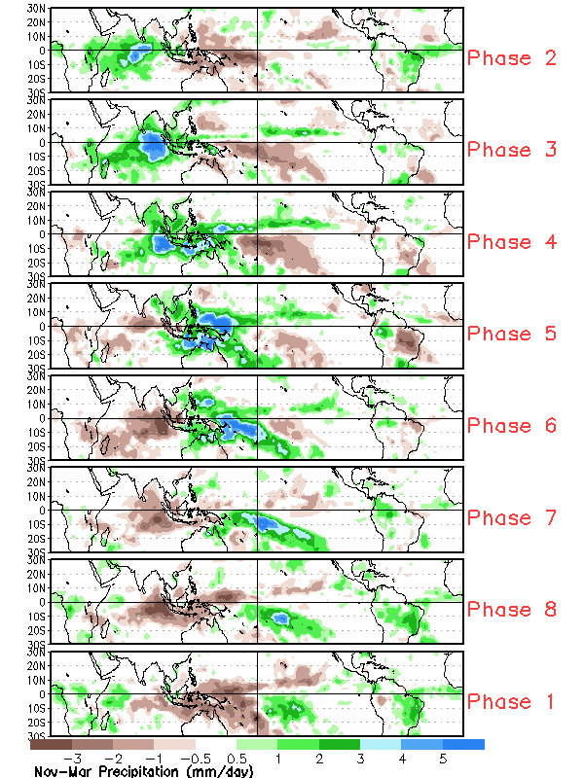
MJO Rainfall Composites – Global Tropics
Precipitation Anomalies (Nov - Mar)
http://www.cpc.ncep.noaa.gov/products/precip/CWlink/MJO/mjoupdate.pdf

Slide 16
MJO Contribution?
The current and projected phases of MJO suggest enhanced rainfall in East Africa

Slide 17
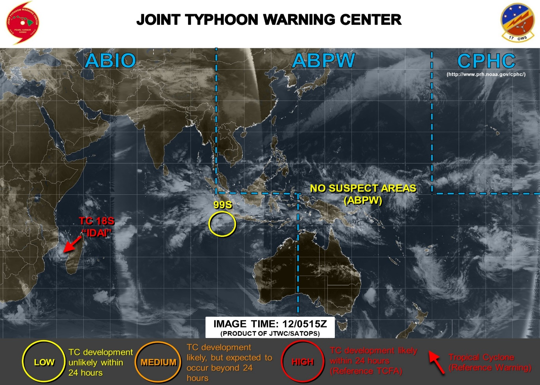
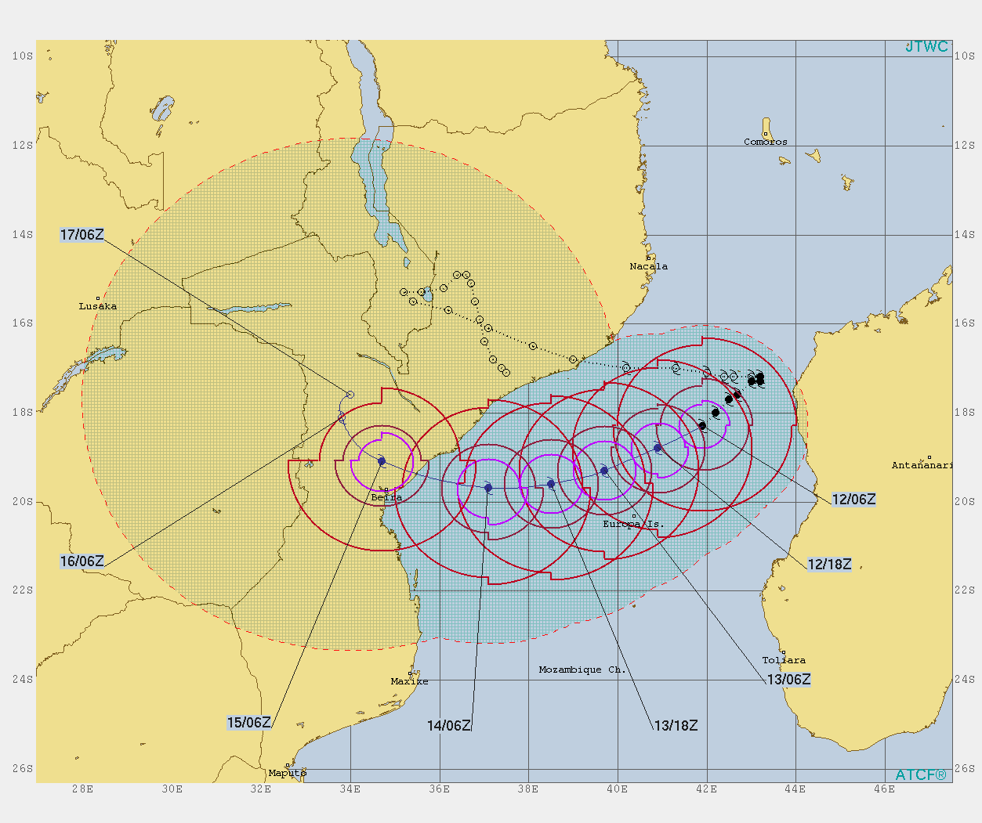
Tropical Cyclone?
Active Tropical Cyclone, Hurricane, Typhoon??
Tropical Cyclone Idai

Slide 18
Tropical Cyclone Contribution?
Enhanced Precip in Southeast Africa

Slide 19
Model Guidance
Significant lower and upper-level circulation anomalies?
Model rainfall guidance?

Slide 20
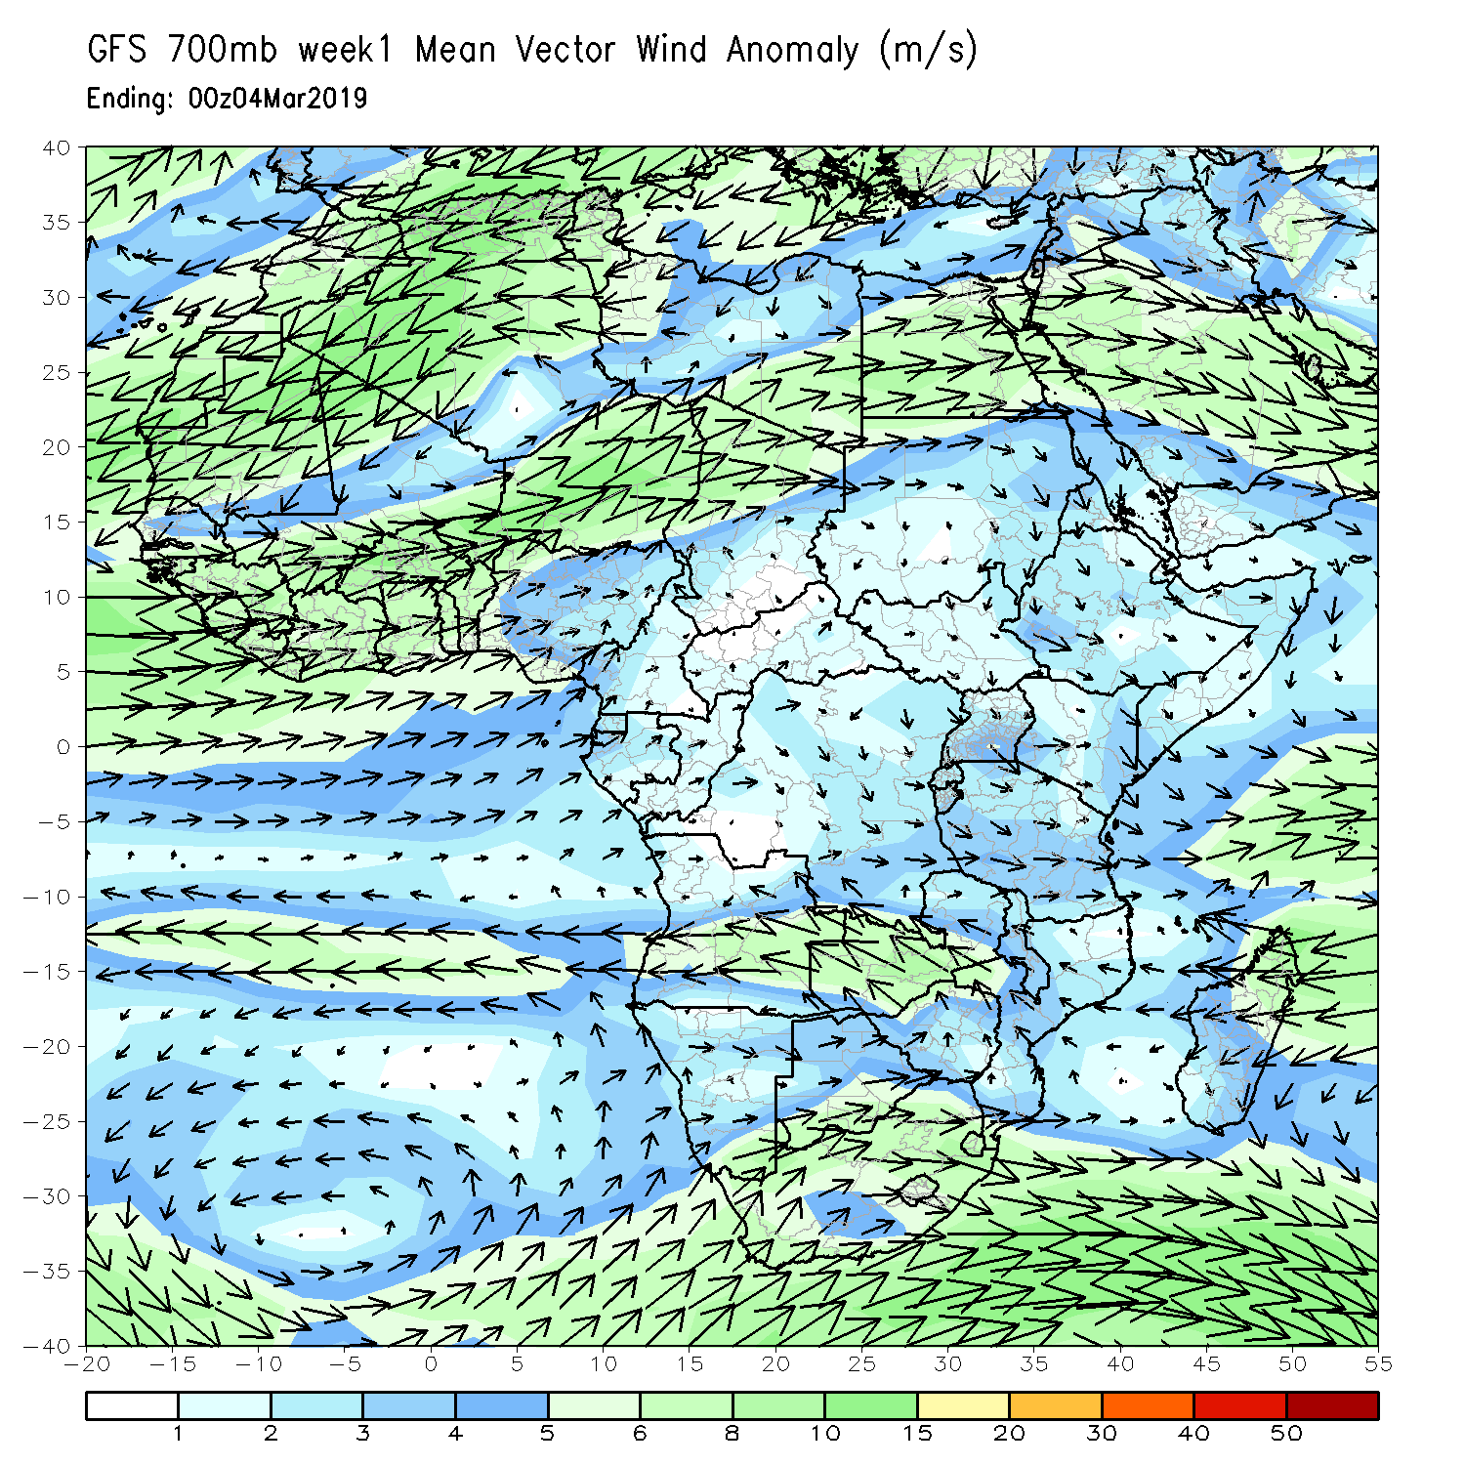
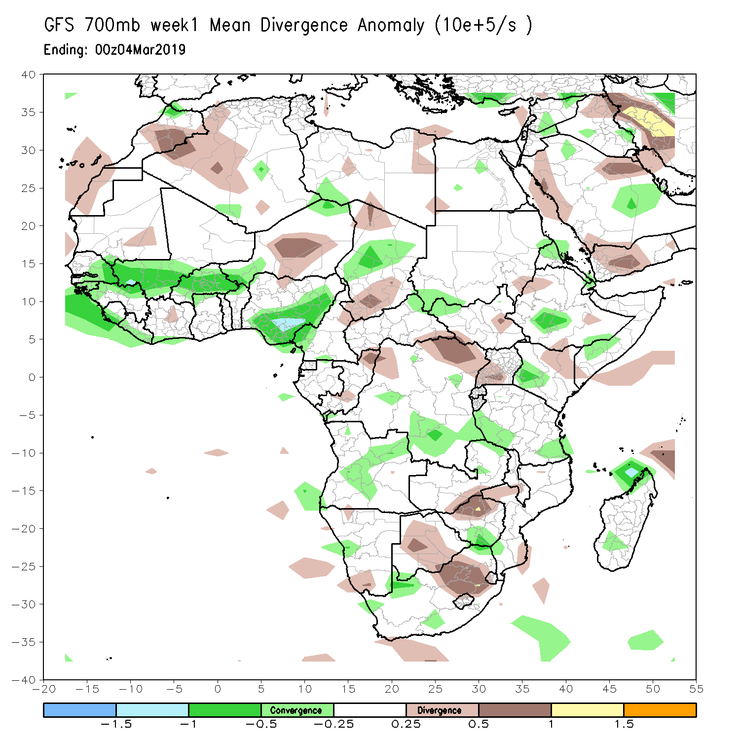
NCEP GFS 700mb 7-day Forecast Week 1

Slide 21
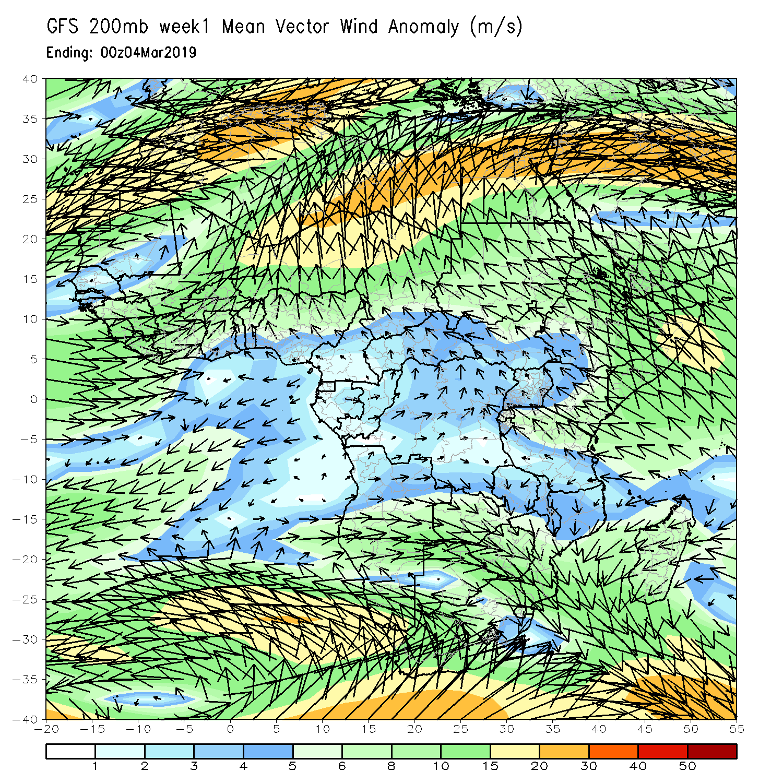
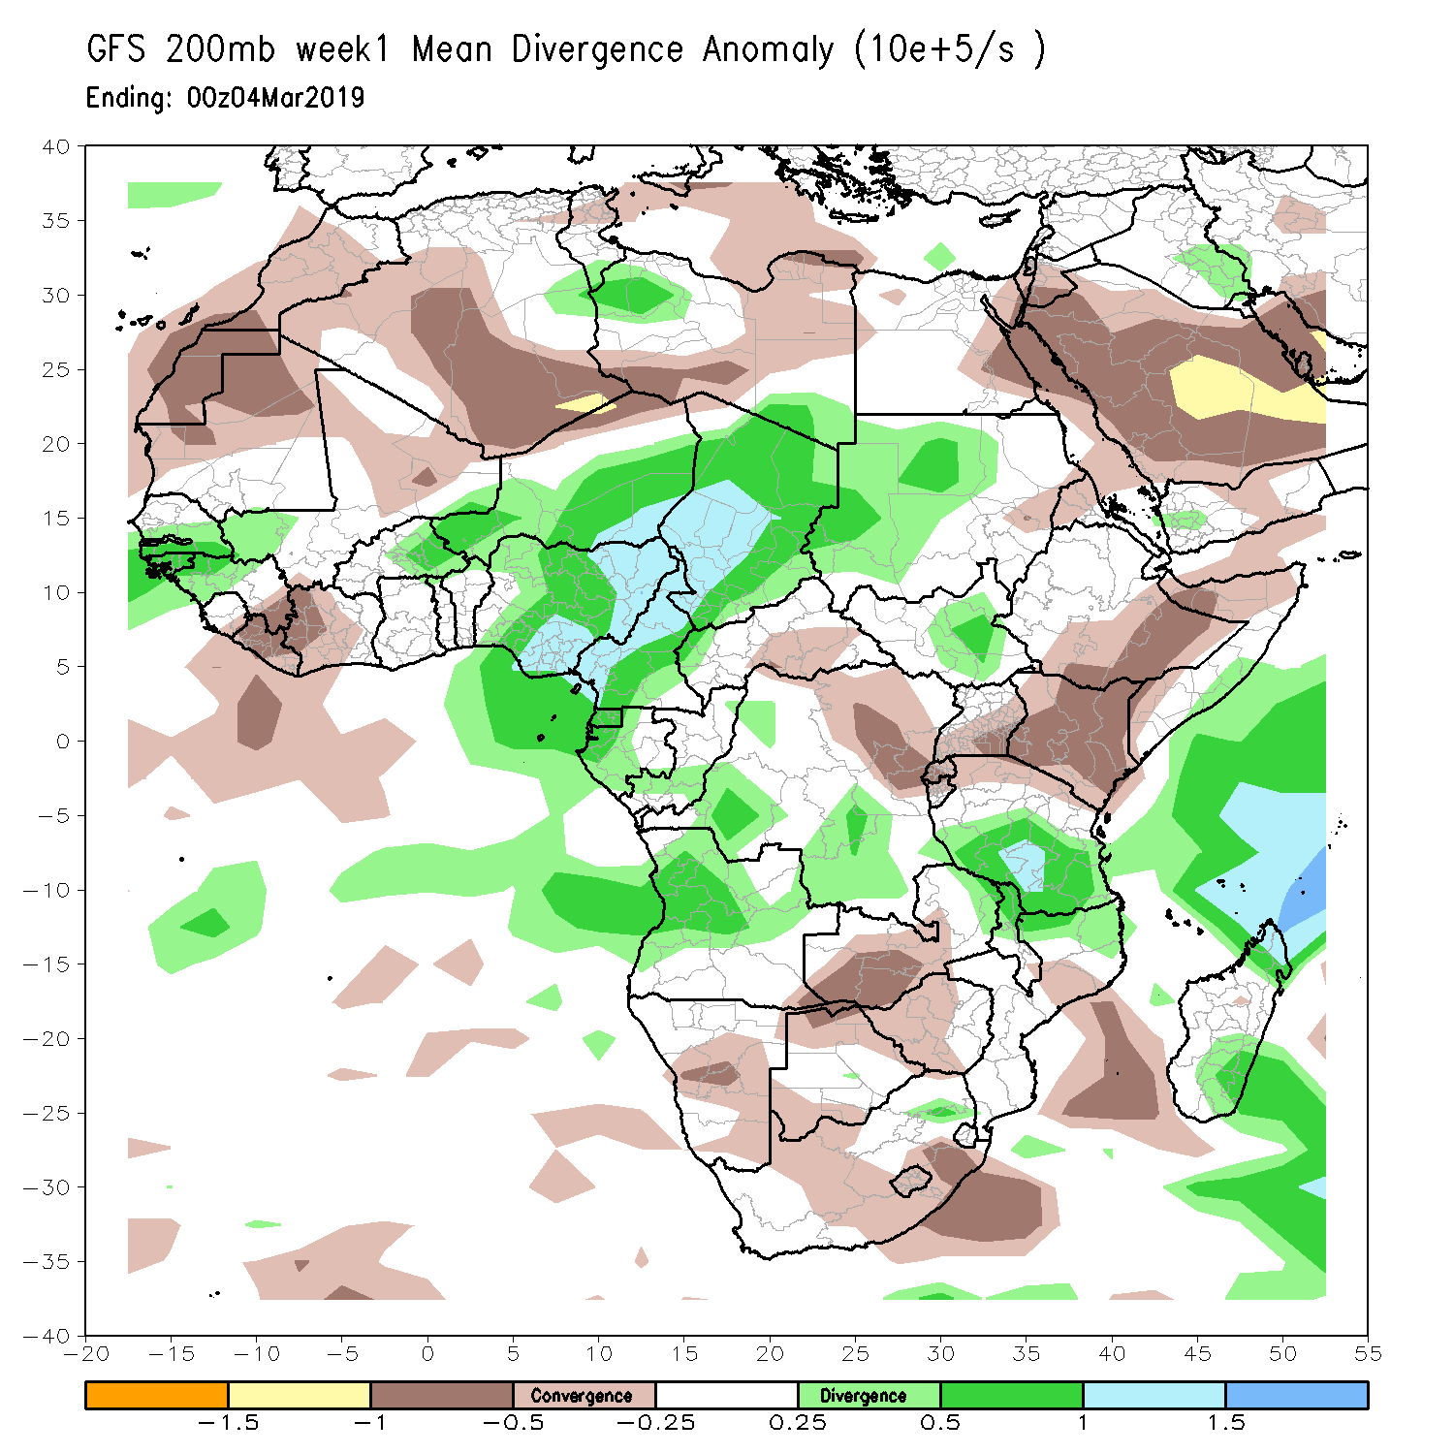
NCEP GFS 200mb 7-day Forecast Week 1

Slide 22
NCEP GFS 700/200mb 7-day Forecast Week 1

Slide 23
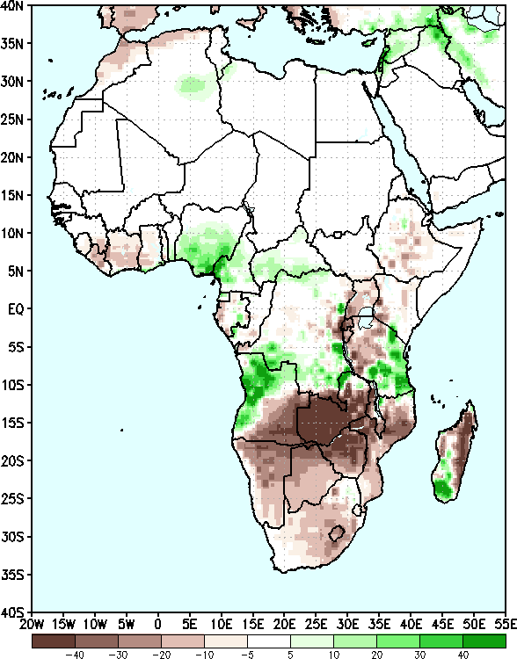
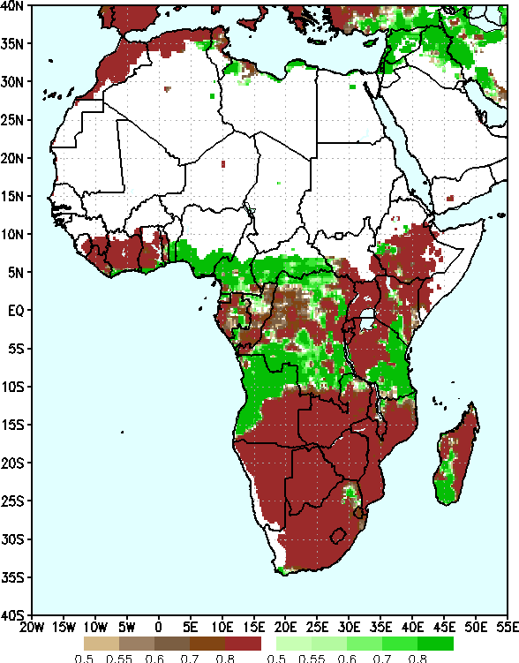
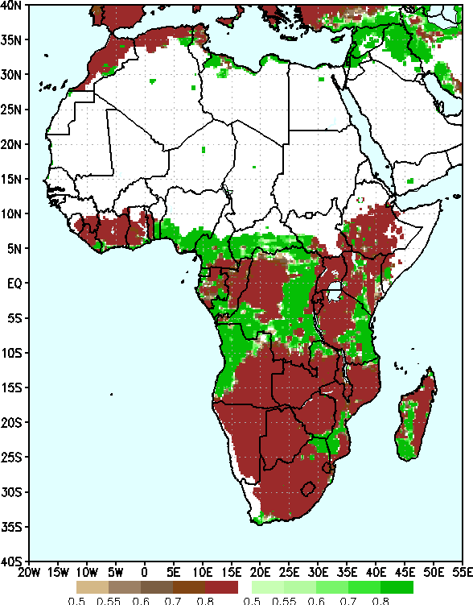
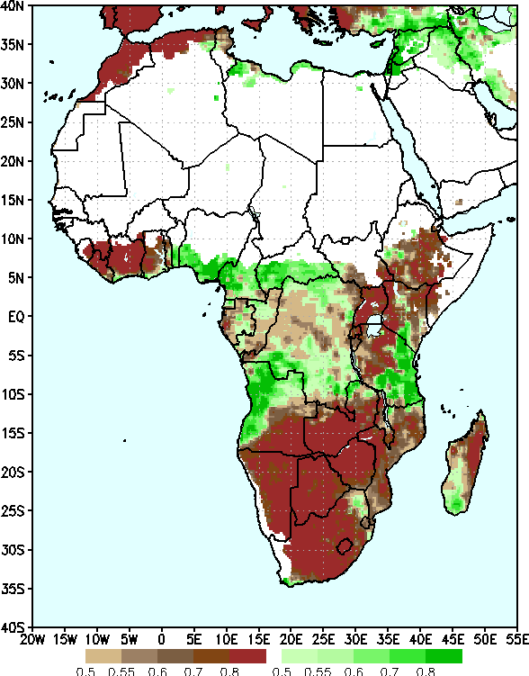
NCEP GEFS Precip forecasts for Week 1, Valid: Feb 26-Mar 4, 2019
Two-category Probabilistic Forecast - Raw
Two-category Probabilistic Forecast – Bias Corrected
Two-category Probabilistic Forecast – Reg - Calibrated
Ensemble Mean Anomaly

Slide 24
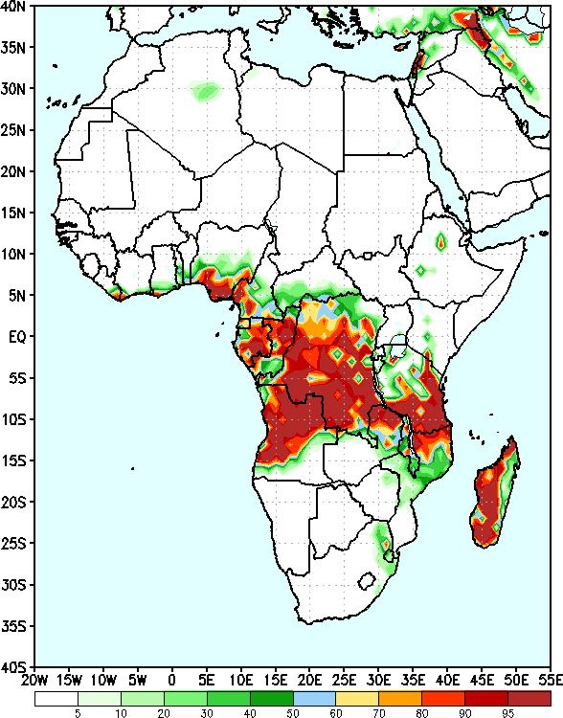
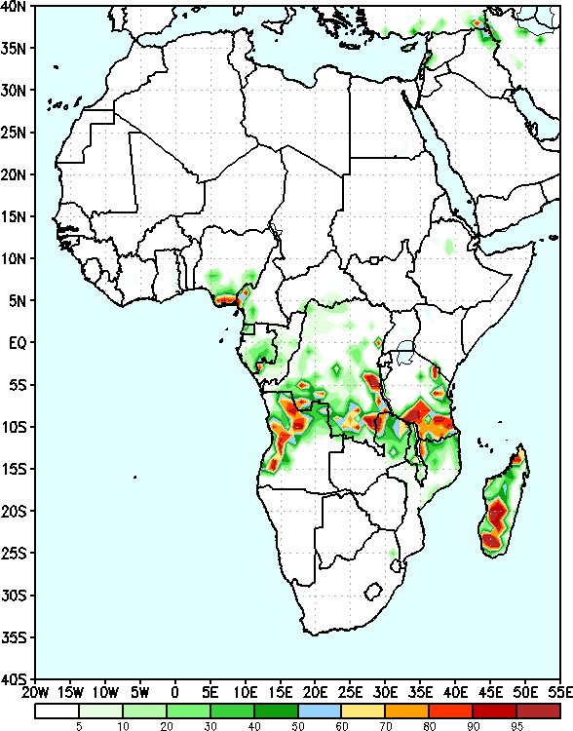
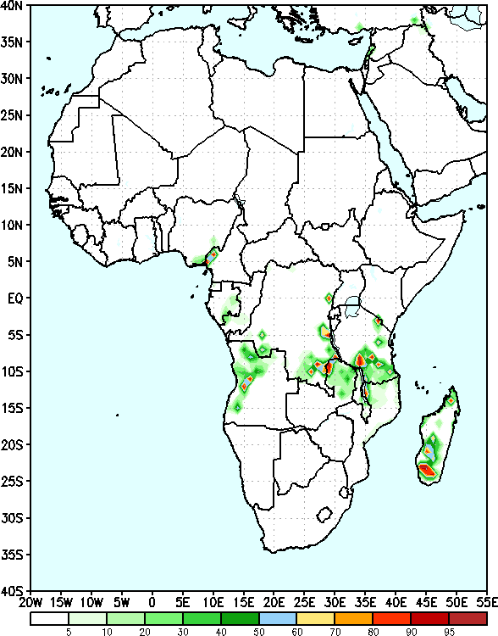
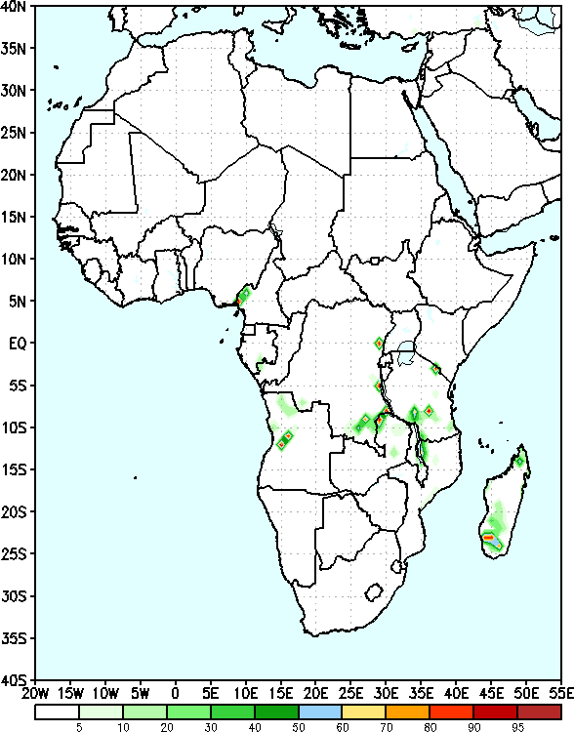
GEFS Week-1 Exceedance Probability
>25mm
>50mm
>75mm
>100mm

Slide 25
Convergence of Evidence?
Wet
MJO -> phase-1/2 in week-1 plus lower level westerly flow & and upper –level divergence -> above – average for East Africa
Onshore flow coupled with upper-level divergence over eastern Gulf of Guinea -> Above-average Rainfall
Higher exceedance probabilities for moderate to heavy rainfall over parts of East Africa.
Rainfall forecasts suggest above-average over eastern Gulf of Guinea and portions of East Africa
Dry
Broad area of anticyclone @7000-hPa coupled with areas of convergence @ 200-hapa over Southern Africa -> below-average
Exceedance Probability -> <10% probability for weekly rainfall totals to exceed 25mm for southern Africa
GEFS week-1 rainfall anomalies -> mostly below-average rainfall across Southern Africa

Slide 26
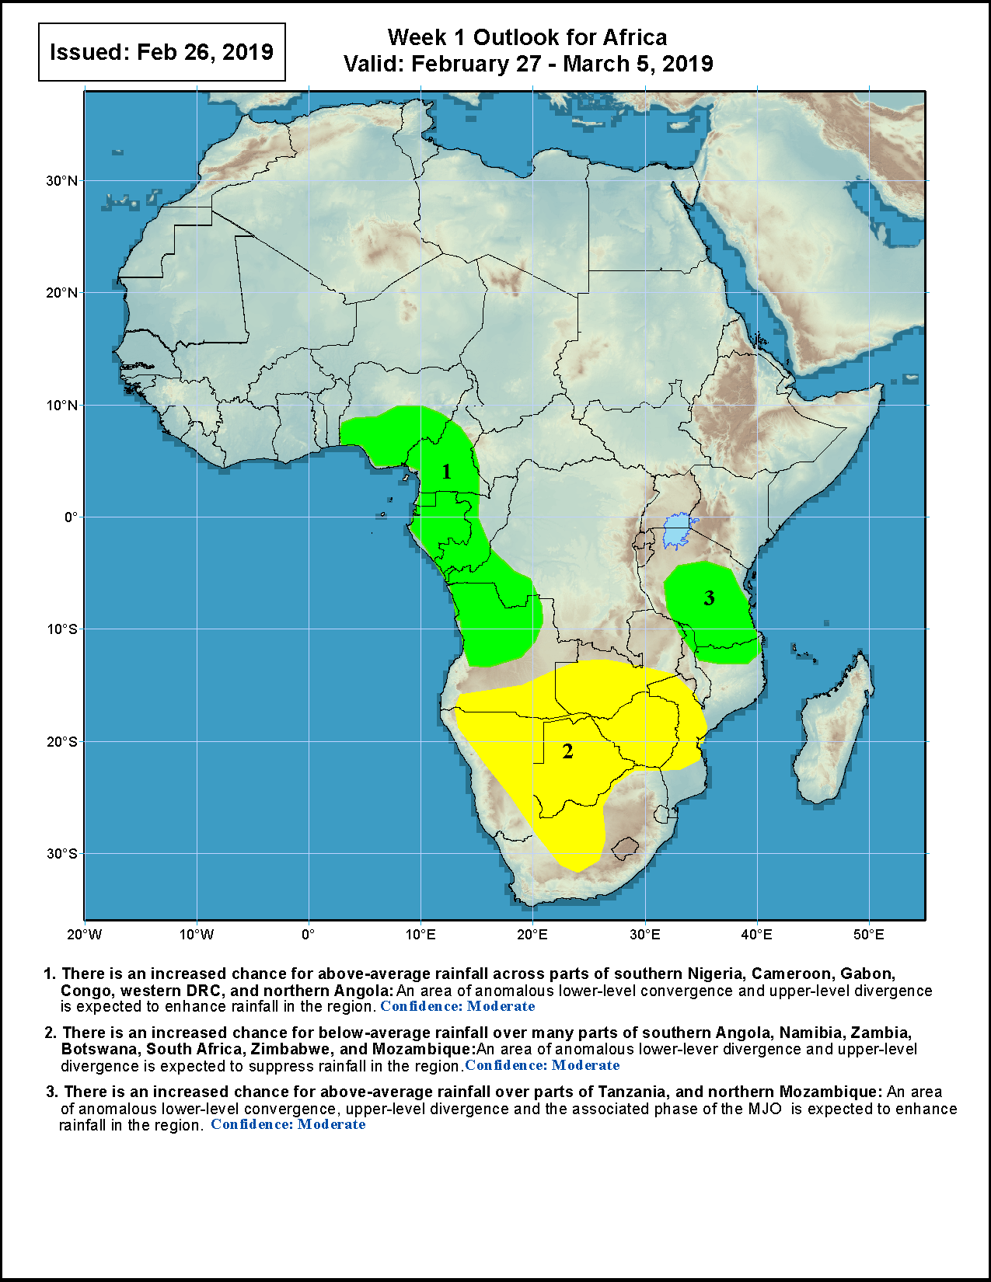
Week1 Rainfall Outlook

Slide 27
Exercise
Do similar diagnostics for week-2

Slide 28
200 hPa Velocity Potential Anomaly
Green shade indicates areas of upper level divergence and convection or precipitation at surface. Brown contours indicate areas of upper level convergence or subsidence and suppressed precipitation at surface.

Slide 29
Wheeler-Hendon Index - Forecasts
Dynamical, GFS/GEFS
Statistical

Slide 30
Evolution of MJO-related anomalies
Initial date: 24 February 2019
Red shade indicate areas
of suppressed convection
Blue shade indicate areas
of enhanced convection
1 - 5 days ave. Forecast
6-10 days ave. Forecast
11-15 days ave. Forecast

Slide 31
MJO Rainfall Composites – Global Tropics
Precipitation Anomalies (Nov - Mar)
http://www.cpc.ncep.noaa.gov/products/precip/CWlink/MJO/mjoupdate.pdf

Slide 32
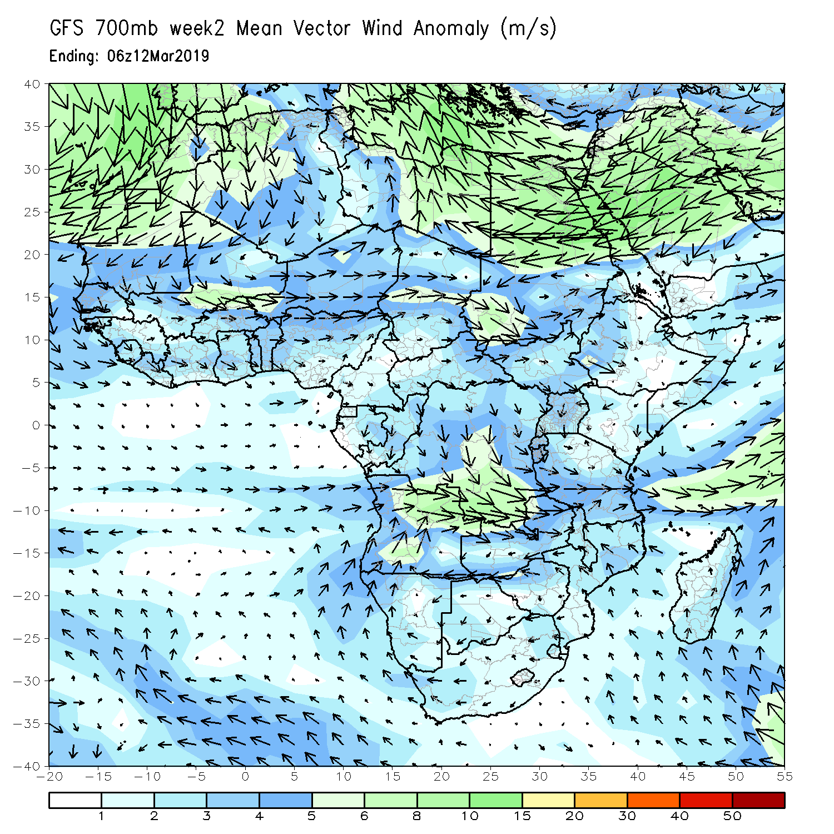
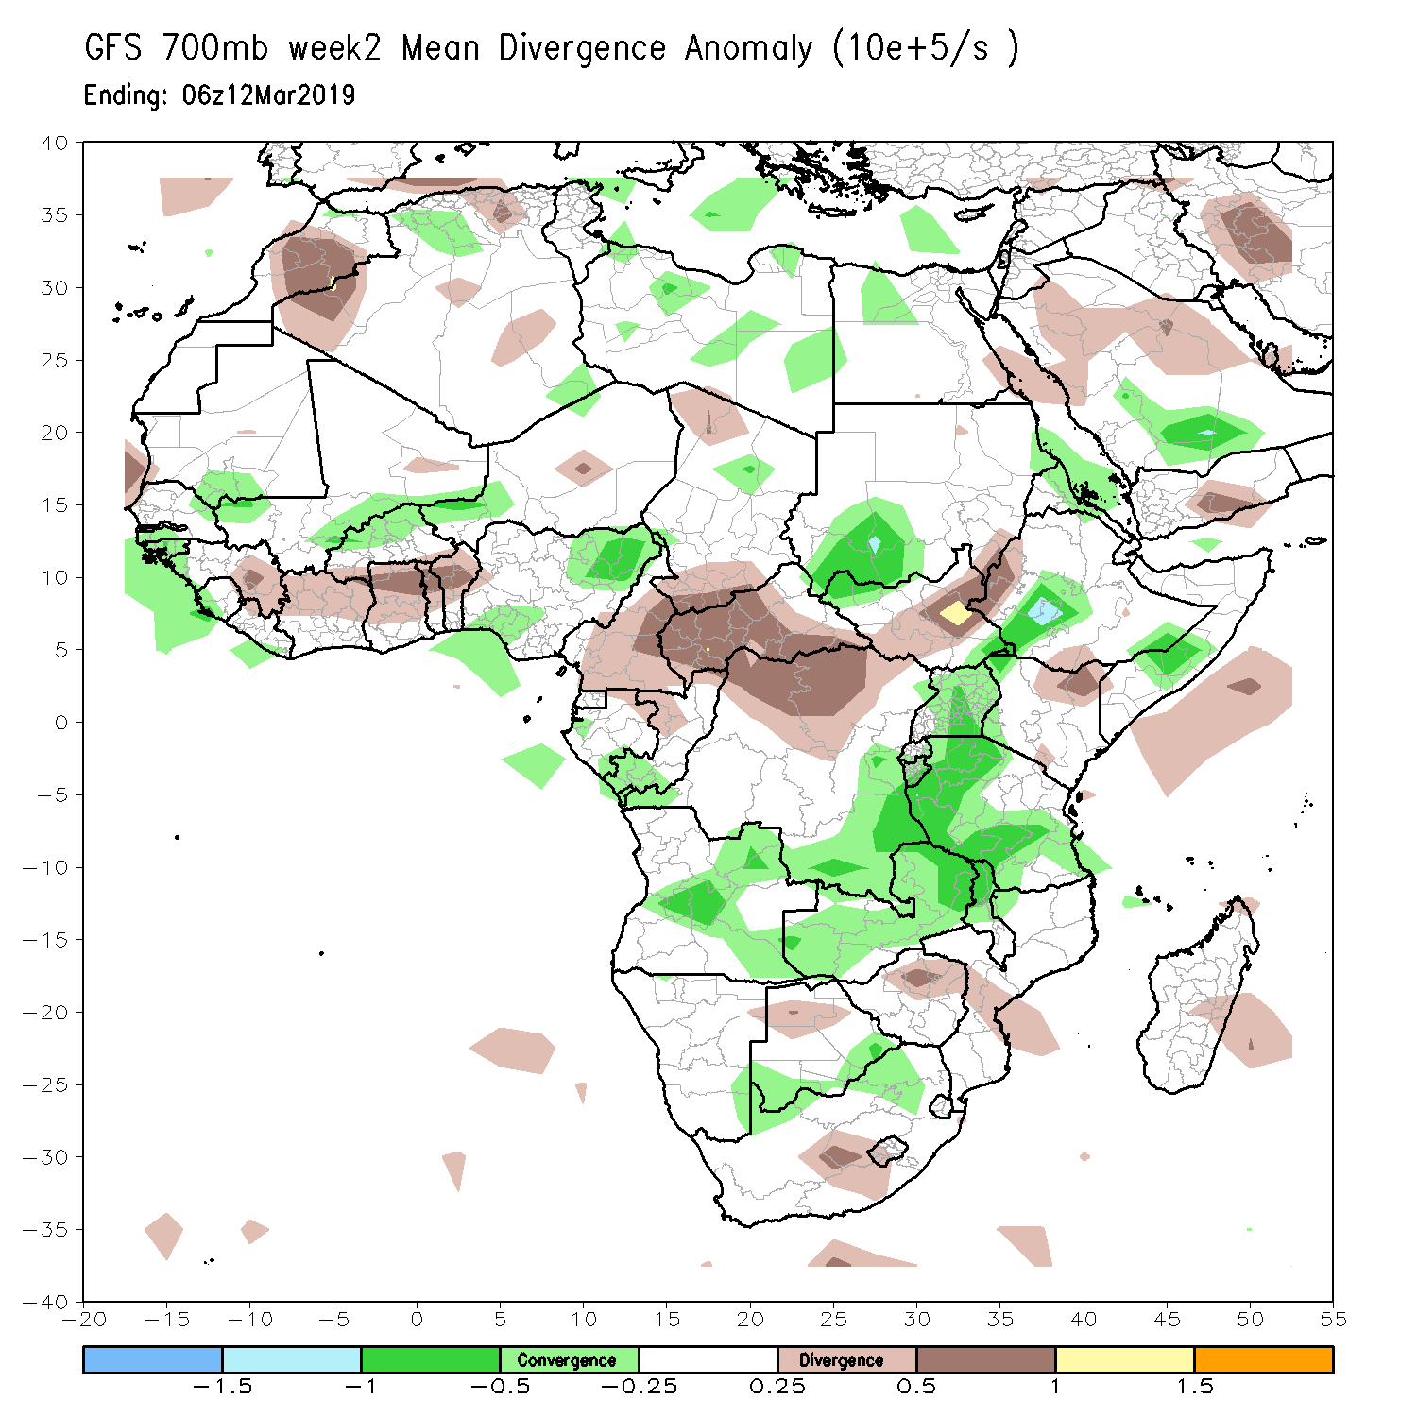
NCEP GFS 700mb 7-day Forecast Week 2

Slide 33
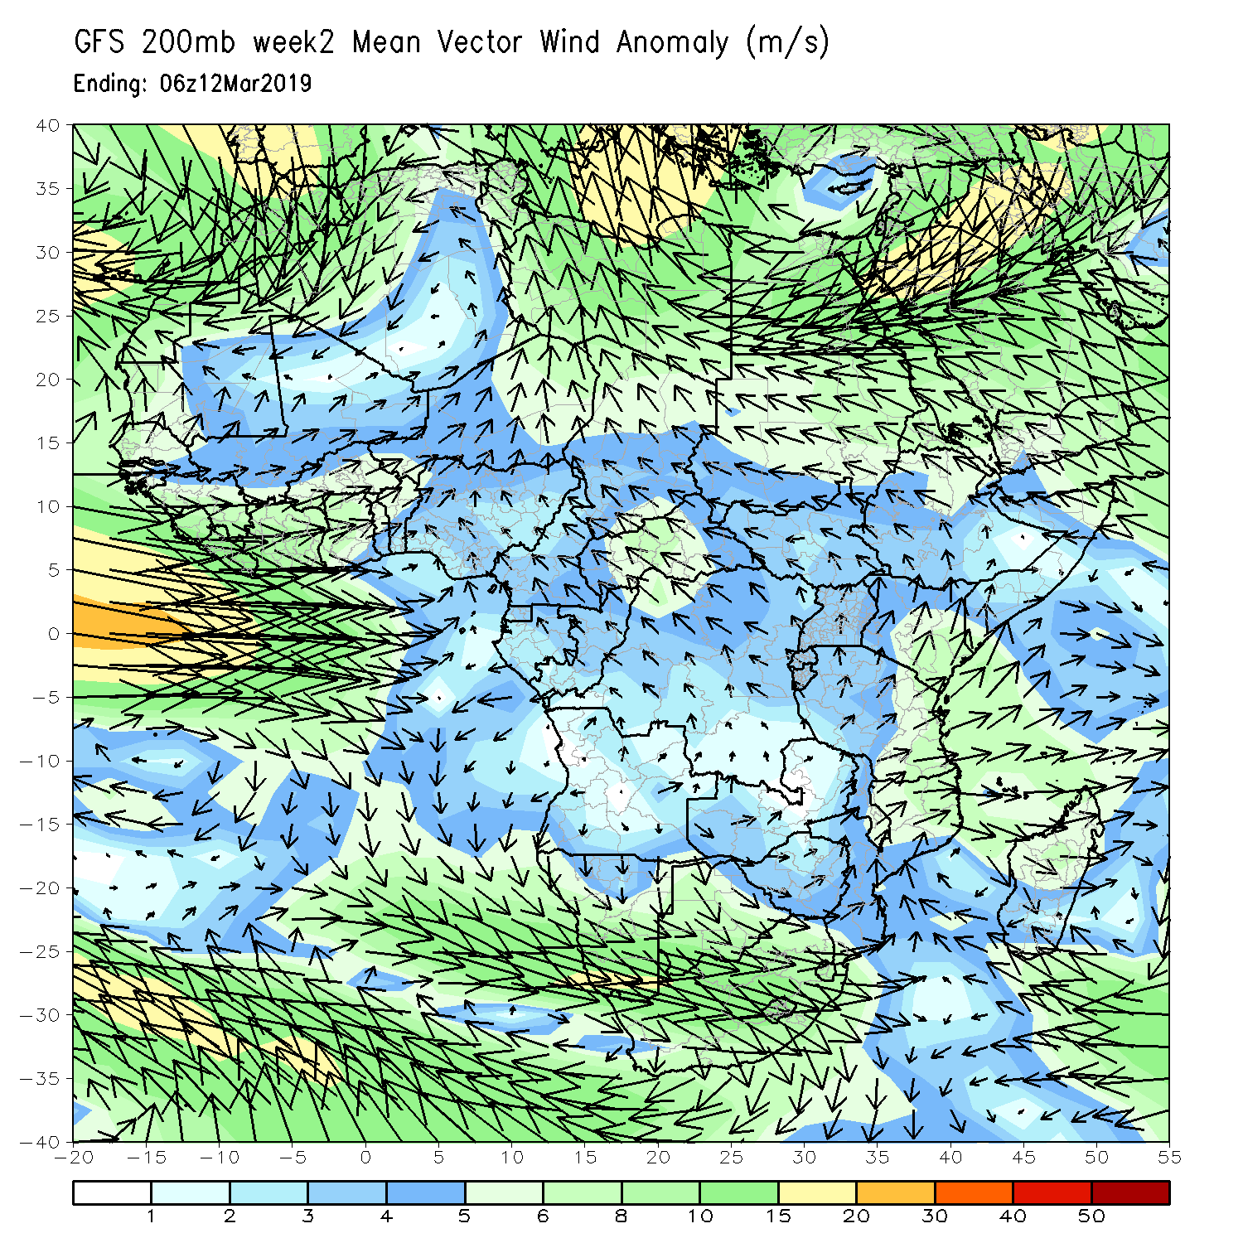
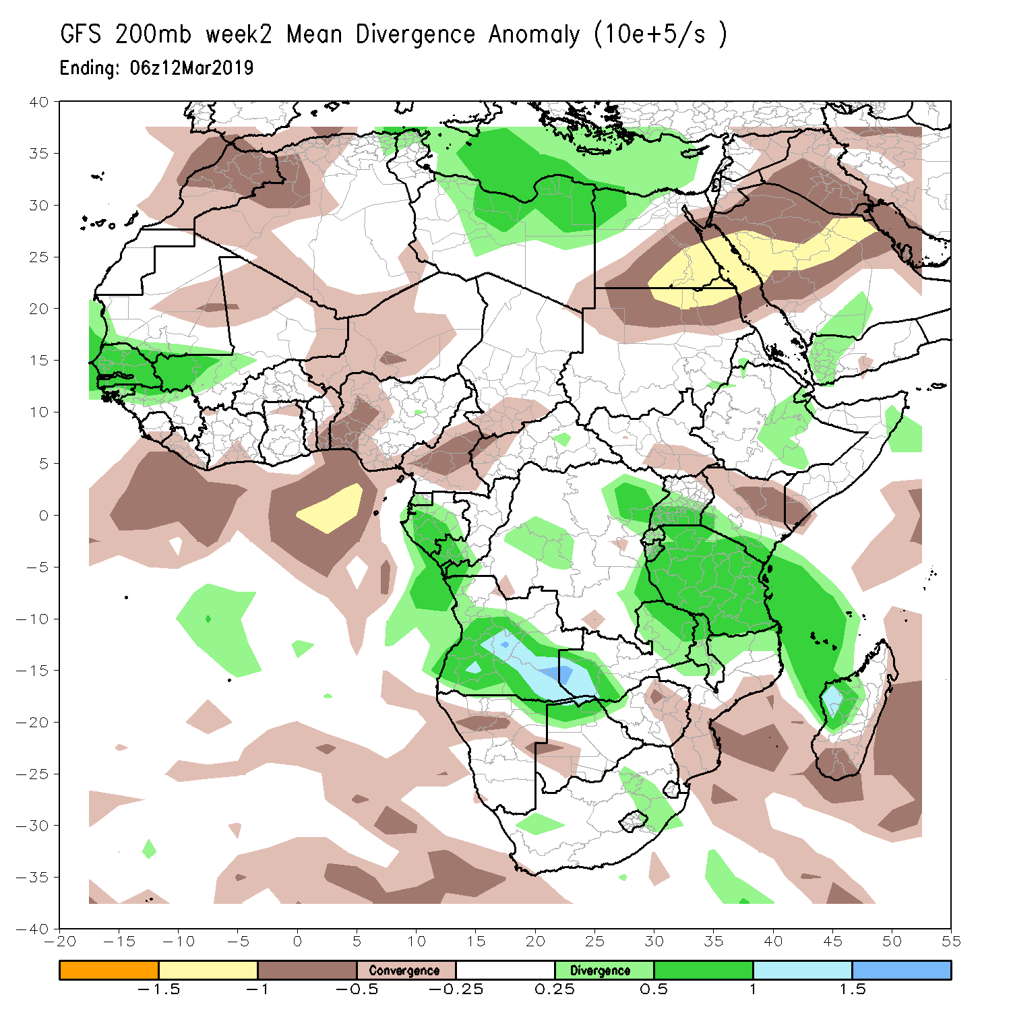
NCEP GFS 200mb 7-day Forecast Week 2

Slide 34
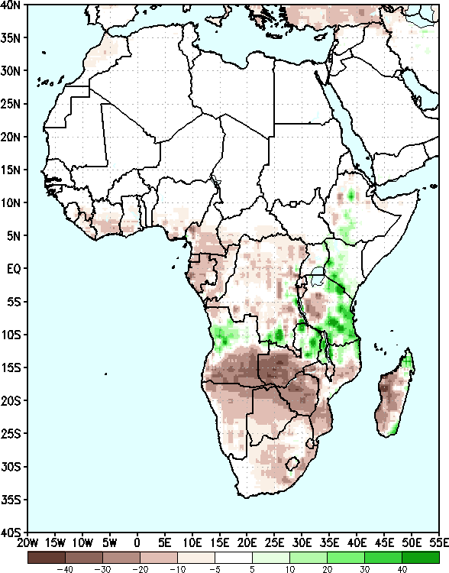
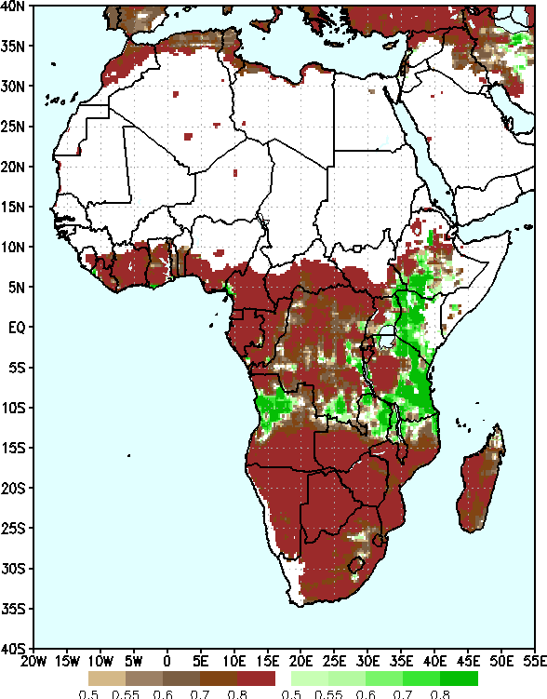
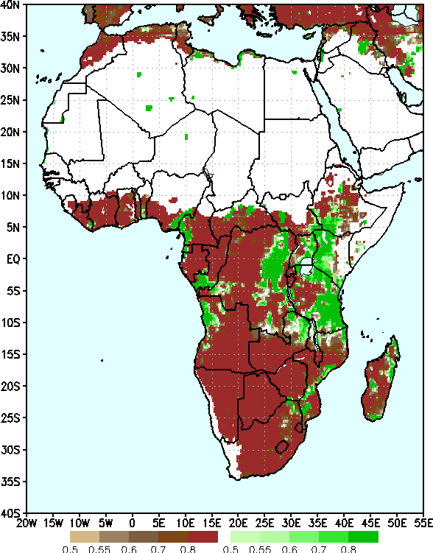
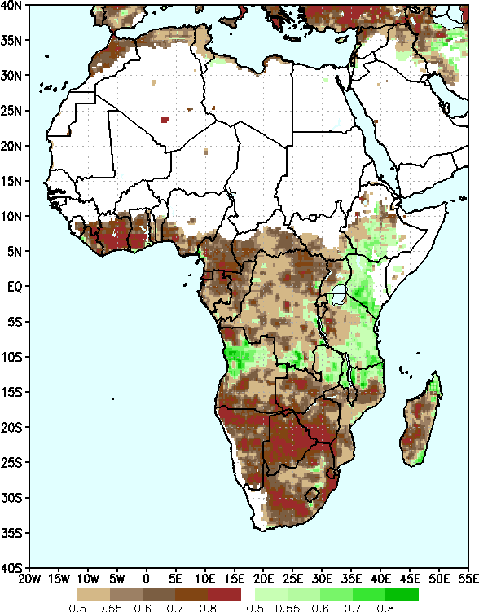
NCEP GEFS Precip forecasts for Week 2, Valid: 5 – 11 March, 2019
Two-category Probabilistic Forecast - Raw
Two-category Probabilistic Forecast – Bias Corrected
Two-category Probabilistic Forecast – Reg - Calibrated
Ensemble Mean Anomaly

Slide 35
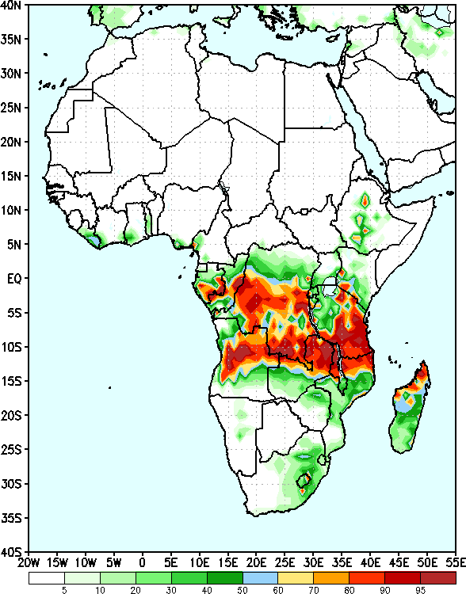
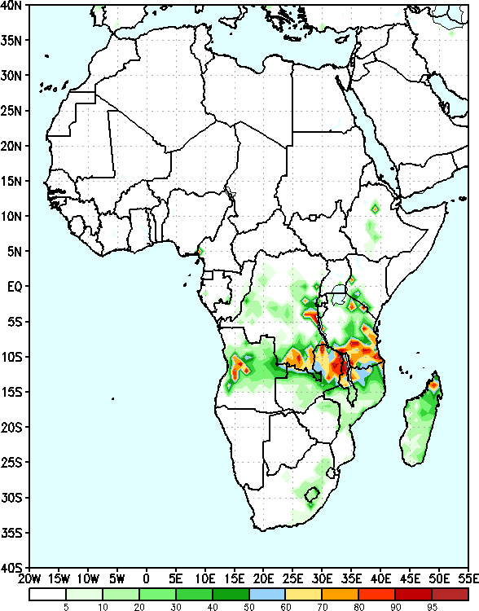
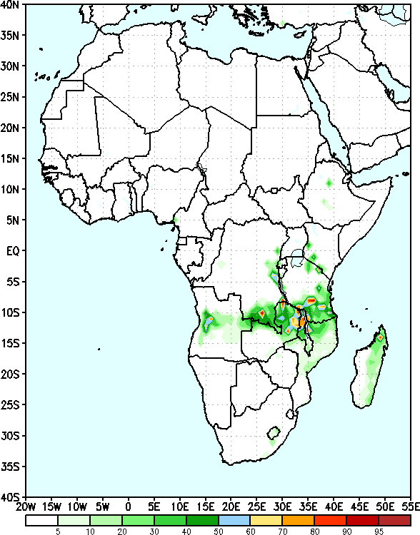
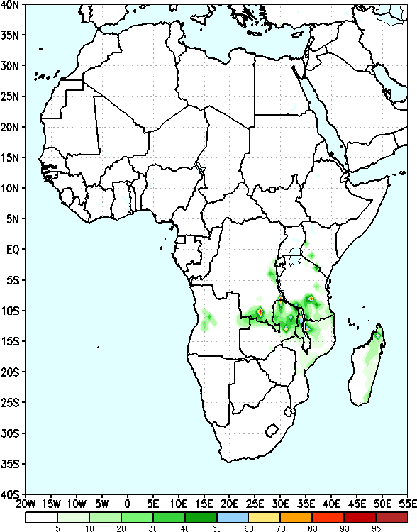
GEFS Week-2 Exceedance Probability
>25mm
>50mm
>75mm
>100mm

Slide 36
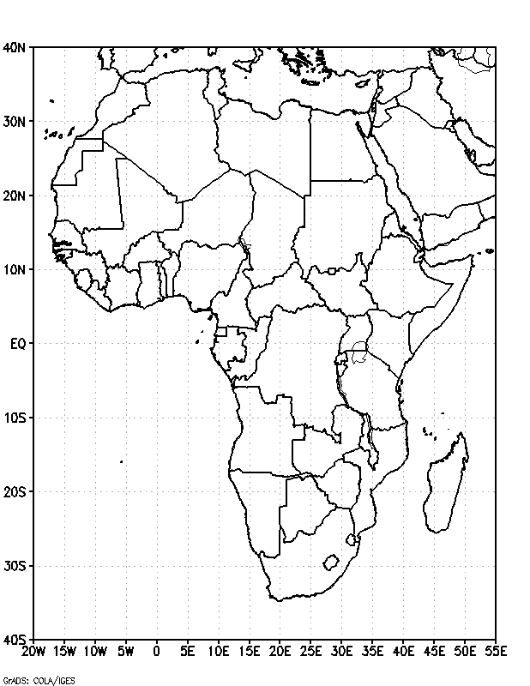
Week-2 Rainfall Outlook
Use the PPT drawing tools (oval shape) to draw Week-2 wet and dry polygons.
You may use blue color wet polygon and red color for dry polygon.

