Slide 1
Extended range prediction of Heat waves over Indian Region
Atul Kumar Sahai
Project Director Monsoon Mission Indian Institute of Tropical Meteorology
sahai@tropmet.res.in
Collaborators : D. R. Pattanaik, Abhilash, Phani, Chatopadhyay, Joseph, Mandal and De
Symposium on the Global Climate System, Ankara, Turkey, 24 – 26 April, 2019

Slide 2
Excerpts from Inter- Governmental Panel on Climate Change (IPCC) Report (AR5)
Global temperature has risen by 0.85⁰C, over a period from 1880 to 2012 with uncertainty of 0.20⁰ C.
Human influence on the climate system is clear, and recent anthropogenic emissions of greenhouse gases are the highest in history.
Recent climate changes have had widespread impacts on human and natural systems

Slide 3
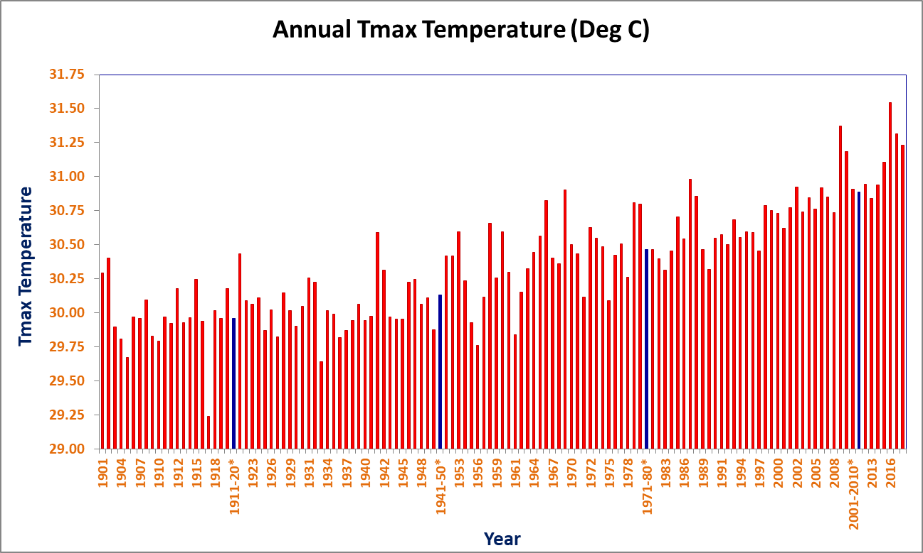
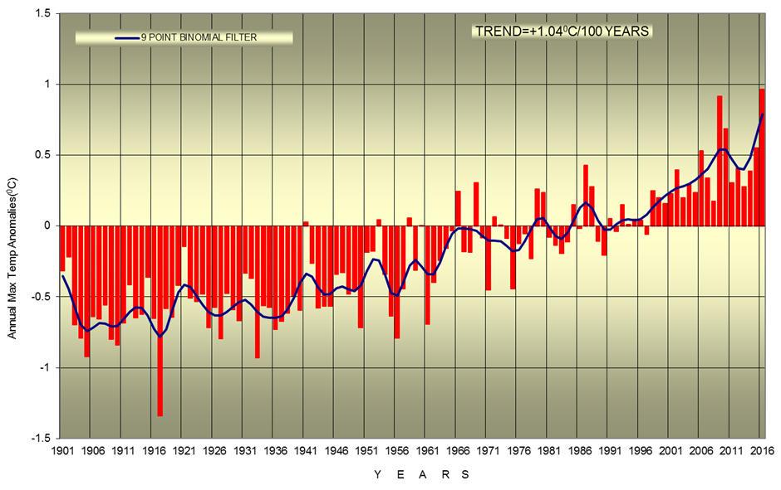
Observed annual maximum temperature (actual and anomaly) over India during 1901-2018
+0.144 °C/10 Yrs

Slide 4
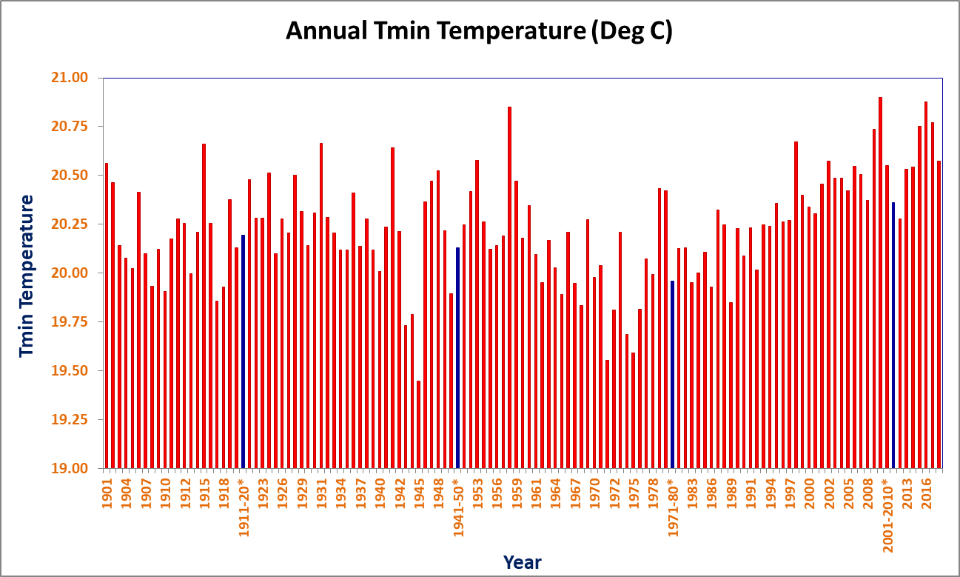
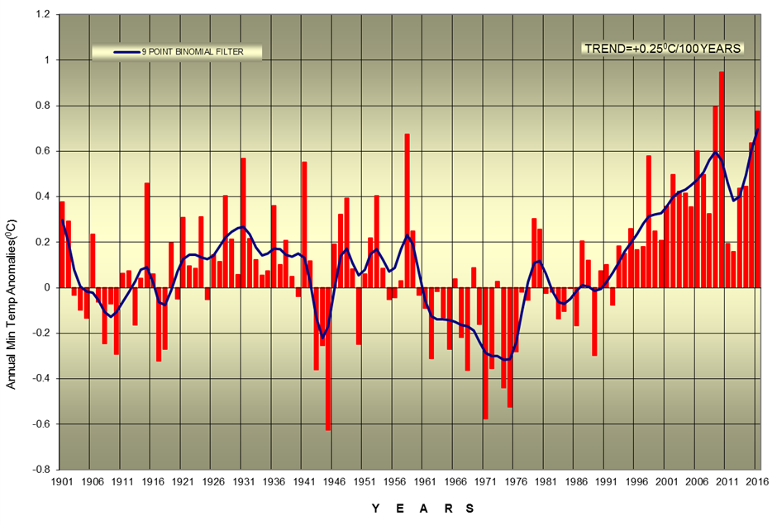
Observed annual minimum temperature (actual and anomaly) over India during 1901-2018
+0.193 °C/10 Yrs

Slide 5
Annual cycle of All-India daily maximum and minimum temperatures
1970-2005
Clear sky
High radiation
Kothawale et al. (2010), J. Earth Syst. Sci

Slide 6
Heat Waves
Generally heat waves over Indian region occur during March to June month of the year
Relative humidity over Indian sub-continent remains less during these summer months, since the monsoon onset occurs at the end of May. Thus the HWs over India are mainly triggered by maximum temperature.
If there is a drought like situation before the occurrence of any HW spell, then the situation becomes more worse.

Slide 7
Meteorological aspects of Heat wave
Stronger than normal anticyclone- subsidence
clear sky conditions, high solar radiation
Hot air advection
lack of moisture over the mainland
Formation of intense low pressure system over the Bay of Bengal thus weakening the High Pressure Cell affecting moisture incursion over east coast
Shift of trough/ wind discontinuity close to the east coast
Subdued thunderstorm activity
Persistence of very high temperatures for days together

Slide 8
Cont…
Domination of Northwesterly/westerly dry winds over the Indian Land mass
Large scale subsidence due to El-Nino conditions
late setting or cutting off of sea breeze from coastal regions
late arrival of SW monsoon in the region
Long hiatus/break in SW monsoon rainfall
Global warming

Slide 9
Possible non-meteorological causes compounding the impacts
Deforestation
Change in crop pattern/land uses/water bodies
Increase in Industrial-Vehicular pollutions
Urbanization Effect-Heat Islands
Changes in Housing Pattern etc

Slide 10
Heat-wave Related Deaths in India

Slide 12
Heat Wave situation in Odisha
Heat Wave related death (line) with number of Heat Wave days (bar) in Odisha after 1998
Heat waves in Odisha killed 2042 in 1998 and in 1999, the state implemented its first HAP.
Despite already having a HAP in place, the state experienced another massive Heat Wave casualty in 2005 losing 236 lives.

Slide 13
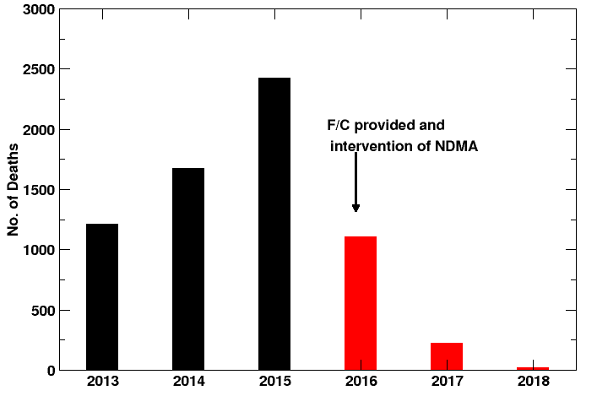
Heat-wave Related Deaths in India

Slide 14
Heat Wave related Cases and Deaths
SN. | Name of the State | Cumulative no of cases reported due to Heat Related Illness |  |  |  | Cumulative no of deaths reported due to Heat
 |  | 2015 | 2016 | 2017 | 2018 | 2015 | 2016 | 2017 | 2018
1 | Andhra Pradesh | 28500# | 21800 | 12832 | 309 | 1422 | 723 | 74 | 8
2 | Bihar | 106 | 990 | 10 | 217 | - | Nil | 0 | 2
3 | Chhattisgarh | 379 | 310 | 393 | 153 | - | 1 | 0 | 0
4 | Delhi | Nil | 8 | 269 | 253 | - | - | 0 | 0
5 | Gujarat | 58 | 447 | 463 | 775 | 17 | 7 | 0 | 0
6 | Haryana | 2 | 0 | 0 | 0 | Nil | Nil | 0 | 0
7 | Jharkhand | 177 | 1166 | 316 | 45 | - | 4 | 0 | 0
8 | Karnataka | Nil | Nil | 6 | 2 | - | Nil | 2 | 0
9 | Maharashtra | 28 | 686 | 313 | 538 | - | 7 | 9 | 2
10 | Madhya Pradesh | 826 | 2546 | 2584 | 2201 | - | Nil | 3 | 1
11 | Odisha | 2071 | 1193 | 1231 | 359 | 60 | 36 | 17 | 7
12 | Punjab | 2 | 0 | 0 | 0 | Nil | Nil | 0 | 0
13 | Rajasthan | 412 | 676 | 246 | 885 | - | 9 | 9 | 1
14 | Tamil Nadu | Nil | 117 | 110 | 18 | Nil | Nil | 0 | 0
15 | Telangana | 807# | 5107 | 20635 | 264 | 541 | 324 | 108 | 0
16 | Uttar Pradesh | 4 | 75 | 155 | 62 | - | Nil | 0 | 0
17 | West Bengal | Nil | Nil | Nil | NA^ | - | Nil | 0 | 1^
TOTAL |  | 33372 | 35121 | 39563 | 6081 | 2040 | 1111 | 222 | 22
Source: Casualty data confirmed by Revenue and DM Division of respective State Governments and IDSP- NCDC (Integrated Diseases Surveillance Project - National Centre for Disease Control, Ministry of Health and Family Welfare

Slide 16
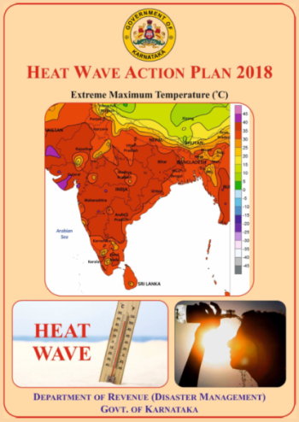
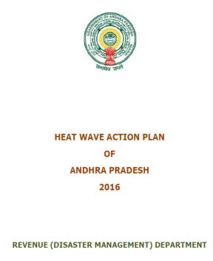
Heat-Wave Action Plan
Initiatives and best practices by States
13 states and more than 101 district/cities have a plan
State having Heat Action Plan:
Andhra Pradesh, Bihar, Delhi, Gujarat, Haryana, Jharkhand, Karnataka, Maharashtra, Odisha, Rajasthan, Tamil Nadu, Telangana, Uttar Pradesh

Slide 17
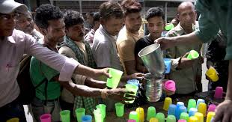
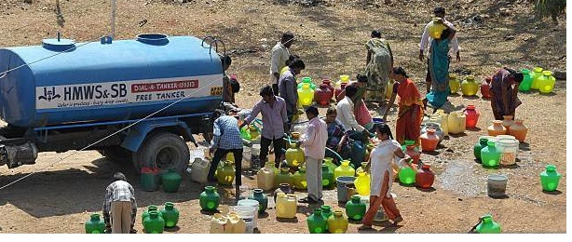
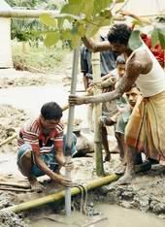
Mitigation
Early start and early closure of schools/ colleges institutions/department
Drinking water kiosk/stall.
Supply of water through tankers.
Setting up special shelters for “Wage Employment programme”
Work timings for outdoor/construction workers are adjusted to avoid exposure to extreme hot weather periods
Construction of Animal shelters with fodder banks
Pre-positioning of adequate veterinary medicines and supplies

Slide 18
Best Practices
Early warning dissemination
Issue of daily warning using email, fax, mobiles whatsapp etc.
Warnings published in local local media.
Display board of colour coding for heat wave alertness
Advisories for tourists.
Preparedness
Setting up of state/district control room
Implementation of Heat Wave Action Plans
Stockpiling of Oral Rehydration Solution (ORS)
Repairing Drinking Water hand pumps
Renovation and deepening of water bodies under MNREGA
Capacity Building of Health personnel

Slide 19
Long term measures
Adopting Cool roof as a Long term measure
Improving Forest Coverage and green areas
Health impacts in Urban Planning
Incentivising different modes of transport
Green Buildings
…………………………………….

Slide 22
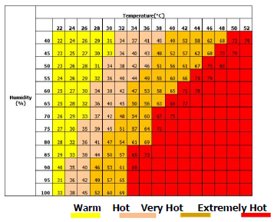
THERMAL HEAT INDICES
Globally, a combination of maximum temperature and relative humidity are used to assess the impact of 'Heat Wave' conditions.
For Indian conditions, the hand book of Energy Conscious Buildings by Ministry of New and Renewable Energy, GOI, indicates the zones of human comfort based on ambient temperature and humidity, mean radiant temperature, wind speed, solar radiation and evaporative cooling.

Slide 23
Heat wave and severe heat wave criteria by IMD
Heat wave need not be considered till maximum temperature of the stations reaches at least 40 °C for plains and at least 30 °C for Hilly regions
a. Based on departure from normal:
HW : maximum temperature departure from normal is 4.5 - 6.4 °C
SHW : maximum temperature departure from normal is $≥$6.4 °C
b. Based on actual maximum temperature:
HW : actual maximum temperature is $≥$45 °C
SHW : actual maximum temperature is $≥$47 °C
c. Criteria for coastal stations:
HW : when maximum temperature departure $≥$ 4.5 °C and actual
maximum temperature $≥$37 °C

Slide 24
New Criteria for Heat Wave (For Gridded data)
HEAT WAVE | Tmax > 36°C AND Tmax > 95th percentile (MAMJ) AND Tmax at least 3.5°C higher than normal OR Tmax > 44°C
SEVERE HEAT WAVE | Tmax > 36°C AND Tmax > 95th percentile (MAMJ) AND Tmax at least 5.5°C higher than normal OR Tmax > 46°C

Slide 25
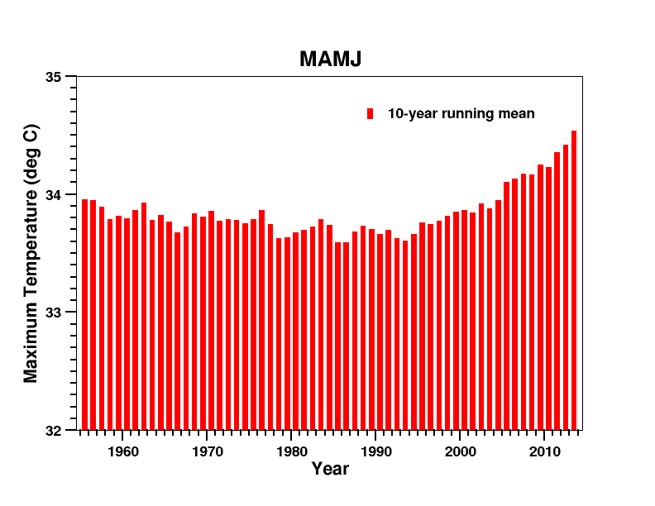
All India averaged Tmax during MAMJ
10 years running mean
In recent decades, the mean maximum temperature duiring MAMJ has been increased. In turn, the total no. of HW days in recent years has also increased

Slide 26
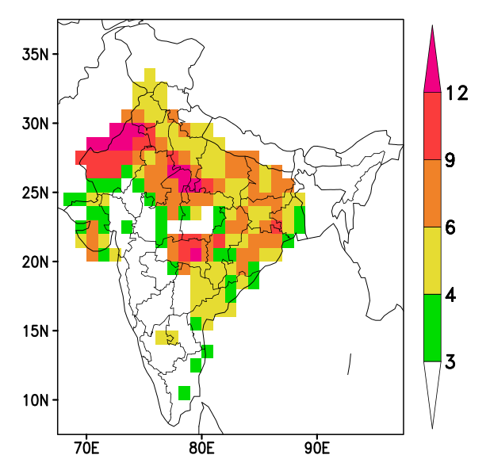
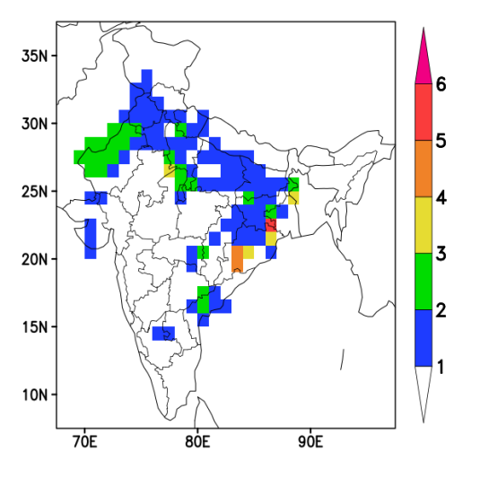
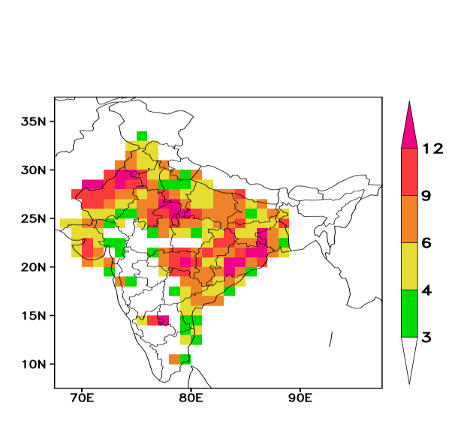
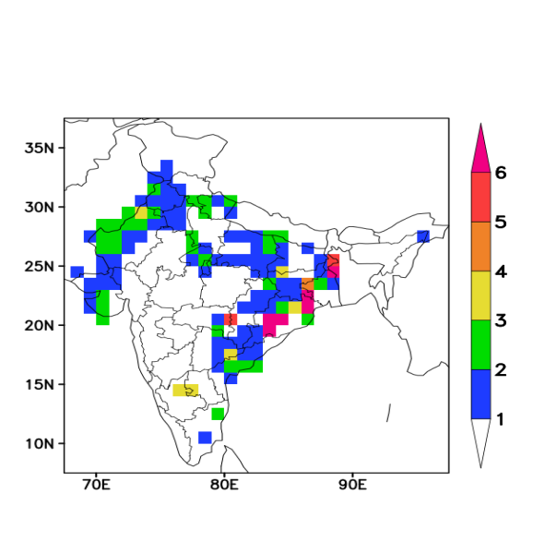
Average number of HW and SHW Days during MAMJ
HW
1981-2017
SHW
In recent years the HW days are more over SE regions
2001-2017
HW
SHW

Slide 27
Heat Wave Prone region
Based on the observed pattern of average no. of heat-wave days exceeding 3 days: NW and SE
1981-2017
Identification of HW events based on different HW prone regions
When the area-averaged Tmax value exceeds 43°C and 40°C for a minimum of 6 consecutive days over NW and SE HW prone regions.
Thresholds are chosen based on the area average 95th percentile values of Tmax over those regions respectively
The spells over NWSE region are identified from the spells over NW and SE regions, that overlap (at least for one day) with each other.

Slide 28
Identified heat wave spells over different regions during 1981-2018 Durations are mentioned in brackets
North-West (NW) | South-East (SE) | Northwest-Southeast (NWSE)
1981: 14-21 Jun (8) 1985: 15-22 May (8) 1987: 03-08 Jun (6) 1988: 06-15 May (10) 1988: 22May-05Jun (15) 1989: 11-24 May (14) 1991: 31May-06Jun (7) 1992: 14-19 Jun (6) 1993: 02-08 May (7) 1993: 23-28 May (6) 1993: 05-13 Jun (9) 1994: 18May-09Jun (23) 1995: 27May-10Jun (15) 1996: 28May-04Jun (8) 1999: 26Apr-05May (10) 2002: 03-08 May (6) 2006: 04-09 May (6) 2009: 16-23 May (8) 2010: 14-19 Apr (6) 2010: 11-28 May (18) 2014: 02-11 Jun (10) 2016: 03-08 Jun (6) | 1983: 29May-03Jun (6) 1994: 07-13 May (7) 1997: 20-25 May (6) 1997: 28May-02Jun (6) 2002: 09-15 May (7) 2002: 19-24 May (6) 2008: 15-22 May (8) 2012: 16-21 May (6) 2014: 17-24 May (8) 2016: 10Apr-04May (25) 2017: 16-30 Apr (15) 2017: 13-26 May (14) 2018: 17Apr-01May (15) 2018: 05-13 May (9) | 1984: 17May-01Jun (16) 1998: 15May-06Jun (23) 2003: 26May-09Jun (15) 2005: 18May-09Jun (23) 2012: 24May-09Jun (17) 2013: 15-26 May (12) 2015: 18-31 May (14) 2016: 11-28 May (18) 2018: 17May-05Jun (20)
Red-coloured spells are during El-Nino Years

Slide 29
Composites of maximum temperature
Actual
Anomaly

Slide 30
Prediction and verification of Heat Waves in ERP

Slide 31
CFSv2 based Grand Multi-model Ensemble (CGMME) System
Hindcast and Forecast Strategy
Obtain Ocean/Atmos IC’s From INCOIS & NCMRWF
CFSv2 T126
4 members
Forecast
Correction of SST bias
GFSv2bc T126
4 members
Forecast
MME
Generate ensembles of IC’s
CFSv2 T382
4 members
Forecast
Correction of SST bias
GFSv2bc T382
4 members
Forecast
Abhilash et al. (2014a,b, 2015 ) ; Sahai et al. (2013, 2015) ; Borah et al. (2013)

Slide 32
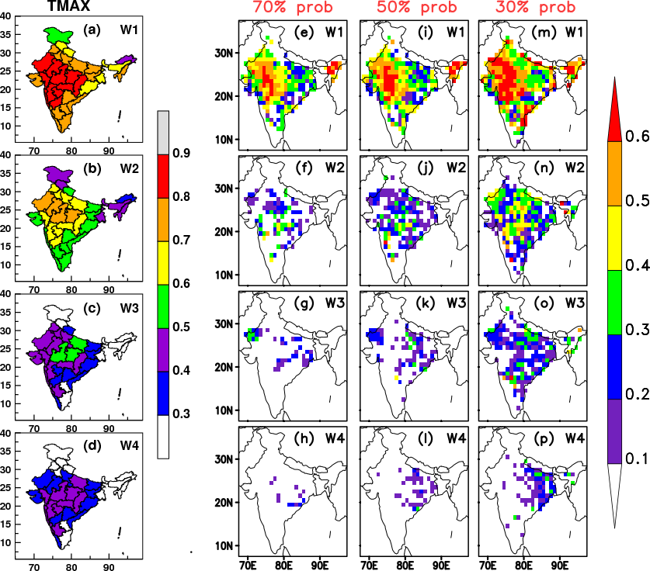
Anomaly Correlation Coefficient (significant at 99.9% significance level)
Symmetric Extremal Dependence Index (SEDI) values for different HW probabilities
Skill of IITM-IMD ERP forecast system for different week lead
MAMJ
Hindcast period 2003-2017

Slide 33
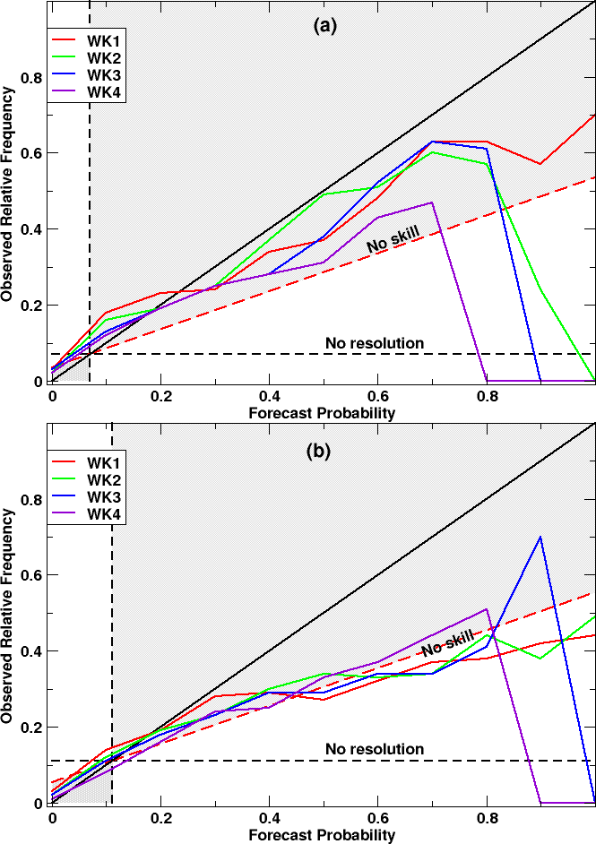
NW
Reliability diagrams for the HW event (satisfying the proposed HW criterion) during MAMJ (2003-17) for two heat wave prone regions namely NW and SE for four different leads
SE

Slide 34
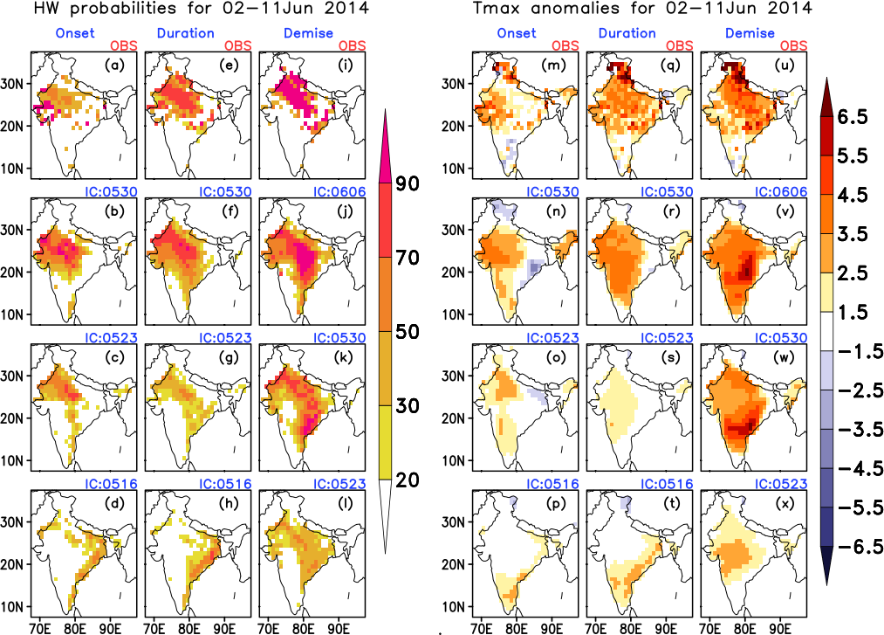
NW heat wave spell: 02-11 June 2014

Slide 35
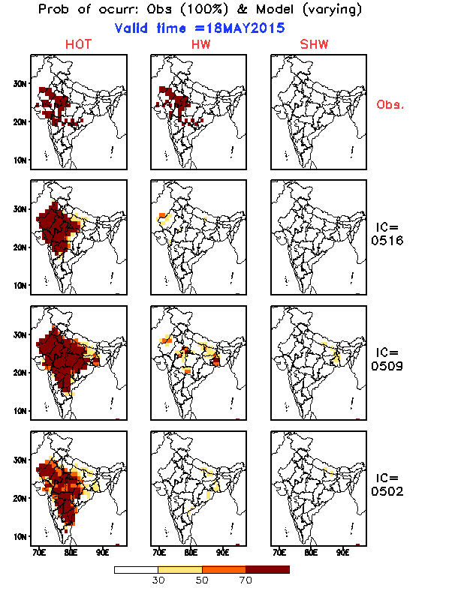
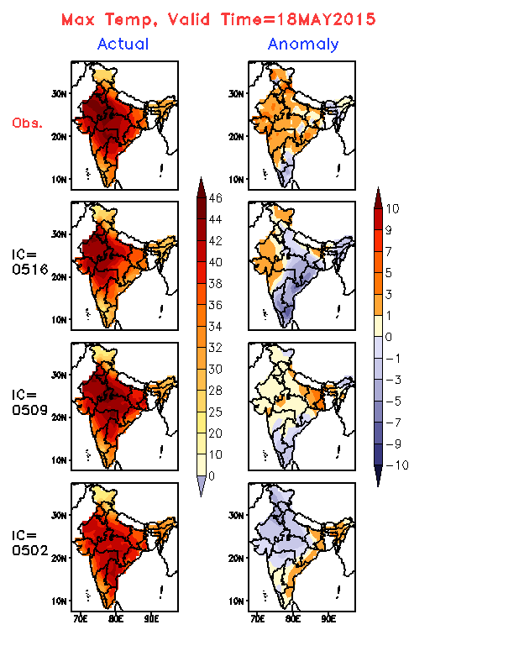
NWSE HW spell: 19-31 May 2015

Slide 36
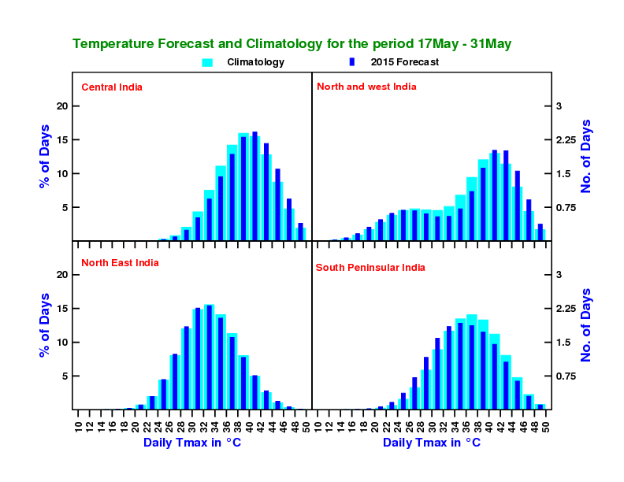
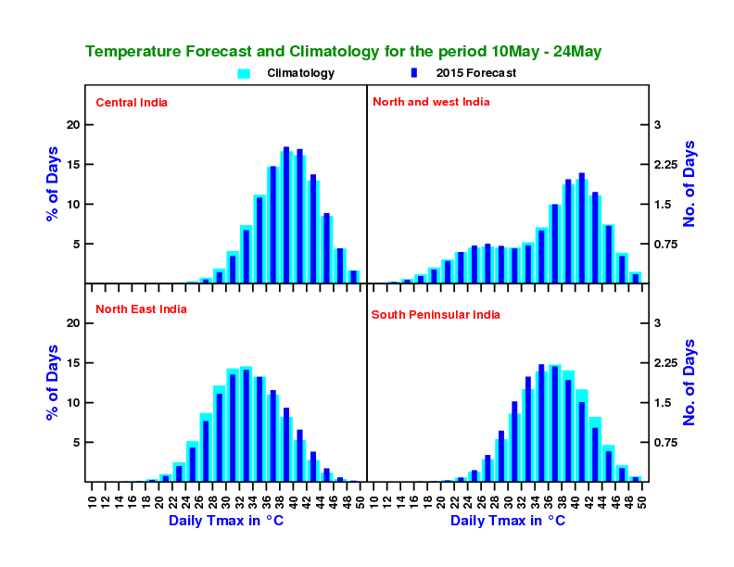
Histogram of Forecasted Maximum Temperature for 4-homogeneous regions of India during 2015
IC=0516
IC=0509
CEI
NWI
CEI
NWI
NEI
SPI
NEI
SPI

Slide 37
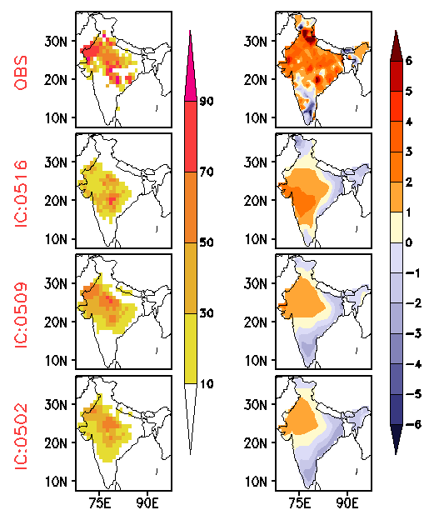
NW spell: 18May-01Jun 2018
Probabilities of occurrence of HW
Averaged Tmax anomalies
Averaged RH at 2m anomalies

Slide 38
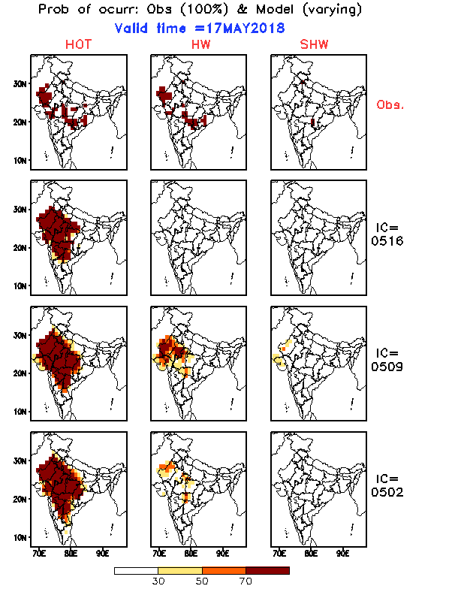
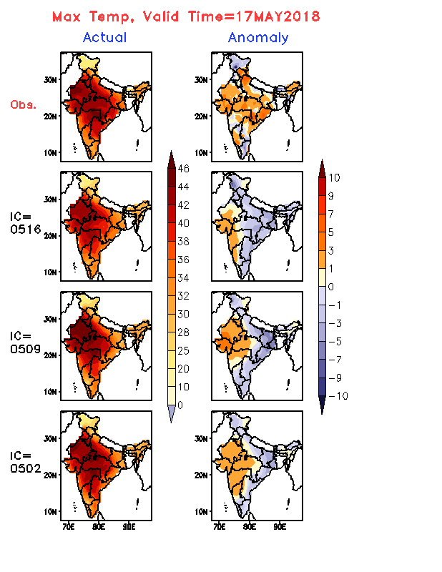
NW HW spell: 18May-01Jun 2018

Slide 39
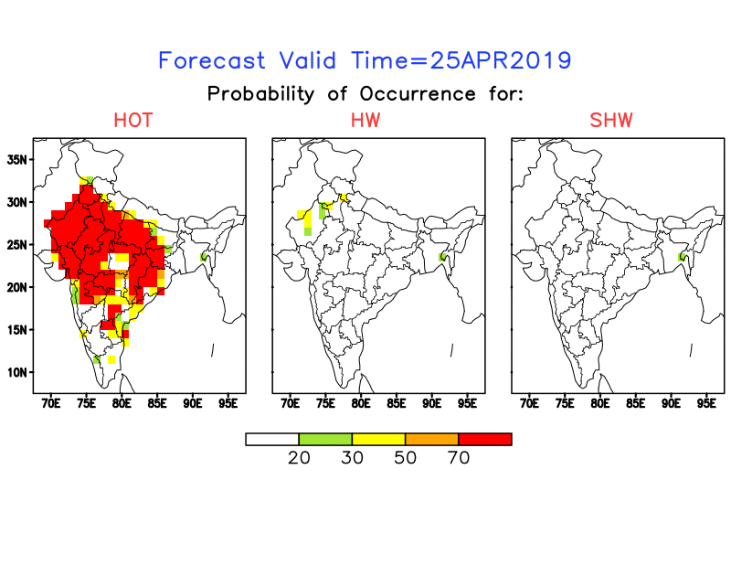
Heat wave occurrence Probability
(Latest forecast from 24 April 2019 IC)
HOT: Hot day
HW: Heat wave
SHW: Severe heat wave
Notes:
Circle regions with some skill on both forecast and ACC map – these are areas where it is worth looking at
Problem calculating these – don’t match with colder temperature forecasts

Slide 40
Discussions
New HW criteria for Indian region is developed using bias corrected Tmax & Tmin daily gridded data
For model, the temperature datasets are bias corrected
The observed HW patterns indicate that in recent decade the HW spells are occurring early in the summer season also their extension towards southern parts of the country
Different HW prone regions namely North-West, South-East and Northwest-Southeast are identified where the average no. of HW days per year is more than 3.
It is found that the ERP system is skilful at least two week lead (i.e. 14 days lead time), even for 70% probability of occurrence of HW.
Outlook on the impending HW spells were given in advance, although with some spatio-temporal errors.
This HW prediction can be very useful for the other sectors (e.g. Health, Power & Agriculture) as a guidance for preparing health warning strategies, agricultural bulletin etc.

Slide 41
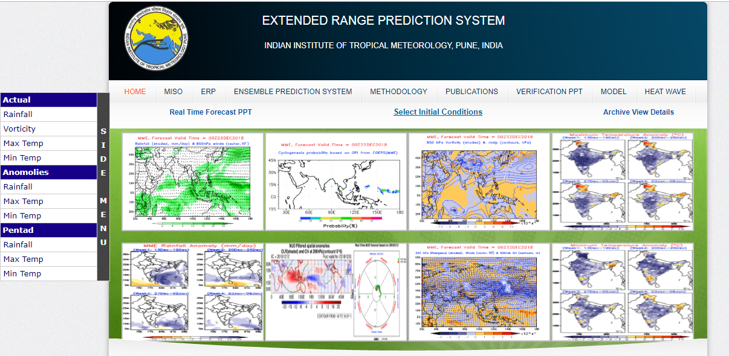
http://www.tropmet.res.in/erpas/index.php
Thank You!!!

