Slide 1
NOAA-USAID 11ITWCVP
2nd Symposium on the Variability and Predictability
of the Global Climate System,
Ankara, Turkey, 15 – 26 April, 2019
Experimental predictions of Malaria in West Africa
Ibrahima DIOUF and Wassila THIAW
NOAA Center for Weather and Climate Prediction / Climate Prediction Center, College Park, MD, United States
This study is a contribution to the Climate and Health Project in development at the CPC/NOAA

Slide 2





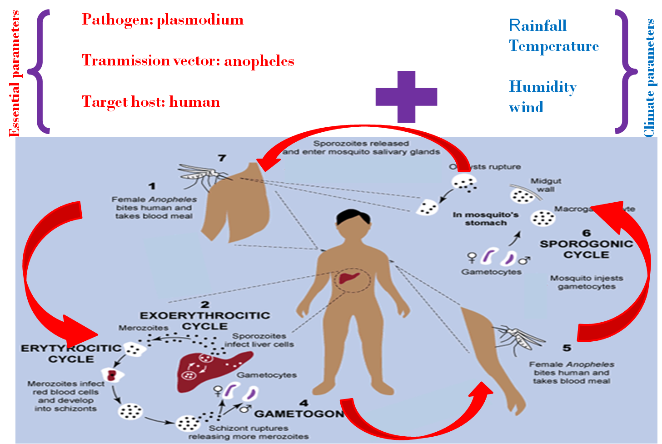
Climate and Malaria Relationship
Essential parameters
Climate drivers of malaria
Rainfall : provides breeding sites for
mosqutoes.
Temperature: larvae growth, vector
survival, egg development and parasite development in vector.
Pathogen agent: plasmodium
Vector of transmission : anopheles
Host: human
Interventions
Human
climate
vector
Parasite
Environment
Socio-economic, environmental and climate factors of malaria transmission

Slide 3
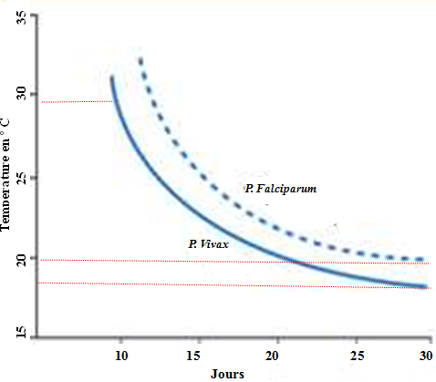
Rainfall and Temperatures Influences on Malaria
- rainfall
Before flooding
After flooding
Malaria cases from 2006 to 2009 in Diamaguene Sicap Mbao, Dakar (Fall, 2010, personnal communication)
Duration of the extrinsic cycle of P. falciparum and P. vivax in anopheles. (Source: Danis and Mouchet, 1991)

Slide 4
Data and Tool
Data:
Daily rainfall and daily temperature extracted from available datasets at CPC/NOAA
Simulated malaria parameters such as Incidence in %
Malaria data obtained from National Program for Malaria Control (like in Senegal )
Tools:
Liverpool Malaria Model (LMM) (Hoshen etal, 2004)
VECTRI model (VECtor borne disease community model of ICTP, TRIeste) (Tompkins AM, & Ermert V, 2013)
Canonical Correlation Analysis (CCA) (Thompson B., 2005) under the CPT tool (Cf Training course)

Slide 5
LMM Model Outputs
name | Definition / units
ActiveMo | total number of mosquitoes biting at this time step
Gdays | length of the gonotrophic cycle in days
Immcount | total number of larval mosquitoes
Incidence* | cases per 100 people
InfectiveMosquitoCount | Total number of infectious mosquitoes biting at this time step
nMatureMosquitoes | Total number of adult mosquitoes
Prevalence | proportion of the human population infectious
Sdays | length of the sporogonic cycle in days
* Variable under study in the following

Slide 6
VECTRI Model Outputs
name | Definition | Units
population | population density | N.m−2
rain | rainfall | mm day−1
temp | temperature | ºC
water frac | fraction of grid box covered by pond breeding sites | %
vector | mosquito density | N.m−2
larvae | larvae density | N.m−2
larvae biomass | larvae biomass | Mg.m−2
PRd | % of population with detectable malaria (day 10+)
hbr | human biting rate | number of bites person−1 day−1
cspr | Circum sporozoite protein ratio (eir/hbr) fraction | fraction
Eir* | entomological inoculation rate (number of infectious bites) | number person−1 day−1
Cases* | number of new cases | fraction
immunity | proportion of immune population | fraction

Slide 7
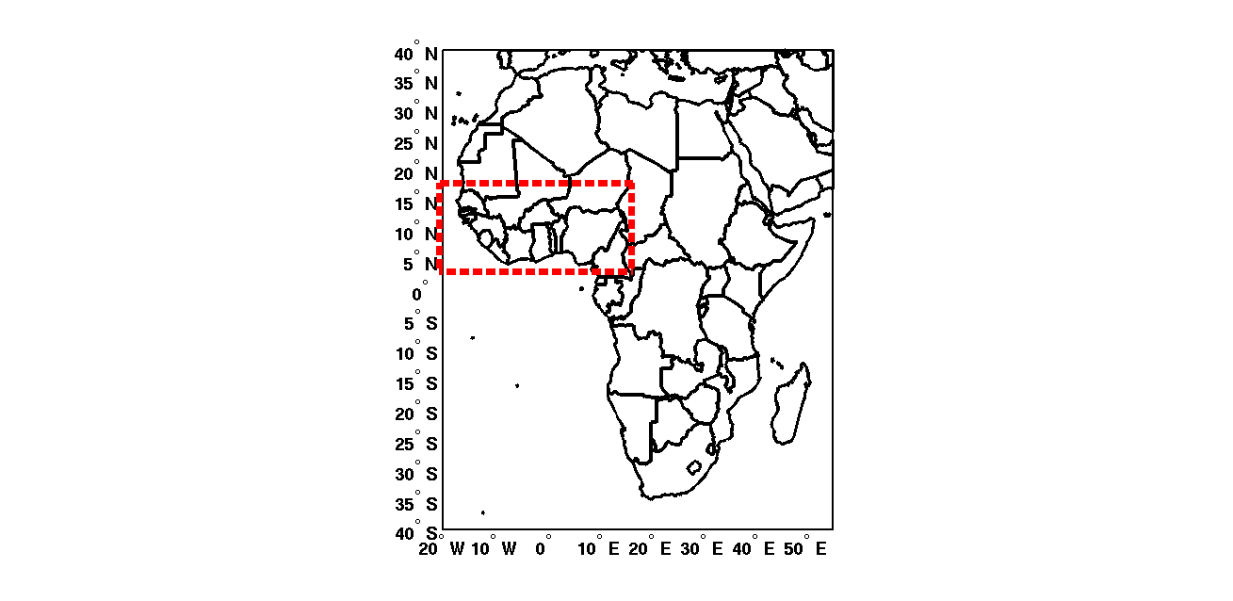
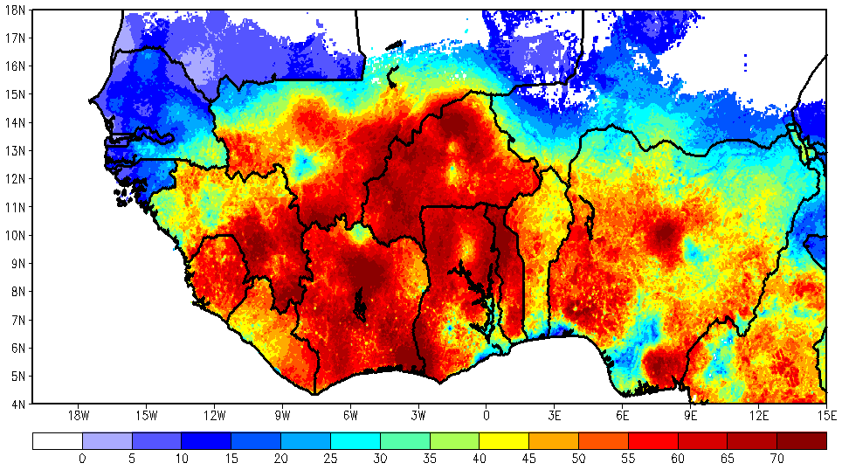
Study Area: West Africa
This map represents the prevalence rate of
P. falciparum malaria in 2-10 year olds in WA, (average 2000-2015).
These data are collected from different malaria locations across African countries via the Malaria Atlas Project (MAP), they could serve to partially validate the model outputs.
Malaria prevalence is low in Senegal, this is related to malaria control parameters such as interventions with insecticide-treated bed nets, but also the Artemisinin-based combination therapy (ACT) for treatment.
The wetter area (south of West Africa) experiences endemic malaria prevalence.
Source MAP data: https://map.ox.ac.uk/explorer/#/explorer
Location of the study area: West Africa delimited in red color, - 4 ºN to 18 ºN and 20 ºW to 15 ºE.

Slide 8
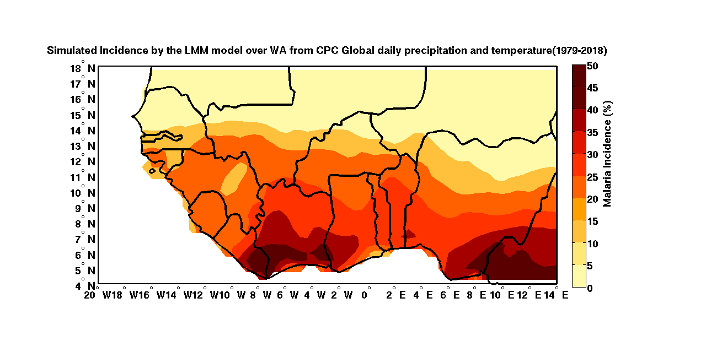
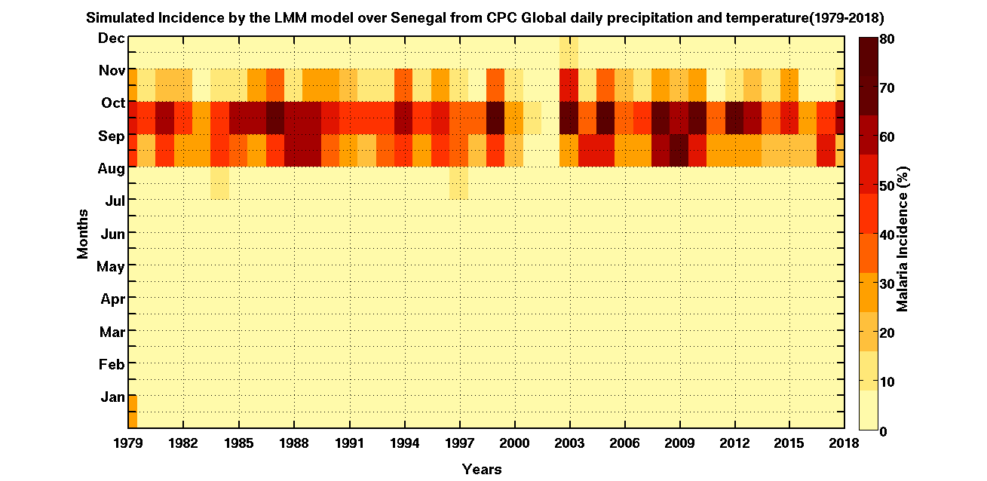
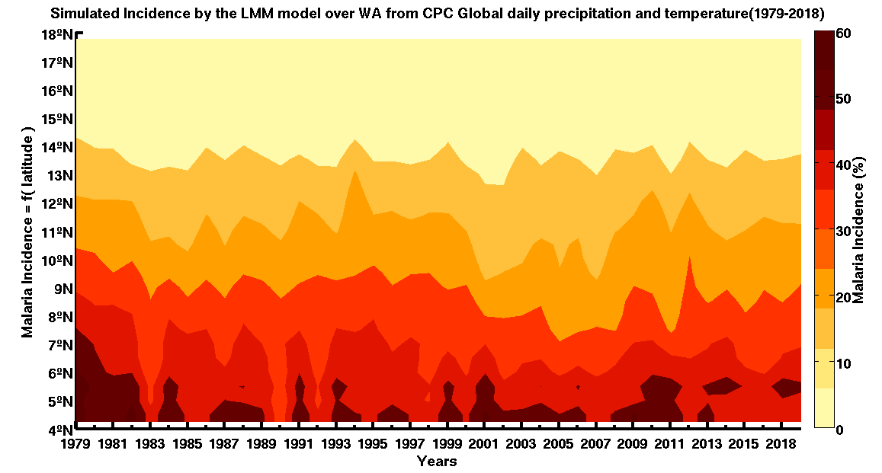
LMM Results in west Africa
Simulated intra/inter-annual variability of malaria incidence in WA from CPC Global daily rainfall and temperature (1979-2017). Maximum malaria incidence is simulated during Sept-Oct-Nov.
Spatial distribution of malaria incidence in WA from CPC Global daily rainfall and temperature (1979-2017). Maximum occurrence area is found in the South and South-eastern of West Africa.
Decrease in inter-annual variability and strong malaria incidence signal over the Southern latitudes

Slide 9
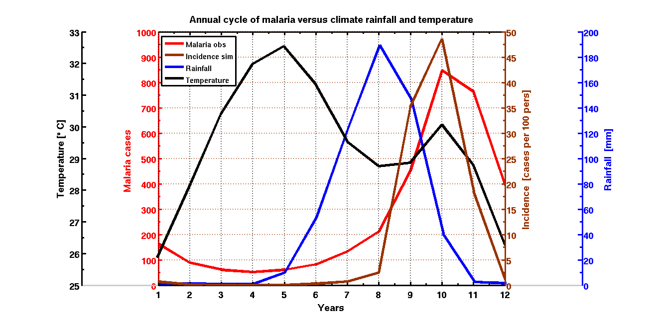
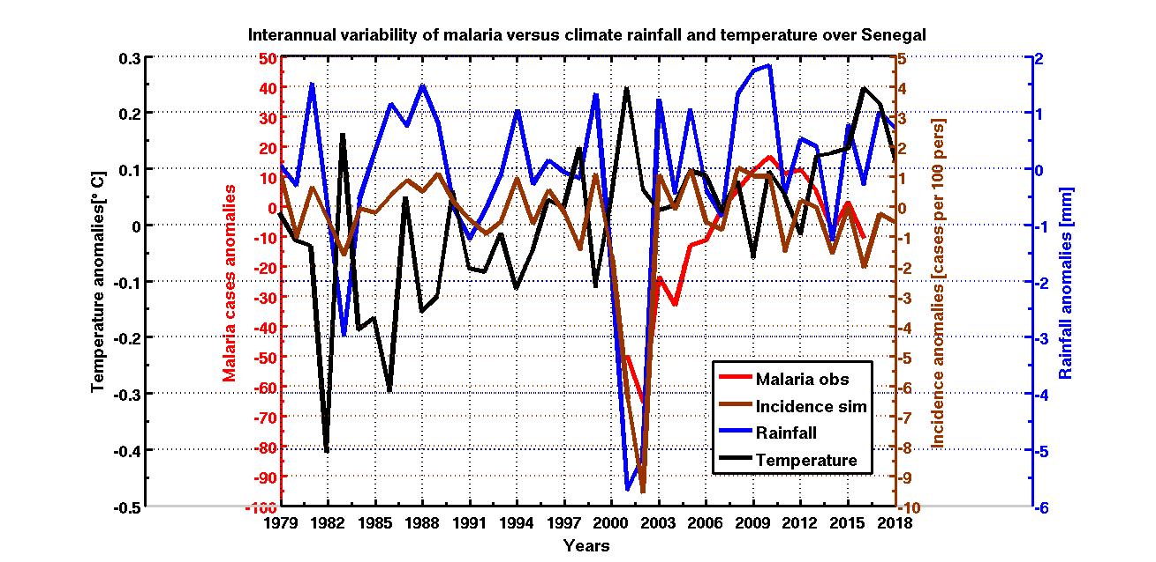
LMM Results vs. Observed Malaria in Senegal
Low malaria in 2001/2002 was implied by particularly dryness in Senegal during the period

Slide 10
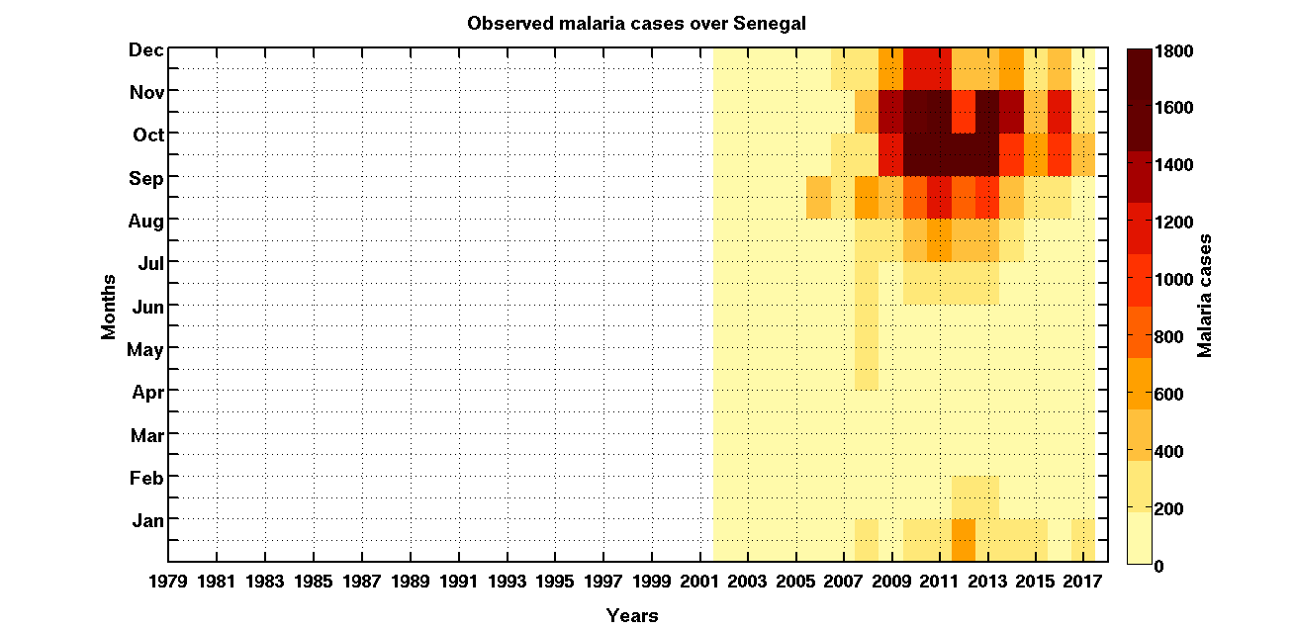
LMM Results vs. Observed Malaria in Senegal
Observed malaria cases malaria
Simulated malaria incidence

Slide 11
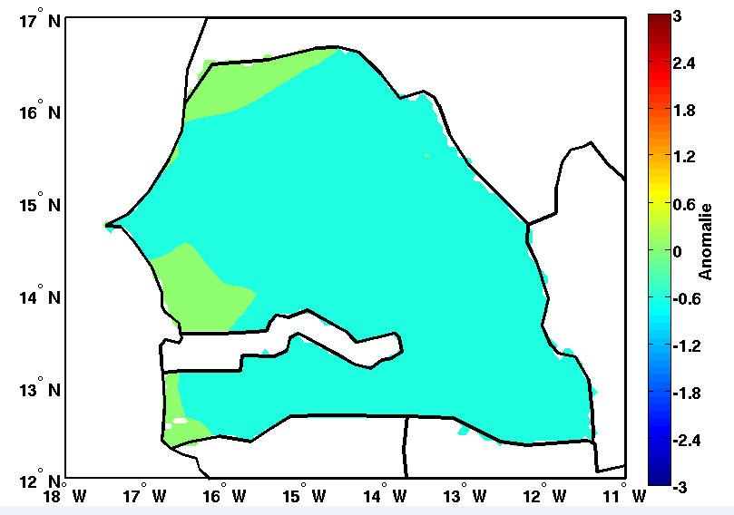
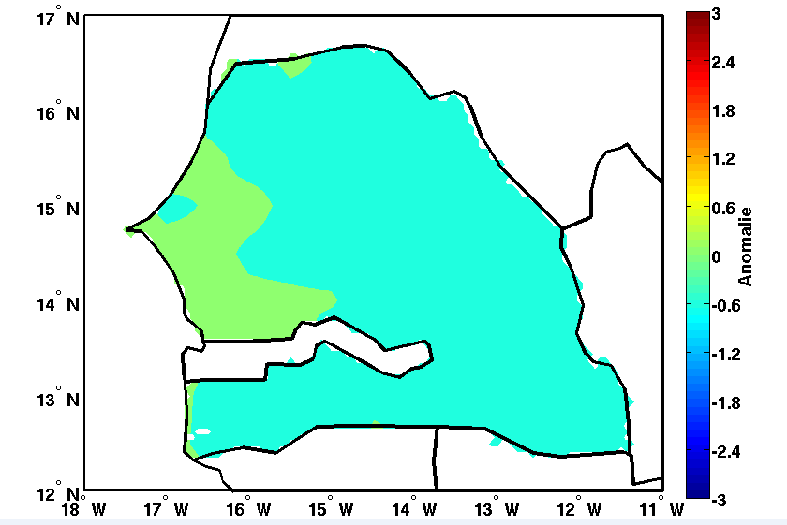
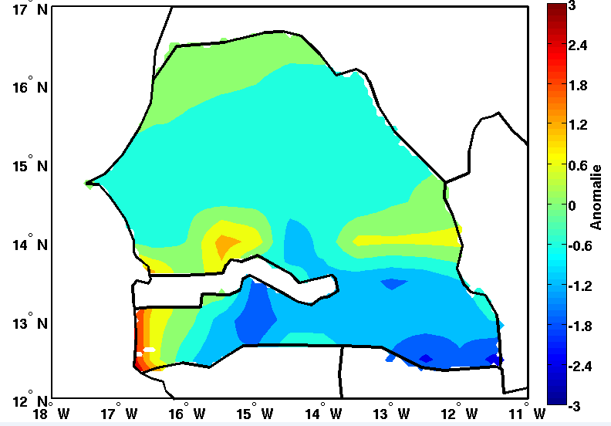
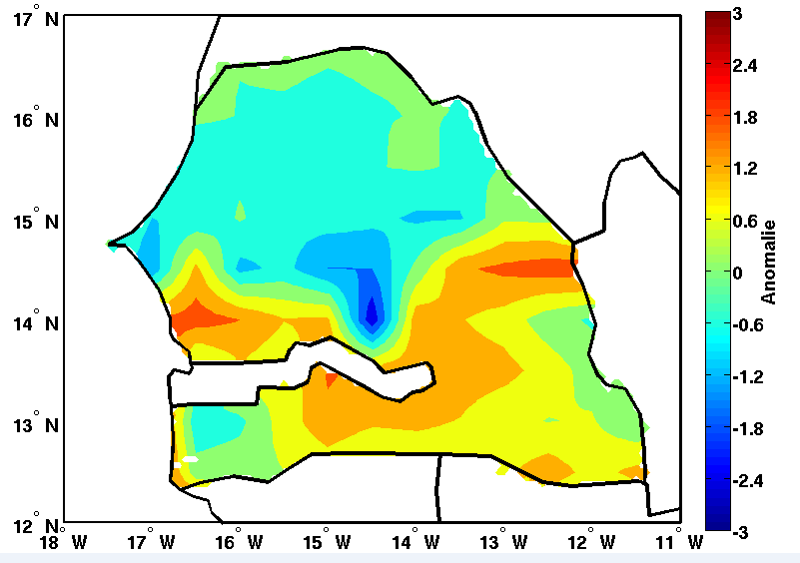
LMM Results vs. Observed Malaria in Senegal
1-31 July 2018
1-31 August 2018
1e-30 September 2018
1e-31 October 2018
In yellow to dark red color, we note an increase in the incidence for the month of October especially in the south-eastern area of Senegal; a drop in blue in the south in September. The situation is almost normal in July and August.

Slide 12
Diagnostically Study :
Malaria over Sahel and Senegal
in particular, Prediction Performance (sensitivity test to the different parts of the tropical oceans)

Slide 13
Target Season: For rainfall: July-August-September (JAS)
For malaria: September-October-November (SON)
Used lead Time: March (mainly) initial conditions
Predictor as SST :
SST (ERSSTv4) in March over the following ocean basins :
Tropical Pacific (TROP-PAC):15N-15S & 70W-120E
Golf of Guinea (GG): 5N-5S & 10E-10W
Tropical North Atlantic (TROP-NTH-ATL): 30N-10S & 15E-45W
NMME´s Models for MARic: CFSv2, CMC1, CMC2, GFDL-FLOR, GFLD, NASA, NCAR-CCSM4 and NMME in March over the same ocean basins
Predictands: Rainfall and Malaria parameters over Senegal :
ARC2 daily rainfall
Simulated Malaria by the LMM model from CPC global daily temperature, and daily ARC2 rainfall

Slide 14
Skill scores and correlation Skill maps
Target Season: JAS rainfall in Sahel

Slide 15
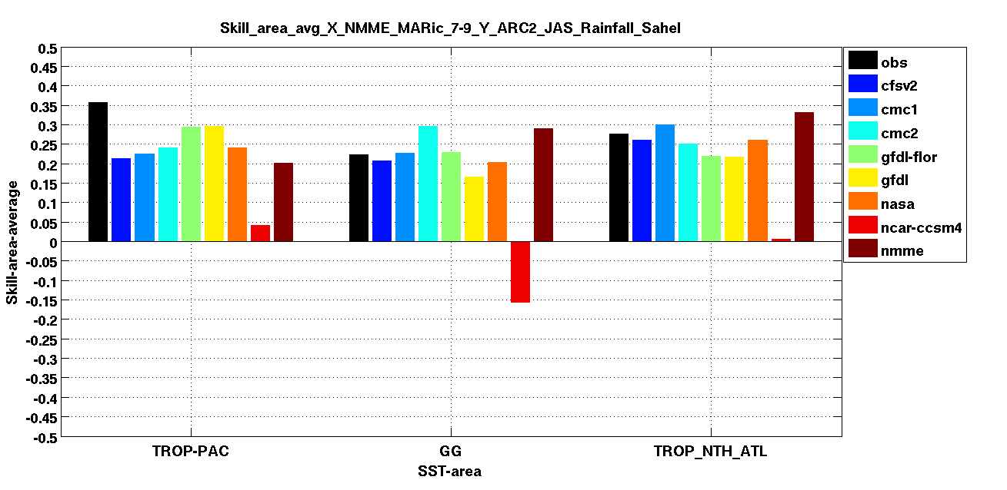
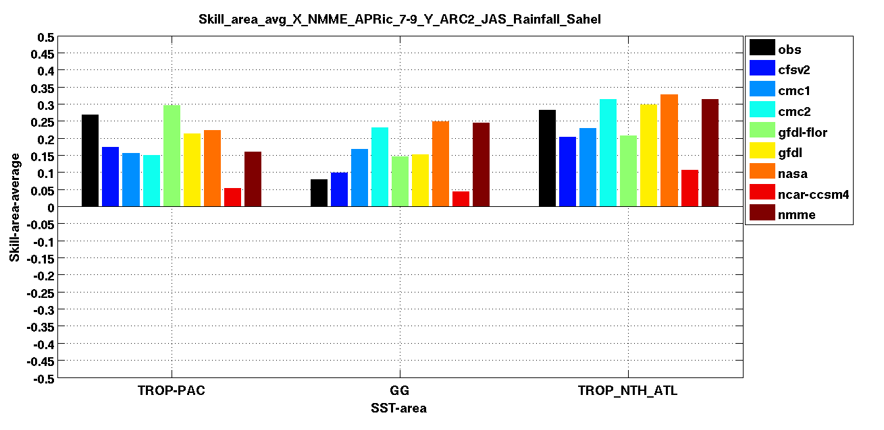
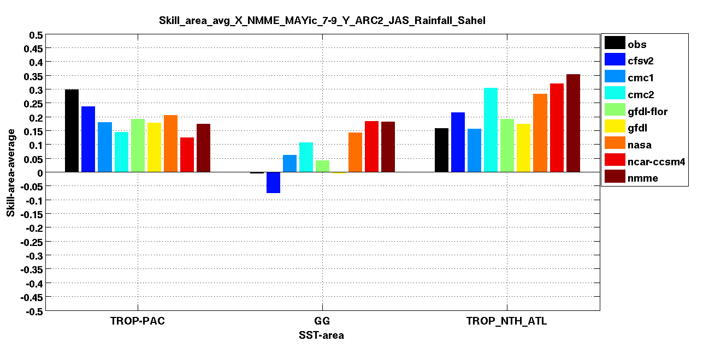
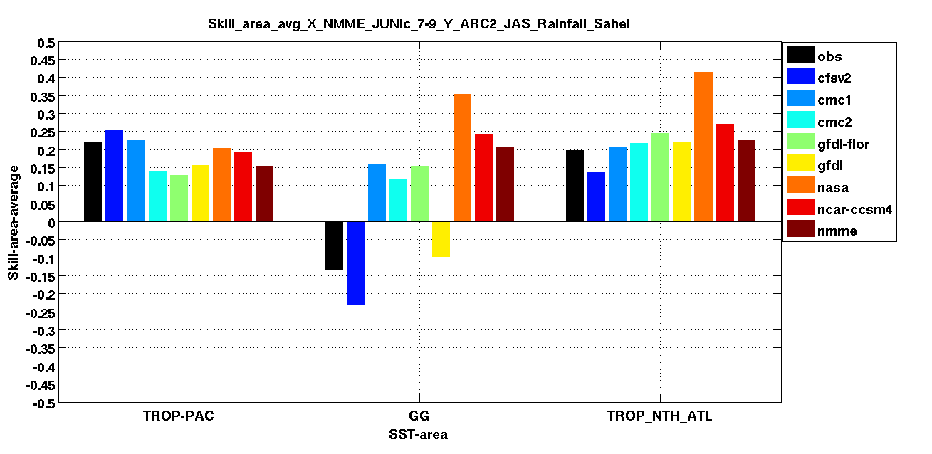
Skill scores distribution based on
SST from observation and NMMME models for different initial conditions
March
April
May
June

Slide 16
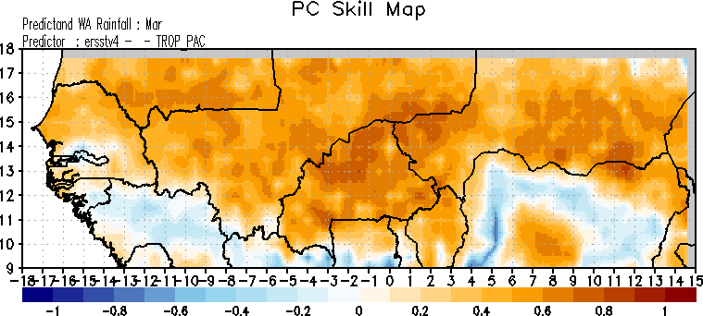
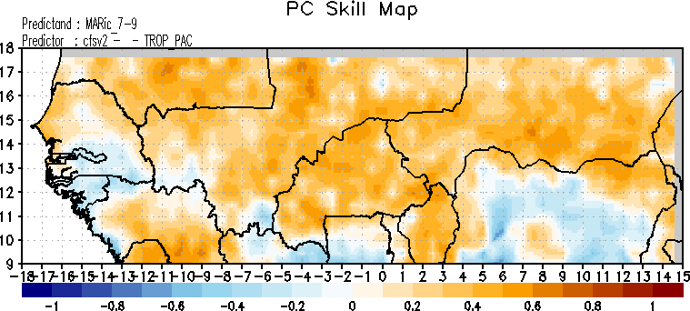
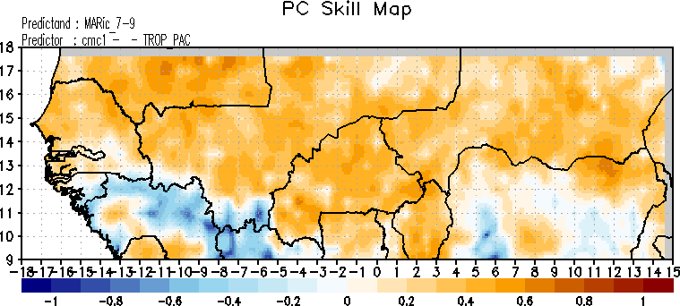
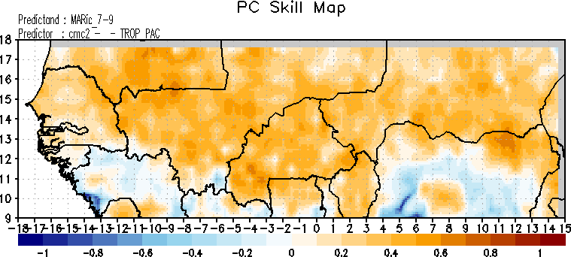
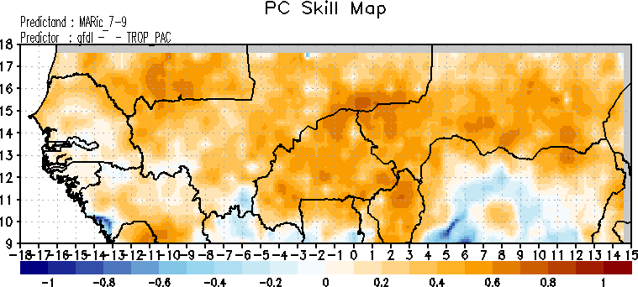
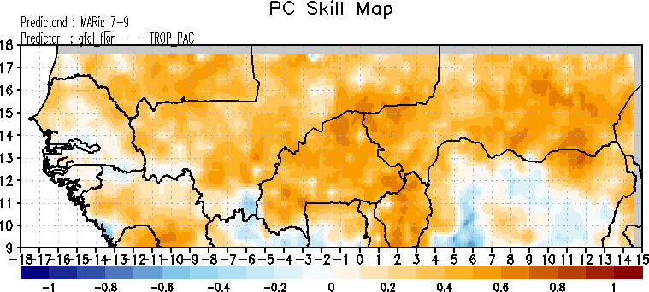
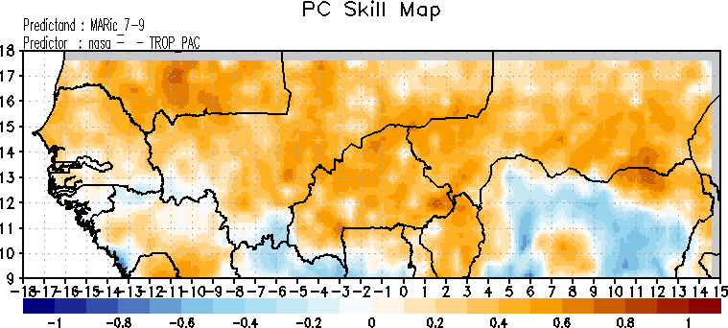
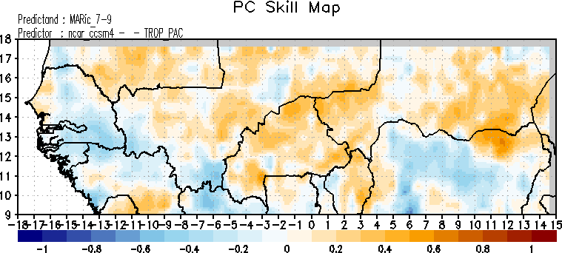
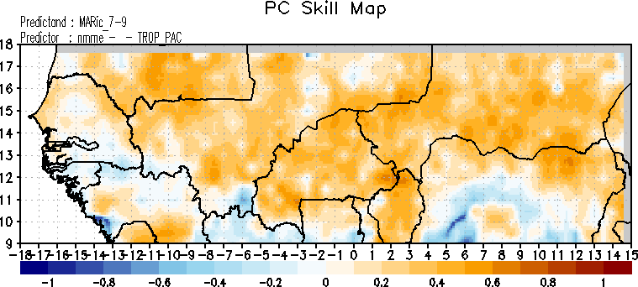
Correlation Skill Maps (ic_March, TROP-PAC), Target Season JAS
Obs
CFSV2 | CMC1 | CMC2 | GFDL
GFDL-floor | NASA | NCAR | NMME

Slide 17
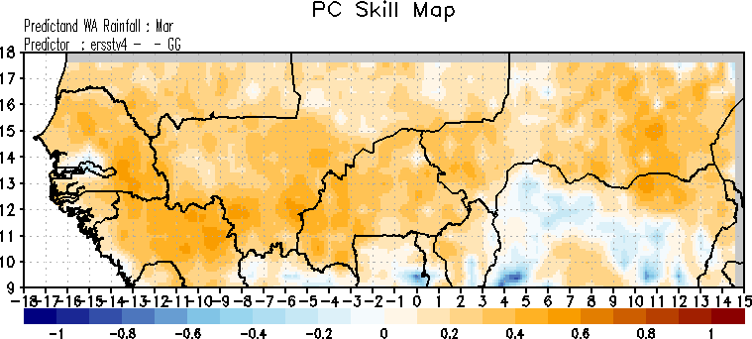
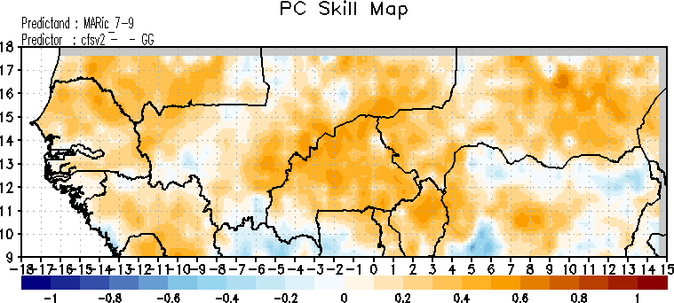
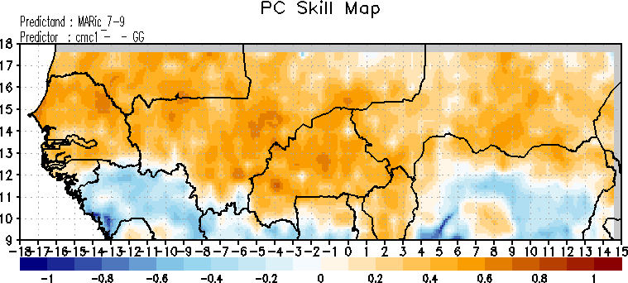
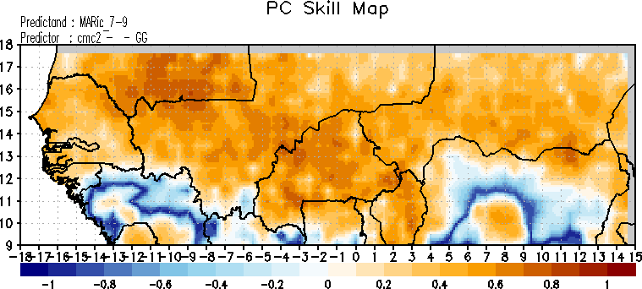
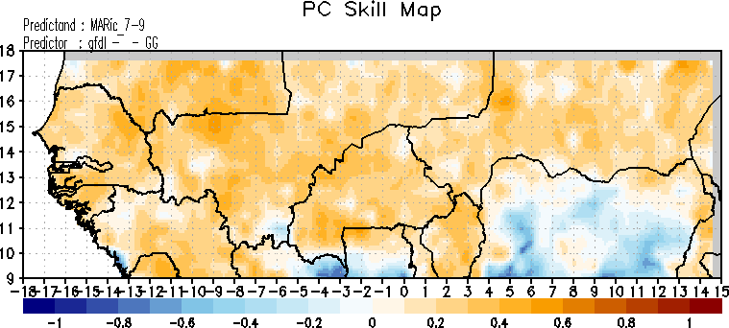
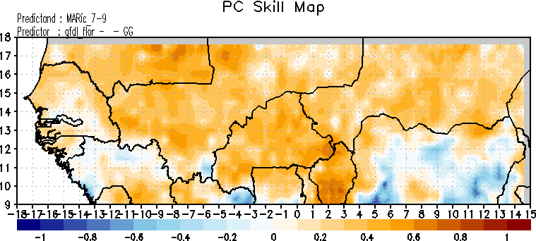
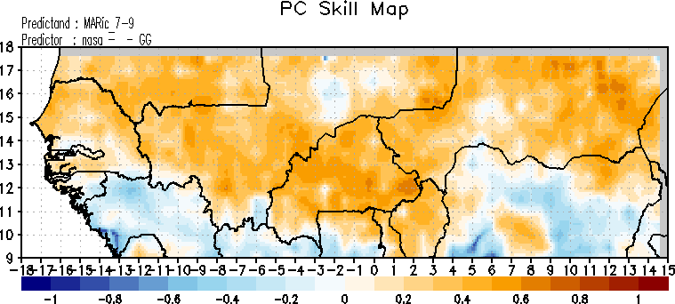
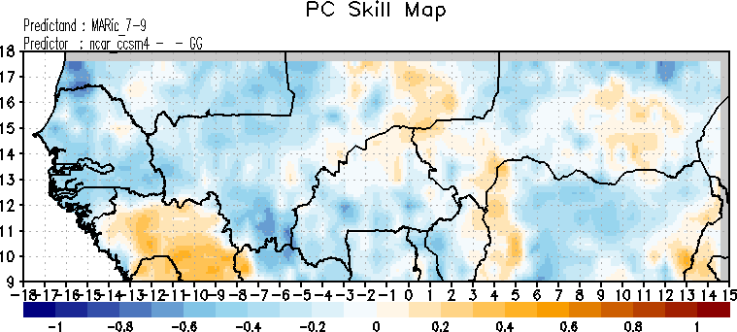
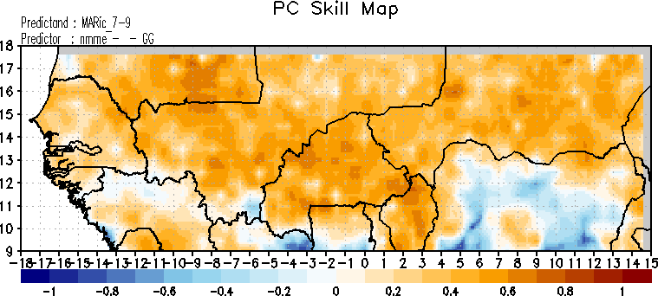
Correlation Skill Maps (ic_March, GG), Target Season JAS
Obs
CFSV2 | CMC1 | CMC2 | GFDL
GFDL-floor | NASA | NCAR | NMME

Slide 18
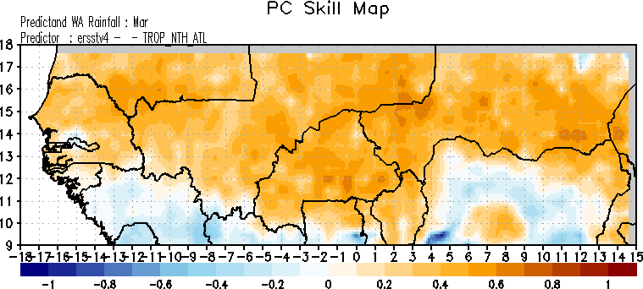
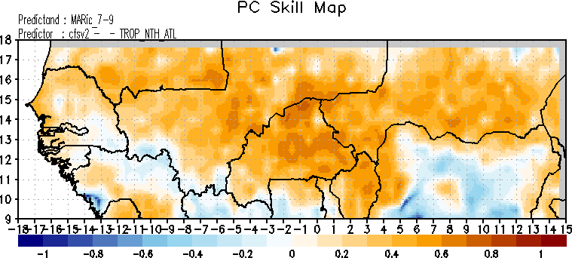
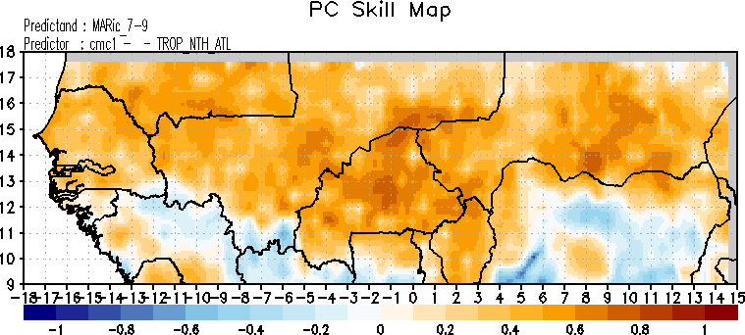
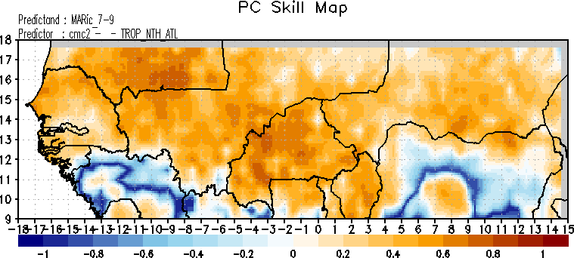
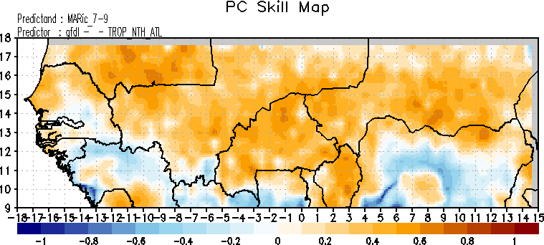
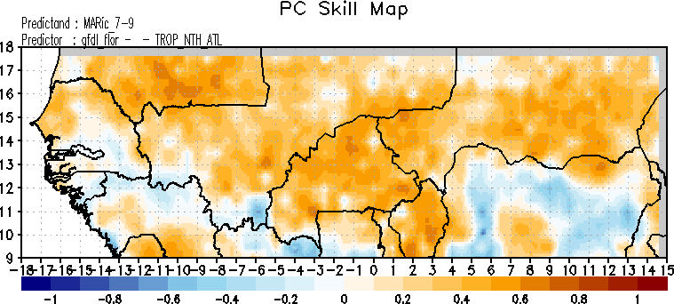
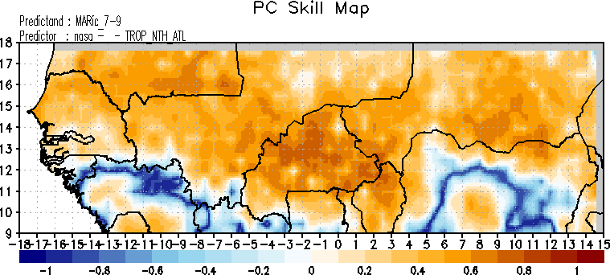
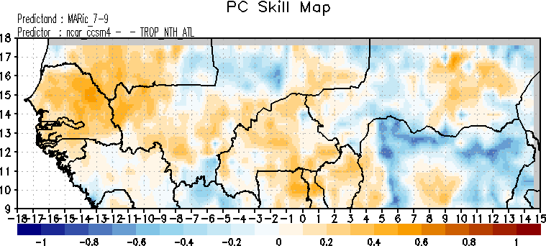
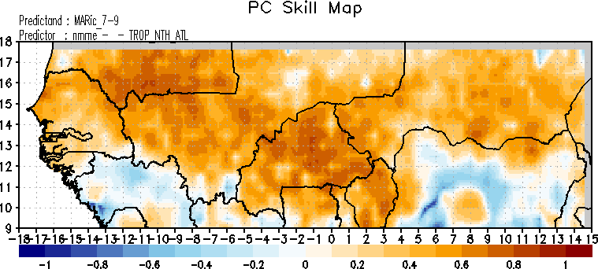
Correlation Skill Maps (ic_March, TROP-NTH-ATL), Target Season JAS
Obs
CFSV2 | CMC1 | CMC2 | GFDL
GFDL-floor | NASA | NCAR | NMME

Slide 19
Correlation Skill maps
Target Season: Malaria SON in Sahel

Slide 20
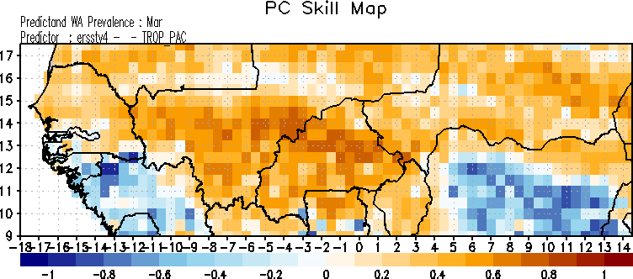
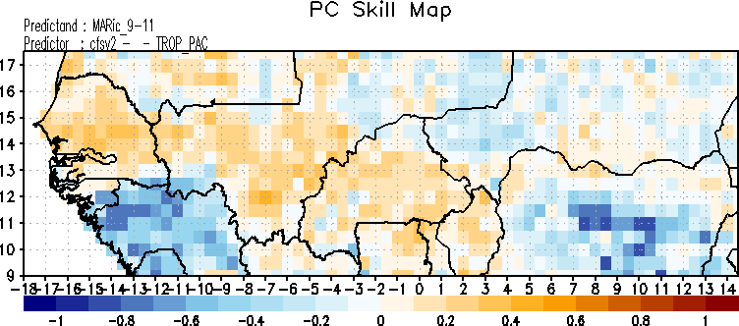
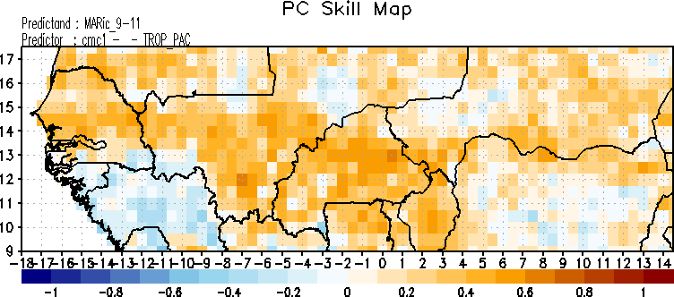
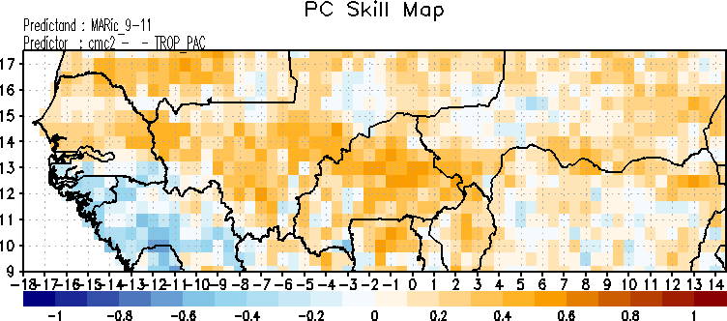
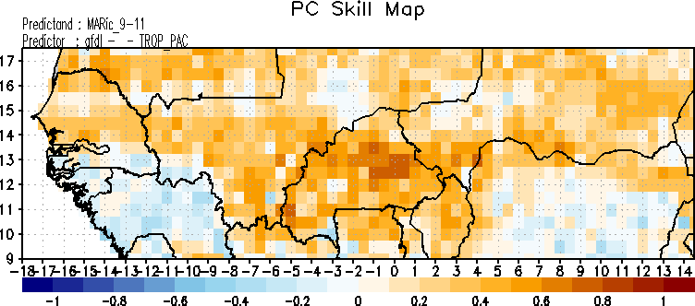




Correlation Skill Maps (ic_March, TROP-PAC), Target Season SON
Obs
CFSV2 | CMC1 | CMC2 | GFDL
GFDL-floor | NASA | NCAR | NMME

Slide 21









Correlation Skill Maps (ic_March, TROP-GG), Target Season SON
Obs
CFSV2 | CMC1 | CMC2 | GFDL
GFDL-floor | NASA | NCAR | NMME

Slide 22









Correlation Skill Maps (ic_March, TROP-NTH-ATL), Target Season SON
Obs
CFSV2 | CMC1 | CMC2 | GFDL
GFDL-floor | NASA | NCAR | NMME

Slide 23
Diagnostically Study : Malaria over Senegal Prediction Performance
(Sensitivity Test to Ocean Basins)

Slide 24









Correlation Skill Maps (ic_March, TROP-PAC), Target Season SON
Obs
CFSV2 | CMC1 | CMC2 | GFDL
GFDL-floor | NASA | NCAR | NMME

Slide 25









Correlation Skill Maps (ic_March, GG), Target Season SON
Obs
CFSV2 | CMC1 | CMC2 | GFDL
GFDL-floor | NASA | NCAR | NMME

Slide 26









Correlation Skill Maps (ic_March, TROP-NTH-ATL), Target Season SON
Obs
CFSV2 | CMC1 | CMC2 | GFDL
GFDL-floor | NASA | NCAR | NMME

Slide 27









X_CCA _ersstv4 and Y_CCA_ARC2-CPCglobal and CCA_TS (TROP_PAC, ic_Mar)
In the Tropical Pacific ocean, for mode 1, a positive anomalous SST signal (warming) is associated with a negative anomalous malaria signal (less malaria transmission). Very high relationship is found (r=0.70 for mode)
X_CCA _ersstv4 and Y_CCA_ARC2-CPCglobal and CCA_TS (GG, ic_Mar)
High correlation coefficients between GG SSTs and malaria (0.68) for mode 1. Cold SSTs imply less rainfall, so less malaria incidence.
X_CCA _ersstv4 and Y_CCA_ARC2-CPCglobal and CCA_TS,
X_CCA _ersstv4 and Y_CCA_ARC2-CPCglobal and CCA_TS (TROP_NTH_ATL, ic_Mar)
Mode 1 exhibits acceptable correlation coefficients between TROP_NTH_ATL SSTs and malaria (0.49). Negative anomalous SSTs is related with less malaria transmission over the northern regions of Senegal and slight positive signal in the south.

Slide 28
Conclusions and Perspectives
High malaria transmission in September-October-November corresponding to two months after the peak of rainfall in August;
Seasonal malaria transmission contrast is closely linked with the latitudinal variation of climatic covariates such as rainfall in West Africa
The relationship between observed and simulated malaria parameters is highlighted;
Good skills with Gulf of Guinea, the Tropical Pacific and the Global Tropics encouraging malaria prediction investigation in Sahel and Golf of Guinea.
Extending our diagnostic study using NMME predicted SST
Monitoring: Running the LMM and VECTRI for past 7days, 10 days and 30days based on monitored GDAS products and CPC station gridded data.
Notes:
La phrase tout entiere est a revoir, que voudrais-tu sur la conclusion de cette phrase? Il y a le contenu qui manque
Essaye d’eviter des mots assez drastique comme “evident”, si c’est le cas alors ajoute une reference. Tu peux utiliser des mots comme “visible”, “highlighed”, “has showned ”, “are observed”
“Plan to work” tu peux dire “Next step” ou “Working on”

Slide 29
Conclusions and Perspectives
Seasonal and sub-seasonal forecast applications:
Plan to run Week 3/4 forecast on malaria with LMM and VECTRI based on NCEP CFSv2 Model products
Other S2S methods if applicable to be included
Operational Real-Time Climate Information for Malaria
Provide access to real time climate information of potential benefit to the health sector over the region
Work with health and meteorological communities in Africa to generate periodic experimental risk maps for malaria in Senegal and West Africa.

Slide 30
THANK YOU FOR YOUR ATTENTION

