Slide 1



Symposium on the Global Climate System,
Ankara, Turkey, 24 – 26 April, 2019
Predictability on seasonal to decadal timescales in southern South America
Carolina Vera, Marisol Osman and Leandro Díaz
CIMA/Universidad de Buenos Aires-CONICET, UMI-IFAECI/CNRS
Argentina

Slide 2
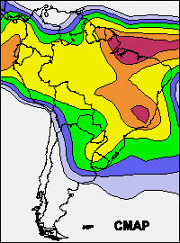
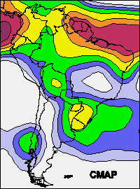
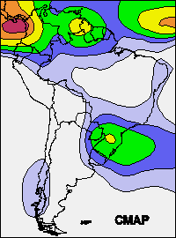
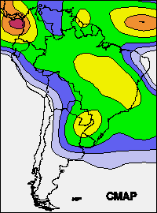
Precipitation Interannual Variability
JFM
AMJ
Observed Year-to-year Seasonal Precipitation Standard Deviation
(CMAP, 1979-1999)
JAS
OND
(Vera and Silvestri, 2009)

Slide 3
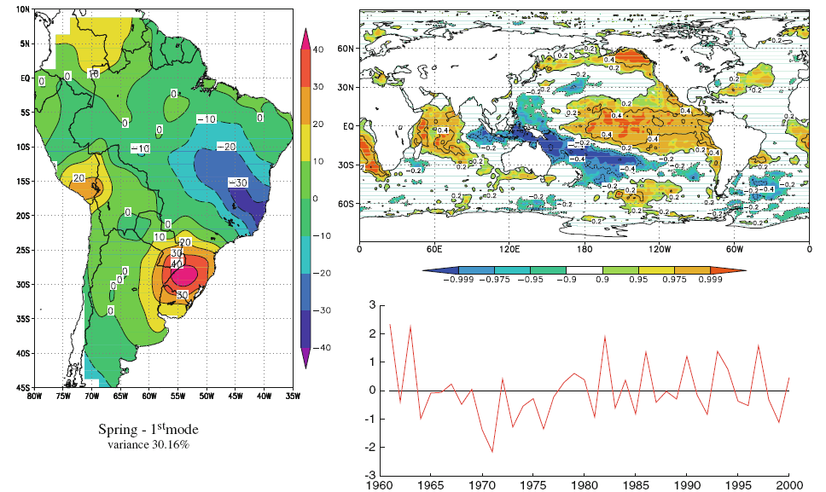
1st leading pattern of precipitation interannual variability in South America
SON Austral Spring
Spatial distribution (left panel) and temporal evolution (right
lower panel) of the first variability mode of precipitation anomaly, with explained variance and the map of correlation coefficients with SST (right panel).
(Grimm and Zili 2009)

Slide 4
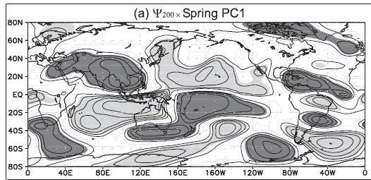
Atmospheric Teleconnections associated to 1st leading pattern of precipitation interannual variability in South America
SON Austral Spring
Changes in the Walker circulation
Rossby wave trains
Correlation coefficients between the spring PC1 of precipitation and the 200-hPa streamfunctions
(Grimm and Zili 2009)

Slide 5
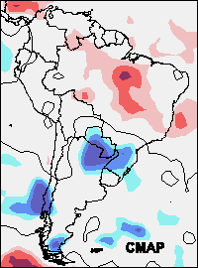
Southern Annular Mode (SAM)
OND (1979-1999)
Correlations between SAM index and (left) precipitation and (right) 500-hPa geopotential height anomalies. Significant values at 90, 95 and 99% are shaded. NCEP reanalysis data.
Silvestri and Vera (2003), Vera and Silvestri (2009)

Slide 6
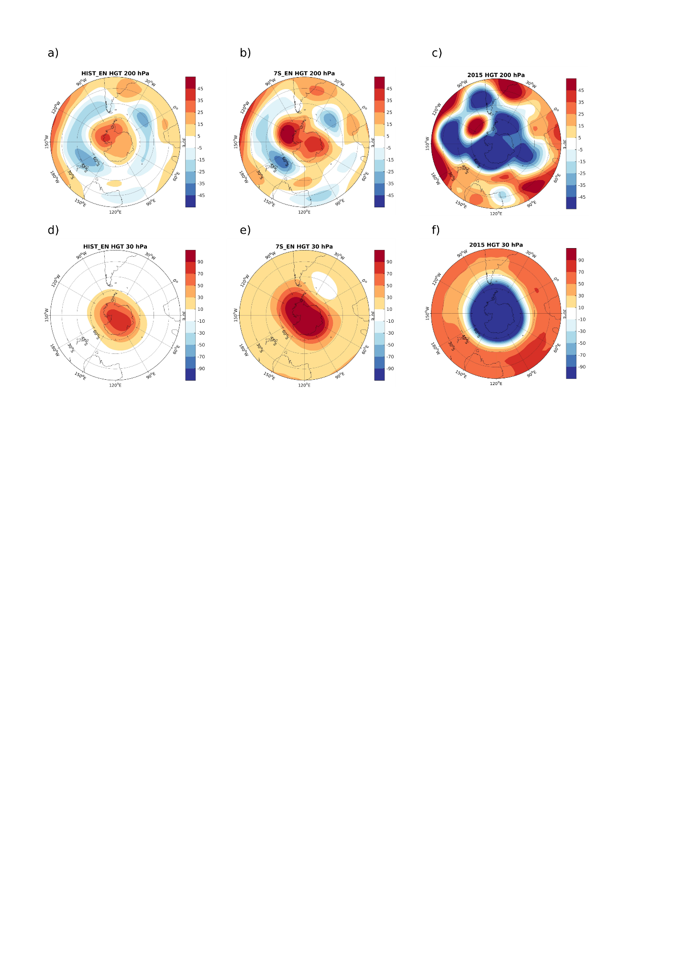
Hemispheric Circulation associated with ENSO and SAM
Composites of NDJ geopotential height anomalies
Hist EN
7S EN
2015-2016
200hPa
30hPa
Vera and Osman (2018)
Notes:
Then, we took a look at the spatial distribution of the HGT anomalies in NDJ at 200hPa and 300hPa for NDJ during all EN events, the 7S EN and EN 15-16. At the stratosphere, the typical positive anomalies observed during EN events, stronger for the 7S EN events are completely different in 2015-2016. At the upper troposphere, positive anomlies at poles observed during EN and 7S El niño also reversed their sign in EN 2015-2016. At midlatitudes, anomalies shifted northward in the souther Pacific while the negative anomaly at the south atlantic ocean moved southwestward

Slide 7
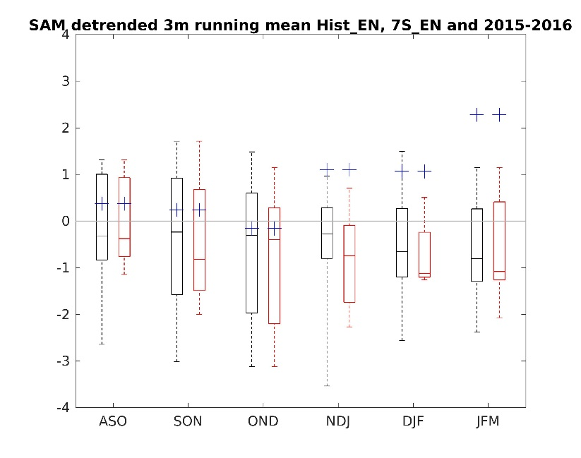
SAM 2015-2016 vs SAM during previous El Niño
Boxplots of the detrended SAM values associated with the Hist_EN events (black) and 7S_EN events (red).
Crosses indicate the SAM values for the seasons of 2015-2016.
From ASO to OND → SAM followed typical behavior
NDJ-JFM → Positive values higher than historical records
Vera and Osman (2018)
Notes:
Then we compared the behaviour of the SAM for 2015-2016 to that during previous EN. This figure shows boxplot of detrended SAM values during all EN events (in black) and 7S EN events (in red). Crosses are SAM values during 2015-2016 During winter and early spring SAM follows the typical progression towards negative values expected in ENSO events. However, in late spring and summer SAM presented anomalous positive values, especially in JFM, never attained during EN nor 7S EN events.

Slide 8
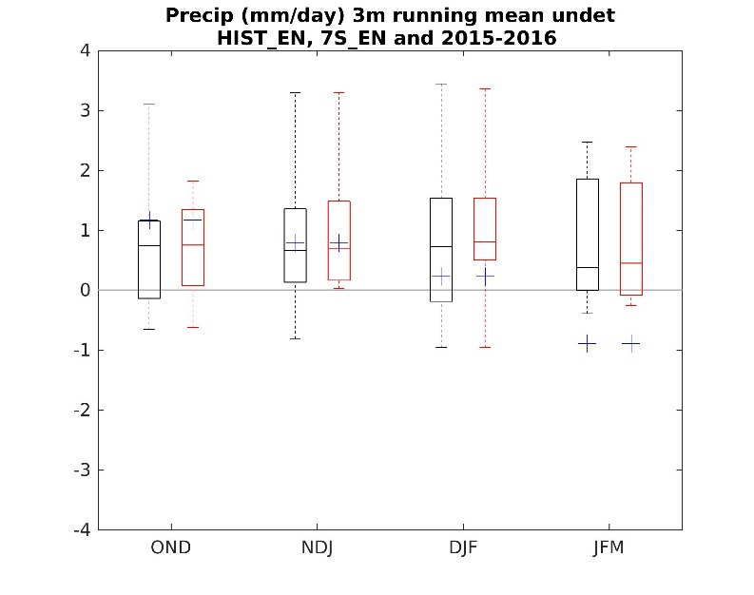
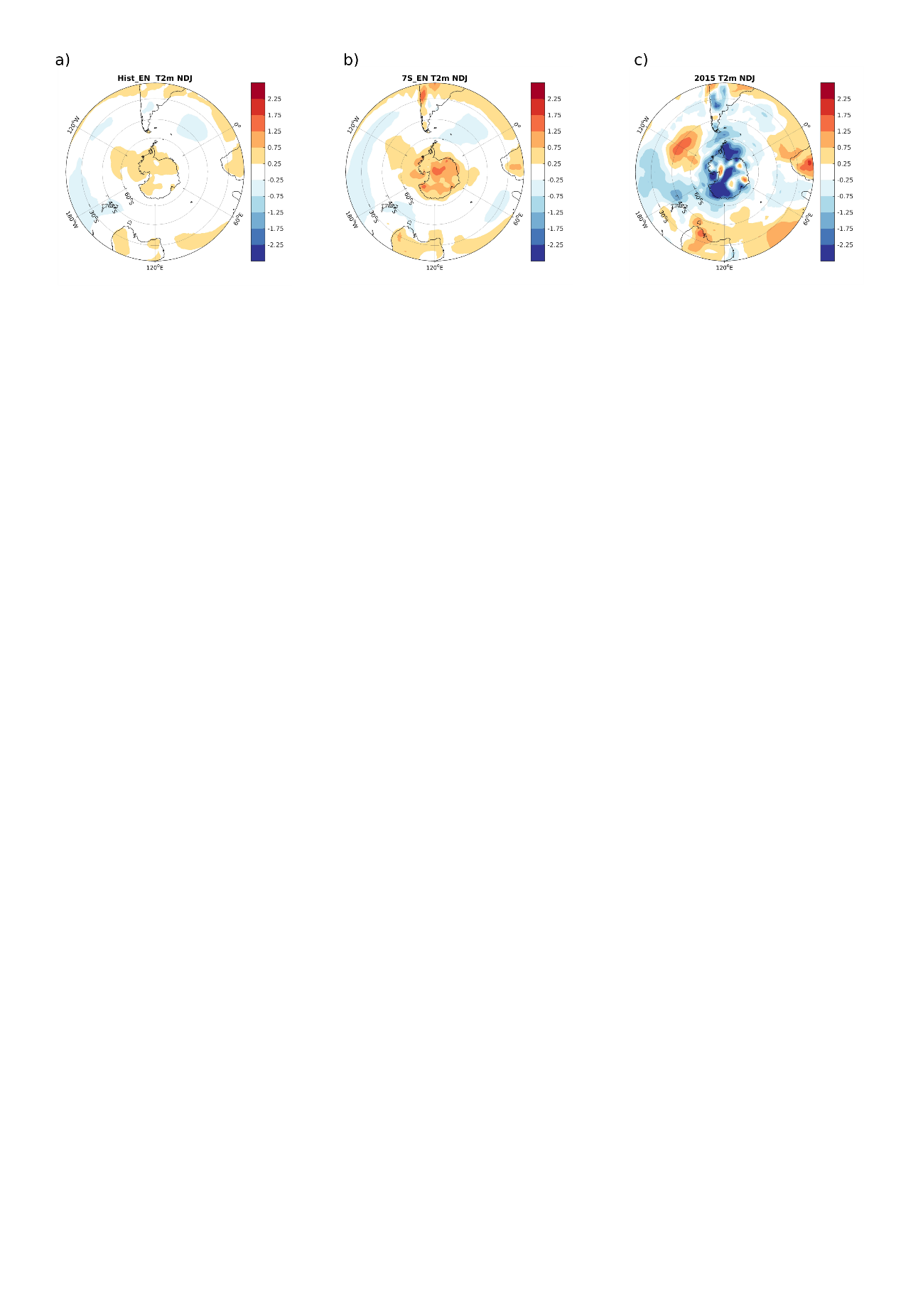
Impacts on Regional climate
Precipitation anomalies in southeastern South America
Temperature anomalies in Antarctica
Hist EN
7S EN
2015-2016
Vera and Osman (2018)
Notes:
The changes observed at the hemisperical circulation impacted in the T2m and pp anomalies. As an example, we calculated the boxplot of precipitation anomalies at South Eastern South America for EN, and 7S EN and 15-16. During spring and early summer pp anomalies follow the expected behaviour and flood were observed there. However, in JFM anomalies were anomalously negative, never recorded. This helped to mitigate the floods previously observed. Temperature anomalies were also completely different over most of the Artarctica since anomalies in 2015-2016 were negative while they tend to be positive in EN years

Slide 9
Seasonal predictability from CHFP models
All years ENSO years
DJF
JJA
Regional precipitation predictability increase in association with ENSO is mostly explained by increments in the signal rather than by noise reductions.
(Osman and Vera 2017).

Slide 10
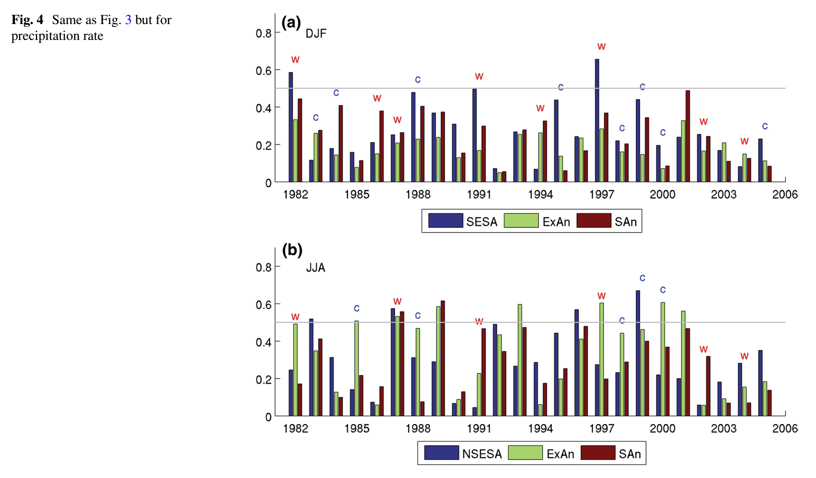
Predictability changes from year to year
Potential Predictability (Signal/(Signal+Noise) of DJF precipitation anomalies in Southeastern South America (SESA), extratropical Andes (ExAn) and southern Andes (SAn). ENSO warm events (W) and cold events (C) are highlighted.
(Osman and Vera 2017).

Slide 11
How is year-to-year climate variability and change in southern South America?

Slide 12
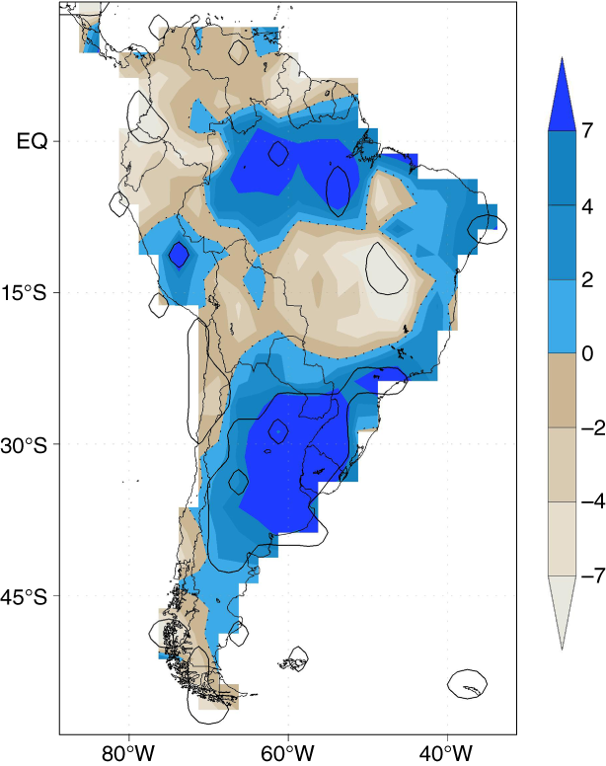
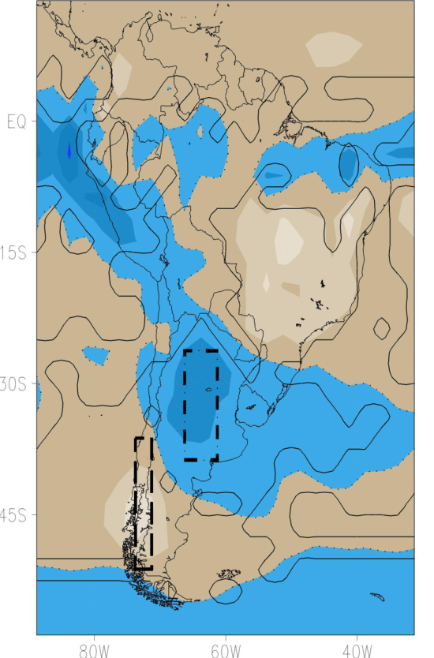
DJF Rainfall linear trends
1902-2005 (mm/summer/decade)
CMIP5 Historical simulations(H)
Multi-model Ensemble (MEM)
Observations (GPCC)
Vera and Díaz (2015)

Slide 13
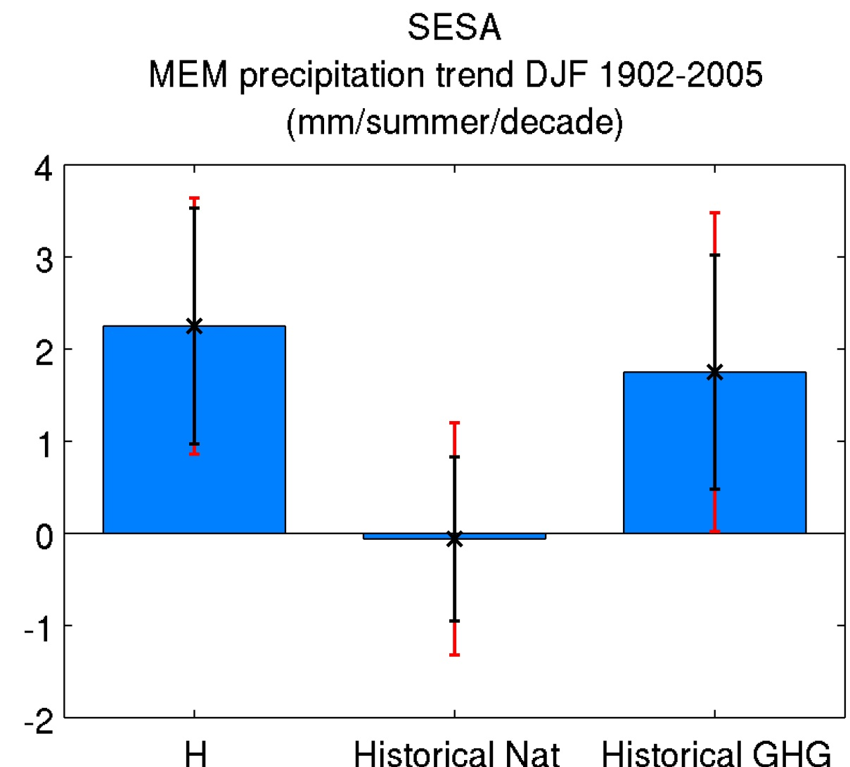
Anthropogenic forcing in CMIP5 models has a detectable influence in explaining the precipitation trends in SESA.
Uncertainties associated with model differences and internal climate variability are large
Inter-model dispersion
Inter-member dispersion
Vera and Díaz (2015)

Slide 14
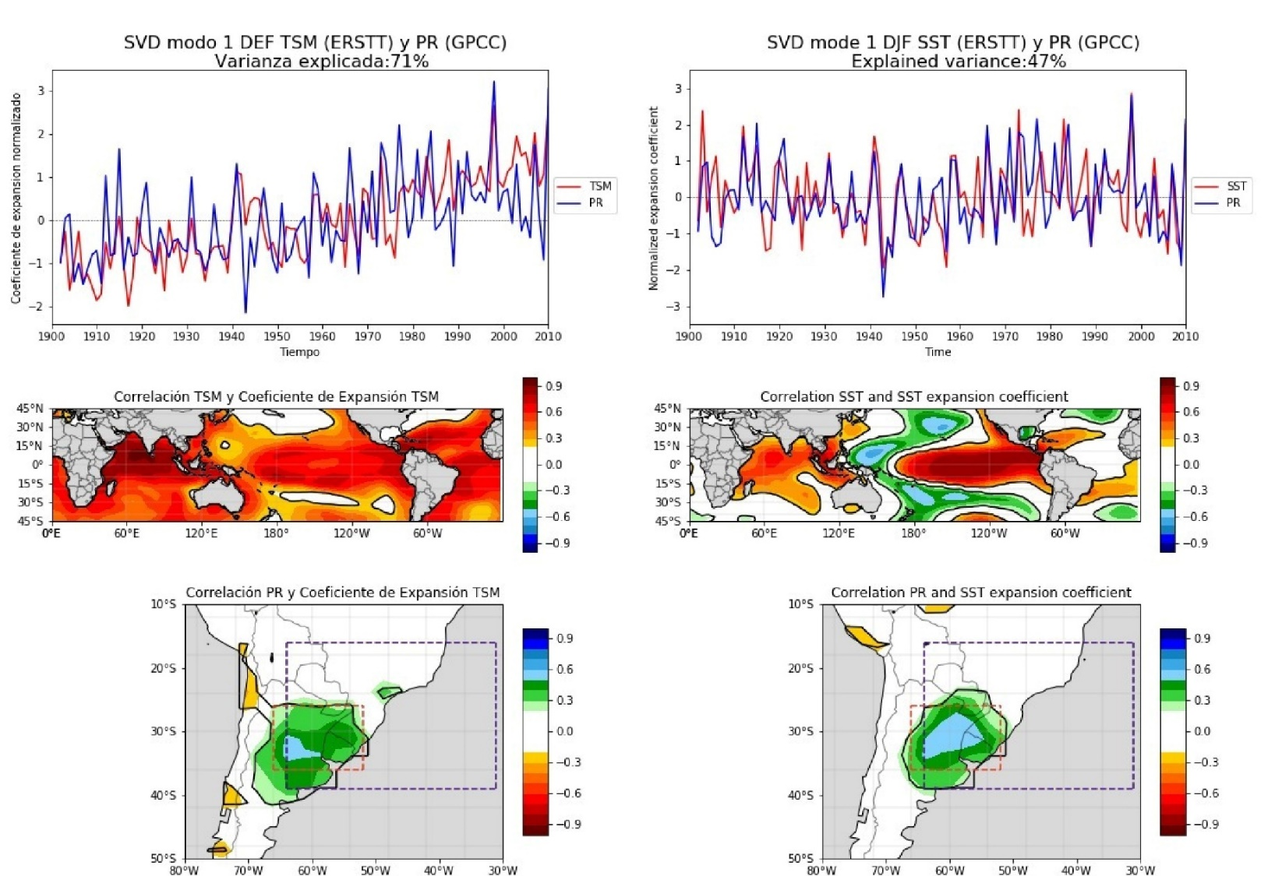
How is the multi-scale nature of the climate variability and change in South America?
1st SVD MODE DJF 1902-2010 SST(ERSST) PP(GPCC)​
With trend
detrended
A singular value decomposition (SVD) analysis was performed between SST Anomalies (45ºS-45ºN) and SESA precipitation Anomalies

Slide 15
How the regional climate variability in South America will evolve in the next years-decades largely depends on:
the internal natural variability mostly associated with the tropical ocean evolution
The external climate forcing associated with both natural and anthropogenic sources

Slide 16
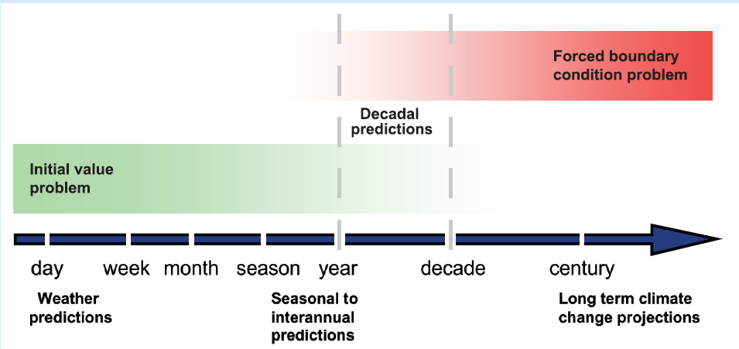
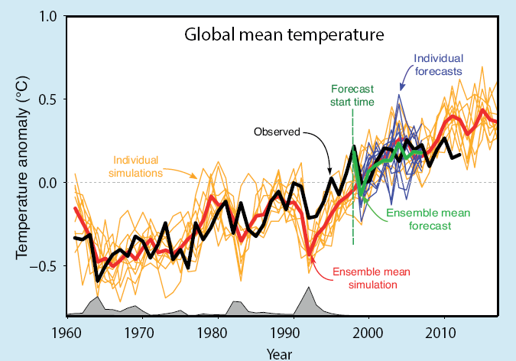
CMIP5 included for the first time global climate predictions on decadal scales (10 an 30 years long, starting from 1960 to 2005)
(Meehl et al. 2009)
Climate decadal predictions are expected to contribute to:
Reduce the uncertainties associated with the future natural variability
predict the phases of the climate variability for the following years-decades.
IPCC-AR5
Notes:
Progression from initial value problems with daily weather forecasts at one end, and multidecadal to century projections as a forced boundary condition problem at the other, with seasonal and decadal prediction in between. At the edge between seasonal forecasting and climate change projections, near-term climate predictions exploit both the predictability of the climate system arising from the
initial-condition information and from the changes in radiative external forcings (Hawkins and Sutton 2009b).
Box 11.1, Figure 1 | The evolution of observation-based global mean temperature T (the black line) as the difference from the 1986–2005 average together with an ensemble of externally forced simulations to 2005 and projections based on the RCP4.5 scenario thereafter (the yellow lines). The model-based estimate of the externally forced component Tf (the red line) is the average over the ensemble of simulations. To the extent that the red line correctly estimates the forced component, the difference between the black and red lines is the internally generated component Ti for global mean temperature. An ensemble of forecasts of global annual mean temperature, initialized in 1998, is plotted as thin purple lines and their average, the ensemble mean forecast, as the thick green line. The grey areas along the axis indicate the presence of external forcing associated with volcanoes.
Box 11.1, Figure 2 | A schematic illustrating the progression from an initial-value based prediction at short time scales to the forced boundary-value problem of climate projection at long time scales. Decadal prediction occupies the middle ground between the two. (Based on Meehl et al., 2009b.)

Slide 17
Can climate models predict the ocean variability influencing South America?
Pacific Decadal Oscillation
ENSO
Tropical Indian Ocean

Slide 18
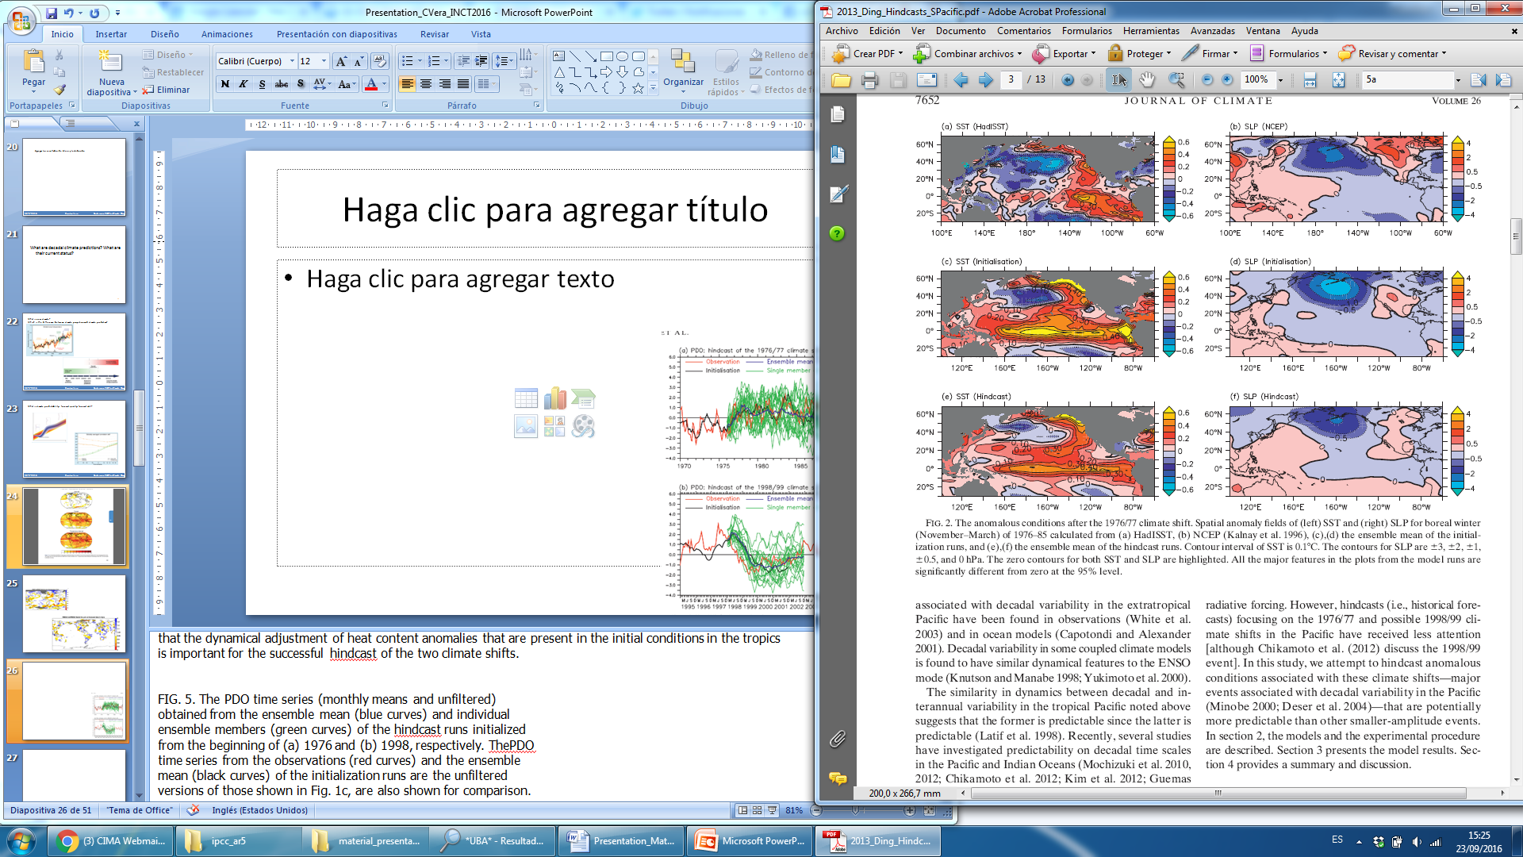
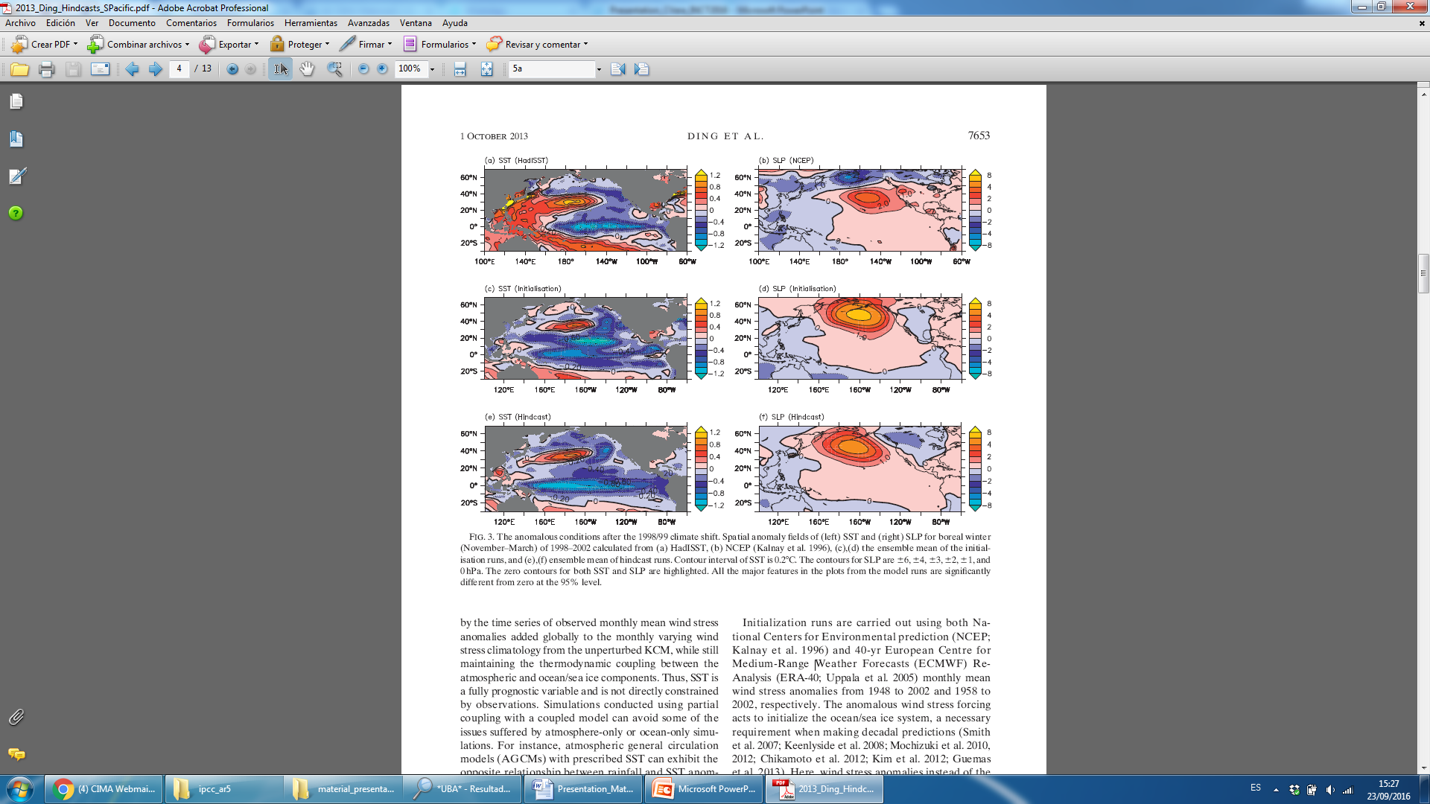
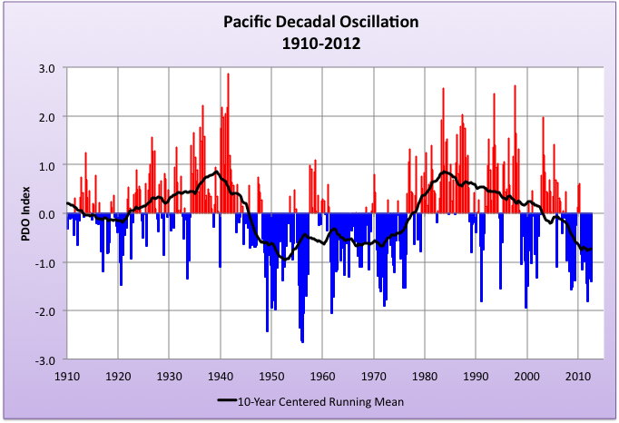
Decadal Predictions of the Pacific Decadal Oscillation (PDO)
PDO Positive Phase PDO negative Phase
(1976-1985) (1998-2002)
Observations
Decadal prediction by Kiel Climate Model
Observed evolution of the PDO index (detrended)
Ding et al. (2013)
Notes:
Ding et al. (2013) used coupled ocean–atmosphere–sea ice model to hindcast (i.e., historical forecast) recent climate variability is described and illustrated for the cases of the 1976/77 and 1998/99 climate shift events in the
Pacific. The initialization is achieved by running the coupled model in partially coupled mode whereby global
observed wind stress anomalies are used to drive the ocean/sea ice component of the coupled model while
maintaining the thermodynamic coupling between the ocean/sea ice and atmosphere components. Here it
is shown that hindcast experiments can successfully capture many features associated with the 1976/77 and
1998/99 climate shifts. For instance, hindcast experiments started from the beginning of 1976 can capture sea
surface temperature (SST) warming in the central-eastern equatorial Pacific and the positive phase of the
Pacific decadal oscillation (PDO) throughout the 9 years following the 1976/77 climate shift, including the
deepening of the Aleutian low pressure system. Hindcast experiments started from the beginning of 1998 can
also capture part of the anomalous conditions during the 4 years after the 1998/99 climate. The authors argue
that the dynamical adjustment of heat content anomalies that are present in the initial conditions in the tropics
is important for the successful hindcast of the two climate shifts.
FIG. 2. The anomalous conditions after the 1976/77 climate shift. Spatial anomaly fields of (left) SST for boreal winter (November–March) of 1976–85 calculated from (a) HadISST, (e) the ensemble mean of the hindcast runs
FIG. 3. The anomalous conditions after the 1998/99 climate shift. Spatial anomaly fields of (left) SST for boreal winter (November–March) of 1998–2002 calculated from (a) HadISST, and (e),(f) ensemble mean of hindcast runs.
FIG. 5. The PDO time series (monthly means and unfiltered)
obtained from the ensemble mean (blue curves) and individual
ensemble members (green curves) of the hindcast runs initialized
from the beginning of (a) 1976 and (b) 1998, respectively. ThePDO
time series from the observations (red curves) and the ensemble
mean (black curves) of the initialization runs are the unfiltered
versions of those shown in Fig. 1c, are also shown for comparison.

Slide 19
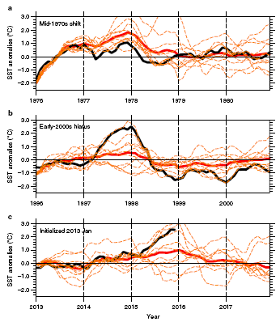
Decadal Predictions of the Pacific Decadal Oscillation (PDO)
Initialized predictions of eastern equatorial Pacific sea surface temperatures.
Observations
Individual model ensemble members
Model ensemble mean
(NCAR/CCSM4 Model)
Meehl et al. (2016)
Notes:
Ding et al. (2013) used coupled ocean–atmosphere–sea ice model to hindcast (i.e., historical forecast) recent climate variability is described and illustrated for the cases of the 1976/77 and 1998/99 climate shift events in the
Pacific. The initialization is achieved by running the coupled model in partially coupled mode whereby global
observed wind stress anomalies are used to drive the ocean/sea ice component of the coupled model while
maintaining the thermodynamic coupling between the ocean/sea ice and atmosphere components. Here it
is shown that hindcast experiments can successfully capture many features associated with the 1976/77 and
1998/99 climate shifts. For instance, hindcast experiments started from the beginning of 1976 can capture sea
surface temperature (SST) warming in the central-eastern equatorial Pacific and the positive phase of the
Pacific decadal oscillation (PDO) throughout the 9 years following the 1976/77 climate shift, including the
deepening of the Aleutian low pressure system. Hindcast experiments started from the beginning of 1998 can
also capture part of the anomalous conditions during the 4 years after the 1998/99 climate. The authors argue
that the dynamical adjustment of heat content anomalies that are present in the initial conditions in the tropics
is important for the successful hindcast of the two climate shifts.
FIG. 2. The anomalous conditions after the 1976/77 climate shift. Spatial anomaly fields of (left) SST for boreal winter (November–March) of 1976–85 calculated from (a) HadISST, (e) the ensemble mean of the hindcast runs
FIG. 3. The anomalous conditions after the 1998/99 climate shift. Spatial anomaly fields of (left) SST for boreal winter (November–March) of 1998–2002 calculated from (a) HadISST, and (e),(f) ensemble mean of hindcast runs.
FIG. 5. The PDO time series (monthly means and unfiltered)
obtained from the ensemble mean (blue curves) and individual
ensemble members (green curves) of the hindcast runs initialized
from the beginning of (a) 1976 and (b) 1998, respectively. ThePDO
time series from the observations (red curves) and the ensemble
mean (black curves) of the initialization runs are the unfiltered
versions of those shown in Fig. 1c, are also shown for comparison.

Slide 20
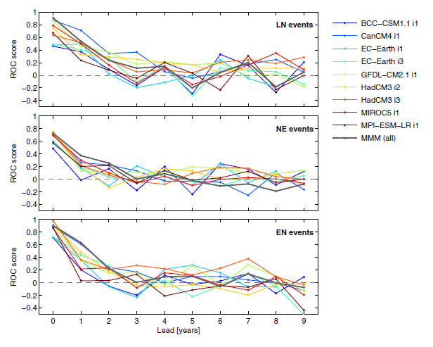
CMIP5 decadal probabilistic prediction skill for DJF ENSO phases
La Niña
ENSO-Neutral
El Niño
Gonzalez and Goddard (2016)
Notes:
Gonzalez and Goddard (2016)

Slide 21
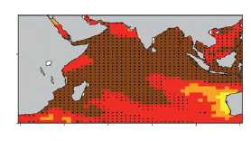
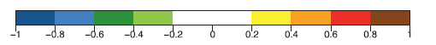
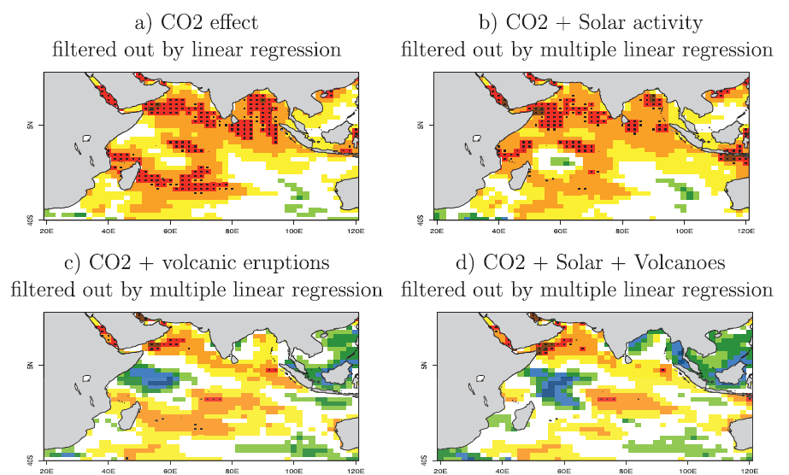
A high SST skill in the Indian Ocean: Contribution of the external forcings
Correlation between the ensemble-mean predicted and ERSST sea surface temperature anomalies for CMIP5 Init predictions
Guemas et al. (2016)
Notes:
Fig. 1 (a),(b) Correlation between the ensemble-mean predicted and ERSST sea surface temperature anomalies (8C) averaged across
the forecast times ranging from 2 to 5 and 6 to 9 years in the CMIP5 Init decadal hindcasts. The black dotted regions indicate where the
correlation is significant to the 95%level according to a t test that accounts for the autocorrelation of the data. (c),(d) Skill scores computed
against theERSST data across the start dates, longitude, and latitude dimensions simultaneously after applying a 4-yr running mean: correlation
skill and RMSE for the Indian (408S–308N, 208–1208E), North Atlantic (08–658N, 1008W–408E), North Pacific (08–658N, 1008–2608E), South
Atlantic (458S–08, 758W–208E), South Pacific (458S–08, 1208–2858E), and Southern (708–458S) Oceans in CMIP5 Init hindcasts.
Fig. 2 (left),(middle) Correlation between the ensemble-mean predicted and ERSST sea surface temperature anomalies averaged across the forecast times ranging from(a),(c) 2 to 5 and (b),(d) 6 to 9 years in the (a),(b)CMIP5 decadal hindcasts.The left and middle columns correspond respectively to the Init and NoInit ensembles. Difference in correlation between the (a),(b) CMIP5 Init (5-yr start dates) decadal hindcasts and the CMIP5 NoInit historical simulations.
Fig. 3: Correlation between the ensemble-mean predicted and ERSST sea surface temperature anomalies averaged across the forecast times ranging from 2 to 5 years in the (a)–(d) CMIP5 Init decadal hindcasts and (e) CMIP5 NoInit historical simulations after (e) c),(e) after filtering out the anthropogenic greenhouse gas warming effect and the volcanic eruption effect by a multiple linear regression onto the base-2 logarithm of
the Mauna Loa CO2 concentration and stratospheric optical thickness at 550 nm.
The Indian Ocean stands out as the region where the state-of-the-art decadal climate predictions of sea
surface temperature (SST) perform the best worldwide for forecast times ranging from the second to the
ninth year, according to correlation and root-mean-square error (RMSE) scores. This paper investigates the
reasons for this high skill by assessing the contributions from the initial conditions, greenhouse gases, solar
activity, and volcanic aerosols. The comparison between the SST correlation skill in uninitialized historical
simulations and hindcasts initialized fromestimates of the observed climate state shows that the high Indian
Ocean skill is largely explained by the varying radiative forcings, the latter finding being supported by a set
of additional sensitivity experiments. The long-term warming trend is the primary contributor to the high
skill, though not the only one. Volcanic aerosols bring additional skill in this region as shown by the
comparison between initialized hindcasts taking into account or not the effect of volcanic stratospheric
aerosols and by the drop in skill when filtering out their effect in hindcasts that take them into account.
Indeed, the Indian Ocean is shown to be the region where the ratio of the internally generated over the
externally forced variability is the lowest, where the amplitude of the internal variability has been estimated
by removing the effect of long-term warming trend and volcanic aerosols by a multiple least squares linear
regression on observed SSTs.

Slide 22
Can climate models predict SVD1?
1st SVD MODE DJF
MEM Init Lead Time 1
MEM Init Lead Time 4
Good SVD1 representation in Hindcasts, even for higher lead times

Slide 23
Can climate models predict SVD1?
CMIP5 decadal prediction skill for detrended SVD1
Initialization improves prediction for first two years (Skill > 0.3)
MEM improves Individual models

Slide 24
How does global warming influence SVD1 predictability?
CMIP5 decadal prediction skill for non-detrended SVD1
Skill higher to 0.3 for all lead times, due to global warming trend information. Initialization only improves prediction for Year 1.

Slide 25
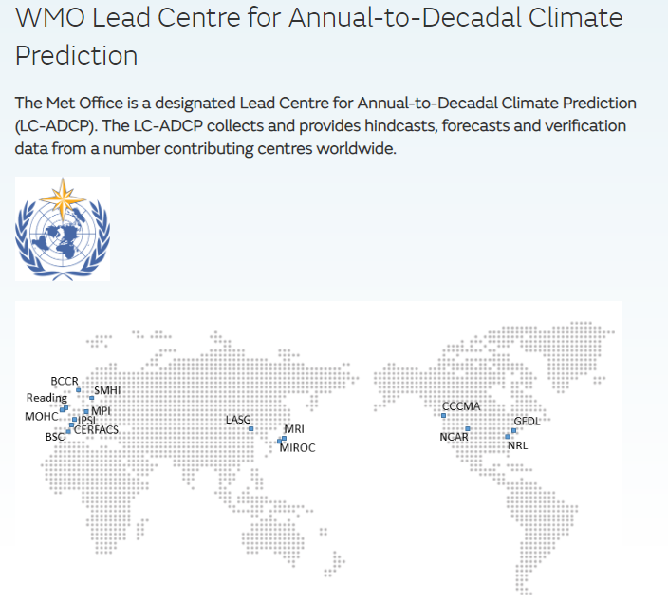
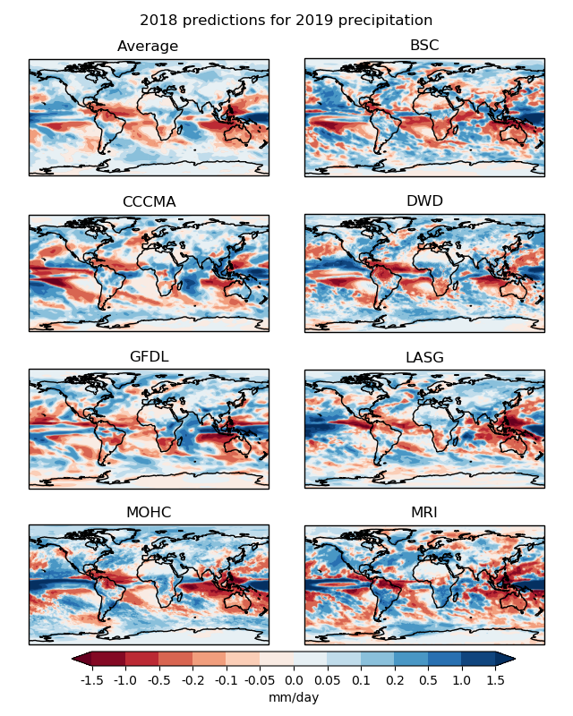

Slide 26
Concluding remarks (Decadal)
Precipitation in SESA exhibits large interannual and interdecadal variability and it is strongly related with tropical Pacific and Indian Oceans
Most CMIP5 historical runs have skill reproducing the SVD 1 of DJF precipitation in SESA
There is an improvement from initialization in CMIP5 decadal hindcasts for SVD1 (detrended and non-detrended).
Higher skill are obtained when global warming effect is also included in SVD1.
These facts represent a promising result for the predictions of rainfall in the SESA region on interannual and larger scales.

Slide 27
CONCLUSIONS (decadal)
There is a need of climate information at all timescales to underpin decision making of many socio-economic sectors in South America
Decadal variability is important. Decadal predictions are new and still don´t have much skill on regional scales but skills on predicting large-scale climate patterns are promising
Climate variations at yearly and decadal timescales can be characterized integrating historical climate variability knowledge with climate predictions.
Experience shows that the transfer of climate information does not necessarily mean that it is going to be automatically adopted by decision makers.
The climate risk management requires holistic solutions derived from inter-disciplinary research made in the context of co-design and co-production

