Slide 1
Prerequisite Packages and CPT Installation Eleventh International Training Workshop Climate Variability and Predictions (11ITWCVP) Ankara, Turkey, April 2019
NOAA/CPC/International Desks

Slide 2
System Requirements
HARDWARE: Windows (32 or 64 bit, Windows version 7.0 or above)
MEMORY: 4GB or more (if possible)
Free DISK SPACE: 50GB or more
Internet Connection
A windows winzip or 7-zip utility to unpack a tar file
SOFTWARE:
GrADS (v2.2.x or later), V2.02 for windows users
GNU FORTRAN Compiler,
GNU precision calculator (bc),
Notepad ++
Wget
Image Magick

Slide 3
Cygwin Installation (https://cygwin.com/install.html)
Depending on your system type, click on either the 64-bit or 32-bit link to download the installation file (setup-x86_64.exe for 64 –bit system or setup-x86.exe for 32-bit.

Slide 4
Cygwin Installation
Look for the setup file in your download folder, and double click on it to initiate the cygwin installation:-
Click on next to go to the next step
Click on next to install from internet

Slide 5
Cygwin Installation
Click on next to proceed with the recommended selection
Click on next to proceed with the default installation location

Slide 6
Cygwin Installation
Click on next to proceed with the default installation location
Select one of the download sites, click on next to initiate cygwin download

Slide 7
Cygwin Installation
Click on next to proceed with the default packages
Click on next to proceed with the final cygwin installation
In the view drop down menu, change Category to Not Installed, and type bc on the search window (see top right). This will install gnu bc maths package.

Slide 8
Cygwin Installation
Click on next to proceed with the default packages
Click on next to proceed with the final cygwin installation
Click on “skip” on the first raw to change it to 1.06.95-2, and click on next to finalize the cygwin installation.
If everything goes well, you should see the cygwin shortcut icon on your desktop.

Slide 9
Cygwin Installation
Click on two check boxes, and finish the installation
If everything goes well, you should see the cygwin shortcut icon on your desktop:

Slide 10
Wget installation
Using your file explorer go to your Downloads folder, and look for cygwin installation file:
Double click on it to initiate installation, click on next several time until it shows the select packages window (below)

Slide 11
Wget installation
1. Using the dropdown menu, choose Not installed
3. Click on the skip next to wget, and choose the latest version(1.19.1-2)
2. Type wget next to search
4. Click on next to finalize your installation. This will update your cygwin, as well as it installs the missing wget libraries.

Slide 12
Wget installation
On your cygwin terminal, type:
Which wget
A message that looks like the above screenshot confirms successful installation of wget.

Slide 13
GNU GFORTRAN Installation https://gcc.gnu.org/wiki/GFortranBinaries
Download the latest executable file to install GFORTRAN compiler
In your download folder, double click on gfortran-windows-20140629.exe to initiate the GFORTRAN compiler installation.
Click on “ I agree” and next, click on close to finish the installation
Open the cygwin window, and type gfortran to verify your gfortran installation
The message that looks like the screenshot on the right verifies successful installation of GFORTRAN

Slide 14
Installation of OpenGrADS https://sourceforge.net/projects/opengrads/files/grads2/2.2.1.oga.1/Windows/
Click on the executable file to download the installation file
In your download folder, double click opengrads-2.2.1.oga.1-win32_superpack .exe (gfortran-windows-20140629) to initiate the GrADS installation. Click on English, next, and select I agree and click on next.
Click on next several times to initiate the installation.
If your installation is successful, you should see GrADS shortcut icon on your desktop.
Open the cygwin window and type opengrads –p to verify installation of GrADS.
If the GrADS display window opens, it confirms successful installation of GrADS.
It is also okay if you have grads-2.0.2 version on your computer!

Slide 15
ImageMagick Installation https://imagemagick.org/script/download.php#windows
Click on the appropriate link to download the installation files
In your download folder, double click on ImageMagick-7.0.8-28-Q16-x64-dll.exe to initiate ImageMagick installation.
Accept the agreement, and click next several times to agree with the default setup.

Slide 16
Notepad++ Installation https://notepad-plus-plus.org/download/v7.6.3.html
Click on the appropriate link to download the installation files
In your download folder, double click on npp.7.6.3.Installer.x64.exe to initiate notepad++ installation.
Accept the agreement, and click next several times to agree with the default setup.

Slide 17
Notepad++ Installation https://notepad-plus-plus.org/download/v7.6.3.html
You need to set alias and environment variable to have access notepad++ from your cygwin terminal
Go to you cygwin home folder (C:\cygwin64\home\your user name)
Open .bashrc using your favorite text editor
Scroll down to the end and add the following two lines, and save and exit:
export EDITOR="/cygdrive/C/Program\ Files/Notepad++/Notepad++.exe"alias npp="/cygdrive/C/Program\ Files/Notepad++/Notepad++.exe“
This allows you to run notepad++ from your cygwin window (typing npp)

Slide 18
Creating an alias to opengrads
Type
which opengrads
The version of your GrADS is 2.2, if you get a message that looks like:
/cygdrive/c/OpenGrADS-2.2/Contents/Cygwin/Versions/2.2.1.oga.1/i686/opengrads
Make sure that you are in your home directory, by typing
cd
Open your .bashrc by typing:
npp .bashrc
Scroll down to the end of the file, and add this line:
alias grads= /cygdrive/c/OpenGrADS-2.2/Contents/Cygwin/Versions/2.2.1.oga.1/i686/opengrads
Save and exit
Close your cygwin terminal, and reopen it. And then type grads –p,

Slide 19
Prerequisite Packages for Linux Users

Slide 20
Installing Perl-Env and Gnu Precision
Install perl-Env
sudo apt-get install perl-Env (Debian/Ubuntu users)
sudo yum install perl-Env (RHEL/CentOS users)
sudo dnf install perl-Env (Fedora 22+ users)
Install gnu precision calculator (bc)
sudo apt-get install bc (Debian/Ubuntu users)
sudo yum install bc (RHEL/CentOS users)
sudo dnf install bc (Fedora 22+ users)

Slide 21
Installing gfortran and ImageMagick
Install gfortran compiler
sudo apt-get install gcc-gfortran (Debian/Ubuntu users)
sudo yum install gcc-gfortran (RHEL/CentOS users)
sudo dnf install gcc-gfortran (Fedora 22+ users)
Install ImageMagick
sudo apt-get install imagemagick (Debian/Ubuntu users)
sudo yum install ImageMagick (RHEL/CentOS users)
sudo dnf install ImageMagick (Fedora 22+ users)

Slide 22
Installing OpenGrADS
Using your linux terminal change your directory to /usr/local/bin, by typing cd /usr/local/bin
Download grads package using:
Sudo wget https://sourceforge.net/projects/opengrads/files/grads2/2.2.1.oga.1/Linux%20%2864%20Bits%29/opengrads-2.2.1.oga.1-bundle-x86_64-pc-linux-gnu-glibc_2.17.tar.gz
Unpack the package using:
sudo tar -xzvf opengrads-2.2.1.oga.1-bundle-x86_64-pc-linux-gnu-glibc_2.17.tar.gz
Copy GrADS binaries and associated files into the current folder:
sudo cp –rf opengrads-2.2.1.oga.1/Contents/* .
You may remove the unwanted files and folders:
sudo rm –rf opengrads-2.2.1.oga.1
sudo rm opengrads-2.2.1.oga.1-bundle-x86_64-pc-linux-gnu-glibc_2.17.tar.gz
Test your GrADS installation:
Close and reopen the terminal and type grads –p
your installation is successful, if GrADS runs without error message

Slide 23
Prerequisite Packages for mac Users

Slide 24
Preinstalled packages
Usually Mac comes with preinstalled packages such as:
gcc, bc, and curl
You may checkout this by typing:
wchich gcc
which bc
which curl

Slide 25
Missing packages
You may not have some packages on your Mac:
gfortran and wget
You may checkout this by typing:
wchich gfortran
which wget

Slide 26
Installing Missing packages
You may follow instructions provided @ http://skipperkongen.dk/2012/04/27/how-to-install-gfortran-on-mac-os-x/ to install gfortran
You may also check out the information provided @ https://coolestguidesontheplanet.com/install-and-configure-wget-macos/ to install wget

Slide 27
CPT Installation Guideline for Windows (Desktop or Cygwin) and Linux users
NOAA/CPC/International Desks

Slide 28
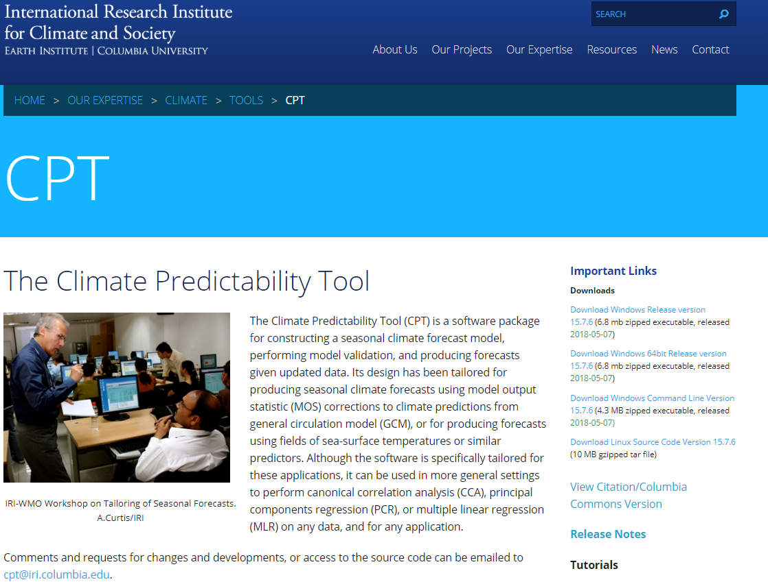
Getting the installation files (https://iri.columbia.edu/our-expertise/climate/tools/cpt/)
Depending on your system type (Linux/Windows), click to download the installation file.
Click here for the Windows version
Click here for the Linux/Cygwin version

Slide 29
Guidelines for installing CPT under Windows Desktop Environment

Slide 30
Windows: Desktop installation (1)
In your download folder look for the zipped executable file named CPT_installation_15.7.6.exe_
Unzipped it to extract the CPT_installation_15.7.6.exe installation file in your download folder
double click on it to initiate the installation - Allow your system to start the process.
Click next - Accept the agreement - Click next several times to agree with the default setup

Slide 31
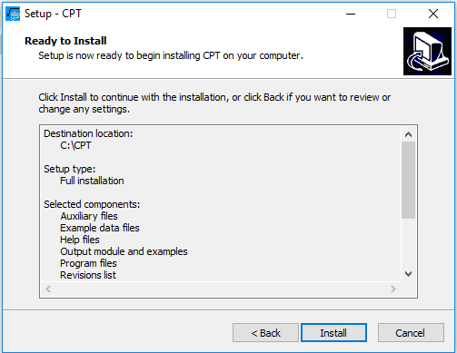
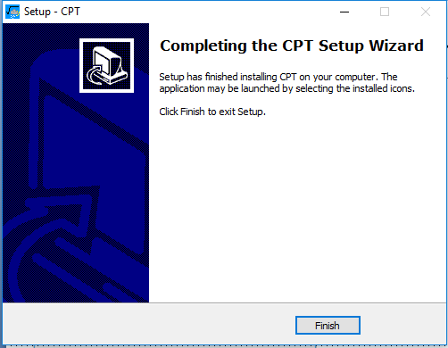
Windows: Desktop installation (2)
If everything goes well, you should see the screen below. Click on finish to close.
Click on Install to proceed
Check CPT shortcut icon on your desktop

Slide 32
Guidelines for installing CPT under Cygwin Environment

Slide 33
Windows: installation for Cygwin (1)
In your windows Downloads folder look for the .tar.gz packed file named CPT.15.7.6.tar.gz
Using file explorer copy this file into your cygwin home folder (C:\cygwin64\home\your user name)
On your desktop click on the cygwin icon to open a terminal
Type the following commands to create a new directory and unpack the source code
mkdir -p /opt/CPT
tar xzvf CPT.15.7.6.tar.gz -C /opt/CPT --strip-components=1

Slide 34
Windows: installation for Cygwin (2)
Move into the extracted folder by typing the following command:
cd /opt/CPT/15.7.6
Proceed with the compilation process by typing the following commands:
make all
make
make install
make deepclean

Slide 35
Windows: installation for Cygwin (3) You need to set environment variable to access CPT from your cygwin terminal.
In the cygwin terminal type the following command lines :
cd
npp .bashrc &
Scroll down to the end and add the following two lines, and save and exit:
export PATH=/opt/CPT/15.7.6/bin:$PATH
export CPT_BIN_DIR=C:/cygwin64/opt/CPT/15.7.6/bin
Click here to save
Click here to .bashrc file
Click here to close Notepad++
To verify the success of the installation,
close the cygwin terminal and follow the instructions on the next slide.

Slide 36
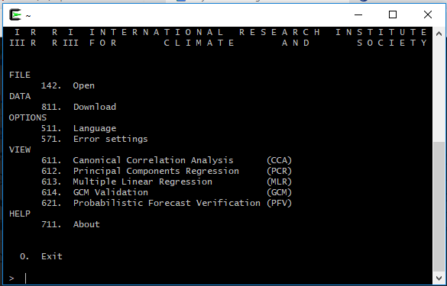
Windows: installation for Cygwin (4) Verifying if the installation was complete with success
On your Desktop double click on cygwin icon to open a terminal and type CPT.x
A message that looks like the below screenshot confirms successful installation of CPT under Cygwin.
To exit CPT type the number 0

Slide 37
Guidelines for Linux and Mac users

Slide 38
Installation guide for Linux Users (1)
Using your terminal go to your home folder and create a new folder:
cd
mkdir CPT
Change your directory to this newly created folder
cd CPT
Use curl or wget to download the CPT packed file:
curl -o CPT.15.7.6.tar.gz https://iri.columbia.edu/wp-content/uploads/2018/05/CPT.15.7.6.tar.gz
Type the command below to unpack the file:
tar –xvf CPT.15.7.6.tar.gz

Slide 39
Installation guide for Linux Users (2) Proceed to the installation
Move into the extracted folder using the following command line:
cd ~/CPT/15.7.6
Proceed with the compilation process by typing the following commands:
make all
make
make install
make deepclean

Slide 40
Installation guide for Linux Users (3) You need to set environment variable to access CPT from your cygwin terminal.
In the linux terminal type the following command lines :
cd
gedit ~/.bashrc &
Scroll down to the end and add the following two lines, and save and close:
export PATH=~/CPT/15.7.6/bin:$PATH
export CPT_BIN_DIR=~/CPT/15.7.6/bin
Into the terminal, type these command lines:
source ~/bashrc &
CPT.x
A message that looks like the above screenshot confirms successful installation of CPT under linux

Slide 41
Installation guide for Mac Users (1)
Using your terminal go to your home folder and create a new folder:
cd
mkdir CPT
Change your directory to this newly created folder
cd CPT
Use curl or wget to download the CPT packed file:
curl -o CPT.15.7.6.tar.gz https://iri.columbia.edu/wp-content/uploads/2018/05/CPT.15.7.6.tar.gz
Type the command below to unpack the file:
tar –xvf CPT.15.7.6.tar.gz

Slide 42
Installation guide for Mac Users (2) Proceed with the installation
Move into the extracted folder using the following command:
cd 15.7.6
Proceed with the compilation process:
make all
make
make install
make deepclean

Slide 43
Installation guide for Mac Users (3) You need to set environment variable to access CPT from your cygwin terminal.
In the linux terminal type the following command lines :
cd
gedit .bashrc &
Scroll down to the end and add the following two lines, and save and close:
export PATH=/home/username/CPT/15.7.6/bin:$PATH
export CPT_BIN_DIR==/home/username//CPT/15.7.6/bin
Into the terminal, type these command lines:
source ~/bashrc &
CPT.x
A message that looks like the above screenshot confirms successful installation of CPT under linux

Slide 44
Downloading Workshop Files
Using your cygwin/Linux terminal go to your home folder, by typing
cd
Download GrADS Exerrcise files:
curl –o grads_excercise.tar.gz https://ftp.cpc.ncep.noaa.gov/International/11ITWCVP_Ankara2019/Endalk/grads_excercise.tar.gz
Download Shell/GrADS based subseasonal demonstration files:
curl –o subseason_with_grads.tar.gz https://ftp.cpc.ncep.noaa.gov/International/11ITWCVP_Ankara2019/Endalk/subseason_with_grads.tar.gz

