Slide 1
Recent Analyses of Drought Character and Prediction
Randal Koster, GMAO, NASA/GSFC
(with help from numerous colleagues: Sarith Mahanama, Greg Walker, Siegfried Schubert, Max Suarez, Tiffany Townsend, Dennis Lettenmaier, Ben Livneh, etc., etc....)

Slide 2
Three topics:
Hydrological drought: Streamflow prediction on seasonal time scales.
Agricultural drought: Persistence vs. forcing prediction in soil moisture forecasts.
3. Meteorological drought: Some results regarding attribution.

Slide 3
Three topics:
Hydrological drought: Streamflow prediction on seasonal time scales.
Agricultural drought: Persistence vs. forcing prediction in soil moisture forecasts.
3. Meteorological drought: Some results regarding attribution.

Slide 4
Larger snowpack → Increased streamflow during snowmelt season.
→ Knowledge of snow in winter provides predictability / forecast skill for springtime streamflow.

Slide 5
How about soil moisture?
Snow over wet soil: most spring snowmelt water runs off into streams, reservoirs
Snow over dry soil: most spring snowmelt water infiltrates the soil and is lost to water resources
→ Knowledge of soil moisture in winter provides predictability / forecast skill for springtime streamflow.

Slide 6
Experiment:
1. Perform multi-decadal offline simulation covering CONUS, using observations-based meteorological data. Determine streamflows in various basins for MAMJJ and compare against (naturalized) streamflow observations. (Not a synthetic study!)
2. Repeat, but doing forecasts: Simulate MAMJJ streamflow knowing only soil moisture and snow conditions on January 1. (Use climatological met forcing for January – July.)
3. Repeat, knowing only snow conditions on January 1.
4. Repeat, knowing only soil moisture conditions on January 1.

Slide 7
Skill of model simulation of
MAMJJ streamflow given:
-- Realistic January 1 initial
conditions
-- “Perfect” prediction of
forcing during forecast
period
Skill (r²)

Slide 8
Skill of model simulation of
MAMJJ streamflow given:
-- Realistic January 1 initial
conditions
-- “Perfect” prediction of
forcing during forecast
period
Skill of model simulation of
MAMJJ streamflow given:
-- Realistic January 1 initial
conditions
-- No skill in prediction of
forcing during forecast
period (use climatology)
Skill (r²)

Slide 9
Results with Jan. 1 snow initialization only
Results with Jan. 1 soil moisture initialization only

Slide 10
Summary of streamflow forecast study:
1. Today’s LSMs are capable of producing skillful seasonal forecasts of snowmelt-season streamflow.
2. Soil moisture information, by itself, contributes to this skill.
Snow initialization more important toward northwest of study area.
Soil moisture initialization more important toward southeast of study area.

Slide 11
Three topics:
Hydrological drought: Streamflow prediction on seasonal time scales.
Agricultural drought: Persistence vs. forcing prediction in soil moisture forecasts.
3. Meteorological drought: Some results regarding attribution.

Slide 12
Integrate forecast model: apply forecasted P, T, q, ...
Soil Moisture
Initial Conditions on Forecast Start Date
Soil Moisture
Conditions at Forecast Validation Date
Assuming perfect soil moisture initial conditions and a perfect LSM, skill in forecasting soil moisture depends on two things:
forecasted rainfall, temperature, wind speed, humidity...
the LSM’s inherent soil moisture memory

Slide 13
Experiment:
1. Perform multi-decadal offline simulation covering CONUS, using observations-based meteorological data. Compute soil moistures during summer months; call them “truth”. (This time, a synthetic study.)
2. Perform forecasts: Start with “truth” initial conditions and integrate model with climatological forcing. (i.e., assume no skill in predicted forcing.

Slide 14
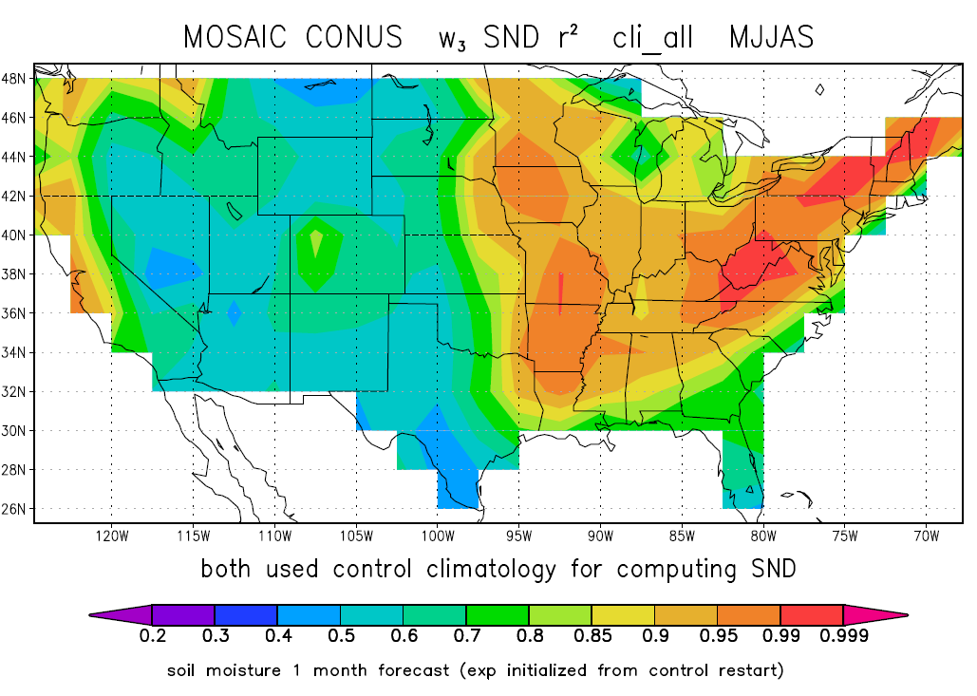
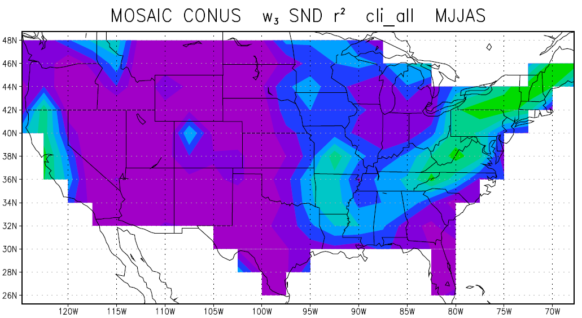
r² of forecast vs. synthetic truth: climatological forcings
1 month out
Soil moisture memory induces significant skill, particularly where (in this model) the water holding capacity is larger.
5 months out

Slide 15
Experiment:
1. Perform multi-decadal offline simulation covering CONUS, using observations-based meteorological data. Compute soil moistures during summer months; call them “truth”. (This time, a synthetic study.)
2. Perform forecasts: Start with “truth” initial conditions and integrate model with climatological forcing. (i.e., assume no skill in predicted forcing.
3. Perform forecasts again, using climatological forcing for everything except precipitation. (For precipitation, assume perfect forecasts.)

Slide 16
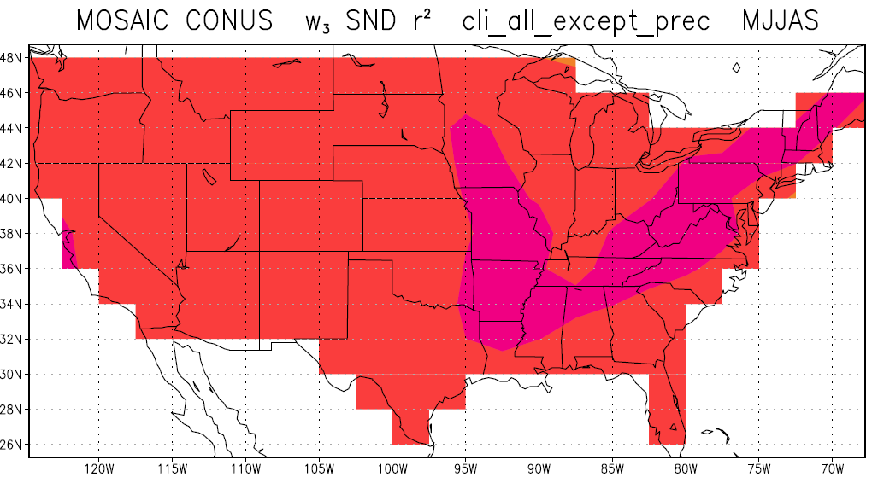
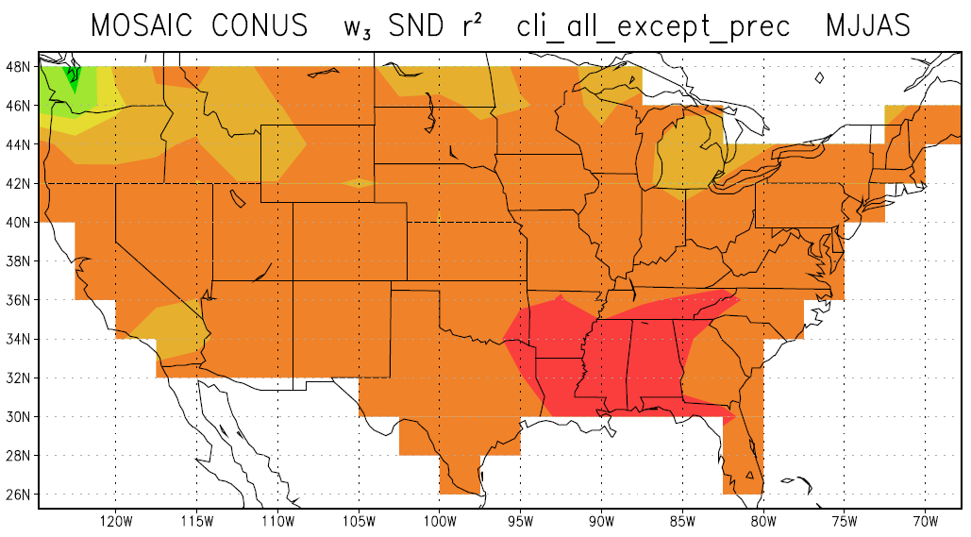
r² of forecast vs. synthetic truth: “truth” P but climatological T, q, wind, radiation...
Getting the precipitation right in a forecast returns most of the skill. Getting the radiations, temperatures, etc., right is secondary – these forcings contribute almost nothing to skill.
1 month out
5 months out

Slide 17
Summary of (synthetic, model-dependent) soil moisture prediction study:
An LSM’s inherent soil moisture memory contributes strongly to soil moisture forecast skill, particularly in regions of large water holding capacity.
Of all the meteorological forcings provided by a forecast system, precipitation is overwhelmingly the most important. (Inability to predict temperatures, humidities, wind speeds, etc., is not that important.)
While these things are already intuitive, it’s important to estimate these contributions quantitatively with any system used to predict soil moisture.

Slide 18
Three topics:
Hydrological drought: Streamflow prediction on seasonal time scales.
Agricultural drought: Persistence vs. forcing prediction in soil moisture forecasts.
3. Meteorological drought: Some results regarding attribution.

Slide 19
GHCN stations with at least 50 consecutive years of precipitation data.

Slide 20
At each of these stations:
Rank the annual precipitation rates. Determine if a given year’s precipitation lies in the lower, middle, or upper tercile of all values.
Determine the probability that a dry (wet) tercile year follows another dry (wet) tercile year.
Compare these probabilities with those obtained for a random distribution of yearly precipitations (via extensive Monte Carlo analyses).
Determine the significance level to which nature is not acting randomly: the confidence level to which we can say multi-year drought results from some non-random process.

Slide 21
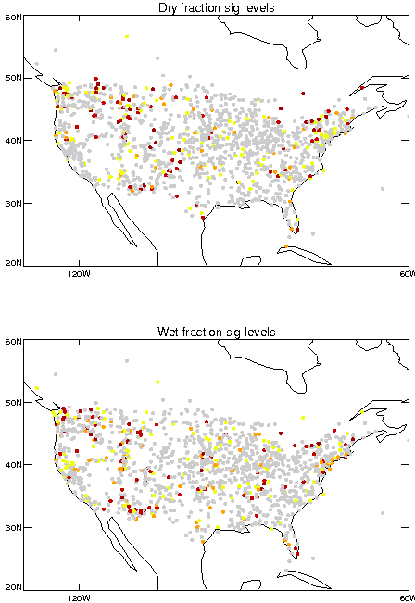
Nature is not behaving randomly with a confidence level of:
80%
90%
95%
99%

Slide 22
What about field significance?
Fraction of dots that would show up as yellow (or darker) on previous maps, if yearly precipitation was completely random (no connection between years).
Fraction of dots that did show up as yellow (or darker) for observations (dry gdry)
Fraction of dots that did show up as yellow (or darker) for observations (wet g wet)
80%
confidence
90%
confidence
95%
confidence
99%
confidence

Slide 23
Key point: When multi-year meteorological drought occurs in the U.S., it’s natural to want to perform some sort of “drought attribution” – to explain the length of the drought through some kind of physical mechanism that acts on multi-year time scales. Perhaps such a mechanism exists, but...
The observational record is not inconsistent with the idea that multi-year drought is simply a consequence of the random clumping of independent dry years.

Slide 24
There does seem to be a “non-random signal” in the equatorial region for multi-year droughts and pluvials.

Slide 25
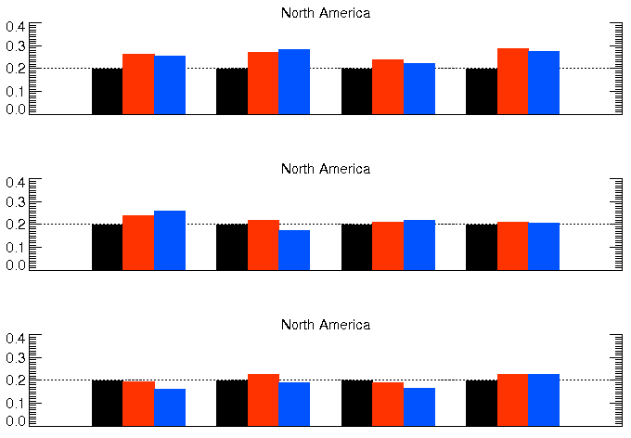
North America results for shorter time scales: 3-month dry (wet) period leads to 3-month dry (wet) period.
OND - JFM
NDJ - FMA
DJF - MAM
JFM - AMJ
FMA - MJJ
MAM - JJA
AMJ - JAS
MJJ - ASO
JJA - SON
JAS - OND
ASO - NDJ
SON - DJF

Slide 26
North America results for shorter time scales: 3-month dry (wet) period leads to 3-month dry (wet) period.
Signal in winter, spring?
OND - JFM
NDJ - FMA
DJF - MAM
JFM - AMJ
FMA - MJJ
MAM - JJA
AMJ - JAS
MJJ - ASO
JJA - SON
JAS - OND
ASO - NDJ
SON - DJF

Slide 27
Summary of (preliminary) rainfall analysis:
For North America, the multi-decadal record of station observations supports the possibility that multi-decadal drought could be the result of the random juxtaposition of dry years.
However, for North America, the multi-decadal record does suggest that some shorter-term droughts (~6 months) are controlled by external mechanisms during the winter and spring.
Winter/spring: SSTs control large-scale circulation?
Summer/fall: Random component of convection
is too important?

Slide 28
Drought predictability?
Three topics:
Hydrological drought: Streamflow prediction on seasonal time scales.
Agricultural drought: Persistence vs. forcing prediction in soil moisture forecasts.
3. Meteorological drought: Some results regarding attribution.
Potential for skill at seasonal time scales
Skill varies geographically; depends on precip. forecast skill and model-dependent soil moisture memory
Perhaps no skill possible(?) on multi-year time scale in US; skill on sub-yearly timescales possible in winter/spring

