Slide 1
Monthly Climate Review December 2012
January 8, 2013
Steve Baxter

Slide 2
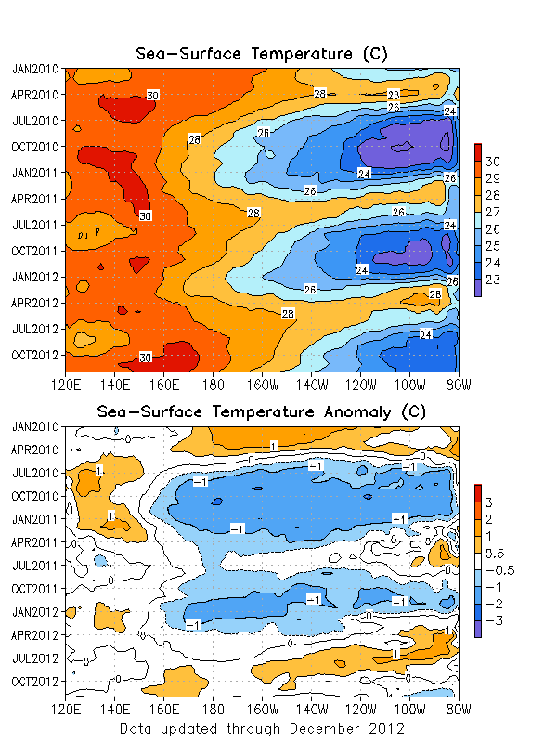
ENSO
Sea surface temperatures were near normal across most of the equatorial Pacific.
ENSO neutral conditions persist.

Slide 3
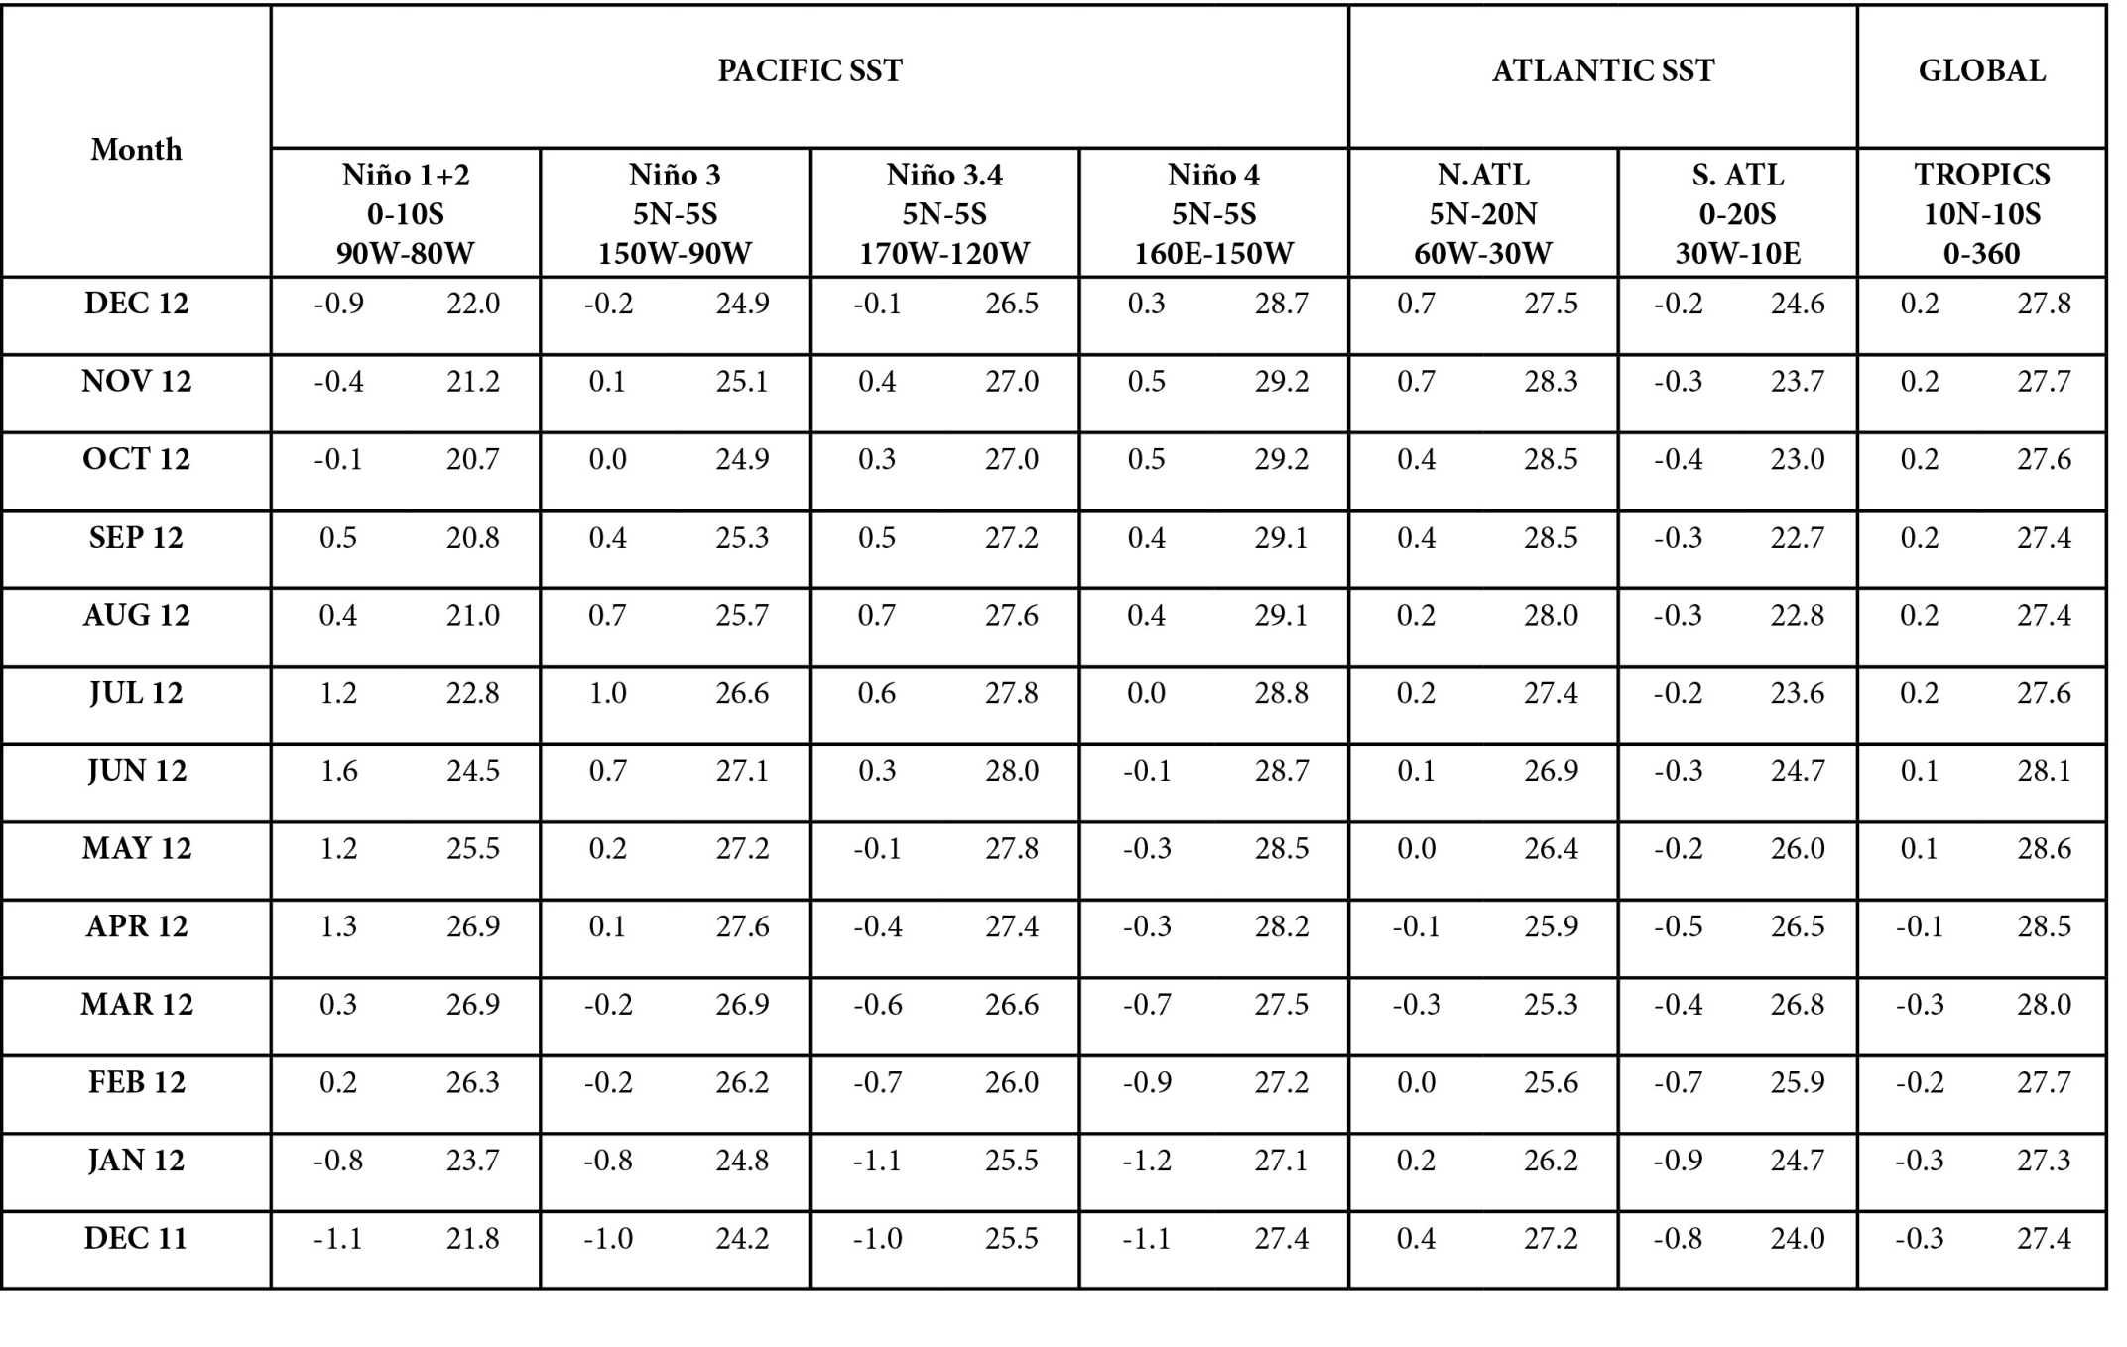

Slide 4
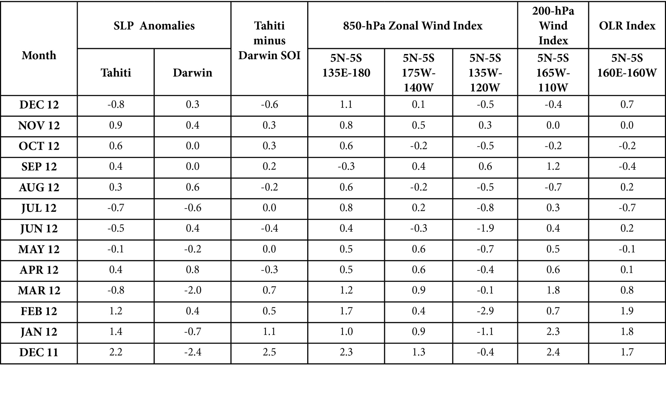

Slide 5
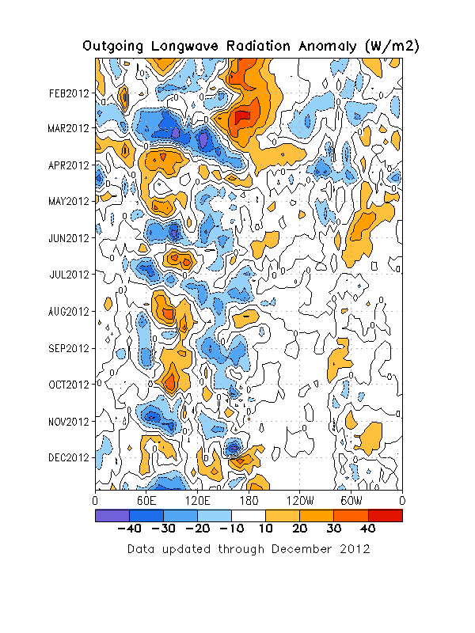
Outgoing Longwave Radiation
Positive OLR anomalies persisted near the dateline for much of the month.
Convection in the Indian Ocean increased throughout the month as a result of developing MJO activity and equatorial Rossby wave activity.

Slide 6
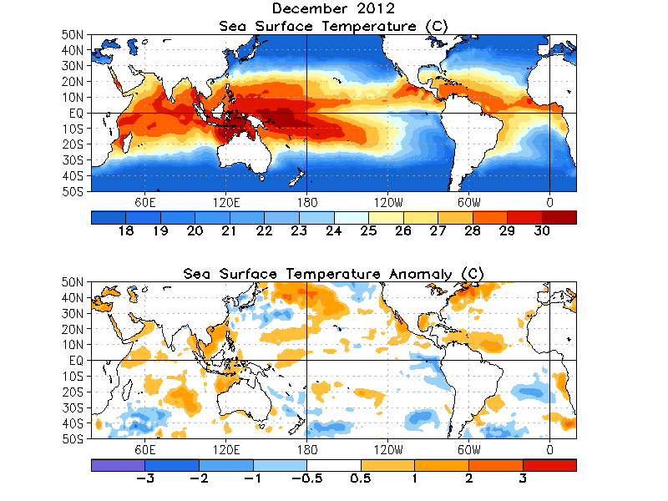
Global SST

Slide 7
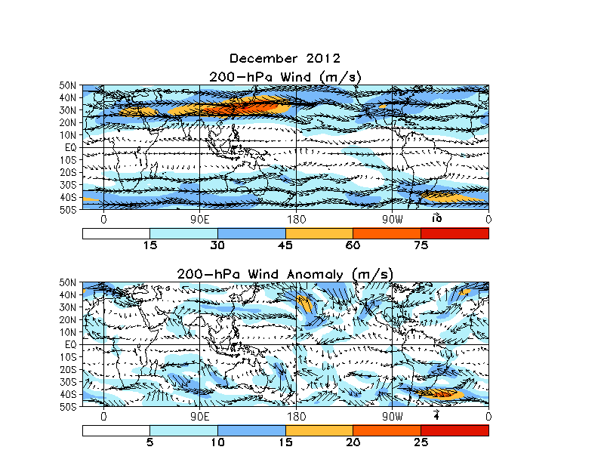
200-hPa Wind Anomalies
Some evidence of suppressed East Asian jet stream.
Wave pattern evident over eastern Pacific, likely driving downstream hydroclimate.

Slide 8
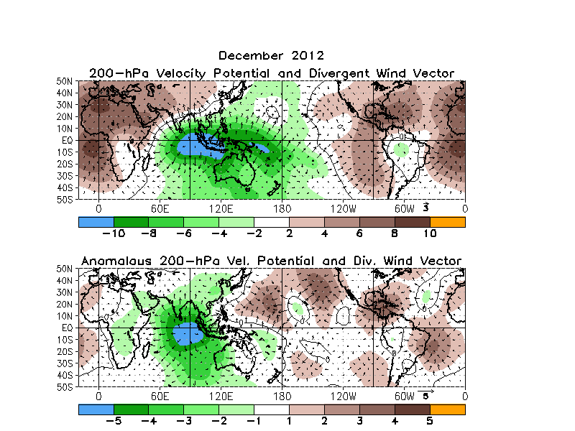
200-hPa Velocity Potential
Anomalous divergence over the eastern Indian Ocean seems consistent with downstream wave pattern.

Slide 9
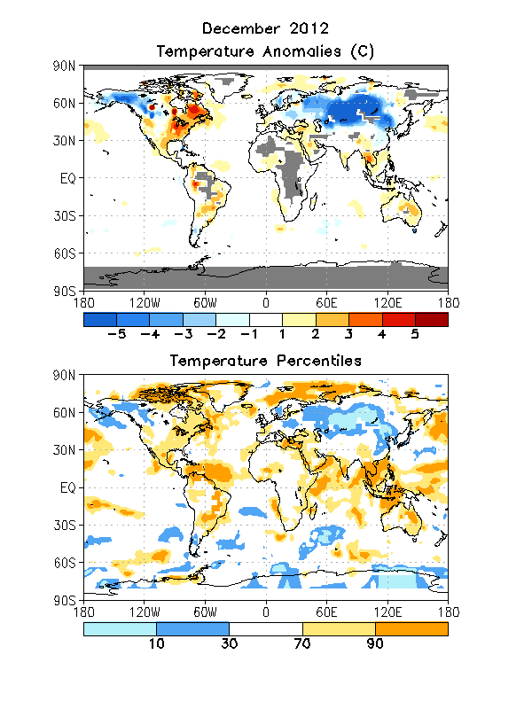
Global Temperatures
Extremely cold over interior Asia, extending into the Far East. Also cold over interior Alaska and northwestern Canada.
Warmest midlatitude land area was eastern North America.
Also extremely warm over Northern polar regions.

Slide 10
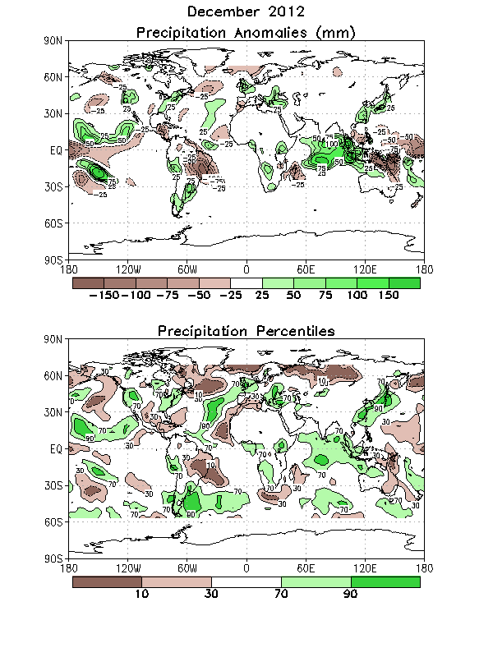
Global Precipitation
West Coast and East Coast were generally wet.
Important wet anomalies are also evident over far eastern Asia and the Indian Ocean.
Especially dry across most of the sub-polar regions.

Slide 11
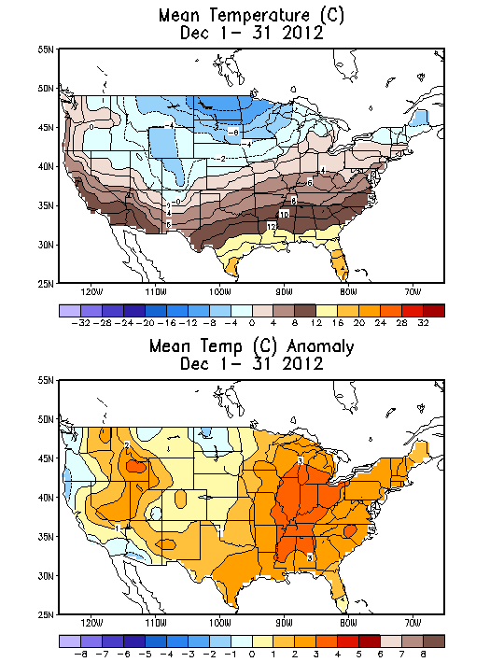
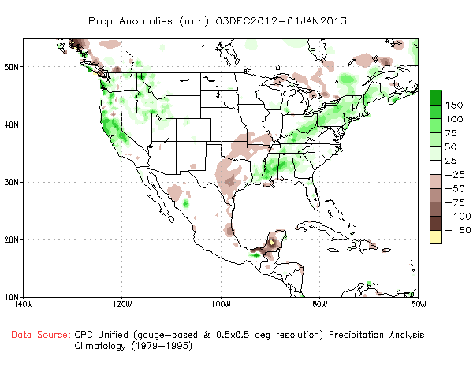
US Temperature and Precip

Slide 12
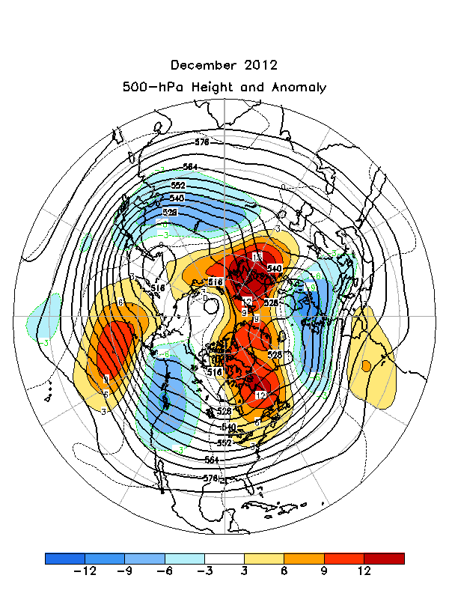
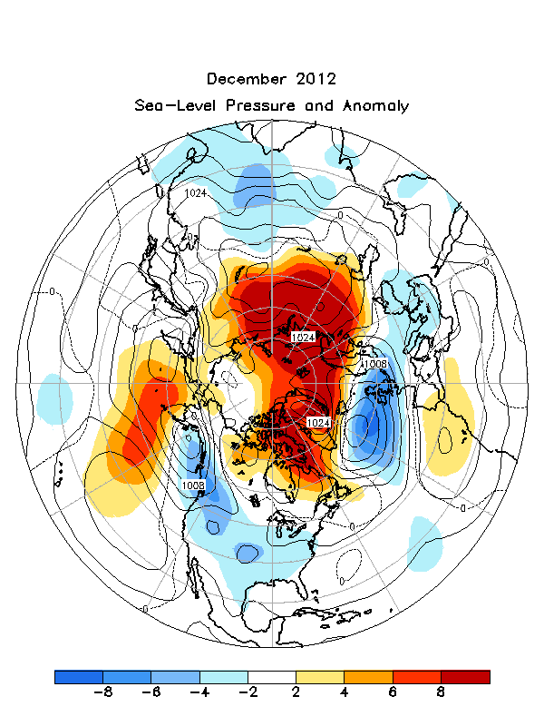
NH 500-hPa Height Anomalies and Sea-level Pressure Anomalies

Slide 13
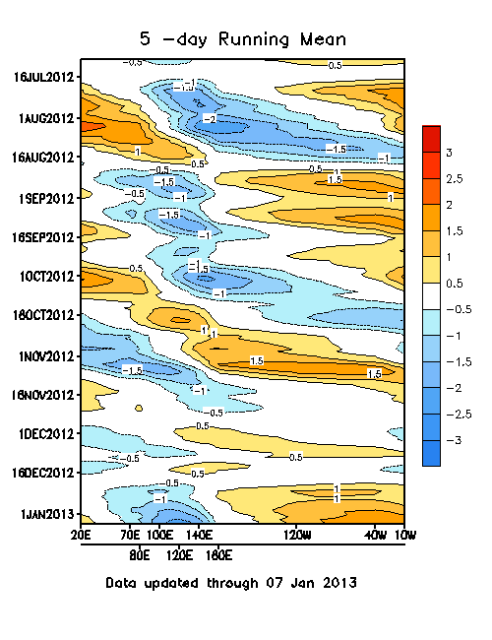
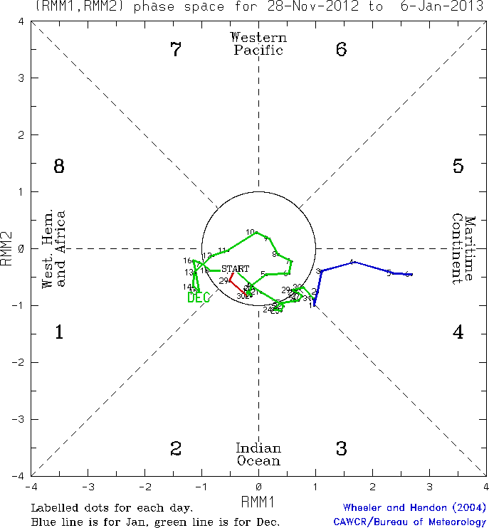
MJO Index

Slide 14
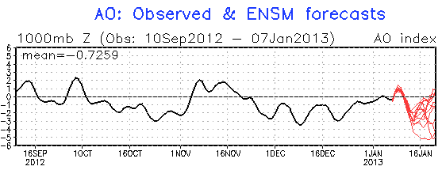
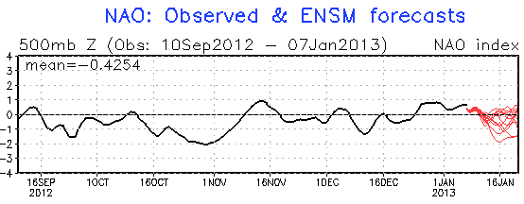
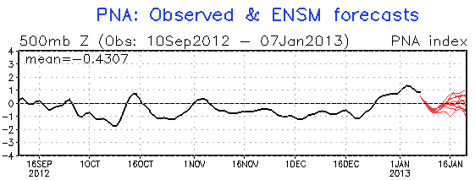
Teleconnections

Slide 15
Pressing Question
With negative AO, why was it so mild across eastern North America.
Has something like this happened recently?

Slide 16
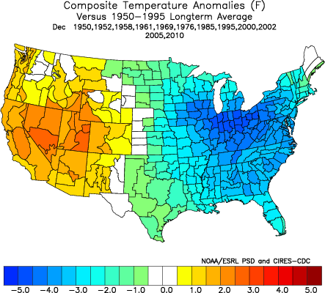
Composite of Decembers with Strongly Negative AO Index (excluding 2009)

Slide 17
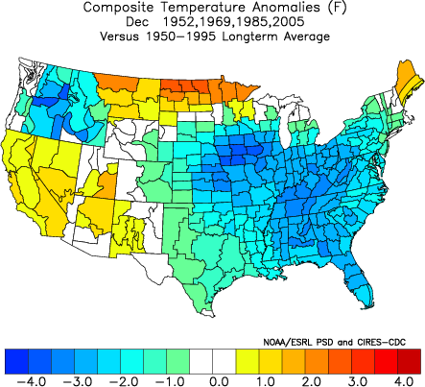
NAO was Neutral – So What?

Slide 18
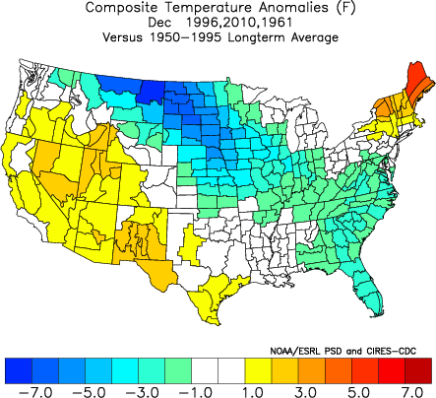
PNA was Negative – Right?
Only three years had strongly negative AO and strongly negative PNA – 1961, 1996, 2010.
It appears that 1996 appears to be closest.
Something similar to this has happened, but it’s rare.

Slide 19
Verification
Monthly, Seasonal, Week-2

Slide 20
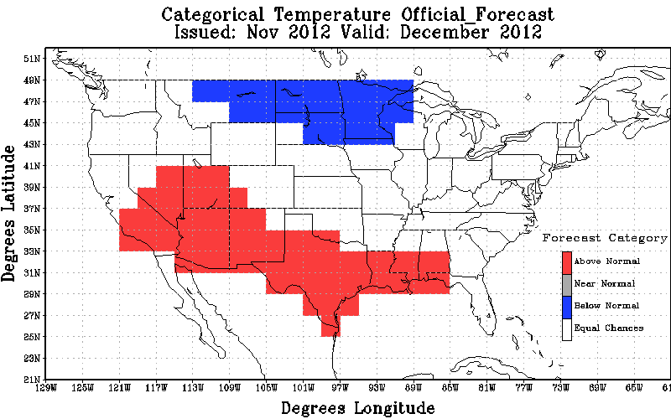
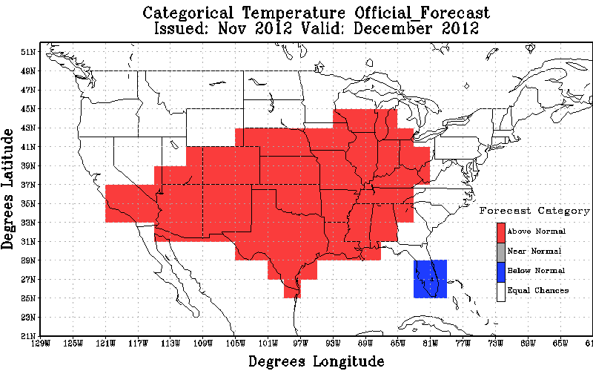
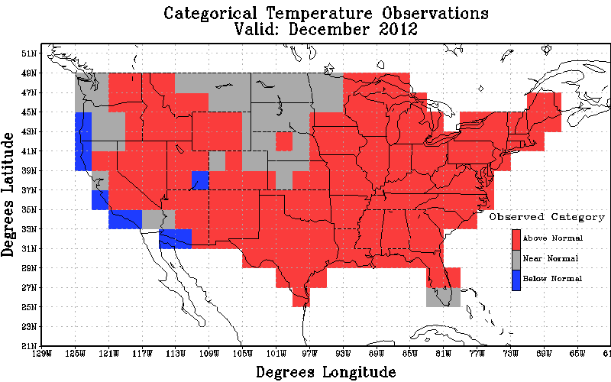
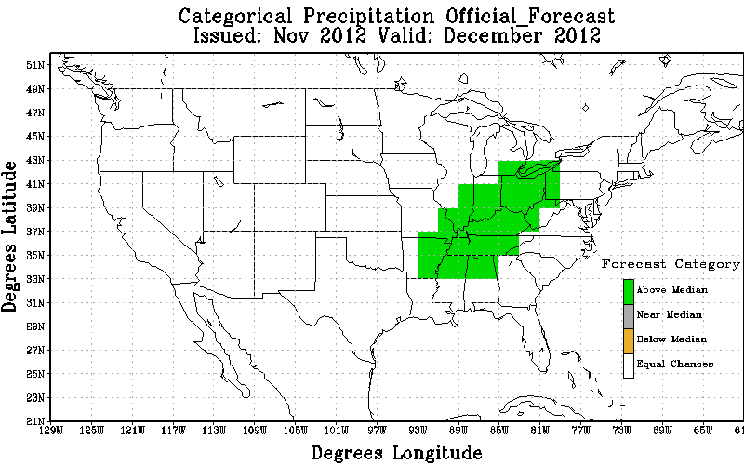
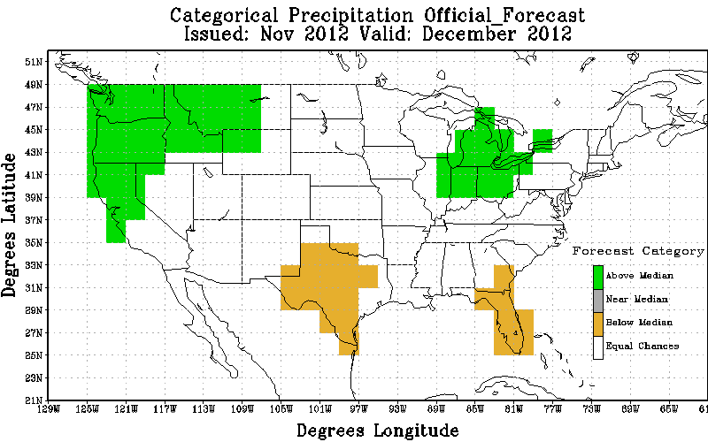
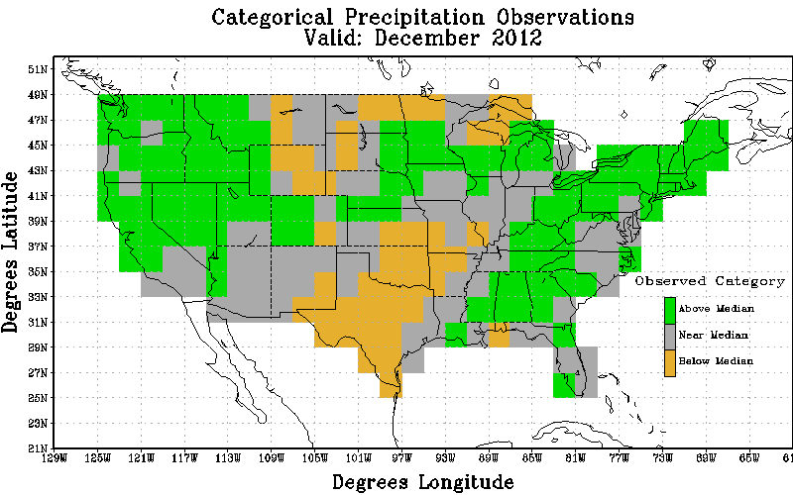
Temp
Official
Revised
Obs
Non-Equal Chance(non EC) forecasts: 40.7
All forecasts: 15.1
% coverage not Equal Chance forecasts : 37.1
Non-Equal Chance(non EC) forecasts: 74.4
All forecasts: 37.5
% coverage not Equal Chance forecasts : 50.4
Precip
Official
Revised
Obs
Non-Equal Chance(non EC) forecasts: 31.8
All forecasts: 3.0
% coverage not Equal Chance forecasts : 9.5
Non-Equal Chance(non EC) forecasts: 56.9
All forecasts: 17.9
% coverage not Equal Chance forecasts : 31.5

Slide 21
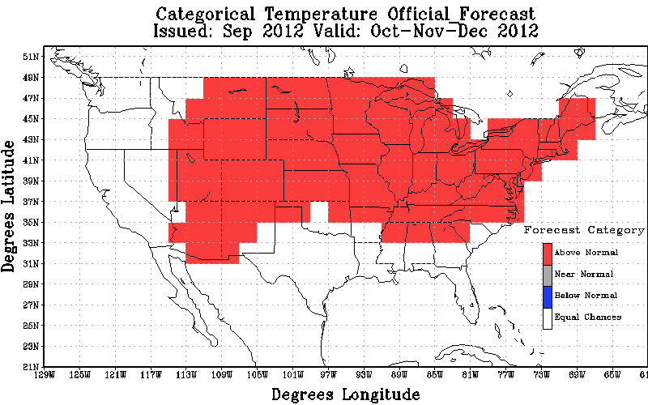
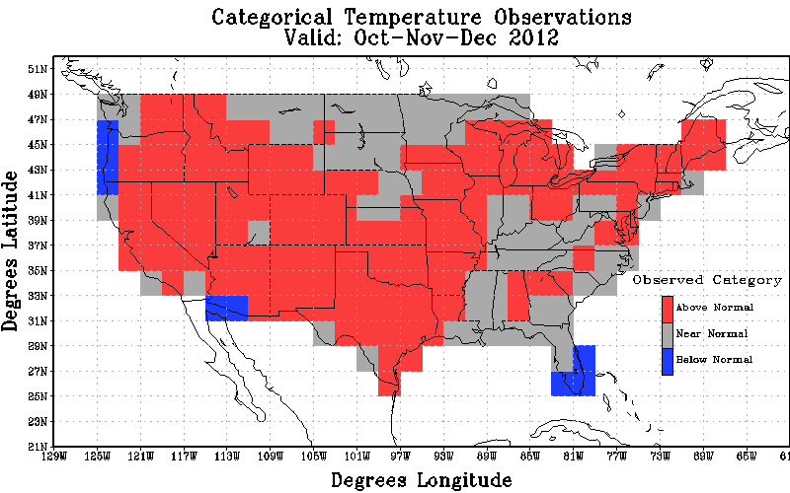
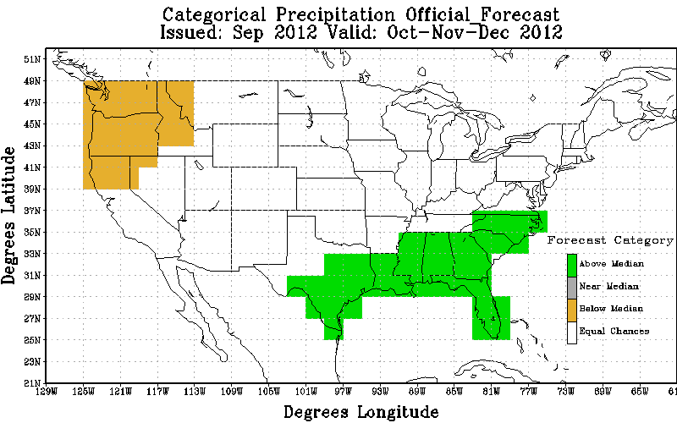
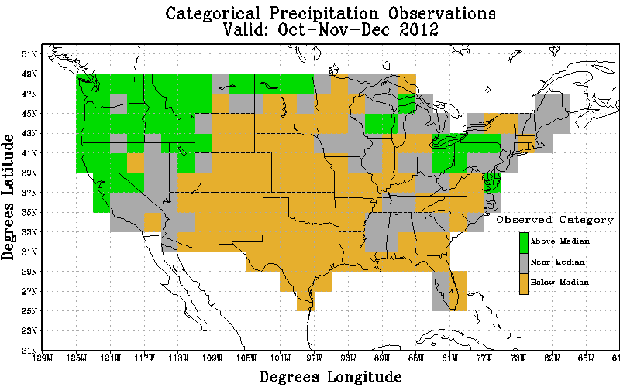
Temp
Official
Revised
Obs
Non-Equal Chance(non EC) forecasts: 48.3
All forecasts: 30.8
% coverage not Equal Chance forecasts : 63.8
Precip
Official
Revised
Obs
Non-Equal Chance(non EC) forecasts: -50.0
All forecasts: -13.79
% coverage not Equal Chance forecasts : 27.6

Slide 22
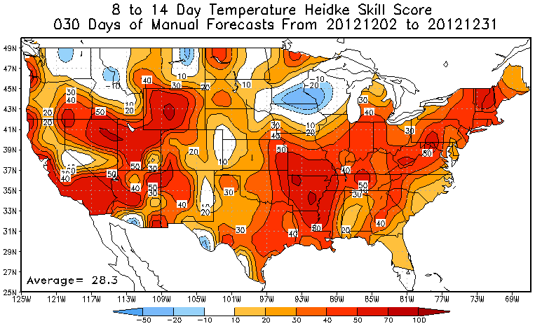
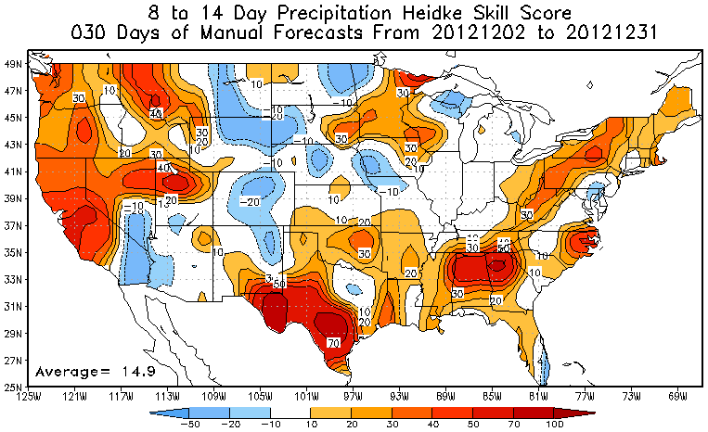
8-14 Day Temperature and Precipitation Scores

Slide 23
Current Predictions
Monthly, Seasonal, ENSO

Slide 24
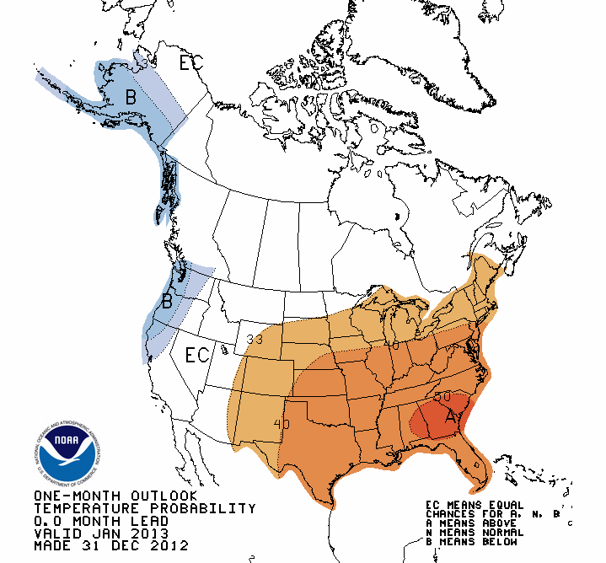
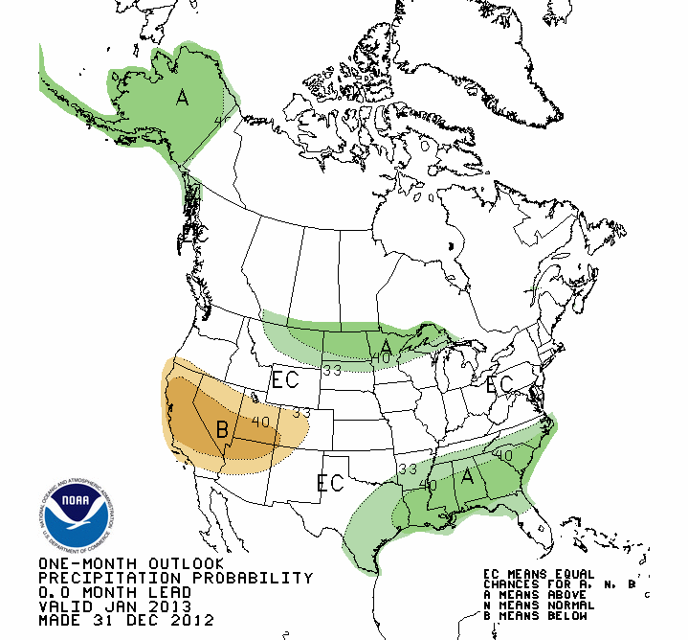
January 2013 Revised Outlook

Slide 25
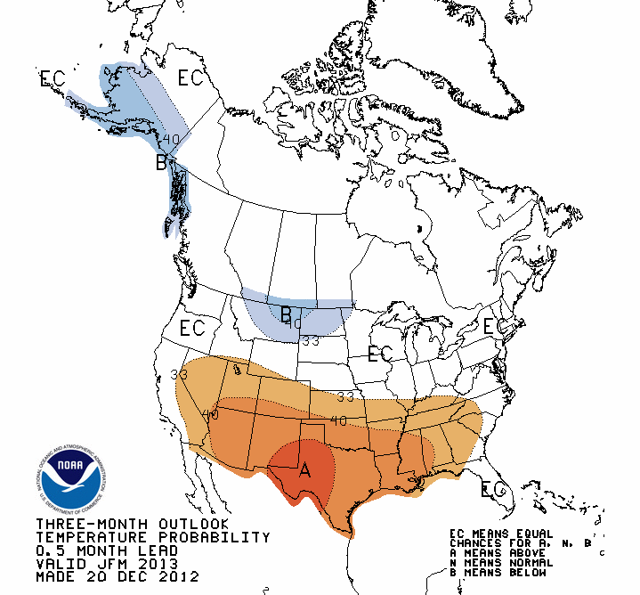
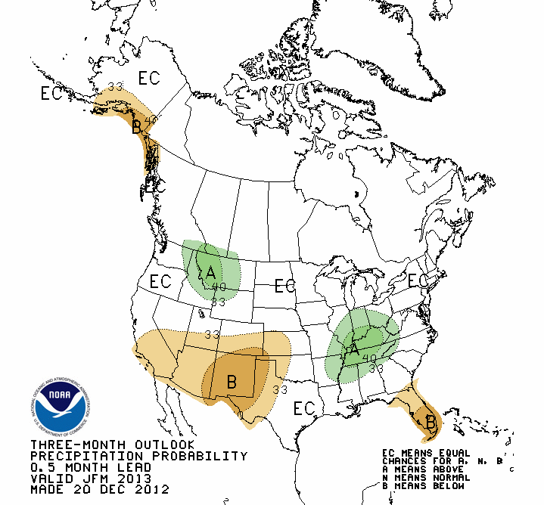
JFM 2013 Seasonal Outlook

Slide 26
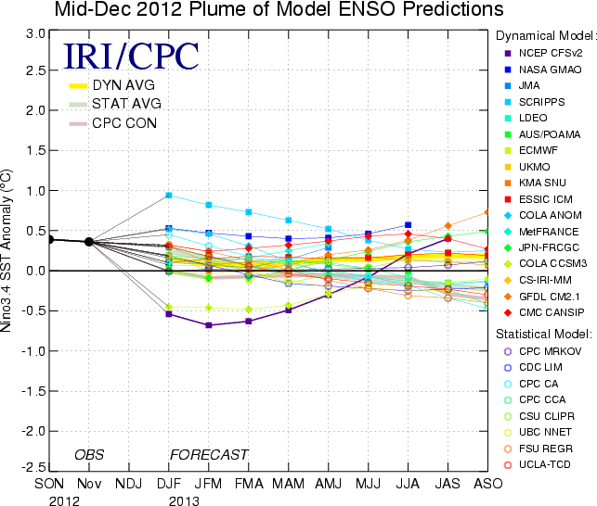
ENSO Forecast Plume

Slide 27
Notable US Climate Events

Slide 28
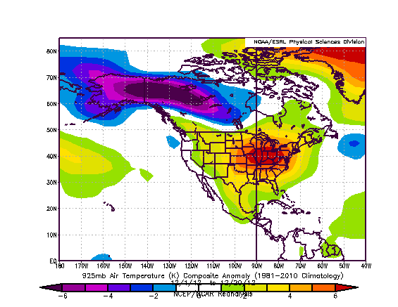
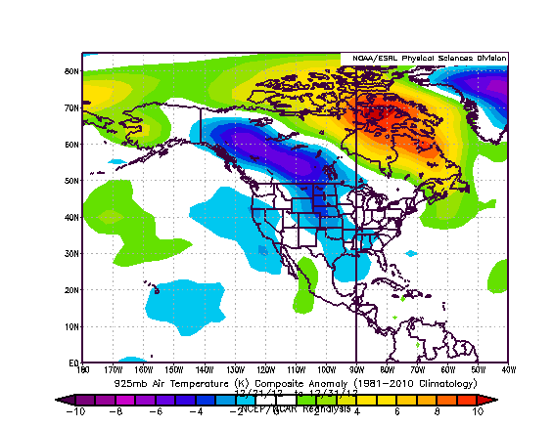
First 20 Days vs. Last 11 Days

Slide 29
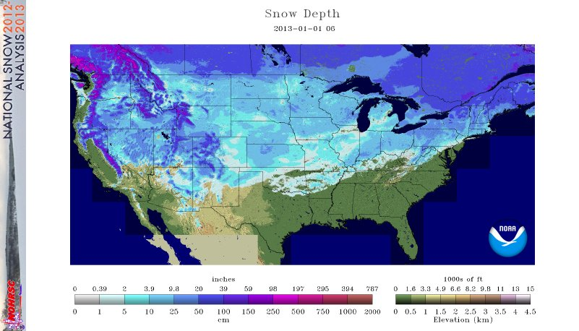
January 1st Snowcover (~67% CONUS)

