Slide 1
August 2013 Monthly Climate Review
Qin Ginger Zhang
Appreciations: Caihong Wen, Melissa Ou, and others

Slide 2
Outline
Tropical Overview:
ENSO conditions
MJO and Tropical Storms
Global Overview
U.S. Climate
Forecast Verification (Monthly/Seasonal/6-10day/8-14day)

Slide 3
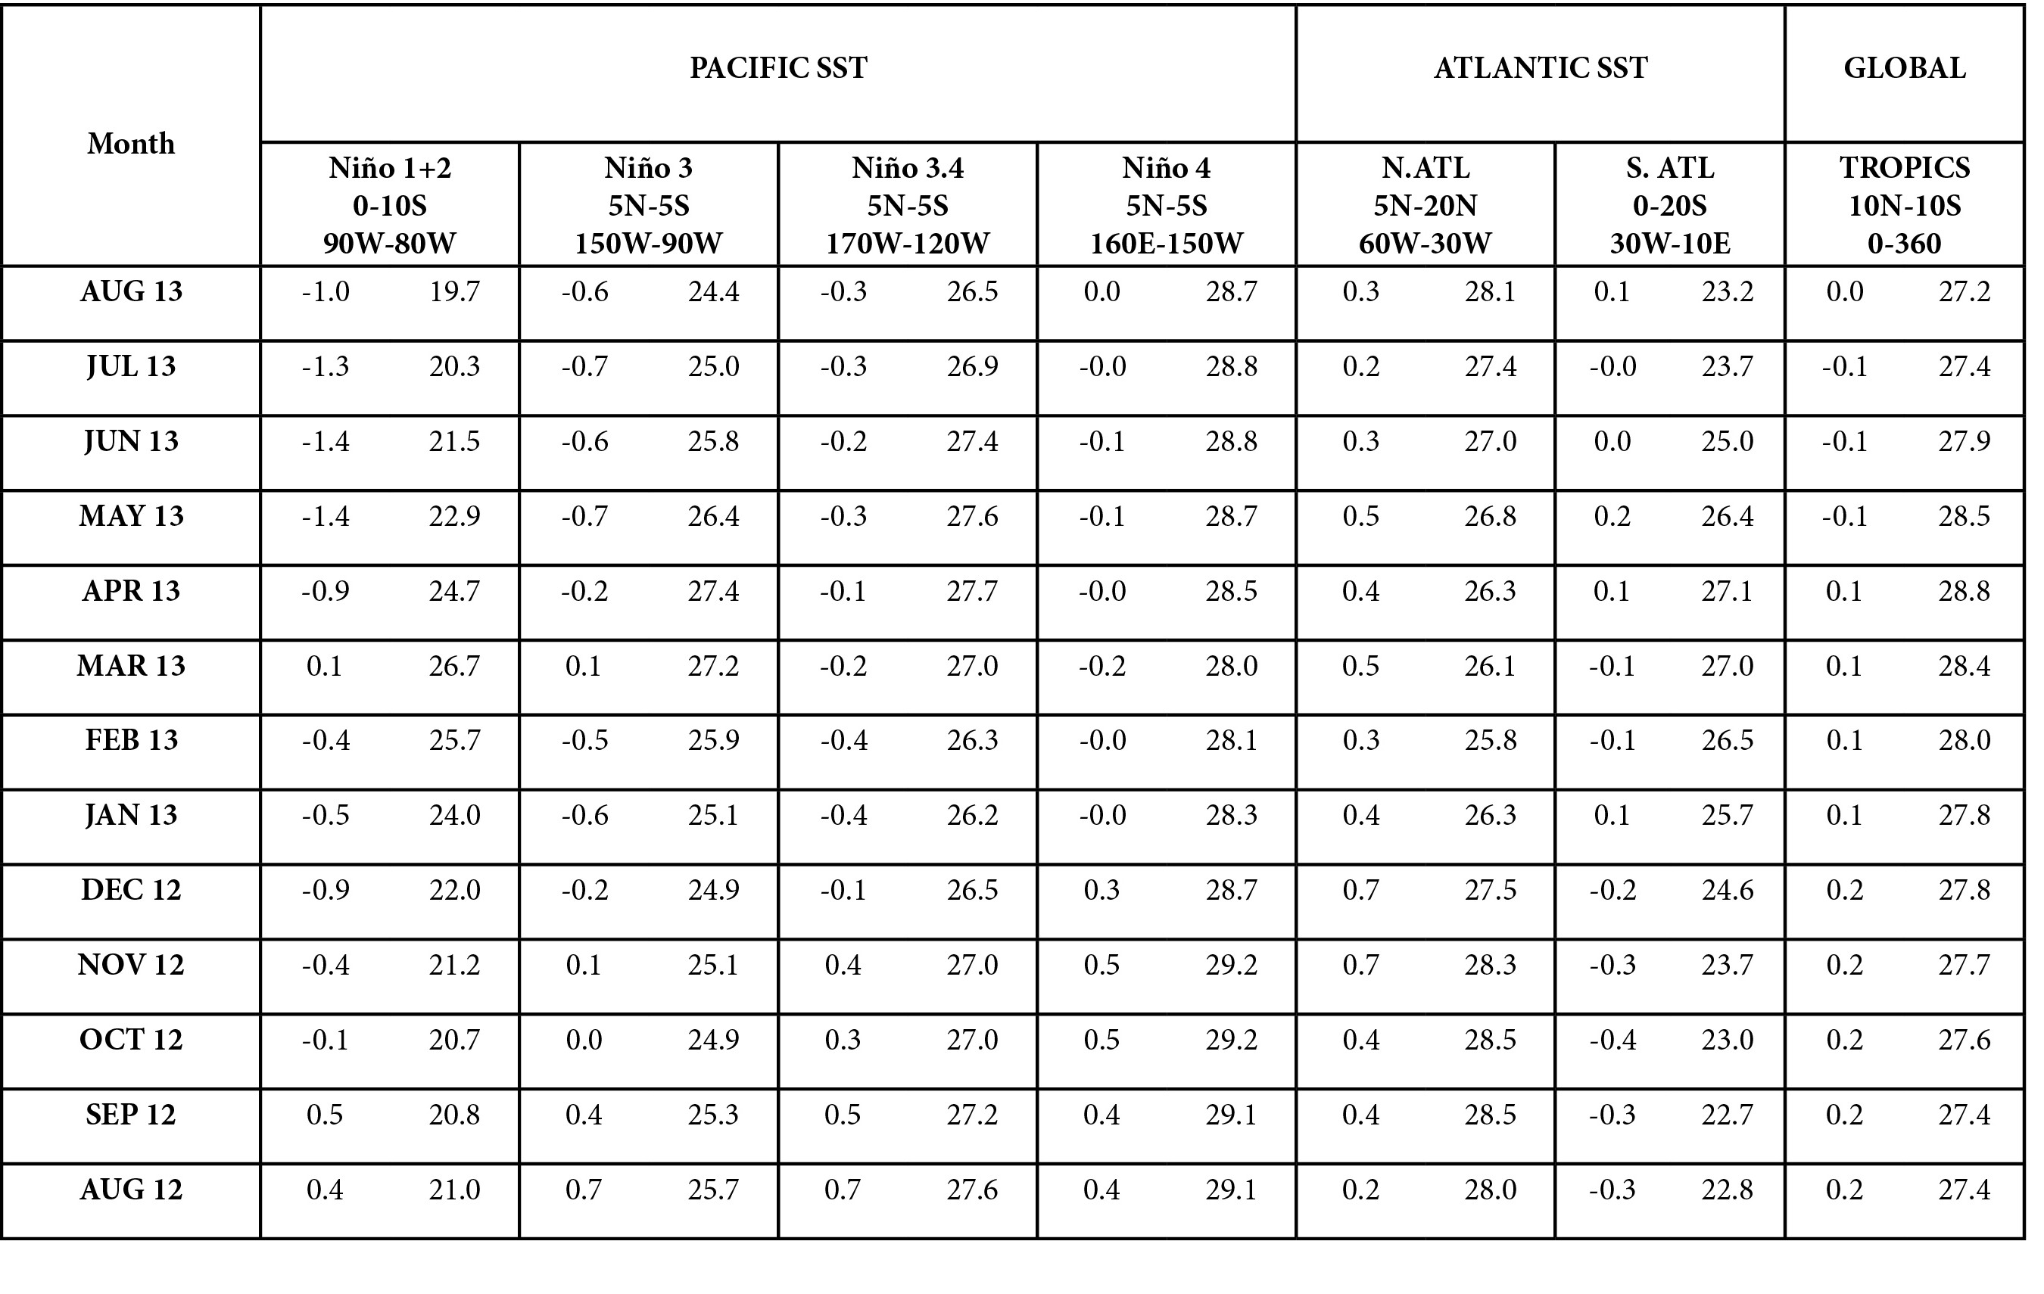
SST Indices
CPC Climate Diagnostics Bulletin

Slide 4
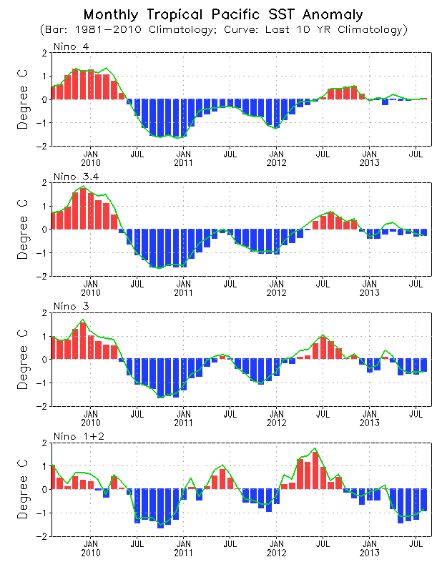
Evolution of Pacific NINO SST Indices
Nino 1+2, Nino3, Nino3.4 indices were negative, with Nino 3.4 = -0.3 ºC
ENSO-neutral conditions continued in August 2013.
The indices were calculated based on OISST. They may have some differences compared with those based on ERSST.v3b.
Fig. P1a. Nino region indices, calculated as the area-averaged monthly mean sea surface temperature anomalies (ºC) for the specified region. Data are derived from the NCEP OI SST analysis, and anomalies are departures from the 1981-2010 (bar) and last ten year (green line) means.

Slide 5
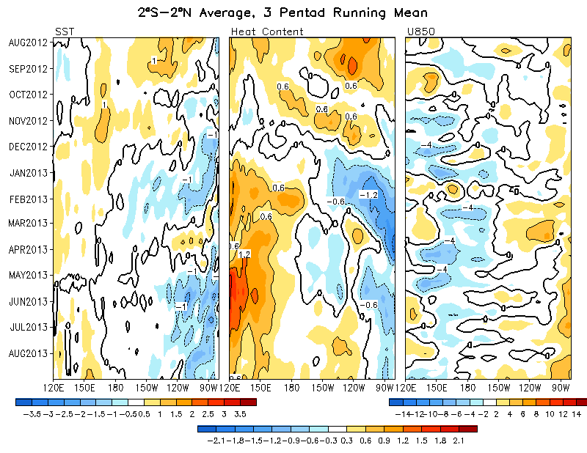
Equatorial Pacific SST (ºC), HC300 (ºC), u850 (m/s)
Below average SSTs was observed in the eastern Pacific since May 2013.
Positive HC300 anomalies in the east-central Pacific continued in August 2013.
Low-level zonal wind anomalies were near normal in August 2013.

Slide 6
Evolution of Pacific SST Anomalies

Slide 7
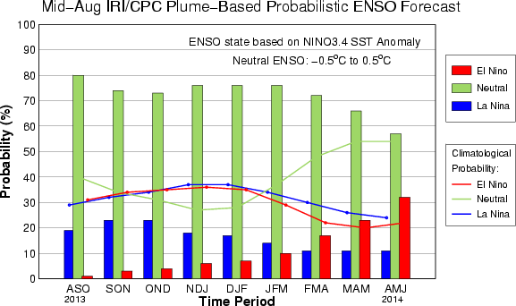
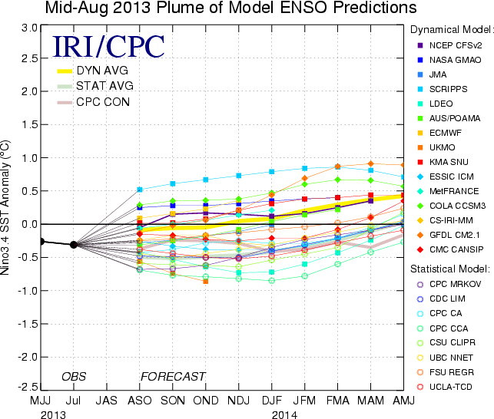
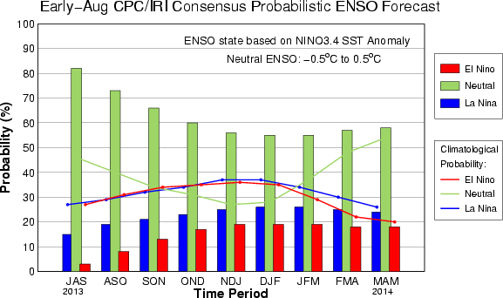
IRI/CPC NINO3.4 Forecast Plume
Ocean Briefing
Most of the models predicted ENSO-neutral in the coming Northern Hemisphere winter and spring.
The consensus forecast favors ENSO-neutral conditions into Northern Hemisphere spring 2014.

Slide 8
MJO

Slide 9
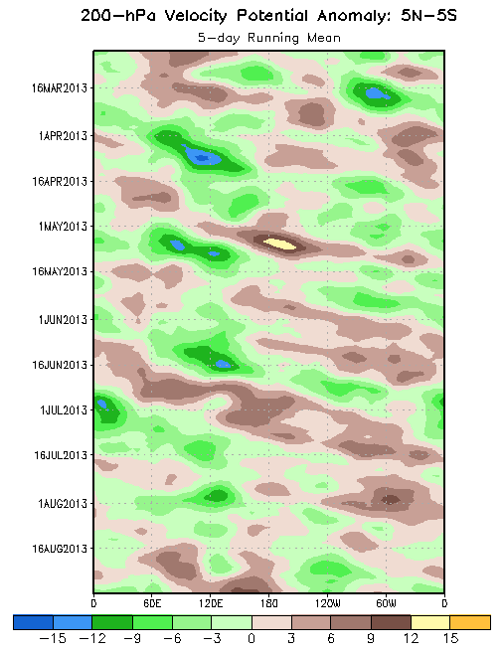
200-hPa Velocity Potential
Anomalies (5°S-5°N)
Positive anomalies (brown shading) indicate unfavorable conditions for precipitation
Negative anomalies (green shading) indicate favorable conditions for precipitation
The MJO was active for much of the March to May 2013 period as shown by generally alternating positive (brown) and negative (green) anomalies with clear eastward propagation.
The MJO was less coherent during much of May.
The MJO strengthened once again during June and the first half of July before weakening by the end of the month.
The MJO was not active during August, although most recently, the upper-level velocity potential anomalies have increased in magnitude along with some eastward propagation.
Time
Longitude
Notes:
9

Slide 10
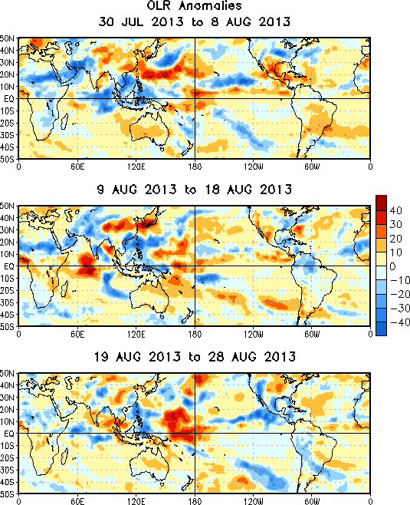
OLR Anomalies – Past 30 days
Drier-than-normal conditions, positive OLR anomalies (yellow/red shading)
Wetter-than-normal conditions, negative OLR anomalies (blue shading)
Although the MJO signal weakened at the end of July, enhanced convection persisted across the Maritime Continent during early August. Suppressed convection expanded across the North American monsoon region.
During mid-August, enhanced (suppressed) convection persisted over parts of the Maritime Continent (the Date Line). Suppressed convection developed across the central Indian Ocean.
During late August, the couplet of enhanced (suppressed) convection persisted over parts of the Maritime Continent (Date Line), while suppressed convective anomalies shifted northward into southern Asia. Enhanced convective anomalies developed over the eastern Pacific and North American Monsoon regions.
Notes:
10

Slide 11
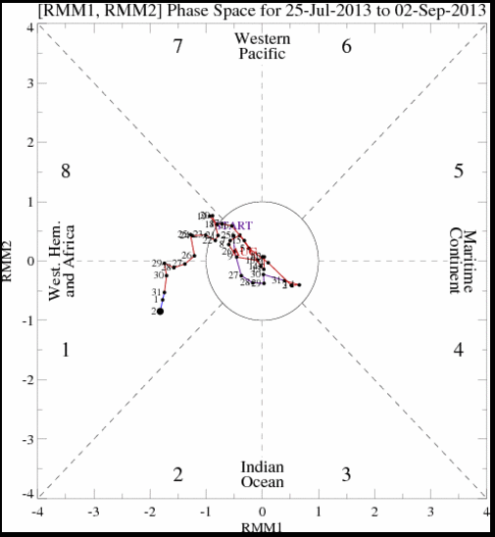
MJO Index -- Recent Evolution
The axes (RMM1 and RMM2) represent daily values of the principal components from the two leading modes
The triangular areas indicate the location of the enhanced phase of the MJO
Counter-clockwise motion is indicative of eastward propagation. Large dot most recent observation.
Distance from the origin is proportional to MJO strength
Line colors distinguish different months
During the previous week, the MJO index indicated an increase in magnitude with eastward propagation.

Slide 12
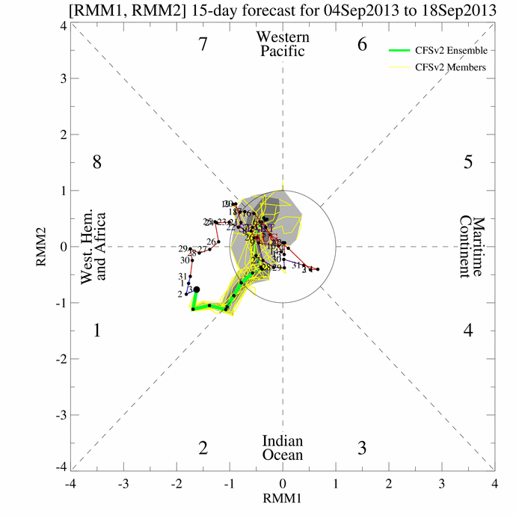
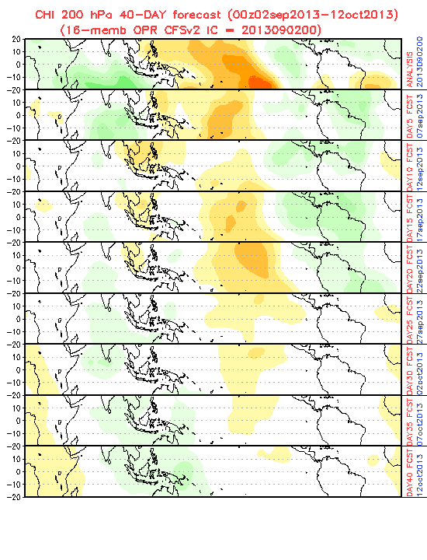
CFSv2 MJO forecast for 30-day WH-MJO Index and 45-day Velocity Potential Anomaly

Slide 13
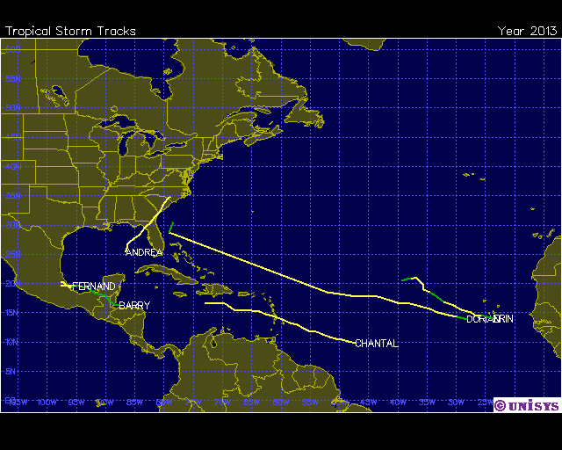
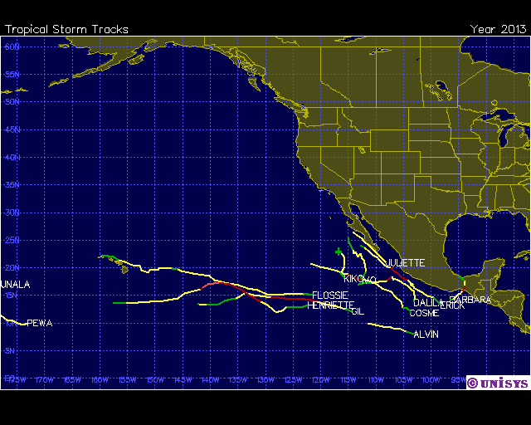
Tropical storms/hurricanes
Atlantic: 3 TCs in August
(total 6 TCs up to now this year)
Dorian
ERIN
FERNAND
Eastern Pacific:
2 Hurricanes and 5 TCs
in August
GIL, HENRIETTE,
TCs:
PEWA, UNALA, IVO, JULIETTE, KIKO

Slide 14
Global Overview

Slide 15
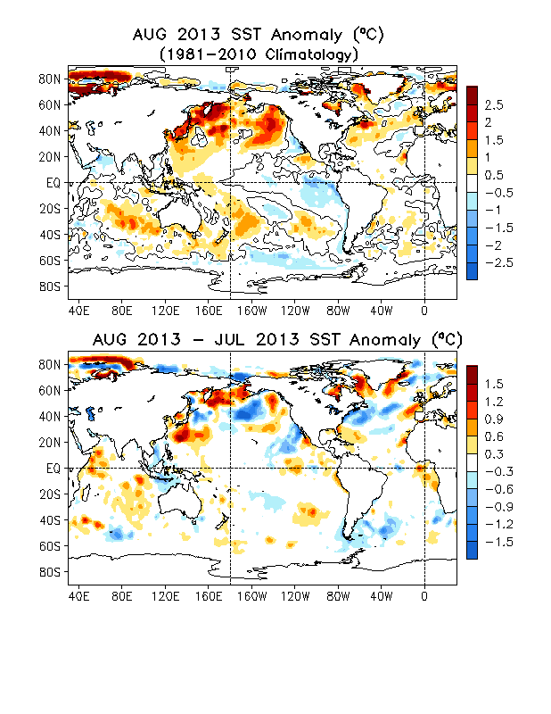
Global SST Anomaly (⁰C) and Anomaly Tendency
Ocean Briefing
SST was near-normal across the western-central tropical Pacific and below normal across the eastern Pacific.
Strong SST warming continued in the high latitudes of North Pacific and Arctic Oceans in Aug. 2013.
Positive SSTA dominated the North Atlantic Ocean.
A strong warming tendency was observed near the Bering Sea and East China Sea and subpolor North Atlantic.
Positive SSTA near the Gulf Stream extension weakened in Aug.2013.
Fig. G1. Sea surface temperature anomalies (top) and anomaly tendency (bottom). Data are derived from the NCEP OI SST analysis, and anomalies are departures from the 1981-2010 base period means.

Slide 16
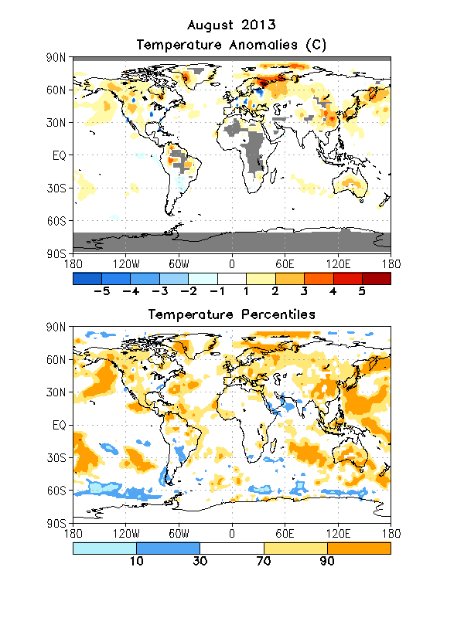
Global Monthly Mean Temperature Anomaly
Notes:
CPC Global Land Surface Air Temperature Analysis (Fan, Y. & H. van den Dool, JGR 2008). The climatology is calculated based 1971-2000 data. The soil moisture in the current month will be re-calculated with monthly data on the 8th of next month.

Slide 17
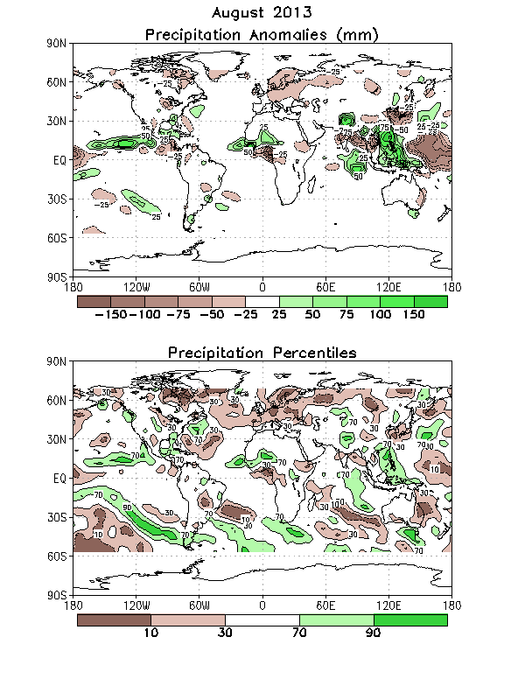
Global Monthly Mean Precipitation Anomaly
Notes:
The precipitation and temperature are monthly data over the globe from CPC PRECipitation REConstruction over Land (Chen, M., P. Xie, J. E. Janowiak and P. A. Arkin, 2002: Global land precipitation: A 50-yr monthly analysis based on gauge observations. J. Hydrometeor., 3, 249-266)

Slide 18
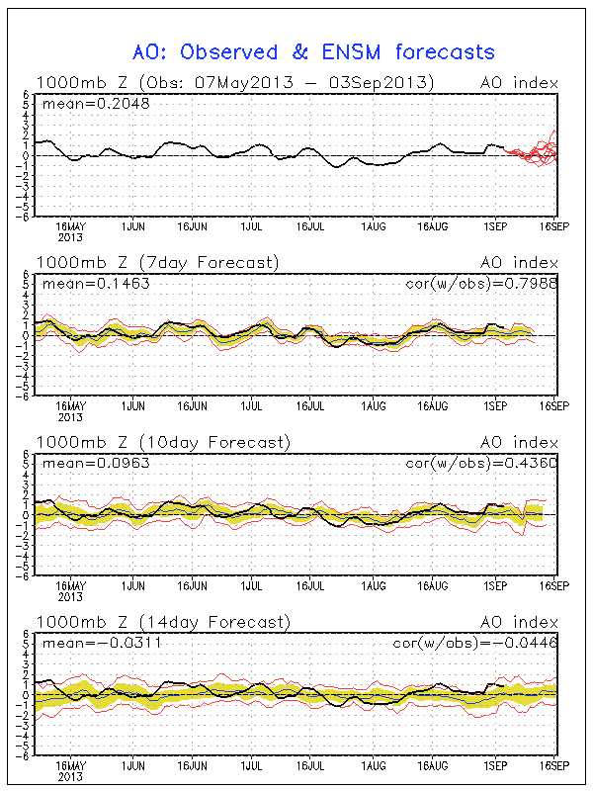
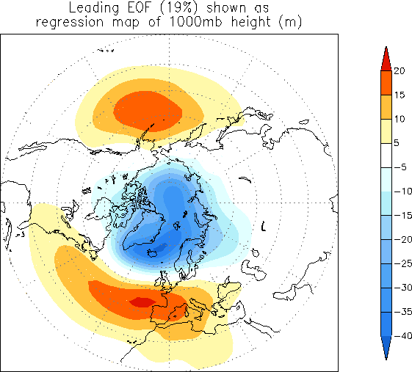
AO Index

Slide 19
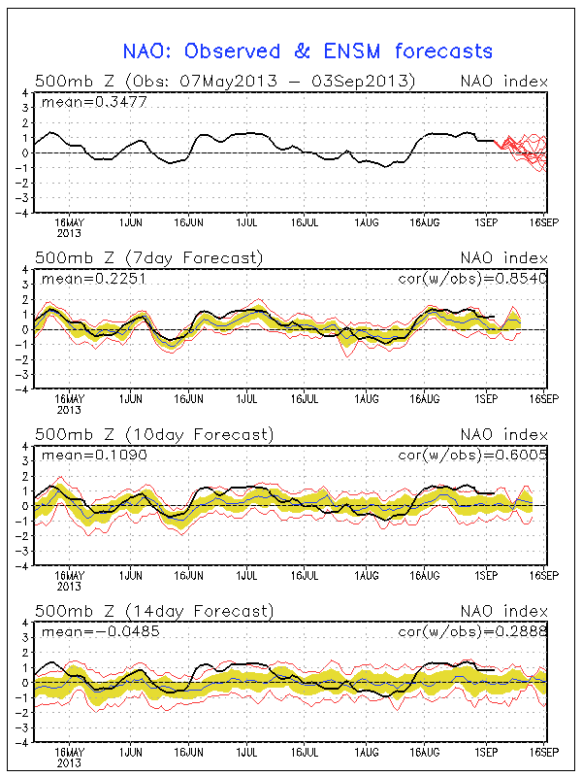
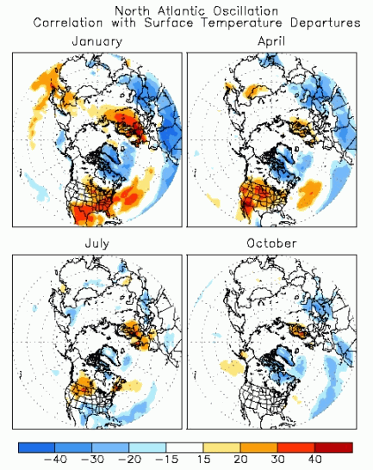
NAO Index

Slide 20
US Climate: August 2013

Slide 21
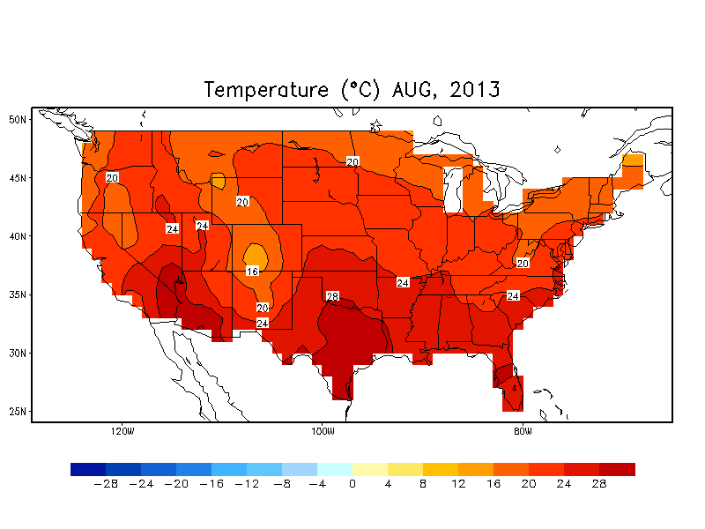
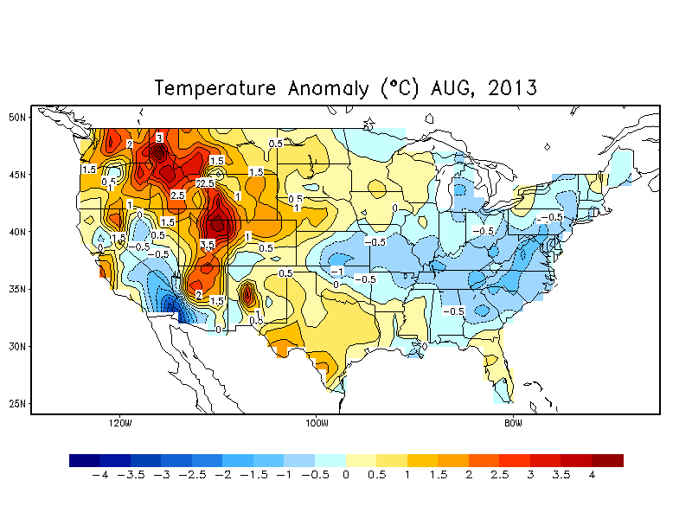
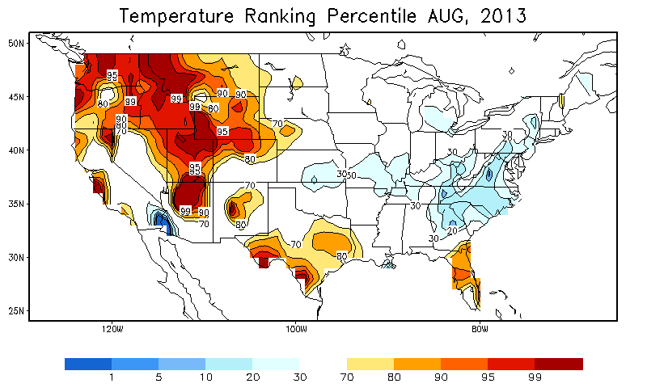
August Temperature

Slide 22
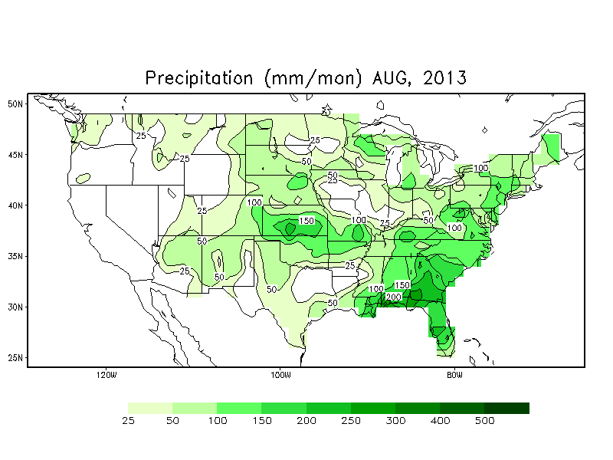
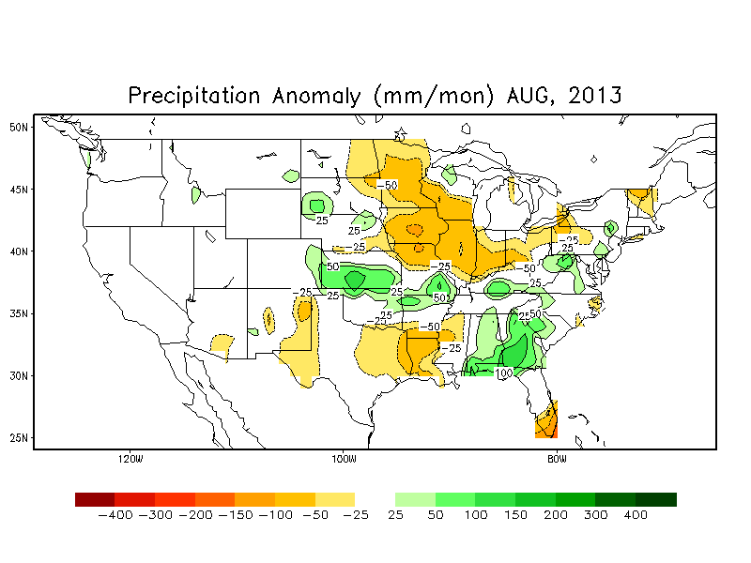
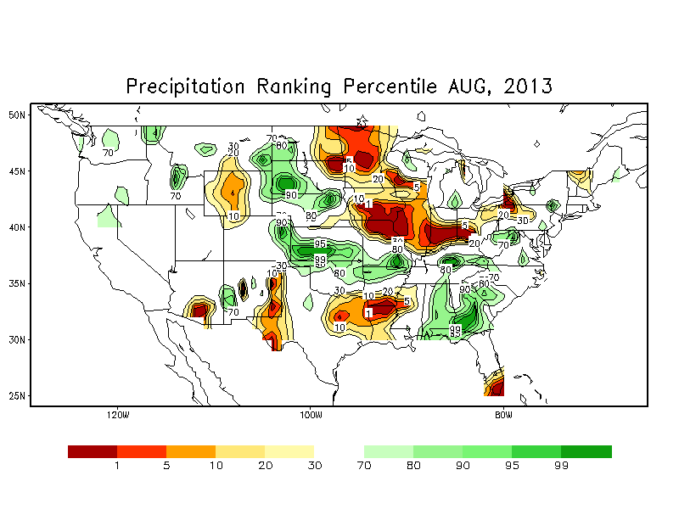
August Precipitation
Notes:
http://www.cpc.ncep.noaa.gov/products/tanal/temp_analyses.php

Slide 23
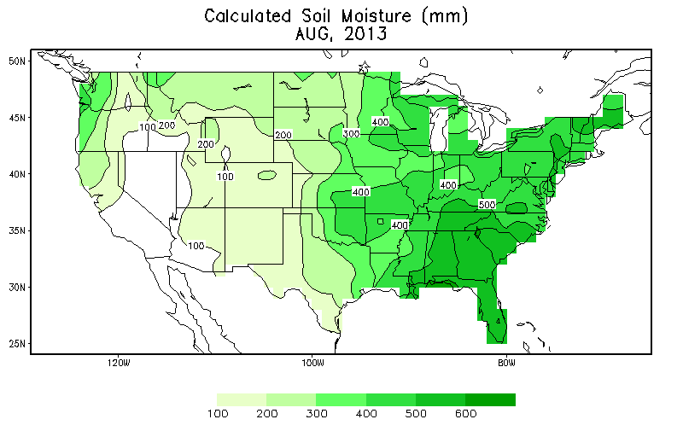
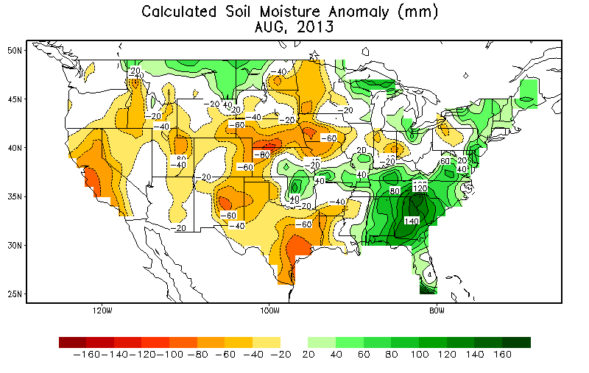
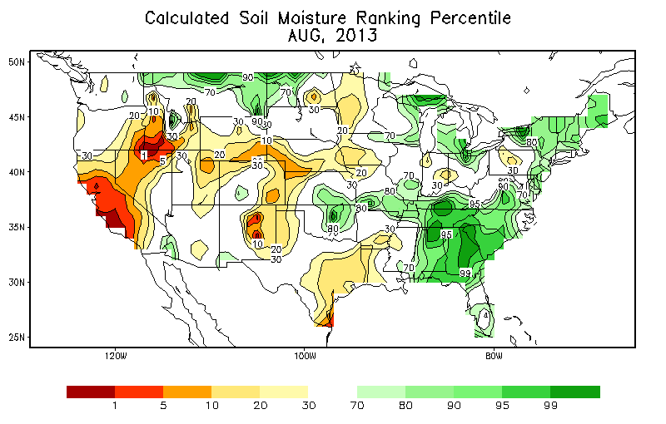
Monthly Mean Soil Moisture (Leaky Bucket Model)
Notes:
http://www.cpc.ncep.noaa.gov/products/tanal/temp_analyses.php

Slide 24
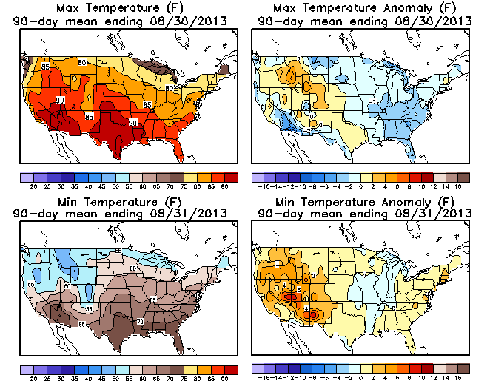
Seasonal Temperature Anomaly

Slide 25
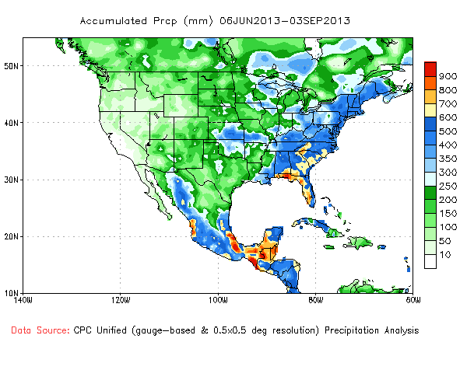
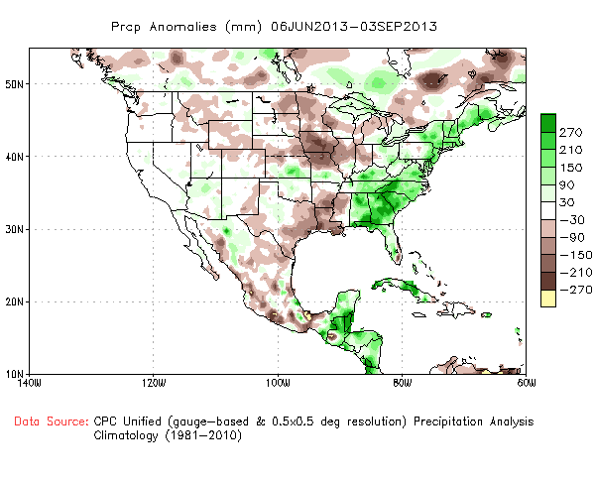
Seasonal Precipitation

Slide 26
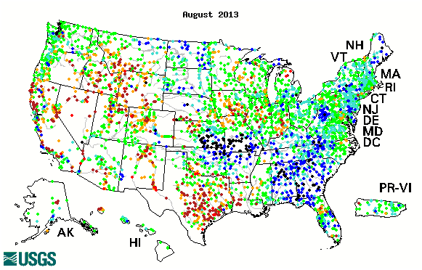
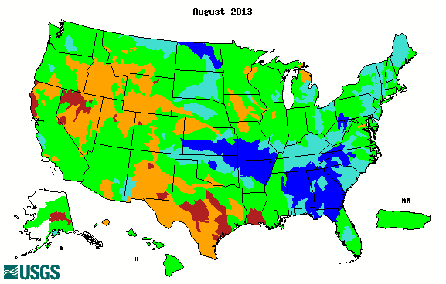
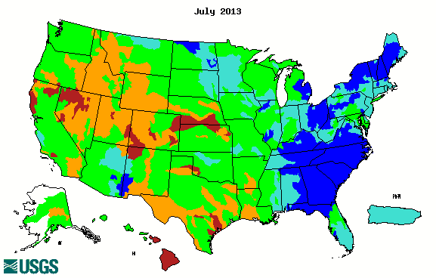
Streamflow Percentile (USGS)
Below normal rain caused dry over Texas and New Mexico.
Above normal rain caused flooding over the Southeast and Missouri, Arkansas and Kansas.
Good monsoon rainfall over the Southwest improved drought conditions over AZ.
Notes:
http://waterwatch.usgs.gov/?m=mv01d&r=us&w=real%2Cmap

Slide 27
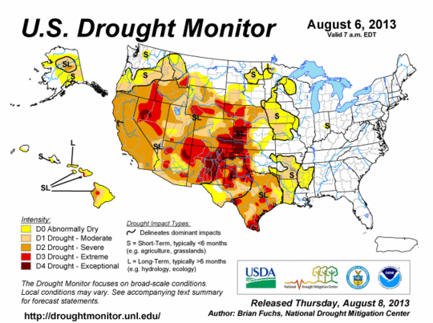
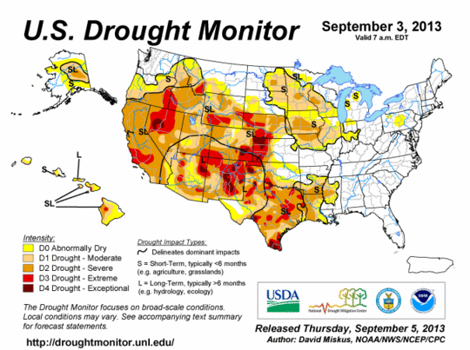
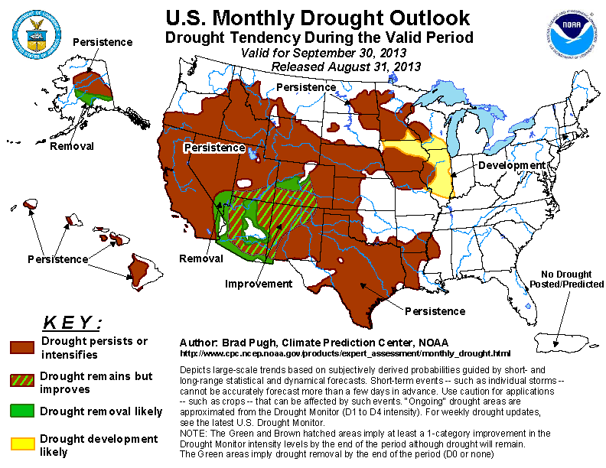
Drought monitor
The pattern is similar to the DM last month but the intensity decreases
the Western States are still under drought except Washington and Montana
Notes:
Our web site

Slide 28
Forecast Verification: August and JJA

Slide 29
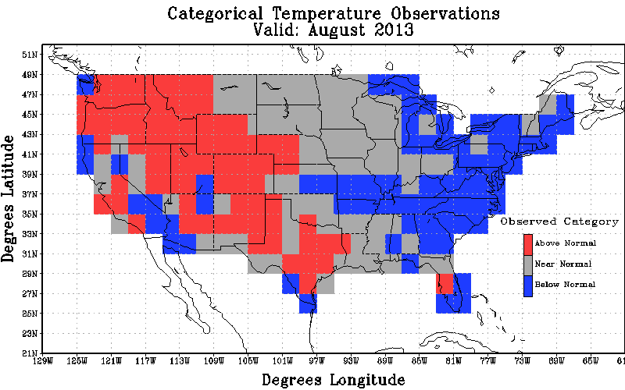
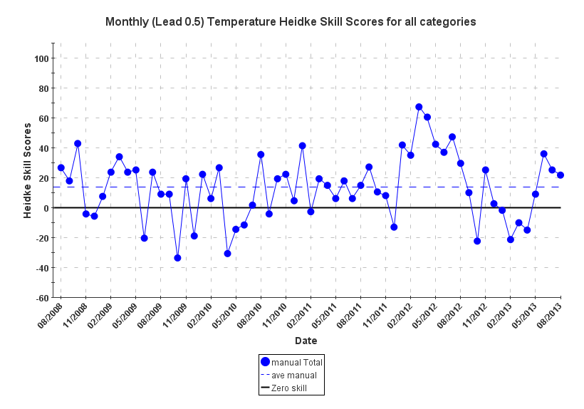
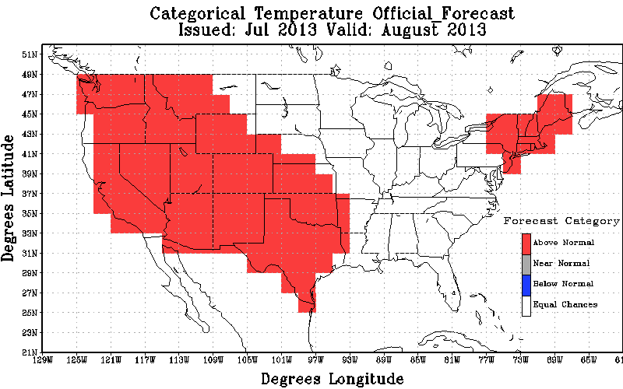
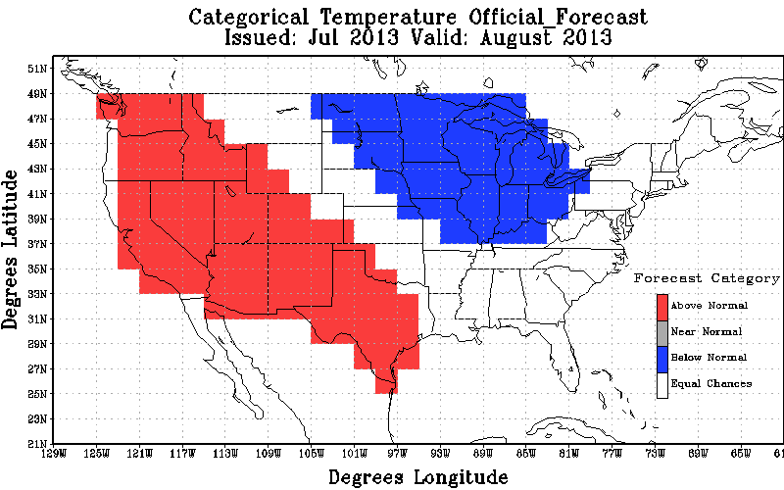
August Temperature Forecast Verification
Observations
Heidke skill scores = 13.37% for 2008-2013
Revised Forecast
Original Forecast
Revised Forecast
Non-EC Skill Score: 38.31; non-EC coverage: 53.45%
All Forecasts: 20.47
Non-EC Skill Score: 27.66; non-EC coverage: 60.78%
All Forecasts: 16.81

Slide 30
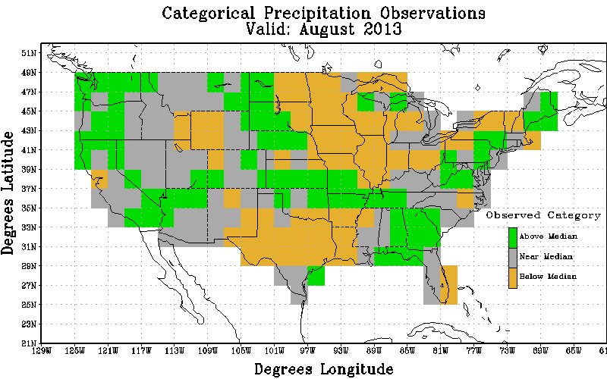
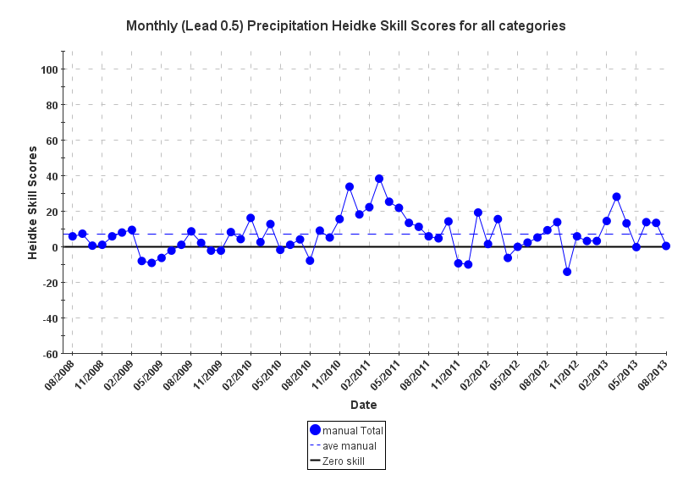
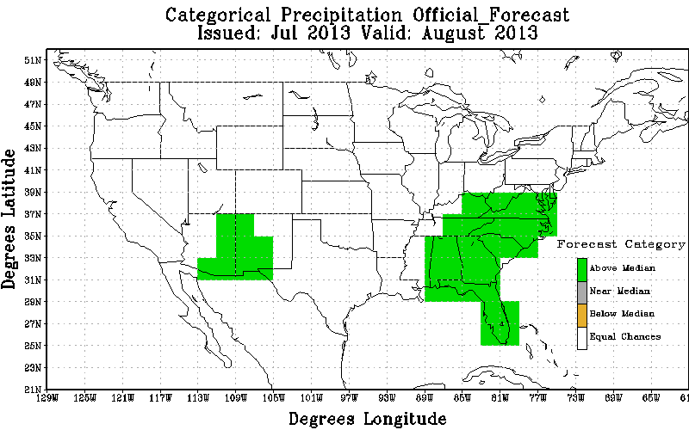
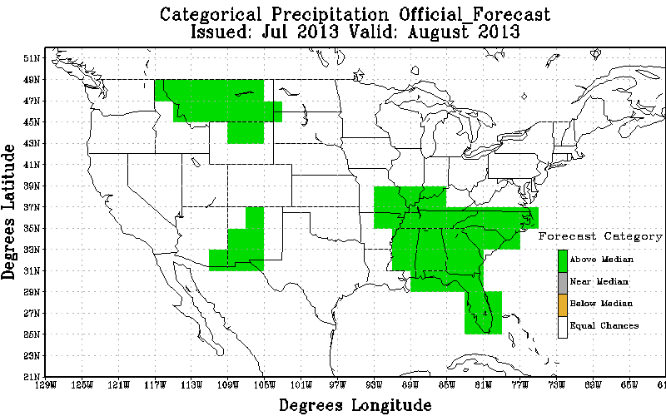
August Precipitation Forecast Verification
Observations
Heidke skill scores = 6.84% for 2008-2013
Original Forecast
Revised Forecast
Non-EC Skill Score: 1.32; non-EC coverage: 16.38%
All Forecasts: 0.22
Non-EC Skill Score: 0.94; non-EC coverage: 22.84%
All Forecasts: 1.22

Slide 31
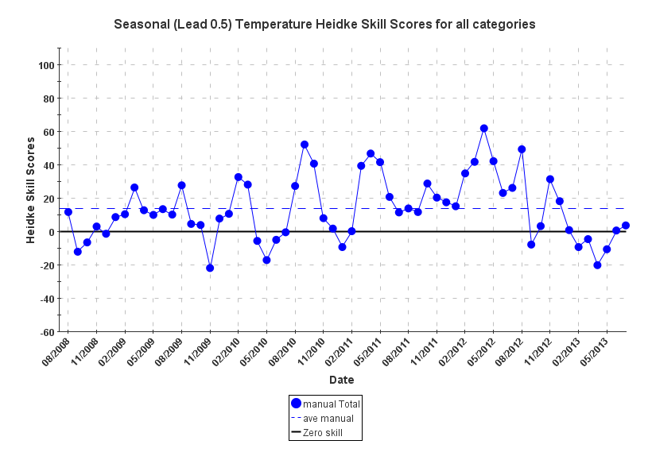
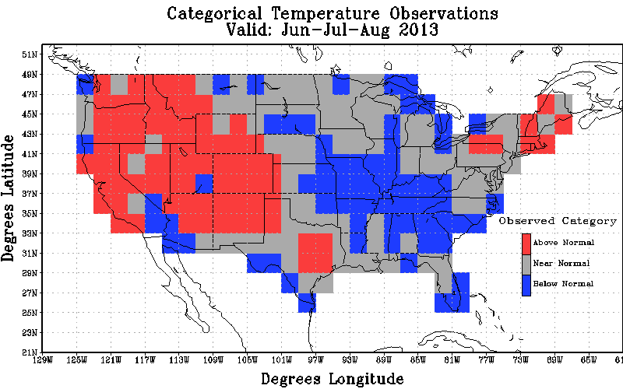
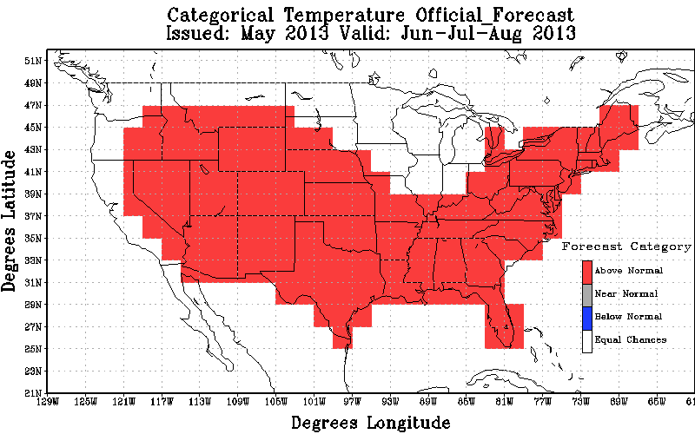
JJA Temperature Forecast Verification
Observations
Heidke skill scores = 13.54% for 2008-2013
Official Forecast
Non-EC Skill Score: 4.71;
non-EC coverage: 73.28%
All Forecasts: 3.45

Slide 32
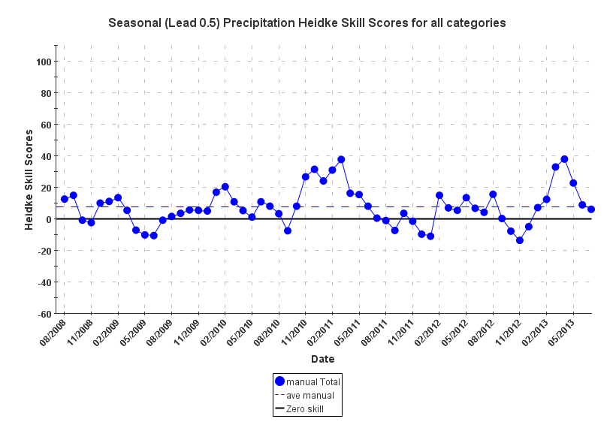
JJA Precipitation Forecast Verification
Observations
Heidke skill scores = 7.54% for 2008-2013
Official Forecast
Non-EC Skill Score: 22.50;
non-EC coverage: 25.86%
All Forecasts: 5.82

Slide 33
6-10 day and 8-14 day Temperature and Precipitation Forecast Verification
New Verification Web Tool:
http://cpcintradev.ncep.noaa.gov/apps/vwt/index.php?page=chart

Slide 34
6-10 Day Temperature Heidke Scores
Heidke skill scores = 34.2% for last 365 days

Slide 35
8-14 Day Temperature Heidke Scores
Heidke skill scores = 24.7% for last 365 days

Slide 36
6-10 Day Precipitation Heidke Scores
Heidke skill scores = 22.8% for last 365 days

Slide 37
8-14 Day Precipitation Heidke Scores
Heidke skill scores = 15.6% for last 365 days

Slide 38
Thanks!

