Slide 1
The African Monsoon Recent Evolution and Current Status Include Week-1 and Week-2 Outlooks
Update prepared
26 February 2024
For more information, visit:
http://www.cpc.ncep.noaa.gov/products/Global_Monsoons/African_Monsoons/precip_monitoring.shtml

Slide 2
Outline
Highlights
Recent Evolution and Current Conditions
NCEP GEFS Forecasts
Summary

Slide 3
Highlights: Last 7 Days
During the past 7 days, in East Africa, rainfall was above-average in local areas in west-central Ethiopia, pocket areas in central Kenya, and parts in northern and southeastern Tanzania. Rainfall was below average in southern Uganda, central Burundi, western and central Tanzania. In central Africa, rainfall was above-average in western and parts in central DRC, southwestern and central Congo, and portion in southern and eastern Gabon. Rainfall was below-average in western and eastern Cameroon, Equatorial Guinea, central Gabon, western CAR, northeastern and far southern DRC. In West Africa, rainfall was above-average in pocket areas in southern Cote d’Ivoire, southern Ghana, southern Togo, southern Benin, and southwestern Nigeria. Rainfall was below-average in eastern Liberia, central Cote d’Ivoire, western Ghana, and southeastern Nigeria. In southern Africa, rainfall was above-average over northwestern Angola, local areas in northern Zambia, pocket areas in central Namibia and southwestern Botswana, northern Malawi, areas in central Mozambique, and west-central Madagascar. Rainfall was below-average over eastern and southern Angola, northern Namibia, western and southern Zambia, northern Botswana, Zimbabwe, southern Malawi, eastern and northeastern South Africa, most parts in Mozambique, and eastern and southern Madagascar.
The Week-1 outlook calls for above-average rainfall along central and eastern Gulf of Guinea, part of Central Africa, most parts in equatorial East Africa, and the far western and far eastern southern Africa, including central and western Madagascar. In contrast, there is an increased chance for below-average rainfall over parts of Liberia and central southern Africa. The Week-2 outlook calls for below-average rainfall along the Gulf of Guinea, northern DRC, and a wide area in southern Africa. In contrast, there is an increased chance for above-average rainfall in pocket areas in central Ethiopia, part of Gabon, western DRC, northwestern Angola, parts in Uganda, Kenya, Tanzania, east-central, and southern Madagascar.

Slide 4
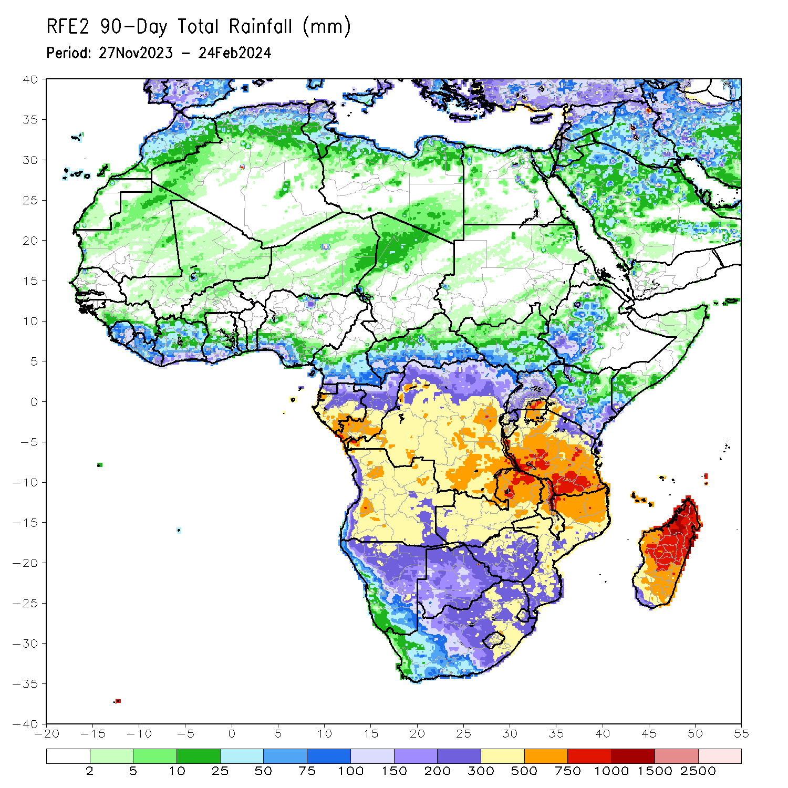
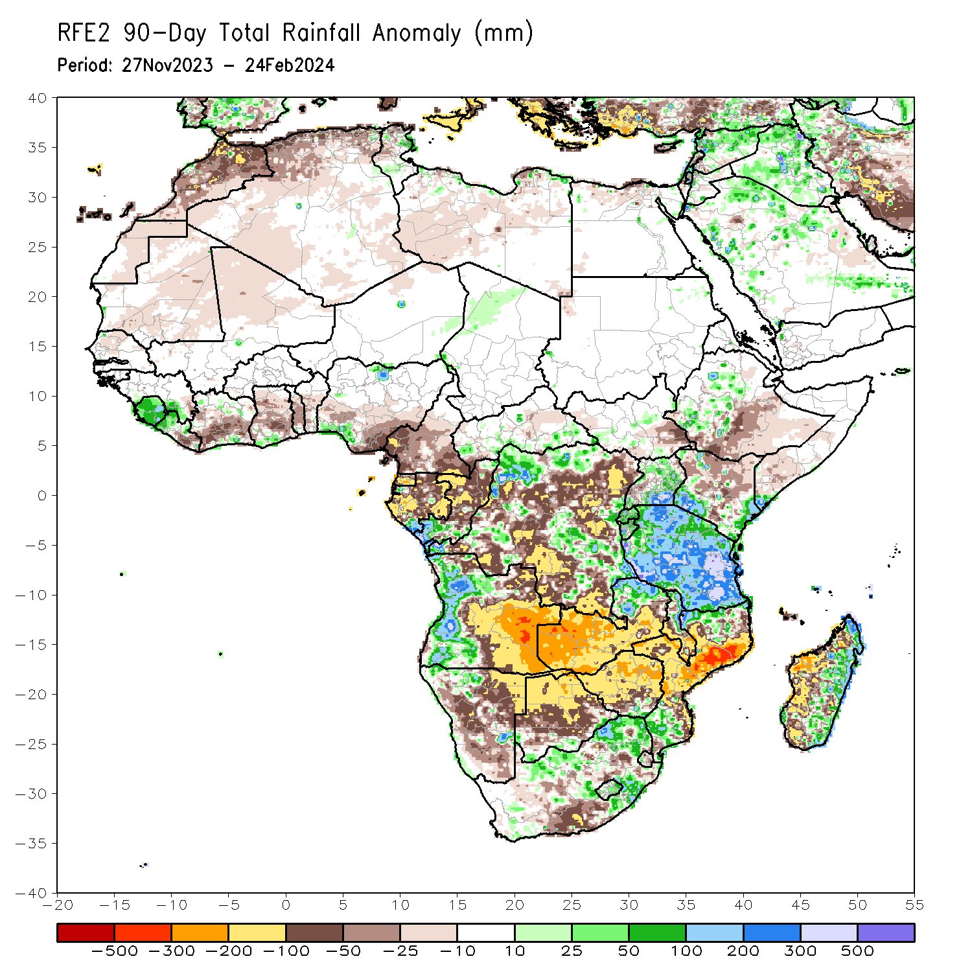
Rainfall Patterns: Last 90 Days
Over the past 90 days, in East Africa, rainfall was above-average in parts of central South Sudan, parts in western and central Ethiopia, Uganda, southwestern and eastern Kenya, southern Somalia, Rwanda, Burundi, and Tanzania. Rainfall was below-average in southeastern South Sudan, southern and south-central Ethiopia, central Kenya, and south-central Somalia. In Central Africa, rainfall was above-average in southern CAR, far western and parts in northern, eastern, and central DRC, southwestern Congo, and southernmost Gabon. Rainfall was below-average over most parts in Cameroon, Equatorial Guinea, Gabon, central Congo, and parts of western, central, and southwestern DRC. In West Africa, rainfall was above-average over Sierra Leone, western Liberia, parts in northern and southern Cote d’Ivoire, southern Ghana, southern Togo, and southwestern Nigeria. Rainfall was below-average in eastern Liberia, south-central Cote d’Ivoire, south-central Ghana, and southeastern Nigeria. In southern Africa, rainfall was above-average over western Angola, parts in northern Namibia, northern Zambia, southern Zimbabwe, northeastern Malawi, northern and southern Mozambique, parts of eastern, central, and northeastern South Africa, Lesotho, western Eswatini, northern and eastern Madagascar. Rainfall was below-average over central and eastern Angola, northeastern Namibia, western and southern Zambia, northern Botswana, Zimbabwe, parts of southern and east-central South Africa, western, central, and southeastern Mozambique, southern Malawi, western and southwestern Madagascar.
Notes:
4

Slide 5
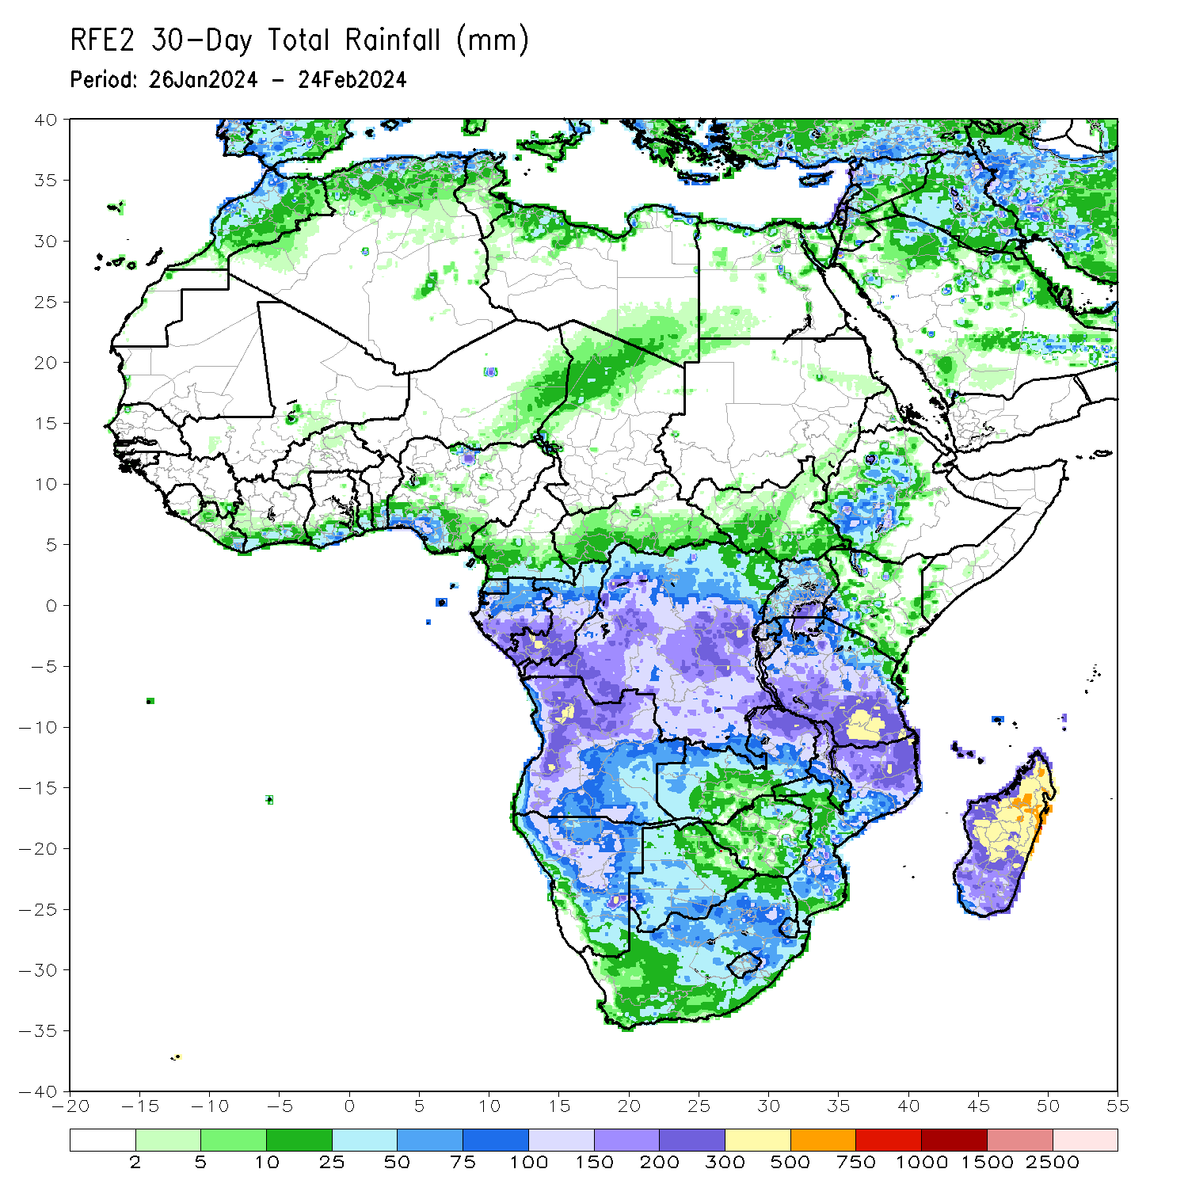
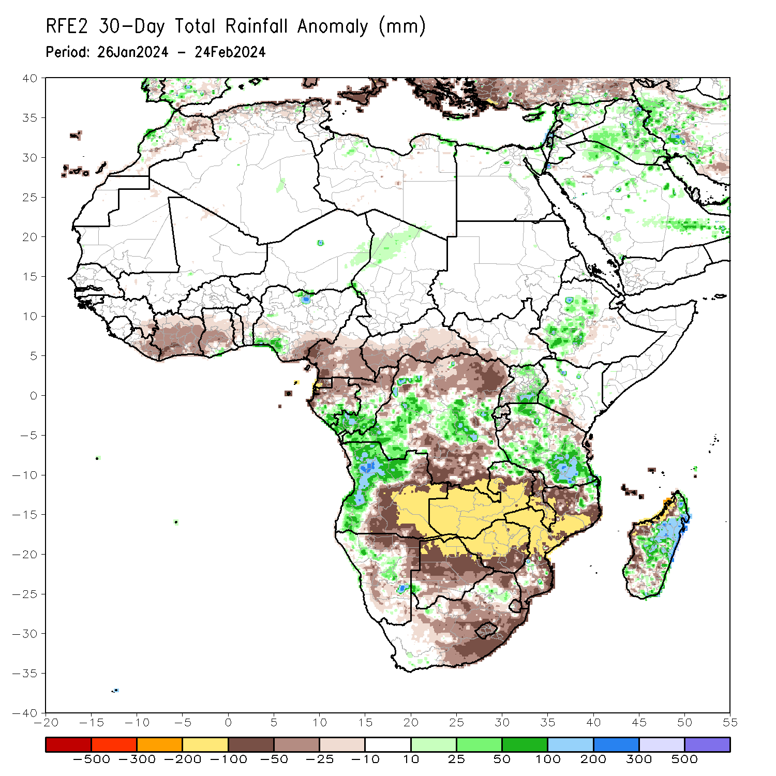
Rainfall Patterns: Last 30 Days
Over the past 30 days, in East Africa, rainfall was above-average in west-central Ethiopia, most parts in Uganda, southwestern Kenya, western Rwanda, western Burundi, and much of Tanzania. Rainfall was below-average in southwestern Uganda, parts in western and northern Tanzania. In Central Africa, rainfall was above-average over western and central DRC, southern Gabon, and southern Congo. Rainfall was below-average across Cameroon, Equatorial Guinea, northern Gabon, northern Congo, northern and southern DRC, and southern CAR. In West Africa, rainfall above-average along southern Ghana and southwestern Nigeria, but was below-average elsewhere along much of the Gulf of Guinea. In southern Africa, rainfall was above-average in western Angola, northwestern and parts in central Namibia, northeastern and parts in south-central Mozambique, parts in east-central South Africa, central and eastern Madagascar. Rainfall was below-average in central and eastern Angola, western Zambia, Malawi, northeastern Namibia, northern Botswana, Zimbabwe, eastern and northeastern South Africa, western and central Mozambique, Lesotho, Eswatini, and coastal western Madagascar.
Notes:
5

Slide 6
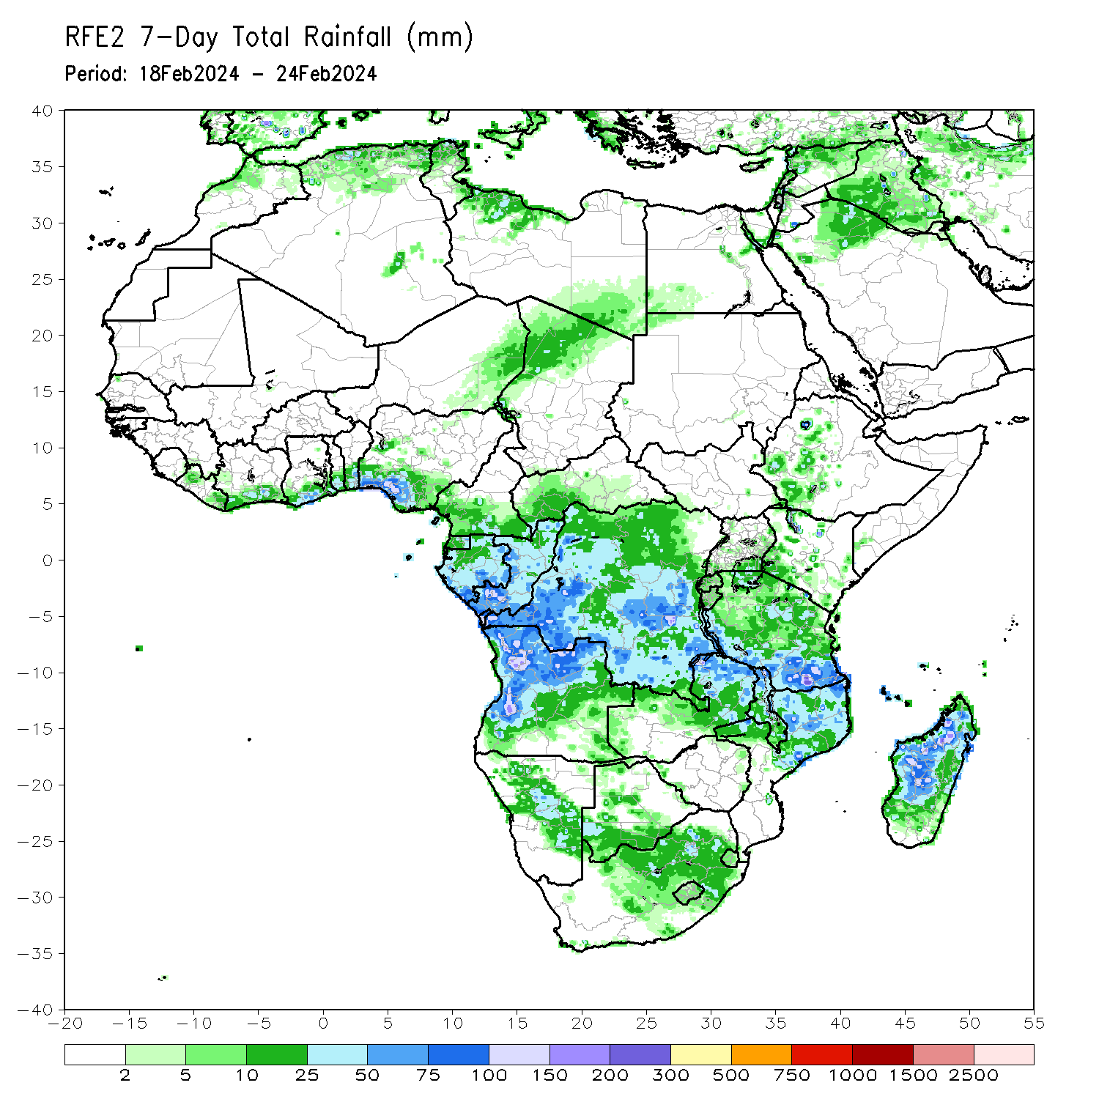
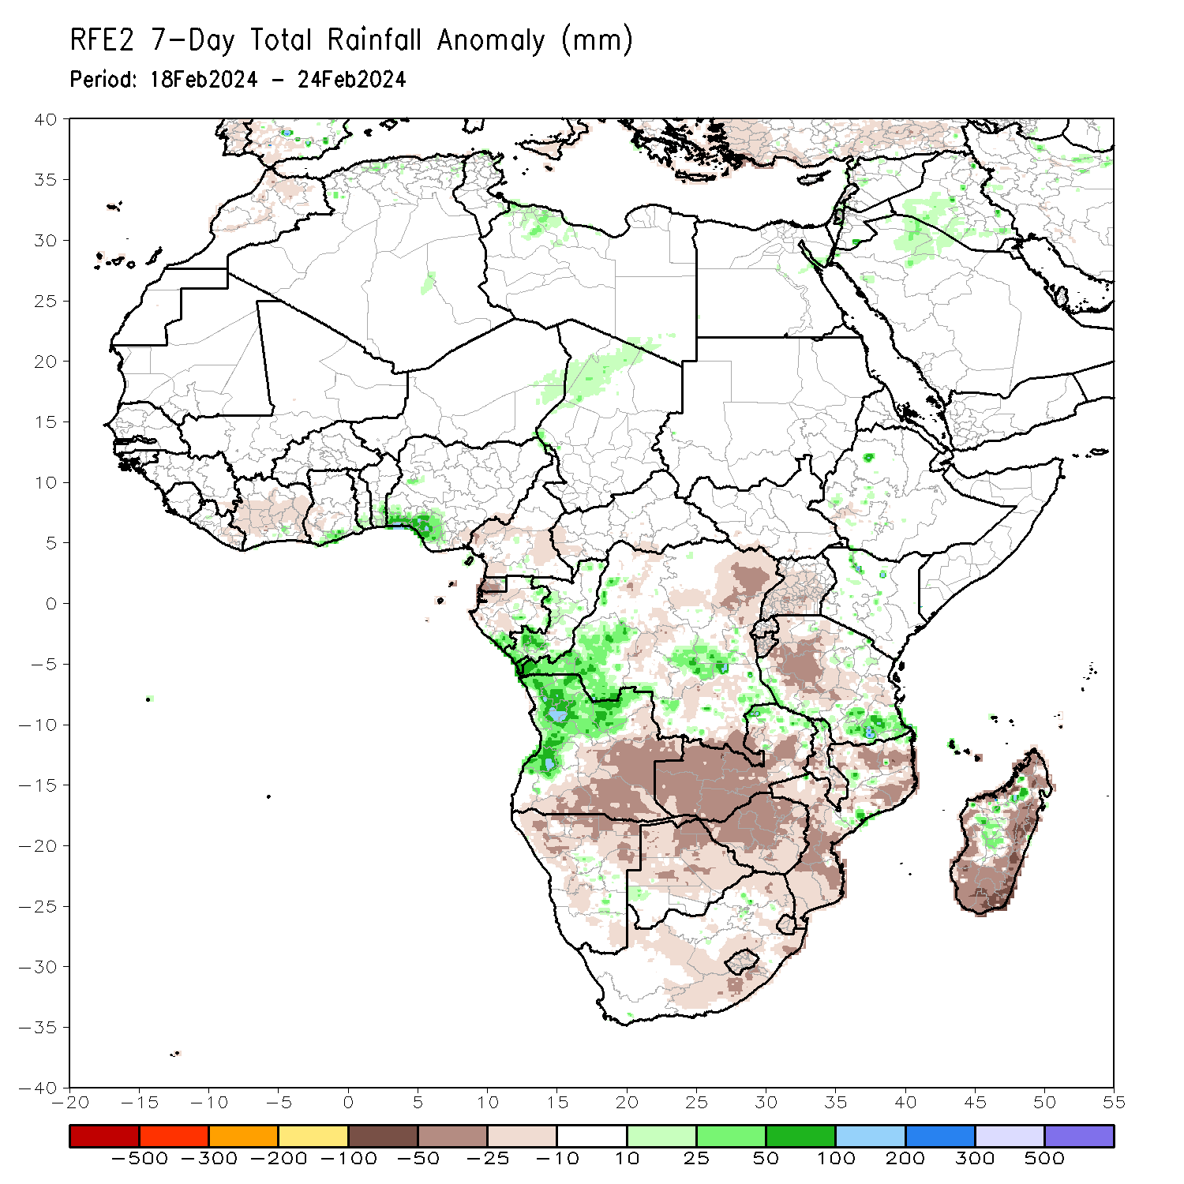
Rainfall Patterns: Last 7 Days
During the past 7 days, in East Africa, rainfall was above-average in local areas in west-central Ethiopia, pocket areas in central Kenya, and parts in northern and southeastern Tanzania. Rainfall was below average in southern Uganda, central Burundi, western and central Tanzania. In central Africa, rainfall was above-average in western and parts in central DRC, southwestern and central Congo, and portion in southern and eastern Gabon. Rainfall was below-average in western and eastern Cameroon, Equatorial Guinea, central Gabon, western CAR, northeastern and far southern DRC. In West Africa, rainfall was above-average in pocket areas in southern Cote d’Ivoire, southern Ghana, southern Togo, southern Benin, and southwestern Nigeria. Rainfall was below-average in eastern Liberia, central Cote d’Ivoire, western Ghana, and southeastern Nigeria. In southern Africa, rainfall was above-average over northwestern Angola, local areas in northern Zambia, pocket areas in central Namibia and southwestern Botswana, northern Malawi, areas in central Mozambique, and west-central Madagascar. Rainfall was below-average over eastern and southern Angola, northern Namibia, western and southern Zambia, northern Botswana, Zimbabwe, southern Malawi, eastern and northeastern South Africa, most parts in Mozambique, and eastern and southern Madagascar.

Slide 7
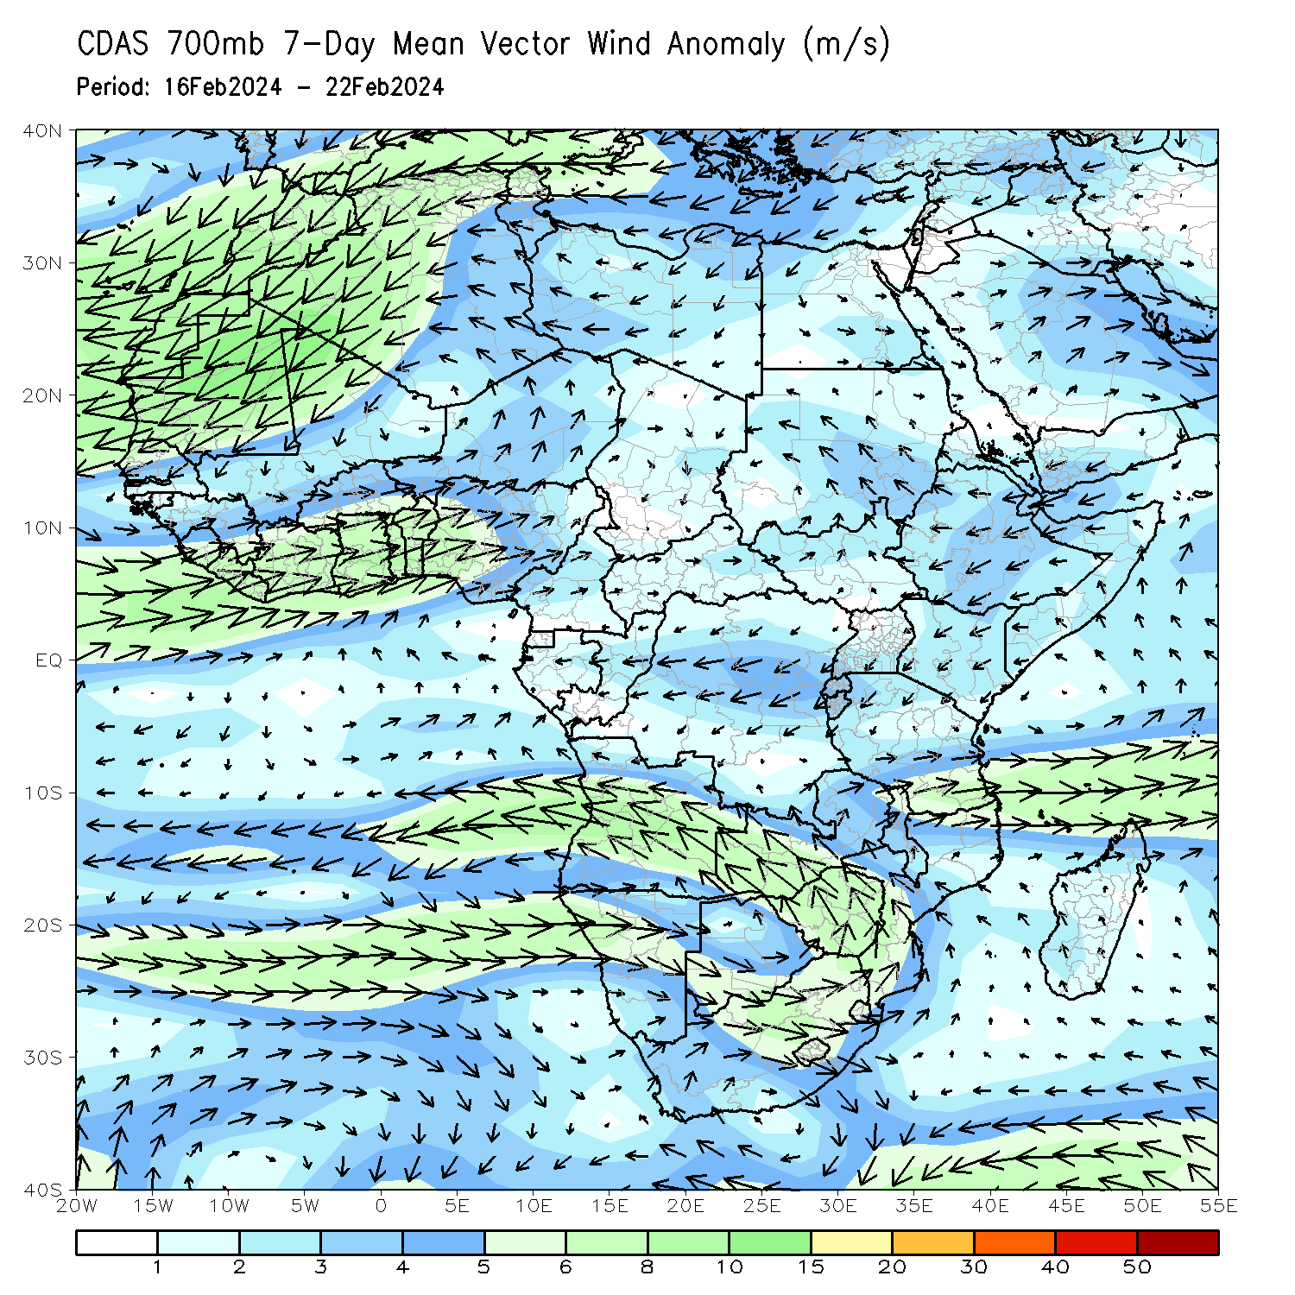
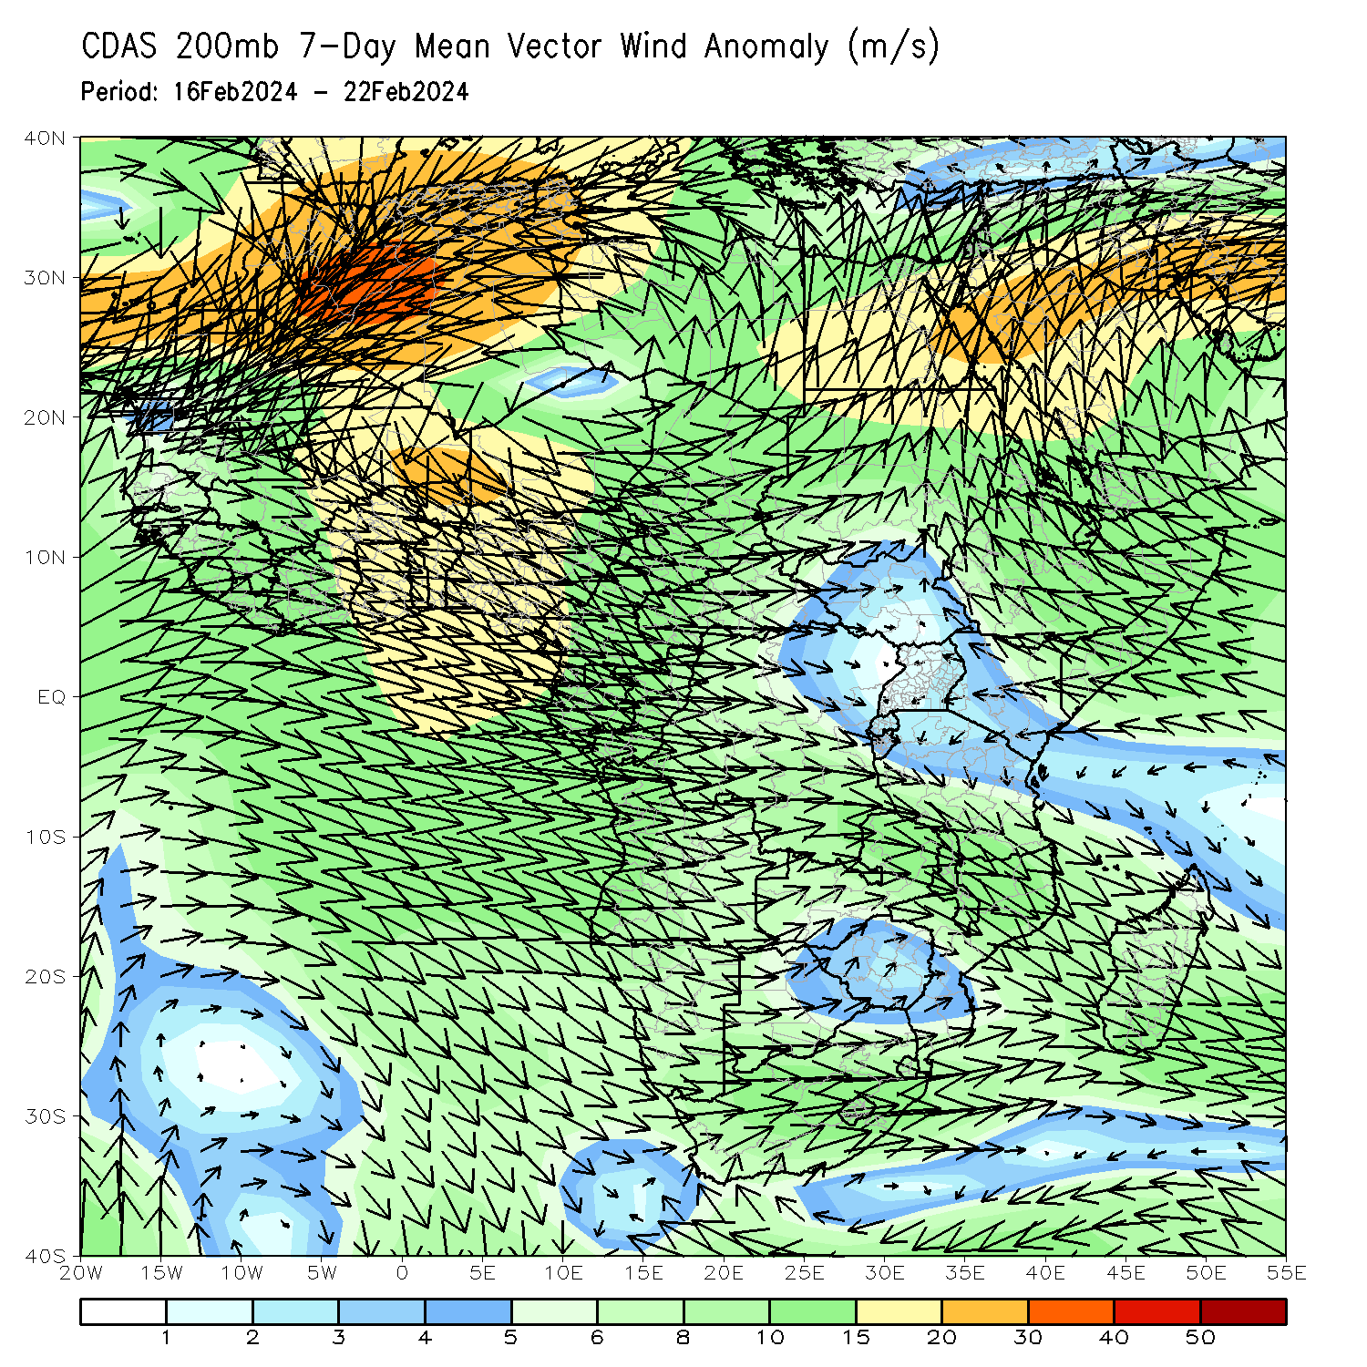
Atmospheric Circulation: Last 7 Days
At 700-hPa level (left panel), the anomalous lower-level convergence in northern Angola and western DRC may have contributed to the observed above-average rainfall in the region. At 200-hPa level (right panel), anomalous upper-level convergence across the central part in southern Africa and Madagascar may have contributed to the below-average rainfall in the region.

Slide 8
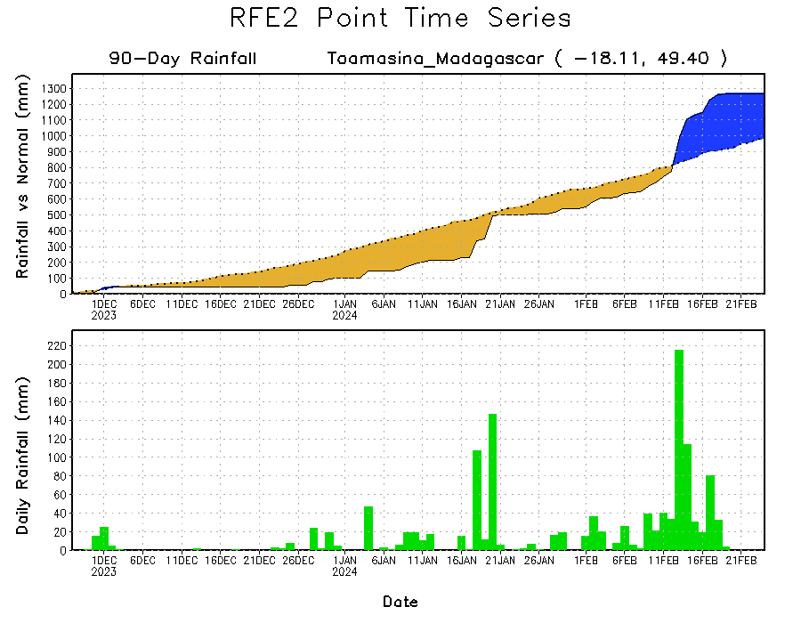
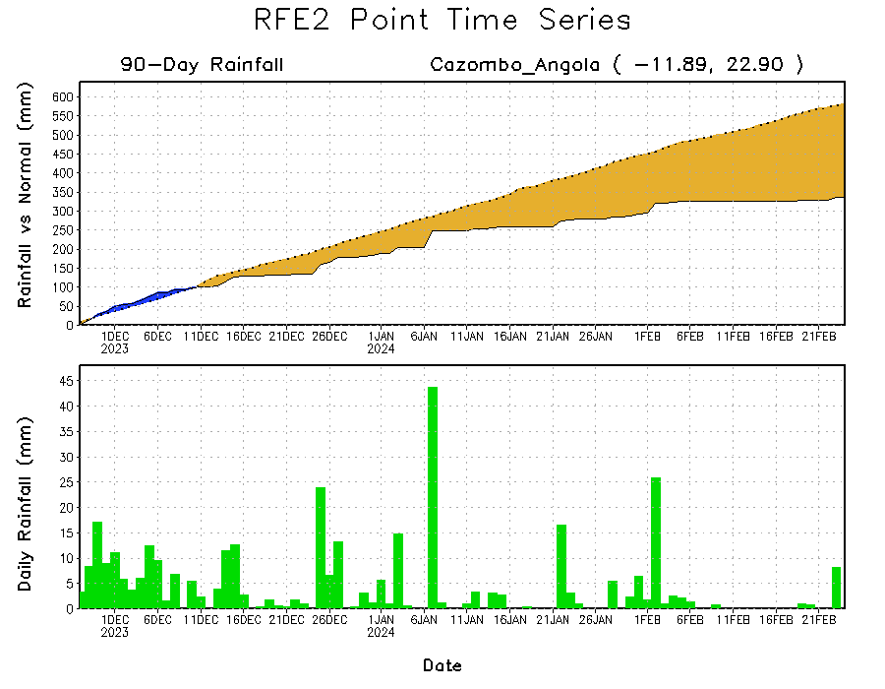
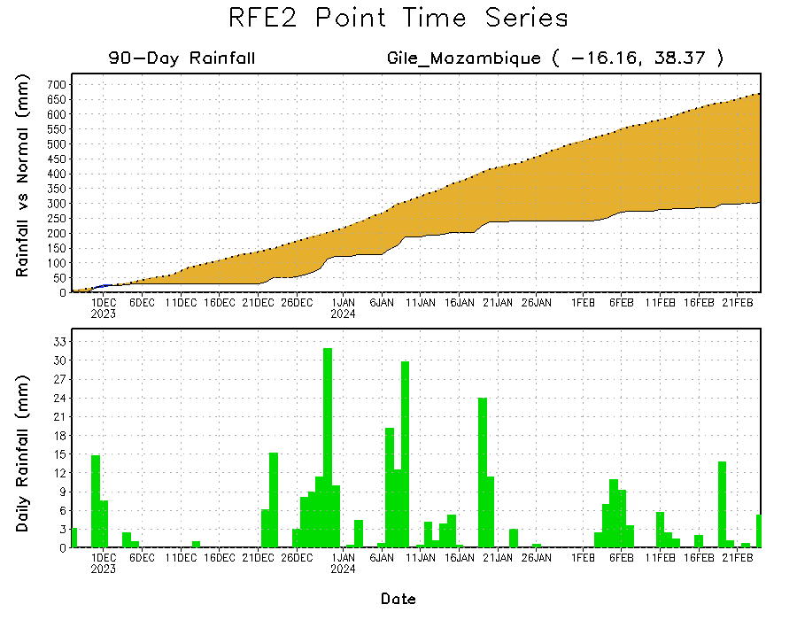
Rainfall Evolution
Daily evolution in rainfall at selected locations over the past 90 days shows growing deficits over parts of eastern Angola (bottom left) and northeastern Mozambique (bottom right). Conversely, rainfall surpluses persist in eastern Madagascar due to heavy and above-average rainfall during mid-February (top right).

Slide 9
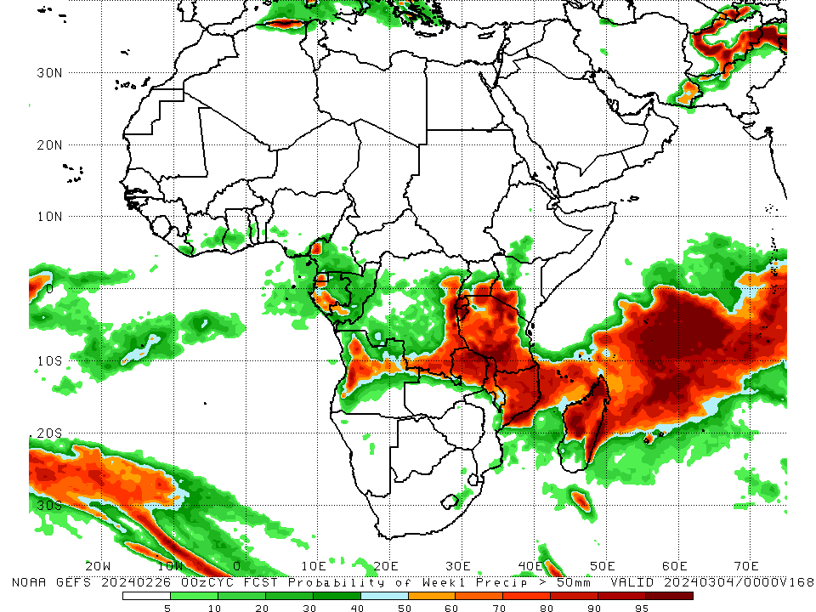
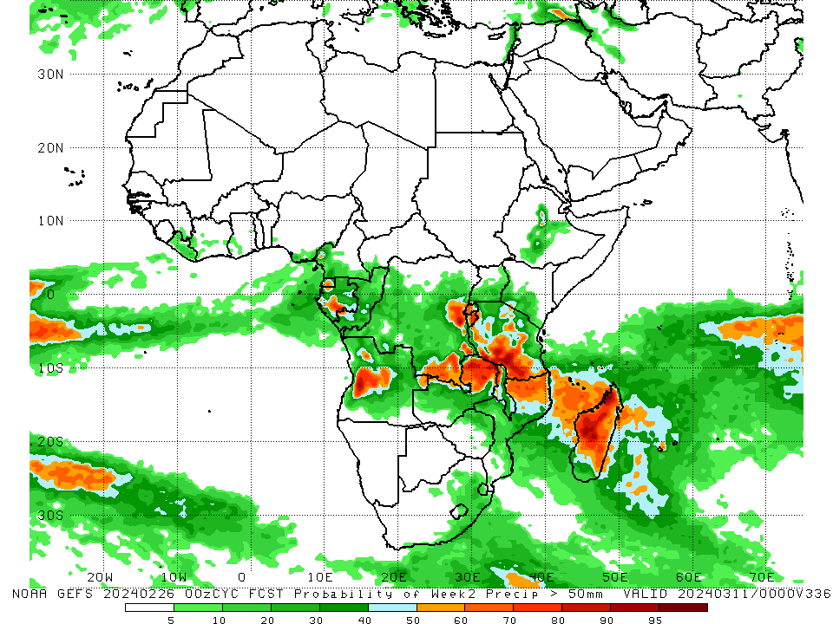
NCEP GEFS Model Forecasts Non-Bias Corrected Probability of precipitation exceedance
Week-1, Valid: 27 Feb – 4 Mar 2024
Week-2, Valid: 5 – 11 Mar 2024
For week-1 (left panel) the GEFS forecasts indicate a moderate to high chance (over 70%) for rainfall to exceed 50 mm over area in northwestern Cameroon, Equatorial Guinea, western Gabon, western and central Angola, eastern and southern DRC, Rwanda, Burundi, southeastern Uganda, southwestern Kenya, eastern Zambia, much of Tanzania, northern Malawi, northern Mozambique, western, eastern, and northern Madagascar. For week-2 (right panel), the GEFS forecasts indicate a moderate to high chance (over 70%) for rainfall to exceed 50 mm over south-central Gabon, west-central Angola, eastern and southern DRC, Rwanda, Burundi, southern Tanzania, eastern Zambia, northwestern Malawi, and the western, central, and northern part in Madagascar.
Notes:
9

Slide 10
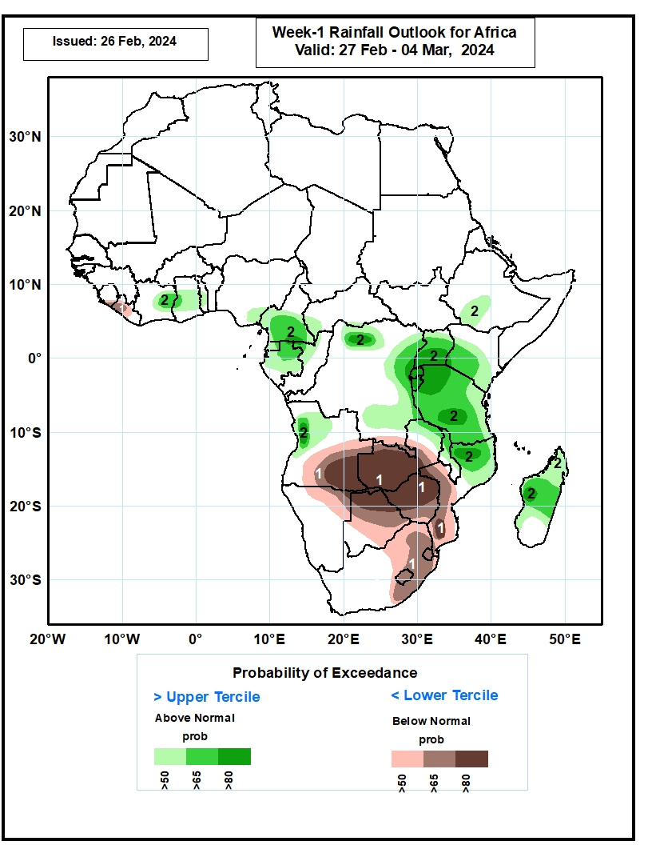
Week-1 Precipitation Outlooks
27 Feb – 4 Mar 2024
1) The probabilistic forecasts call for above 50% chance for weekly total rainfall to be below-normal (below the lower tercile) over southeastern Sierra Leone, western and central Liberia, central and eastern parts of Angola, southern part of DR Congo,
much of Zambia, central and southern parts of Mozambique, northeastern Namibia, much of Botswana, Zimbabwe, northern and central parts of South Africa, Lesotho, and Eswatini. There is above 80% chance for below-normal rainfall over eastern
Angola, western and central Zambia, northern Botswana, much of Zimbabwe, and southern part of Mozambique.
2) The probabilistic forecasts call for above 50% chance for weekly rainfall to be above-normal (above the upper tercile) over central part of Cote d’Ivoire, central Ghana, central Togo, southeastern Nigeria, central and southern Cameroon, southwestern CAR, Equatorial Guinea, much of Gabon, western part of Congo, northern, eastern and southern parts of DR Congo, northwestern Angola, southwestern Ethiopia, Uganda, western and central Kenya, Rwanda, Burundi, Tanzania, northern part of Zambia, northern and central Malawi, northern Mozambique, and northern and central Madagascar. There is above 80% chance for above-normal rainfall over southern part of Cameroon, northern and eastern parts of DR Congo, northwestern Angola, southern Uganda, Rwanda, Burundi, northwestern and southern parts of Tanzania, northern Mozambique, and west-central Madagascar.
Notes:
10

Slide 11
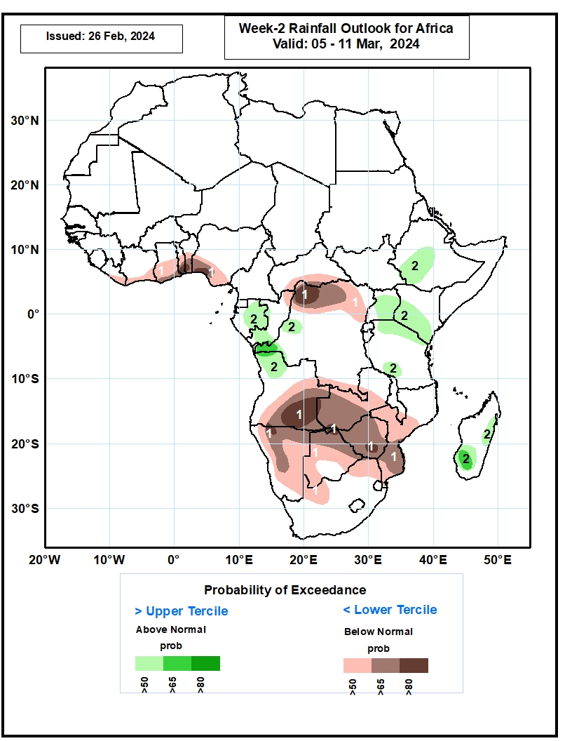
Week-2 Precipitation Outlooks
5 – 11 Mar 2024
1. The probabilistic forecasts call for above 50% chance for weekly total rainfall to be below-normal (below the lower tercile) over southern part of Liberia, southern Cote d’Ivoire, central and
southern Ghana, central and southern Togo, central and southern Benin, western and southern parts of Nigeria, southern CAR, northern Congo, northern and southern parts of DR Congo, central and eastern parts of Angola, much of Zambia, southern
Malawi, central and southern Mozambique, much of Namibia, much of Botswana, Zimbabwe, and northern and western parts of South Africa. There is above 80% chance for below-normal rainfall over southern Togo, southwestern Nigeria, northwestern
DR Congo, southeastern Angola, north-central Namibia, north-central Botswana, and southern part of Zimbabwe.
2. The probabilistic forecasts call for above 50% chance for weekly rainfall to be above-normal (above the upper tercile) over central and eastern Gabon, southern Congo, western part of DR Congo, northwestern Angola, southwestern and central parts of Ethiopia, much of Uganda, western and central parts of Kenya, northern and southwestern parts of Tanzania, and eastern and southern parts of Madagascar. There is above 65% chance for above-normal rainfall over western DR Congo, and
southwestern Madagascar.
Notes:
11

Slide 12
Summary
Over the past 30 days, in East Africa, rainfall was above-average in west-central Ethiopia, most parts in Uganda, southwestern Kenya, western Rwanda, western Burundi, and much of Tanzania. Rainfall was below-average in southwestern Uganda, parts in western and northern Tanzania. In Central Africa, rainfall was above-average over western and central DRC, southern Gabon, and southern Congo. Rainfall was below-average across Cameroon, Equatorial Guinea, northern Gabon, northern Congo, northern and southern DRC, and southern CAR. In West Africa, rainfall above-average along southern Ghana and southwestern Nigeria, but was below-average elsewhere along much of the Gulf of Guinea. In southern Africa, rainfall was above-average in western Angola, northwestern and parts in central Namibia, northeastern and parts in south-central Mozambique, parts in east-central South Africa, central and eastern Madagascar. Rainfall was below-average in central and eastern Angola, western Zambia, Malawi, northeastern Namibia, northern Botswana, Zimbabwe, eastern and northeastern South Africa, western and central Mozambique, Lesotho, Eswatini, and coastal western Madagascar.
During the past 7 days, in East Africa, rainfall was above-average in local areas in west-central Ethiopia, pocket areas in central Kenya, and parts in northern and southeastern Tanzania. Rainfall was below average in southern Uganda, central Burundi, western and central Tanzania. In central Africa, rainfall was above-average in western and parts in central DRC, southwestern and central Congo, and portion in southern and eastern Gabon. Rainfall was below-average in western and eastern Cameroon, Equatorial Guinea, central Gabon, western CAR, northeastern and far southern DRC. In West Africa, rainfall was above-average in pocket areas in southern Cote d’Ivoire, southern Ghana, southern Togo, southern Benin, and southwestern Nigeria. Rainfall was below-average in eastern Liberia, central Cote d’Ivoire, western Ghana, and southeastern Nigeria. In southern Africa, rainfall was above-average over northwestern Angola, local areas in northern Zambia, pocket areas in central Namibia and southwestern Botswana, northern Malawi, areas in central Mozambique, and west-central Madagascar. Rainfall was below-average over eastern and southern Angola, northern Namibia, western and southern Zambia, northern Botswana, Zimbabwe, southern Malawi, eastern and northeastern South Africa, most parts in Mozambique, and eastern and southern Madagascar.
The Week-1 outlook calls for above-average rainfall along central and eastern Gulf of Guinea, part of Central Africa, most parts in equatorial East Africa, and the far western and far eastern southern Africa, including central and western Madagascar. In contrast, there is an increased chance for below-average rainfall over parts of Liberia and central southern Africa. The Week-2 outlook calls for below-average rainfall along the Gulf of Guinea, northern DRC, and a wide area in southern Africa. In contrast, there is an increased chance for above-average rainfall in pocket areas in central Ethiopia, part of Gabon, western DRC, northwestern Angola, parts in Uganda, Kenya, Tanzania, east-central, and southern Madagascar.

