Slide 1
The African Monsoon Recent Evolution and Current Status Include Week-1 and Week-2 Outlooks
Update prepared
18 December 2023
For more information, visit:
http://www.cpc.ncep.noaa.gov/products/Global_Monsoons/African_Monsoons/precip_monitoring.shtml

Slide 2
Outline
Highlights
Recent Evolution and Current Conditions
NCEP GEFS Forecasts
Summary

Slide 3
Highlights: Last 7 Days
During the past 7 days, in East Africa, rainfall was above-average in western, northwest and central-eastern regions of Tanzania, eastern and southeast Uganda, southern and southeast Kenya, southern Burundi, and pockets of southeast Somalia. Below-average rainfall was observed over southern and central-southern regions of Tanzania and pockets of central Uganda and central Kenya. In central Africa, above-average rainfall was observed over pockets of southern Congo and southeast DRC and in for pockets of western DRC. Rainfall was below-average over Equatorial Guinea, southern, central, northern and eastern Gabon, central Congo, and southern Cameroon, western, central, southern and central-eastern DRC. In West Africa, below-average rainfall was observed over eastern Liberia, and southern parts of Cote d’Ivoire and Ghana. In southern Africa, rainfall was above-average over western and western-central Angola, southern and northwest Zambia, northern, southeast and pockets of western Botswana, central, southern, northern-central and southeast Zimbabwe, central and southern Mozambique, western, northern and northeast South Africa, western and central Lesotho, and central and southern Eswatini. Below-average rainfall was observed over southern and eastern Angola, in for northern Namibia, western, central and eastern Zambia, Malawi, northern Mozambique, and Madagascar.
The Week-1 outlook calls for above-average rainfall in Equatorial Guinea, Gabon, central and southern Congo, western, central, eastern and southern DRC, Angola, northern and eastern Namibia, southern Uganda, Rwanda, Burundi, western Tanzania, southeast Kenya, western Zambia, northern, western, central and southern Botswana, western, central and eastern South Africa, Lesotho, Eswatini, and central and eastern Madagascar. In contrast, there is an increased chance for below-average across Zimbabwe, Malawi, central and southern Madagascar, central and eastern Zambia, southern and southeast Tanzania, southern Madagascar, Liberia, and southern parts of Cote d’Ivoire and Ghana. The Week-2 outlook calls for above-normal rainfall in Equatorial Guinea, Gabon, central and southern Congo, western, central, eastern and southern DRC, northern and eastern Angola, southern Uganda, Rwanda, Burundi, western and northern Tanzania, central and southern Kenya, many parts of Zambia, Malawi, Zimbabwe and Botswana, western, central and southern Mozambique, western, northern, central and eastern South Africa, Lesotho, Eswatini, and central, southeast and eastern Madagascar. In contrast, there is an increased chance for below-average in southwest Angola, northern and central Namibia, southeast Tanzania, northeast Mozambique, Liberia, and southern parts of Cote d’Ivoire and Ghana.

Slide 4
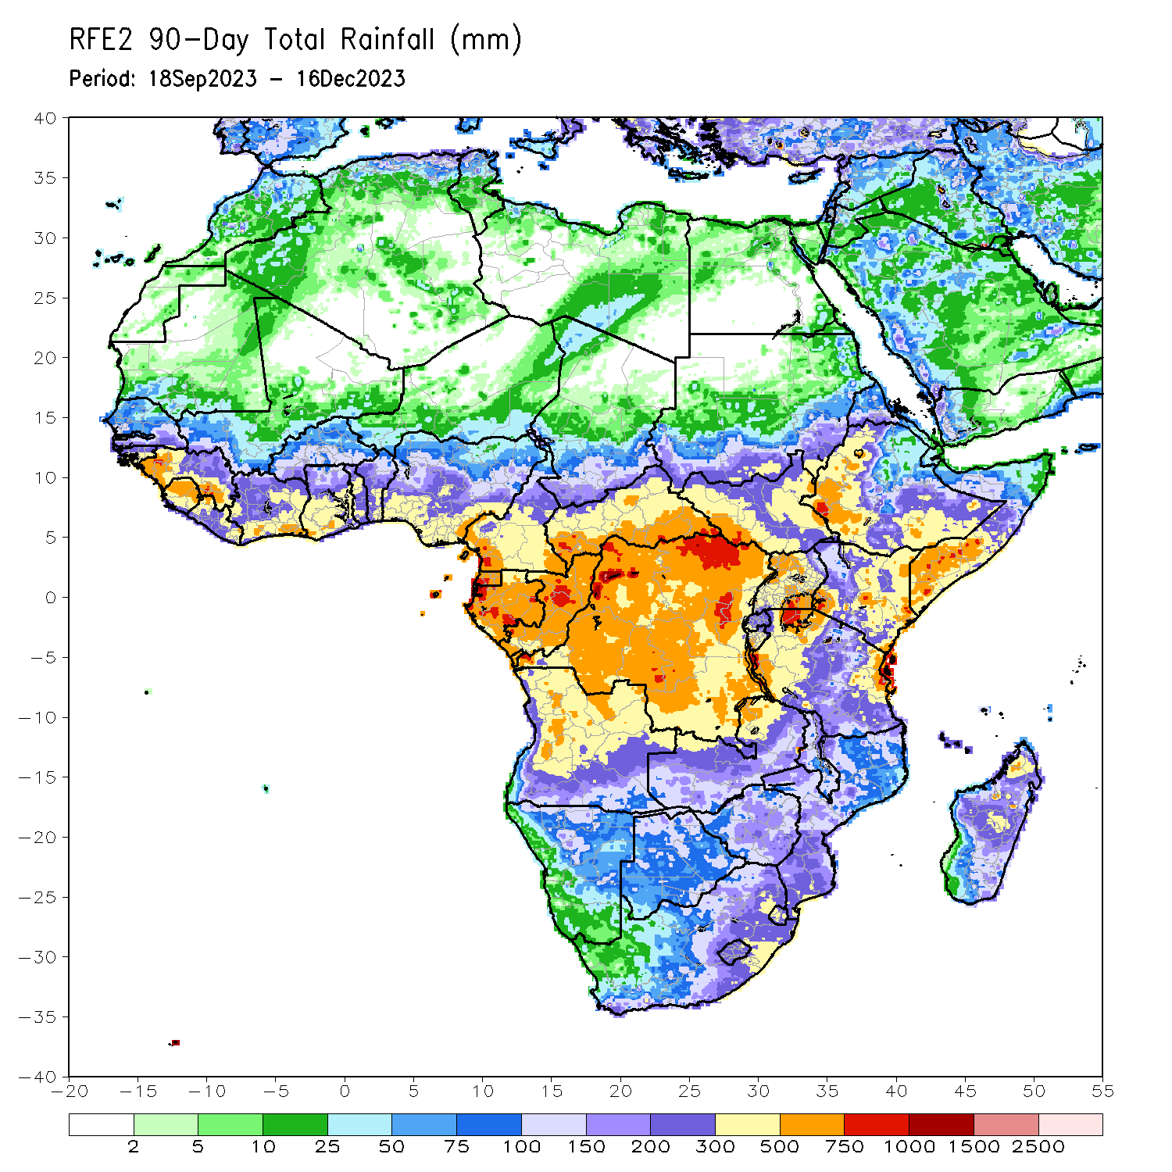
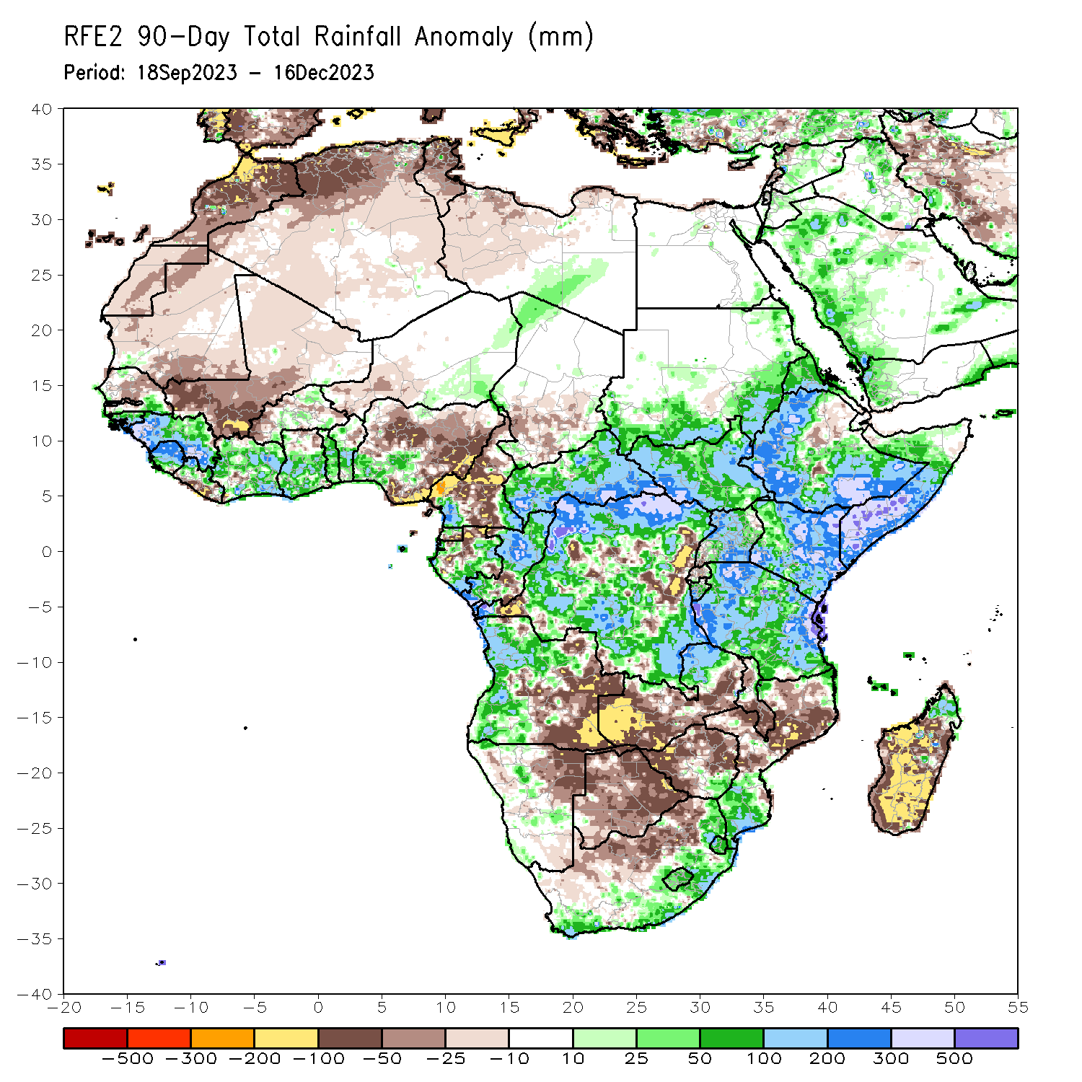
Rainfall Patterns: Last 90 Days
Over the past 90 days, in East Africa, above-average rainfall was observed in many parts of South Sudan, Kenya, Tanzania, Burundi and Uganda, southwest, southern, central and eastern Sudan, northern and central Eritrea, northern, western, southern and eastern Ethiopia, and southern, central, western, eastern and northwest Somalia. Rainfall was below-average over central-eastern Ethiopia, southern Eritrea, northern Djibouti, central and northern Burundi, and pockets of southwest Uganda. In Central Africa, rainfall was above-average in many parts of CAR, northern, western, southern and southeast DRC, northern, central and southwest Congo, eastern and southern Gabon, northwest Chad, and pockets of southwest and southeast Cameroon. Rainfall was below-average over northern, central, western and southern Cameroon, southern Equatorial Guinea, northern Gabon, southern-central Congo, southern Chad, pockets of southwest and central DRC, and eastern DRC. In West Africa, rainfall was above-average over southeast Senegal, Guinea-Bissau, Guinea, Sierra Leone, northern Liberia, many parts of Cote d’Ivoire and Togo, central and southern parts of Ghana and Benin, northern and southern Burkina Faso, southeast and eastern Niger, and southwest Nigeria. Below-average rainfall was observed over central and northeast Senegal, Gambia, southeast Mauritania, western Mali, western Burkina Faso, southeast Liberia, southwest Niger, and central, eastern and southeast Nigeria. In southern Africa, above-average rainfall was observed over northwest, western, central and southwest Angola, pockets of central Namibia, northern Zambia, southeast Zimbabwe, southern Mozambique, southeast, eastern and northeast South Africa, Eswatini, Lesotho, and northern Madagascar. Below-average rainfall was observed over southeast and eastern Angola, northeast Namibia, western, southern and eastern Zambia, many parts of Botswana, western, northern and eastern Zimbabwe, western South Africa, central Mozambique, southern Malawi, and western, southern central and eastern Madagascar.
Notes:
4

Slide 5
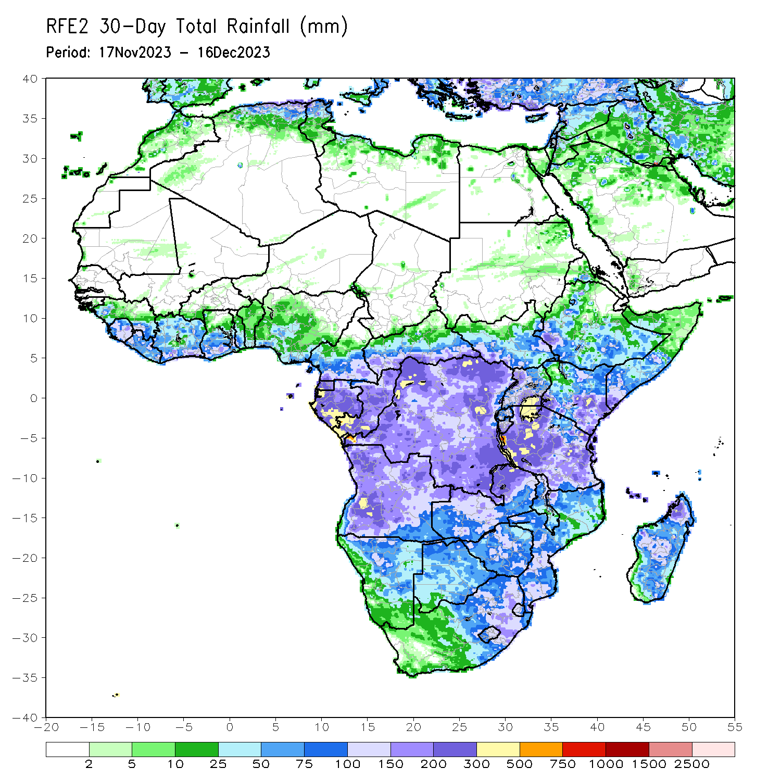
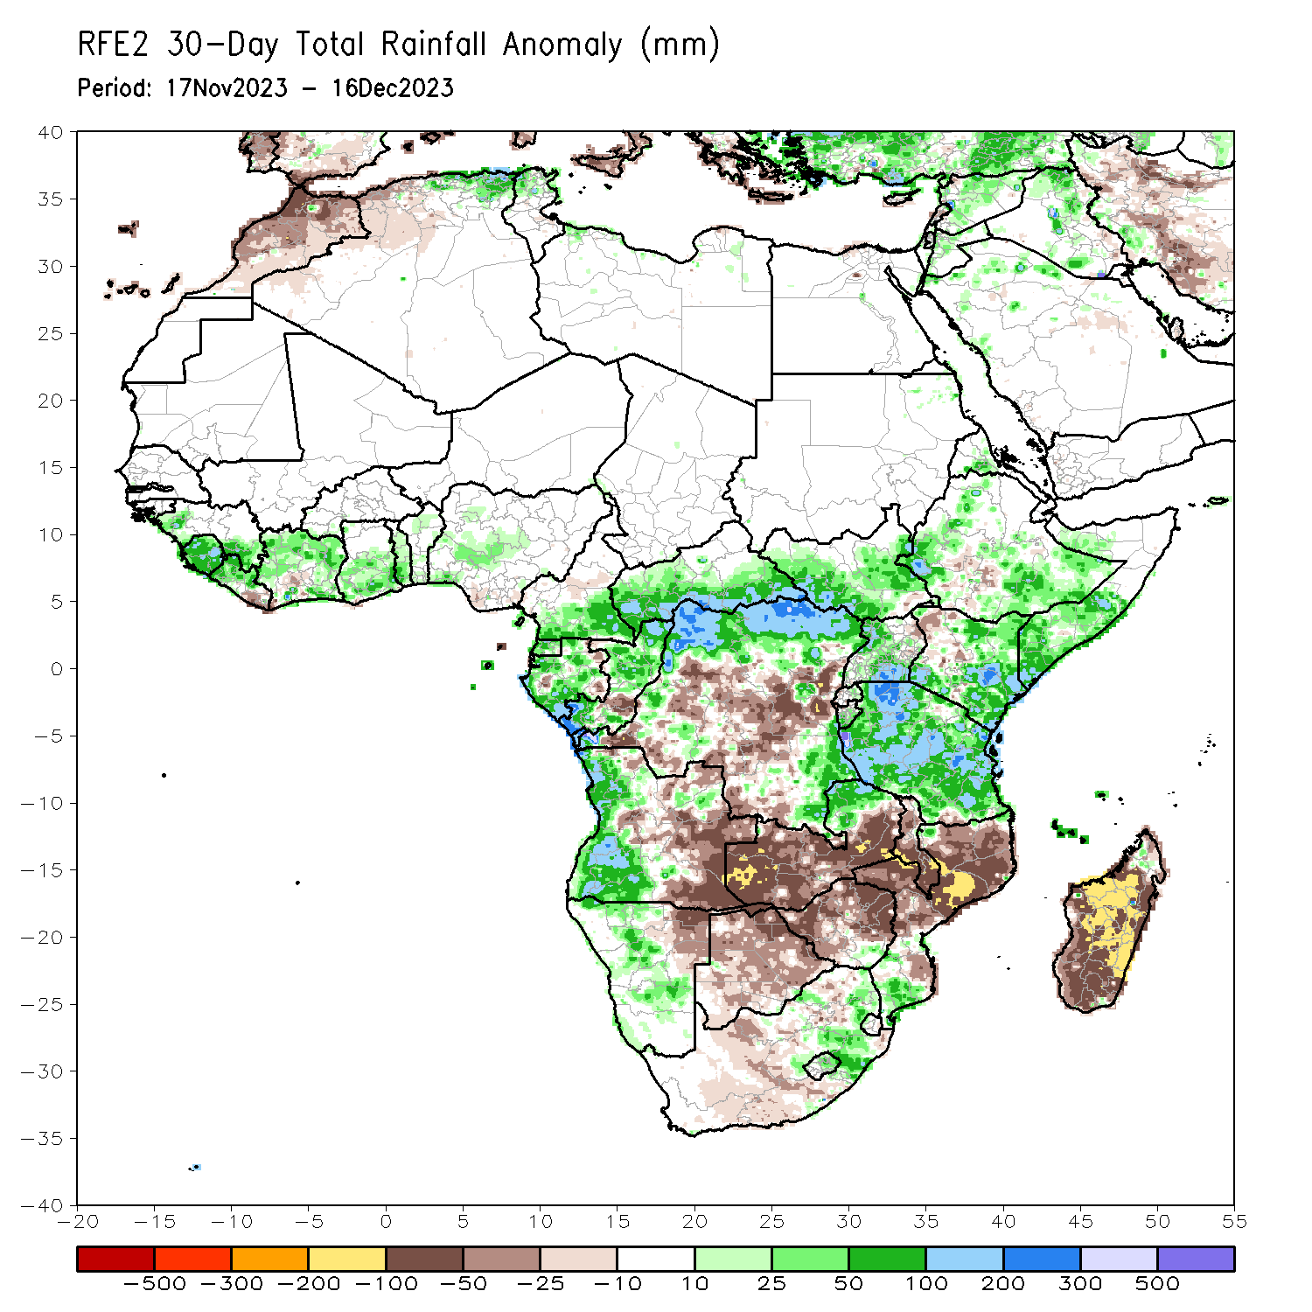
Rainfall Patterns: Last 30 Days
Over the past 30 days, in East Africa, above-average rainfall was observed in western, central, eastern and southwest parts of South Sudan, western, central and southern Uganda, many parts of Tanzania and Burundi, eastern Rwanda, and northern, central, western, southeast and eastern Ethiopia, central Eritrea, and central, southern, western and northwest Somalia. Rainfall was below-average over pockets of southern South Sudan, northwest and wester-central Uganda, and central-southern Ethiopia. In Central Africa, rainfall was above-average across Equatorial Guinea, western, southern and eastern CAR, northern, western, southern and central Gabon, southern Cameroon, northern, central and southern Congo, and northern, northwest, northeast and southeast DRC. Below-average rainfall was observed in central-southern Congo, central, central-eastern and southern DRC, and pockets of central Cameroon. In West Africa, rainfall was above-average over western and southeast Senegal, Sierra Leone, western and northern Liberia, western, northern, eastern and southeast Cote d’Ivoire, central and southern Ghana, Togo, northern and southern Benin, and western, central and southwest Nigeria. Below-average rainfall was observed over eastern Liberia and pockets of central-southern Cote d’Ivoire and southeast Nigeria. In southern Africa, above-average rainfall was observed in northwest, western and southwest Angola, northern and central Namibia, northern parts of Zambia, pockets of southeast Zimbabwe, southern Mozambique, central and northern Lesotho, and northeast and central-eastern South Africa. Below-average rainfall was observed over in many parts of Botswana, Zimbabwe, Malawi and Madagascar, central and southeast Angola, northeast Namibia, western, southern, eastern and central Zambia, central and northern Mozambique, and western and southeast South Africa.
Notes:
5

Slide 6
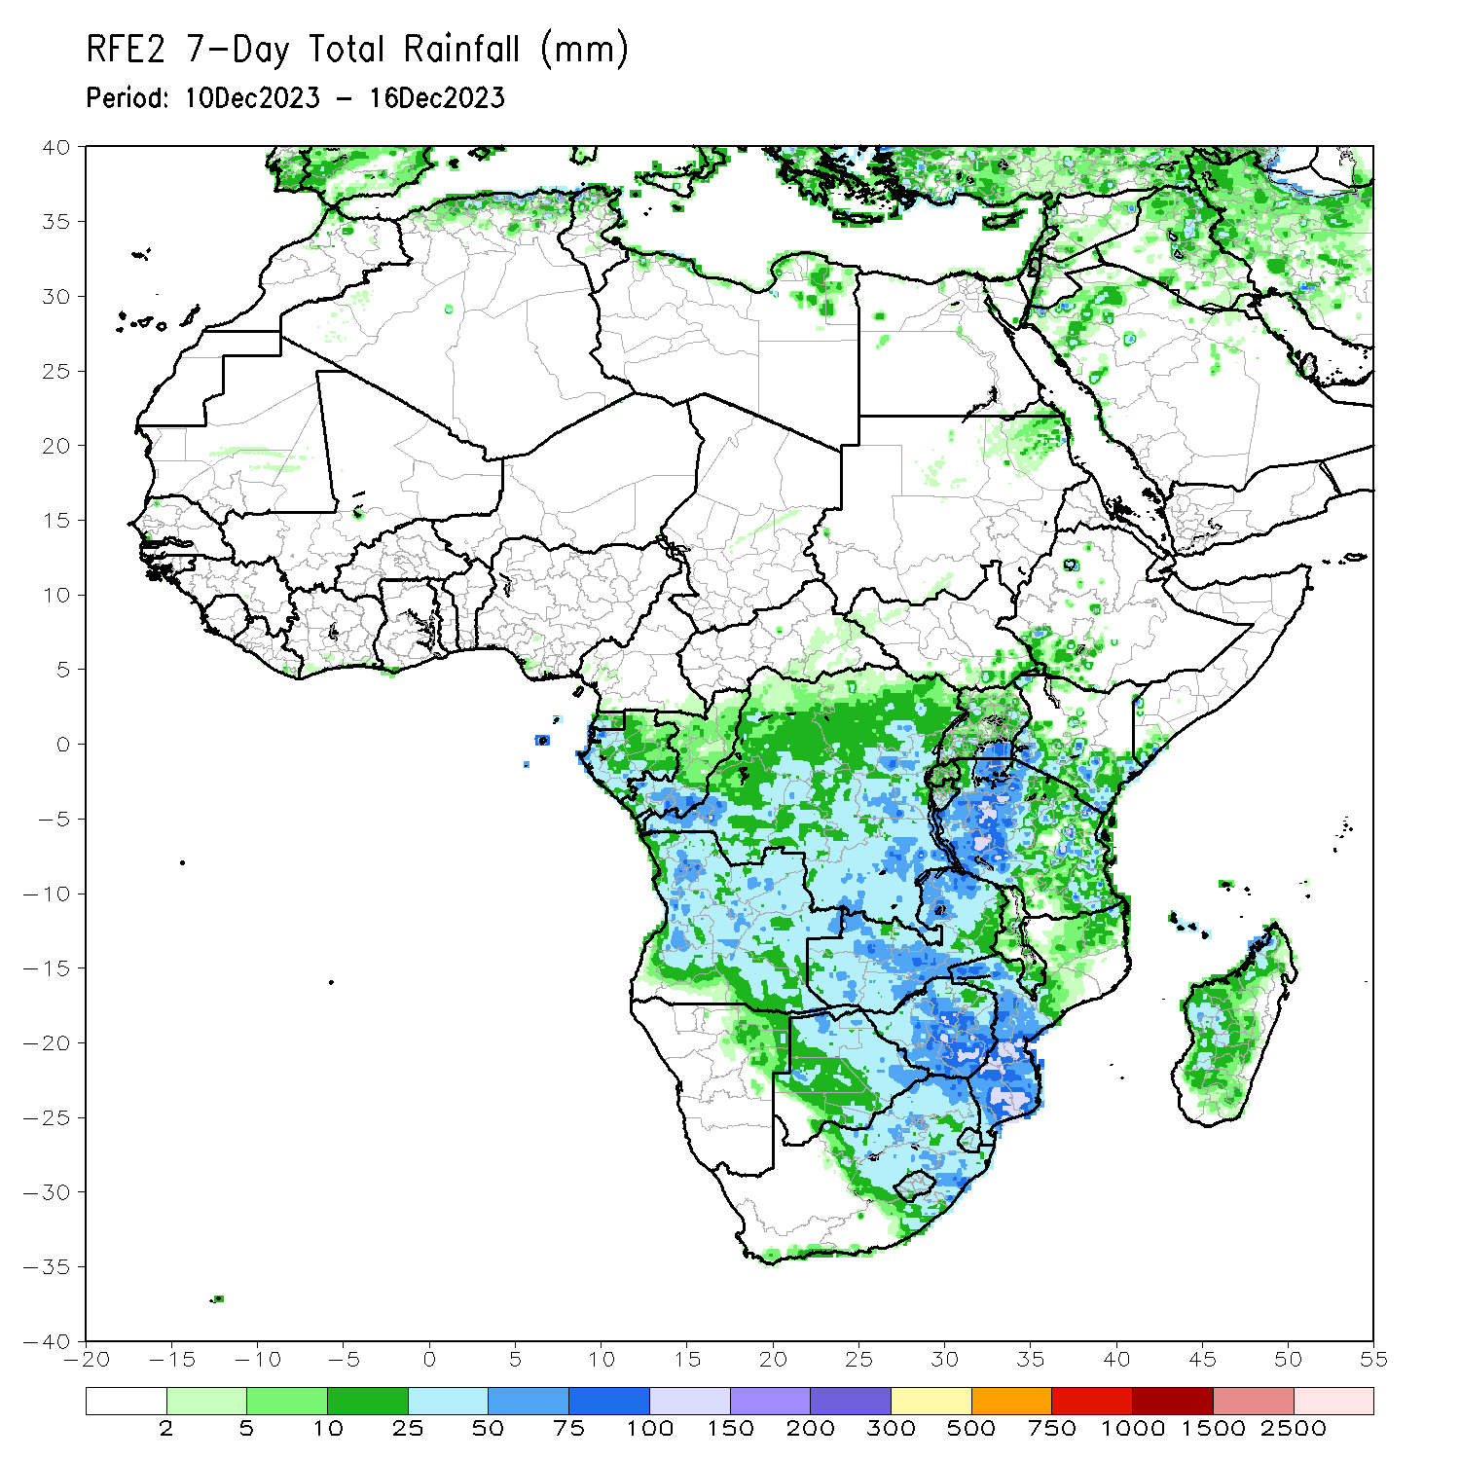
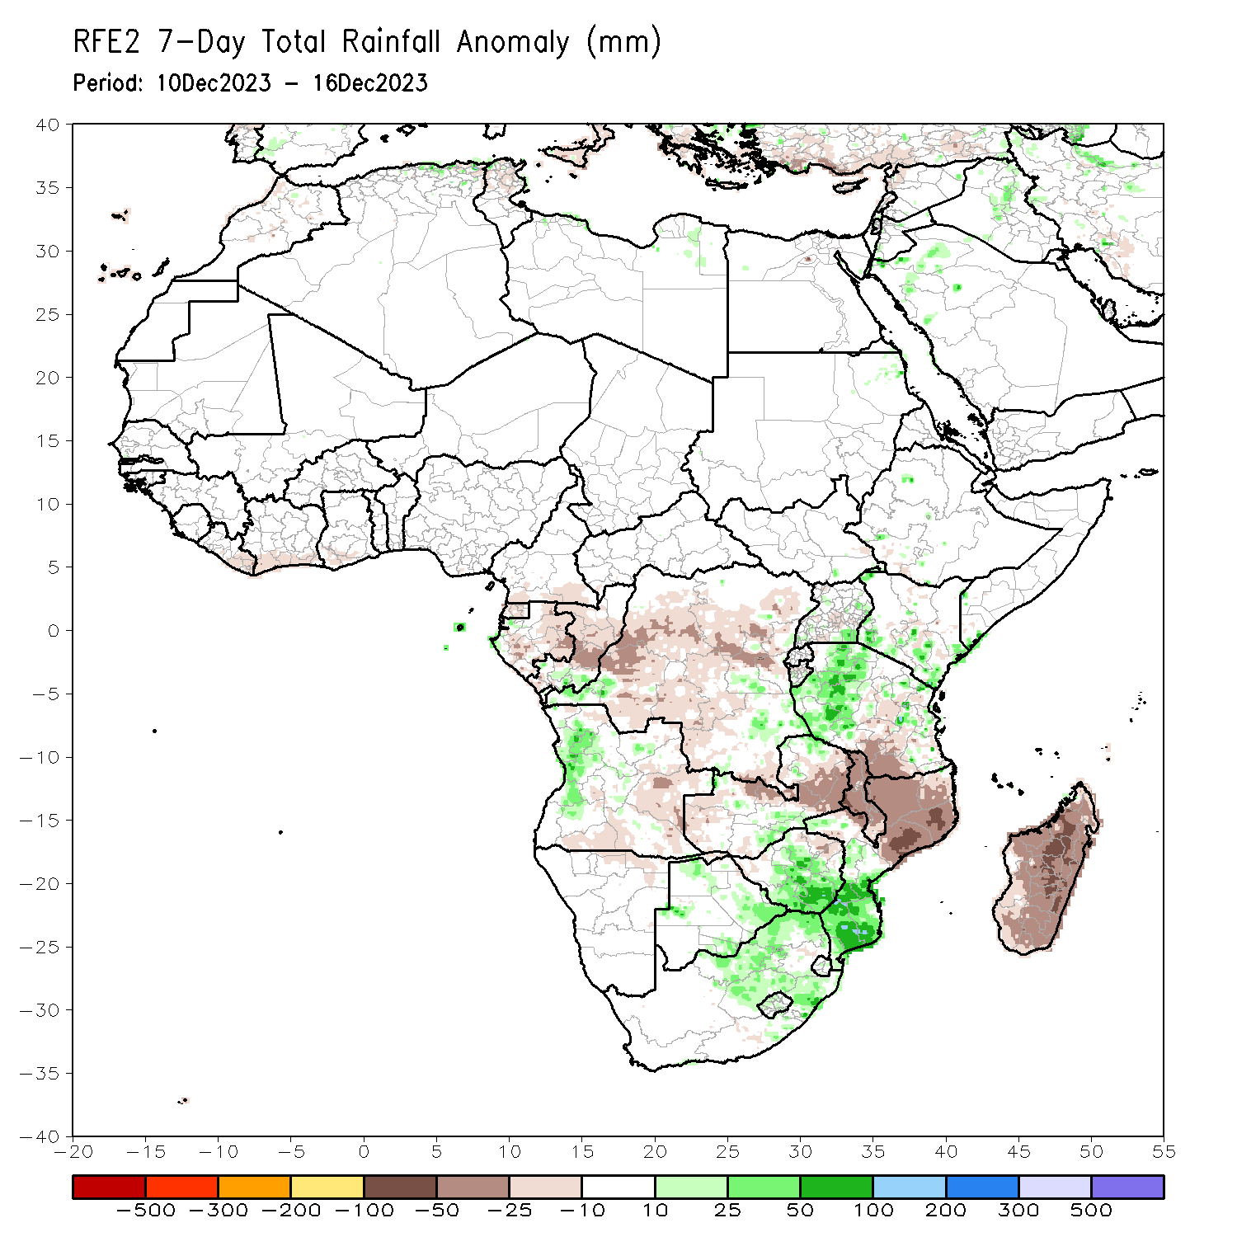
Rainfall Patterns: Last 7 Days
During the past 7 days, in East Africa, rainfall was above-average in western, northwest and central-eastern regions of Tanzania, eastern and southeast Uganda, southern and southeast Kenya, southern Burundi, and pockets of southeast Somalia. Below-average rainfall was observed over southern and central-southern regions of Tanzania and pockets of central Uganda and central Kenya. In central Africa, above-average rainfall was observed over pockets of southern Congo and southeast DRC and in for pockets of western DRC. Rainfall was below-average over Equatorial Guinea, southern, central, northern and eastern Gabon, central Congo, and southern Cameroon, western, central, southern and central-eastern DRC. In West Africa, below-average rainfall was observed over eastern Liberia, and southern parts of Cote d’Ivoire and Ghana. In southern Africa, rainfall was above-average over western and western-central Angola, southern and northwest Zambia, northern, southeast and pockets of western Botswana, central, southern, northern-central and southeast Zimbabwe, central and southern Mozambique, western, northern and northeast South Africa, western and central Lesotho, and central and southern Eswatini. Below-average rainfall was observed over southern and eastern Angola, in for northern Namibia, western, central and eastern Zambia, Malawi, northern Mozambique, and Madagascar.

Slide 7
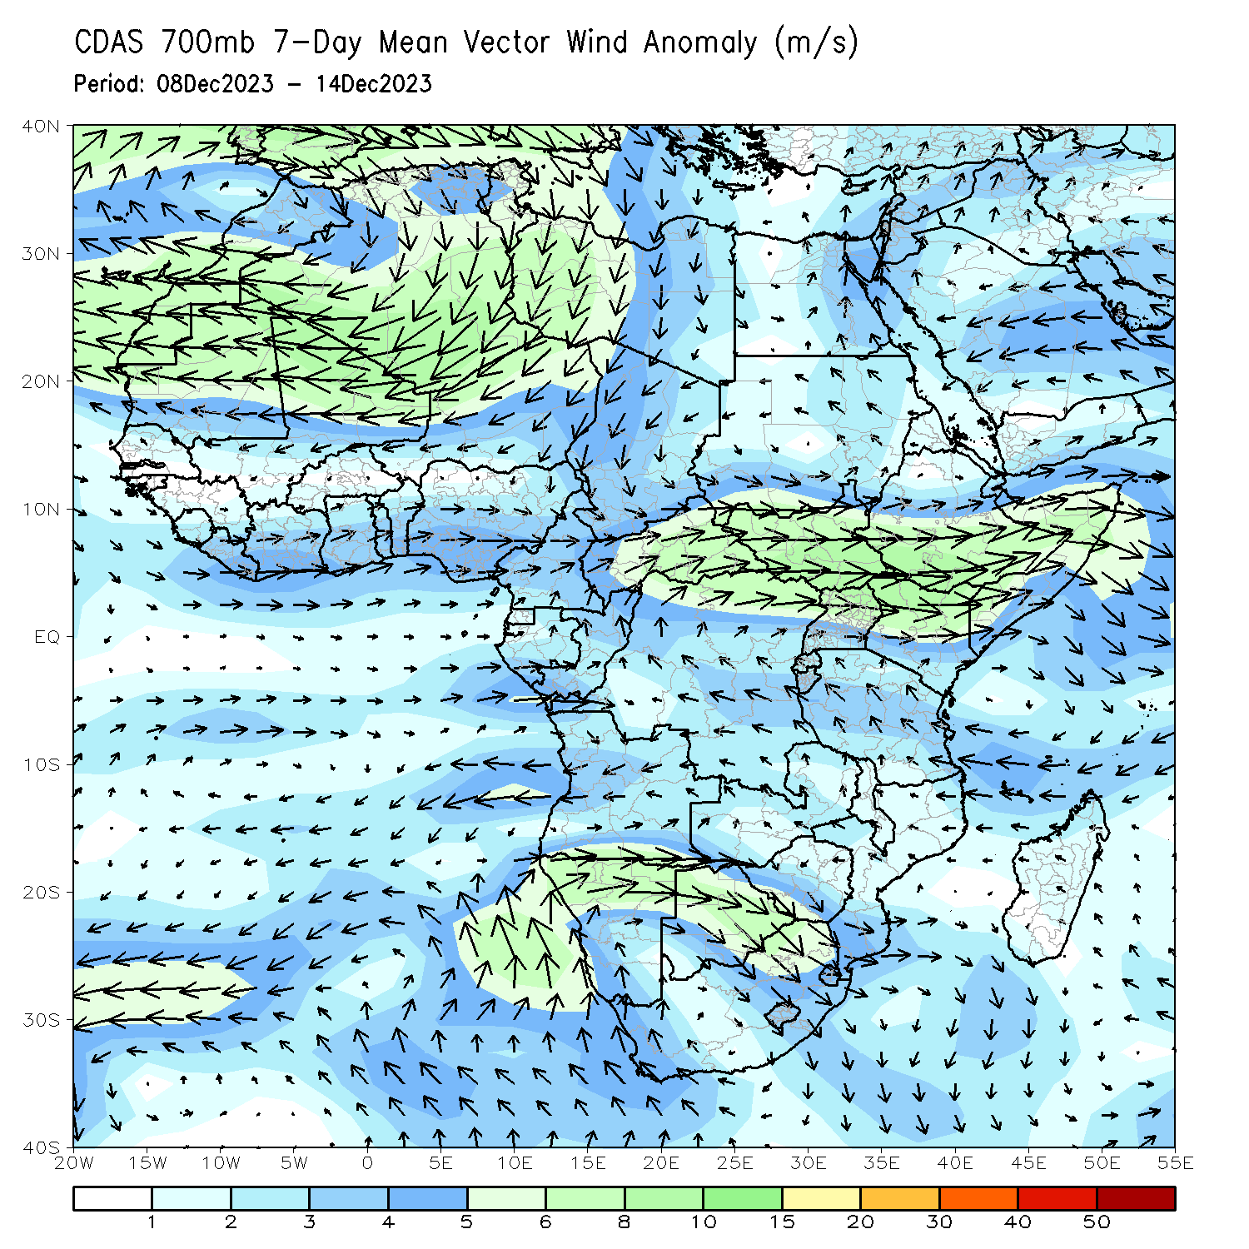
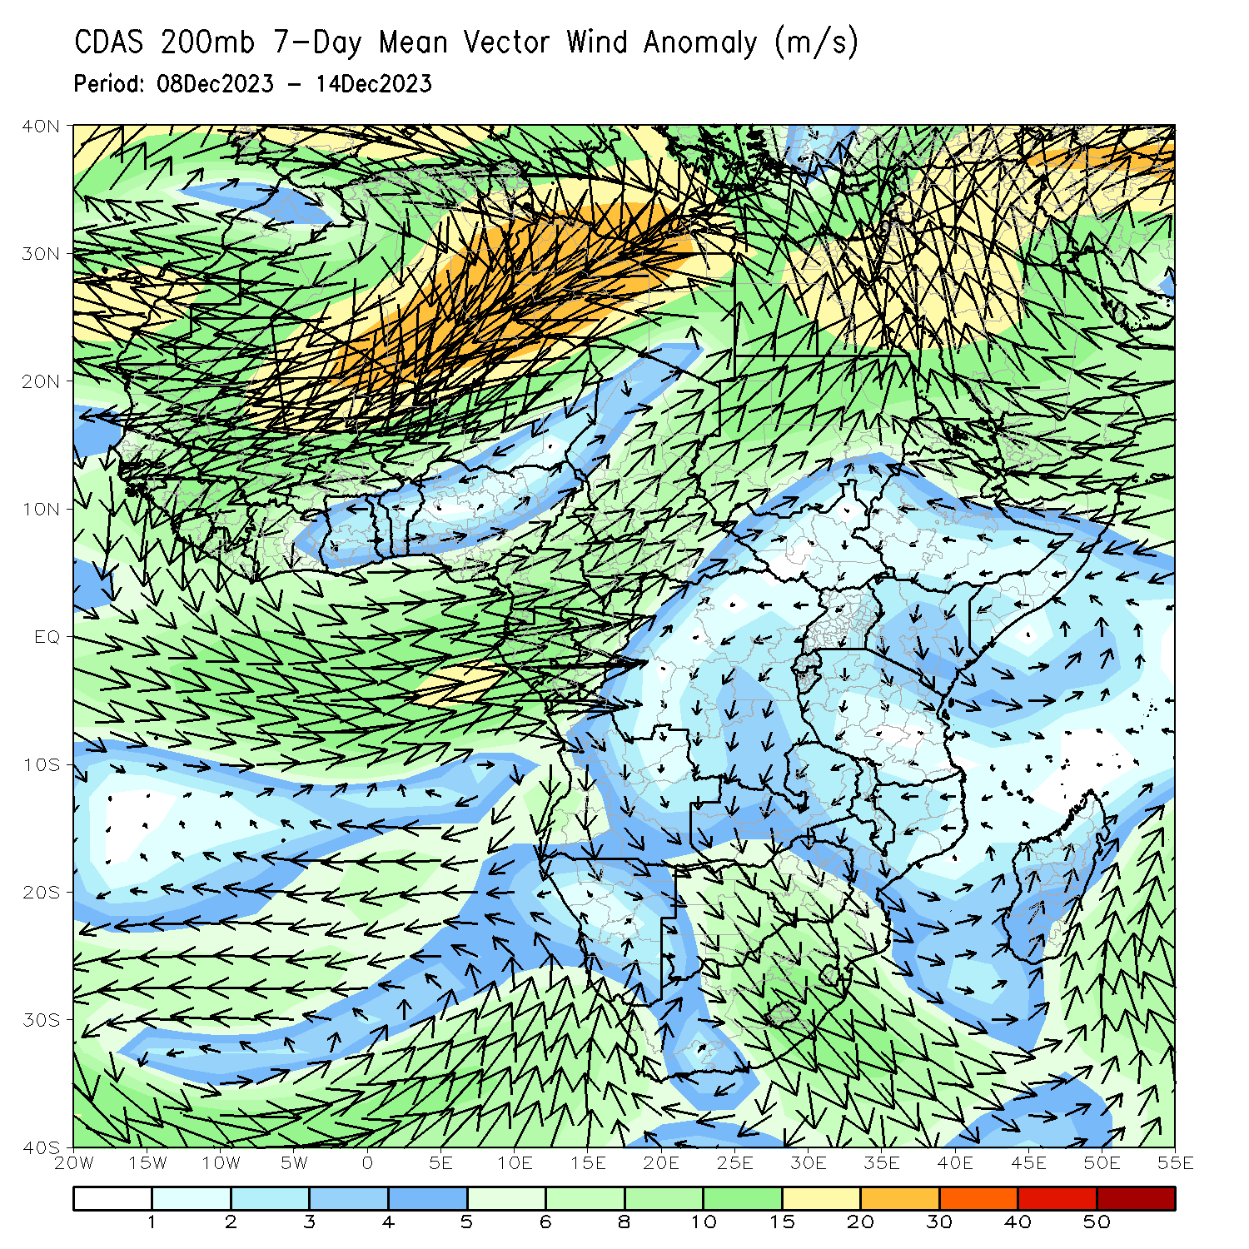
Atmospheric Circulation: Last 7 Days
At 850-hPa level (left panel), anomalous lower-level cyclonic trough may have contributed to the observed above-average rainfall in many parts of Botswana, Zimbabwe, southern Mozambique, western, northern, central and northeast South Africa, Lesotho, Eswatini.

Slide 8
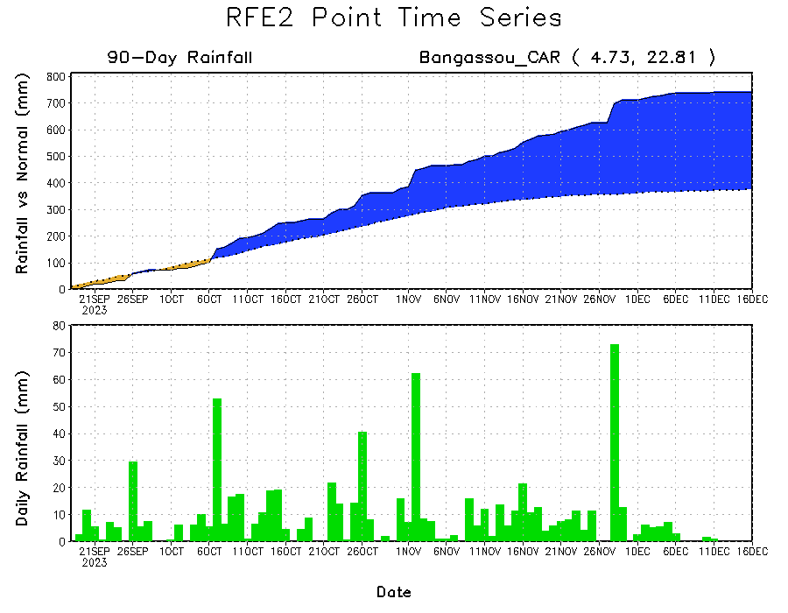
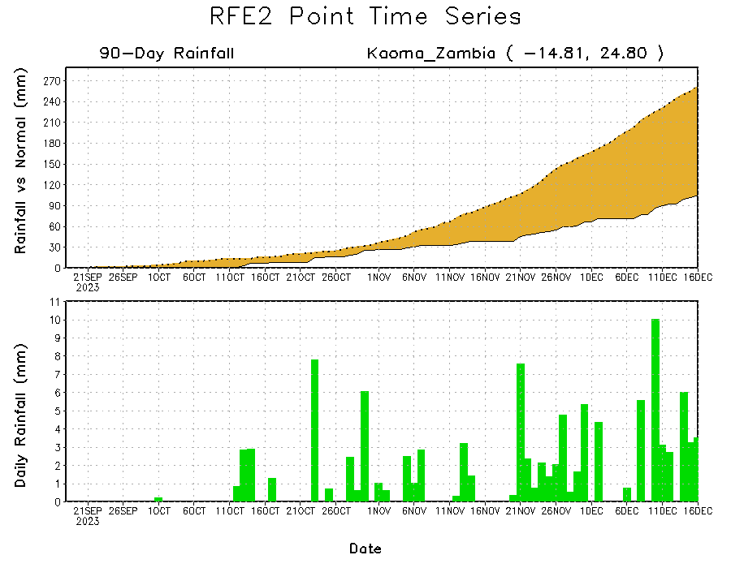
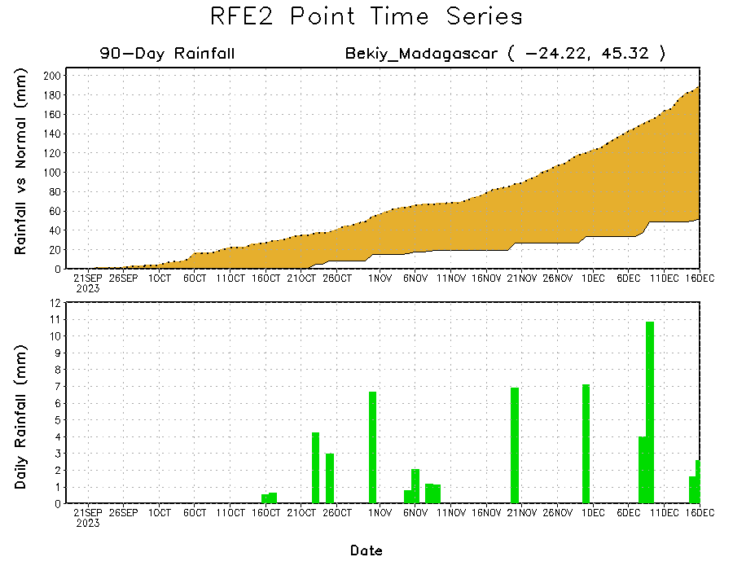
Rainfall Evolution
Daily evolution of rainfall over the last 90 days at selected locations shows a growing dryness over parts of western Zambia (bottom left) and southwest Madagascar (bottom right). Seasonal total rainfall remained above-average over southern CAR due to the moderate to heavy rainfall fell in southern CAR during last 2 months (top right).

Slide 9
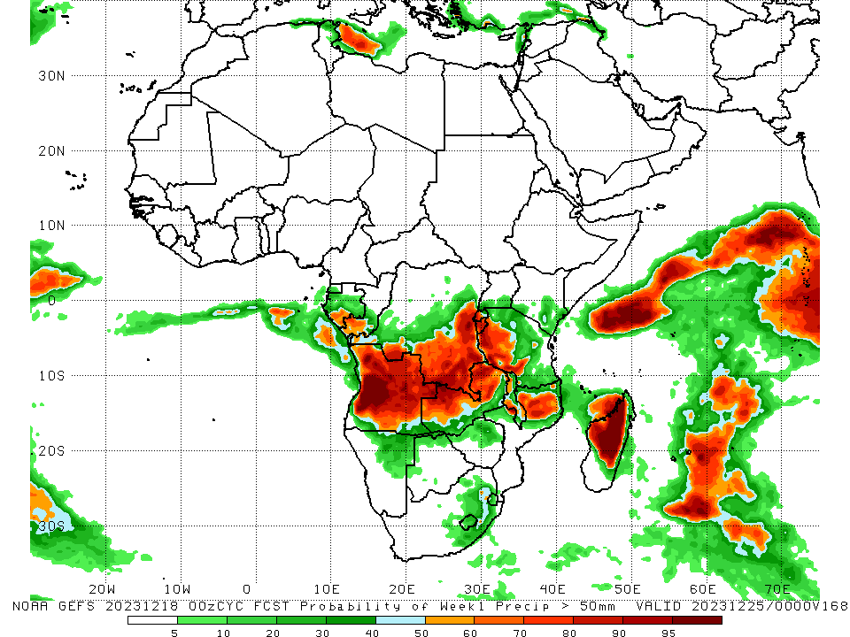
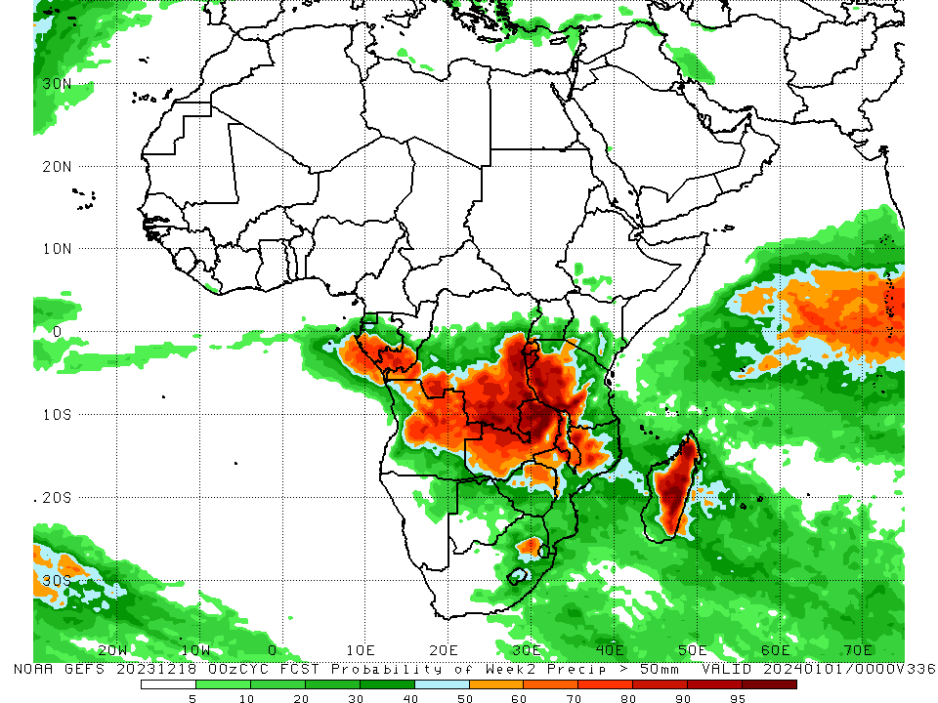
NCEP GEFS Model Forecasts Non-Bias Corrected Probability of precipitation exceedance
Week-1, Valid: 19 – 25 Dec 2023
Week-2, Valid: 26 Dec 2023 – 01 Jan 2024
For week-1 (left panel) the GEFS forecasts indicate a moderate to high chance (over 70%) for rainfall to exceed 50 mm over northern, western, central and eastern Angola, southern and eastern DRC, southern Congo, western and northern Zambia, Burundi, western Rwanda, western Tanzania, western Malawi, northern Mozambique, and western, northwest and central Madagascar. For week-2 (right panel), the GEFS forecasts indicate a moderate to high chance (over 70%) for rainfall to exceed 50 mm over southern Gabon, southern Congo, central and eastern Angola, southern and eastern DRC, Rwanda, Burundi, western and western-central Kenya, many parts of Zambia and Malawi, northwest Mozambique, northern, central and eastern Madagascar, and pockets of northeast South Africa (near western border of Eswatini).
Notes:
9

Slide 10
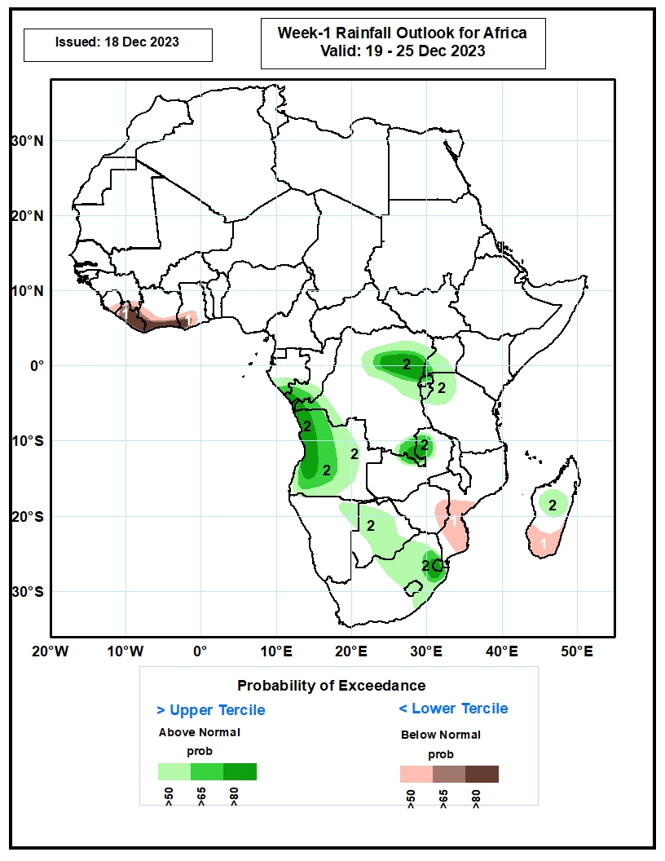
Week-1 Precipitation Outlooks
19 – 25 Dec 2023
The probabilistic forecasts call for above 50% chance for weekly total rainfall to be below-average (below the lower tercile) over eastern Sierra Leone, Liberia, southern Cote d’Ivoire, southern Ghana, eastern Zimbabwe, central and southern parts of Mozambique, and southern Madagascar. There is above 80% chance for below-average rainfall over much of Liberia, southern Cote d’Ivoire, and southwestern Ghana.
The probabilistic forecasts call for above 50% chance for weekly rainfall to be above-average (above the upper tercile) over southern Gabon, southern Congo, western, northern and southern parts of DR Congo, western and southern parts of Uganda, Rwanda, Burundi, northwestern Tanzania, much of Angola, northern Zambia, northeastern Namibia, much of Botswana, northern and central parts of South Africa, Lesotho, Eswatini, and central part of Madagascar. There is above 80% chance for above-average rainfall over southern Congo, northern, western and southern parts of DR Congo, western Angola, northern Zambia, northeastern South Africa, and much of Eswatini.
Notes:
10

Slide 11
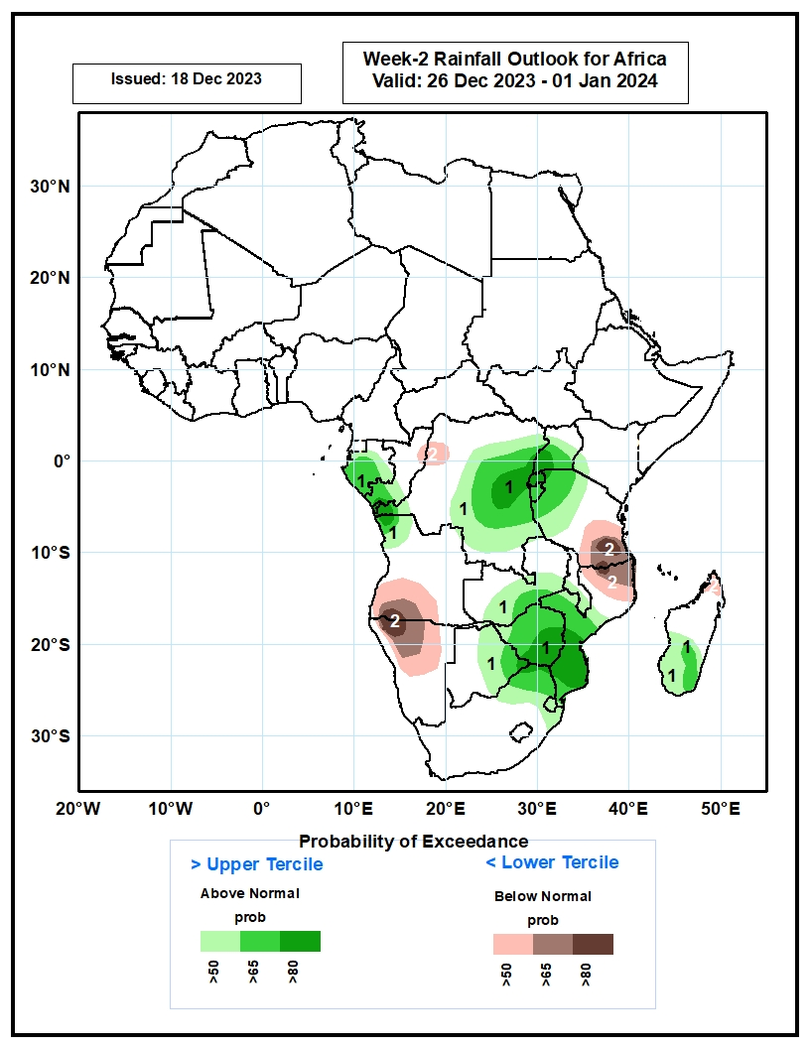
Week-2 Precipitation Outlooks
26 Dec 2023 – 01 Jan 2024
The probabilistic forecasts call for above 50% chance for weekly rainfall to be above-average (above the upper tercile) over much of Gabon, southern Congo, much of DR Congo, Rwanda, Burundi, much of Uganda, southwestern Kenya, northern and central parts of Tanzania, central and southern parts of Zambia, central and southern parts of Malawi, central and eastern Botswana, Zimbabwe, central and southern Mozambique, northern South Africa, Eswatini, and central and southern parts of Madagascar. There is above 80% chance for above-average rainfall over western, central and northeastern parts of DR Congo, Rwanda, eastern Botswana, southern Zimbabwe, and southern Mozambique.
The probabilistic forecasts call for above 50% chance for weekly total rainfall to be below-average (below the lower tercile) over northeastern Congo, northwestern DR Congo, southern part of Angola, northern and central parts Namibia, southern Tanzania, northern Mozambique, and northern Madagascar. There is above 80% chance for below-average rainfall over southwestern Angola, northwestern Namibia, southern part of Tanzania, and northern part of Mozambique.
Notes:
11

Slide 12
Summary
Over the past 30 days, in East Africa, above-average rainfall was observed in western, central, eastern and southwest parts of South Sudan, western, central and southern Uganda, many parts of Tanzania and Burundi, eastern Rwanda, and northern, central, western, southeast and eastern Ethiopia, central Eritrea, and central, southern, western and northwest Somalia. Rainfall was below-average over pockets of southern South Sudan, northwest and wester-central Uganda, and central-southern Ethiopia. In Central Africa, rainfall was above-average across Equatorial Guinea, western, southern and eastern CAR, northern, western, southern and central Gabon, southern Cameroon, northern, central and southern Congo, and northern, northwest, northeast and southeast DRC. Below-average rainfall was observed in central-southern Congo, central, central-eastern and southern DRC, and pockets of central Cameroon. In West Africa, rainfall was above-average over western and southeast Senegal, Sierra Leone, western and northern Liberia, western, northern, eastern and southeast Cote d’Ivoire, central and southern Ghana, Togo, northern and southern Benin, and western, central and southwest Nigeria. Below-average rainfall was observed over eastern Liberia and pockets of central-southern Cote d’Ivoire and southeast Nigeria. In southern Africa, above-average rainfall was observed in northwest, western and southwest Angola, northern and central Namibia, northern parts of Zambia, pockets of southeast Zimbabwe, southern Mozambique, central and northern Lesotho, and northeast and central-eastern South Africa. Below-average rainfall was observed over in many parts of Botswana, Zimbabwe, Malawi and Madagascar, central and southeast Angola, northeast Namibia, western, southern, eastern and central Zambia, central and northern Mozambique, and western and southeast South Africa.
During the past 7 days, in East Africa, rainfall was above-average in western, northwest and central-eastern regions of Tanzania, eastern and southeast Uganda, southern and southeast Kenya, southern Burundi, and pockets of southeast Somalia. Below-average rainfall was observed over southern and central-southern regions of Tanzania and pockets of central Uganda and central Kenya. In central Africa, above-average rainfall was observed over pockets of southern Congo and southeast DRC and in for pockets of western DRC. Rainfall was below-average over Equatorial Guinea, southern, central, northern and eastern Gabon, central Congo, and southern Cameroon, western, central, southern and central-eastern DRC. In West Africa, below-average rainfall was observed over eastern Liberia, and southern parts of Cote d’Ivoire and Ghana. In southern Africa, rainfall was above-average over western and western-central Angola, southern and northwest Zambia, northern, southeast and pockets of western Botswana, central, southern, northern-central and southeast Zimbabwe, central and southern Mozambique, western, northern and northeast South Africa, western and central Lesotho, and central and southern Eswatini. Below-average rainfall was observed over southern and eastern Angola, in for northern Namibia, western, central and eastern Zambia, Malawi, northern Mozambique, and Madagascar.
The Week-1 outlook calls for above-average rainfall in Equatorial Guinea, Gabon, central and southern Congo, western, central, eastern and southern DRC, Angola, northern and eastern Namibia, southern Uganda, Rwanda, Burundi, western Tanzania, southeast Kenya, western Zambia, northern, western, central and southern Botswana, western, central and eastern South Africa, Lesotho, Eswatini, and central and eastern Madagascar. In contrast, there is an increased chance for below-average across Zimbabwe, Malawi, central and southern Madagascar, central and eastern Zambia, southern and southeast Tanzania, southern Madagascar, Liberia, and southern parts of Cote d’Ivoire and Ghana. The Week-2 outlook calls for above-normal rainfall in Equatorial Guinea, Gabon, central and southern Congo, western, central, eastern and southern DRC, northern and eastern Angola, southern Uganda, Rwanda, Burundi, western and northern Tanzania, central and southern Kenya, many parts of Zambia, Malawi, Zimbabwe and Botswana, western, central and southern Mozambique, western, northern, central and eastern South Africa, Lesotho, Eswatini, and central, southeast and eastern Madagascar. In contrast, there is an increased chance for below-average in southwest Angola, northern and central Namibia, southeast Tanzania, northeast Mozambique, Liberia, and southern parts of Cote d’Ivoire and Ghana.

