Slide 1
September 2017 Experimental Sea Ice Outlook Climate Prediction Center, NCEP/NWS/NOAA
Acknowledgments: This work was supported by NOAA CPO Climate Variability and Predictability Program. Both hindcasts and forecasts were produced on NOAA GAEA computer.

Slide 2
Procedure
Use Climate Forecast System Version 2 (CFSv2) model initialized with Pan-Arctic Ice Ocean Modeling and Assimilation System (PIOMAS) initial sea ice thickness conditions (20 initializations: September 21-25, 2017).
Correct biases using 2005-2015 mean error with respect to NSIDC observations
Present unbiased results
The following maps are included
SIE Monthly time series (mean and spread)
SIC Monthly forecast panels (Ensemble mean)
SIC Monthly standard deviation panels
Monthly ice cover probability
Mean first ice freeze day/ standard deviation (Alaska region)

Slide 3
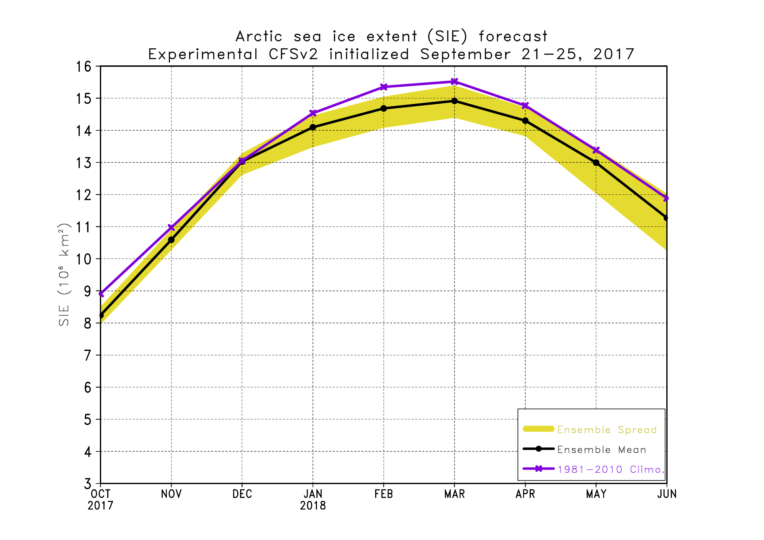
SIE Plot

Slide 4
September 2017 SIE Values
Source | SIE Value (10⁶ km²)
NSIDC 1981-2010 Climatology | 6.51
NSIDC 2016 | 4.72
NSIDC 2017 Daily Minimum* | 4.64 (September 13)
Arctic sea ice extent reached its daily minimum on September 13 and was the 8th lowest in the satellite record. The value was larger than last year’s daily minimum of 4.14 million square km.
Sea ice is beginning to expand across the Arctic.
*The final September monthly minimum will be higher than the daily minimum as all days in the month are averaged

Slide 5
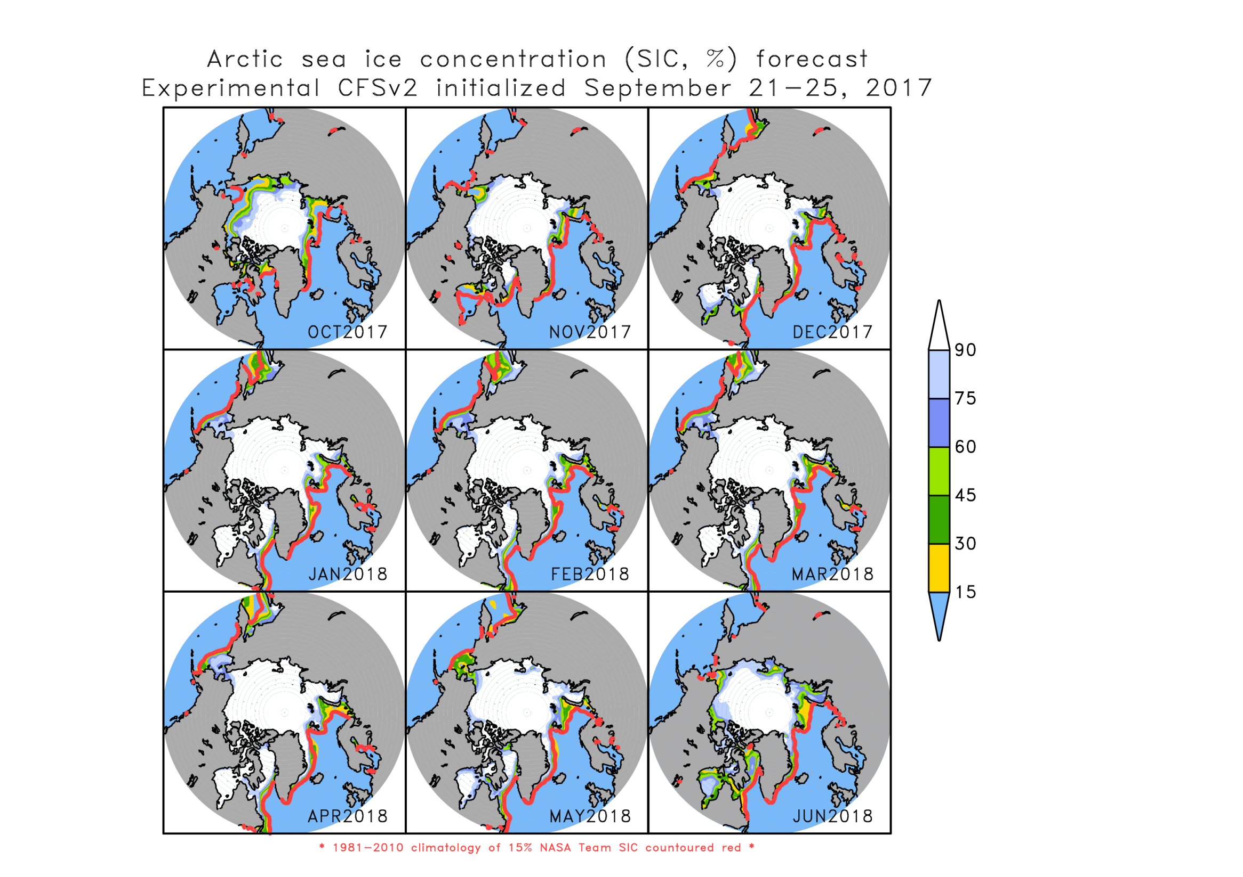

Slide 6
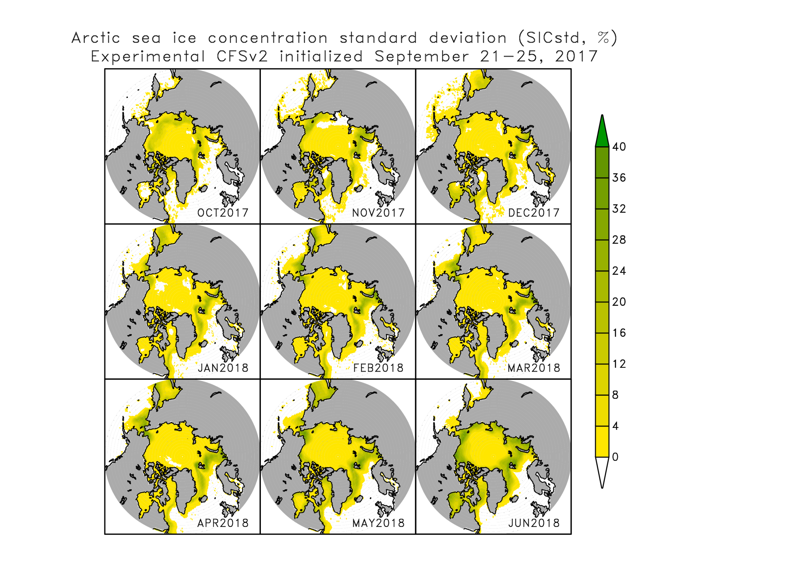
Sea ice concentration standard deviation

Slide 7
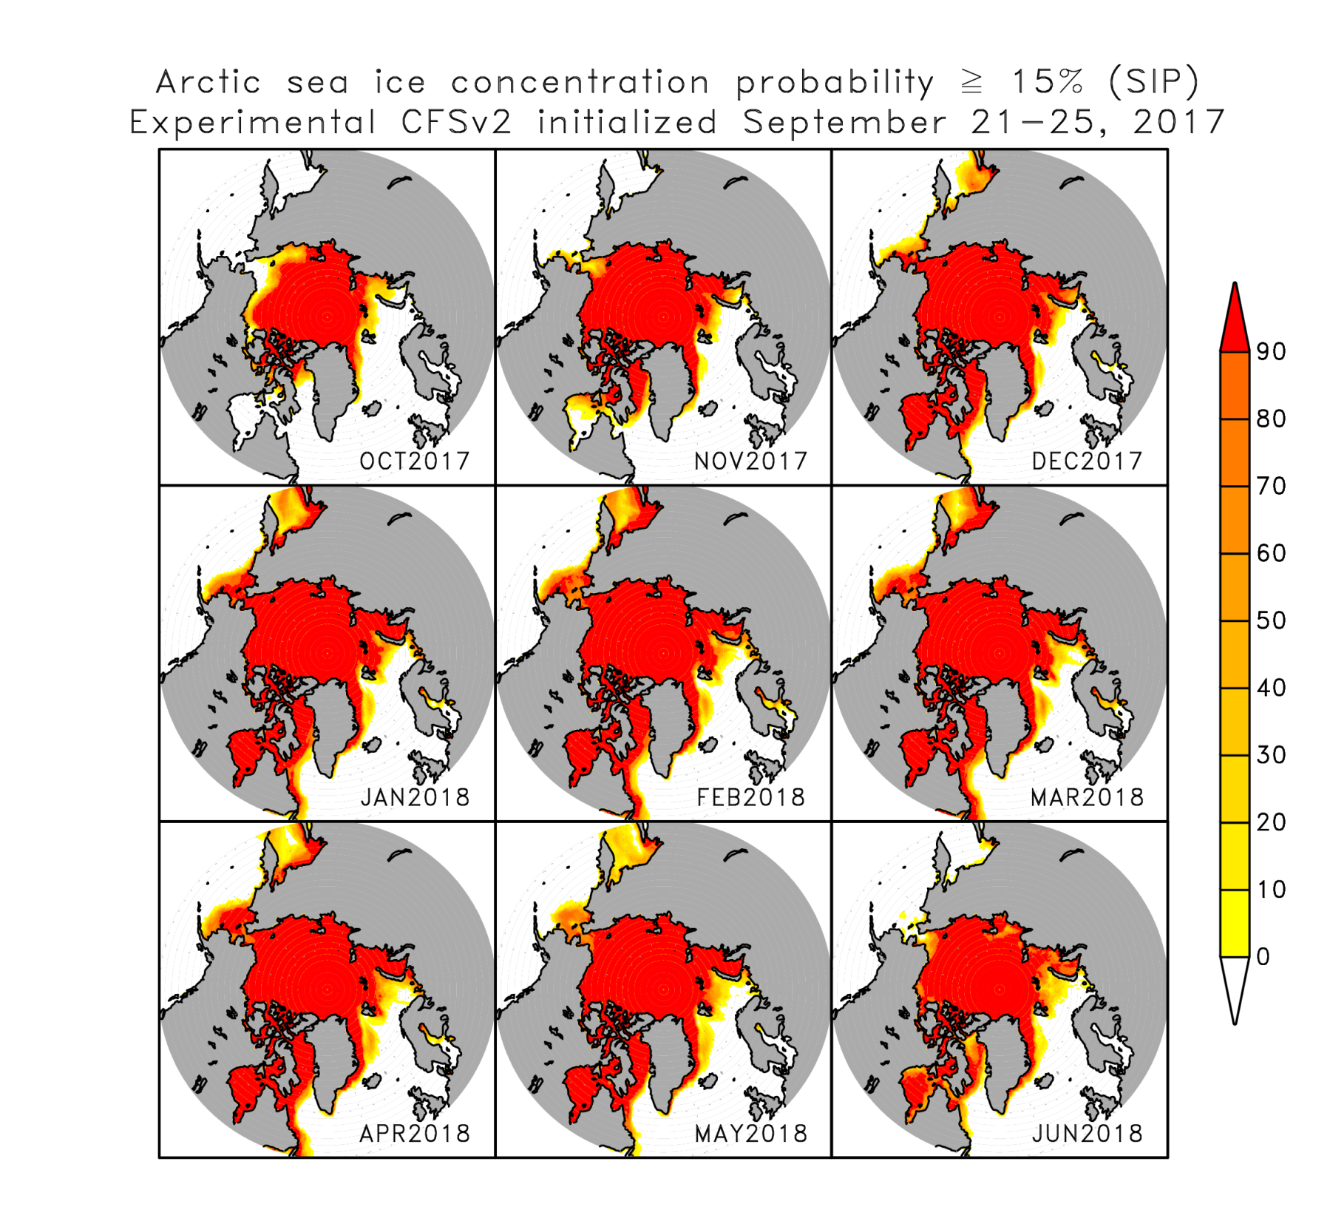

Slide 8
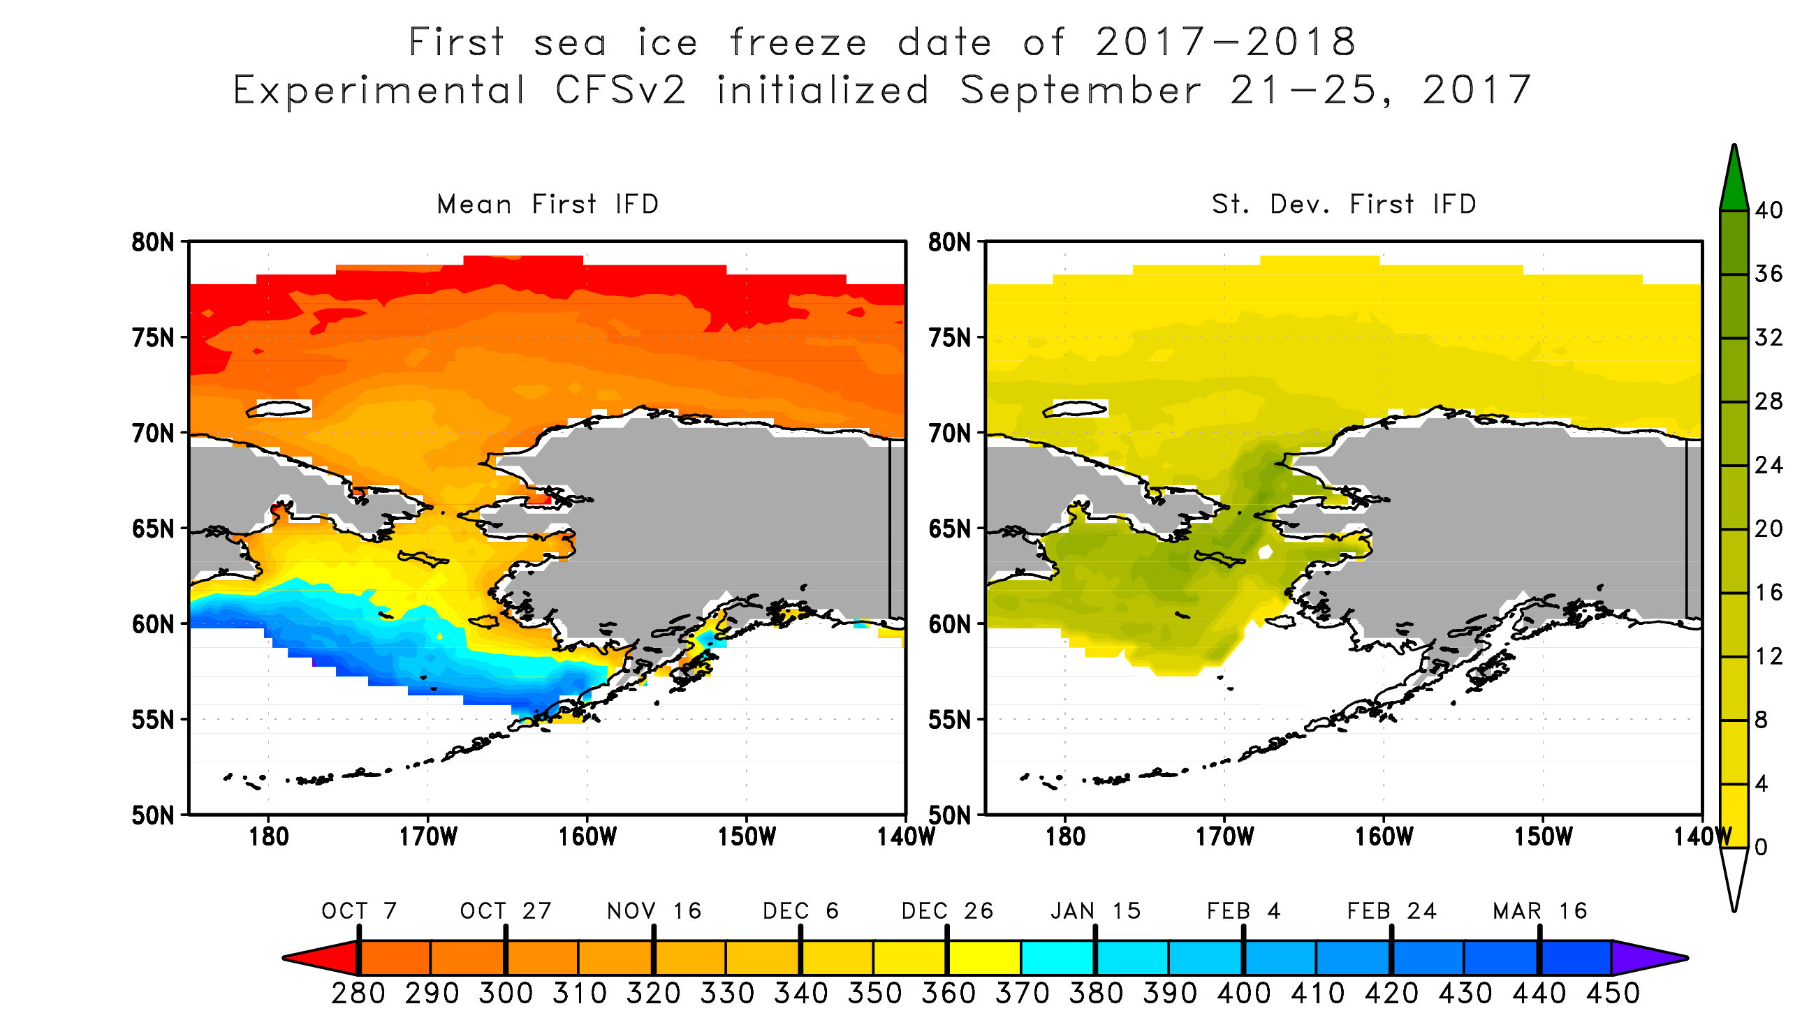
Time step is every 12 hours so 2 observations per day which are averaged to create a single daily observation. If one of the observations increases above 15%, the value on the map reflects the day of year occurred. If ice is permanent or if there is never ice, the value is set to undefined. Values greater than 365 denote days in 2018.

