Slide 1
May 2017 Experimental Sea Ice Outlook Climate Prediction Center, NCEP/NWS/NOAA
Acknowledgments: This work was supported by NOAA Science and Technology Integration. Both hindcasts and forecasts were produced on NOAA GAEA computer.

Slide 2
Procedure
Use Climate Forecast System Version 2 (CFSv2) model initialized with Pan-Arctic Ice Ocean Modeling and Assimilation System (PIOMAS) initial sea ice thickness conditions (20 initializations: May 21-25, 2017).
Correct biases using 2005-2015 mean error with respect to NSIDC observations
Present unbiased results
The following maps are included
SIE Monthly time series (mean and spread)
SIC Monthly forecast panels (Ensemble mean)
SIC Monthly standard deviation panels
Monthly ice cover probability
Mean first ice melt day/ standard deviation (Alaska region)

Slide 3
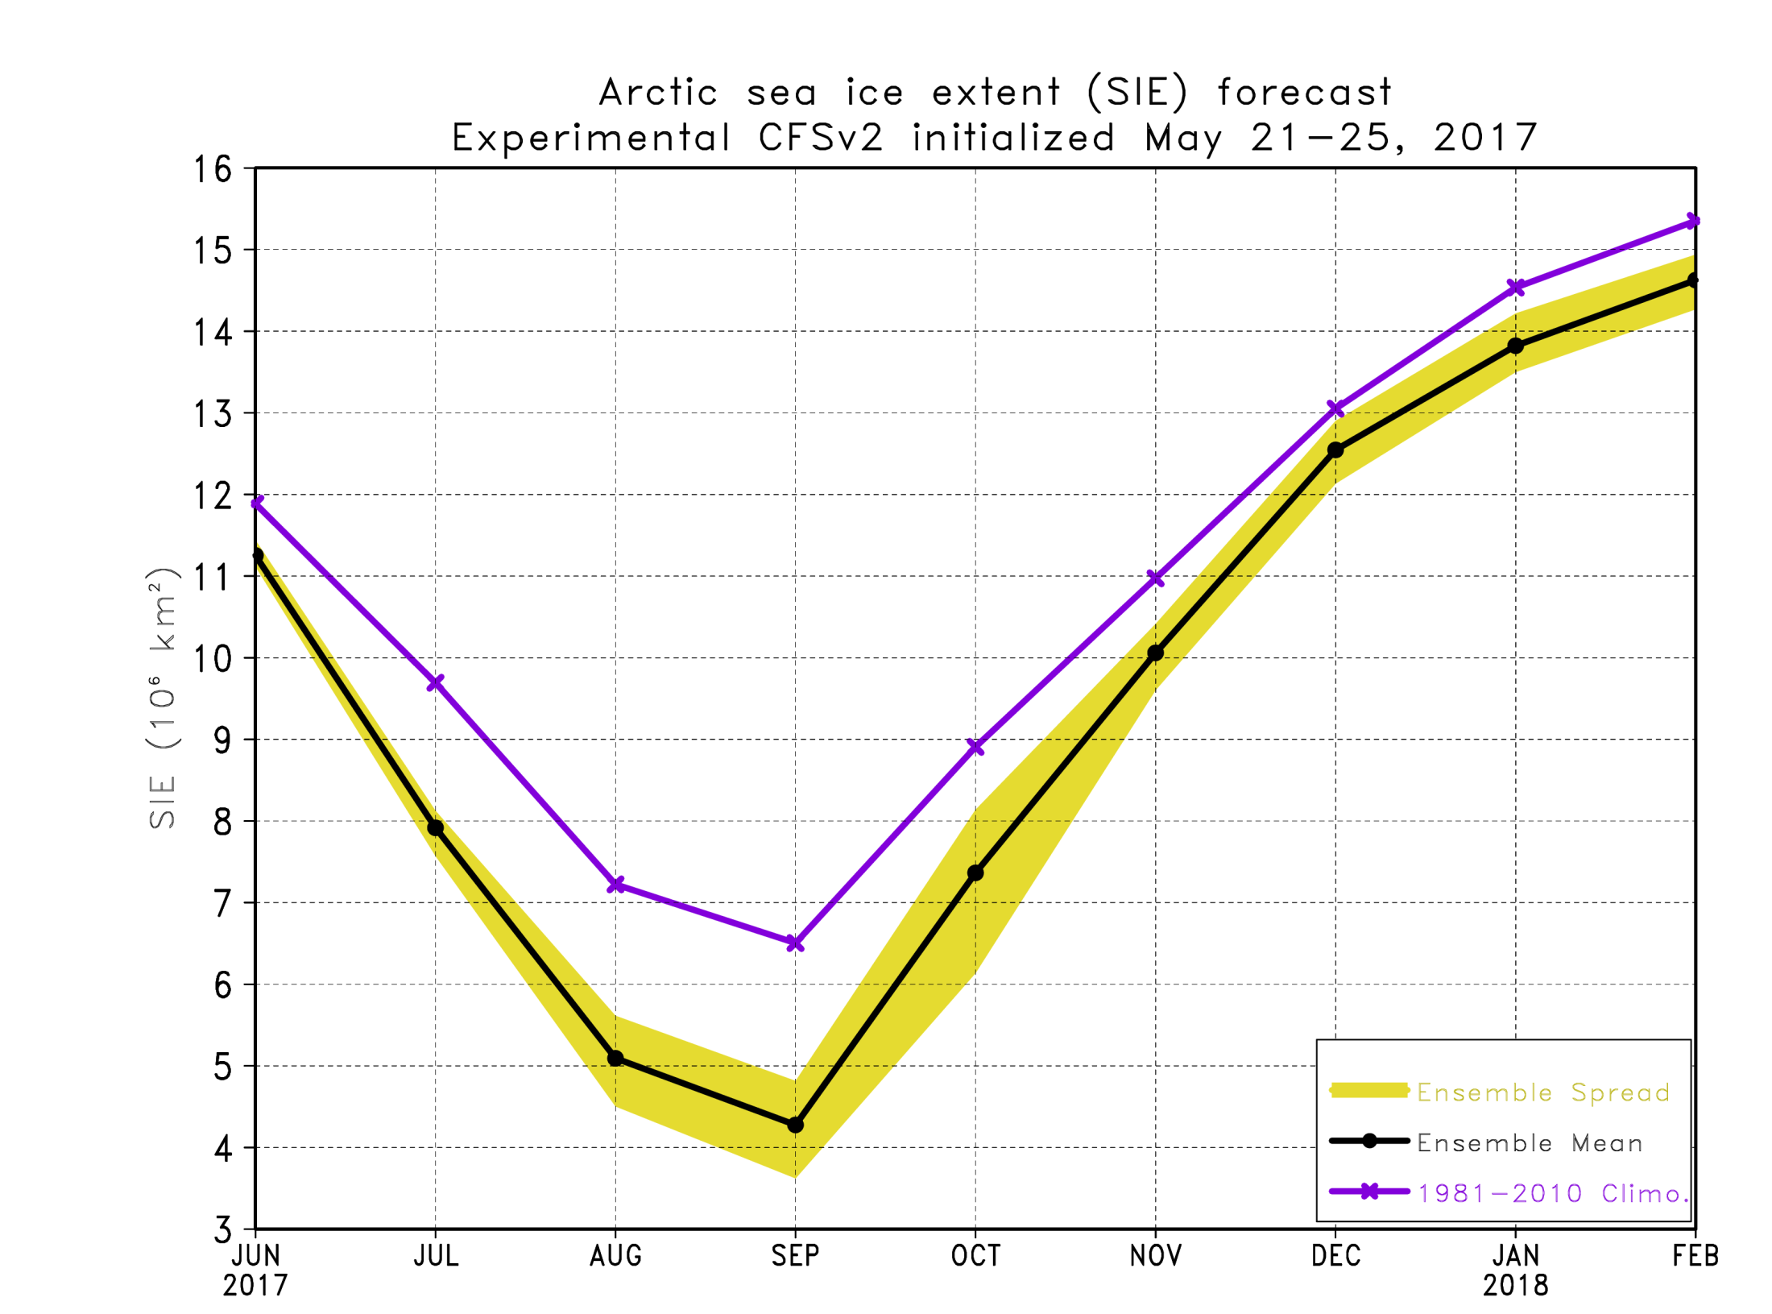
SIE Plot

Slide 4
September 2017 SIE forecast
Source | SIE Value (10⁶ km²)
NSIDC 1981-2010 Climatology | 6.51
NSIDC 2016 | 4.72
NSIDC 2012 (record low) | 3.63
Experimental CFSv2 2017 forecast | 4.28
Based on these simulations, the September 2017 sea ice extent minimum is forecasted to be below last year’s value
Month to Month September Prediction for this year’s forecasts
Month | March | April | May | June | July | August
Ens. Mean | 3.87 | 4.08 | 4.28
Std. Dev. | 0.46 | 0.21 | 0.32

Slide 5
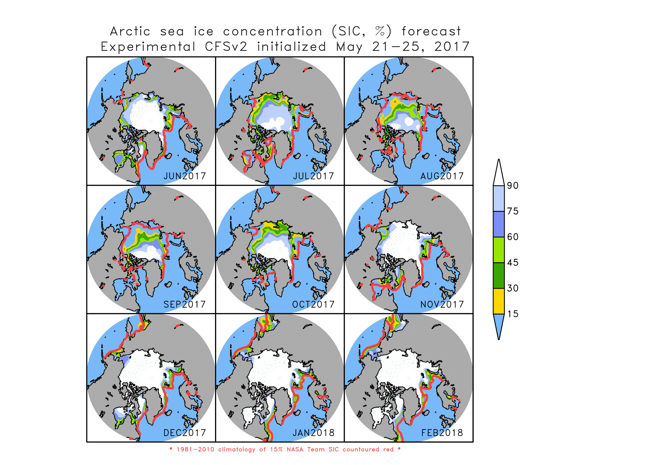

Slide 6
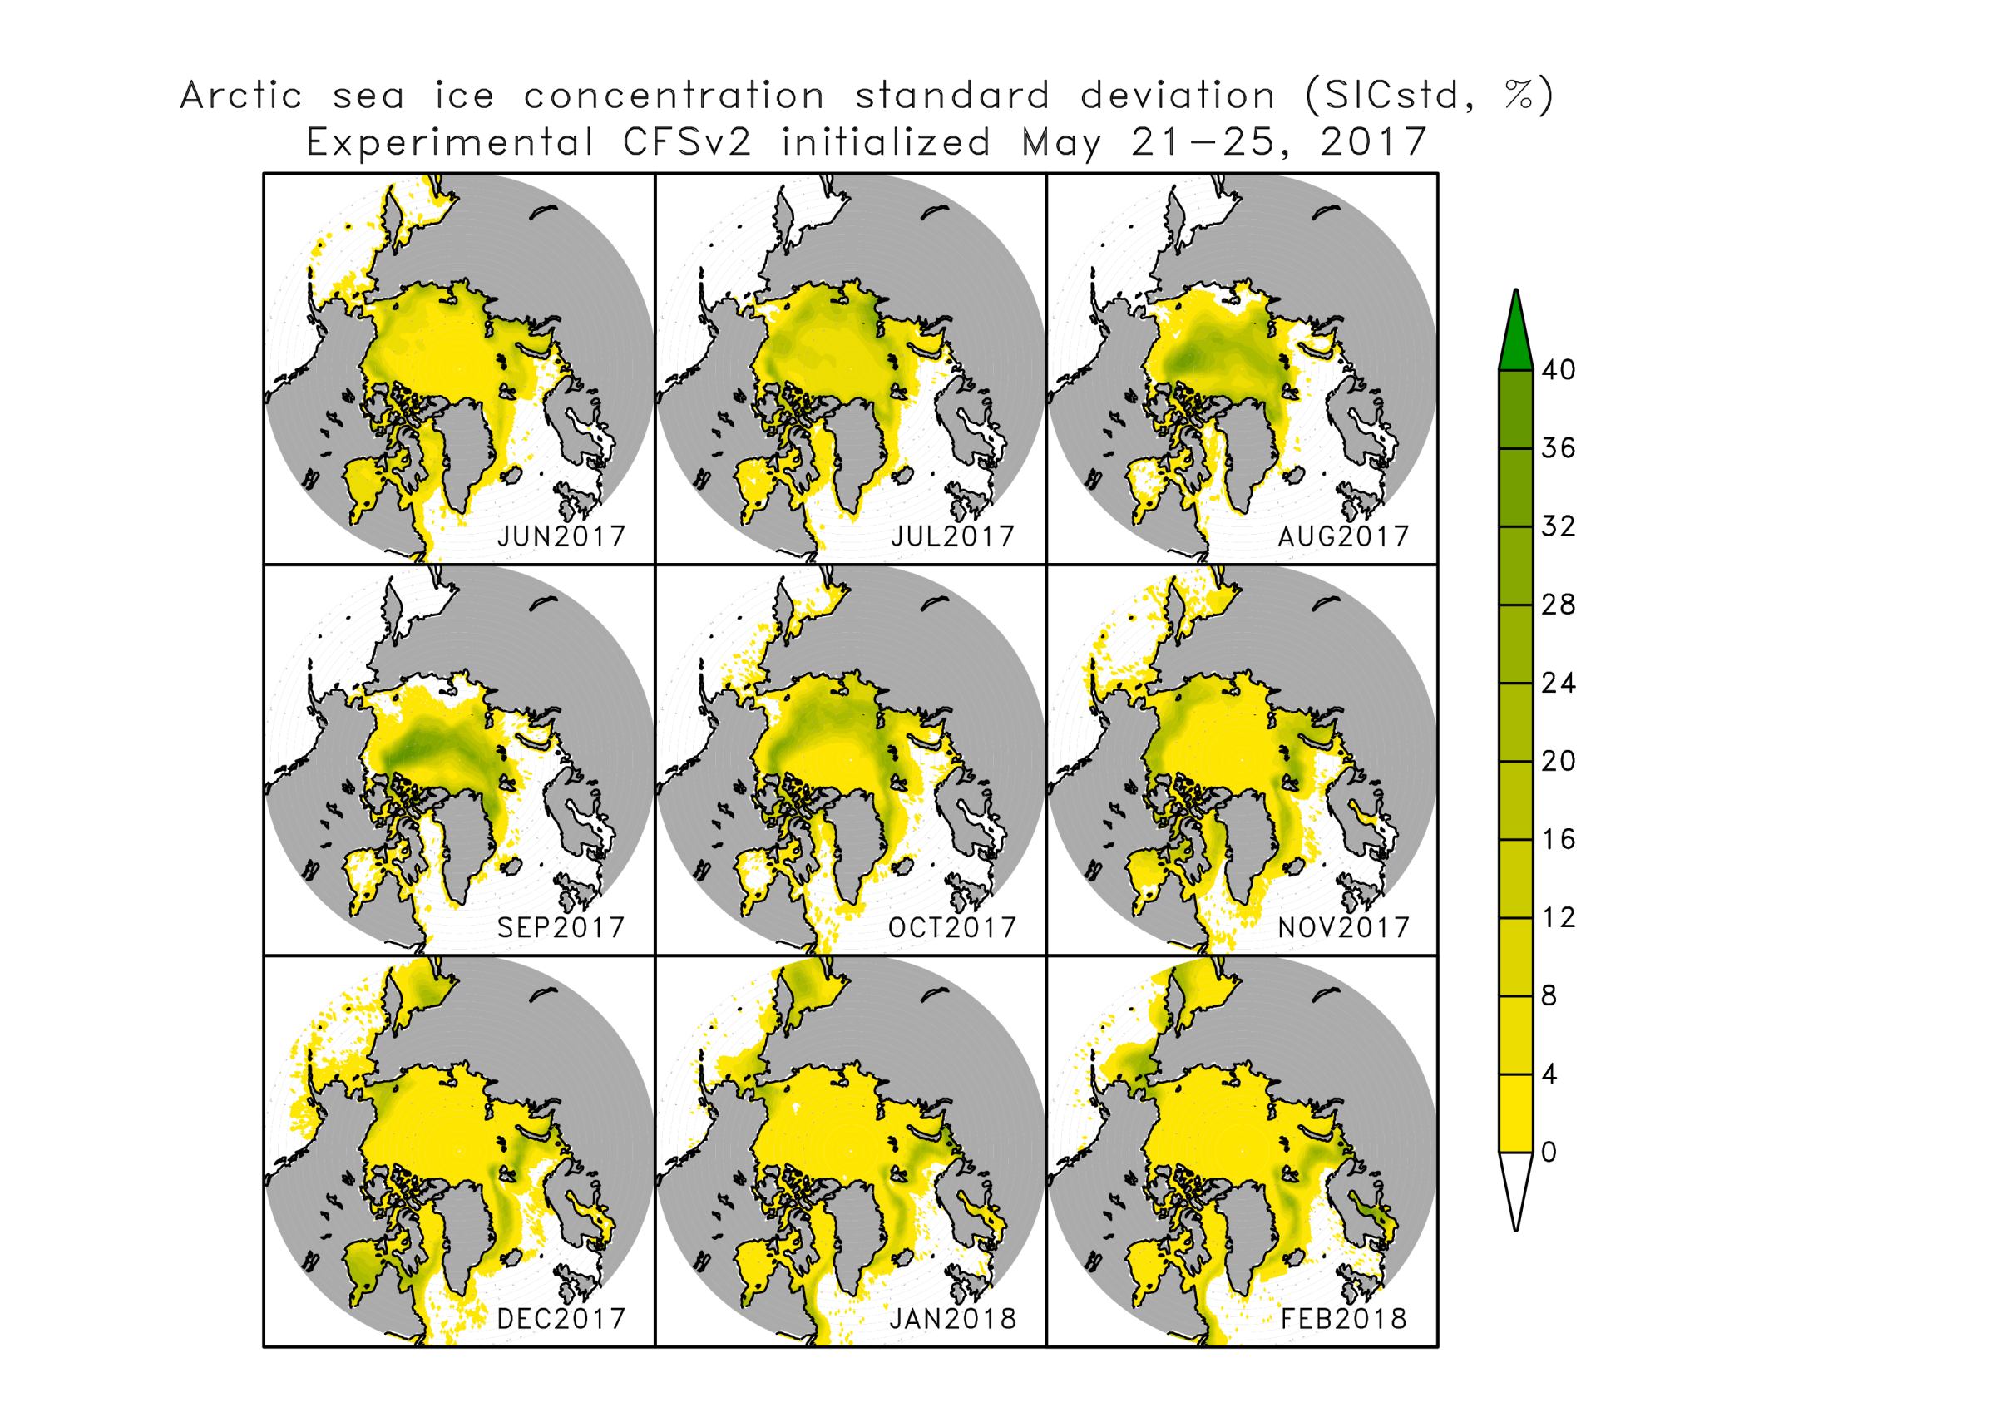
Sea ice concentration standard deviation

Slide 7
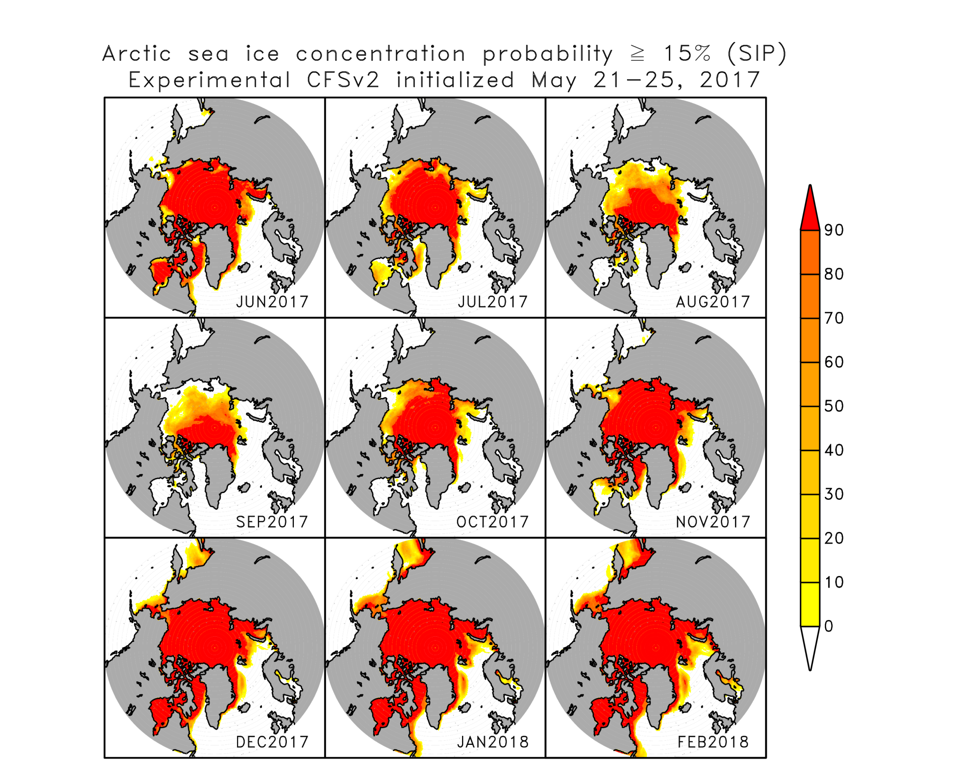

Slide 8
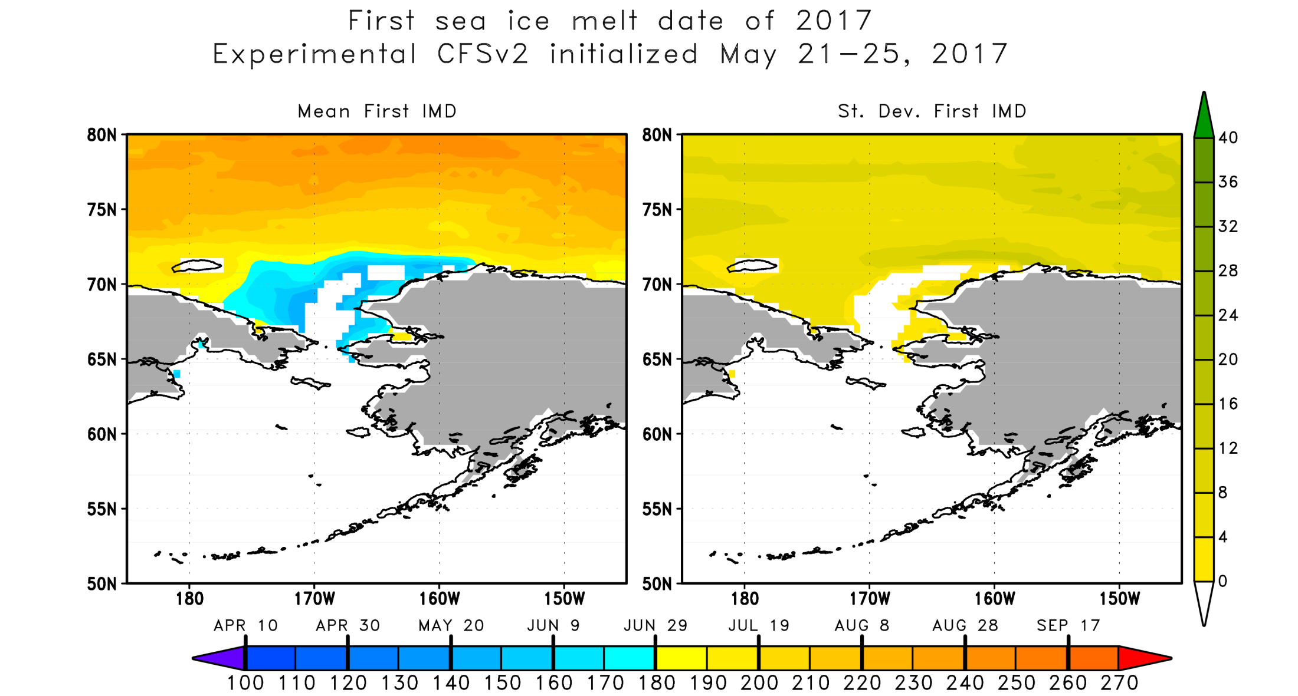
Time step is every 12 hours so 2 observations per day which are averaged to create a single daily observation. If one of the observations decreases below 15%, the value on the map reflects the day of year occurred. If ice is permanent or if there is never ice, the value is set to undefined.

