Slide 1
Hindcast of weekly TC activity for ATL, ENP, and WNP
One predictor
Vertical wind shear (VWS)
SLP1 (local slp, negatively correlated with TC)
SLP2 (remote slp, positively correlated with TC)
Two predictors
VWS + SLP1
VWS + SLP2
SLP1 + SLP2
Three predictors
VWS + SLP1 +SLP2
Regions to constructed predictors
Week 1 and week2: same areas
Week 3 and week 4: same areas

Slide 2
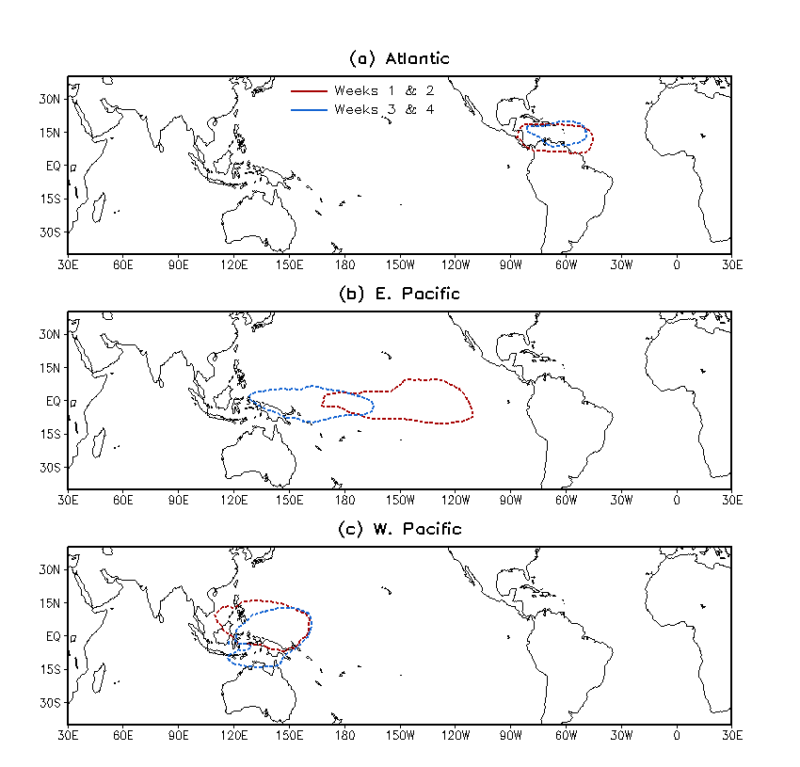
Regions for averaging vertical wind shear

Slide 3
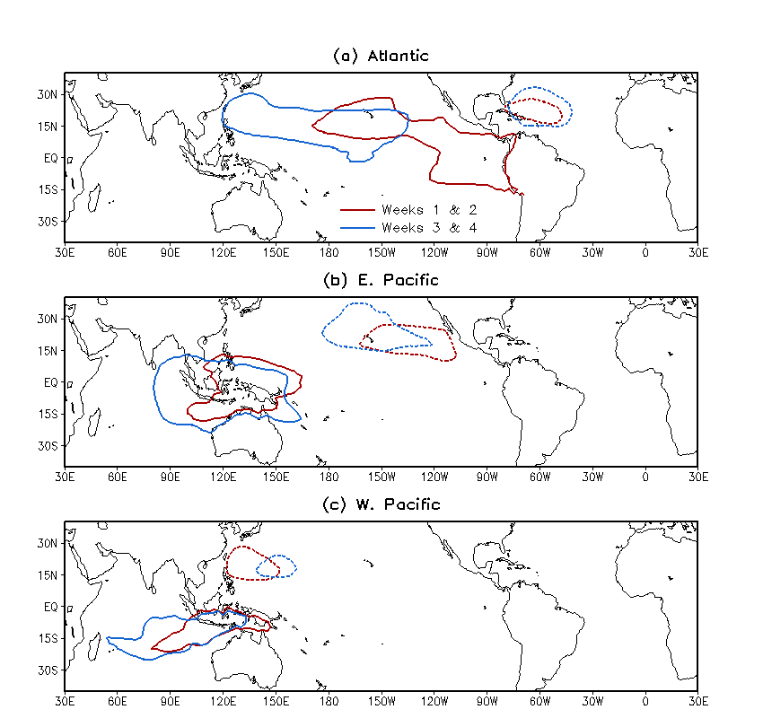
Regions for averaging SLP1 and SLP2
SLP2
SLP1

Slide 4
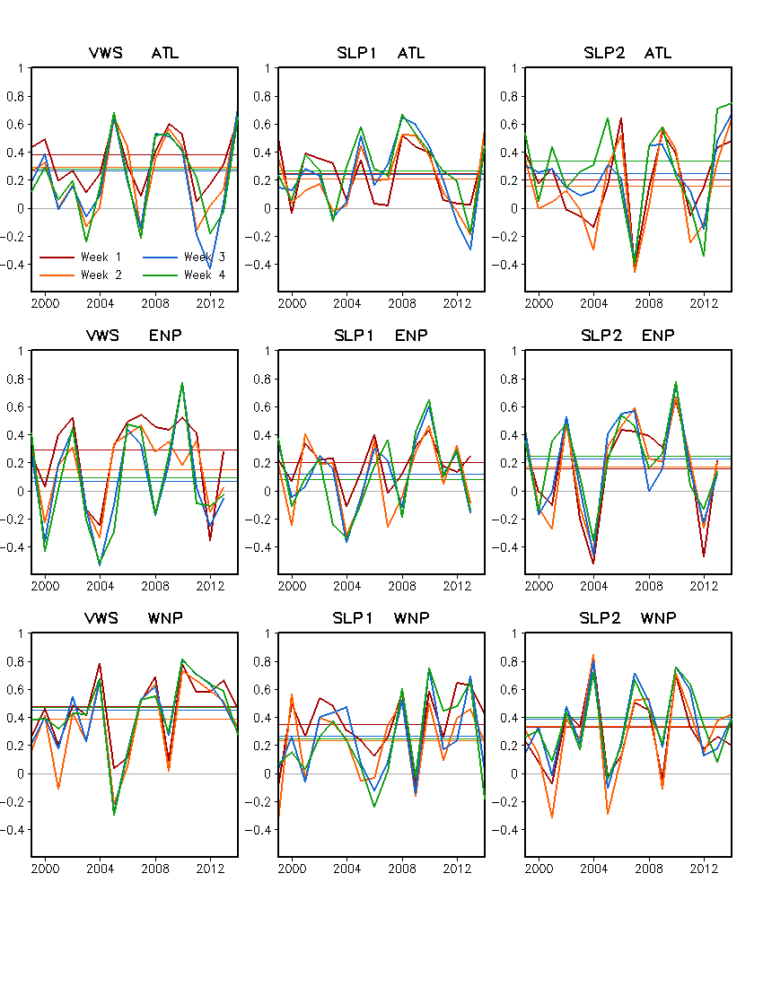
One Predictor
Wind shear
SLP1
SLP2

Slide 5
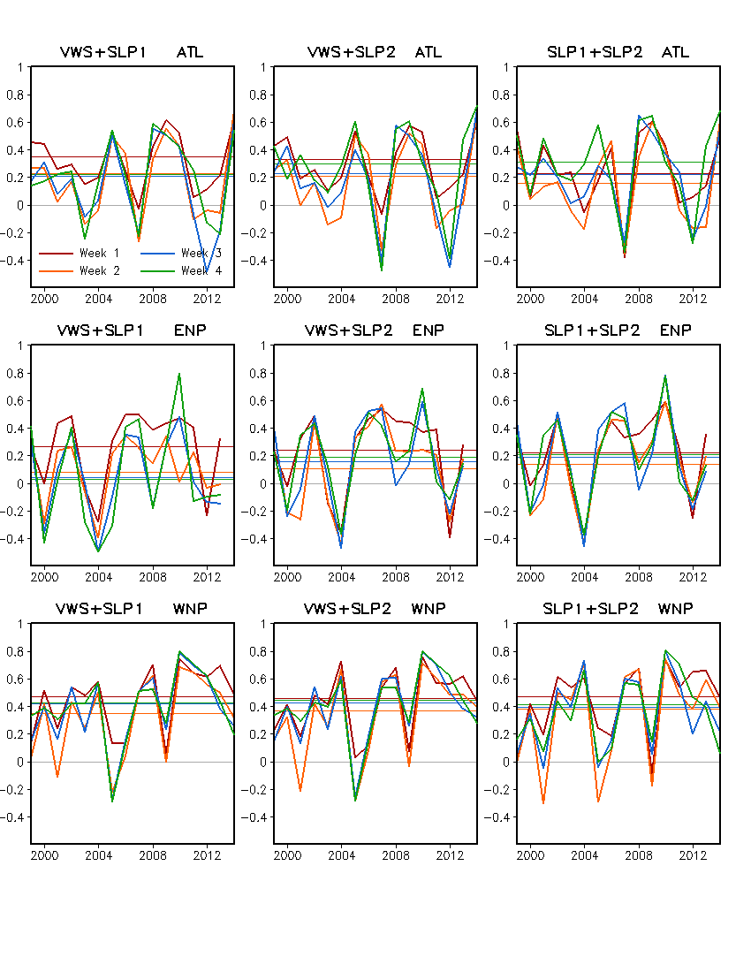
Two Predictors
Wind shear + SLP1
Wind shear + SLP2
SLP1 + SLP2

Slide 6
Three Predictors
Wind shear + SLP1 + SLP2

Slide 7
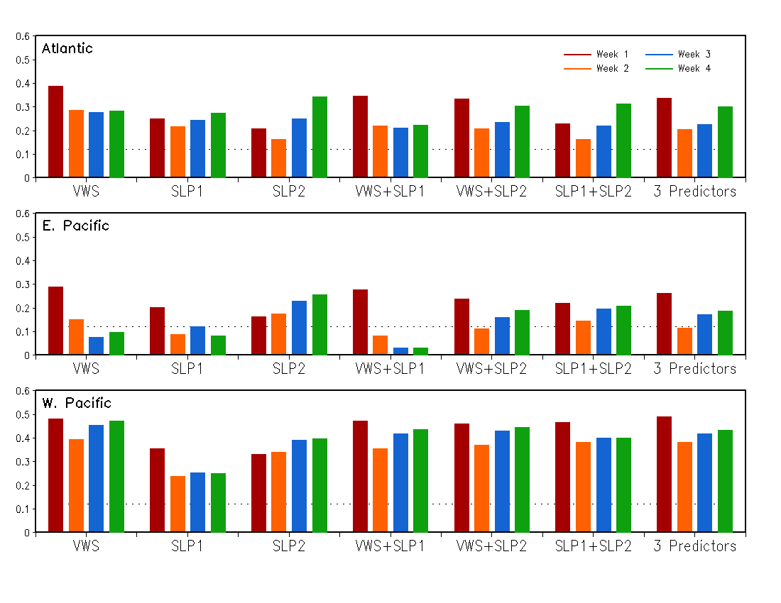
Forecast Skill: Anomaly Correlation 1999 – 2014: 31 weeks x 16 years
99% significance level
Predictors

