Slide 1
Forecast of weekly TC activity using one predictor
The 45-day CFSv2 hindcast data (1999–2012) were extended to 2014 by including the real-time forecasts (2013–2014).
Areas were selected for constructing potential predictors
Vertical wind shear (VWS)
Sea level pressure (SLP)
Hindcasts of weekly TC activity and cross-validations for 1999–2014.
The VWS as a predictor has better forecast skill than the SLP.
Weekly TC activity: TC days (sum of the number of days of each TC occurring during a week)
Future work
Hindcasts and cross-validations using multiple predictors
Using the two MJO indices as predictors

Slide 2
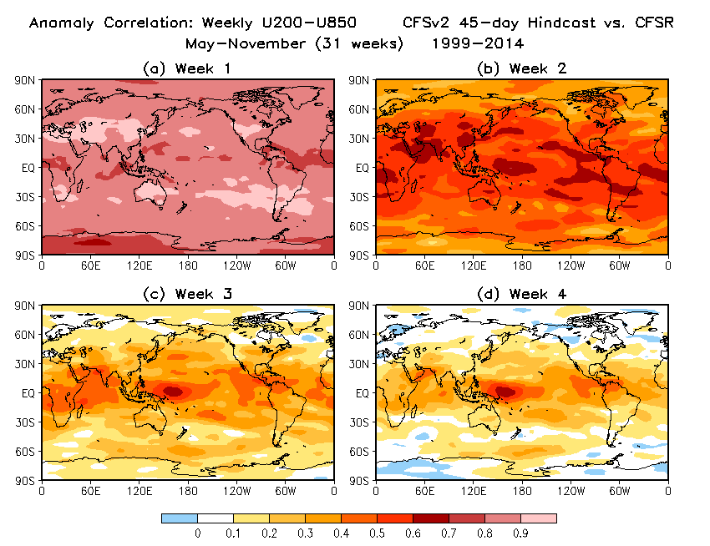

Slide 3
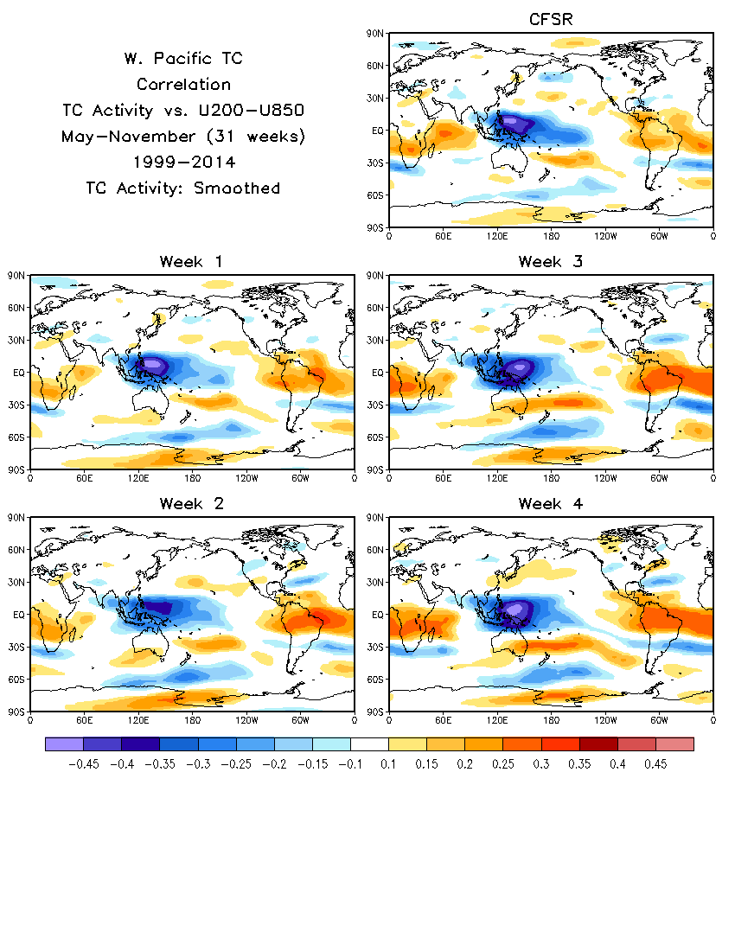
Correlation of observed WNP TC activity with vertical wind shear (VWS; U200 – U850) from CFSR (top) and week 1 – 4 CFSv2 hindcasts (middle and bottom).

Slide 4
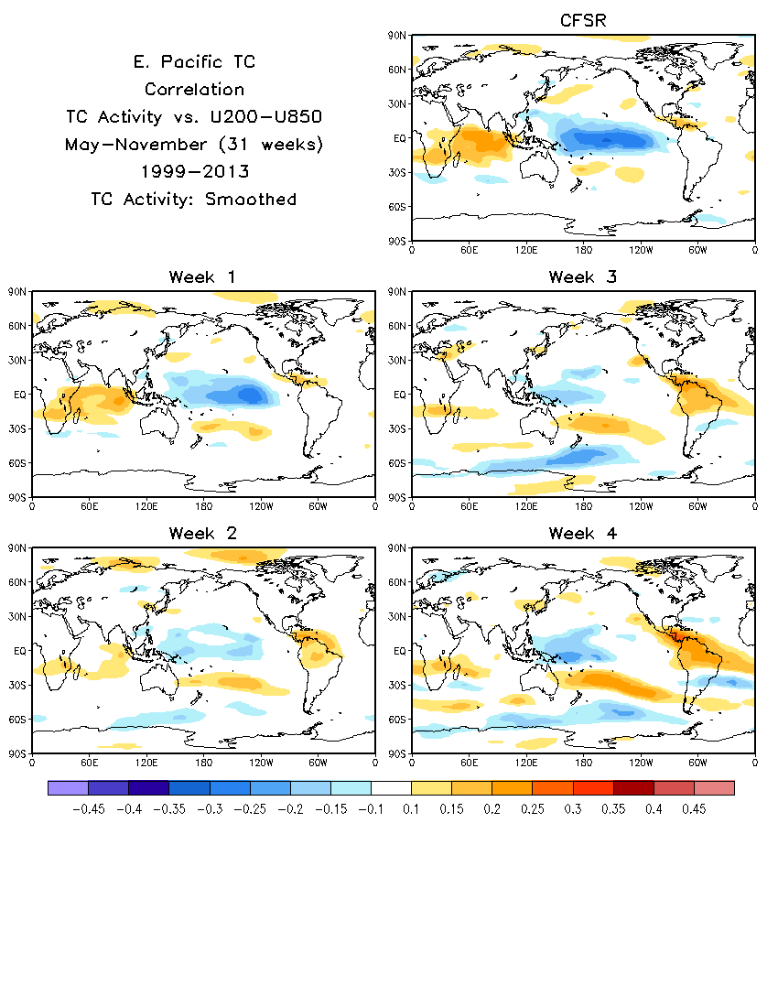
Correlation of observed ENP TC activity with vertical wind shear (VWS; U200 – U850) from CFSR (top) and week 1 – 4 CFSv2 hindcasts (middle and bottom).

Slide 5
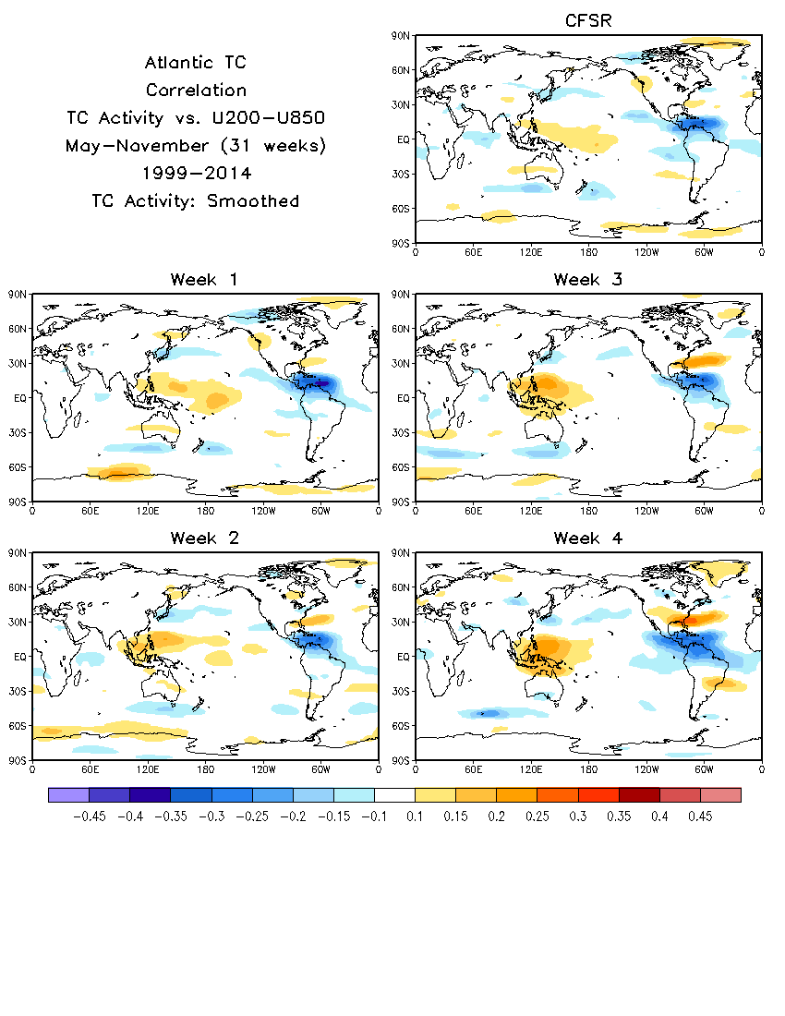
Correlation of observed ATL TC activity with vertical wind shear (VWS; U200 – U850) from CFSR (top) and week 1 – 4 CFSv2 hindcasts (middle and bottom).

Slide 6
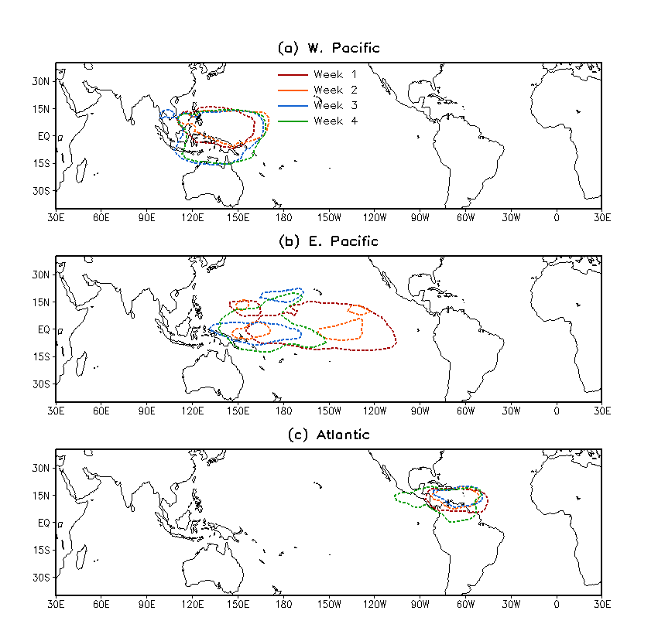
Areas selected for averaging VWS as a predictor for WNP, ENP, and ATL weekly TC activity forecasts based on previous 3 slides (correlation: TC vs. VWS).
Dash lines denote negative correlations between TC activity and VWS.
VWS
VWS
VWS

Slide 7
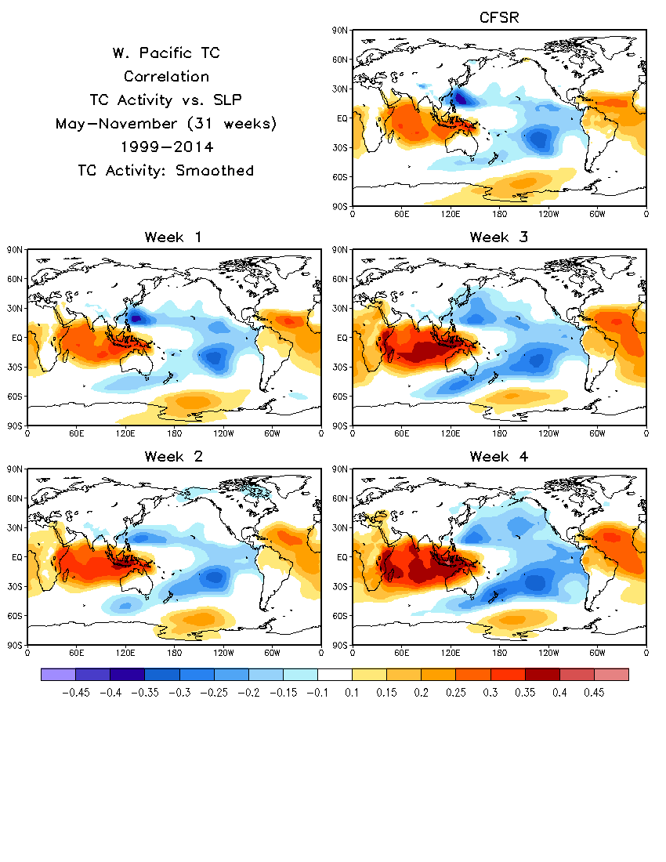
Correlation of observed WNP TC activity with sea level pressure (SLP) from CFSR (top) and week 1 – 4 CFSv2 hindcasts (middle and bottom).

Slide 8
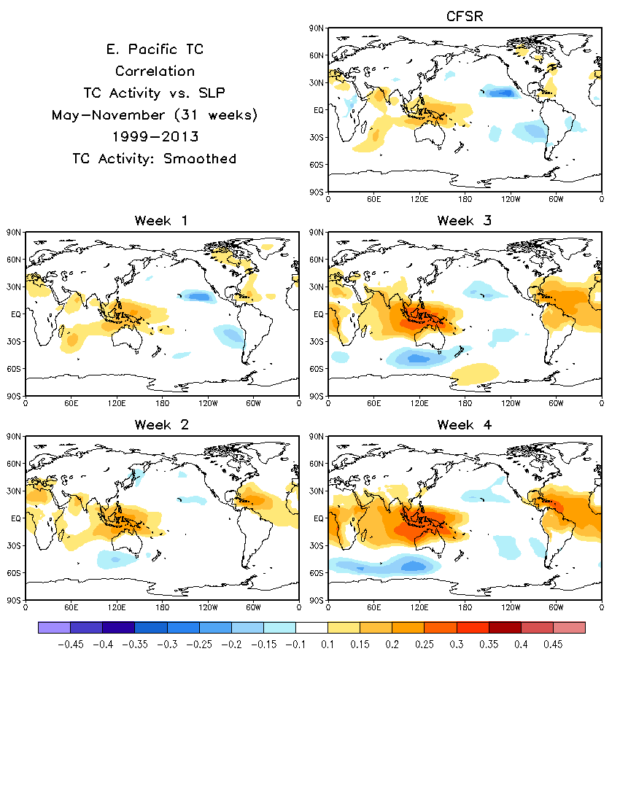
Correlation of observed ENP TC activity with sea level pressure (SLP) from CFSR (top) and week 1 – 4 CFSv2 hindcasts (middle and bottom).

Slide 9
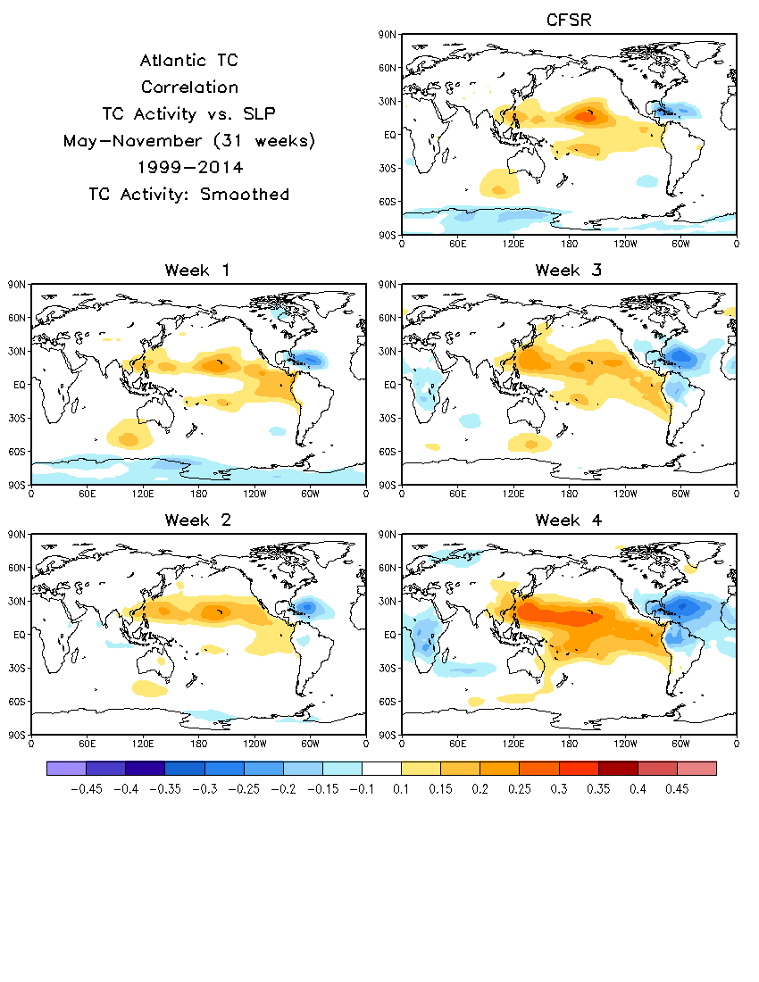
Correlation of observed ATL TC activity with sea level pressure (SLP) from CFSR (top) and week 1 – 4 CFSv2 hindcasts (middle and bottom).

Slide 10
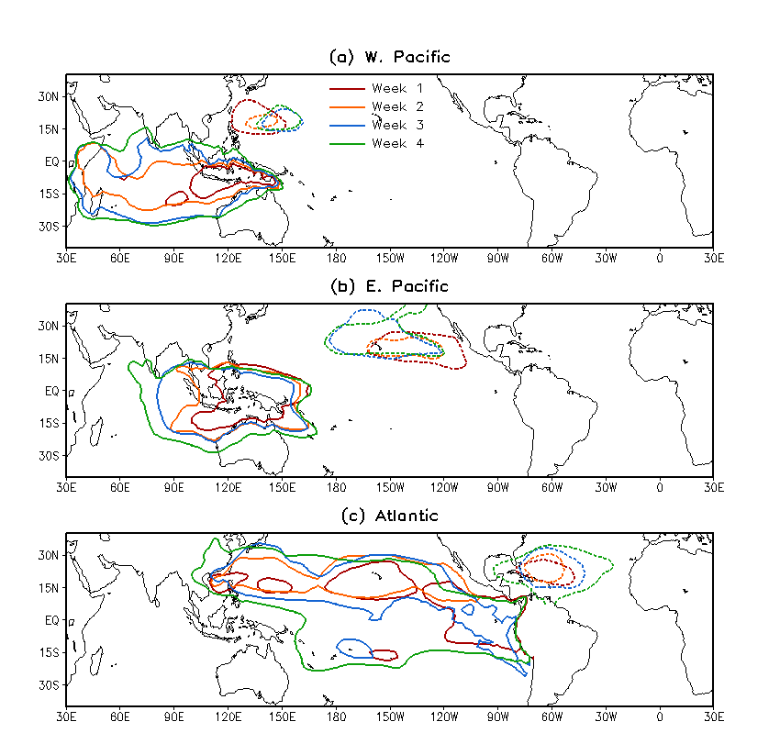
Areas selected for averaging SLP as a predictor for WNP, ENP, and ATL weekly TC activity forecasts based on previous 3 slides (correlation: TC vs. SLP).
Two predictors:
SLP1: local SLP
SLP2: remote area
Solid (Dash) lines denote positive (negative) correlations between TC activity and VWS.
SLP1
SLP2
SLP1
SLP2
SLP2
SLP1

Slide 11
Forecast skills (AC):
Weekly TC activity
Predictor : VWS SLP1 SLP2
Basin
WNP
OBS SD: 2.89
ENP
OBS SD: 1.39
ATL
OBS SD: 1.84
Week | AC | RMSE | AC | RMSE | AC | RMSE
1 | 0.48 | 2.54 | 0.35 | 2.70 | 0.33 | 2.73
2 | 0.40 | 2.64 | 0.25 | 2.80 | 0.36 | 2.70
3 | 0.45 | 2.58 | 0.25 | 2.80 | 0.39 | 2.66
4 | 0.47 | 2.55 | 0.25 | 2.80 | 0.41 | 2.64
1 | 0.29 | 1.33 | 0.20 | 1.36 | 0.16 | 1.37
2 | 0.19 | 1.36 | 0.14 | 1.37 | 0.16 | 1.37
3 | 0.15 | 1.38 | 0.12 | 1.38 | 0.23 | 1.35
4 | 0.13 | 1.38 | 0.11 | 1.38 | 0.25 | 1.34
1 | 0.38 | 1.70 | 0.25 | 1.79 | 0.23 | 1.79
2 | 0.29 | 1.76 | 0.22 | 1.80 | 0.28 | 1.77
3 | 0.28 | 1.78 | 0.24 | 1.79 | 0.26 | 1.78
4 | 0.28 | 1.77 | 0.27 | 1.78 | 0.29 | 1.77
Observed standard deviation of weekly TC activity over the 31 weeks of the 16 years
AC: 31 weeks × 16 yrs = 496 weeks, AC=0.09 (95% significance), AC=0.12 (99% significance)
RMSE is less than the observed one standard deviation of weekly TC activity.

Slide 12
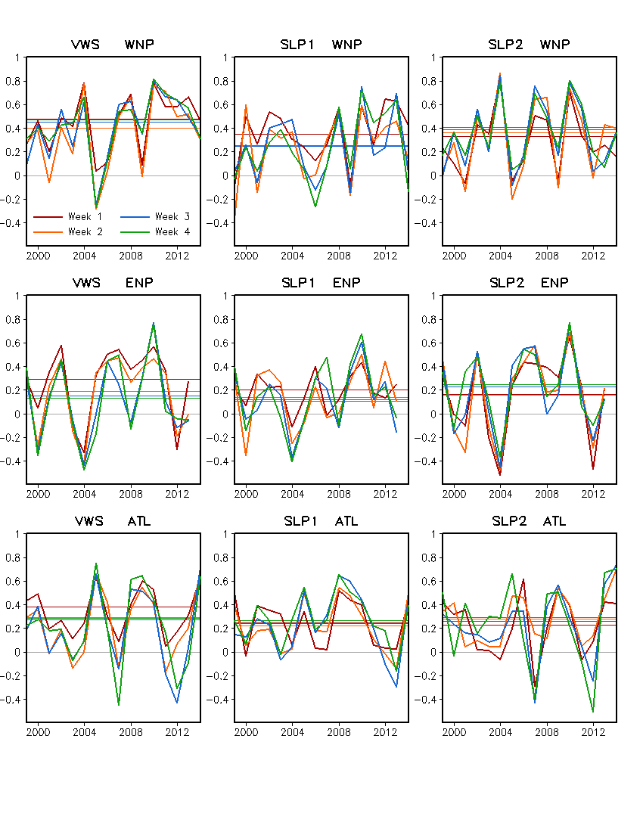
Predictor: VWS SLP1 SLP2
Basin:
WNP
ENP
ATL
AC: anomaly correlation over 31 weeks for each year, 1999 – 2014
Straight line: AC over
31 weeks × 16 years

