Slide 1
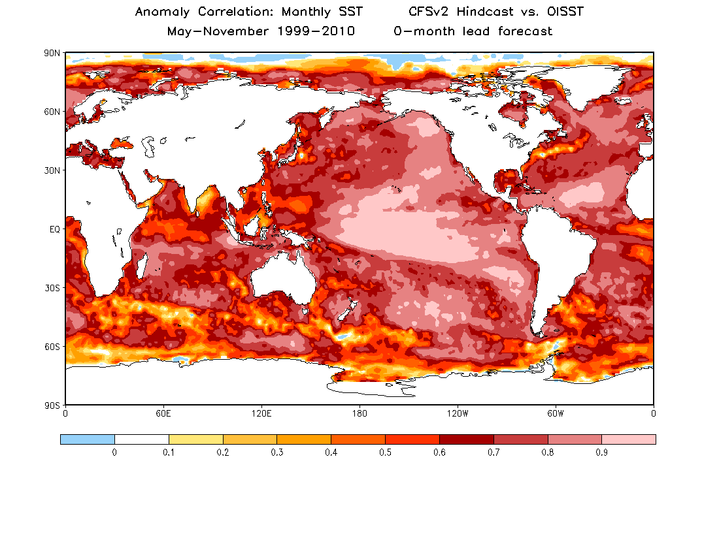
0-month forecast for every month (May – November)

