Slide 1
Composite of OLR anomaly for different MJO phases
Based on daily MJO index (Jan – Dec, 1999 – 2014)
Based on weekly MJO index (May – Dec, 1999 – 2014)
Observational data

Slide 2
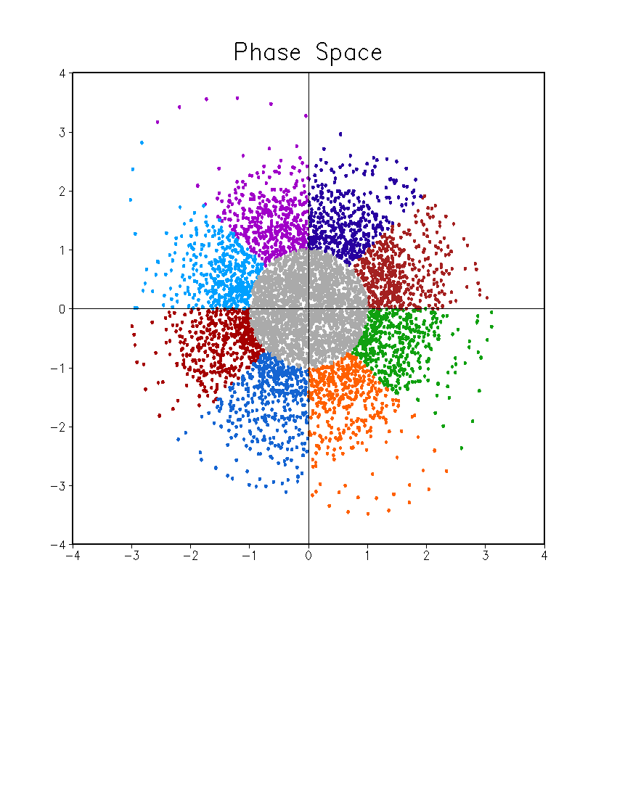
Daily MJO Index
01 Jan 1999 – 31 Dec 2014
Phase 7
Phase 6
Phase 8
Phase 5
PC2
Weak MJO
Phase 1
Phase 4
Phase 2
Phase 3
PC1

Slide 3
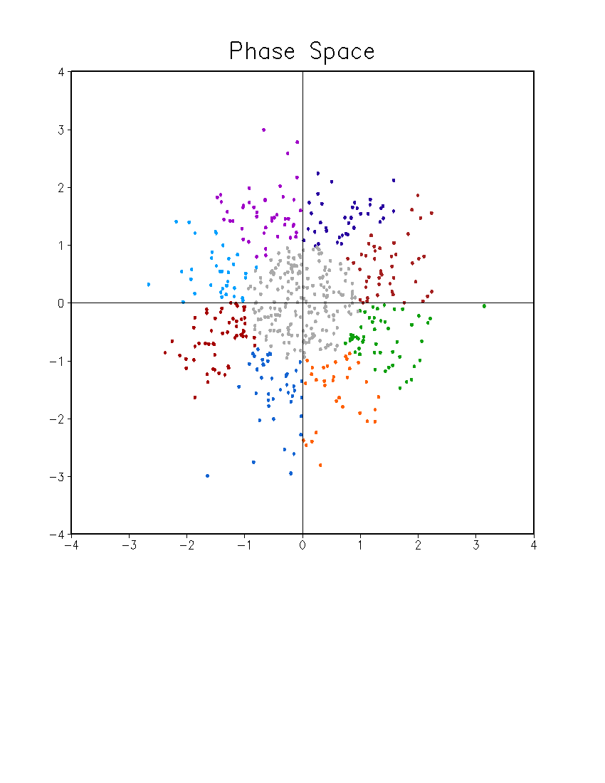
Weekly MJO Index
1999 – 2014
May – December (34 Weeks)
Sunday – Saturday
Phase 7
Phase 6
Phase 8
Phase 5
PC2
Weak MJO
Phase 1
Phase 4
Phase 2
Phase 3
PC1
Weekly MJO index:
Average of daily MJO index from Sunday to Saturday

Slide 4
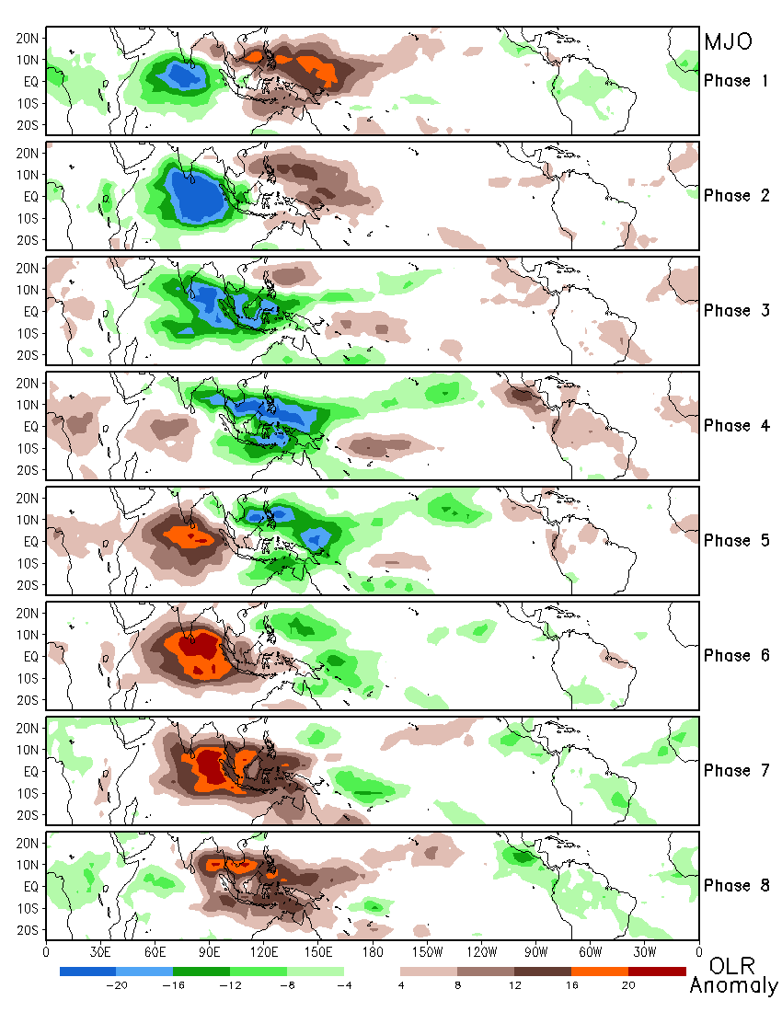
Composite of OLR Anomaly for Different MJO Phases Based on Daily MJO Index
Jan – Dec, 1999 – 2014
Daily OLR anomaly:
unfiltered

Slide 5
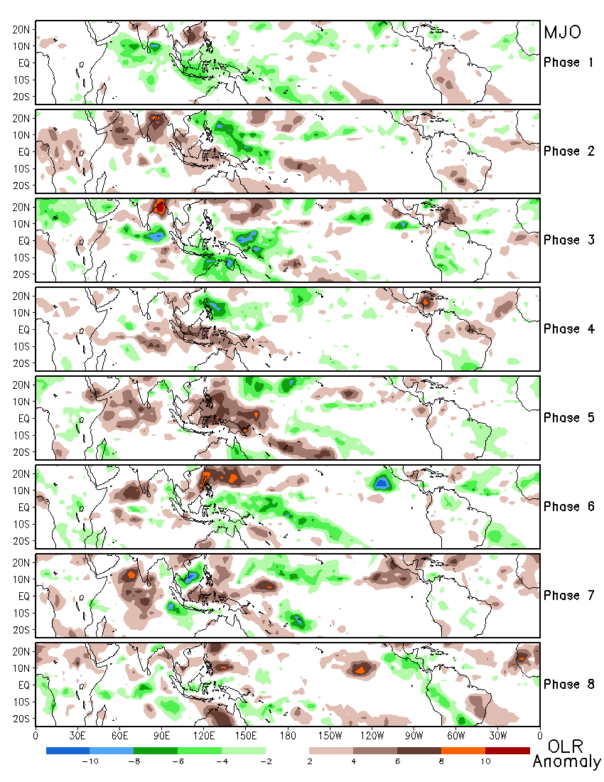
Composite of OLR Anomaly for Different MJO Phases Based on Weekly MJO Index
May – Dec, 1999 – 2014
Weekly OLR anomaly:
unfiltered

Slide 6
Wind shear: U200 – U850
Anomaly correlation between CFSv2 45-day hindcasts and CFSR
Weekly data: 7-day average from Sunday to Saturday
May – November: 31 weeks
1999 – 2012
Different leads: week 1 to week 4
Correlation between observed weekly TC activity and CFSv2 45-day hindcast wind shear
Atlantic, E. Pacific, W. Pacific TC activities
OBS: CFSR
CFSv2 45-day hindcasts: from week 1 to week 4
Potential predictors: area-average over regions with high correlations

Slide 7
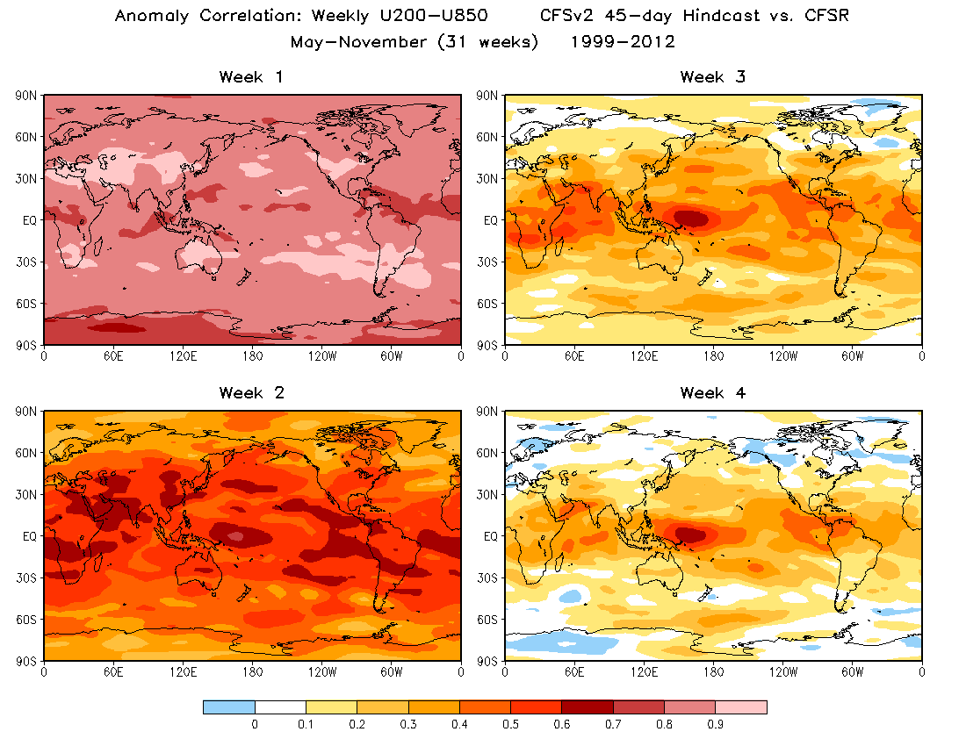

Slide 9
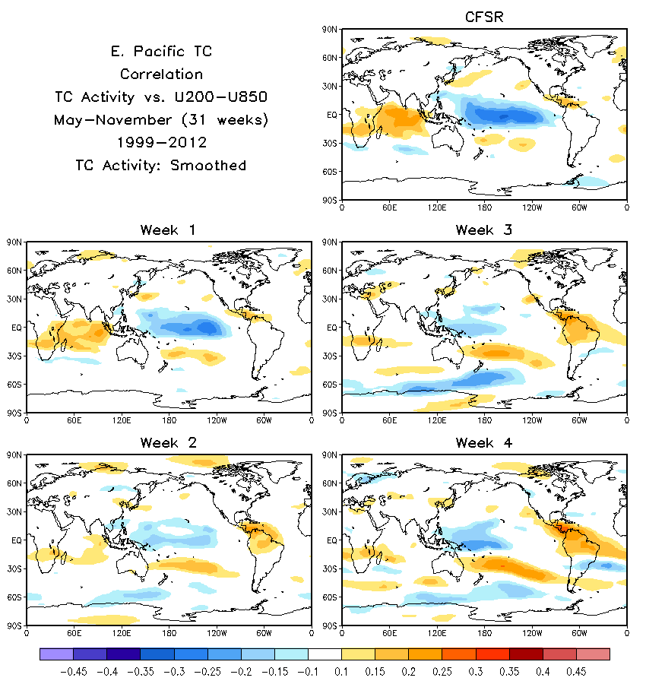

Slide 11
Sea Level Pressure (SLP)
Anomaly correlation between CFSv2 45-day hindcasts and CFSR
Weekly data: 7-day average from Sunday to Saturday
May – November: 31 weeks
1999 – 2012
Different leads: week 1 to week 4
Correlation between observed weekly TC activity and CFSv2 45-day hindcast SLP
Atlantic, E. Pacific, W. Pacific TC activities
OBS: CFSR
CFSv2 45-day hindcasts: from week 1 to week 4
Potential predictors: area-average over regions with high correlations

Slide 12
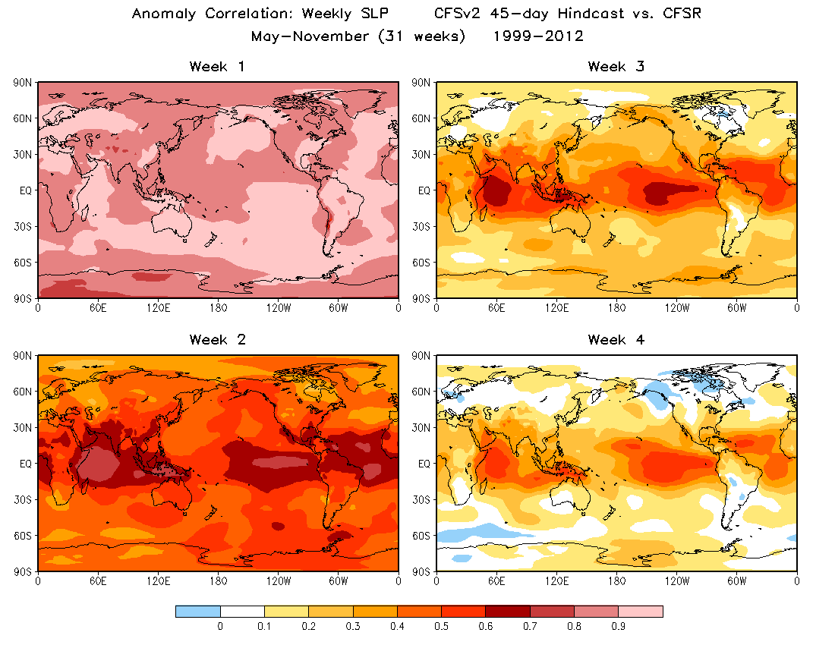

Slide 13
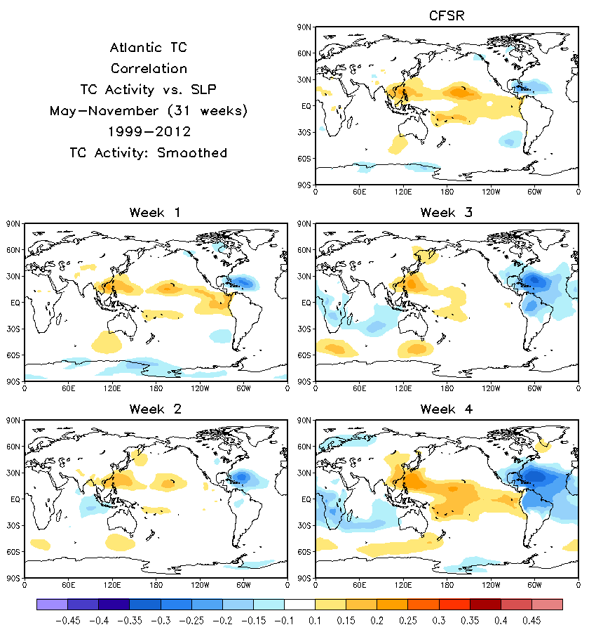

Slide 15
