Slide 1
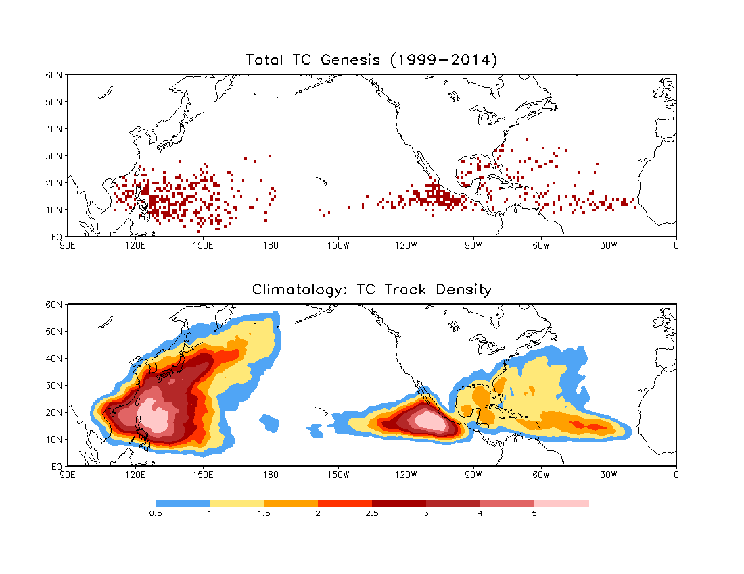

Slide 2
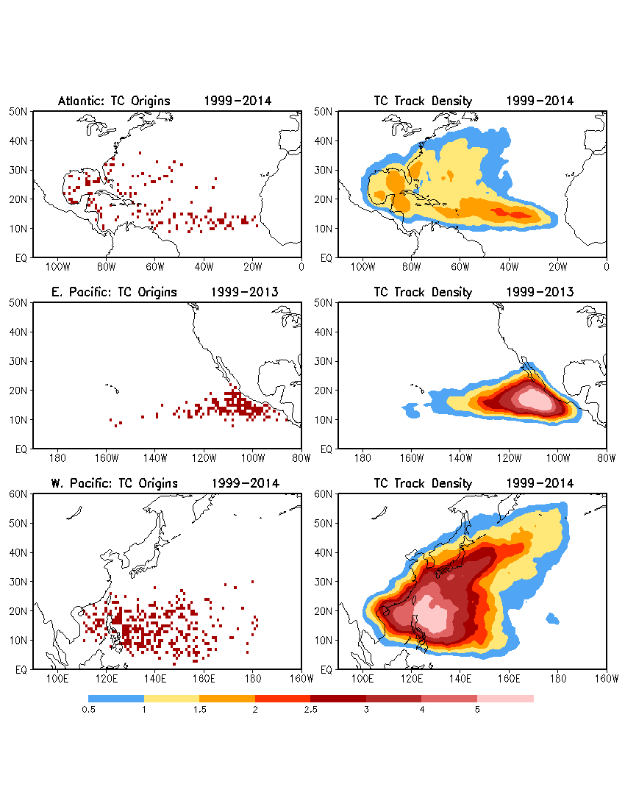

Slide 3
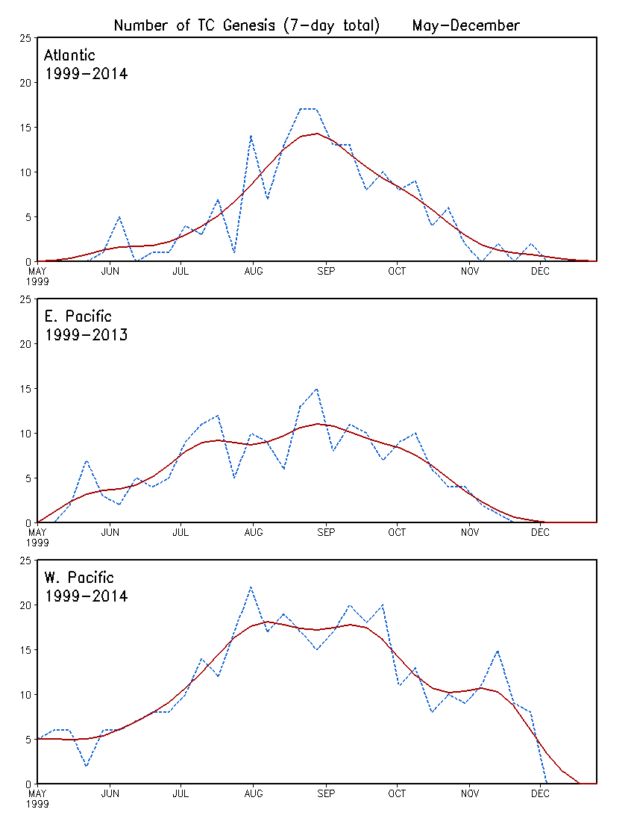

Slide 4
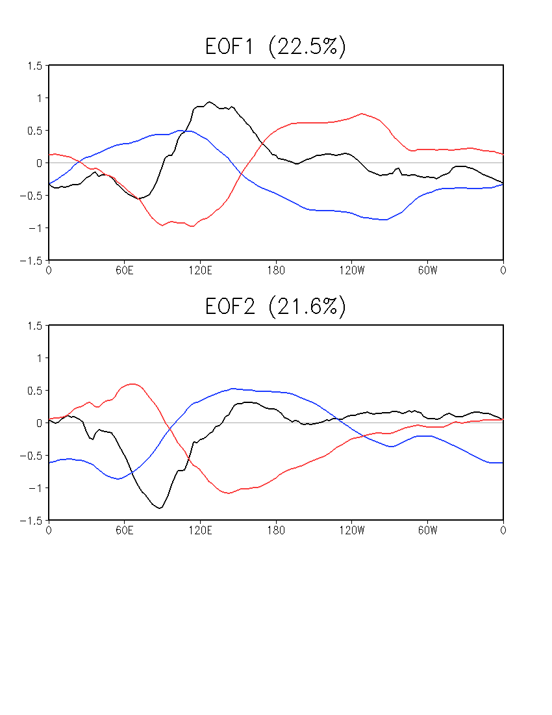
MJO
Combined EOFs of u850, u200, and OLR
Averaged over 15ºS–15ºN
01Jan1999–31Dec2014, daily data
NOAA Interpolated OLR, 1999–2013
CFSR for u850 and u200
CFSR for OLR, 2014
Anomaly w.r.t daily climatology
20–100-day band-pass filter prior to EOF
OLR
U850
U200

Slide 5
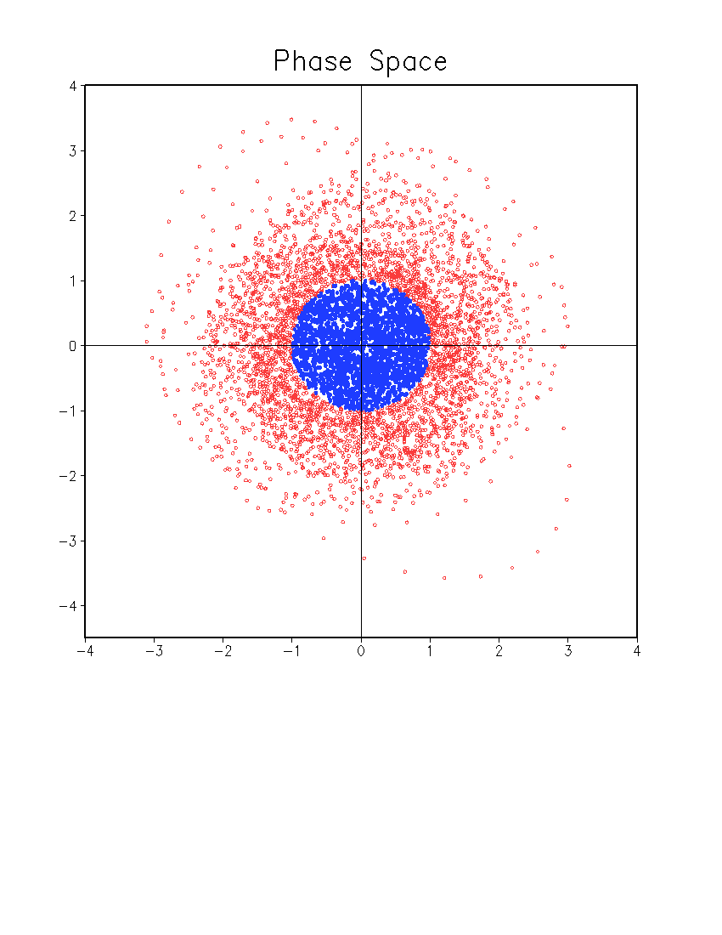
Daily MJO Index
Weak MJO
PC2
PC1

Slide 6
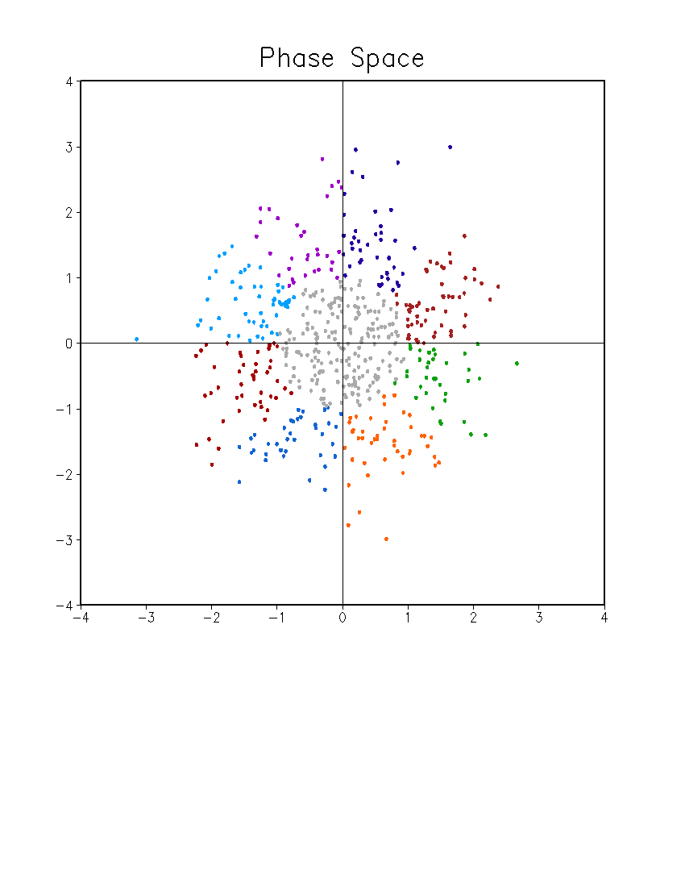
Weakly MJO Index
Normalized
8 phases
May – December
34 weeks (Sunday – Saturday)
Phase 7
Phase 6
Phase 8
Phase 5
PC2
Weak MJO
Phase 1
Phase 4
Phase 2
Phase 3
PC1

Slide 7
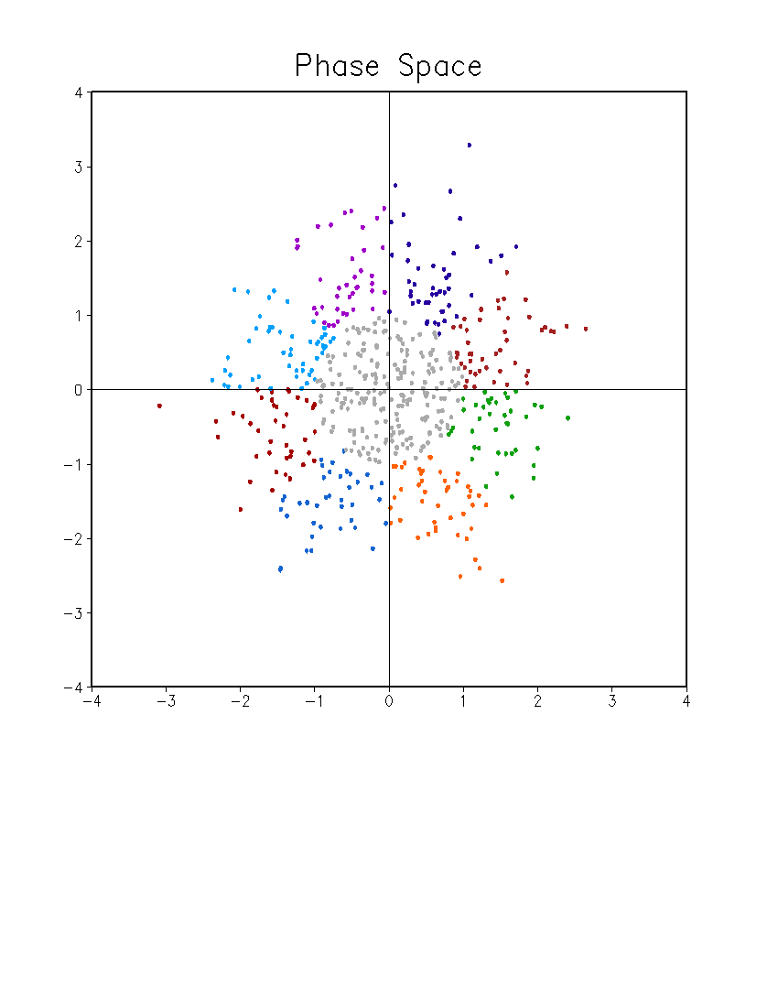
MJO Index
7-day mean index
Normalized
8 phases
May – December
35 weeks (1 May – 31 December)
Phase 7
Phase 6
Phase 8
Phase 5
PC2
Weak MJO
Phase 1
Phase 4
Phase 2
Phase 3
PC1

Slide 8
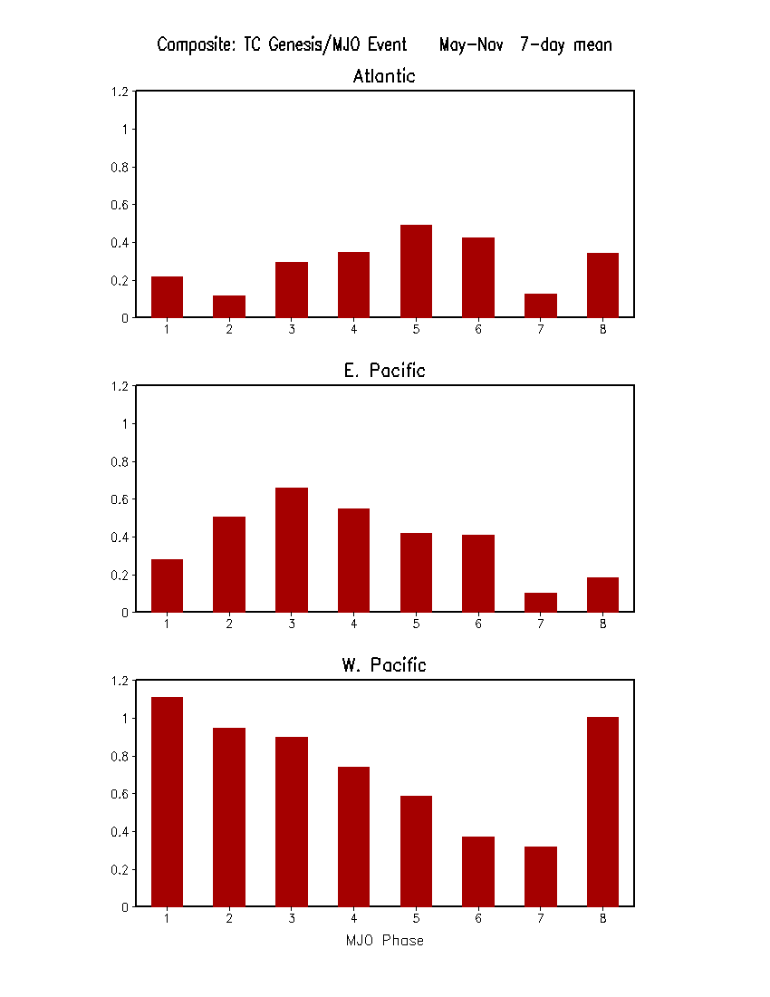
Composite of TC Genesis Based on MJO Phase

Slide 9
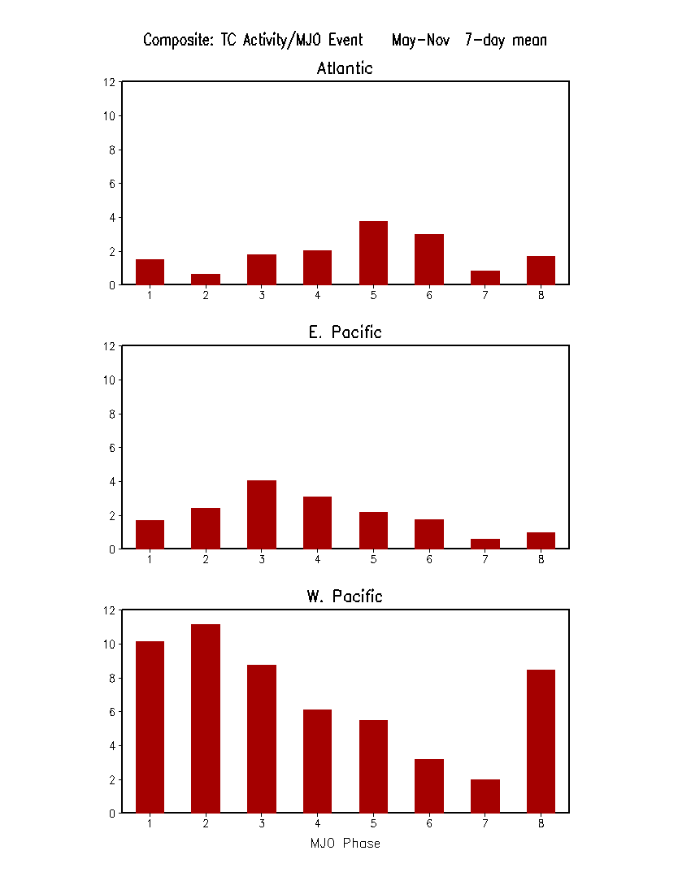
Composite of TC Activity Based on MJO Phase
TC Activity is defined as the sum of days of each TC over a 7-day period. In a 7-day period, if there are two TCs lasting 3 days and 5 days, respectively, then the TC activity is 8 days.

Slide 10
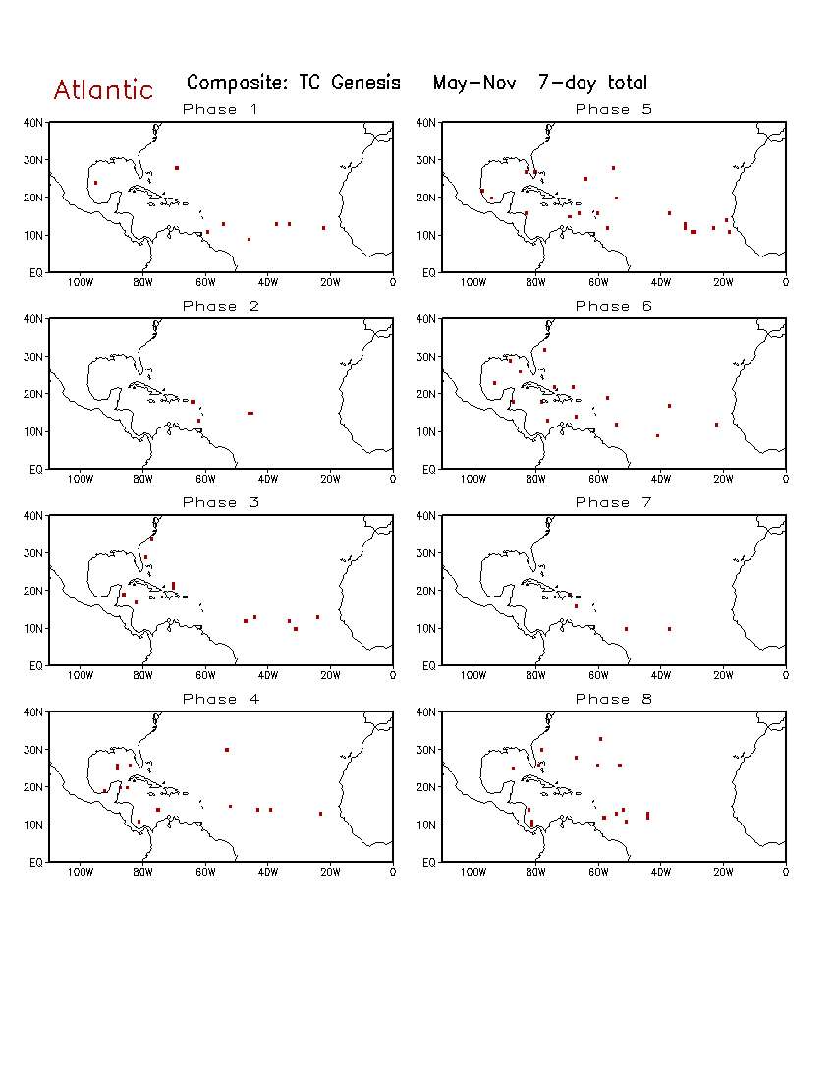
Composite of TC genesis based on MJO phase for Atlantic

Slide 11
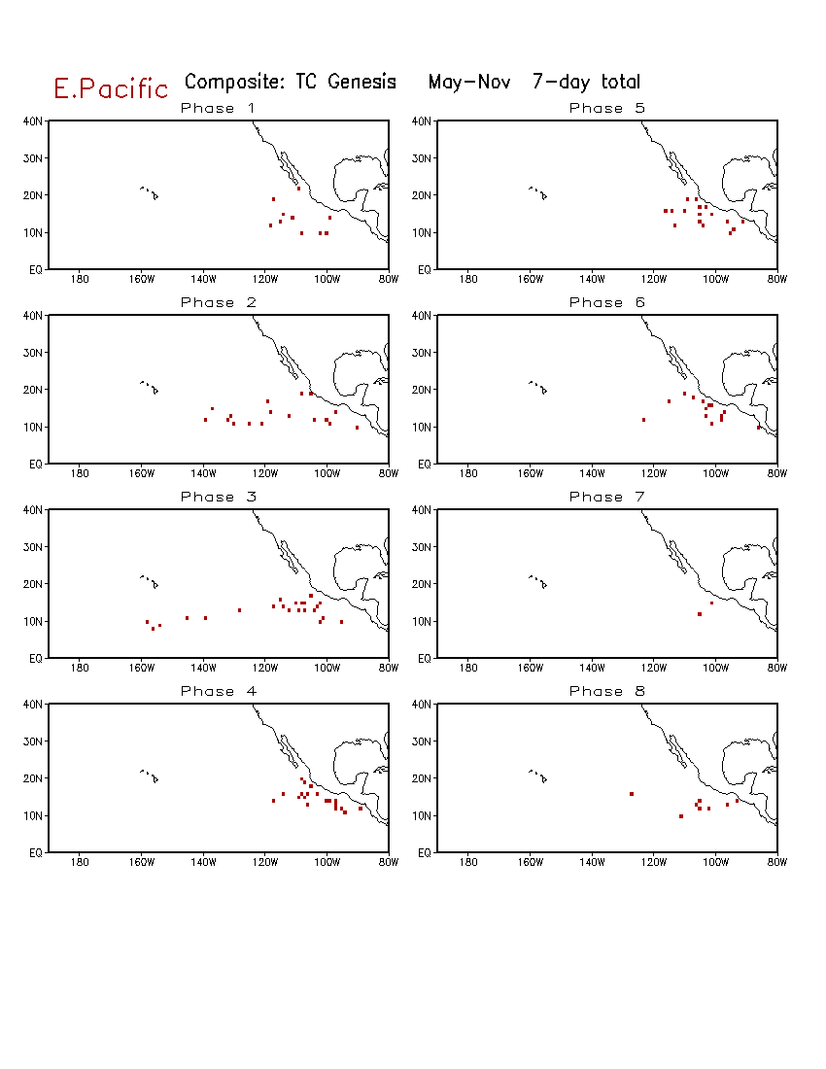
Composite of TC genesis based on MJO phase for E. Pacific

Slide 12
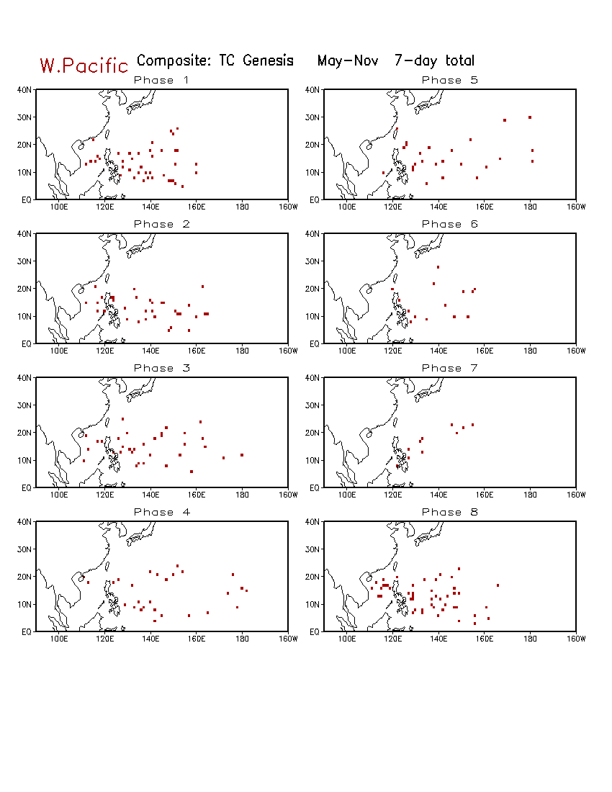
Composite of TC genesis based on MJO phase for W. Pacific

