Slide 1
Correlation between weekly TC activity and corresponding weekly SST/atmospheric circulation fields
Weekly mean data: 7-day average from Sunday to Saturday
Total 34 weeks from May to December
Weekly SST: NOAA OISST v2
Atmospheric fields (CFSR): vertical wind shear U200–U850, 500-mb height and relative humidity, sea level pressure
Weekly TC activity: sum of the days of each TC over the 7-day period
A similar correlation analysis will be performed using the observed weekly TC activity and the SST/circulation from the CFSv2 45-day hindcasts. The regions of high correlations will be used for area-averaging for potential predictors.

Slide 2
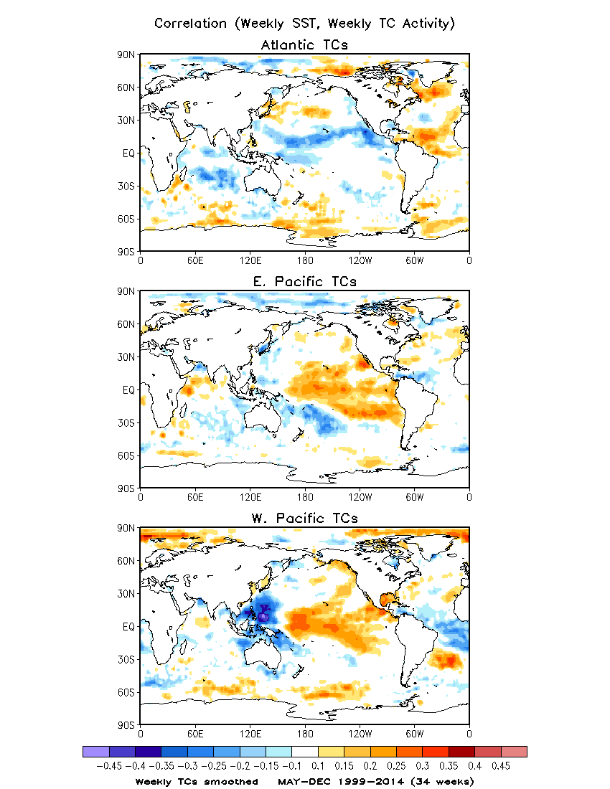
Correlation between
Weekly SST and Weekly TC Activity
Weekly TC activity smoothed
Example of Atlantic weekly TC activity
Smoothed vs. Unsmoothed
Color shadings (correlation > 0.1):
Above the 95% significance level
/cpc/namecpt/hui/2015_R2O/SST

Slide 3
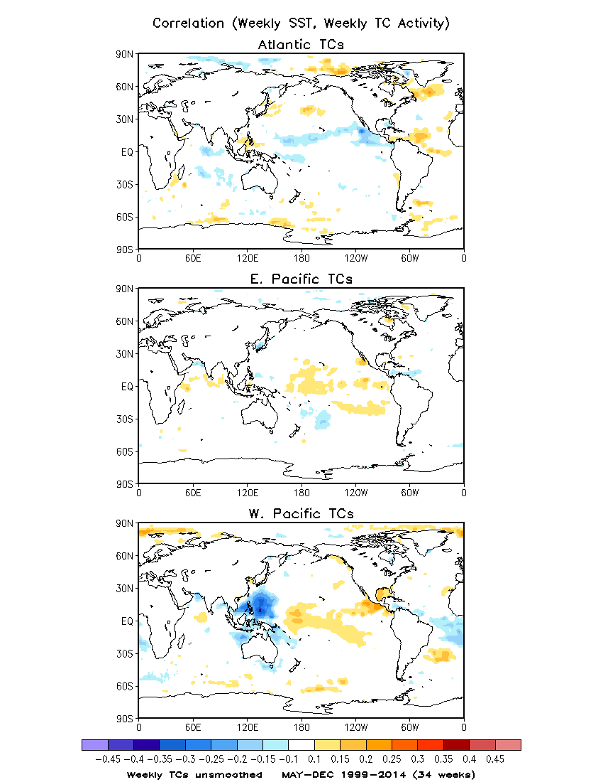
Correlation between
Weekly SST and Weekly TC Activity
Weekly TC activity unsmoothed
Example of Atlantic weekly TC activity
Smoothed vs. Unsmoothed
The correlations of SST with the unsmoothed TC activity are weaker.

Slide 4
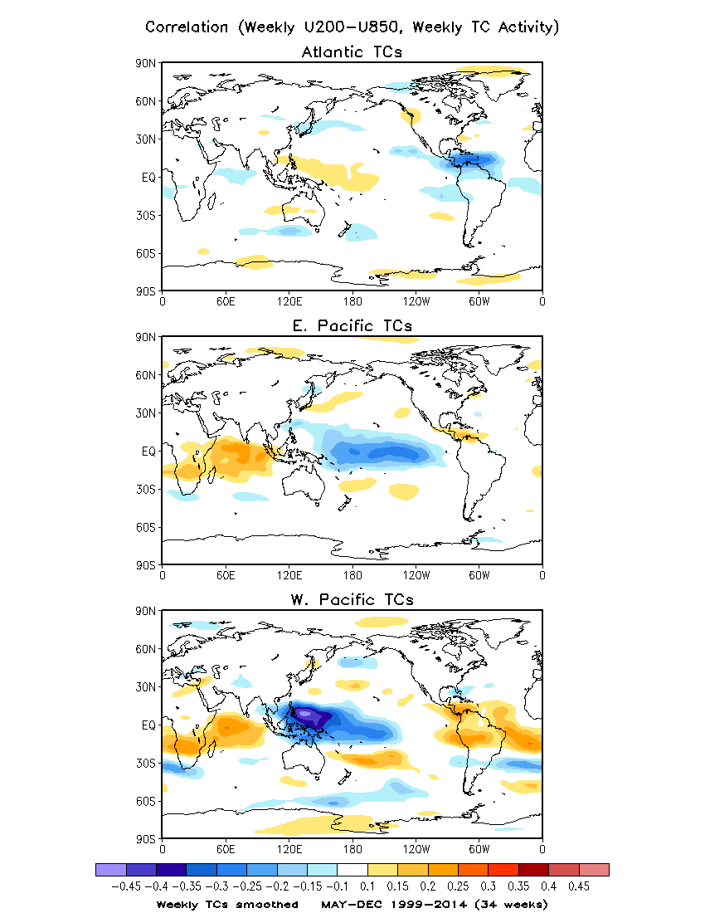
Correlation between
Weekly Wind Shear and Weekly TC Activity
Weekly TC activity smoothed
Vertical wind shear = U200 – U850

Slide 5
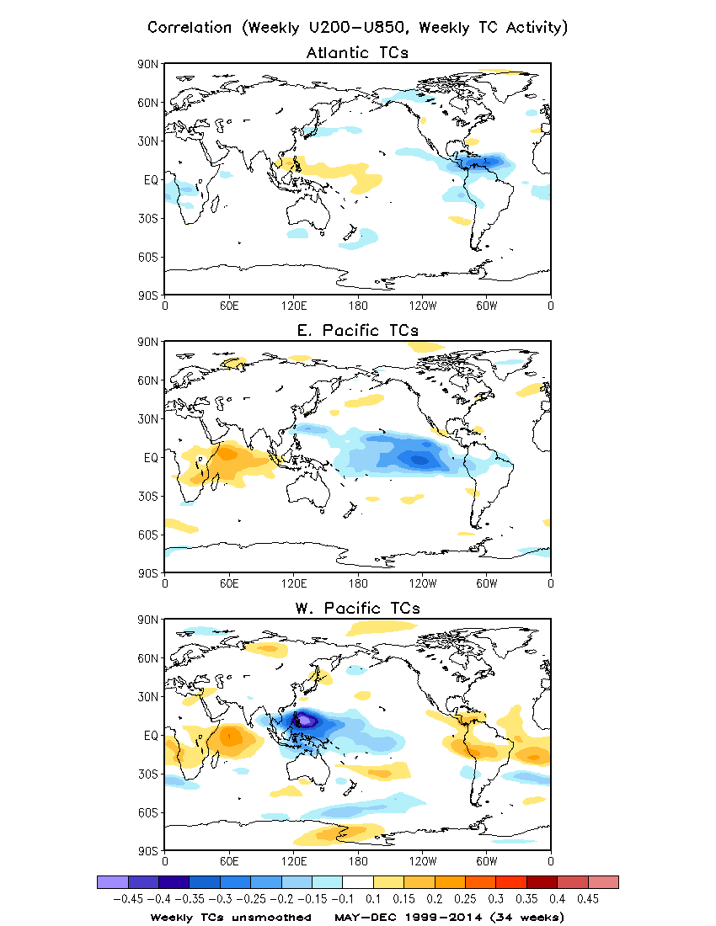
Correlation between
Weekly Wind Shear and Weekly TC Activity
Weekly TC activity unsmoothed
Unlike SST field, vertical wind shear is also highly correlated with the unsmoothed TC activity .

Slide 6
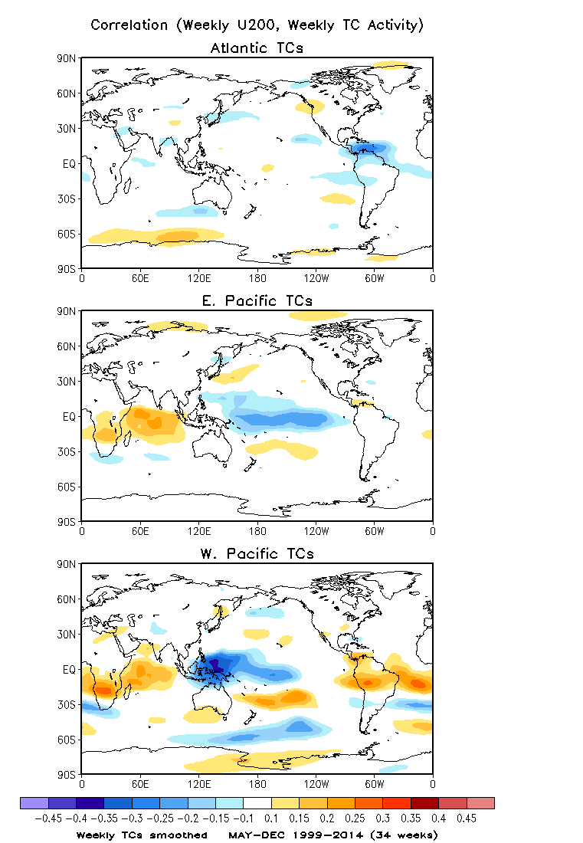
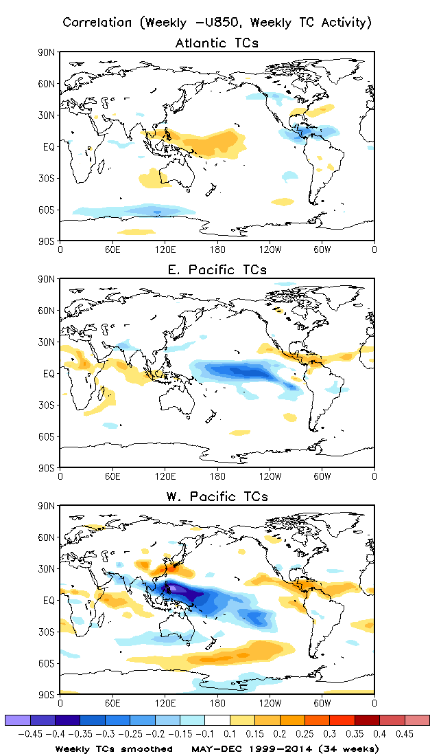
U200
– U850
Both low- and upper-level winds contribute to the vertical wind shear.
Smoothed weekly TC activity

Slide 7
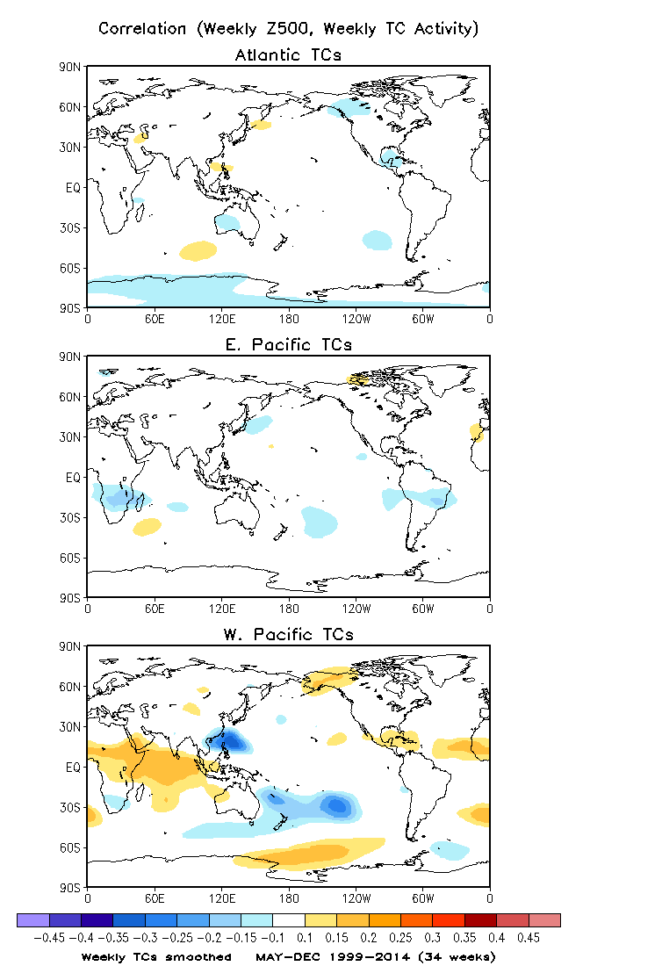
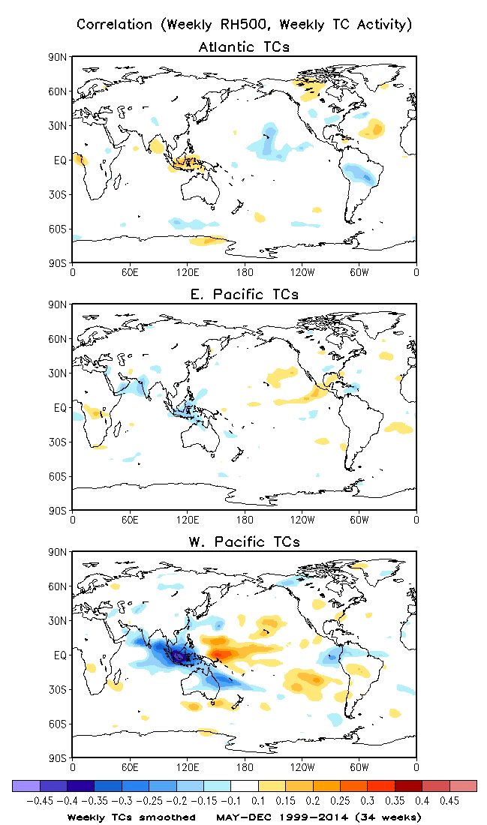
500-mb Height
500-mb Relative Humidity
The correlations of weekly TC activity with both 500-mb height and relative humidity are stronger over the western Pacific than over the eastern Pacific and the Atlantic.
Smoothed weekly TC activity

Slide 8
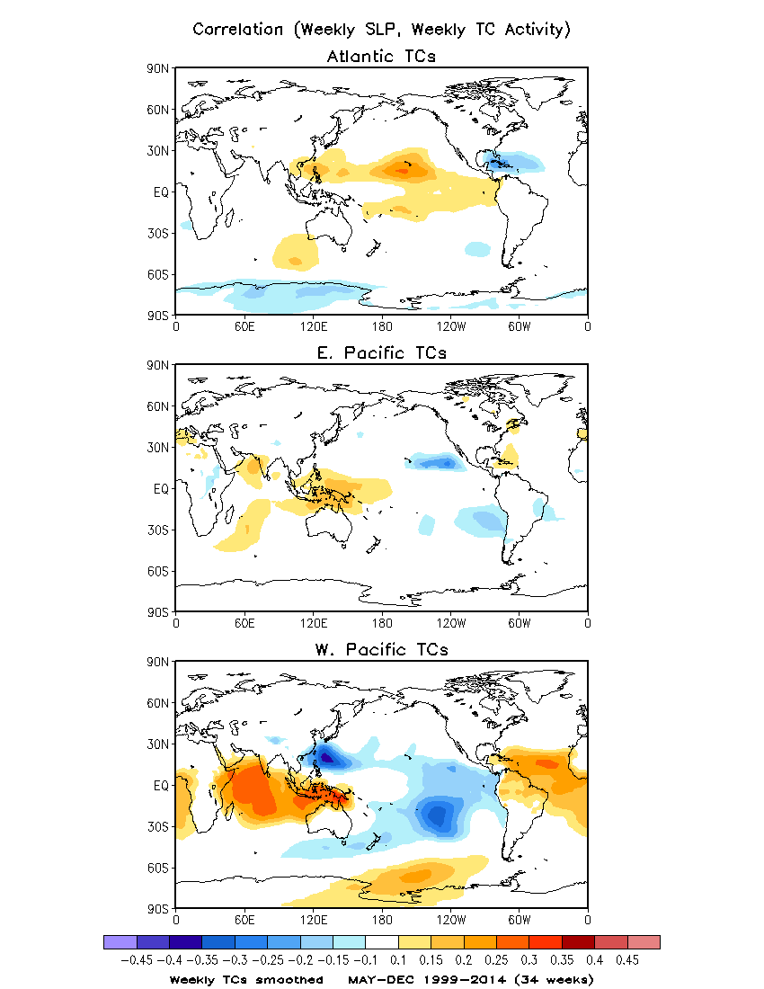
Sea Level Pressure
The weekly TC activity is negatively correlated with local SLP.
Smoothed weekly TC activity

