Slide 1
Observational Analysis
Daily MJO index
Weekly MJO index (7-day average of daily MJO index)
Composite of weekly TCs based on 8 MJO phases
TC Activity is defined as the sum of days of each TC over a 7-day period. In a 7-day period, for example, if there are two TCs lasting 3 days and 5 days, respectively, then the TC activity is 8 days.

Slide 2
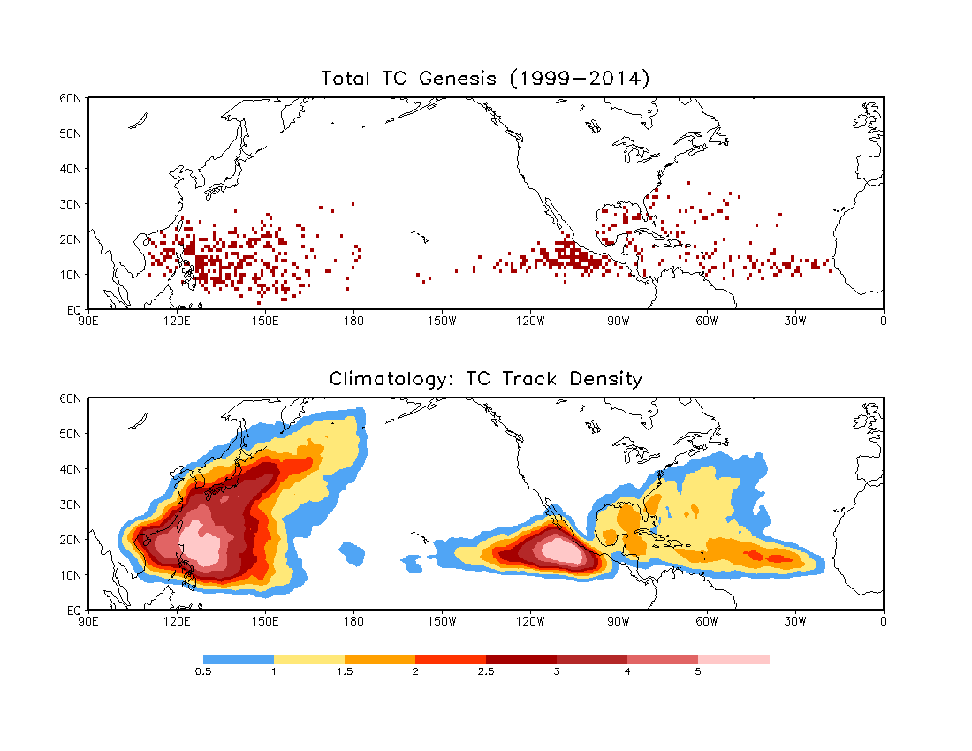
E. Pacific: 1999–2013

Slide 3
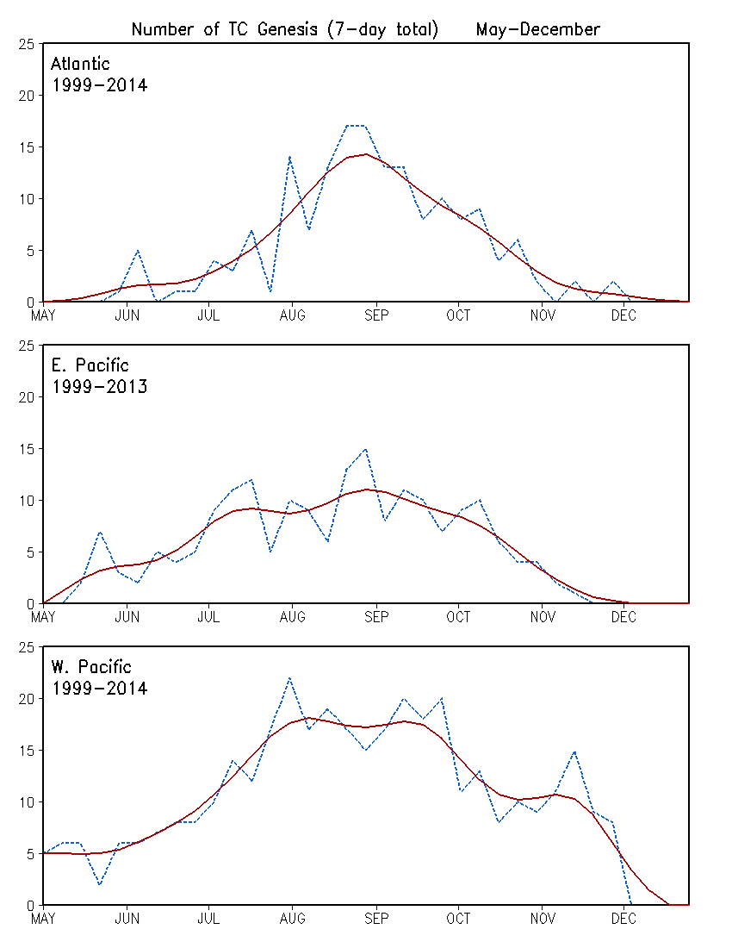
Climatology of Weekly TC Genesis for the Atlantic, E. Pacific and W. Pacific Basins
Raw data
Multiple passes of a 1-2-1 filter

Slide 4
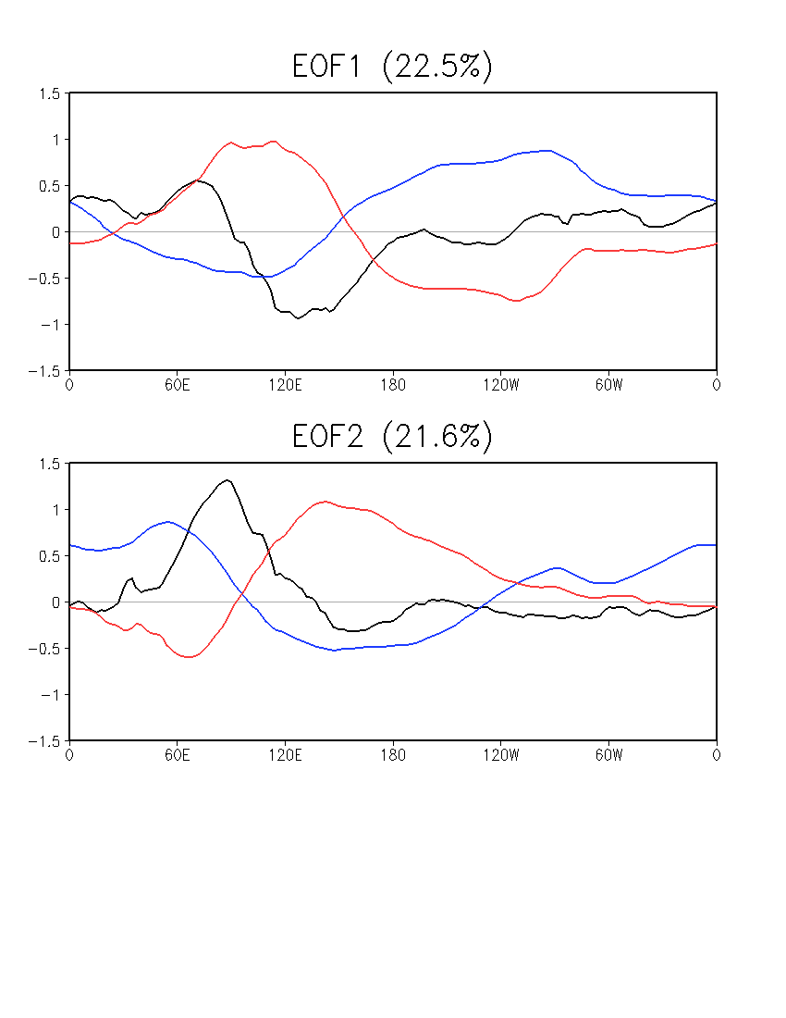
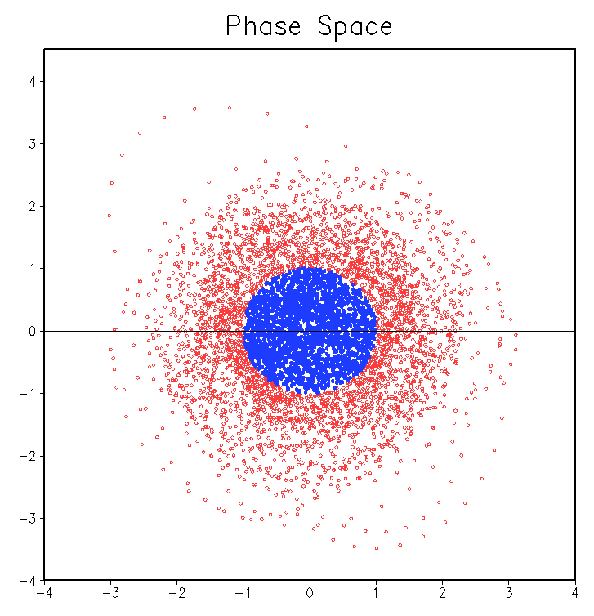
MJO (Wheeler and Hendon 2004)
Combined EOFs of u850, u200, and OLR
Averaged over 15ºS–15ºN
Daily data, 01 Jan 1999–31 Dec 2014
NOAA Interpolated OLR, 1999–2013
CFSR OLR for 2014
CFSR u850 and u200, 1999–2014
Anomaly w.r.t daily climatology
20–100-day band-pass filter prior to EOF
Weak MJO
OLR U850 U200
PC2
Daily MJO Index
Normalized PC1 and PC2
Weak MJO: (PC1² + PC2²) ^{1/2} < 1
PC1

Slide 5
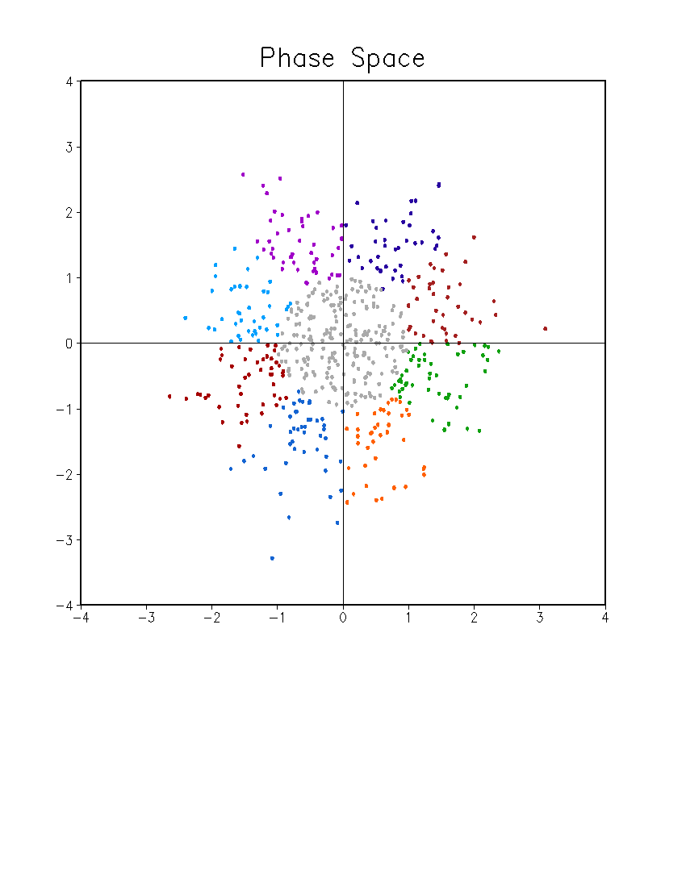
MJO Phases: 8
7-day mean index
Normalized
May – December
35 weeks (1 May – 31 December)
Phase 7
Phase 6
Phase 8
Phase 5
PC2
Weak MJO
Phase 1
Phase 4
Phase 2
Phase 3
PC1

Slide 6
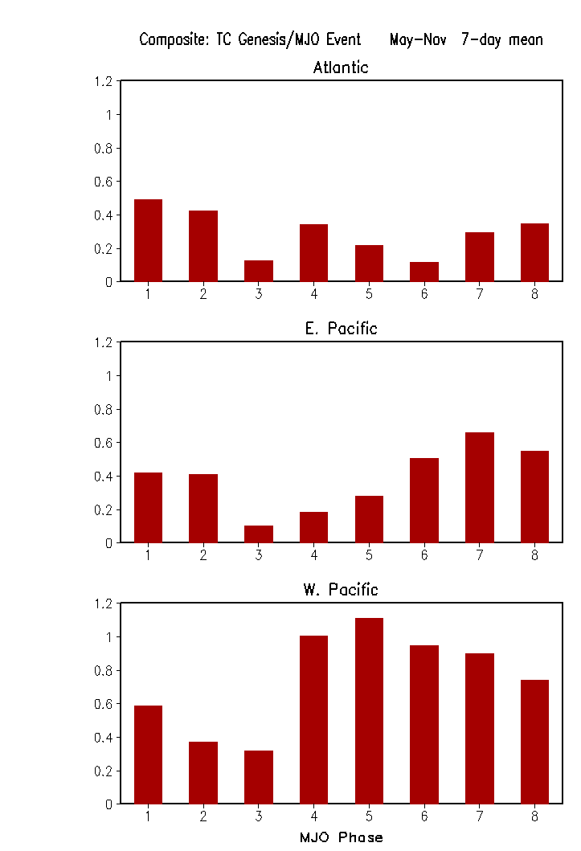
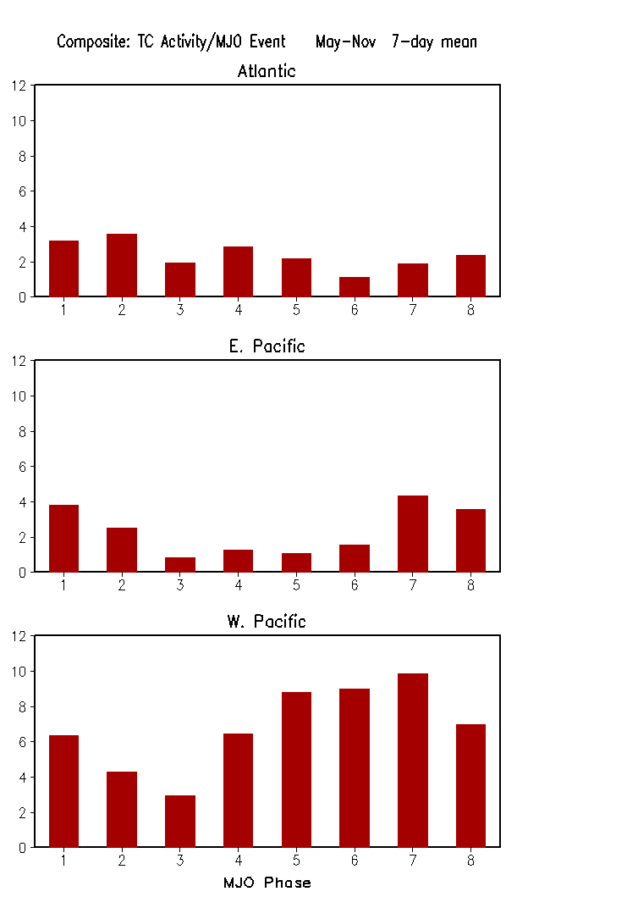
Composites of TC Genesis and TC Activity Based on MJO Phase

Slide 7
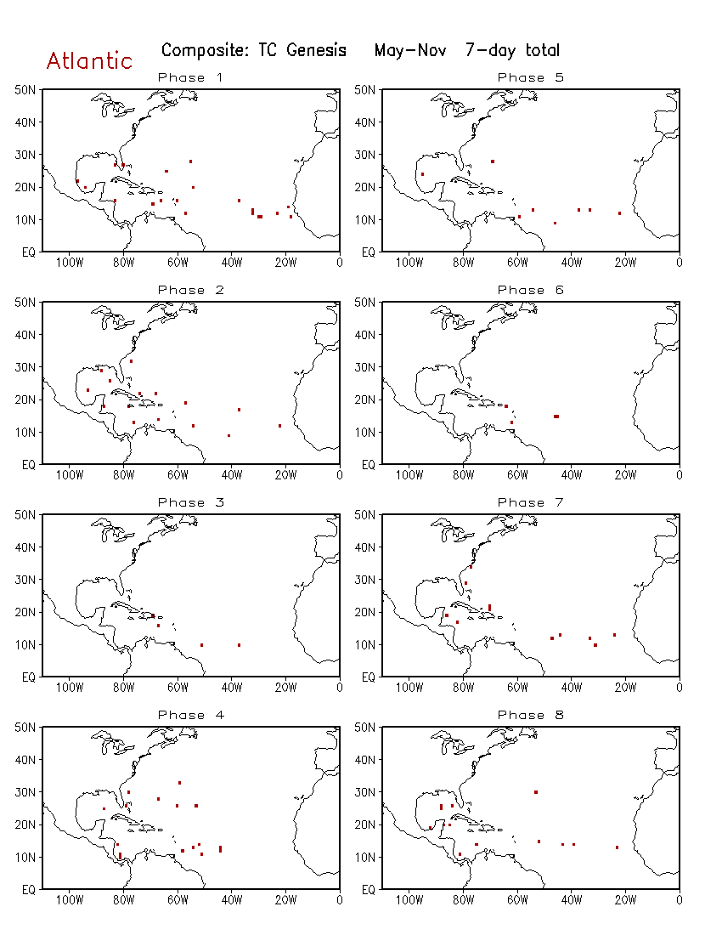
Composite of TC Genesis Based on the MJO Phase for Atlantic

Slide 8
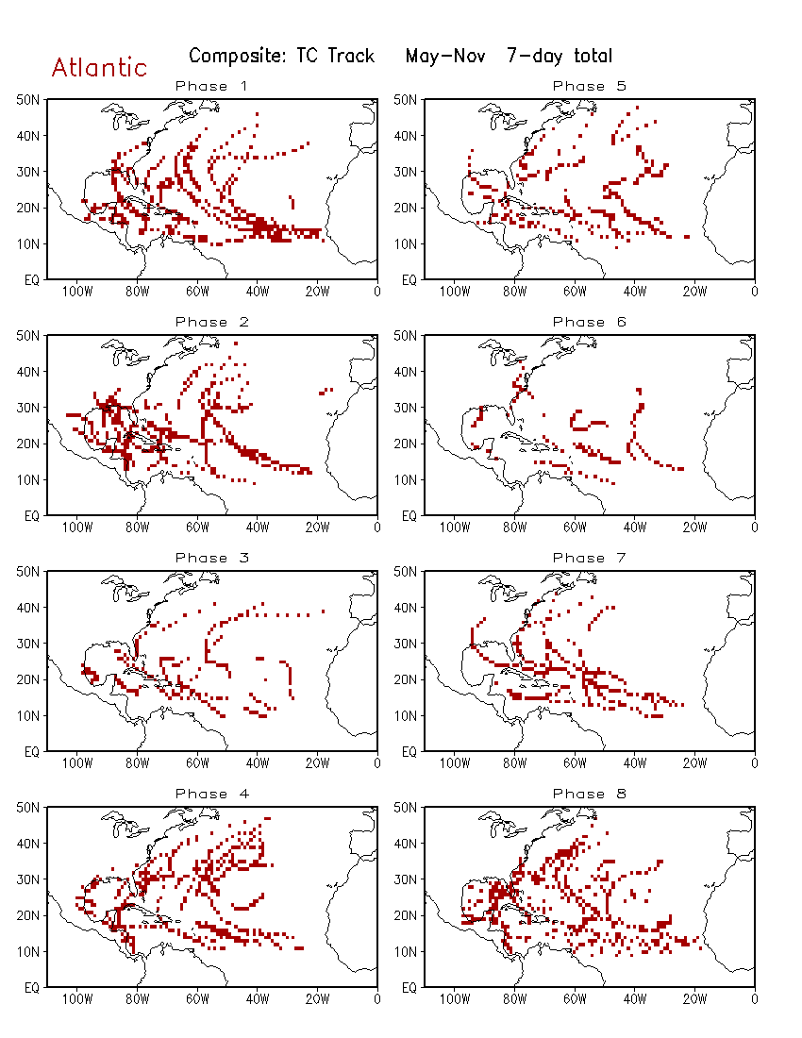
Composite of TC Track Based on the MJO Phase for Atlantic

Slide 9
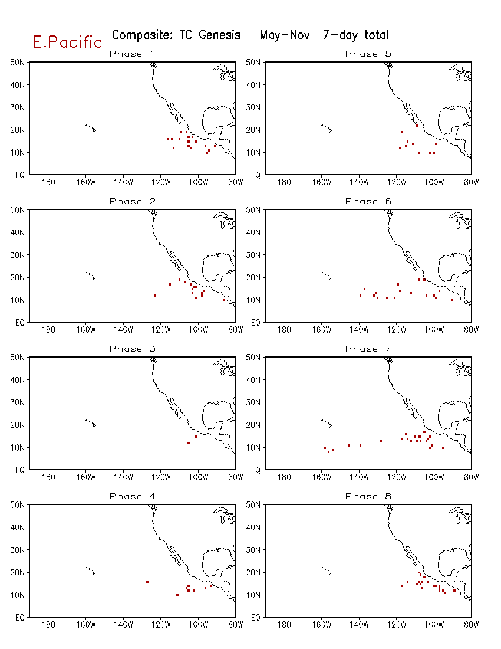
Composite of TC Genesis Based on the MJO Phase for E. Pacific

Slide 10
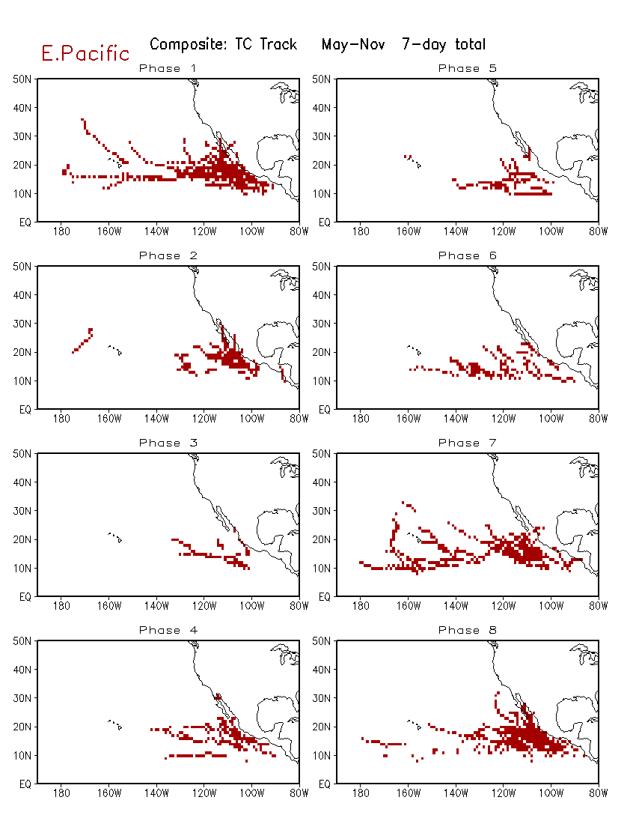
Composite of TC Track Based on the MJO Phase for E. Pacific

Slide 11
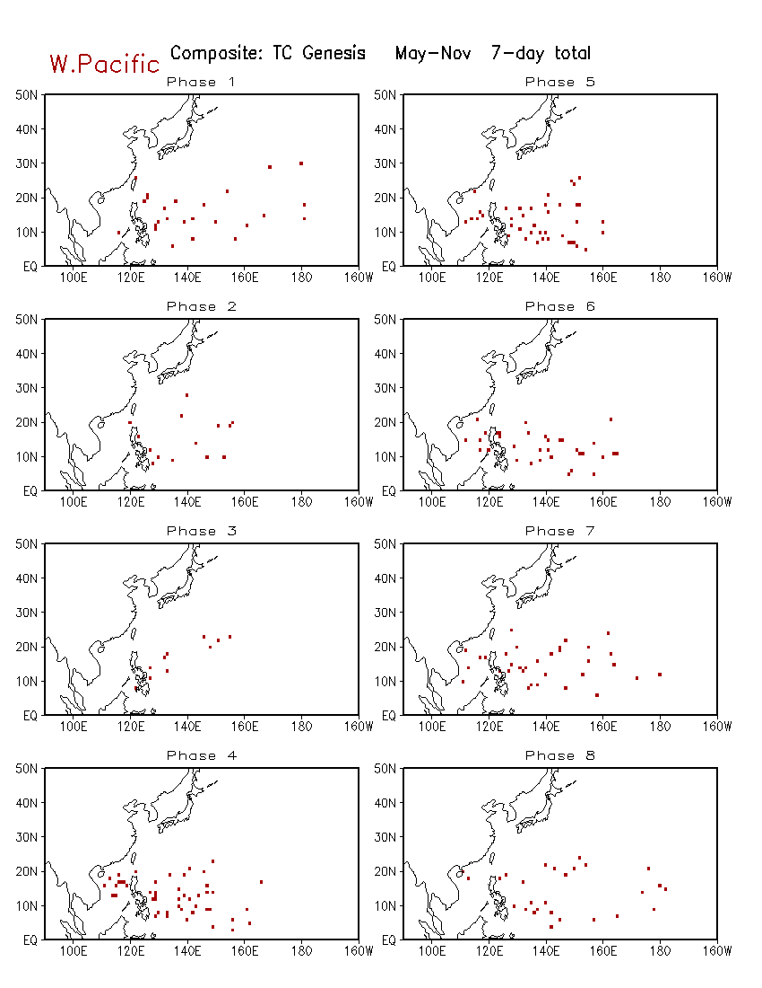
Composite of TC Genesis Based on the MJO Phase for W. Pacific

Slide 12
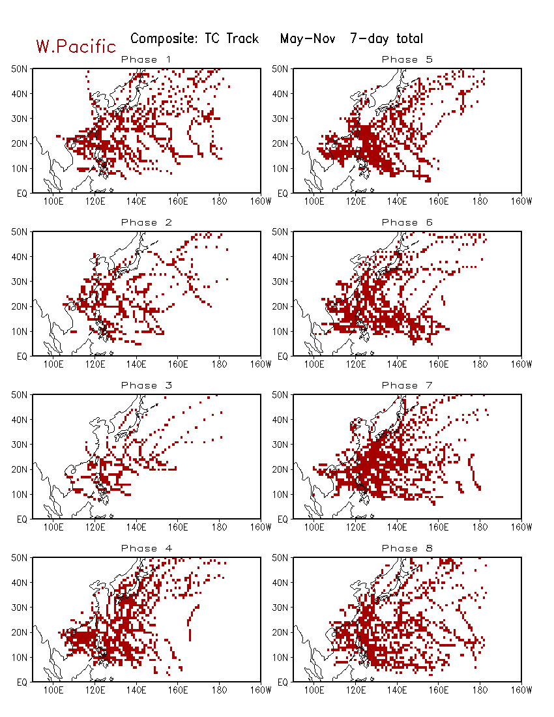
Composite of TC Track Based on the MJO Phase for W. Pacific

