Slide 1
Gridding of the data from SPC
1ºx1º box vs. 5ºx5º box
Year-to-year (Y2Y) difference

Slide 2
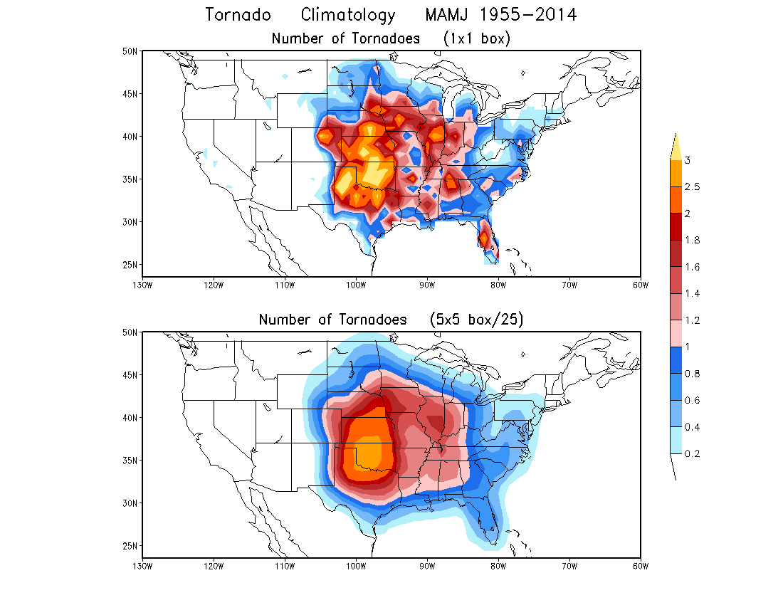
1ºx1º box
vs.
5ºx5º box
Data with 5x5 box are smoother.

Slide 3
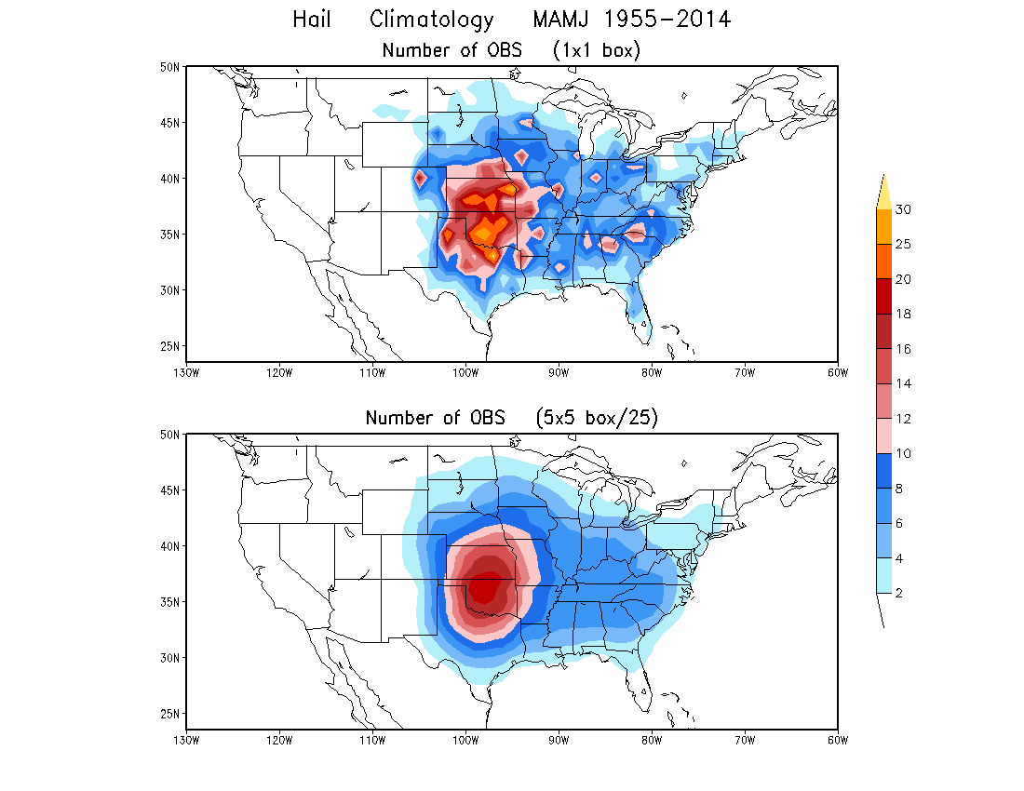
1ºx1º box
vs.
5ºx5º box

Slide 4
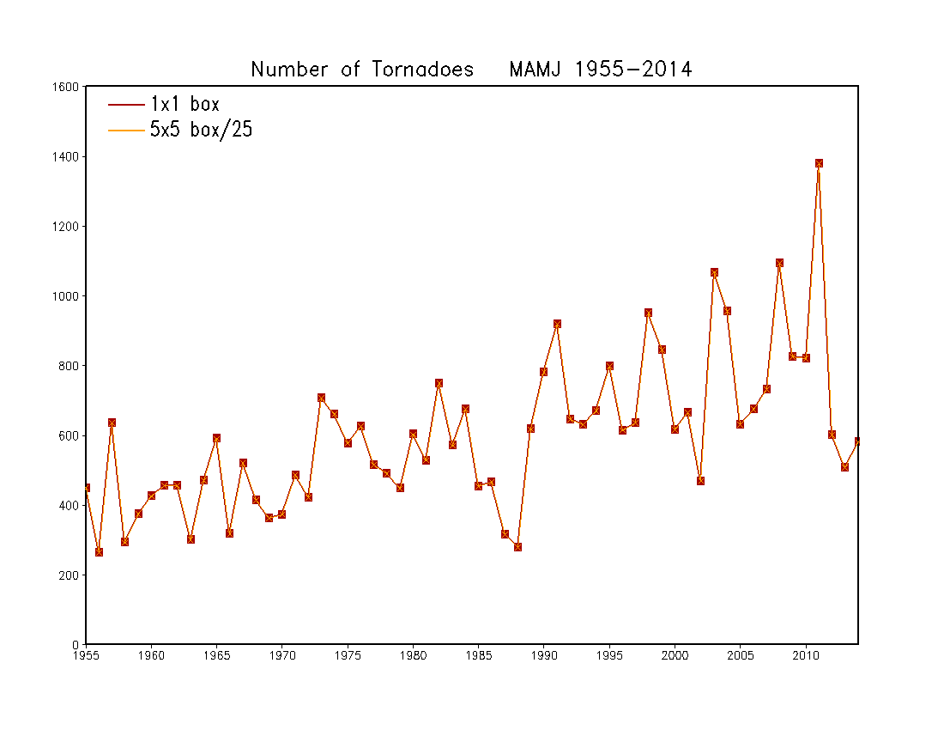
CONUS Total
x

Slide 5
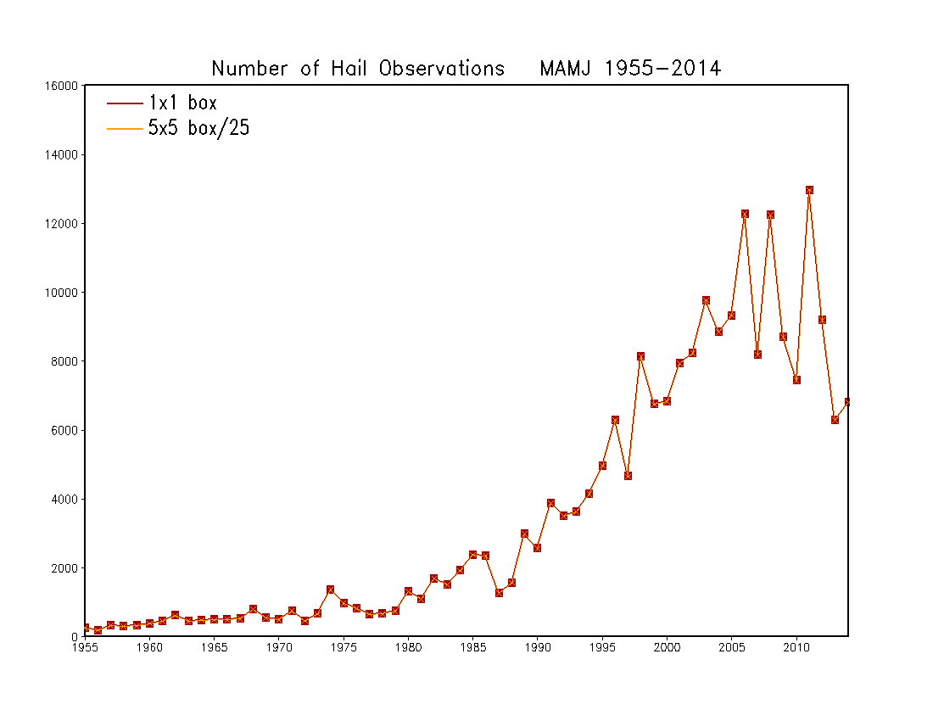
CONUS Total
x

Slide 6
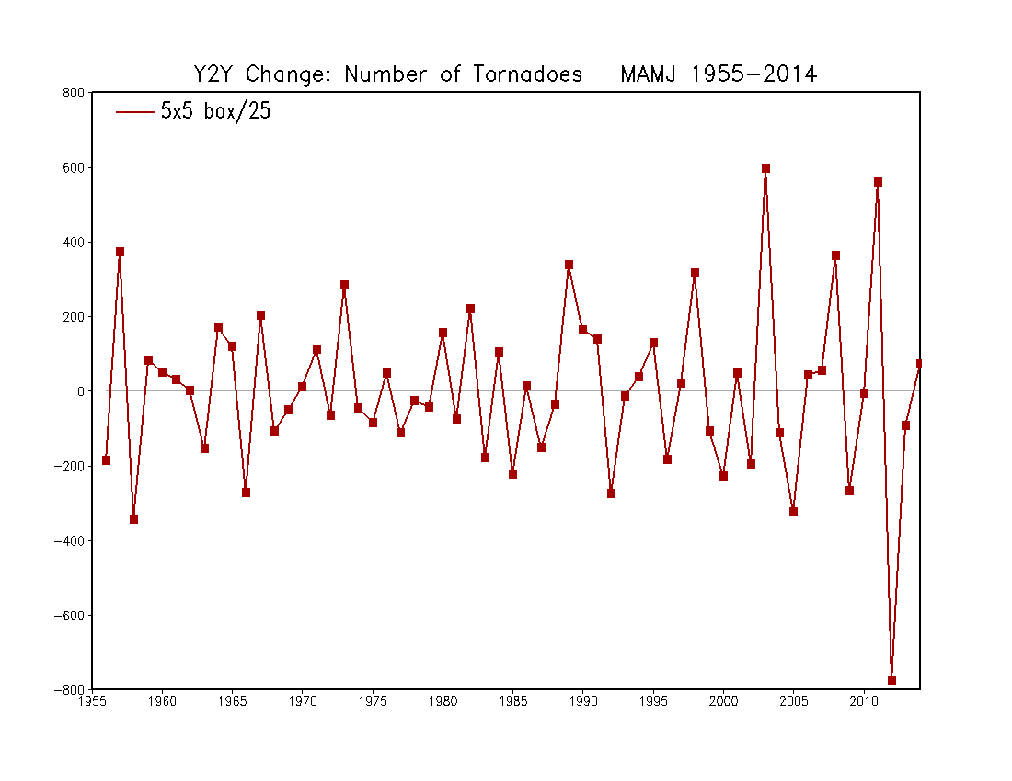
CONUS Year-to-year Change

Slide 7
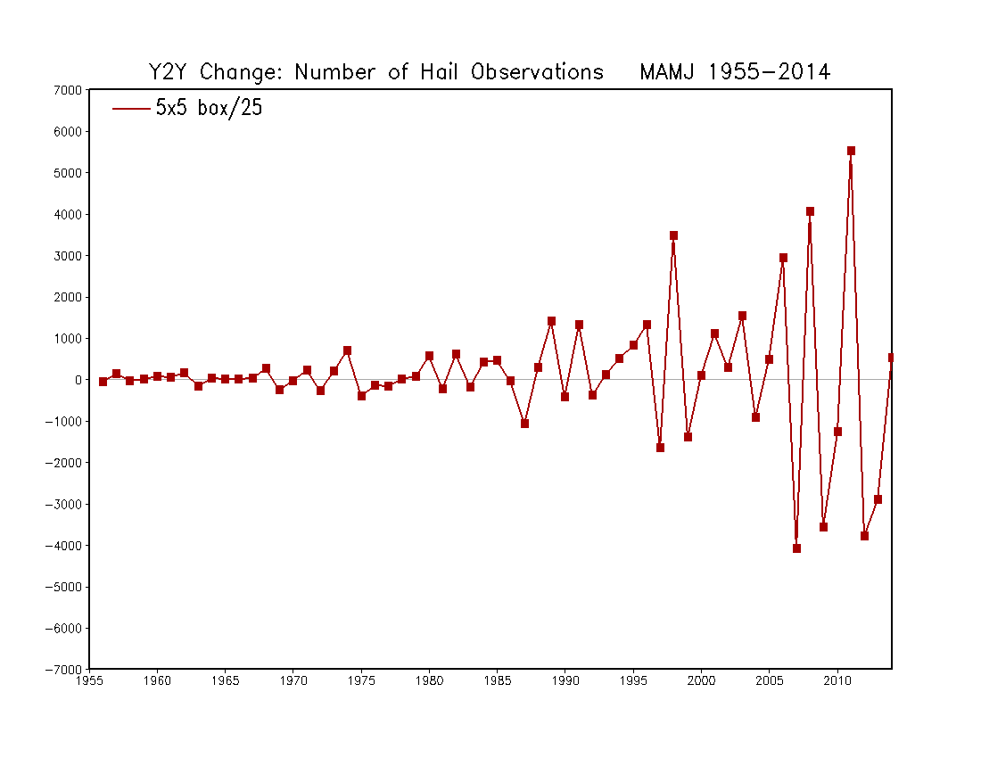
CONUS Year-to-year Change
The data seem to have some problem.

Slide 8
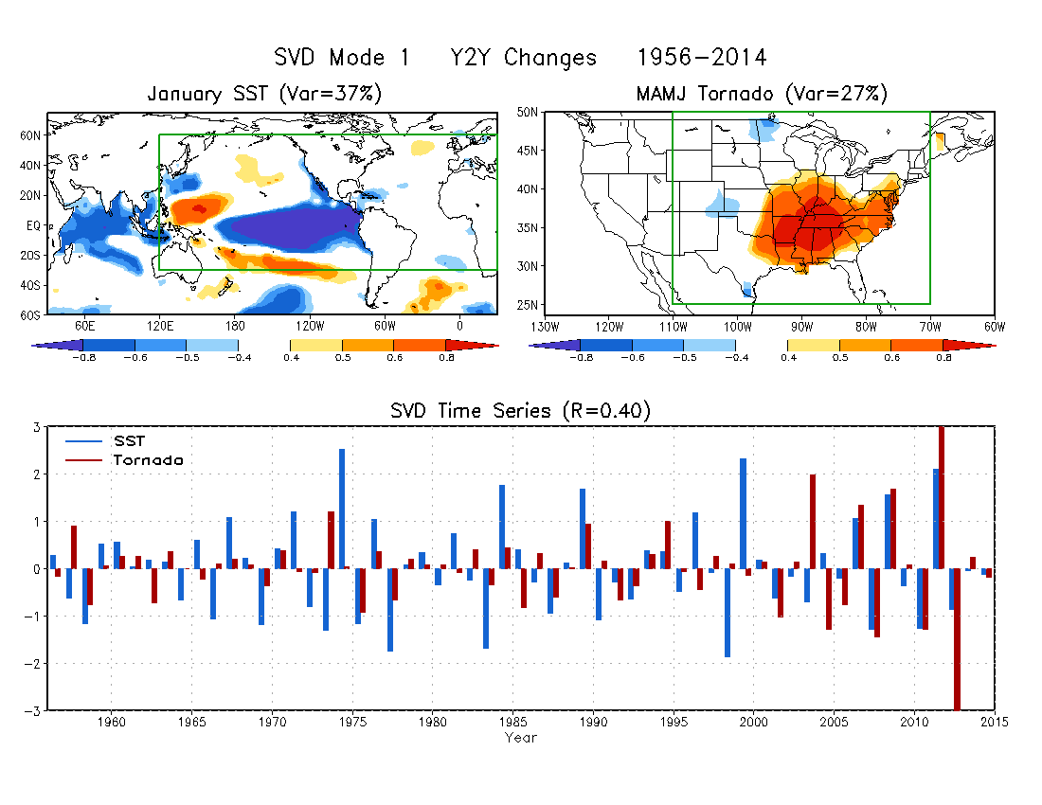

Slide 9
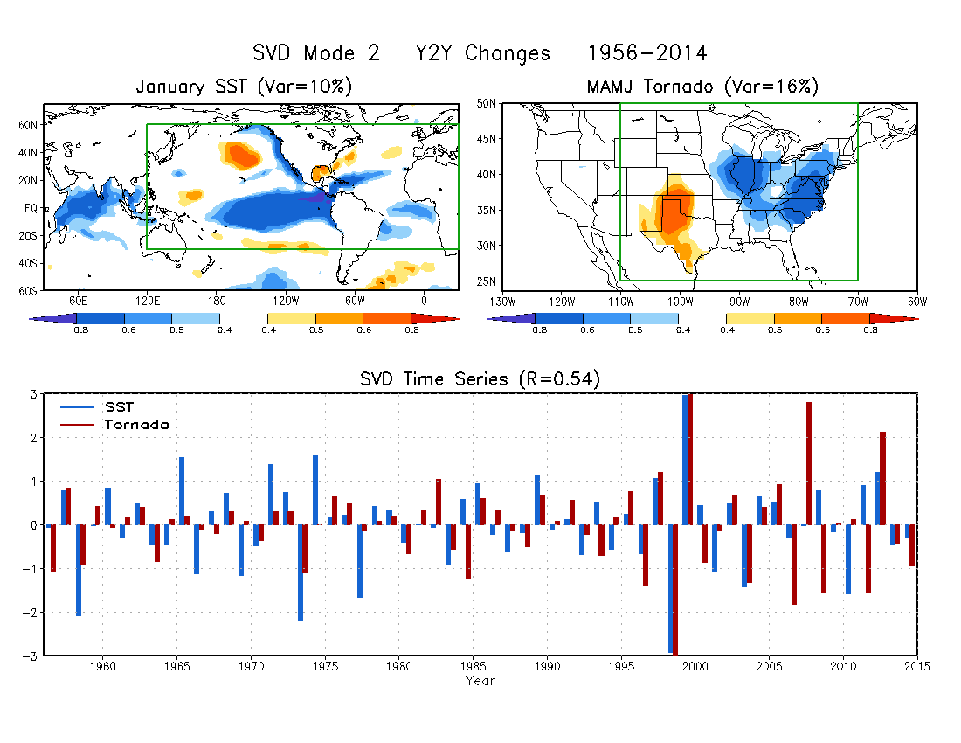

Slide 10
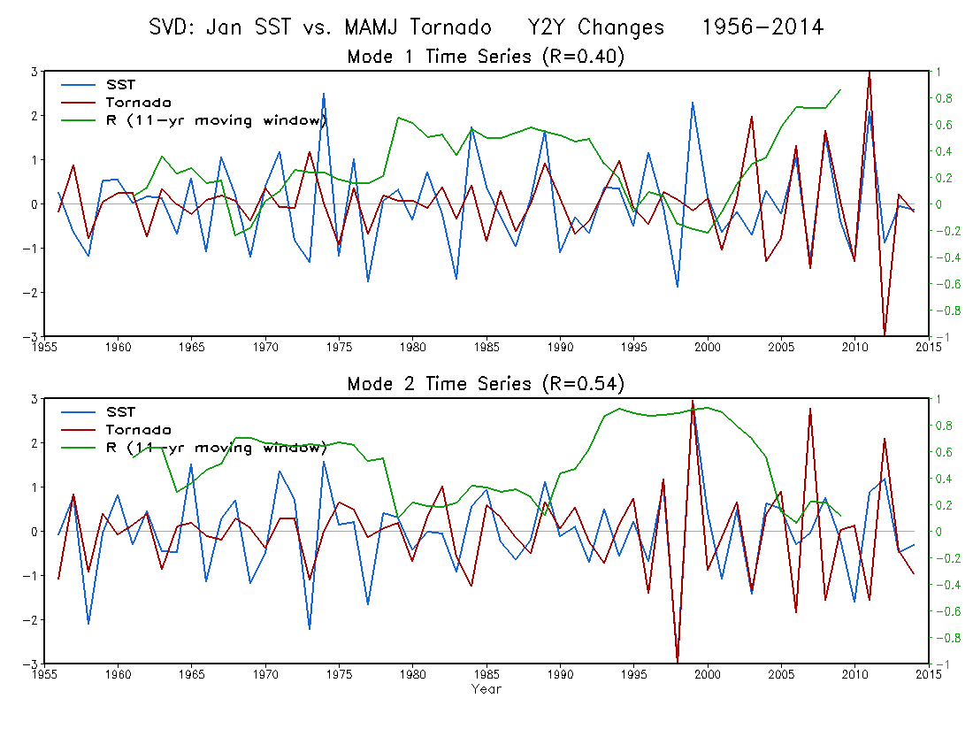
11-year correlation

Slide 11
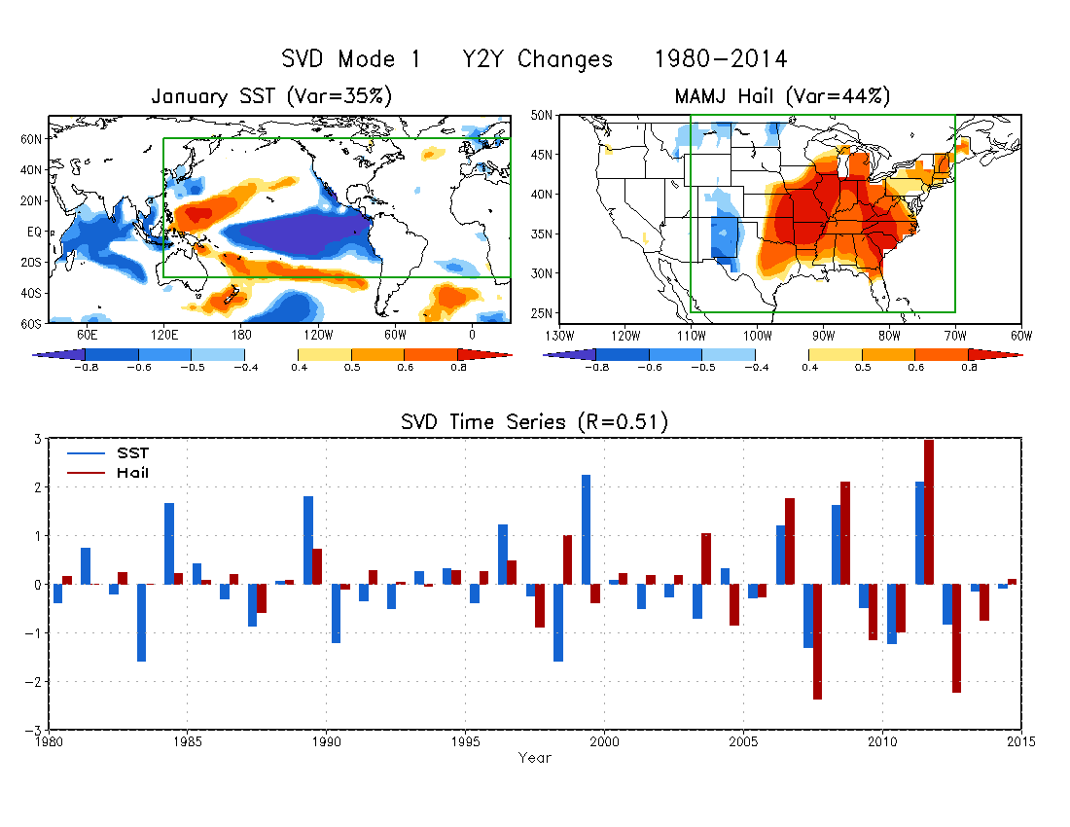

Slide 12
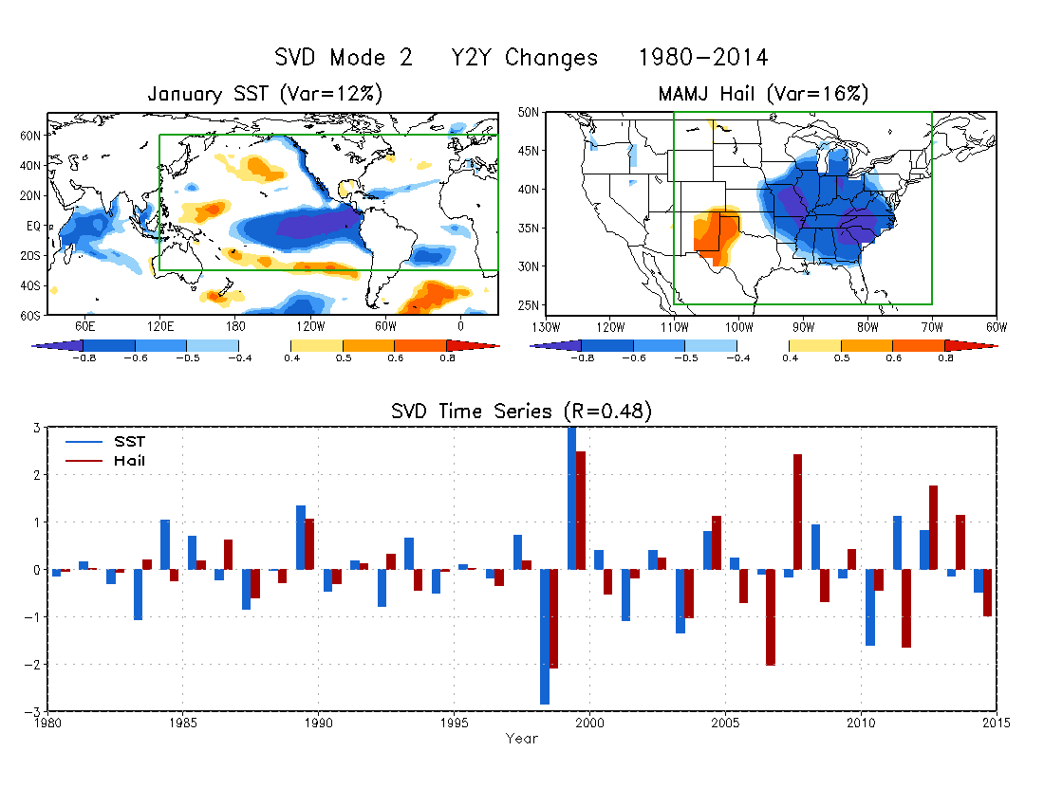

Slide 13
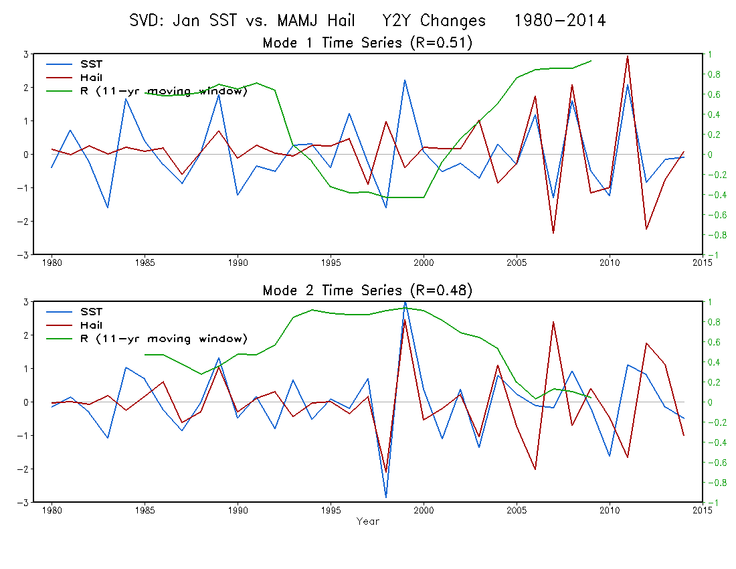
11-year correlation

Slide 14
For both tornado and hail, the first and second SST modes are La Nina-like pattern. The second SST mode is slightly shifted towards the eastern Pacific.
The first and second SST modes are associated with opposite tornado/hail anomaly patterns.
The first mode shows a close relationship between SST and tornado/hail during 2005 – 2014, whereas the second mode shows a close relationship during 1995 – 2004.
Statistical forecast models can be developed based on these lagged SVD relationships.

