Slide 1
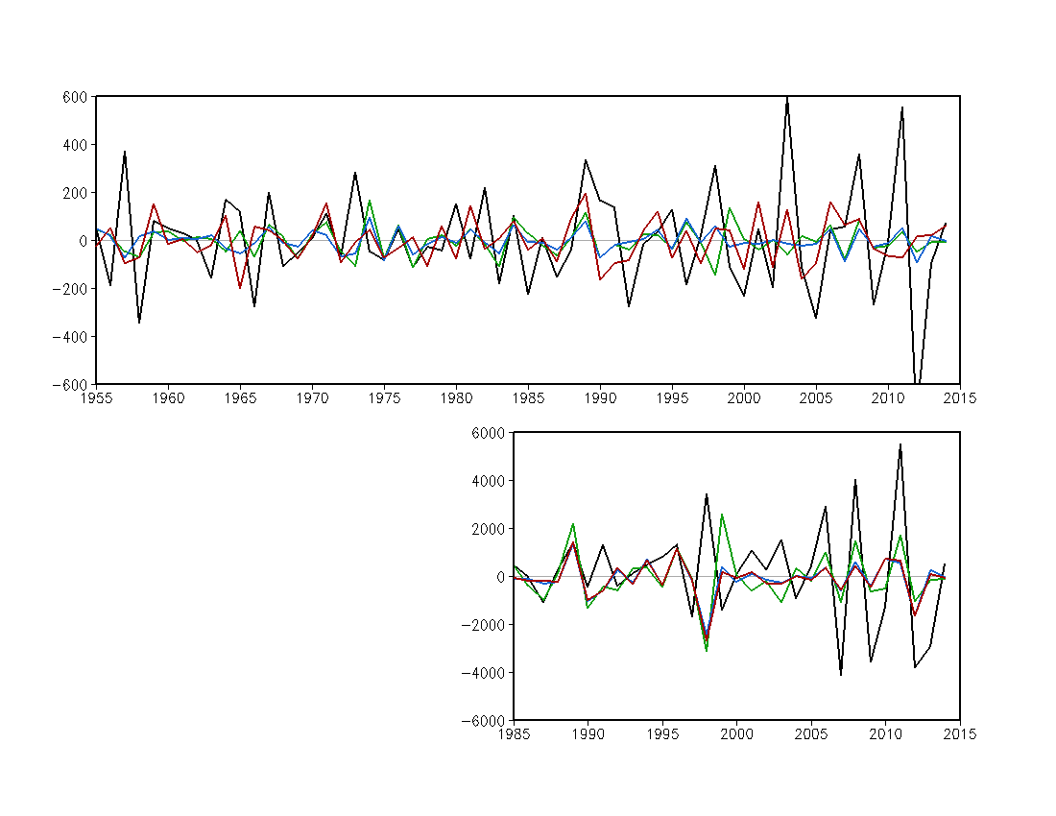
Year-to-year Changes over CONUS MAMJ
Tornado
R=0.09
R=0.22
R=0.19
Observation
Forecast (SVD1)
Forecast (SVD1+SVD2)
Forecast (SVD1+SVD2+SVD3)
Hail
R=0.26
R=0.19
R=0.18

Slide 2
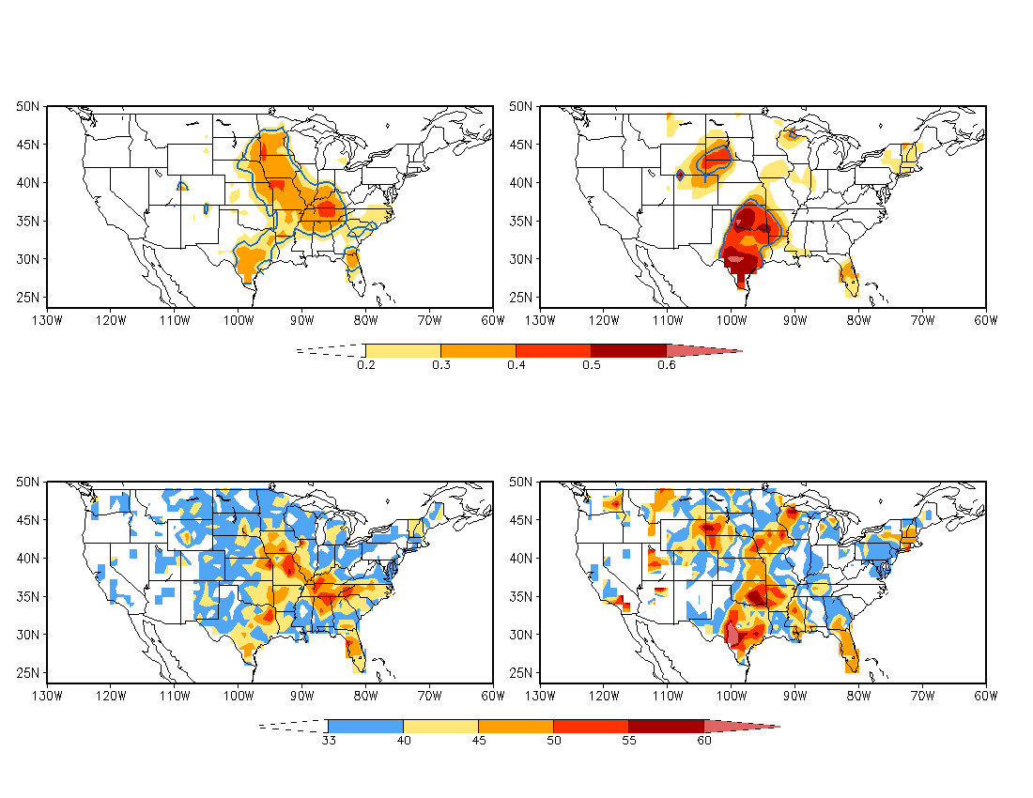
Forecast Skill
Year-to-year Changes
Anomaly Correlation
Tornado
Hail
95%
significance
level
Three categories
Above normal: 33%
Near normal: 33%
Below normal: 33%
Hit Rate (%)
Tornado
Hail

