Slide 1
Follow up analysis from 12 January SSW meeting
4 Feb 2016

Slide 2
Action Items from 12 Jan
Repeat Climatologies using 5 ° x 5°
Repeat SVD analysis for different categories
SVD analysis skill due to individual modes
ENSO analogs
Table format
Composite maps

Slide 3
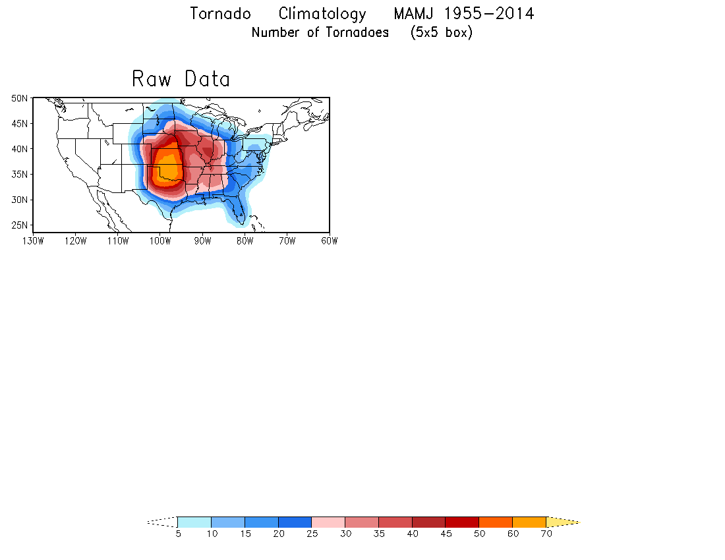
All Data
EF1 – EF5
EF2 – EF5
EF3 – EF5

Slide 4
Hail Climatology MAMJ 1985-2014
Number of Hail Reports (5x5 box)
≥ 1.0”
≥ 1.5”
≥ 2.0”
≥ 2.5”

Slide 5
Methodology
(from 12 Jan)
The statistical forecast model is based on lagged relationships between January SST and MAMJ tornado/hail activity.
The lagged relationships are objectively identified by the singular value decomposition (SVD) method.
Forecast skill is measured by anomaly correlation and hit rate.

Slide 6
Tornado
EF1-EF5 & EF3-EF5

Slide 7
SVD: Spatial Pattern (EF1-EF5)
January SST
MAMJ Tornado
Mode 1
33%
Mode 2
12%
Mode 3
7%

Slide 8
SVD: Spatial Pattern (EF3-EF5)
January SST
MAMJ Tornado
Mode 1
27%
Mode 2
12%
Mode 3
9%

Slide 9
Hail
≥ 1.0” & ≥ 2.0”

Slide 10
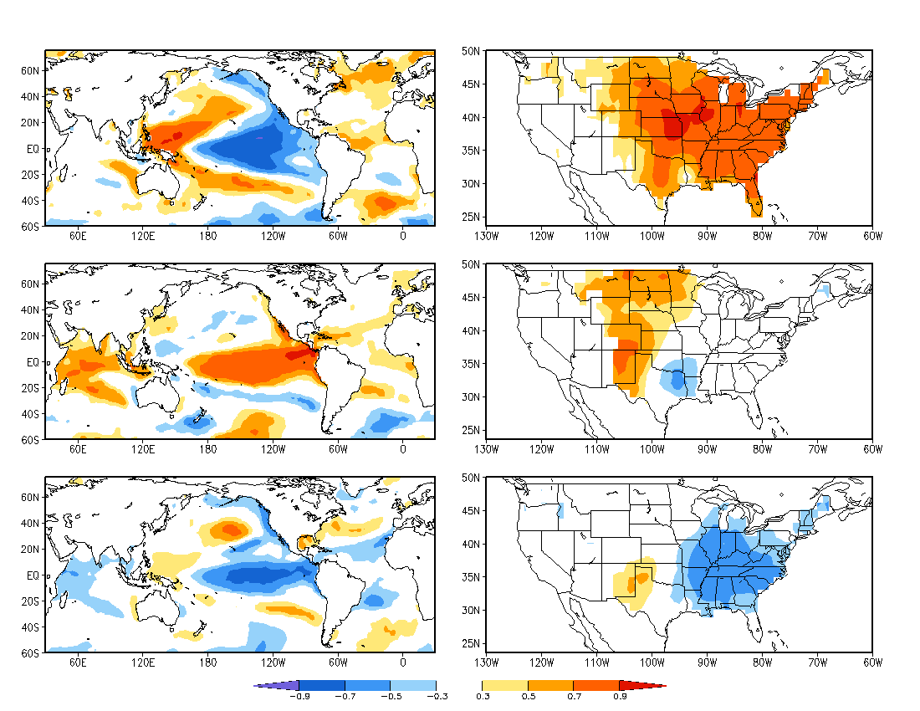
January SST
SVD: Spatial Pattern (≥ 1.0”) (1985-2014)
MAMJ Hail
Mode 1
63%
Mode 2
7%
Mode 3
10%

Slide 11
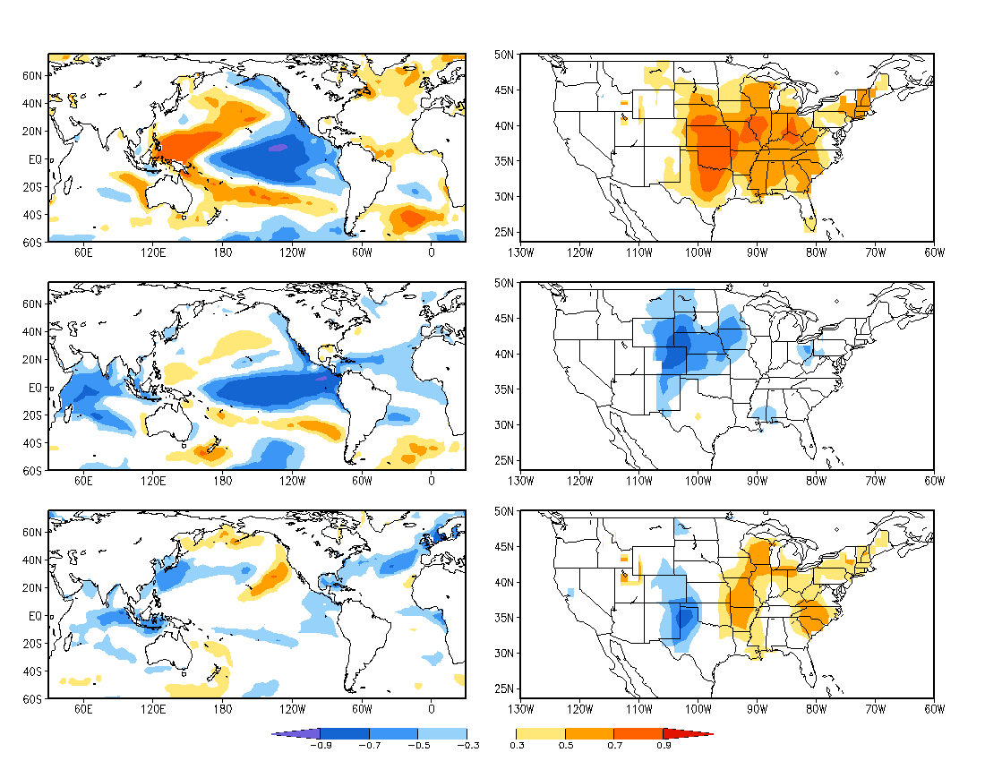
January SST
SVD: Spatial Pattern (≥ 2.0”) (1985-2014)
MAMJ Hail
Mode 1
40%
Mode 2
8%
Mode 3
13%

Slide 12
Skill
Anomaly Correlation & Hit Rate

Slide 13
Tornado (EF1-EF5)
Anomaly Correlation
Hail ( ≥ 1”)
SVD1
SVD1 +SVD2
SVD1 +SVD2+SVD3
Tornado (All data)
Hail ( All data)

Slide 14
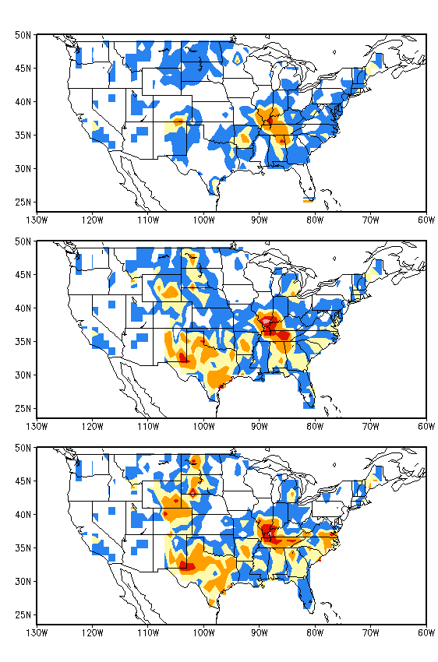
EF1 – EF5
Hit Rate
Hail (≥ 1.0 “)
Three categories
Above normal: 33%
Near normal: 33%
Below normal: 33%
SVD1
SVD1
SVD1 +SVD2
SVD1+SVD2+SVD3
Tornado (All Data)
Hail (All Data)

Slide 15
SVD Summary
EF1 – EF5 has similar pattern to EF0-EF5
Hail > 1.0 “ also has similar pattern to all hail sizes
Anomaly Correlation
EF1-EF5 had zero contribution from mode 1. All modes show smaller area than EF0-EF5
Hail ≥ 1.0” Mode 1 contributes the most to total. All modes show smaller area with larger values over Texas than all hail sizes
Hit Rate
EF1-EF5 smaller area than EF0-EF5, all modes show similar pattern.
Hail ≥ 1.0” similar pattern with larger values than all hail sizes

Slide 16
Displaying ENSO Climate Analogue/ Binning Tool Results
Methodology
Using January ERSSTv4 NINO3.4 values
CONUS (5°x5°) MAMJ storm reports.
ENSO Strength (std. dev) | Tornadoes: % Departure from Average | Range (% Departure) | 1 σ range | # Cases | % Cases with Stated sign of Departure
+2σ and stronger | 20
+1.5to +2σ | 15
+1 σ to +1.5 σ | 10
+0.5 σ to +1 σ | 5
0 to +0.5 σ | 0
-0.5σ to 0 σ | -0
-1σ to -0.5 σ | -5
-1.5 σ to -1 σ | -10
-2 σ to -1.5 σ | -15
-2 σ and colder | -20
Example: Numbers are For Example Only

Slide 17
CONUS (5°x5°) MAMJ Tornado reports (EF1-EF5) with Jan NINO 3.4
(1950-2014)
NINO 3.4 Strength (ERSSTv4) | % departure from avg. (~315/year) | Range (% departure from avg) | 1 σ range (% departure) | # of reports (20,140 total) | % of total reports
≥ +2.0σ | 7.8 | -11.6 to 23.3 | -9.9 to 25.5 | 1,002 | 5.0
+1.5 to +2.0σ | -26.3 | -57.1 to 7.5 | -58.7 to 6.1 | 685 | 3.4
+1.0 to +1.5σ | 19.3 | -22.2 to 84.0 | -28.0 to 66.5 | 1,478 | 7.3
+0.5 to +1.0σ | -8.1 | -44.2 to 24.6 | -30.0 to 13.9 | 2,564 | 12.7
0 to +0.5σ | -8.7 | -60.6 to 40.7 | -43.4 to 26.0 | 3,112 | 15.5
0 to -0.5σ | 0.5 | -36.7 to 50.7 | -28.9 to 29.8 | 4,669 | 23.2
-0.5 to -1.0σ | -6.9 | -32.5 to 22.6 | -26.1 to 12.1 | 2,594 | 12.9
-1.0 to -1.5σ | 18.1 | -60.6 to 158.5 | -53.0 to 89.2 | 2,562 | 12.7
-1.5 to -2.0σ | 18.9 | -64.2 to 71.1 | -40.9 to 78.8 | 1,474 | 7.3
≤ -2.0σ | n/a | n/a | n/a | 0 | 0

Slide 18
CONUS (5°x5°) MAMJ hail reports (≥ 1”) with Jan NINO 3.4
(1985-2014)
NINO 3.4 Strength (ERSSTv4) | % departure from avg. (~6,472/year) | Range (% departure from avg) | 1 σ range (% departure) | # of reports (108,324 total) | % of total reports
≥ +2.0σ | 11.4 | n/a | n/a | 4,021 | 3.7
+1.5 to +2.0σ | -42.5 | n/a | n/a | 2,077 | 1.9
+1.0 to +1.5σ | -18.3 | -78.9 to 42.3 | -104.0 to 67.4 | 5,900 | 5.4
+0.5 to +1.0σ | -3.5 | -41.8 to 30.0 | -40.8 to 33.9 | 13,943 | 12.9
0 to +0.5σ | -24.9 | -73.9 to 16.9 | -60.1 to 10.3 | 18,972 | 17.5
0 to -0.5σ | 17.5 | -39.1 to 64.4 | -34.9 to 70.0 | 12,732 | 11.8
-0.5 to -1.0σ | 4.5 | -59.7 to 79.5 | -45.9 to 55.0 | 26,422 | 24.4
-1.0 to -1.5σ | 25.1 | -48.8 to 161.2 | -67.9 to 118.0 | 18,062 | 16.7
-1.5 to -2.0σ | 71.6 | n/a | n/a | 6,195 | 5.7
≤ -2.0σ | n/a | n/a | n/a | 0 | 0

Slide 19
ENSO Composite Maps
Layout similar to current CPC ENSO Temp/Precip composites
Anomalies and frequency of occurrence (%)
Composite years based on NDJ ONI ENSO years
El Nino Years (22): 1951 1953 1957 1958 1963 1965 1968 1969 1972 1976 1977 1979 1983 1986 1987 1991 1994 1997 2002 2004 2006 2009
La Nina Years (19): 1950 1954 1955 1964 1967 1970 1971 1973 1974 1975 1984 1988 1995 1998 1999 2000 2007 2010 2011

Slide 20
(5 ° x 5 ° gridding)

Slide 21
(5 ° x 5 ° gridding)

Slide 22
ENSO Composite Summary
Table format hinted hail organization
Large range of values and uncertainty ranges for both hail and tornadoes.
Can provide many different combinations of SST and storm reports, what combinations would be most useful for the forecast?
Maps
La Nina and Tornado occurrence showed largest value for anomalies and %.
Similar to table, what combination of SST and storm reports is most useful?

Slide 23
Supplemental

Slide 24
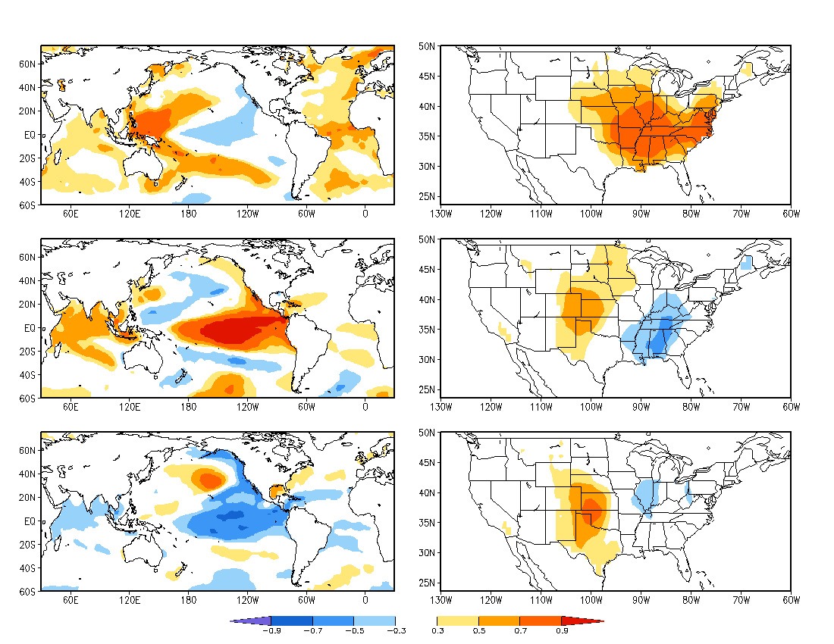
January SST
SVD: Spatial Pattern
MAMJ Tornado
Mode 1
34%
Mode 2
12%
Mode 3
10%

Slide 25
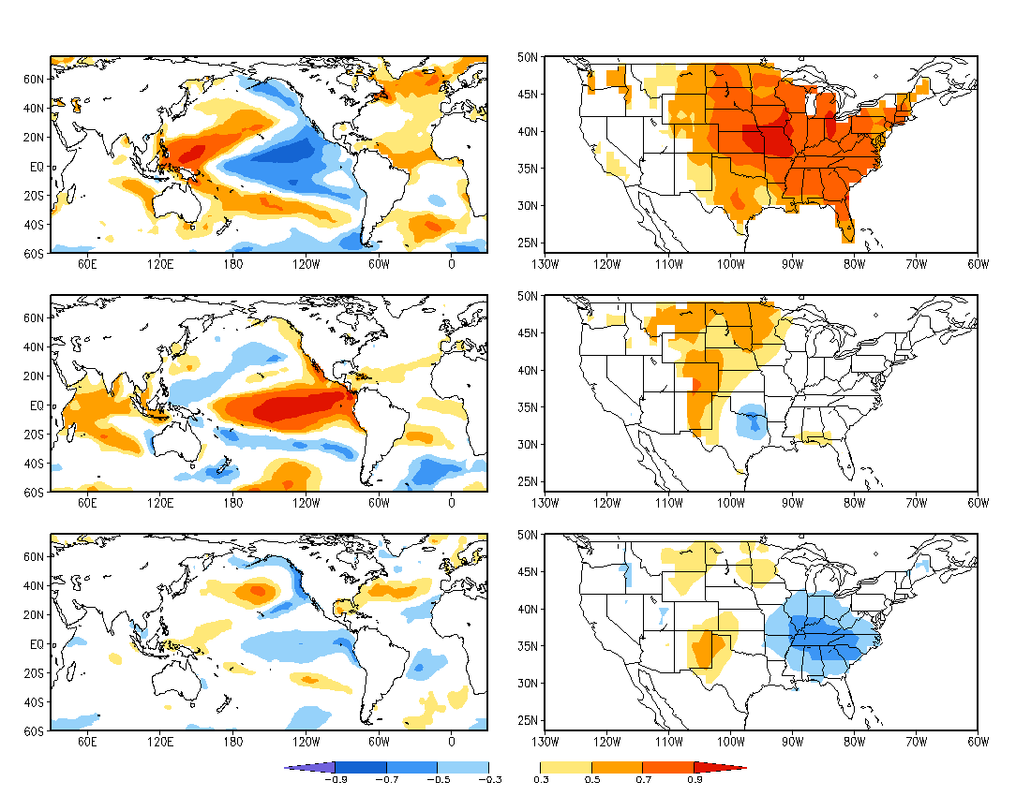
January SST
SVD: Spatial Pattern
MAMJ Hail
Mode 1
66%
Mode 2
4%
Mode 3
10%

