Slide 1
SSW Telecon 04 Feb, 2016

Slide 2
Completed all presentations summarizing various methodologies that could be used
Sang-Ki Lee
John Allen
Ashton Cook
Hui Wang/Kirsten Harnos

Slide 3
The most immediate question is what format of outlook to aim for? The answer to this question will determine work during next couple of weeks and discussion during next telecon

Slide 4
Initial suggestions on the format
A basic format for seasonal severe weather (SSW) outlook may be a spatial map of category that is favored, e.g., a regions with enhanced risk for SSW (tornado and hail); regions with reduced risk for SSW; in principle, one could also have a region with enhanced probability for normal SSW (for CPC’s seasonal forecast this is rarely invoked); and a 4th region for which nothing could be said (climatology as the forecasts)

Slide 5
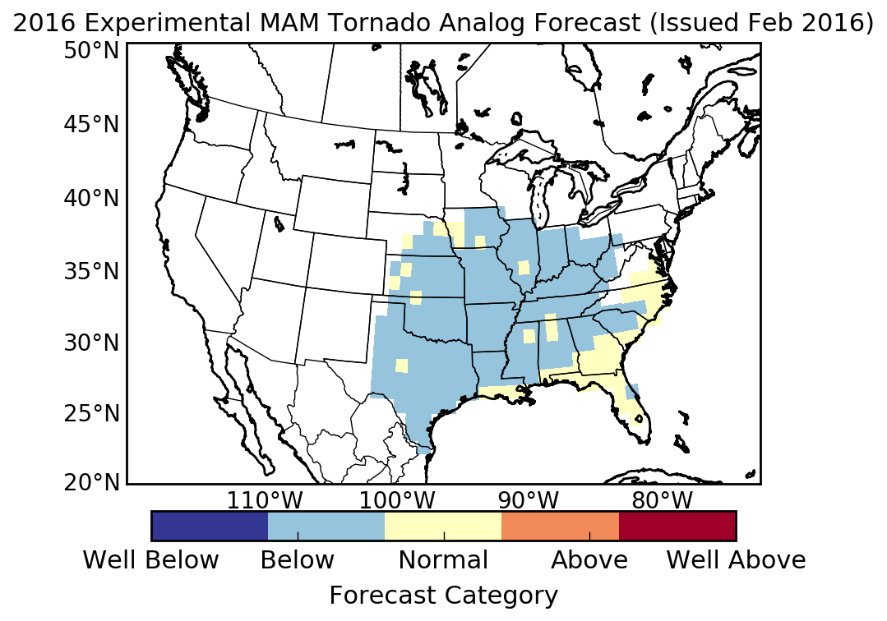
Map will look like the one John distributed
In this approach, we will need to decide forecasts for how many categories – three (like CPC does for seasonal); five (like the one on the right)
My (Arun’s) preference is three categories
Fig. 1: Option1

Slide 6
We could stay with a map like Fig. 1 or add next level of complexity in that add a pie chart that also illustrates probabilities for each category
Fig. 2: Option 2

Slide 7
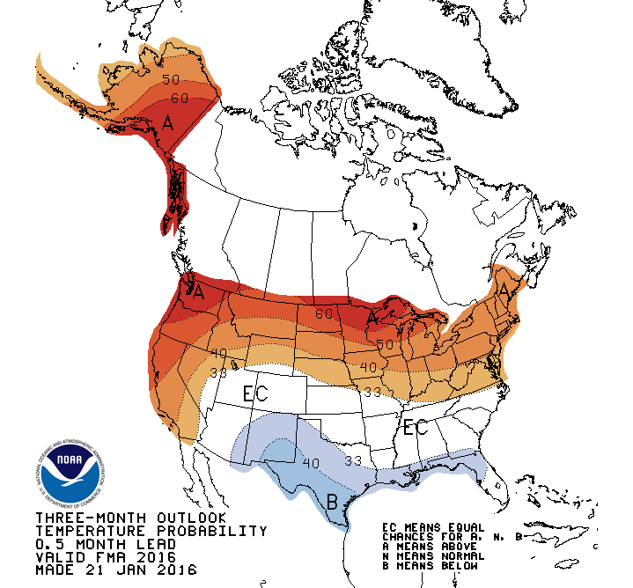
The next level of complexity will be to produce a map like CPC’s seasonal outlooks for surface temperature and precipitation that also differentiate probabilities within a category
Fig. 3:Option 3

Slide 8
Given the state of science, will be best to stay with either option 1 or 2. Comments?

Slide 9
Additional considerations
Will need a text statement accompanying the forecasts that describes science behind
Will need a disclaimer that below normal risk for SSW does not imply letting the guard down!
Gerry (and CPC) have considerable experience in dealing with above two points in the context of Hurricane Seasonal Outlooks, e.g., see http://www.cpc.ncep.noaa.gov/products/outlooks/hurricane2015/August/hurricane.shtml

Slide 10
Timeline
08-12 February, discuss format for the outlook (via emails)
17th February: Telecon to present initial outlooks from various tools (in the format we decide on)
22 February: Telecon with final outlooks from various sources
23-24 February: Finalize the outlook
25 February: release

