Slide 1
Statistical Predictions of Seasonal Tornado Activity
30 November 2015

Slide 2
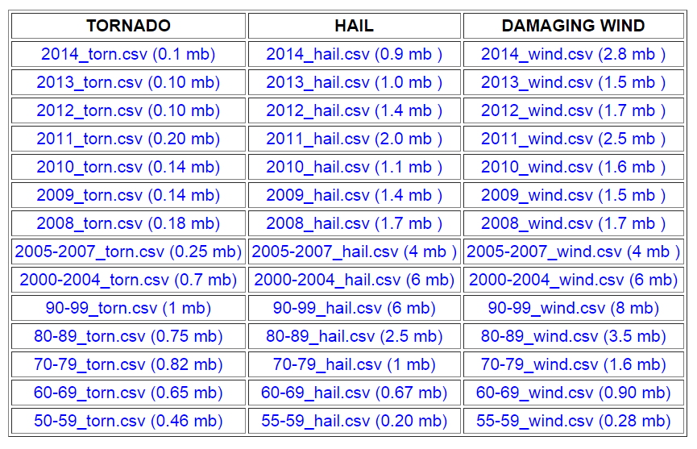
Data
NOAA/NWS/Storm Prediction Center

Slide 3
Climatology
Unit: number of tornados in 5º × 5º box from March to June per year

Slide 4
The forecast model is based on lagged relationships between January SST and MAMJ tornado activity.
The lagged relationships are objectively identified by the singular value decomposition (SVD) method.
The first three SVD modes account for 56% of seasonal tornado variance.
Data: 1955–2014 (60 years)
February SST is not available when issuing forecasts.
January SST should be similar to DJF SST due to strong persistence of winter SST anomaly.

Slide 5
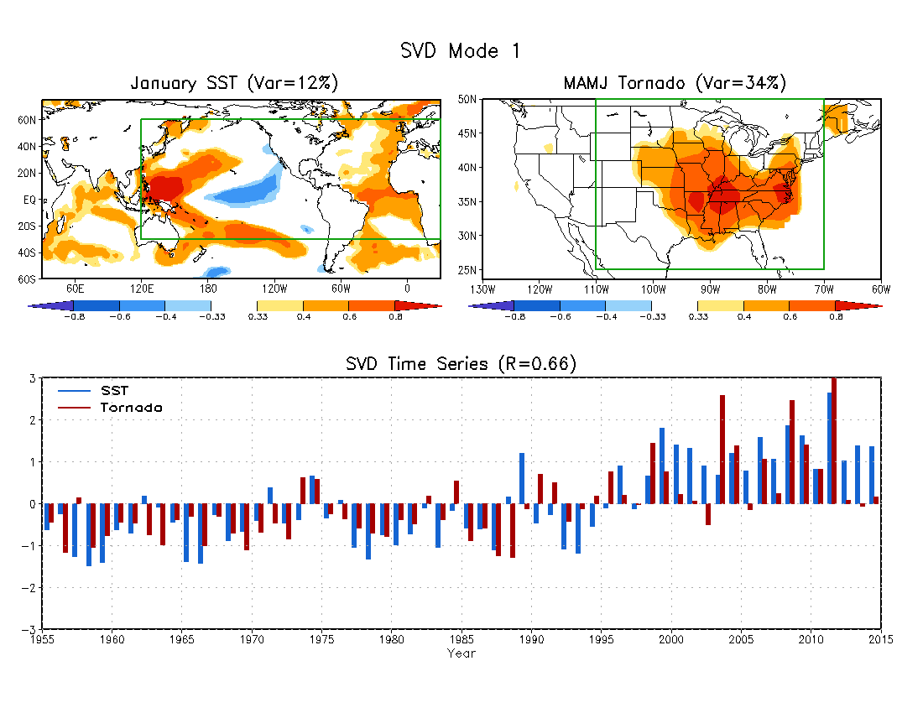
SVD1
Homogeneous correlation map
99% significance level: R=0.33
Domain for
SVD analysis
Mode 1: Tornados in the eastern and central U.S. associated with an SST warming trend

Slide 6
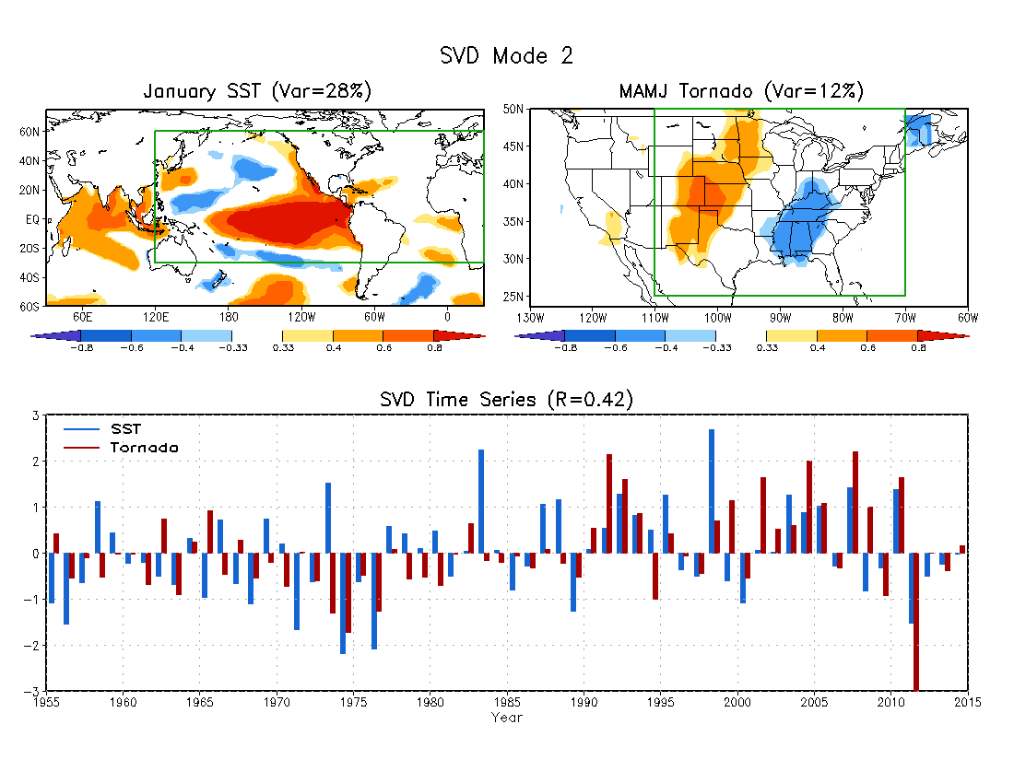
SVD2
Mode 2: Out-of-phase tornado activity in the southeast and Great Plains associated with ENSO

Slide 7
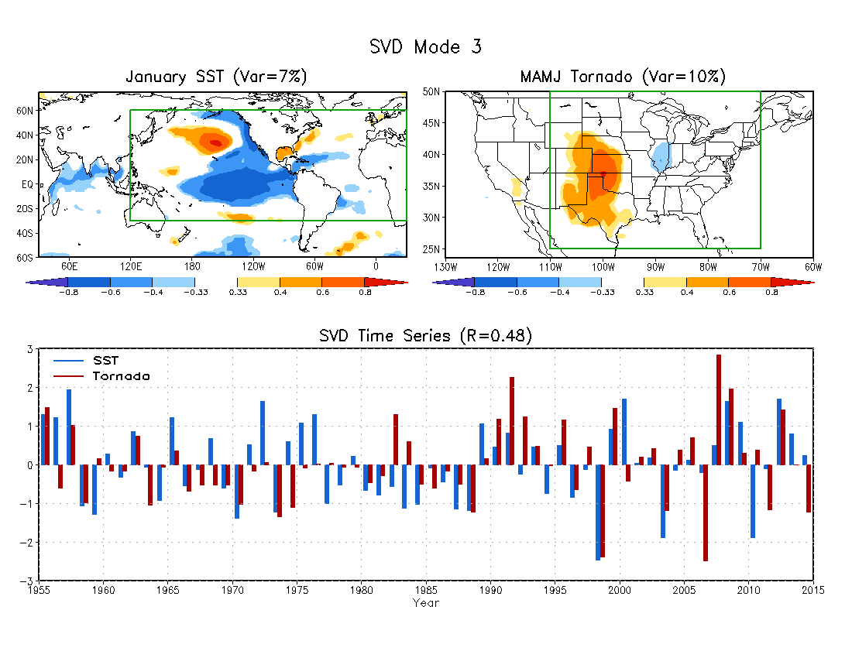
SVD3
Mode 3: Tornados in the Central and Southern Plains associated with the PDO-like SST

Slide 8
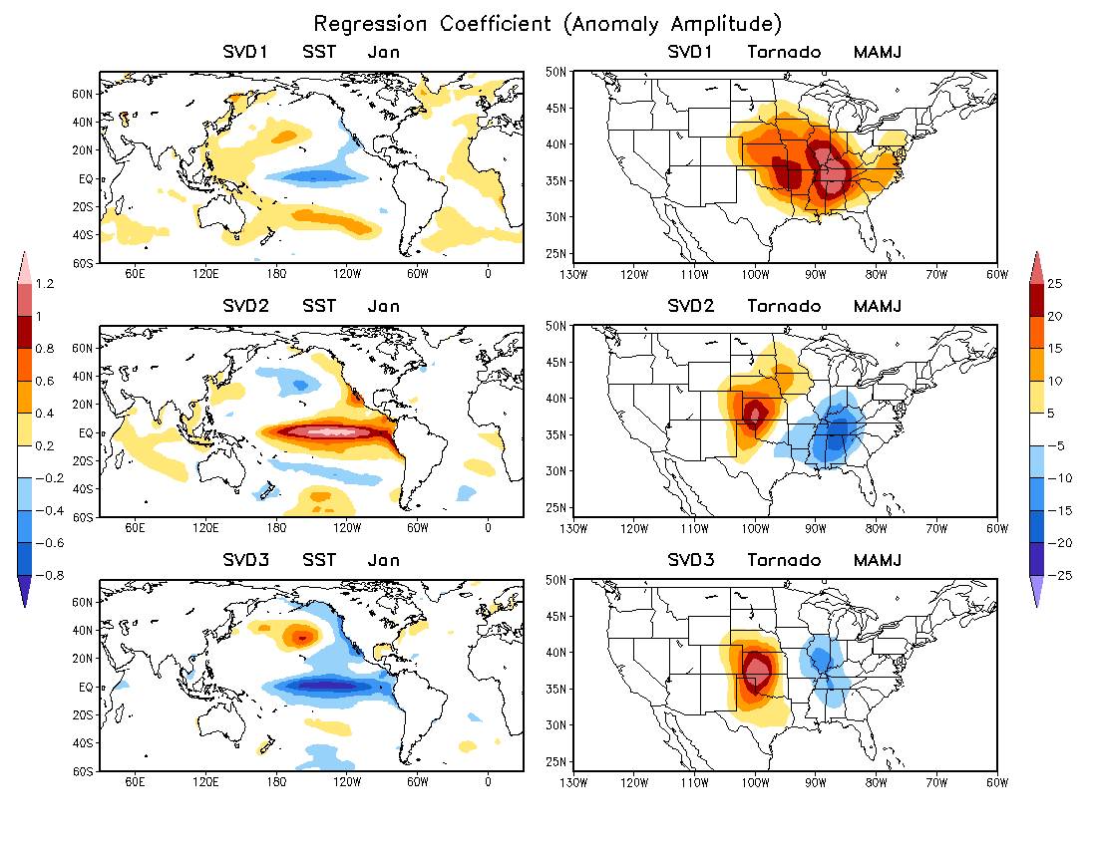
Magnitudes of anomalous SST and tornado activity in the SVD modes

Slide 9
Statistical Forecast model
The methodology is same as Wang et al. (1999). The forecast model is cross-validated by the following steps.
To perform an SVD analysis between January SST and MAMJ tornado activity to establish the lagged relationships, with a target year removed from the SVD analysis.
January SST of the target year is projected onto the SVD SST pattern. The SST projection coefficient is multiplied by the correlation coefficient between the two SVD time series to obtain a tornado projection coefficient for each mode.
The anomalous tornado activity of the target year is predicted by the regression pattern of tornado activity associated with each SVD mode multiplied by the tornado projection coefficient for the target year.
The forecast skill is measured by anomaly correlation and hit rate over the 60 years.
Reference:
Wang, H., M. Ting, and M. Ji, 1999: Prediction of seasonal mean United States precipitation
based on El Niño sea surface temperatures. Geophys. Res. Lett., 26, 1341–1344.

Slide 10
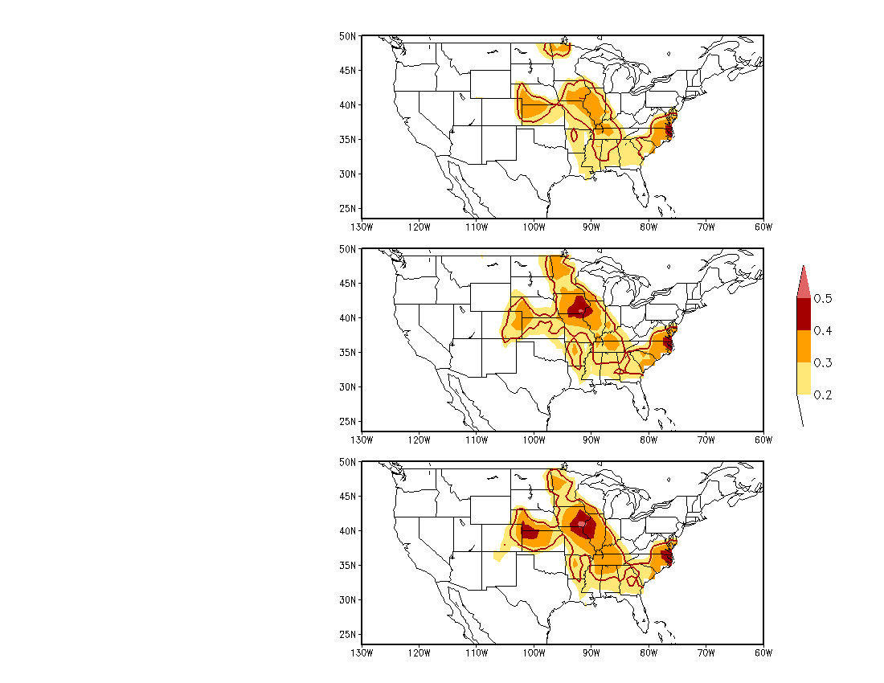
Forecast Skill
Anomaly Correlation between observed and predicted MAMJ tornado activity during 1955 and 2014.
95%
significance
level
SVD1
The forecast skill is increased by including the second and third SVD modes.
SVD1+SVD2
SVD1+SVD2+SVD3

Slide 11
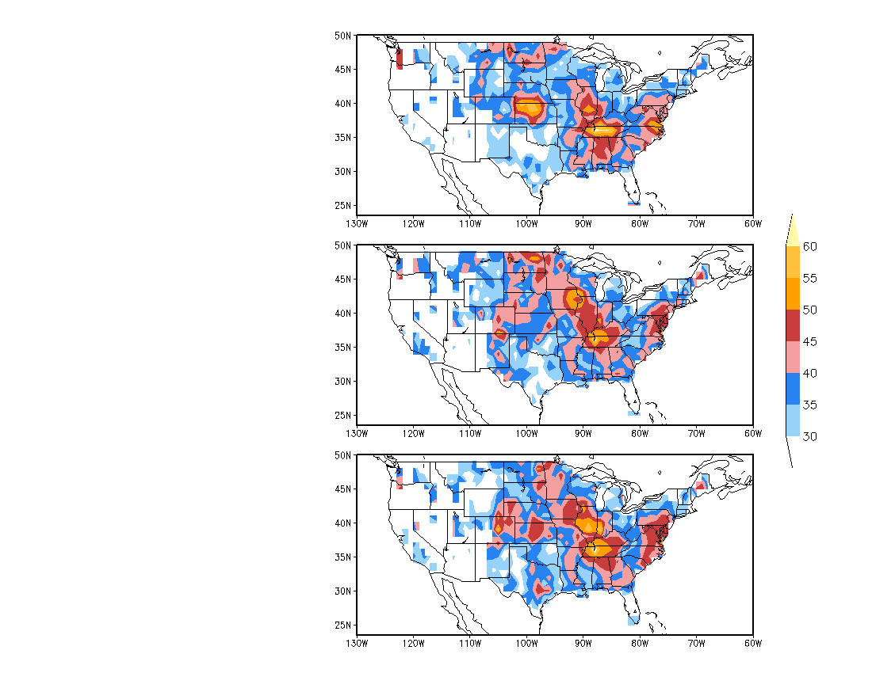
Hit Rate (%)
Three categories:
Above normal: 33%
Near normal: 33%
Below normal: 33%
SVD1
Hit rate: ratio of number of hits (both seasonal forecast and observation fall into the same category) to the total number of years (60 years).
SVD1+SVD2
SVD1+SVD2+SVD3

Slide 12
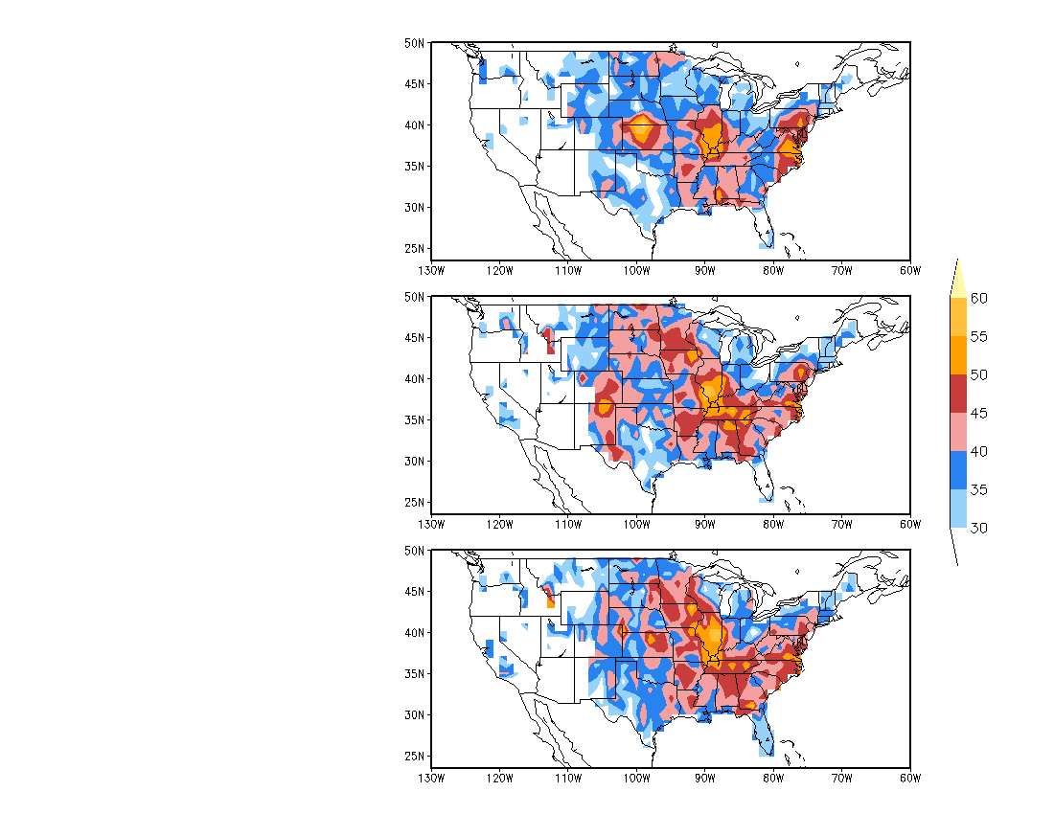
Hit Rate (%)
Three categories:
Above normal: 25%
Near normal: 50%
Below normal: 25%
SVD1
SVD1+SVD2
SVD1+SVD2+SVD3

Slide 13
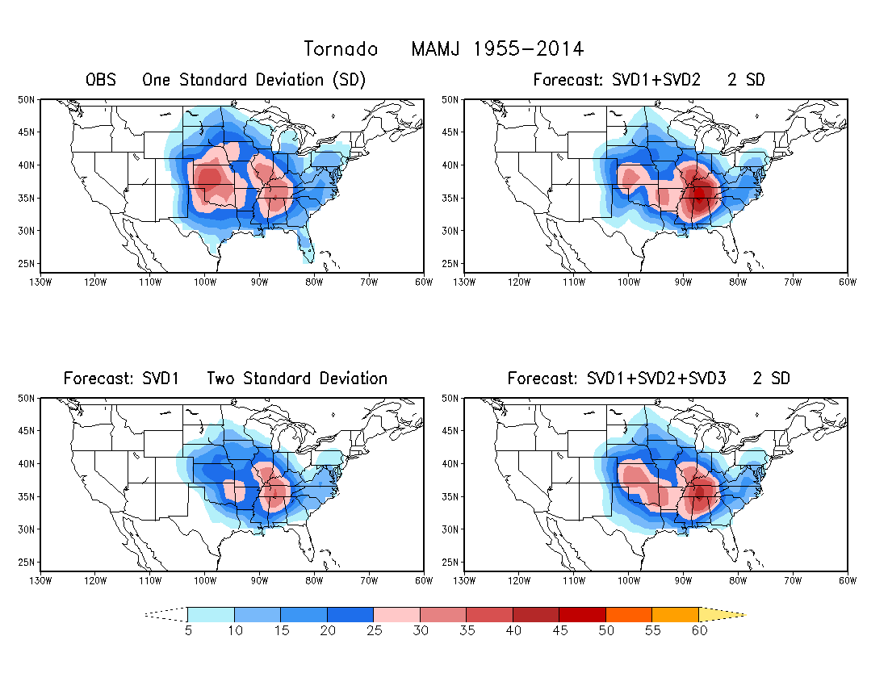
The standard deviation of forecasted tornado activity is about a half of the observed. Therefore, the predicted tornado activity is weaker than the observed.

Slide 14
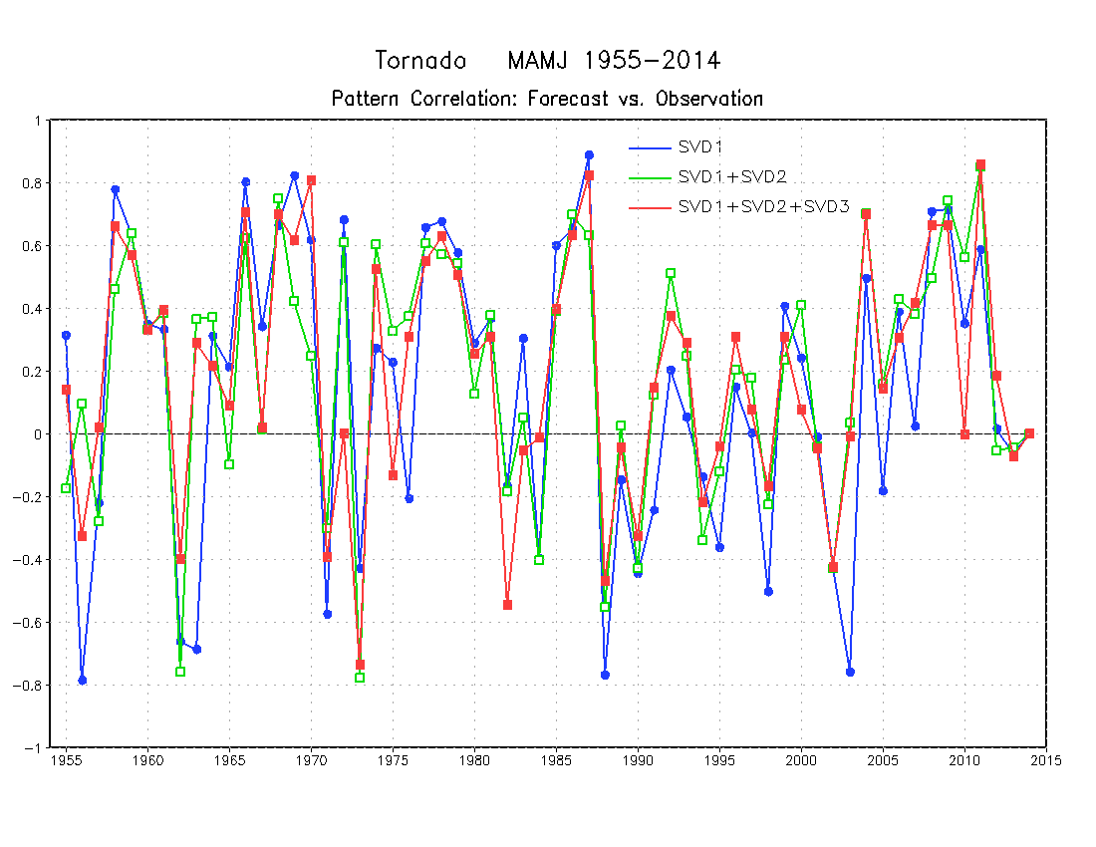
Pattern Correlation
for each year

Slide 15
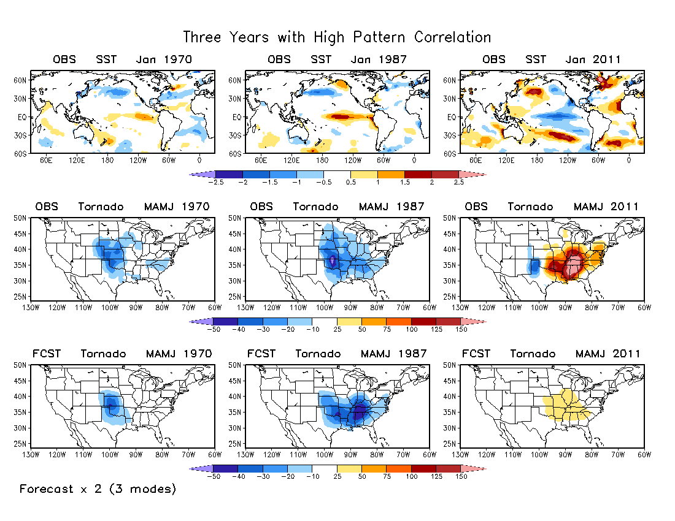
The predicted is much weaker than the observed in 2011.

Slide 16
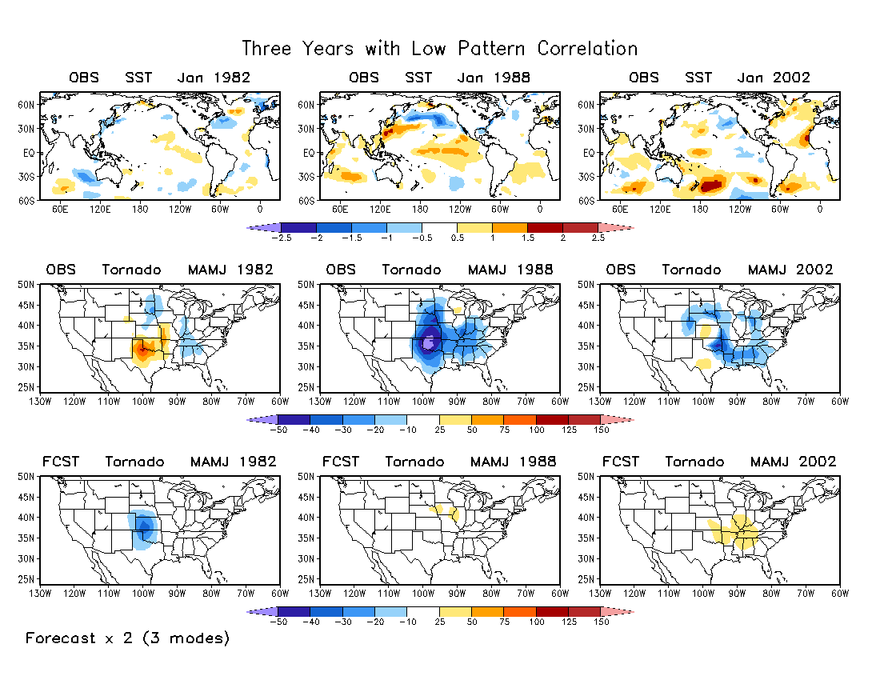
SSTs are weak in 1982 and 2002.

Slide 17
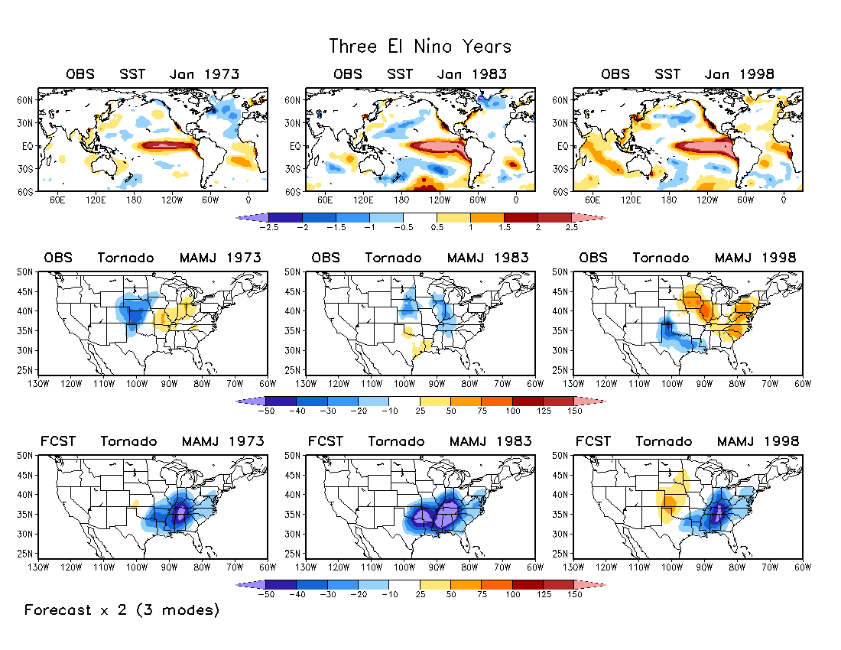
Observations are not coherent among different El Niño years.

Slide 18
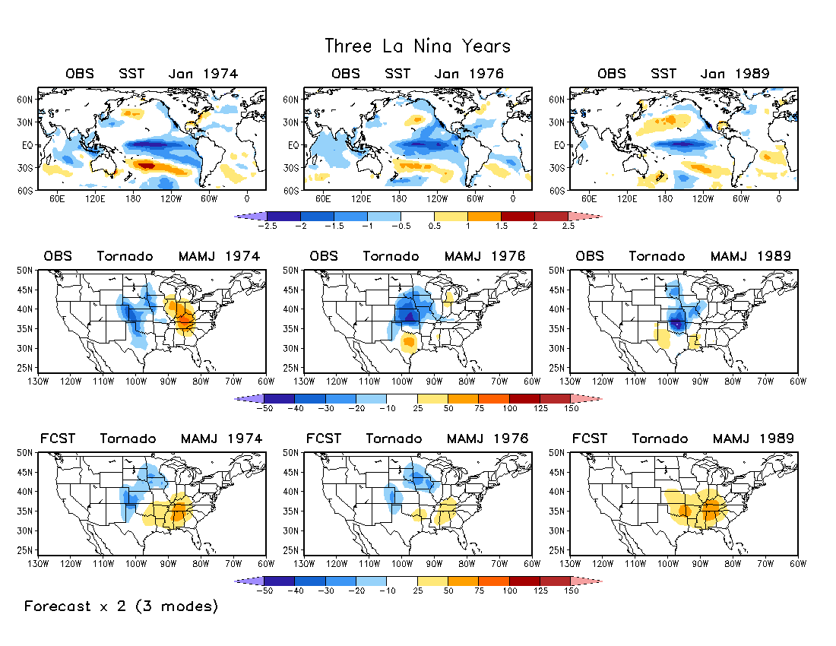
Skills are better in La Niña years than in El Niño years.

Slide 19
Summary
A statistical model was developed for forecasting seasonal tornado activity based on lagged relationships between January SST and MAMJ tornado activity depicted by three SVD modes.
The predictors are January SSTs associated with three specific SST patterns, namely, a warming trend, ENSO, and the PDO-like pattern.
Cross-validations indicate some skills in the central and eastern U.S.
The predicted tornado activity is weaker than observations.
The forecast skill seems higher in La Niña years than in El Niño years.

Slide 20
Potential Future Work
The model may also be used for seasonal prediction of hails.
The method can be used for develop a hybrid dynamical–statistical forecast model, as well as the NMME-based forecasting system, using model predicted SST and atmospheric circulation for the MAMJ season as predictors.
Statistical forecasts for sub-seasonal time scales.

