Slide 1
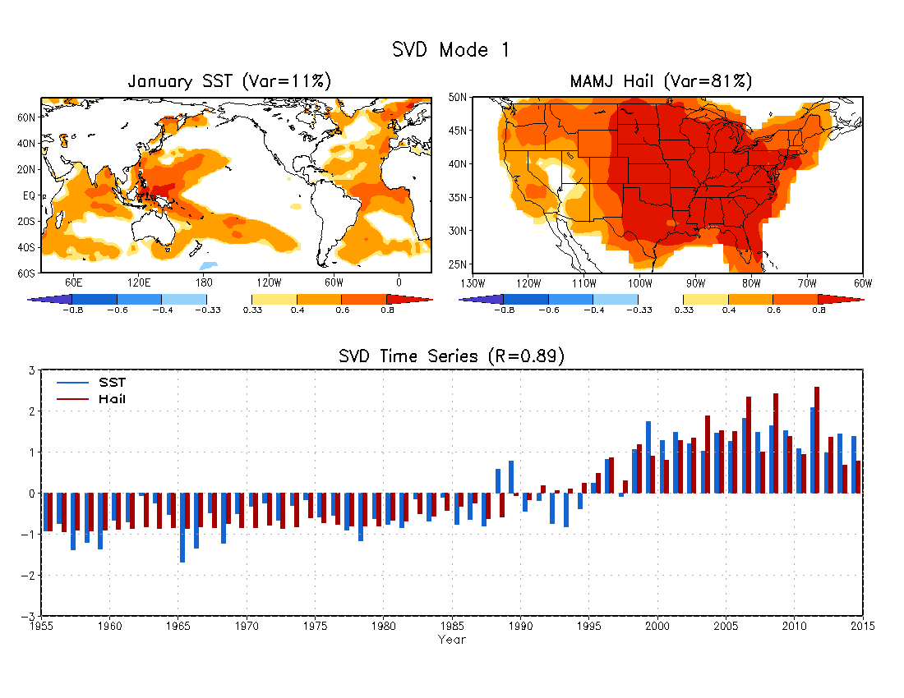
John Allen (2015)

Slide 2
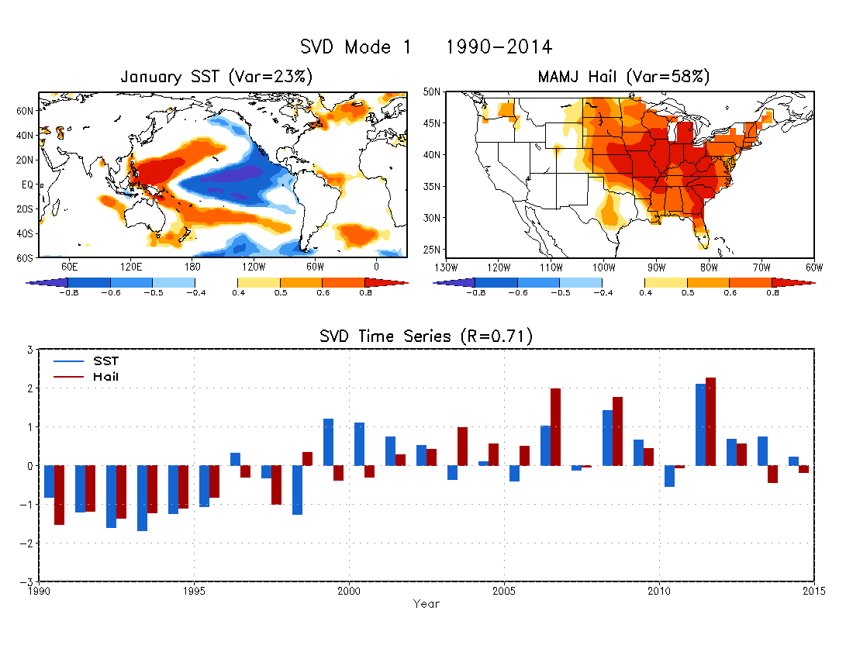

Slide 3
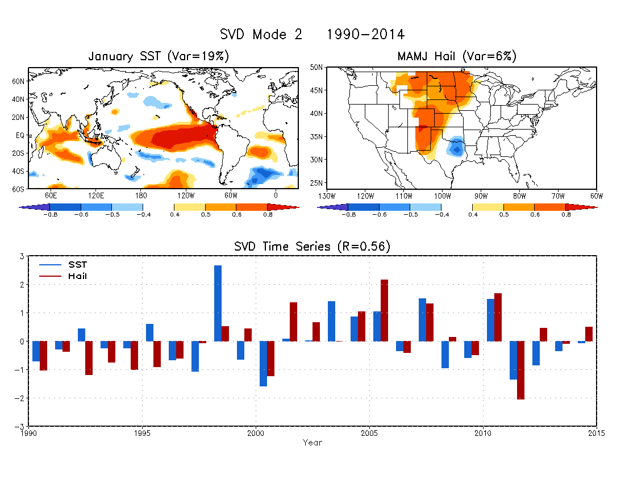

Slide 4
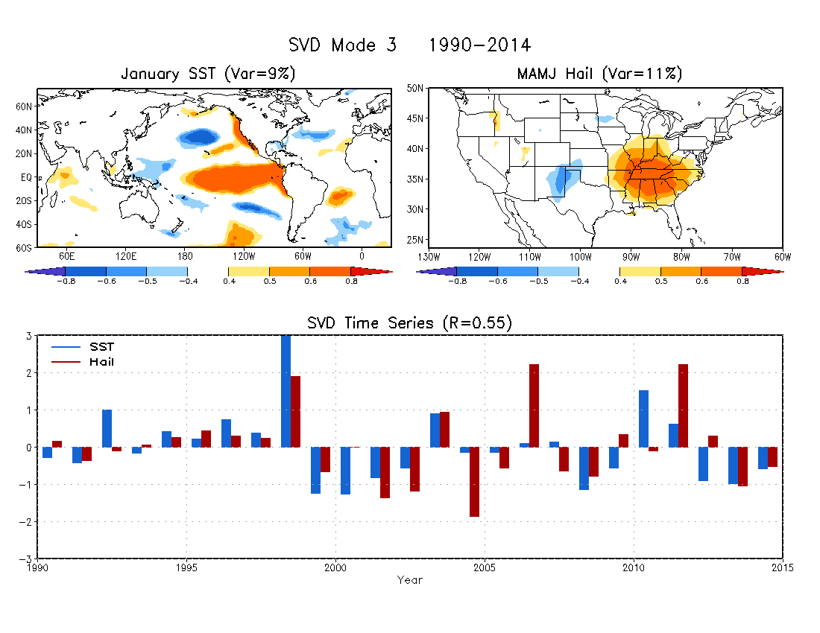

Slide 5
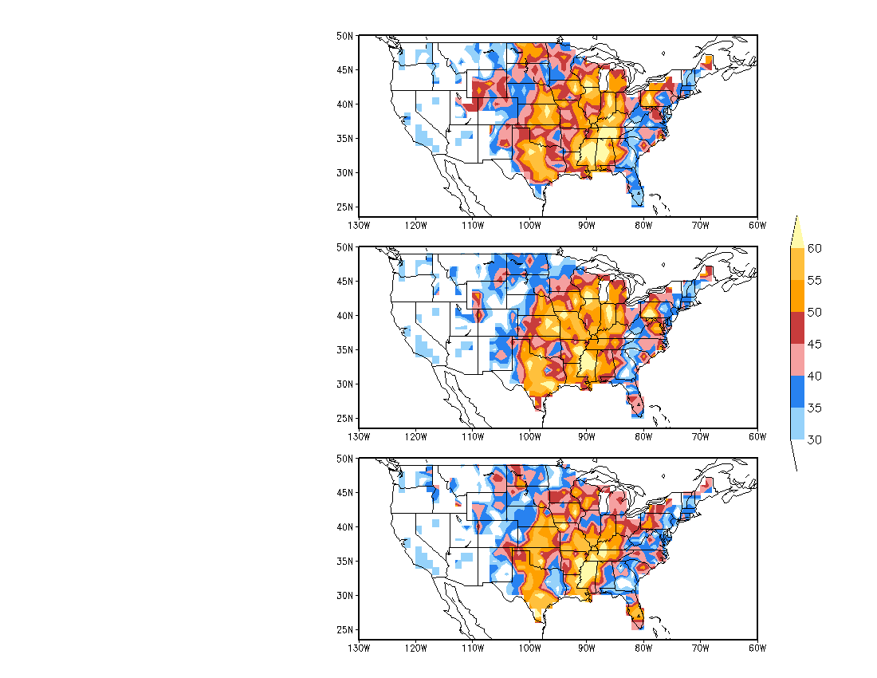
Hit Rate (%)
Three categories:
Above normal: 33%
Near normal: 33%
Below normal: 33%
SVD1
SVD1+SVD2
SVD1+SVD2+SVD3

Slide 6
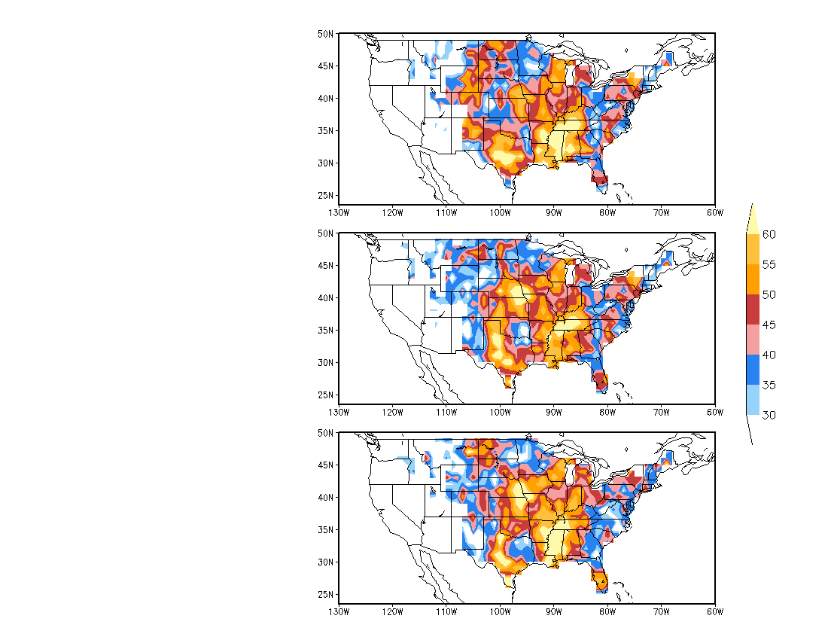
Hit Rate (%)
Three categories:
Above normal: 25%
Near normal: 50%
Below normal: 25%
SVD1
SVD1+SVD2
SVD1+SVD2+SVD3

Slide 7
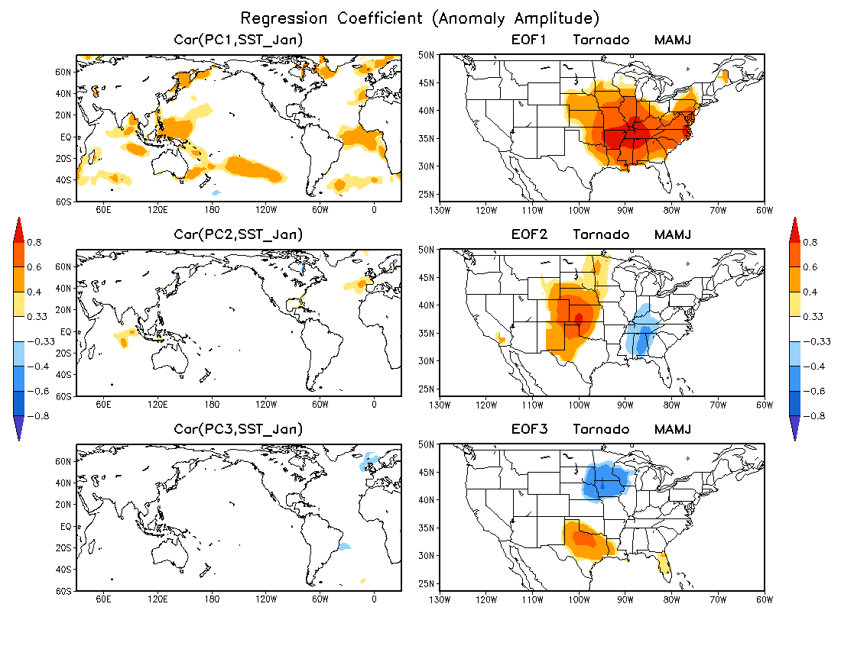

Slide 8
