Slide 1
Interaction between the Indian Ocean Dipole and ENSO Associated with Ocean Subsurface Variability
Hui Wang
NOAA/NCEP Climate Prediction Center
WIO
EIO
SSTA
SON 1997
–3 –2.5 –2 –1.5 –1 –0.5 0 0.5 1 1.5 2 2.5 3 3.5 4 4.5 5 ºC
2017

Slide 2
Outline
1. Background
2. Methodology
• 500-year simulations with/without ENSO
• Related work using the two experiments
3. Results
• IOD without ENSO
• No-ENSO vs. ENSO
• Influence of IOD on ENSO prediction
4. Conclusions

Slide 3
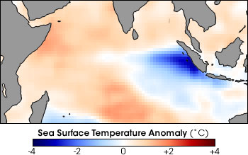
Background Information
Indian Ocean Dipole (IOD)
• Discovered in 1999
• An intrinsic mode that is independent of ENSO,
but ENSO has significant impacts
• Broad impacts on regional climate
• Some mechanisms proposed for its onset and
evolution are controversial
• Debate on its relationship with ENSO
IOD

Slide 4
Methodology
Two 500-year simulations with CFSv1
• ENSO Run:
• No-ENSO Run:
Free coupled simulation
Air-sea interaction over global oceans
ENSO SST variability is suppressed by nudging daily SST to its climatology in the tropical Pacific
SST_{NEW} = (1 – w) SST_{Model} + w SST_{Climatology}
w: weighting coefficient
w = 1/3
w = 0
Extended EOF: Evolution of ENSO, IOD, and the associated
(EEOF) subsurface ocean temperature anomalies

Slide 5
What can we do with the two 500-year simulations (ENSO vs. no-ENSO)?
ENSO in the model
Impact of ENSO
Decadal variability
Impact of ENSO on decadal variability
IOD without ENSO
IOD with ENSO (interaction)

Slide 6
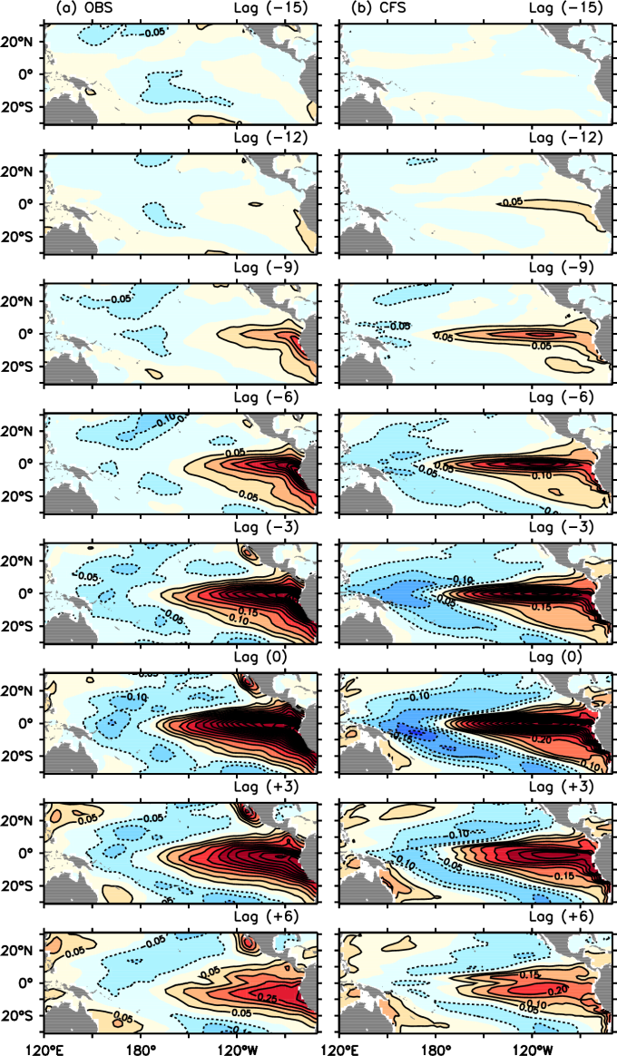
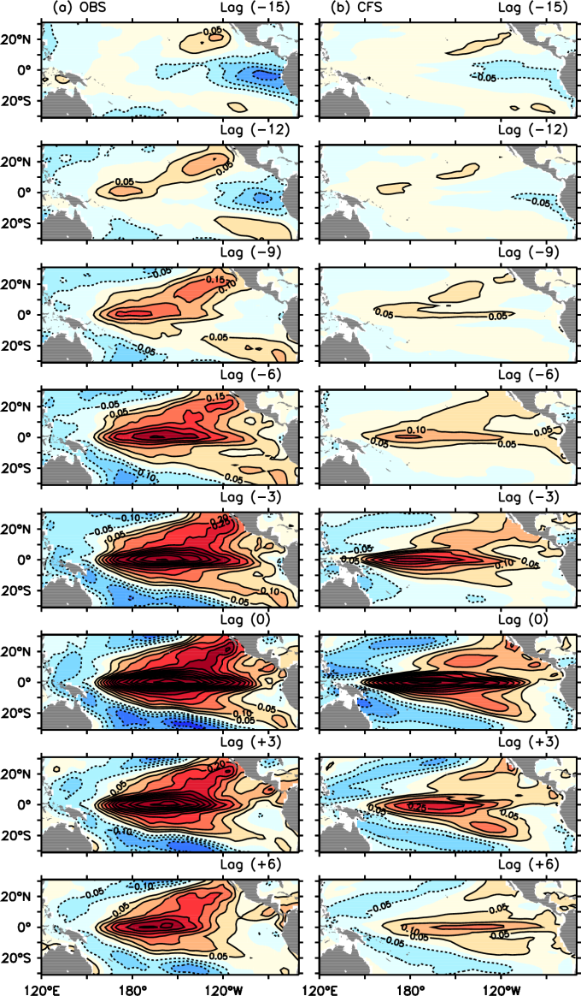
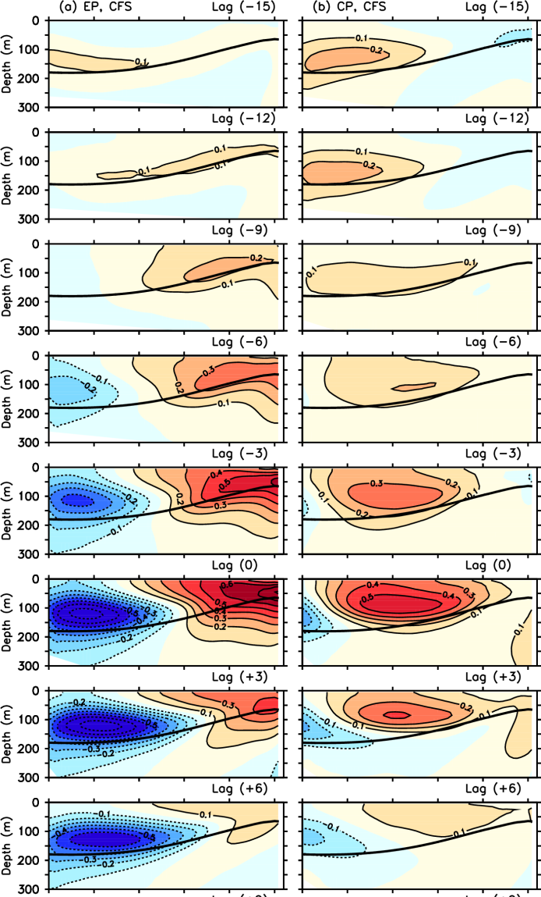
ENSO in the model
Kim et al. (2012) Mon. Wea. Rev.
Examination of the two types of ENSO in the NCEP CFS model and its extratropical associations
EP El Niño
CP El Niño
CFS
OBS CFS
OBS CFS
EP CP

Slide 7
Impact of ENSO
Wang et al. (2015) J. Hydrology
Assessing the impact of ENSO on drought in the U.S. Southwest with NCEP climate model simulations
In the presence of ENSO, the variability of Southwest precipitation is enhanced and shifts toward lower frequencies.

Slide 8
ENSO impact on decadal variability
Liu, Jia et al. (2015) Climate Dynamics
Decadal modulation of East China winter precipitation by ENSO
Correlation of JFM Z200 with ENSO-related precipitation in E. China
Asymmetry in the precipitation and circulation responses to warm and cold phases of ENSO

Slide 9
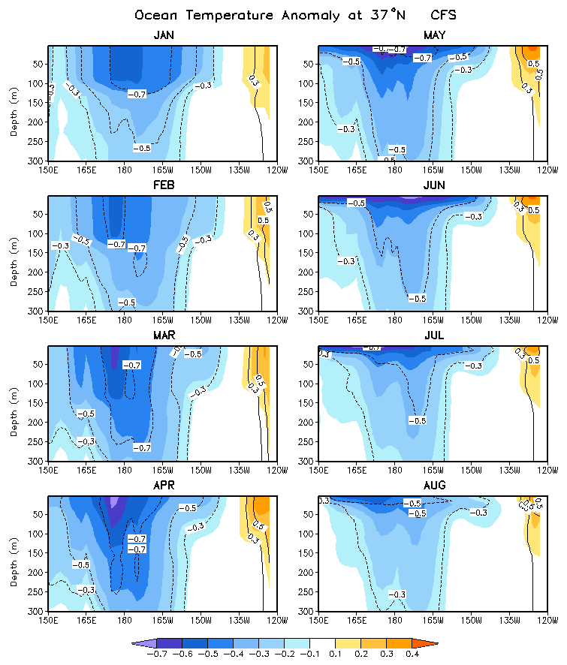
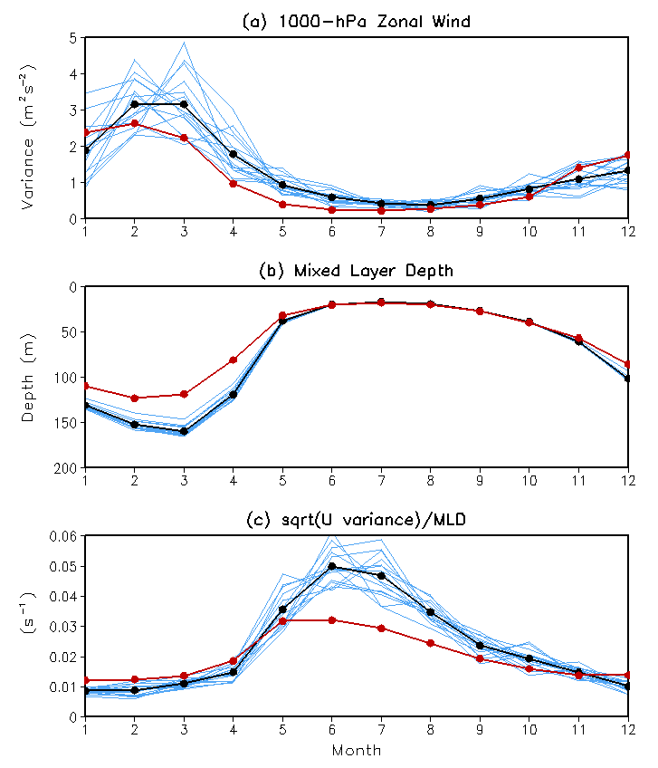
Decadal variability
Wang et al. (2012) J. Climate
Seasonality of the Pacific decadal oscillation
OBS
CFS

Slide 10
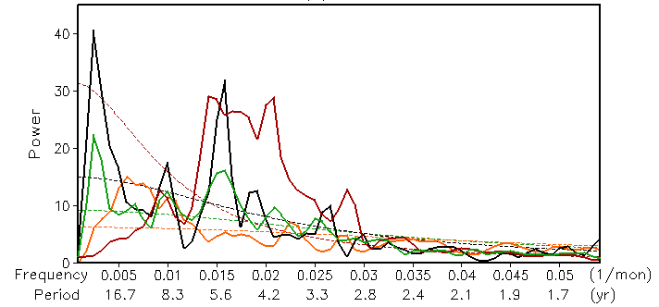
ENSO impact on PDO
Wang et al. (2012) J. Climate
Influence of ENSO on Pacific decadal variability: An analysis based on the NCEP climate forecast system
Power Spectra
Nino3.4 (ENSO run)
PDO (No-ENSO run)
PDO (ENSO run)
PDO (OBS, ERSST)

Slide 11
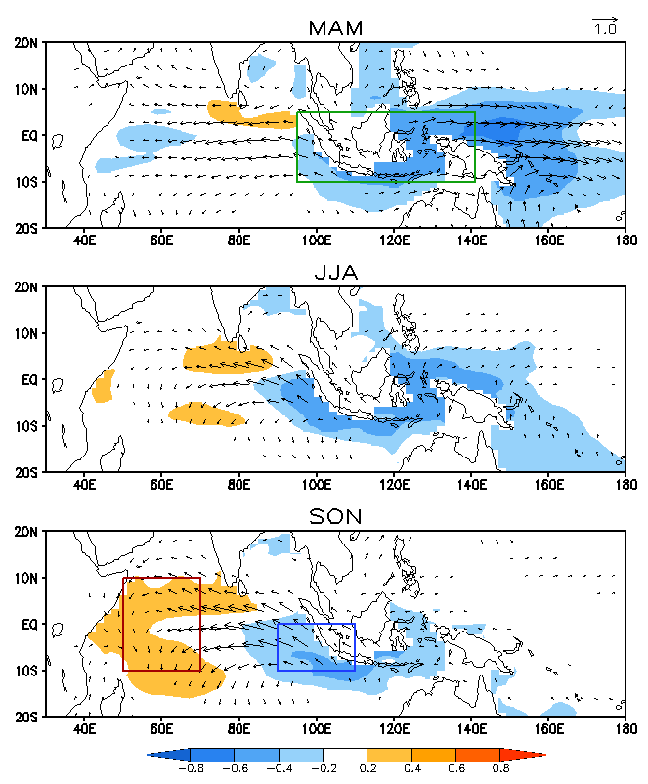
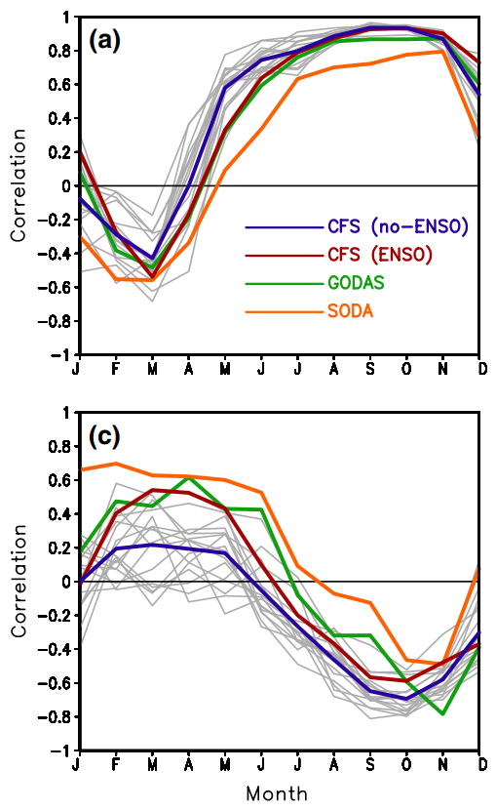
IOD without ENSO
Wang et al. (2016) Climate Dynamics
Evolution of Indian Ocean dipole and its forcing mechanisms in the absence of ENSO
SST and 10-m Wind (No-ENSO Run)
Correlation
EIO SST vs. EIO SSH
– IndoP
EIO SST vs. WIO SST
WIO
EIO

Slide 12
IOD without ENSO
Wang et al. (2016) Climate Dynamics
Evolution of Indian Ocean dipole and its forcing mechanisms in the absence of ENSO
Power Spectrum
Given a strong influence of ENSO on IndoP, IndoP can act as a medium linking ENSO and IOD.

Slide 13
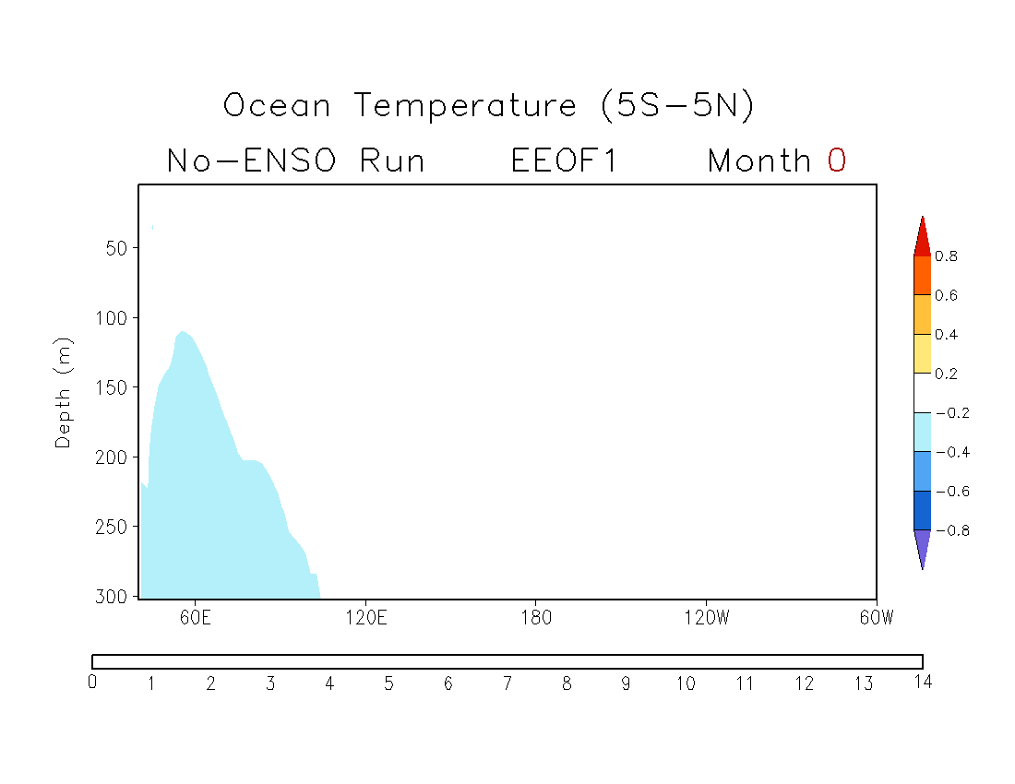
No-ENSO Simulation
EEOF1
Contour: Anomaly (cint=0.25K)
Shading: Correlation
No strong signals in the tropical Pacific
Time (months)

Slide 14
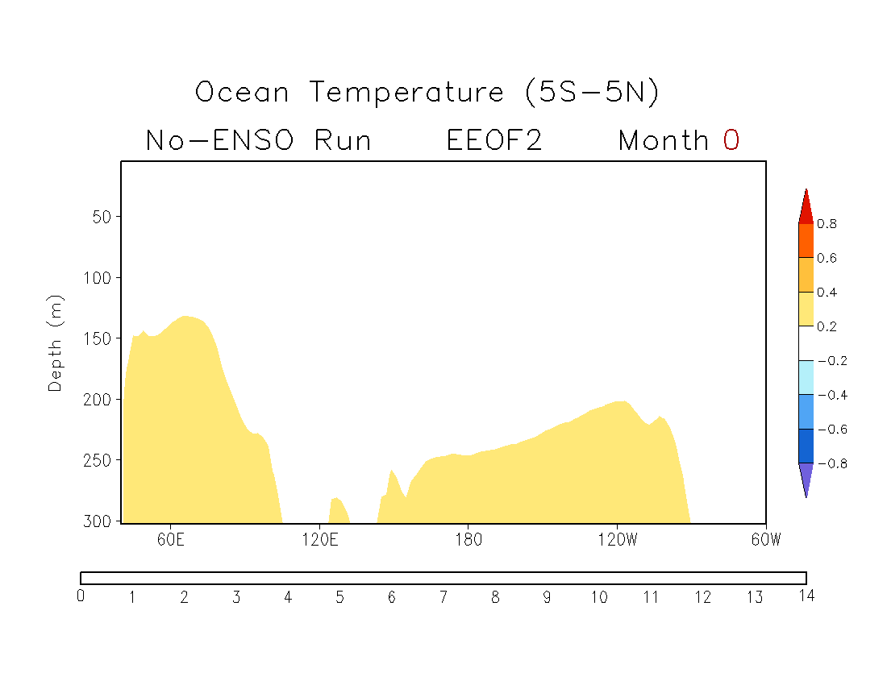
No-ENSO Simulation
EEOF2
No strong signals in the tropical Pacific
Time (months)

Slide 15
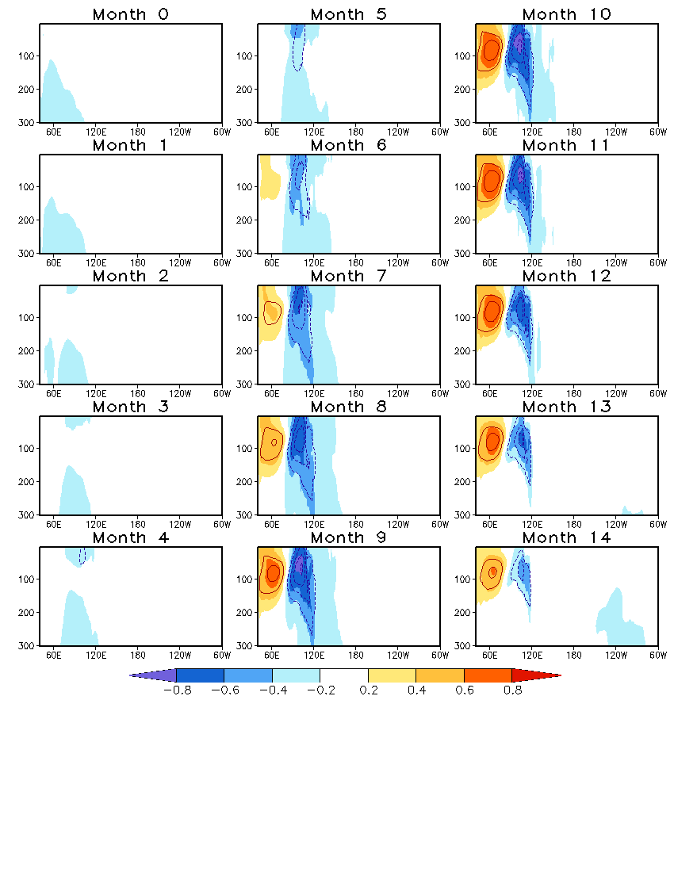
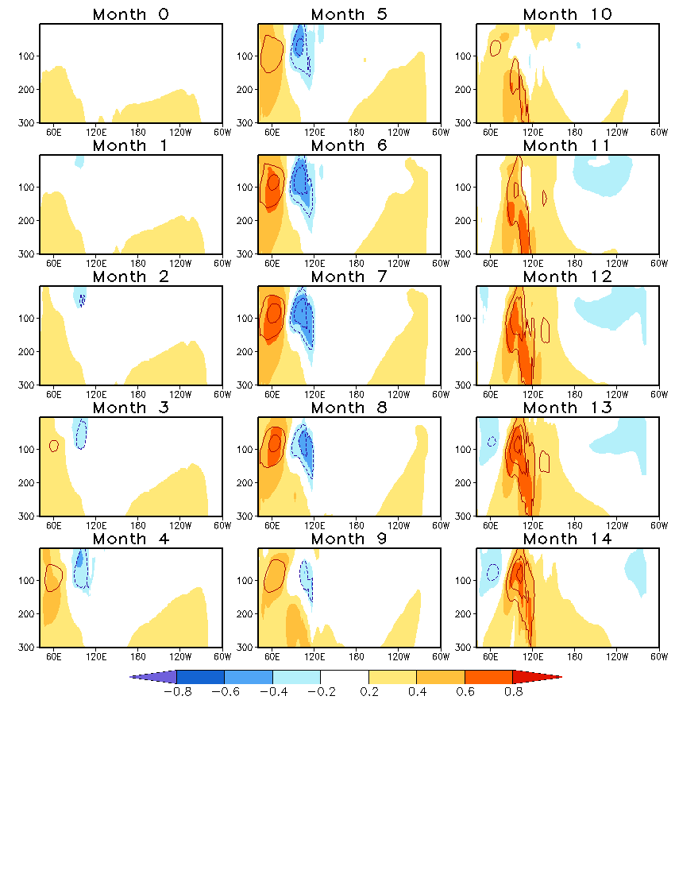
No-ENSO Simulation
EEOF1
EEOF2
Depth (m)
Lead-lag Correlations: PC1 vs. PC2
Time evolution of the IOD involves an oscillation between the two modes.

Slide 16
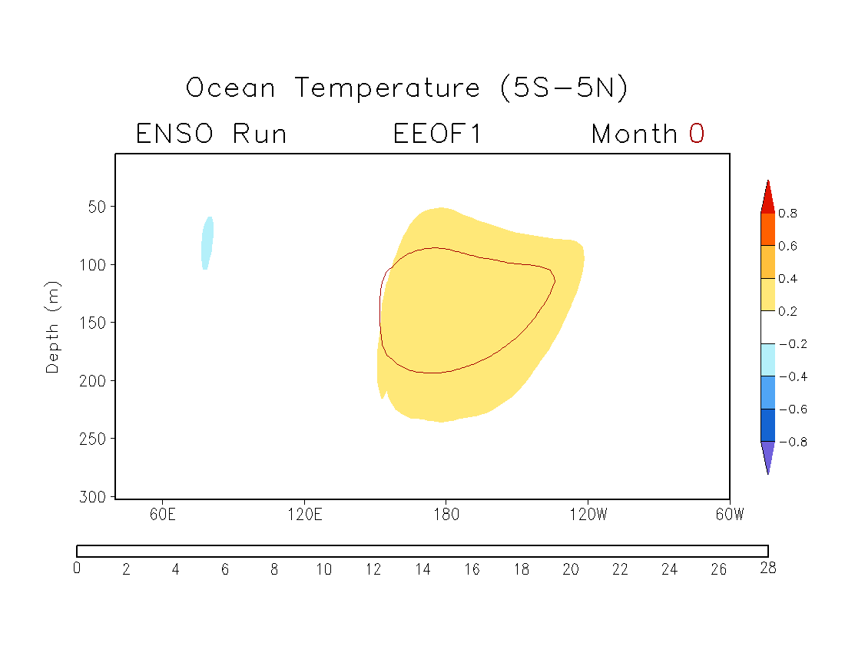
ENSO Simulation
EEOF1
ENSO leads IOD.
Time (months)

Slide 17
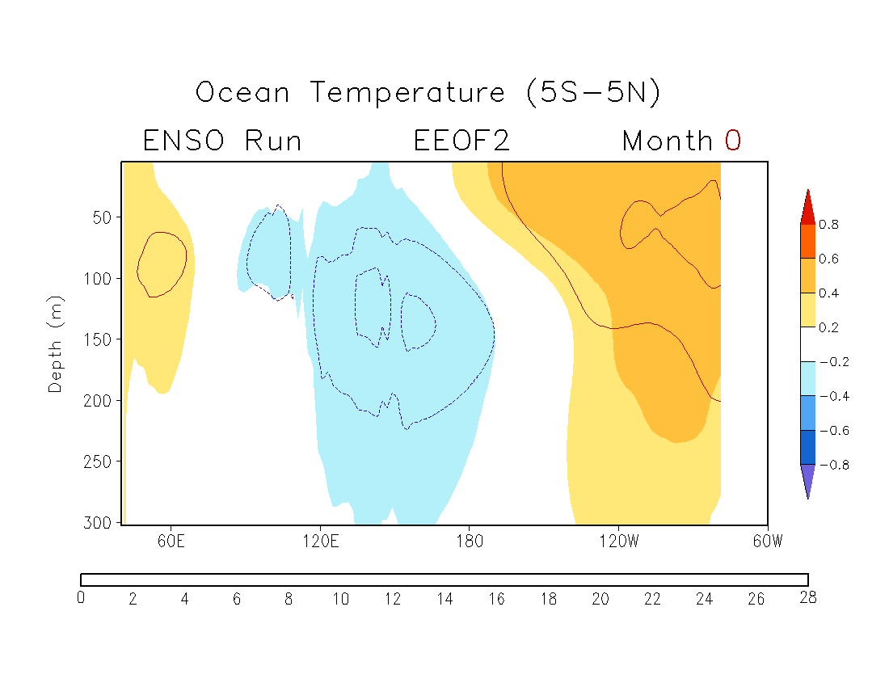
ENSO Simulation
EEOF2
IOD leads ENSO.
Time (months)

Slide 18
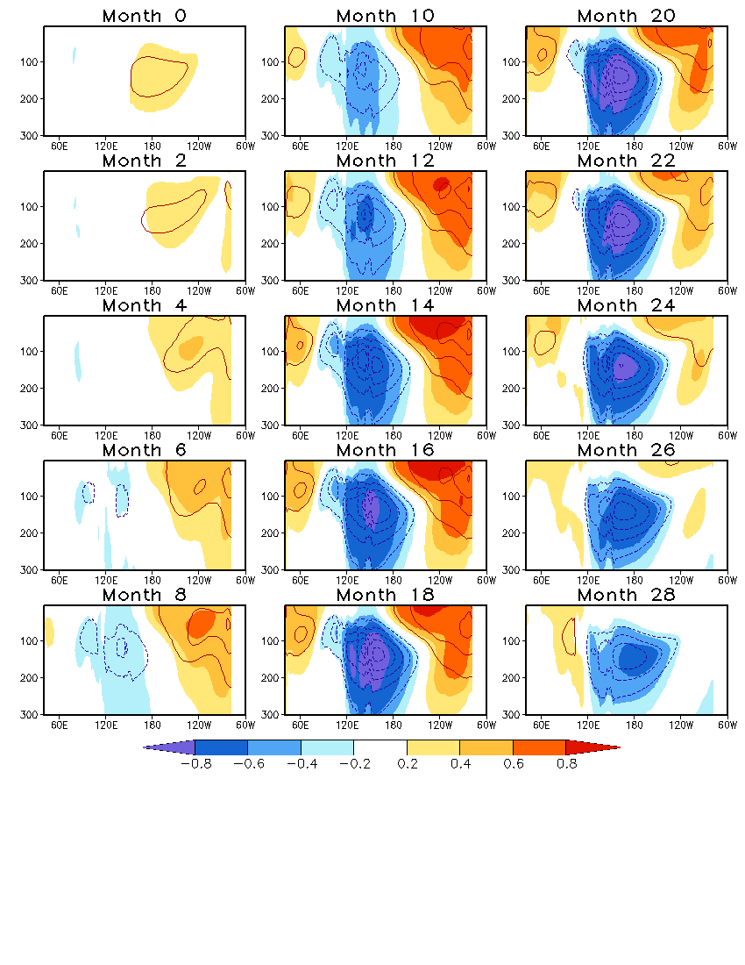
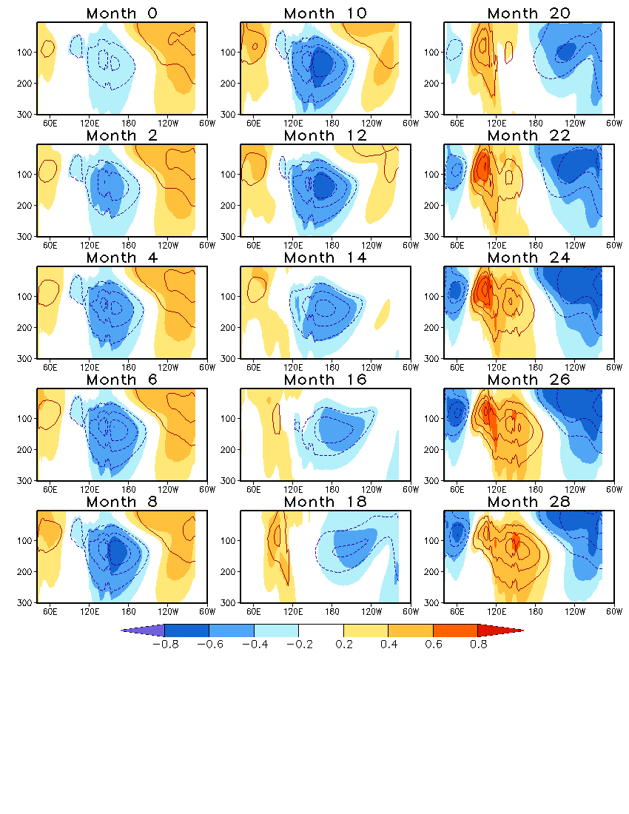
ENSO Simulation
EEOF1
EEOF2
Depth (m)
Lead-lag Correlations: PC1 vs. PC2
ENSO modulates the frequency of IOD.
ENSO
No-ENSO
GODAS

Slide 19
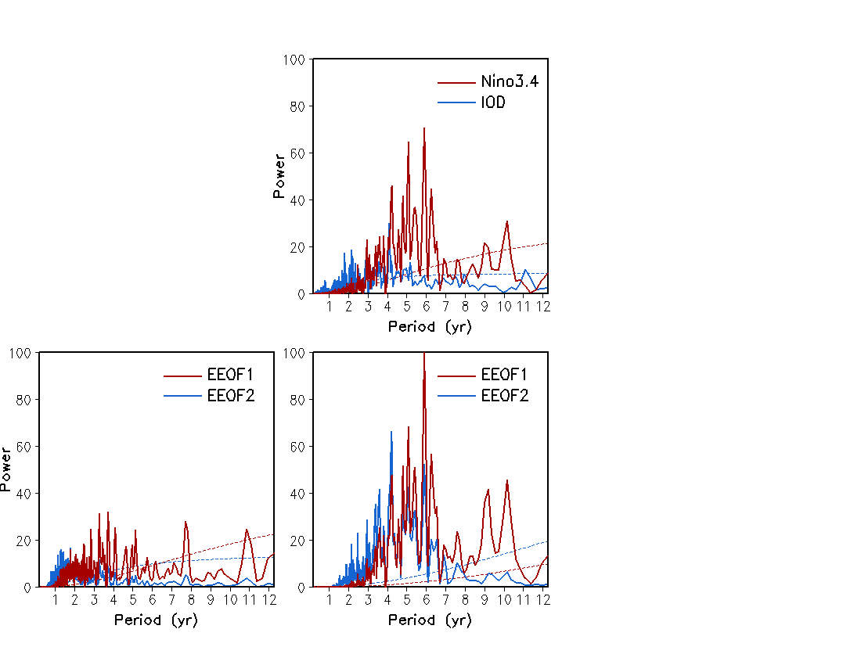
No-ENSO vs. ENSO
Power Spectrum
ENSO Run
480 yr
GODAS
1980–2015
36 yr
Strong covariations between ENSO and IOD on the inter-annual timescale
Modulation of IOD frequency by ENSO
No-ENSO Run
480 yr
ENSO Run
480 yr
GODAS
1980–2015
36 yr

Slide 20
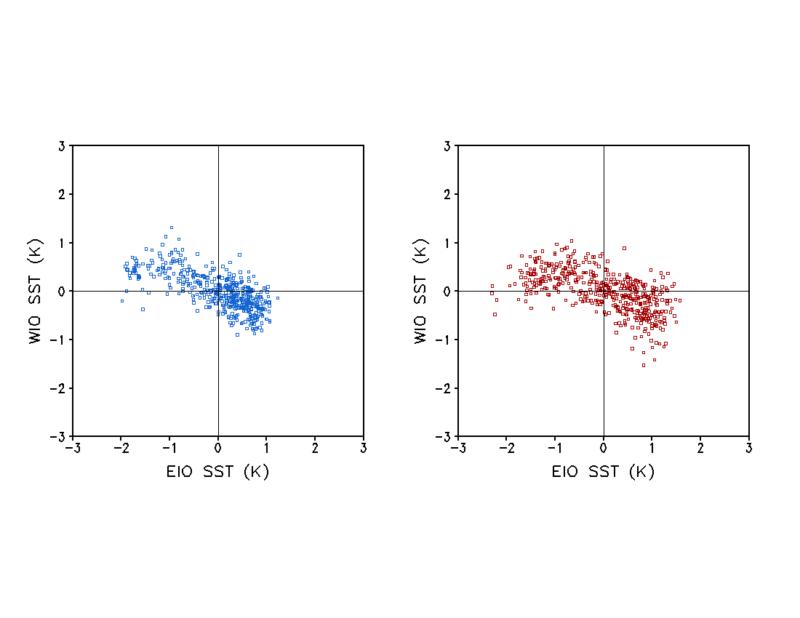
No-ENSO vs. ENSO
No-ENSO Run
ENSO Run
SON
SON
+ IOD
+ IOD
– IOD
– IOD
ENSO enhances the intensity of IOD.

Slide 21
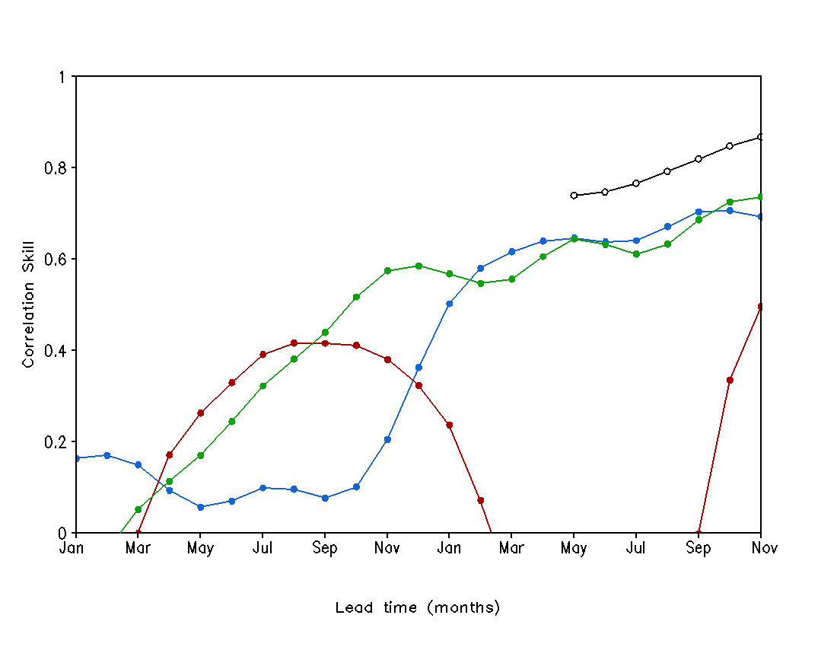
Forecast Skill: DJF Niño 3.4 SST (1983–2010)
Predictors (OBS)
WIO SST
WWV (tropical Pacific)
Predictand
DJF Niño 3.4 SSTA
Nino3.4
WWV
CFSv2
WIO
WIO
WWV + WIO
WWV
Year –1
Year 0
22 20 18 16 14 12 10 8 6 4 2 0

Slide 22
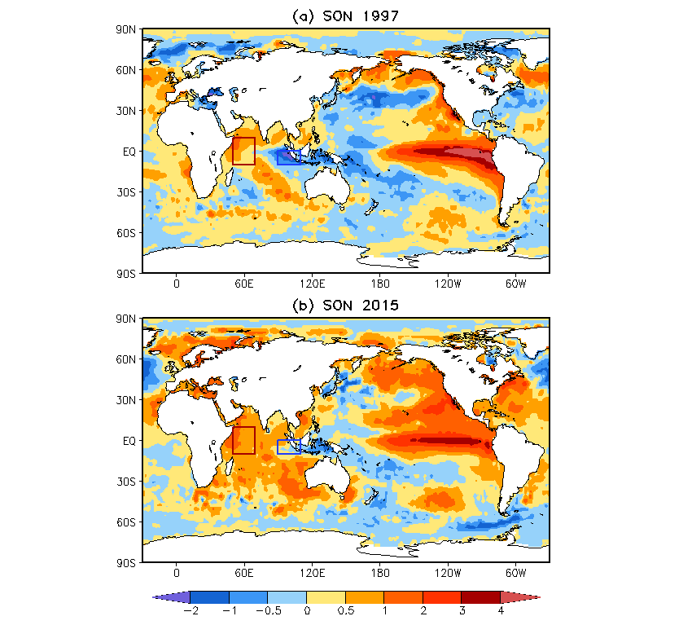
Forecast for 1997 and 2015 El Niño

Slide 23
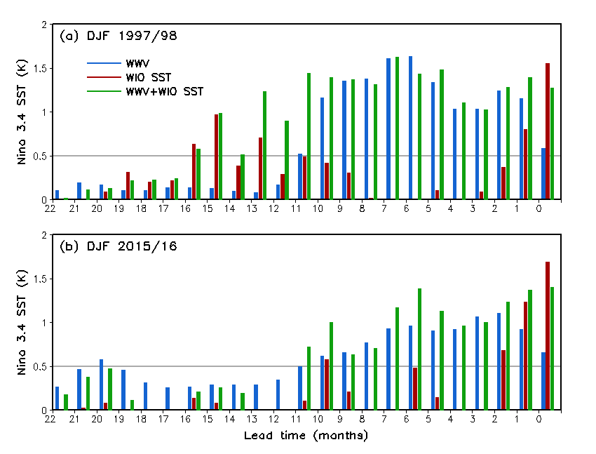
Forecast for 1997 and 2015 El Niño

Slide 24
Conclusions
There are strong co-variations between the IOD and ENSO that are associated with subsurface ocean variability.
ENSO enhances the intensity and lowers the frequency of the IOD.
The IOD may help ENSO prediction at longer lead times.

