Slide 1
Update (4/9/2019)
The forecast skill for week-2 severe weather (LSR3) with the SVD-based hybrid model is higher that that with the simple linear regression model over the eastern and central US.
The forecast with the SVD-based hybrid model is implemented in the experimental real-time forecast for week-2 severe weather.
The week-2 forecasts of LSR3 using the SVD-based hybrid model is consistent with those using the linear regression model, but the magnitude of predicted week-2 SLR3 is slightly larger.

Slide 2
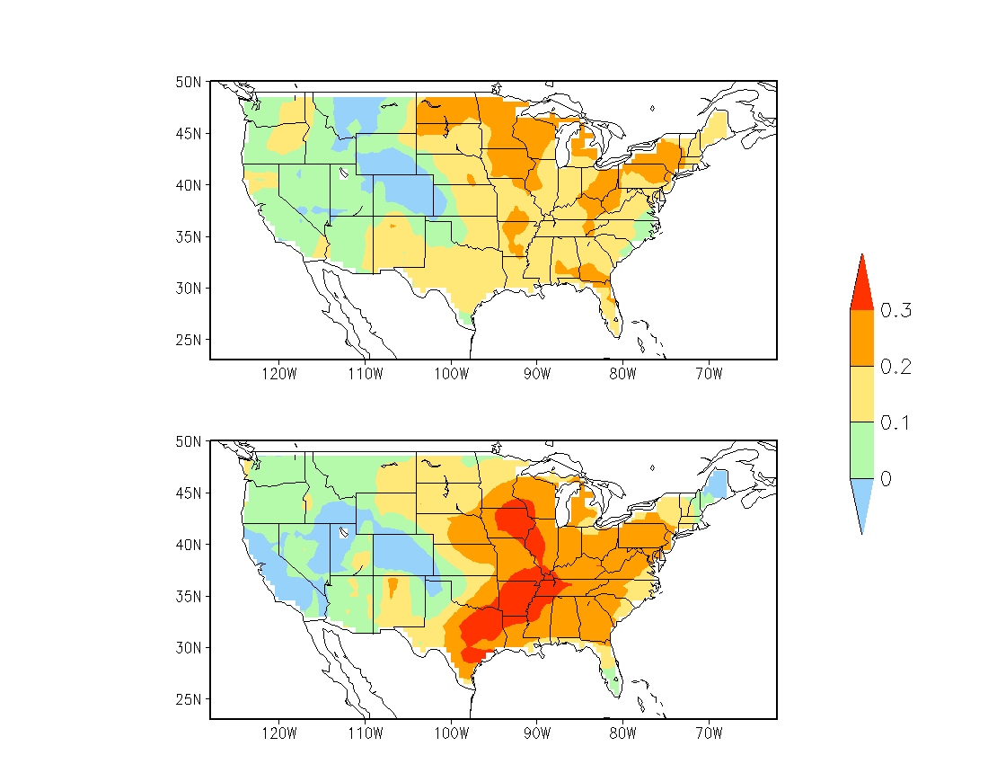
Anomaly Correlation Skill for Week-2 LSR3
Cross-validated over
MAM 1996–2012
Linear Regression Model (5º×5º)
SVD-based Forecast (5º×5º)
Improved skill
Notes:
/cpc/home/hwang/2017_wk34SWx/GEFS_0.5/LSR_fcst.5x5/WG.WEEK34-SW.AC.2plot.gs

Slide 3
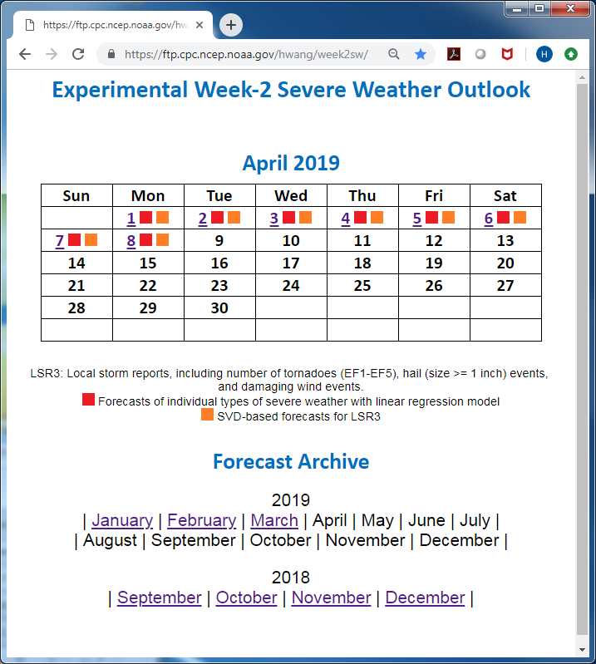

Slide 4
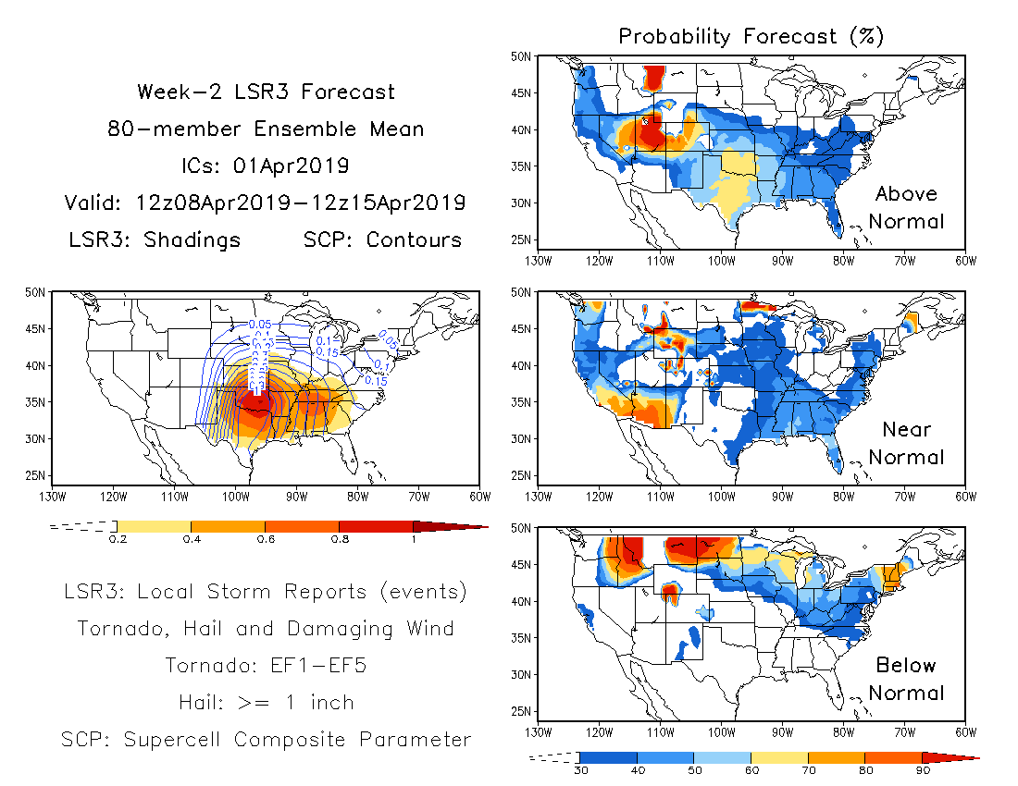
Linear regression model

Slide 5
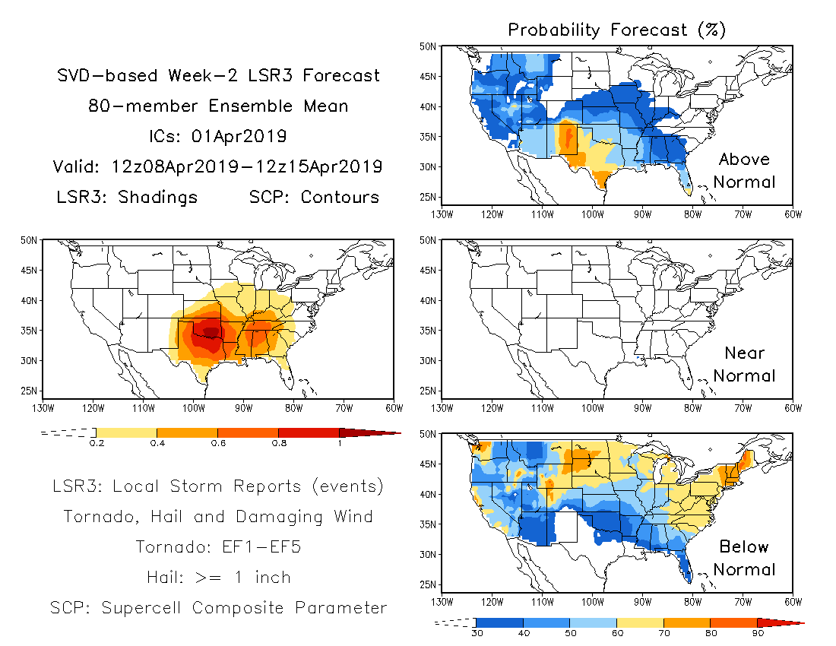
SVD-based hybrid model

