Slide 1
Update
08Aug2017
The relationship between GEFS predicted SCP and observed LSR is the basis for the development of a hybrid forecasting system.
Cross-validations indicate that the forecast skill (anomaly correlation) is consistent with the correlation between model predicted SCP and OBS LSR.
Thus, a higher correlation (GEFS SCP, OBS LSR) may indicate a better forecast skill for LSR.
The correlation (GEFS SCP, OBS LSR) can be increased by averaging both SCP and LSR anomalies in a larger domain (e.g., 5º×5º) prior to calculating the correlation.
One-point correlation suggests that for weekly LSR data, 5º×5º area-averaged anomalies shows better spatial coherence than the 0.5º×0.5º anomalies.

Slide 3
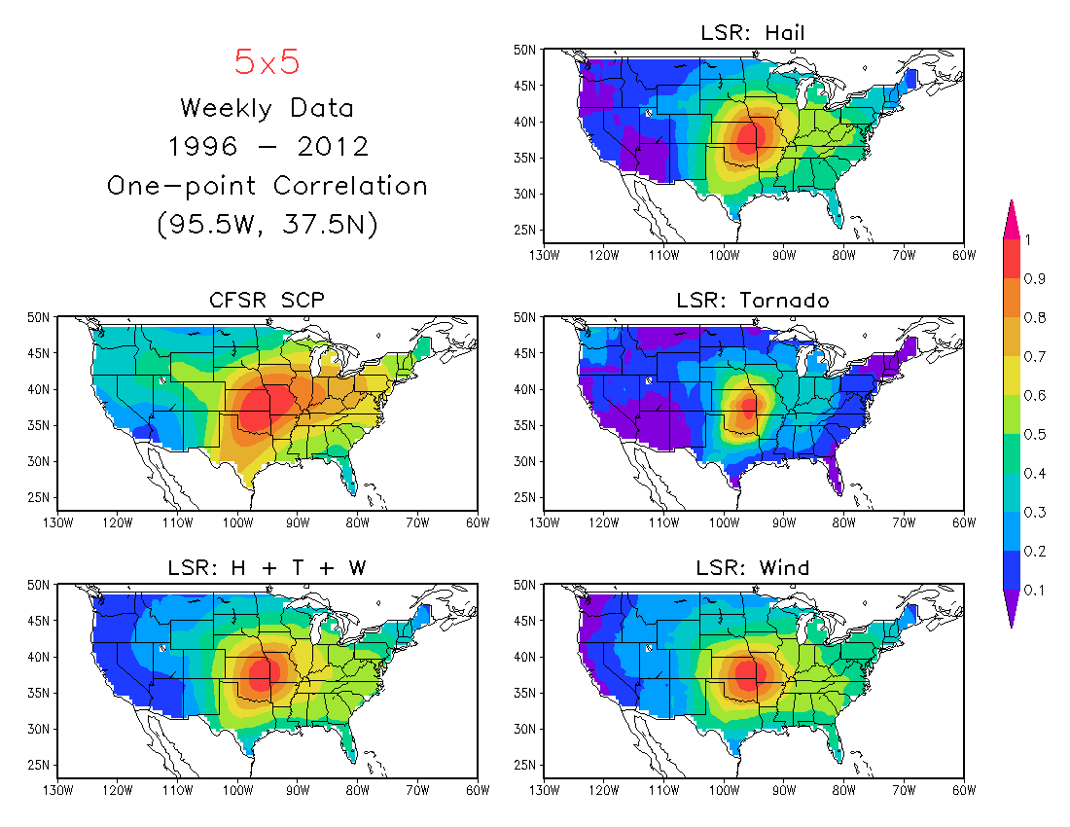
Better spatial coherence for 5º×5º area-averaged LSR anomalies

Slide 4
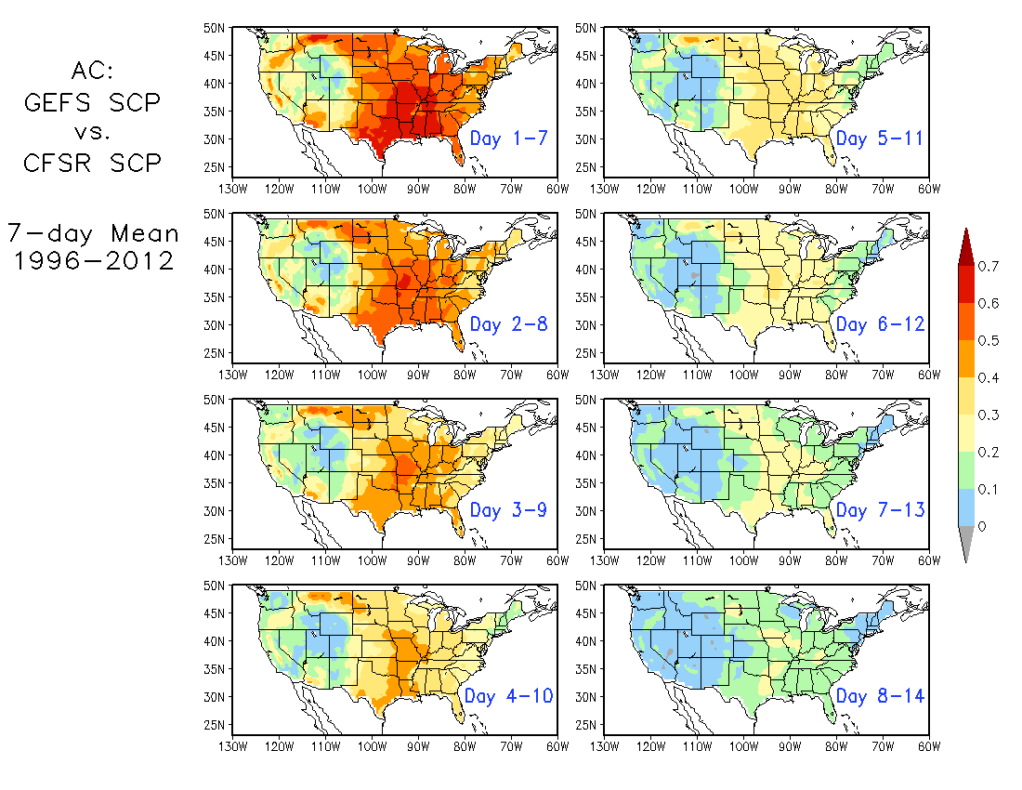
0.5º×0.5º
Forecast Skill
for SCP

Slide 5
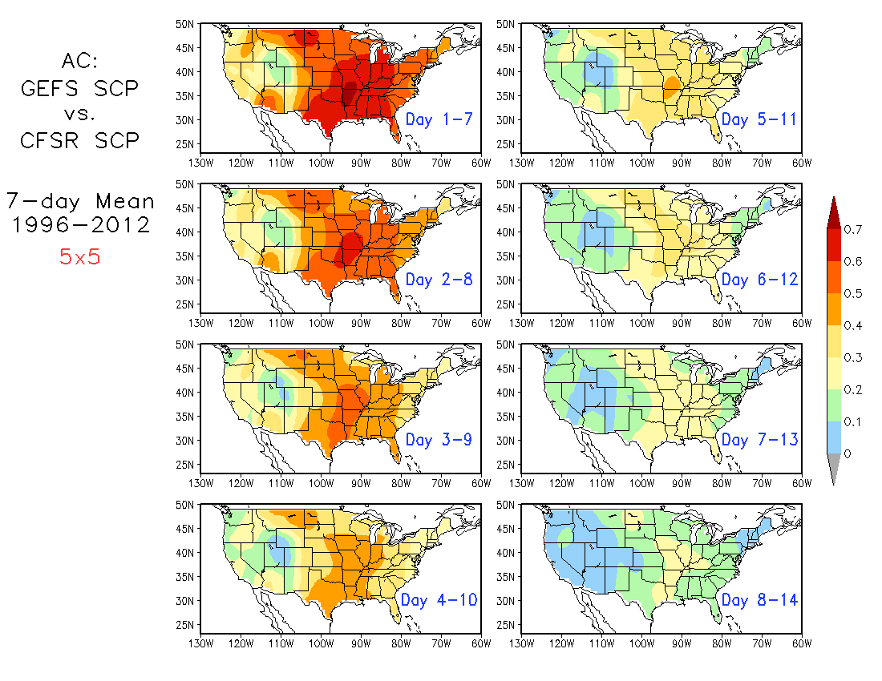
Slightly higher skill
5º×5º
Forecast Skill
for SCP

Slide 6
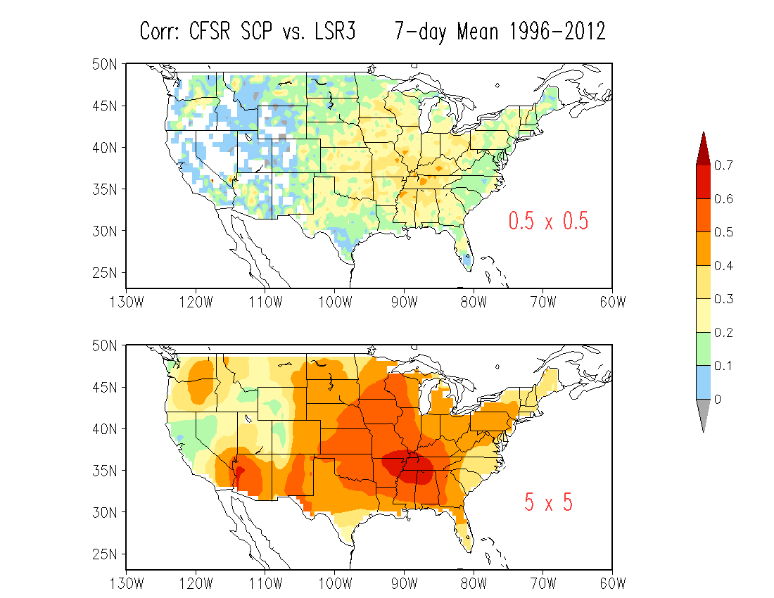
OBS
Significantly increased correlation

Slide 7
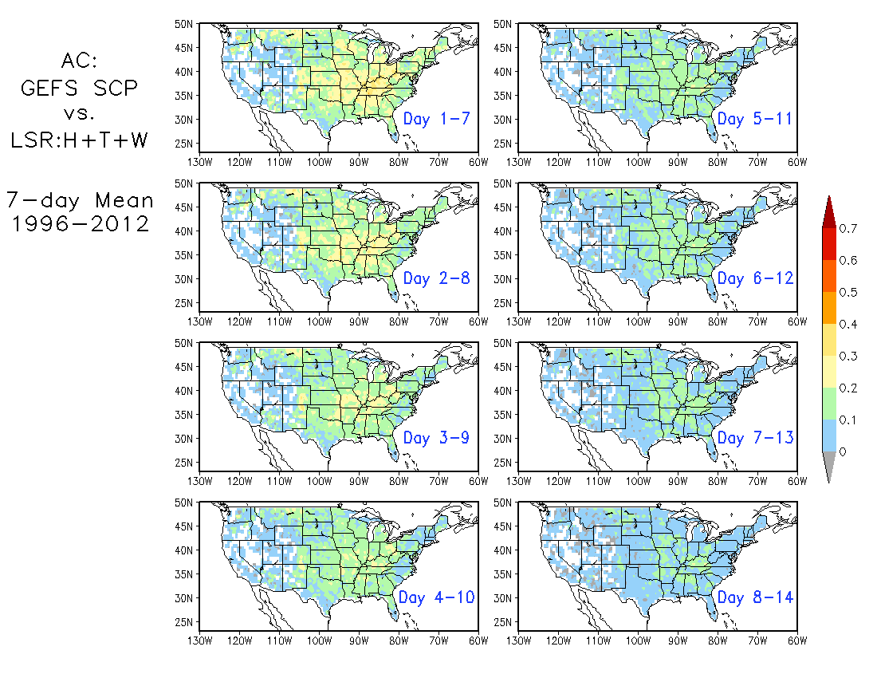
Week 1
0.5º×0.5º
Week 2

Slide 8
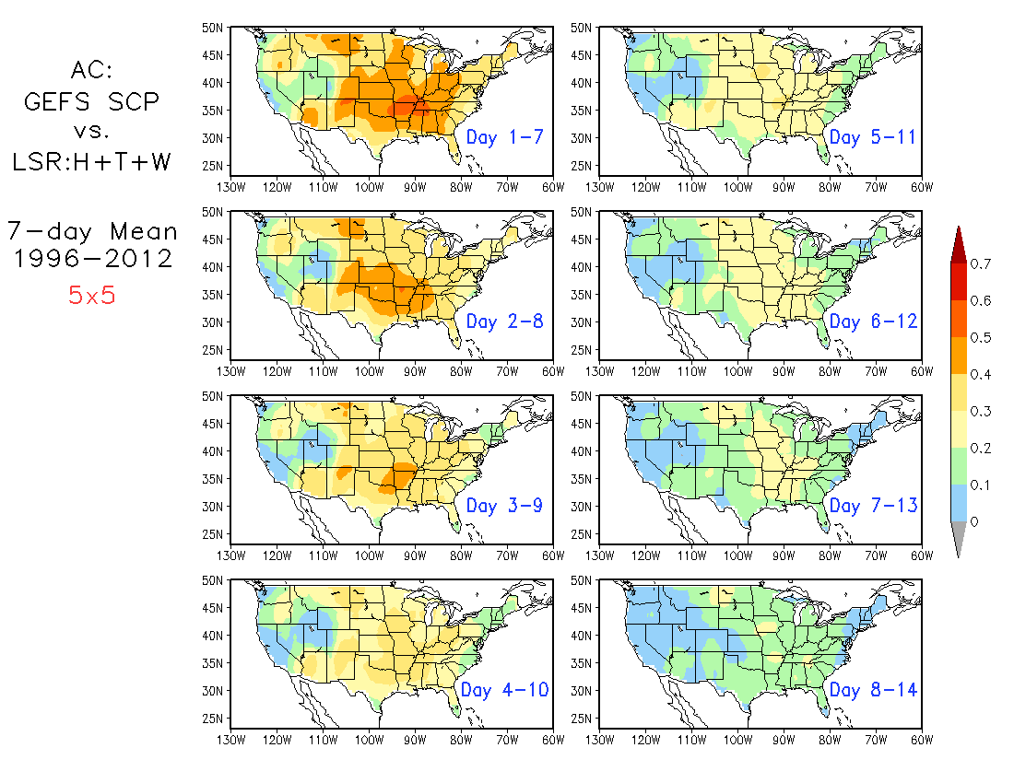
Week 1
5º×5º
Week 2

Slide 9
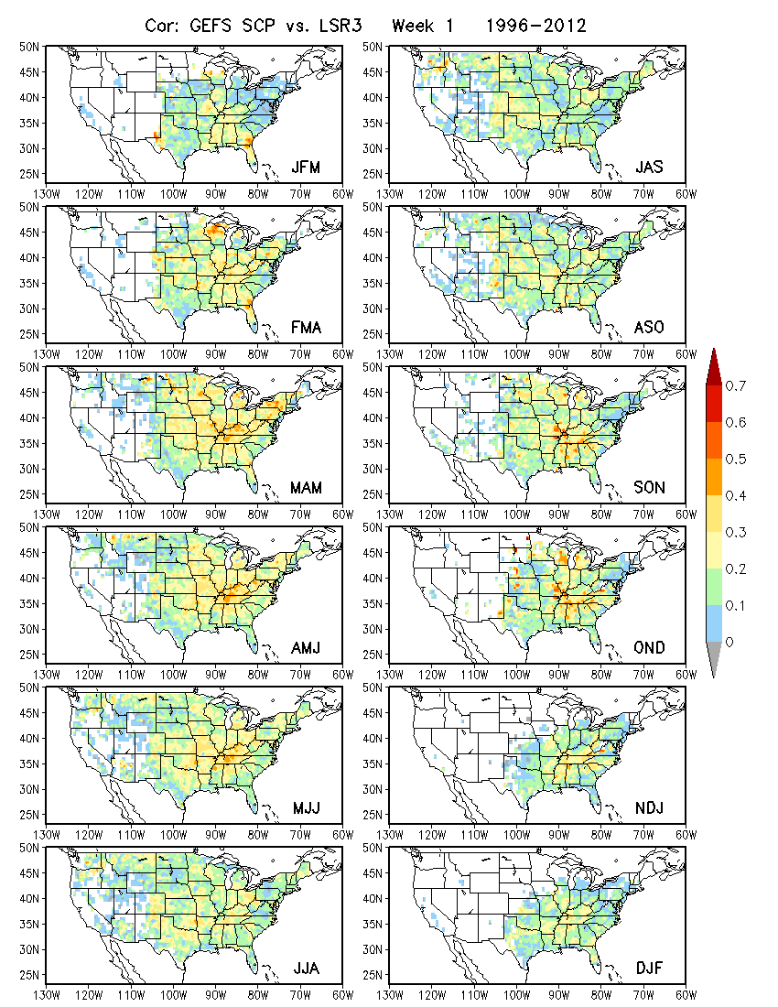
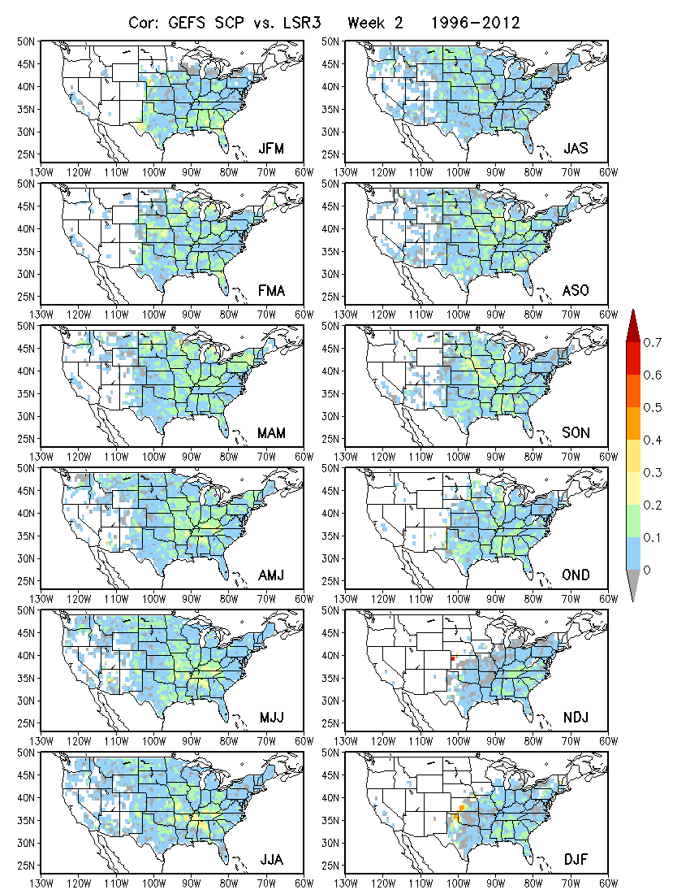
0.5º×0.5º
Week 1 Week 2
3-month Window

Slide 10
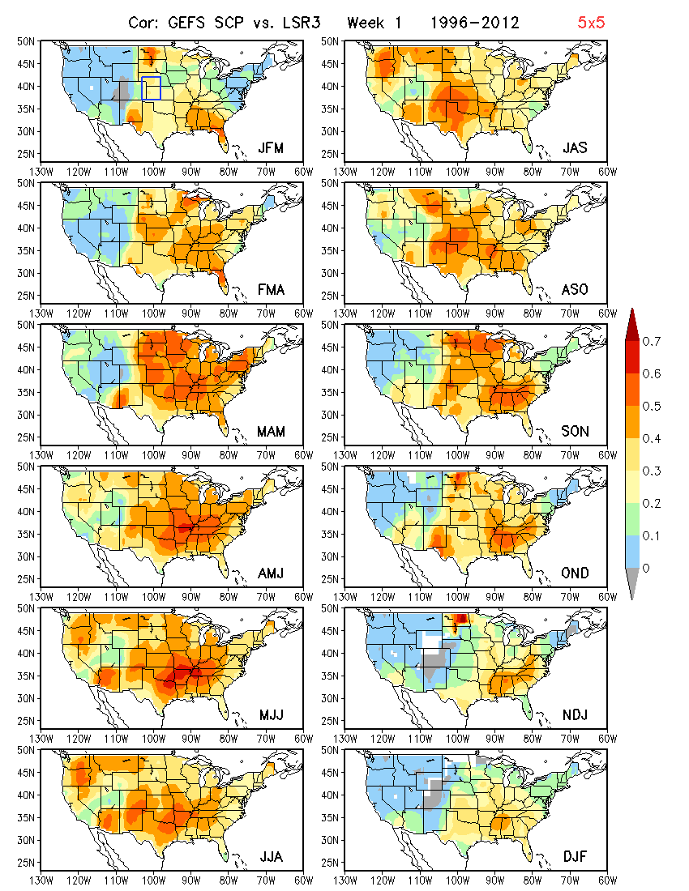
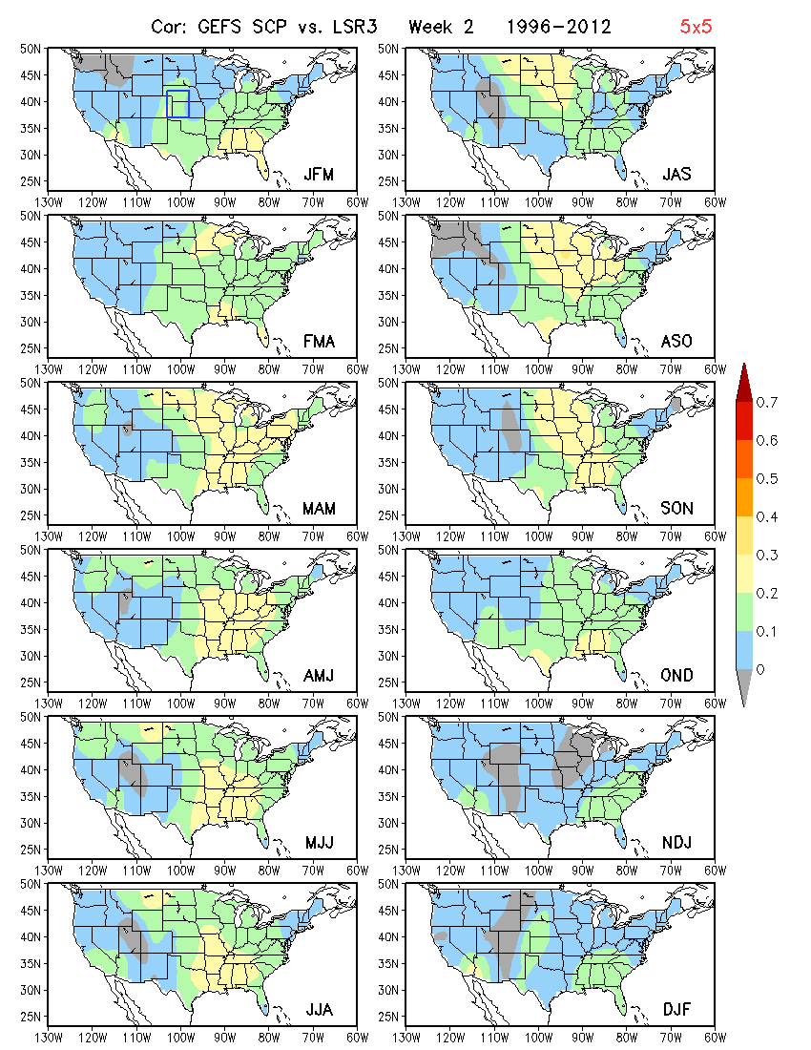
5º×5º
Week 1 Week 2
3-month Window

