Slide 1
Update
25Jul2017
Climatology and seasonality of
SCP
CAPE
BWD
SRH
using CFSR data from 1996 to 2012.
The results suggest that the seasonality of SCP is mainly determined by the seasonal changes of CAPE.

Slide 2
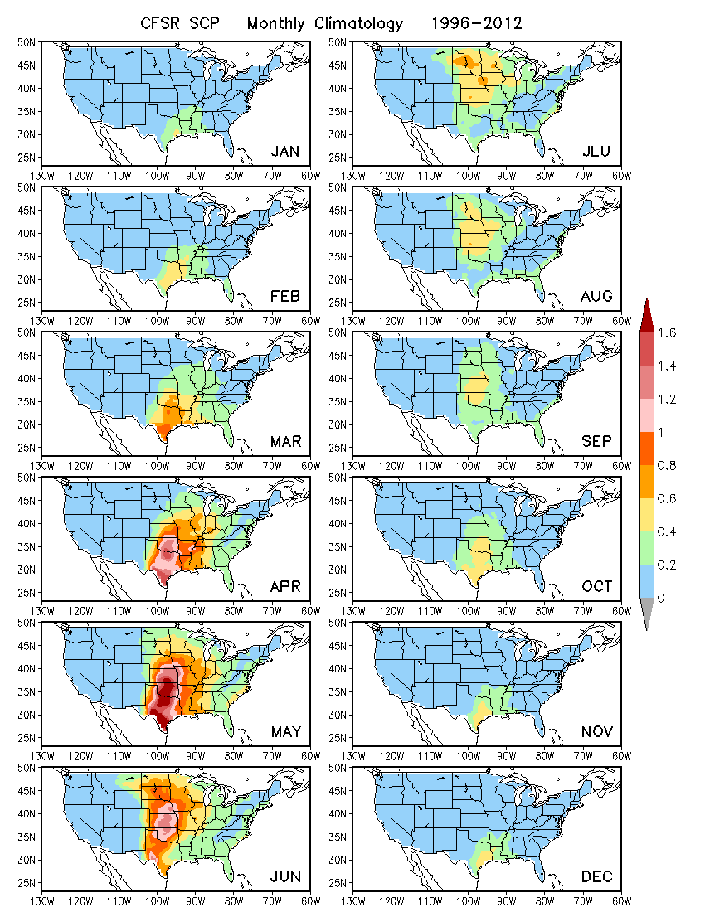
SCP

Slide 3
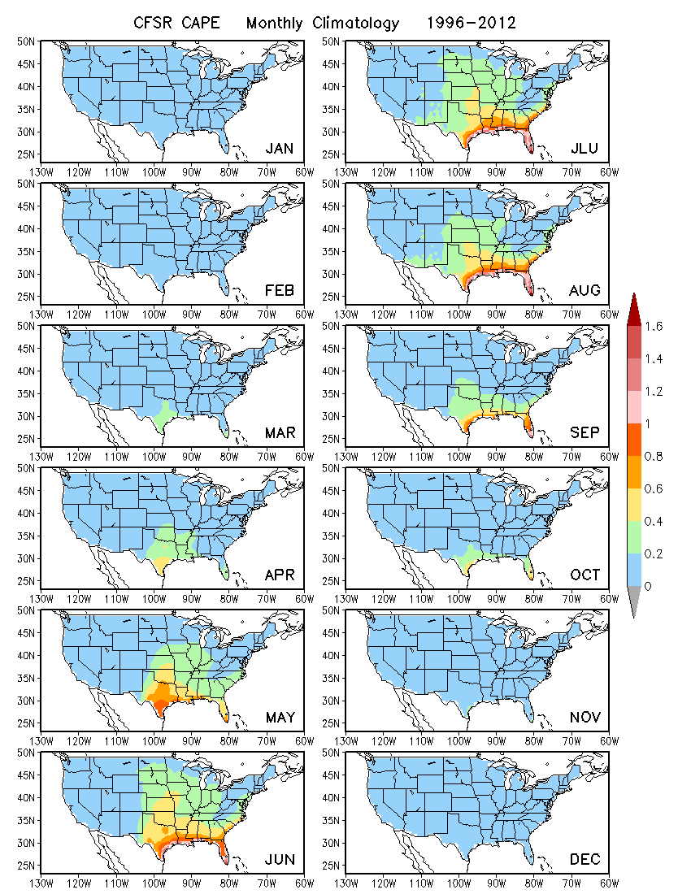
CAPE

Slide 4
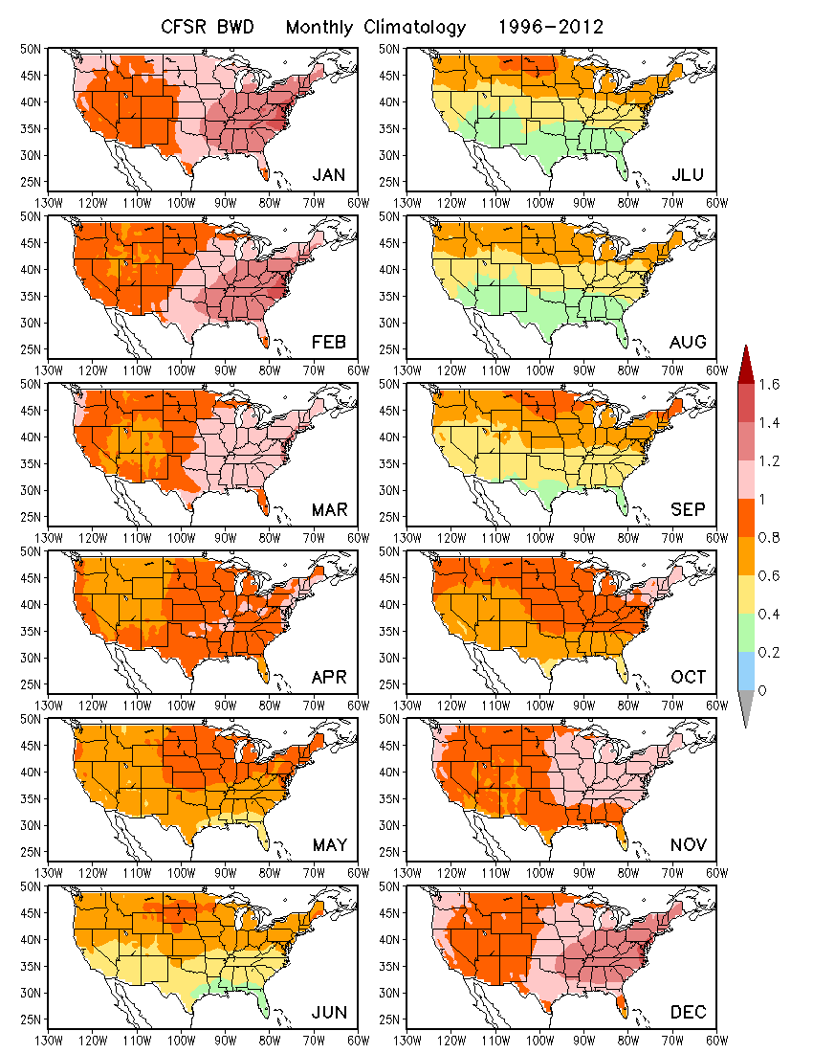
BWD

Slide 5
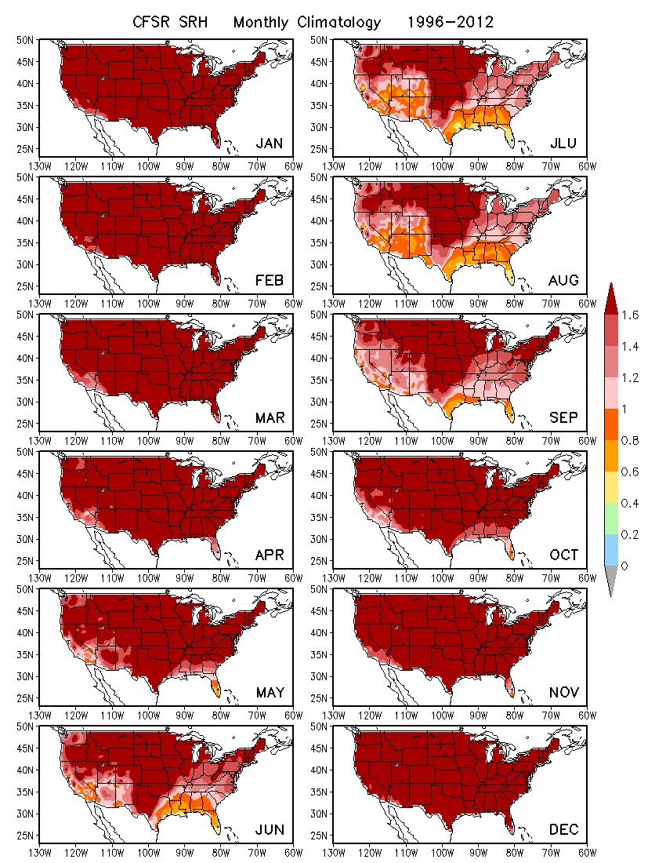
SRH

Slide 6
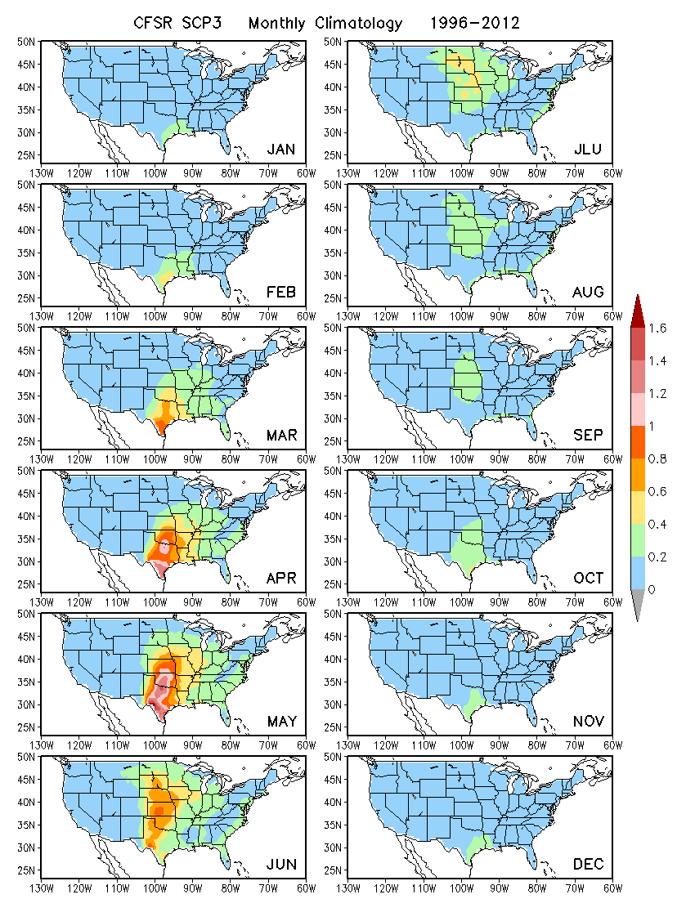
CAPE x BWD x SRH
monthly data
(Reconstruction based on monthly mean data)

