Slide 1
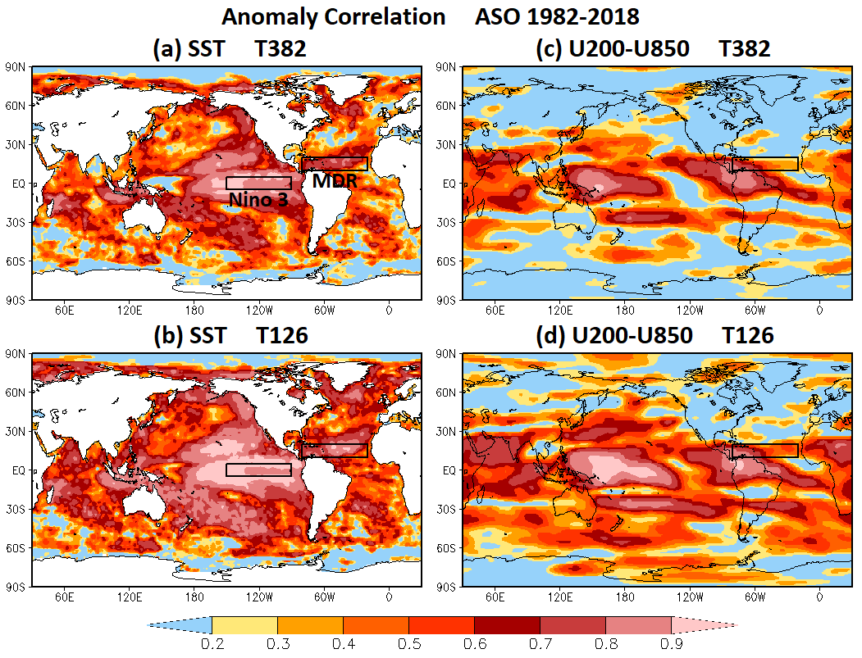
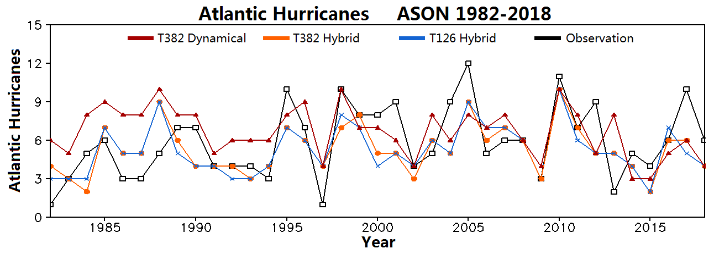
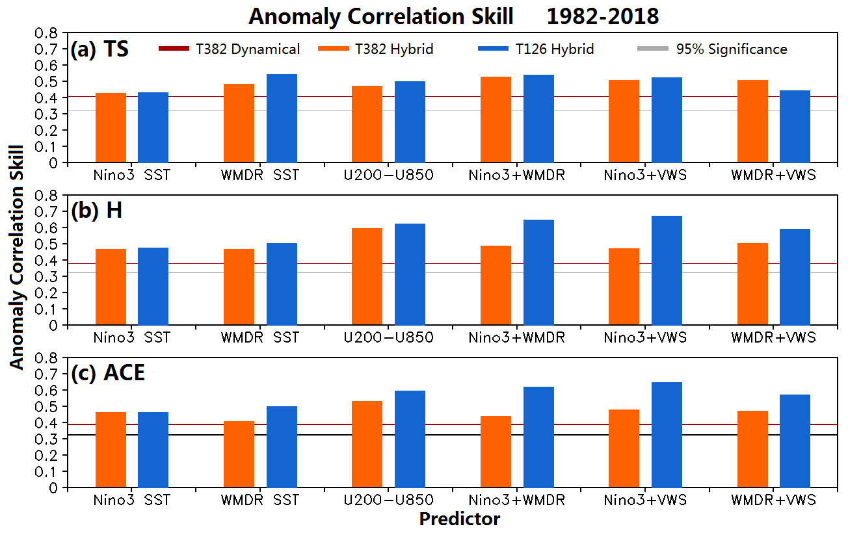
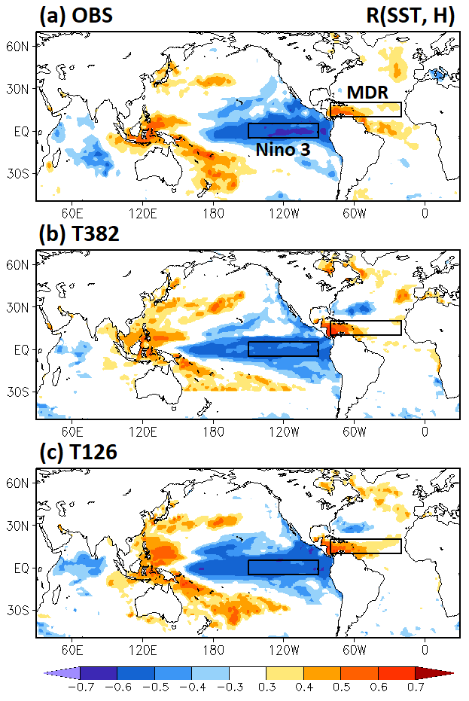
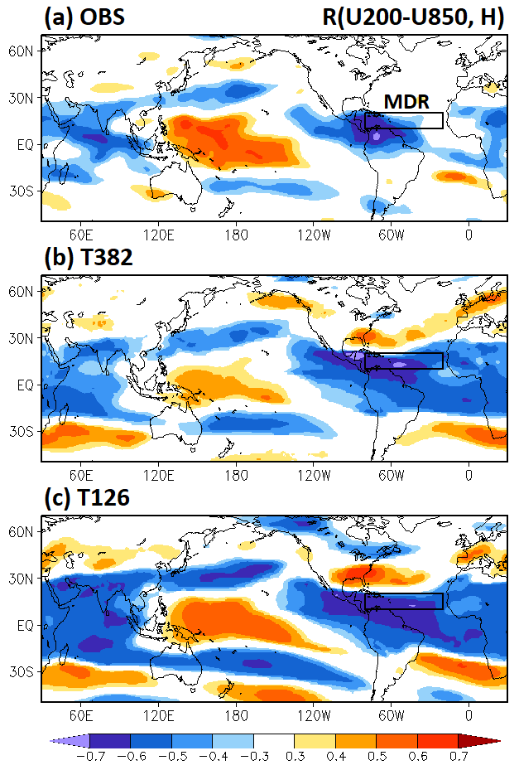
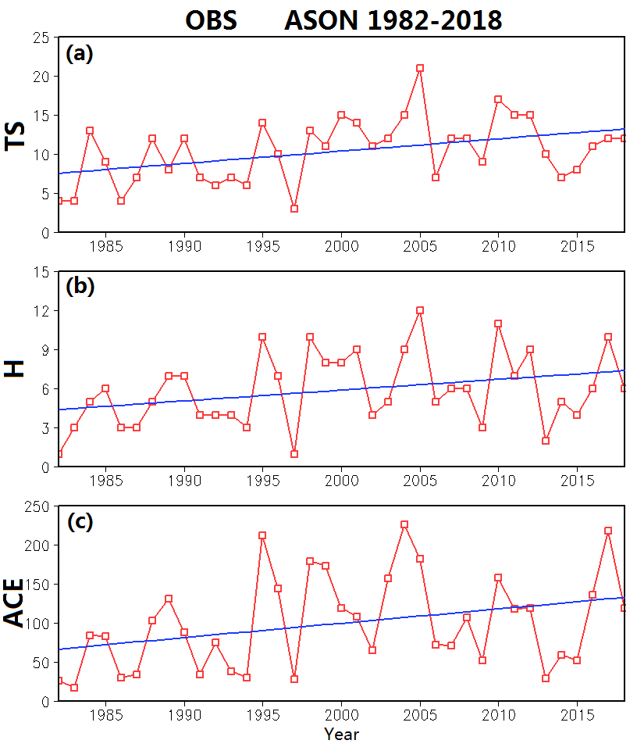
A Comparison of Seasonal Hurricane Forecasts: Dynamical Model versus Dynamical–Statistical Model
Hui Wang, Lindsey N. Long, Arun Kumar
NOAA/NWS/NCEP Climate Prediction Center, College Park, MD 20740
1. Background
To support NOAA Hurricane Season Outlooks, several forecast tools have been developed at CPC, including the high-resolution T382 CFSv2 dynamical model and the low-resolution T126 CFSv2-based hybrid dynamical–statistical model. The goals are
To apply the hybrid model approach with the T382 CFSv2 for the Atlantic seasonal hurricane forecast,
To compare the forecast skills between the dynamical model and the dynamical–statistical model with T382 CFSv2, and
To compare the forecast skills between the T382 CFSv2-based and the T126 CFSv2-based hybrid models.
CFSv2 forecast skill for ASO SST and U200–U850
Comparison of forecast skills
4. Summary and conclusions
Fig. 2. Anomaly correlation skill of (a) T382 CFSv2 and (b) T126 CFSv2 for ASO SST, and (c) T382 CFSv2 and (d) T126 CFSv2 for ASO U200–U850. Boxes indicate the Niño-3 region and Atlantic hurricane Main Development Region (MDR).
Fig. 5
Fig. 5. Time series (1982–2018) of ASON Atlantic hurricanes in observations (black), T328 CFSv2 dynamical forecasts (red), and T382 (orange) and T126 (blue) CFSv2-based hybrid dynamical–statistical model forecasts.
2. Data and methodology
Observational data (1982–2018)
August–November (ASON) Atlantic tropical storms (TS), hurricanes (H), and accumulated cyclone energy (ACE) index
Sea Surface Temperature (SST): NOAA OISSTv2
Vertical Wind Shear (U200–U850): NCEP–DOE Reanalysis
Model data (1982–2018)
T382 CFSv2: Hindcast/forecast initialized in July, 5 members
T126 CFSv2: Hindcast/forecast initialized in July, 24 members
Methodology
A dynamical–statistical forecast tool is developed based on the empirical relationships between observed seasonal hurricane activity and model predicted SST/U200–U850 (predictors).
Forecast skill is cross-validated over the 1982–2018 period.
Fig. 2
High skill in both the Niño-3 region and MDR
Relationships between SST/U200–U850 and hurricane activity
Fig. 3. Maps of correlation between detrended observed Atlantic ASON hurricanes and ASO SST in (a) observations (OBS), (b) T382 CFSv2 forecasts, and (c) T126 CFSv2 forecasts over the 1982–2018 period.
Fig. 4. Same as Fig. 3, but for ASO U200–U850 correlated with the observed Atlantic ASON hurricanes.
Fig. 6
Fig. 3
Fig. 6. AC skill of the forecasts with the T382 CFSv2 dynamical model (red) and T382 (orange) and T126 (blue) CFSv2-based hybrid models for ASON Atlantic (a) tropical storms (TS), (b) hurricanes (H), and (c) ACE index, cross-validated over 1982–2018 using different predictors derived from the CFSv2 forecasts. Observed preseason North Atlantic SST is an additional predictor.
3. Results
Variability of Atlantic
tropical storms and
hurricanes
Fig. 4
Fig. 1. Time series of observed August–November (ASON) Atlantic (a) tropical storms (TS), (b) hurricanes (H), and (c) accumulated cyclone energy (ACE) index from 1982 to 2018, and corresponding linear trend (blue line).
Regions of high correlations in Figs. 3 and 4 are used to construct predictors for the dynamical–statistical model by averaging SST and vertical wind shear (VWS) over these regions.
Predictors:
Niño-3 SST
Western MDR SST
MDR VWS U200–U850
A dynamical–statistical model was developed for forecasting Atlantic seasonal hurricanes using SST and vertical wind shear as predictors derived from the T382 CFSv2 forecasts.
T382 dynamical model vs. T382 CFSv2-based hybrid model: The hybrid model has overall better skills than the dynamical model.
T382 CFSv2-based hybrid model vs. T126 CFSv2-based hybrid model: The low-resolution model has better skills than the high-resolution model, likely due to more ensemble members.
Fig. 1
Large interannual variation + upward trend

