Slide 1
Update on Severe Weather Project
Hui Wang, Alima Diawara, Arun Kumar, David DeWitt
11 March 2019

Slide 2
Previous Meetings with OPB
09/12/2017
02/09/2018

Slide 3
Updates
Week 2 (GEFS based)
Create a website for experimental real-time outlook
Forecasts for LSR3, as well as individual types of SW
Improve forecast skill by considering spatial covariation
Assess forecast skills for various time-means (days 8–10, 10–12, 12–14)
Weeks 3–4
Use the CFSv2 45-day hindcasts/forecasts
Assess forecast skills

Slide 4
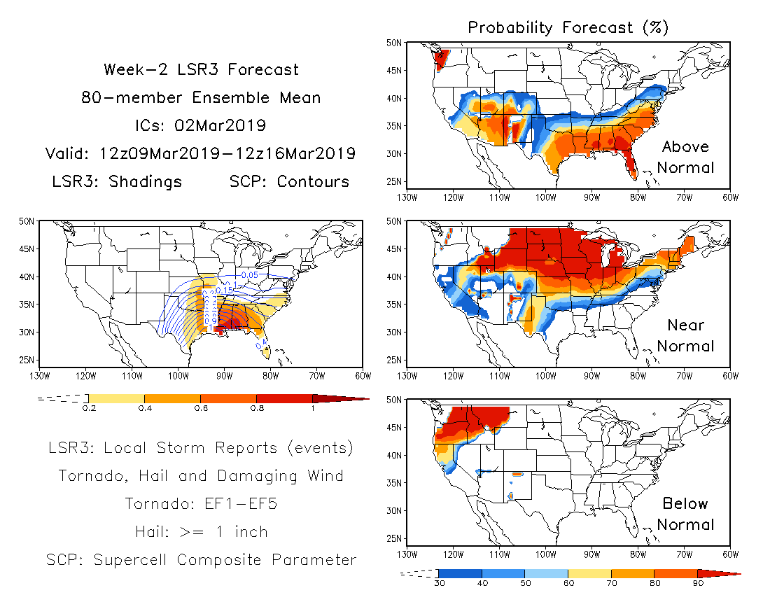
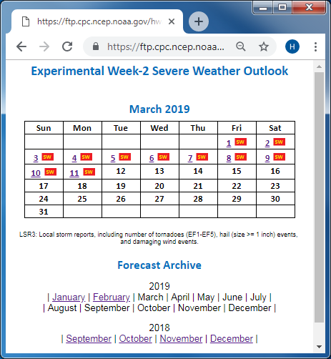
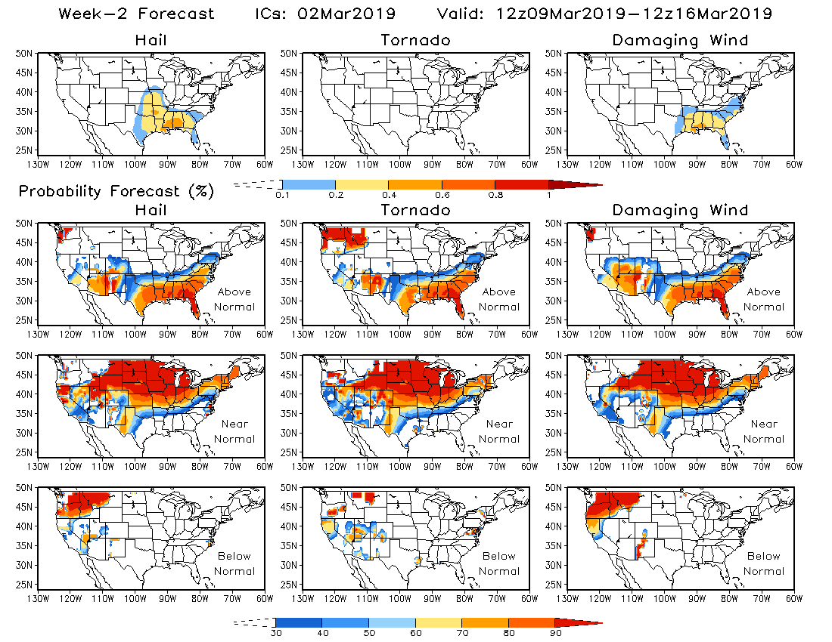
Experimental Real-time Forecast

Slide 5
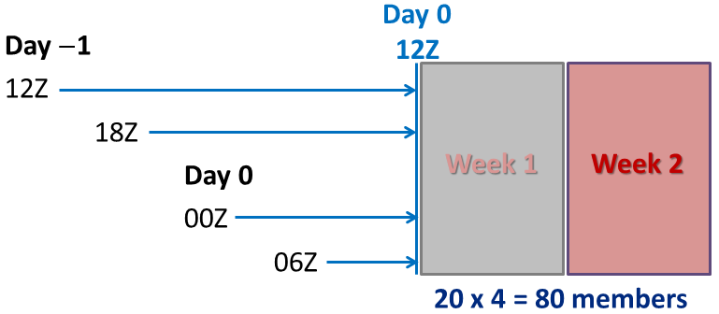
Real-time Week-2 Severe Weather Outlook
Weekly LSR3
Hail + Tornado + Damaging wind
Total field
Probability forecast
Individual types of severe weather
Hail
Tornado
Damaging wind
GEFS Week-2 SCP Forecast
Weekly SCP: 7-day average of daily mean SCP from 12Z to 12Z.

Slide 6
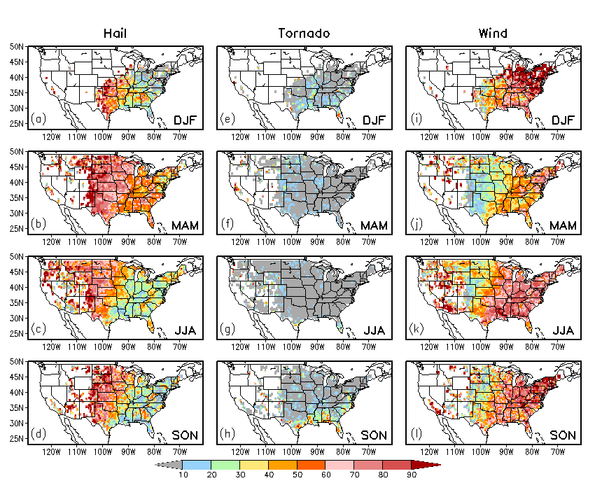
LSR3 = Hail + Tornado + Damaging Wind
Ratio (%) of climatological seasonal total number of individual types of severe weather to the climatological seasonal total number of LSR3 for hail (left), tornado (middle), and damaging wind (right), respectively, in (a,e,i) DJF, (b,f,j) MAM, (c,g,k) JJA, and (d,h,l) SON.

Slide 7
Anomaly Correlation Skill
Week-2 Forecast
5º×5º
LSR3 vs. Hail, Tornado, Wind

Slide 8
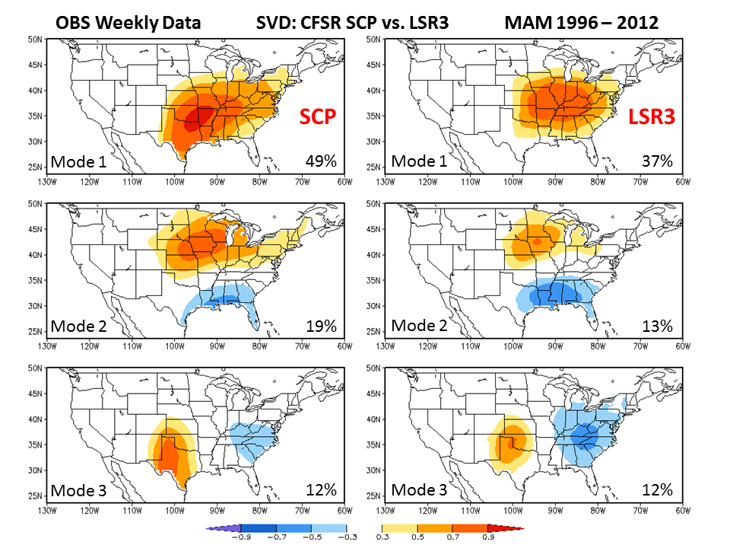
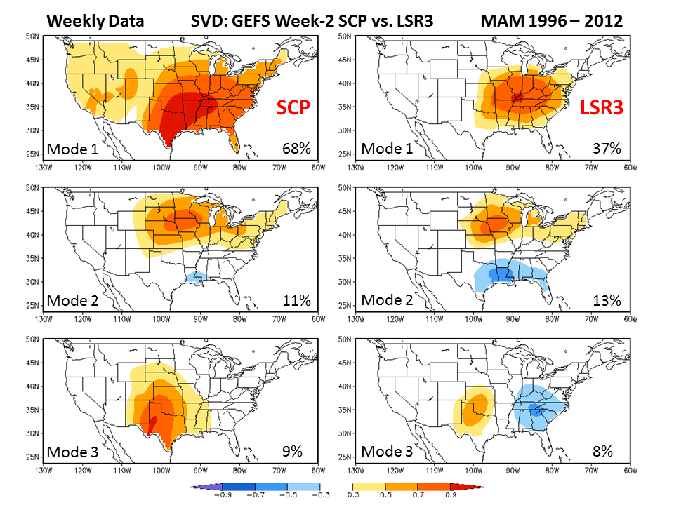
SVD: Spatial Covariation of
SCP and LSR3
OBS
12%
GEFS Week-2 FCST SCP and
OBS LSR3

Slide 9
Forecast Skill for Week-2 Severe Weather
Forecast skills for week-2 severe weather cross-validated over MAM 1996–2012 with (a) simple linear regression model at the 0.5º×0.5º grid, (b) 5º×5º area-averaged anomalies, and (c) the SVD-based hybrid model.

Slide 10
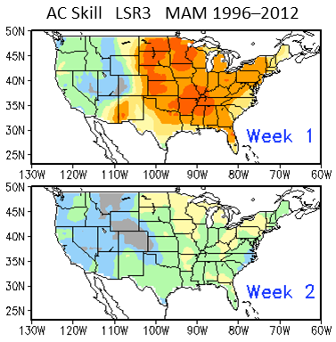
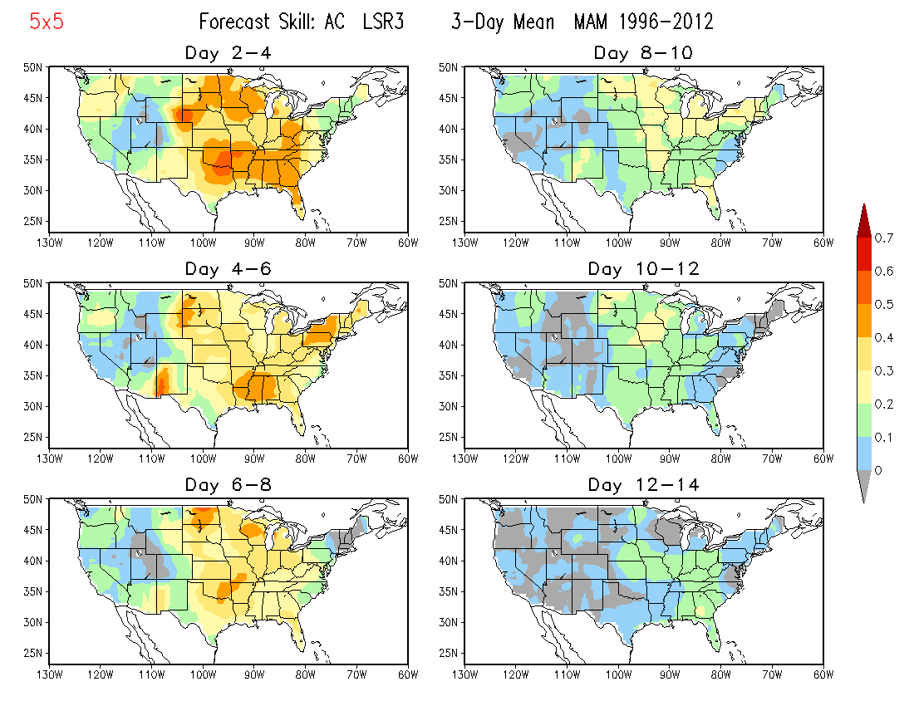
Forecast Skill: Weekly vs. 3-day Mean
Week-1 skill is better than Days 2–4, 4–6, and 6–8.
Week-2 skill is comparable to Days 8–10, but better than Days 10–12 and 12–14.

Slide 11
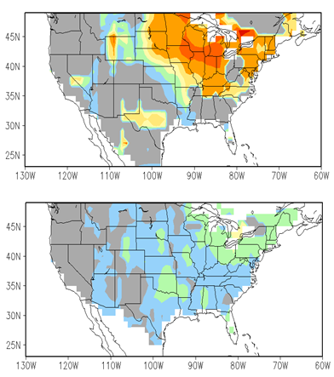
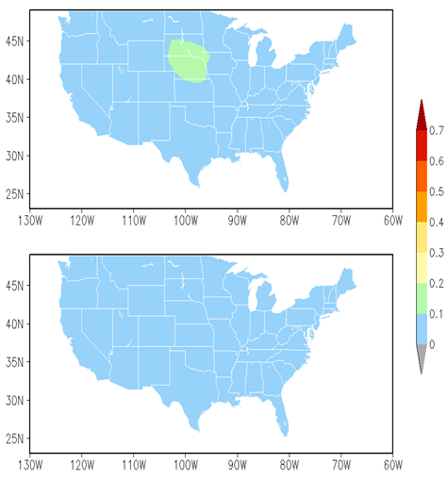
AC Forecast Skill LSR3 (5°x5°)
Cross-Validation over
MAM 1999-2010 (CFSv2 Hindcast Period)
Week 1
Week 3
Week 2
Week 4
Using CFSv2 predicted weekly SCP as a predictor

Slide 12
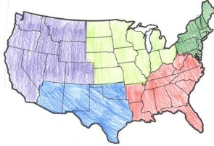
Potential Improvements for Week 3-4 Severe Weather
Using CFSv2 45-day Forecast
SVD-based relationship between CFSv2 SCP and OBS LSR3
Regional forecasts
Northeast
West
Midwest
Southeast
Southwest

Slide 13
Future Work
Implement experimental real-time outlooks with GEFS SCP for various 3-day means
Days 8–10
Days 10–12
Days 12–14
Continue working on the development of forecast tools for week 3-4 severe weather with CFSv2 45-day hindcast/forecast

