Slide 1
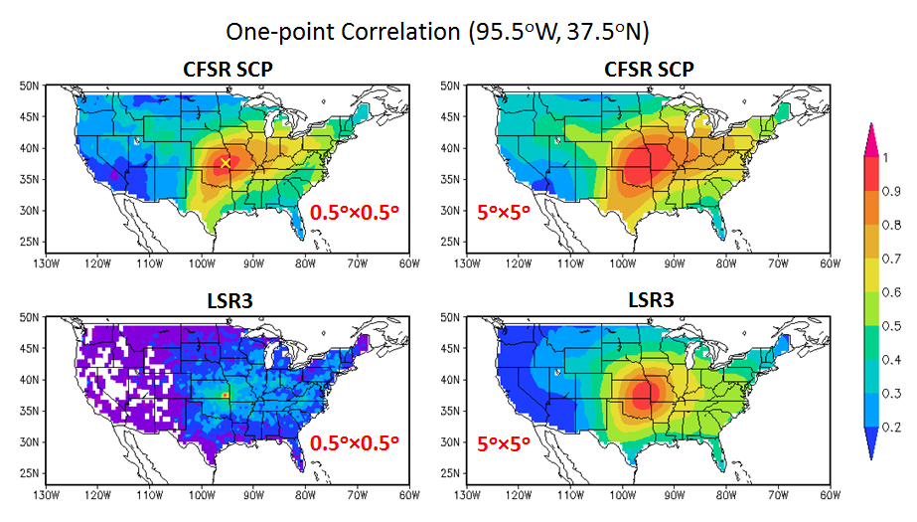
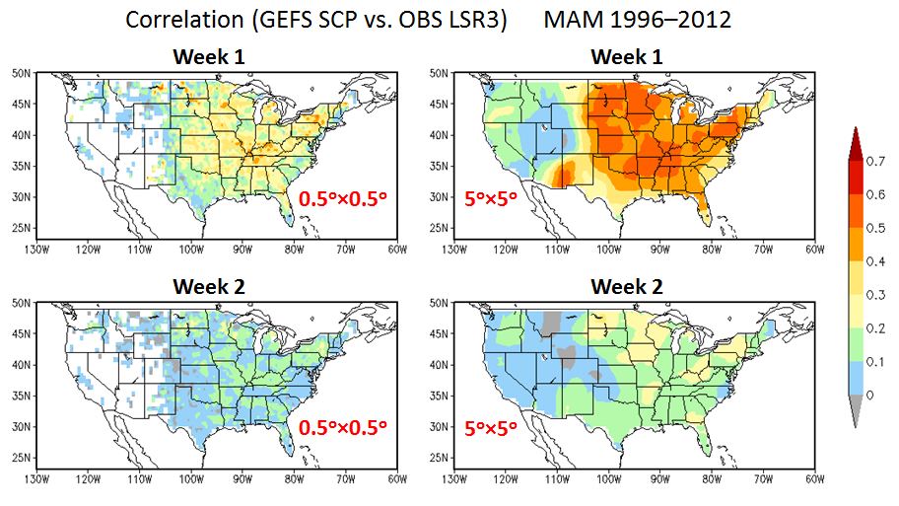
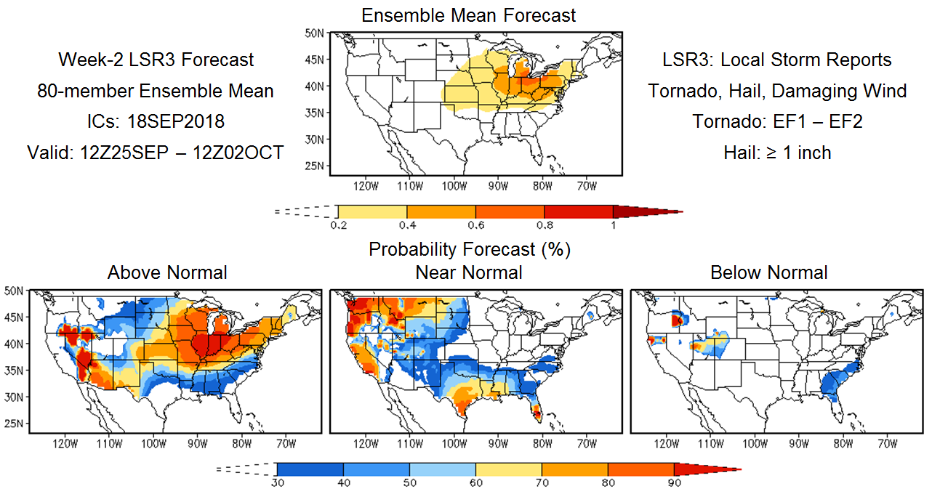
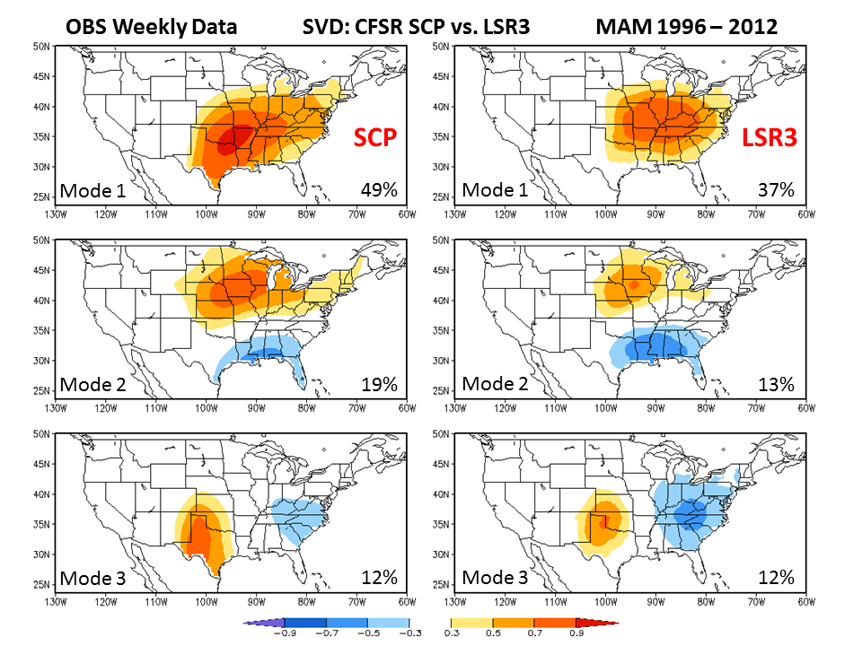
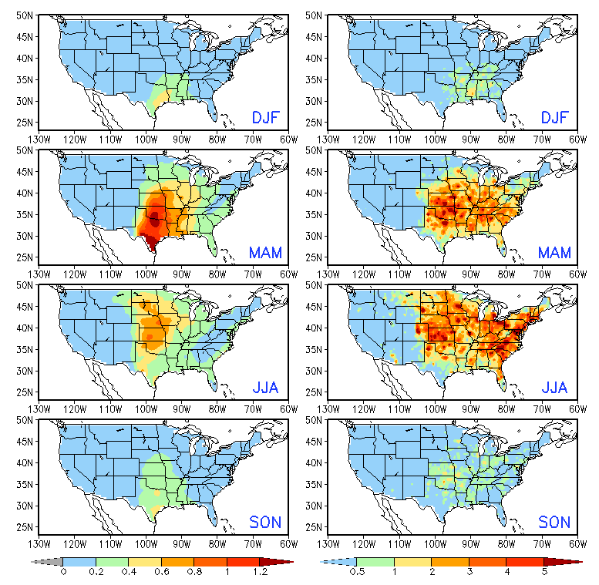
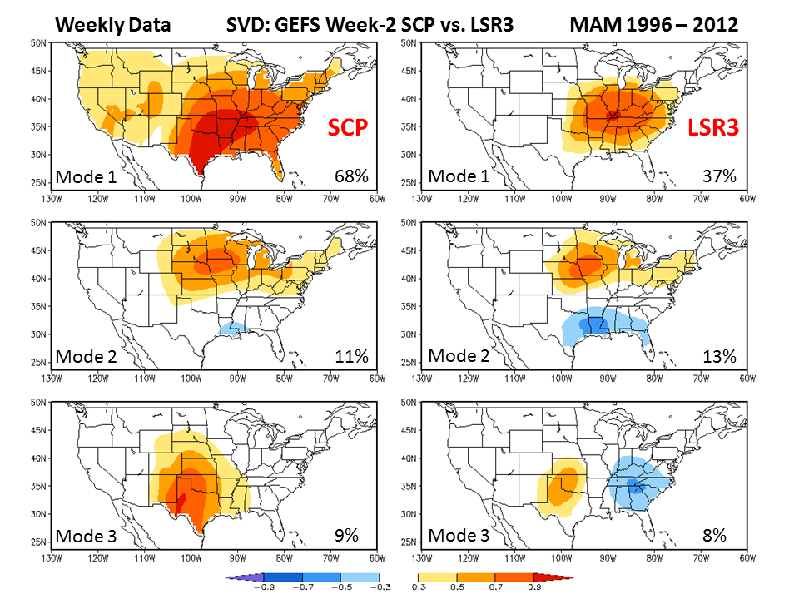
Developing an Experimental Week 2 – 4 Severe Weather Outlook for the United States
Hui Wang, Alima Diawara, Arun Kumar, David DeWitt
NOAA/NWS/NCEP Climate Prediction Center, College Park, MD 20740
1. Background
Developing week 2 to 4 severe weather outlooks is one of the CPC project under the Office of Science and Technology Policy Initiatives. The goals of this project are
To develop experimental forecast for week-2 severe weather over the U.S., and
To explore the feasibility of forecasts for week 3 – 4 severe weather.
Spatial coherence of weekly SCP and LSR3
Forecast skill for week-2 severe weather
Experimental real-time forecast
4. Summary and conclusions
Fig. 2. Maps of one-point correlation for weekly SCP and LSR3 with anomalies at the 0.5º×0.5º grid (left) and those area-averaged over a 5º×5º box (right), respectively. The spatial coherence of weekly LSR3
Fig. 3. Correlation between the GEFS predicted SCP and observed LSR3 for week 1 and week 2 with anomalies at the 0.5º×0.5º grid (left) and those area-averaged over a 5º×5º box (right), respectively.
Fig. 6
Fig. 6. Forecast skills for week-2 severe weather cross-validated over MAM 1996–2012 with (a) simple linear regression model at the 0.5º×0.5º grid, (b) 5º×5º area-averaged anomalies, and (c) the SVD-based hybrid model. The forecast skill can be improved by using the anomalies averaged over a larger domain (b) and by considering the leading patterns of LSR3 spatial co-variations (c). The forecast skill in (b) sets a good benchmark.
2. Data and methodology
Observational data
CFS Reanalysis (CFSR)
NWS Local Storm Report (LSR3) including hail (≥ 1 inch), tornado (EF1–5), and damaging wind (gridded to a 0.5º grid)
Model data
GEFS 16-day hindcasts (1996–2012, 5 members, every 4 days) and real-time forecasts (4×daily, total 80 members)
Methodology
A dynamical–statistical forecast method is developed based on the empirical relationships between observed LSR3 and model predicted large-scale environmental conditions (predictor).
Predictor: Supercell Composite Parameter (SCP),
SCP = (CAPE/1000 J kg⁻¹)×(SRH/50 m⁻² s⁻²)×(BWD/20 m s⁻¹)
CAPE: Convective available potential energy
SRH: Storm-relative helicity; BWD: bulk wind difference
The relationship between observed LSR3 and GEFS SCP is quantified by either the simple linear regression method or the singular value decomposition (SVD) technique.
Fig. 2
is significantly increased with the area-averaged anomalies.
Relationship between model SCP and observed LSR3
Fig. 3
Fig. 4. Maps of homogeneous correlation for the first three SVD modes between weekly CFSR SCP and LSR3 during the MAM of 1996–2012. The percentage of the variance explained by each SVD mode is also provided.
Fig. 5. Same as Fig. 4, but for the three leading SVD modes between the GEFS week-2 SCP and observed LSR3. By projecting the GEFS SCP onto the SCP SVD modes, week-2 LSR3 can be predicted based on the SCP−LSR3 relationship depicted by the SVD results.
Fig. 7
Fig. 7. Example of a real-time week-2 severe weather forecast issued on September 18, 2018, including both the 80-member ensemble mean forecast (top) and probability forecast (bottom).
3. Results
Seasonality of SCP and LSR3
A dynamical–statistical model was developed for forecasting week-2 severe weather over the U.S. using the SCP as a predictor derived from the GEFS 16-day forecasts.
Cross-validations suggest a low skill for week-2 severe weather using the simple linear regression model at the 0.5º grid.
The forecast can be improved by using the 5º×5º area-averaged anomalies, as well as the SVD-based hybrid model.
The model will be tested for week 3−4 severe weather forecast with the SCP derived from the CFSv2 45-day forecasts.
Acknowledgments. We would like to thank Jon Gottschalck, Brad Pugh, Dan Harnos, and Steve Baxter for helpful discussions, and Yuejian Zhu and Hong Guan for providing GEFS model data.
Fig. 4
SCP
OBS Climatology 1996–2012
LSR3
Fig. 1. Observed seasonal climatology of SCP and LSR3. The SCP in GEFS (not shown) has a very similar seasonal cycle to the observations. Both SCP and LSR3 show similar seasonality over the central U.S.
Fig. 1
Fig. 5

