Slide 1
Developing an Experimental Week 2 to 4 Severe Weather Outlook for the United States
Hui Wang, Alima Diwara, Arun Kumar, David DeWitt
NOAA Climate Prediction Center
Acknowledgments:
NCEP/CPC: Brad Pugh, Daniel Harnos, Jon Gottschalck, Stephen Baxter
NCEP/EMC: Yuejian Zhu, Hong Guan
NOAA’s 42nd Climate Diagnostics and Prediction Workshop
23–26 October 2017, Norman, Oklahoma

Slide 2
Outline
1. Background
2. Data and Method
3. Development of a forecast model
• Seasonality of severe weather
• Dynamical-statistical forecast
• Forecast skill (cross-validation)
• Forecast improvement
4. Conclusions

Slide 3
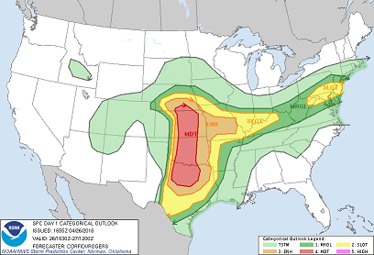
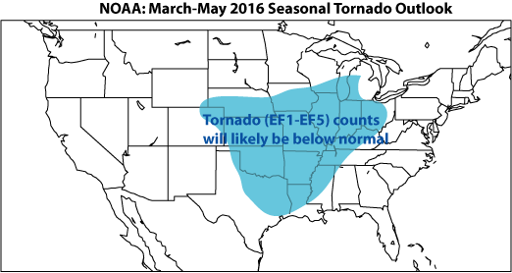
Background
Week 2 to 4 Severe Weather Forecast
One of the CPC proposed projects for the OSTP initiatives
Goals:
To develop experimental forecast tools for Week-2 severe weather (Year 1)
To develop experimental forecast tools for severe weather at Week 3 and 4 time range (Year 2)
Severe Weather Forecast at Different Timescales
Short-term Prediction (∼ days)
(Initial condition)
Seasonal Outlook (∼ months)
(SST, ENSO, AMO, …)
SPC Day-1 Outlook
Extended-range Prediction
(∼ weeks)
Relatively low predictability
CPC Seasonal Outlook

Slide 4
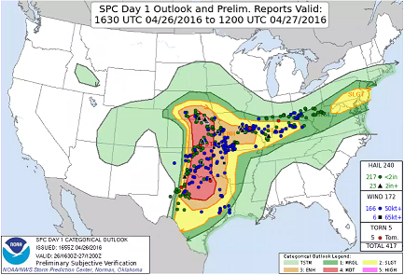
Day 1 Outlook
Example of
Severe Weather Outlook
Storm Prediction Center
Probabilistic forecast
Tornado (•)
Hail (•)
Damaging wind (•)
Verification
Carbin et al. (2016, BAMS)
Based on CFSv2 forecast
Provide extended-range SW environment guidance
Supercell composite parameter (SCP)
SCP > 1

Slide 5
Data and Method
Data
OBS data:
CFSR (CFS Reanalysis)
LSR (Local Storm Report)
Hail, tornado, damaging wind
(Re-gridded → 0.5º×0.5º)
Model data:
GEFS (Global Ensemble Forecast System) 16-day hindcast
1996 – 2012 (17 years)
Every 4 days, 5 members
0.5º×0.5º resolution
SCP (Supercell Composite Parameter)
SCP = (CAPE/1000 J kg⁻¹)×(SRH/50 m⁻² s⁻²)×(BWD/20 m s⁻¹)
CAPE: convective available potential energy
SRH: storm-relative helicity
BWD: bulk wind difference
Hybrid dynamical – statistical model
Using GEFS predicted SCP as a predictor
Statistical relationship between model SCP and OBS LSR
Cross-validation of the forecast model
Forecast improvements

Slide 6
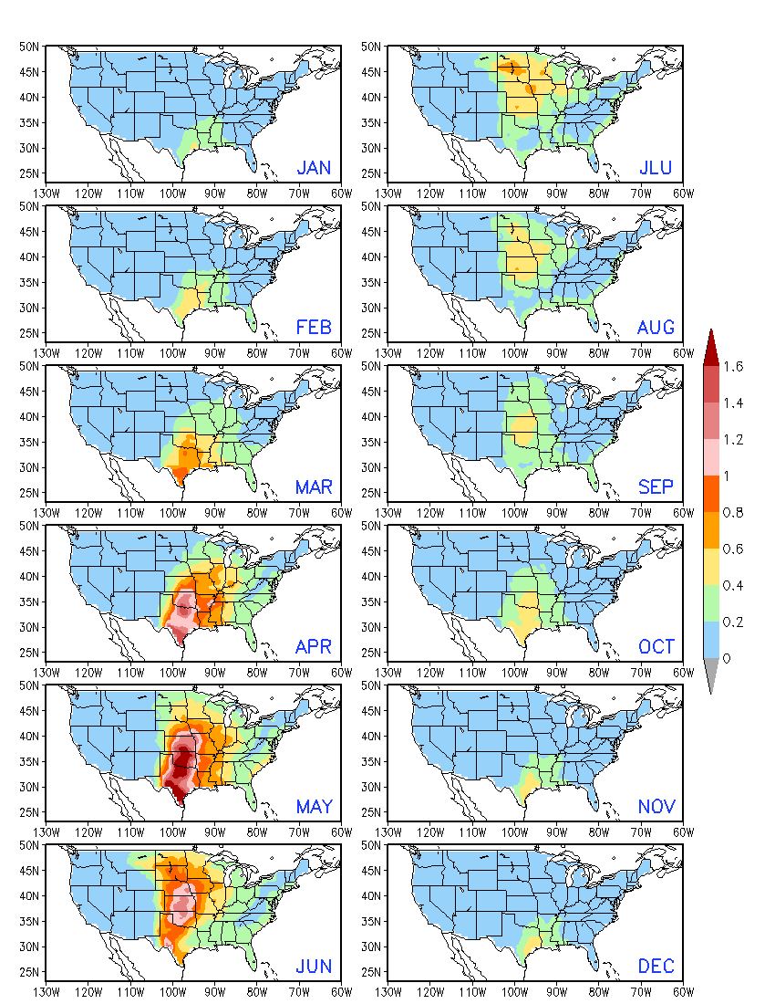
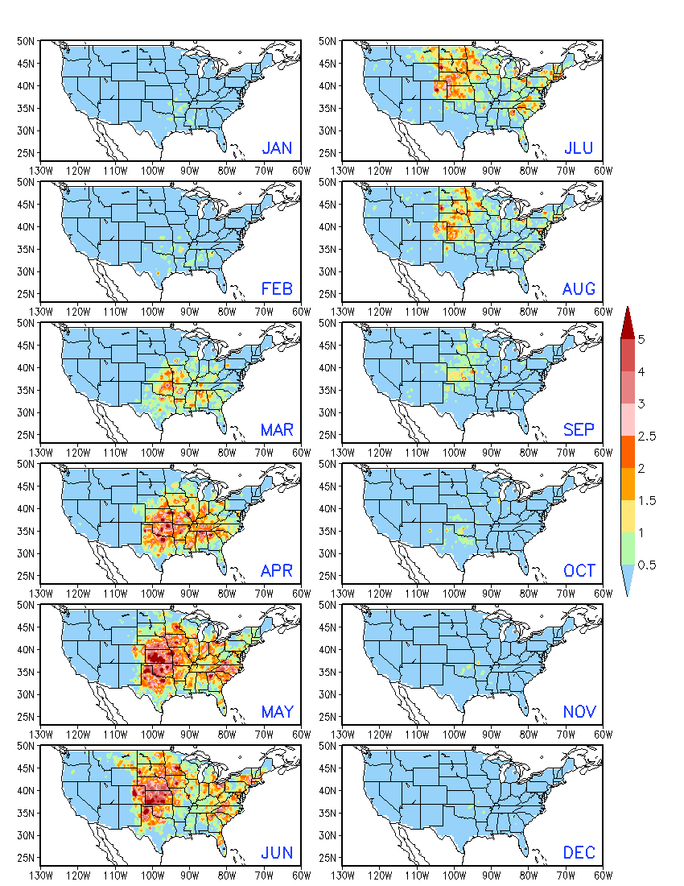
Seasonality
OBS Monthly Climatology 1996 – 2012
CFSR SCP
LSR: Hail

Slide 7
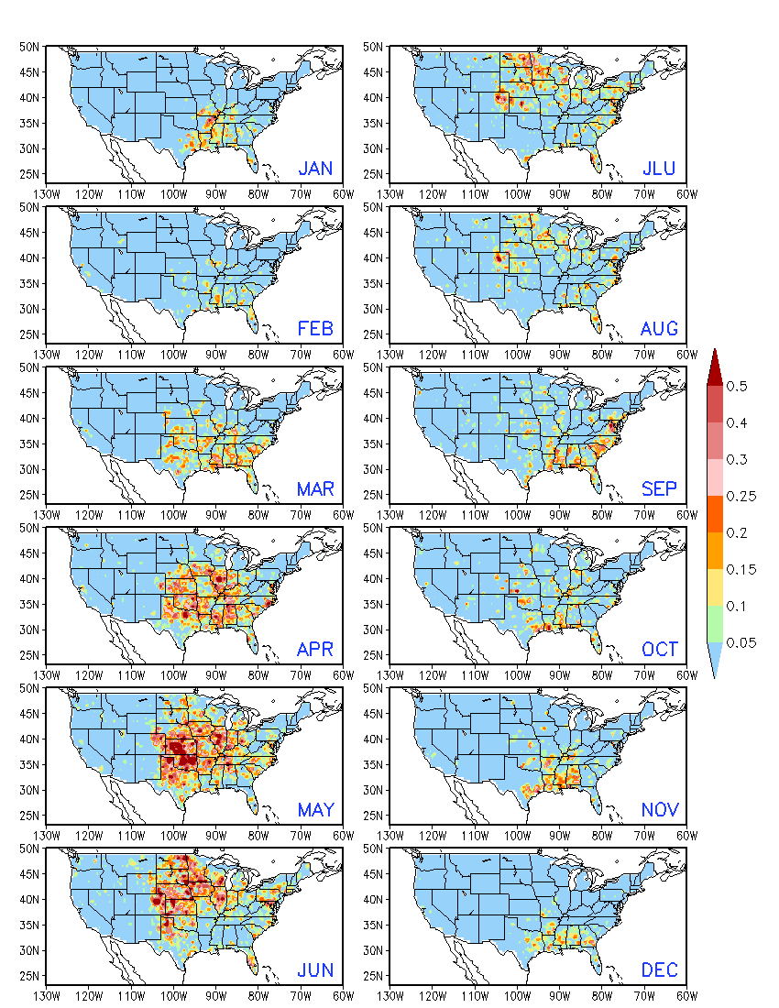
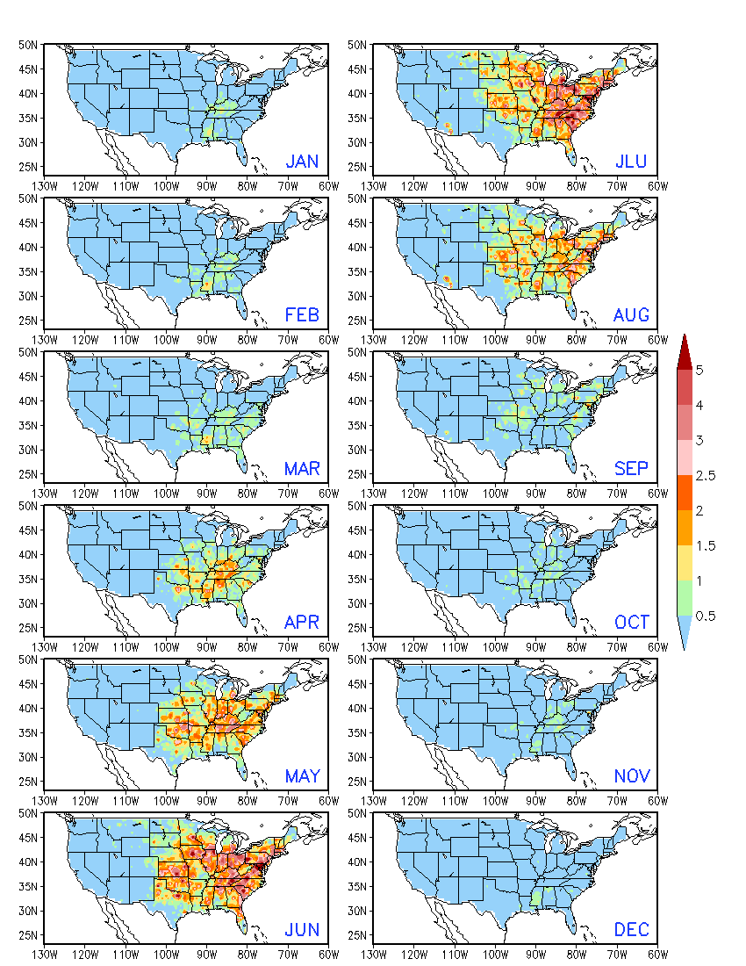
Seasonality
OBS Monthly Climatology 1996 – 2012
LSR: Tornado
LSR: Wind

Slide 8
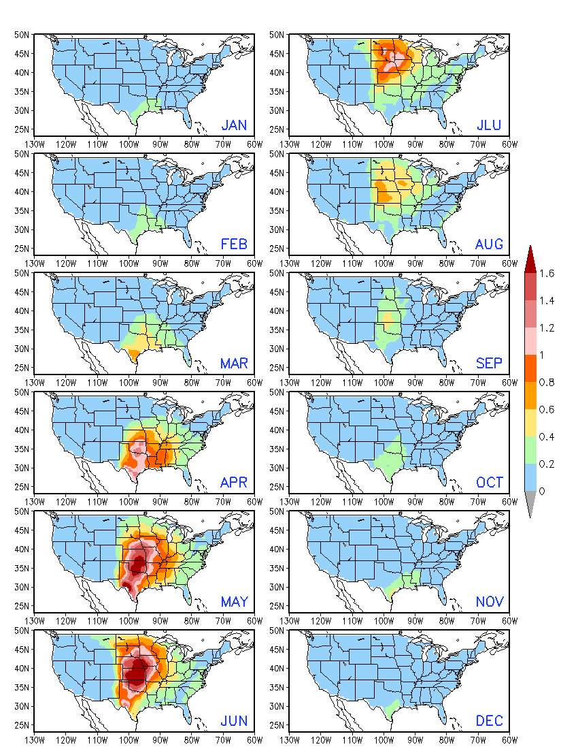
Seasonality
SCP Monthly Climatology 1996 – 2012
CFSR OBS
GEFS Day-1 FCST

Slide 9
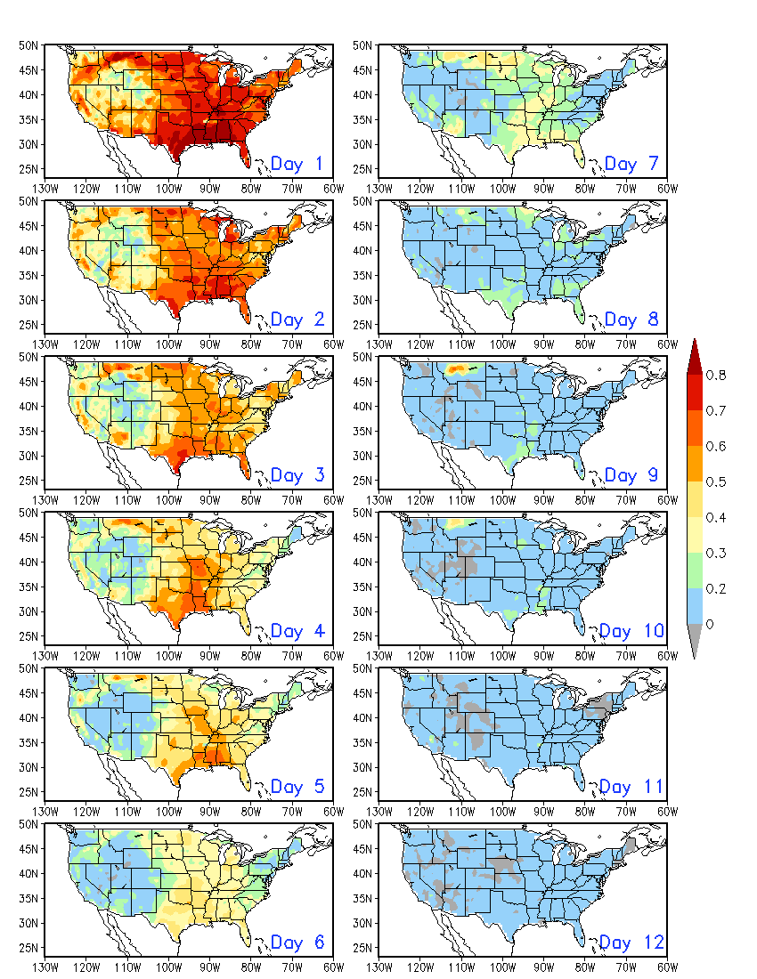
Skill for SCP
Anomaly Correlation: GEFS vs. CFSR 1996 – 2012
Daily Data
Week 1
Week 2
There is a sharp decrease in forecast skill after 7 days
Week 2 skill is much lower than Week 1.

Slide 10
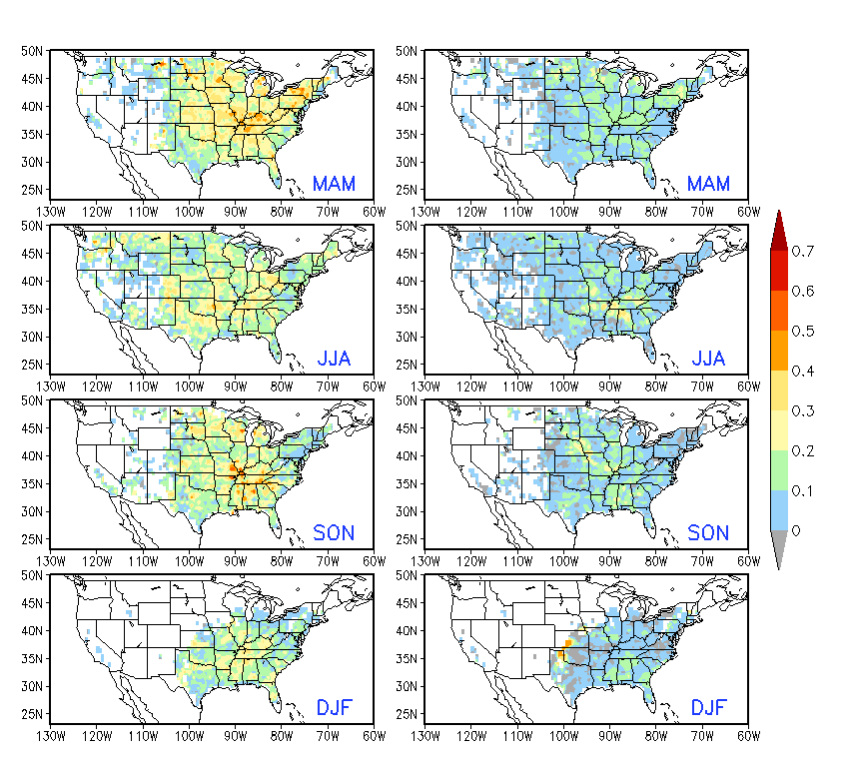
Hybrid Model
Relationship between GEFS SCP & OBS LSR3
Basis for dynamical-statistical prediction
3-month window
LSR3: hail + tornado + wind
Slightly stronger relationship in spring
Weak relationship in winter
Linear Regression Forecast Model
GEFS predicted SCP as a predictor
Week 1 and 2 forecasts of LSR3
Skill assessed with cross-validation
Week 1 Week 2
AC Skill
MAM 1996 – 2012

Slide 11
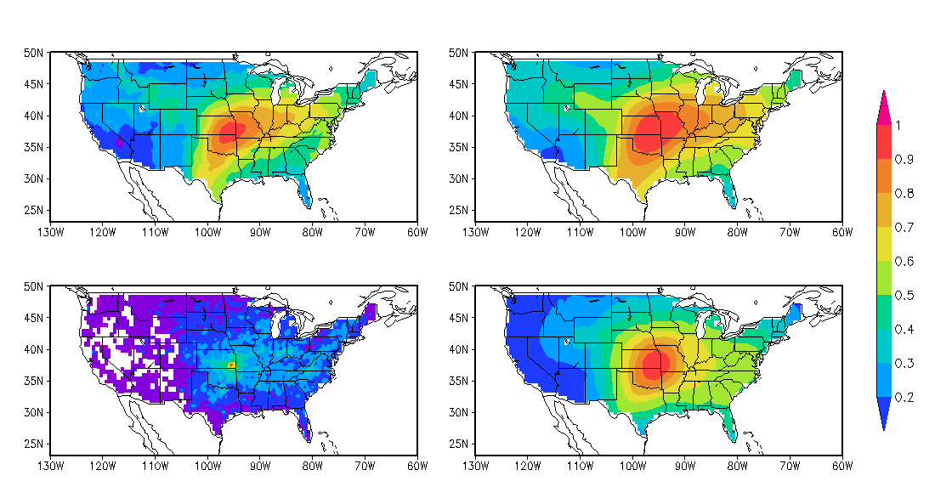
Improvement
Weekly data
1996 – 2012
One-point Correlation (95.5ºW, 37.5ºN)
CFSR SCP
CFSR SCP
×
0.5º×0.5º
5º×5º
LSR3
LSR3
0.5º×0.5º
5º×5º
Higher spatial coherence

Slide 12
Improvement
/cpc/home/hwang/2017_wk34SWx/GEFS_0.5/SCP_x-y/x_AreaAve.5x5_CORRECTION
MAM 1996 – 2012
Correlation (GEFS SCP vs. OBS LSR3) AC Skill
5º×5º
5º×5º
0.5º×0.5º
0.5º×0.5º

Slide 13
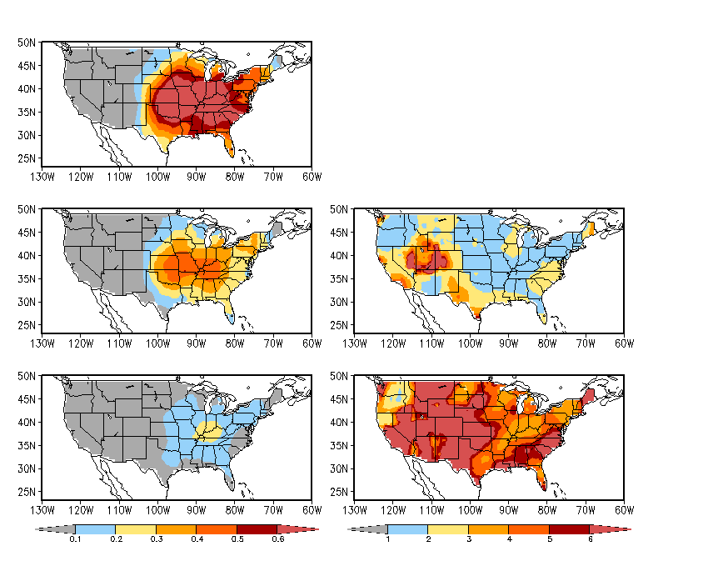
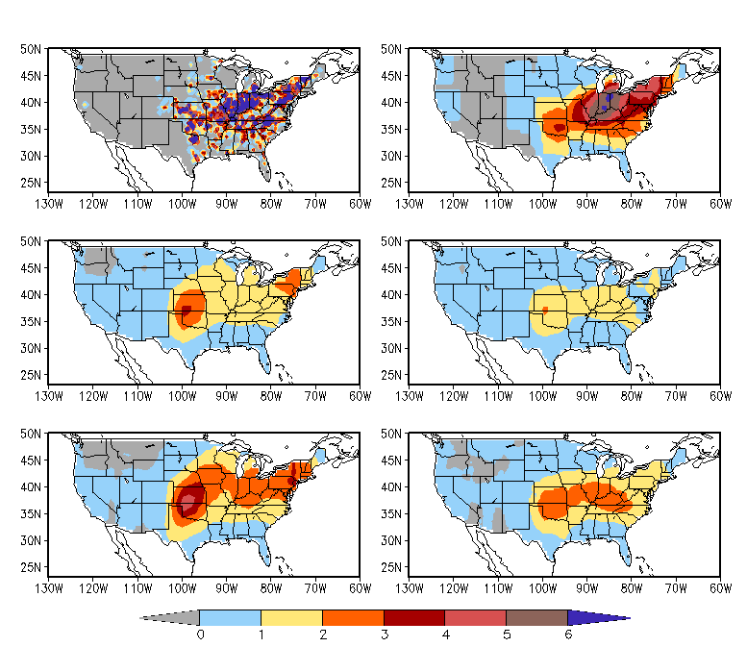
Improvement
MAM 1996 – 2012
May 24, 2011 Tornado Outbreak in Oklahoma
One EF-5, two EF-4, and two EF-3 tornadoes
Standard Deviation
May 24 – 30, 2011
OBS LSR3
OBS Weekly LSR3 0.5º×0.5º
OBS Weekly LSR3 5º×5º
Ratio: OBS/FCST
Week-1 FCST LSR3
OBS/Week-1 FCST
Week-1 FCST LSR3
Week-2 FCST LSR3
Week-2 FCST LSR3
OBS/Week-2 FCST
Week-1 FCST LSR3 (Adj)
Week-2 FCST LSR3 (Adj)
Much smaller SD in FCST
Ratio > 3 for Week-2 FCST
FCST = Anomaly_{FCST} + Clim_{OBS}
Adj FCST = Anomaly_{FCST} × Ratio + Clim_{OBS}

Slide 14
Summary
Following Carbin et al. (2016), SCP was selected as a variable to represent the large-scale environment and link the model forecast to severe weather.
The hybrid model forecasts suggest a low skill for week-2 severe weather.
The forecast can be improved by using 5º×5º area-averaged anomalies and the adjustment of anomaly amplitude.

Slide 15
Future Work
To extend the analysis for Weeks 3 and 4 using the CFSv2 45-day hindcast.
To explore other potential predictors for Week 3 – 4 severe weather.

