Slide 1
SST and OLR Relationship in Observations and CFS
Data:
Observations: Jan. 1982 – Dec. 2018
SST: Monthly mean NCDC SST, 1º × 1º
OLR: NOAA Interpolated OLR, monthly mean, 2.5º × 2.5º
CFSv2: Jan. 1982 – Dec. 2018 (hindcast and forecast)
1º × 1º
20 members
Scatter plots:
SST vs. OLR (averaged in the Niño 3.4 region)
Total field
Anomalies

Slide 2
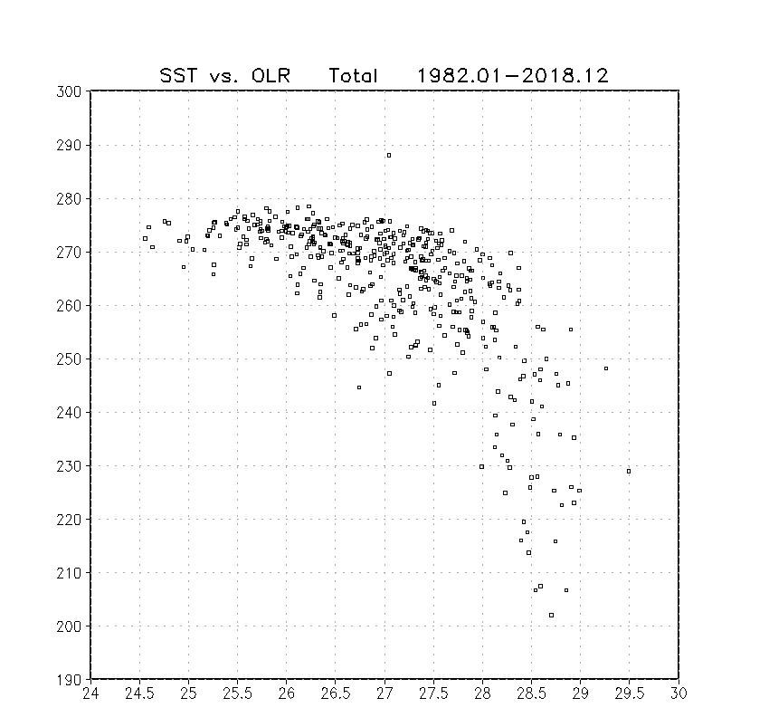
OBS
Monthly mean data
Both SST and OLR are the averages in the Niño 3.4 region.
OLR (W m^{–2})
OLR ≤ 240 W m^{–2}
→ Deep convection
SST threshold (28ºC) for deep convection
SST (ºC)

Slide 3
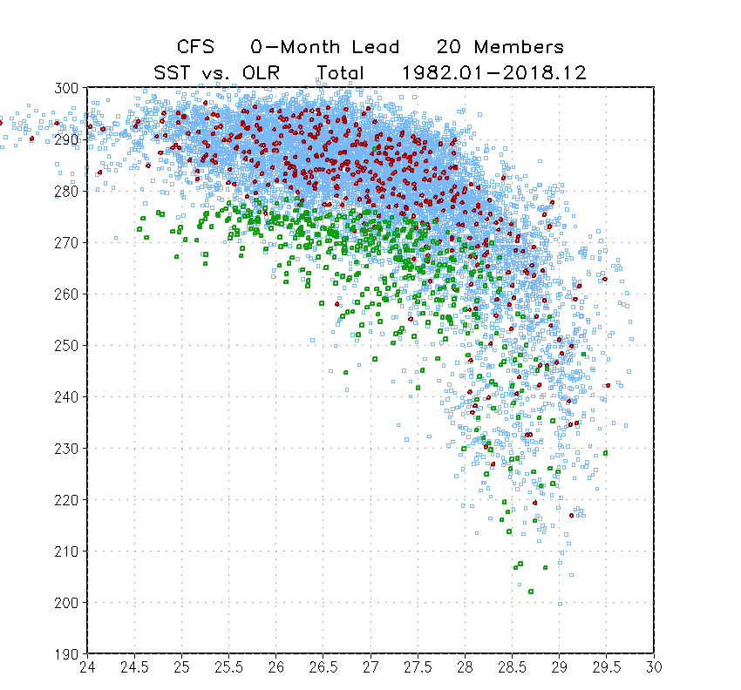
CFS
0-Month Lead
OLR (W m^{–2})
Observations
CFS 20 individual runs
CFS 20-member ensemble mean
SST (ºC)

Slide 4
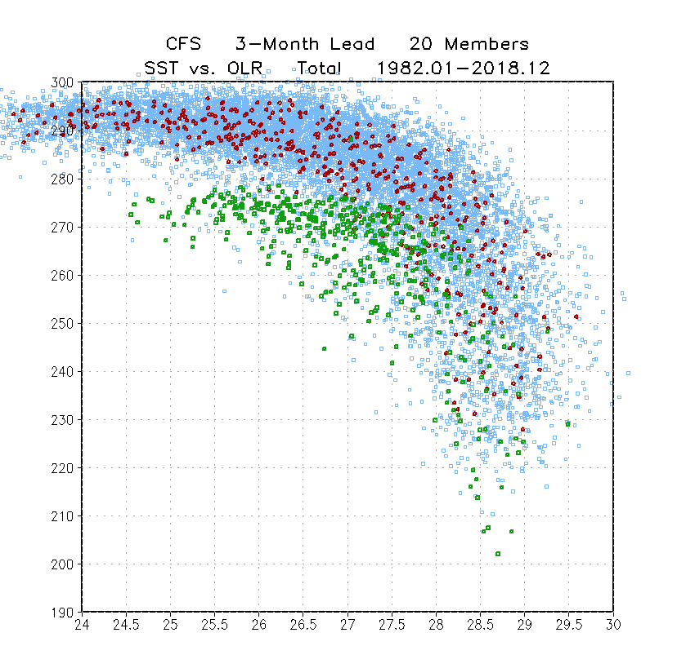
CFS
3-Month Lead
OLR (W m^{–2})
Observations
CFS 20 individual runs
CFS 20-member ensemble mean
SST (ºC)

Slide 5
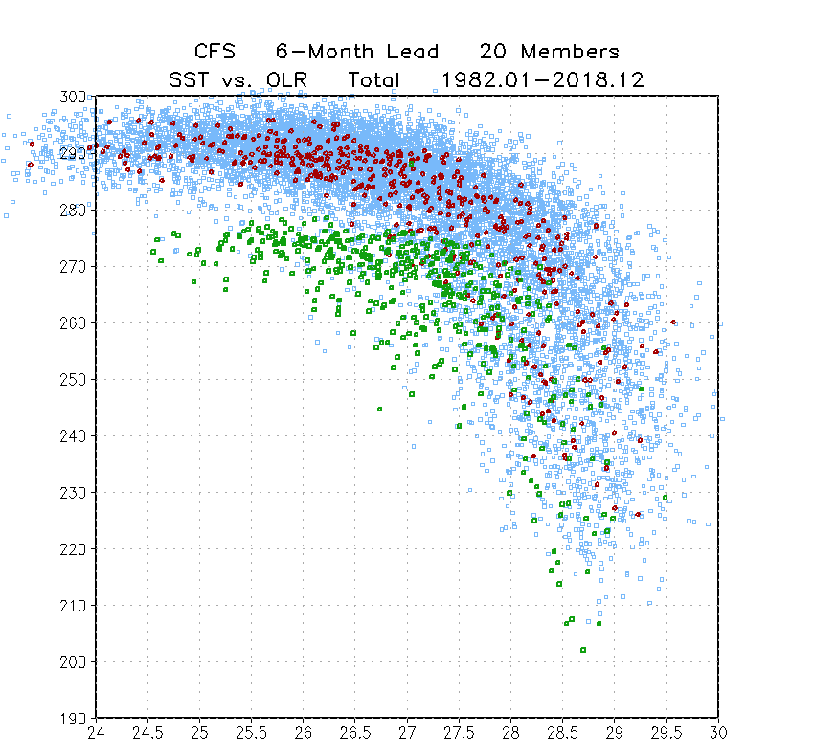
CFS
6-Month Lead
OLR (W m^{–2})
Observations
CFS 20 individual runs
CFS 20-member ensemble mean
SST (ºC)

Slide 6
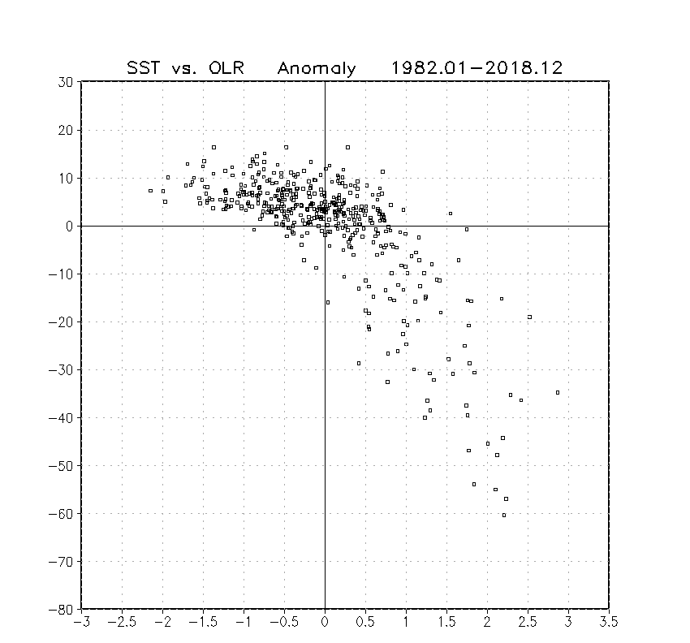
OBS
SST–OLR relationship:
Largely linear
Anomaly
OLR (W m^{–2})
SST (ºC)

Slide 7
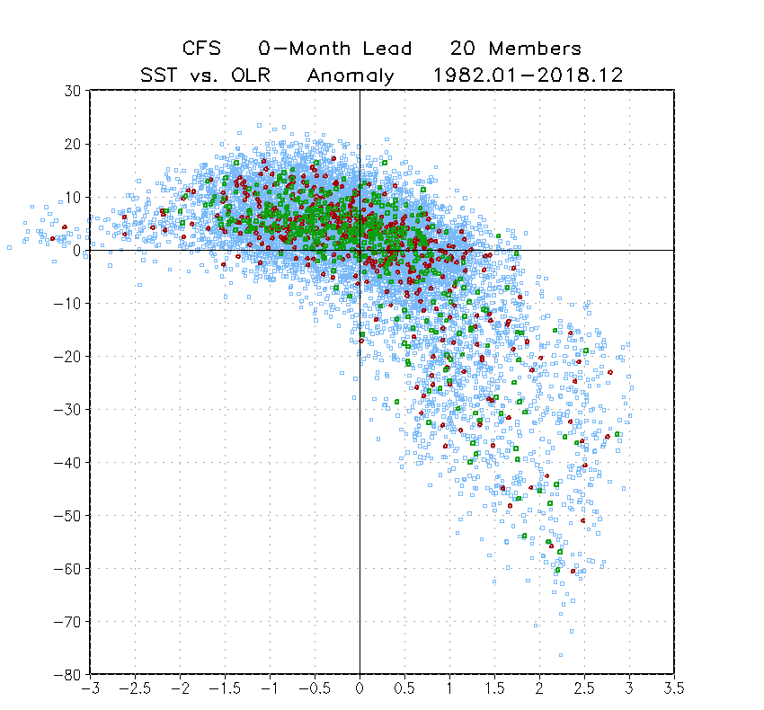
CFS:
0-Month Lead
Anomaly
OLR (W m^{–2})
Observations
CFS 20 individual runs
CFS 20-member ensemble mean
SST (ºC)

Slide 8
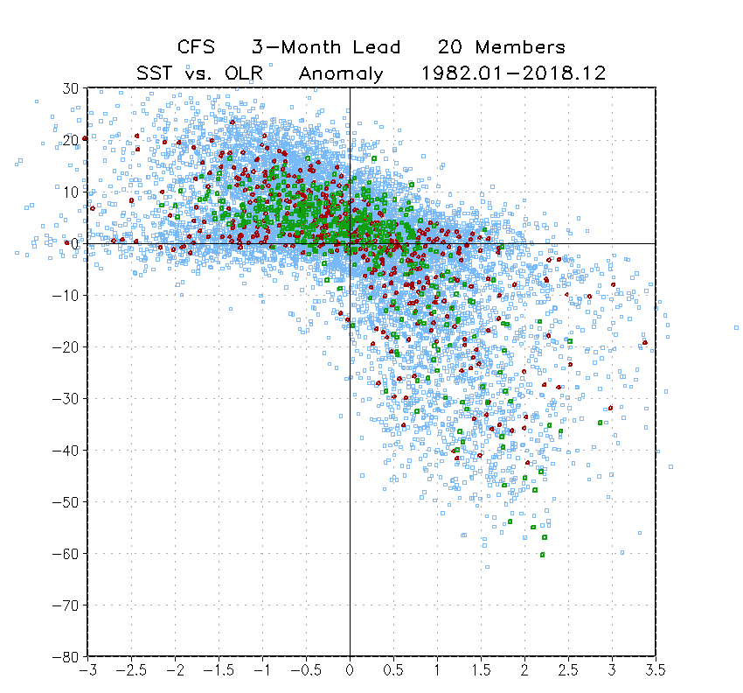
CFS
3-Month Lead
Anomaly
OLR (W m^{–2})
Observations
CFS 20 individual runs
CFS 20-member ensemble mean
SST (ºC)

Slide 9
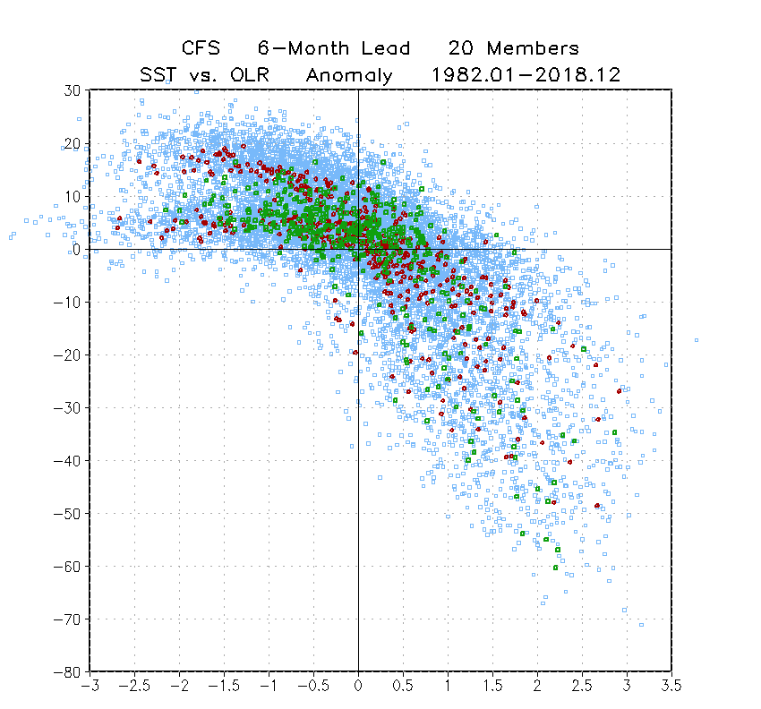
CFS
6-Month Lead
Anomaly
OLR (W m^{–2})
Observations
CFS 20 individual runs
CFS 20-member ensemble mean
SST (ºC)

Slide 10
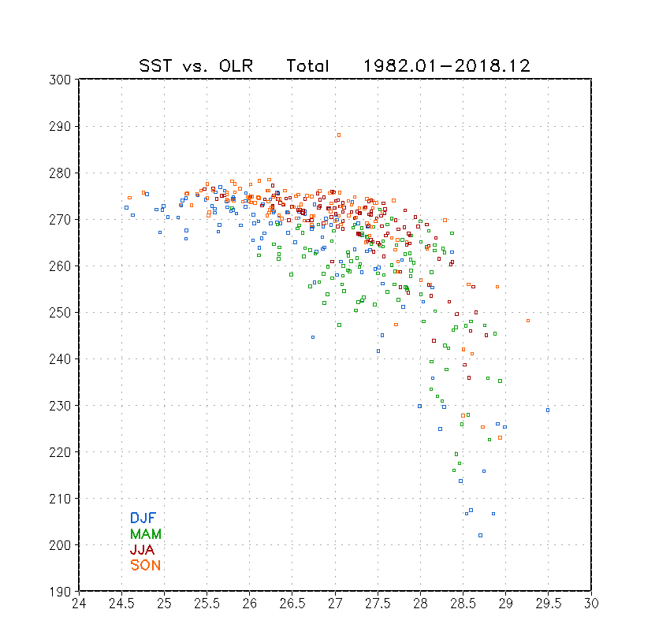
OBS: Seasonality
Monthly mean data
DJF: Dec, Jan, Feb
MAM: Mar, Apr, May
JJA: Jun, Jul, Aug
SON: Sep, Oct, Nov
JJA
SON
DJF
OLR (W m^{–2})
MAM
OLR ≤ 240 W m^{–2}
→ Deep convection
MAM
DJF
SST threshold (28ºC) for deep convection
SST (ºC)

Slide 11
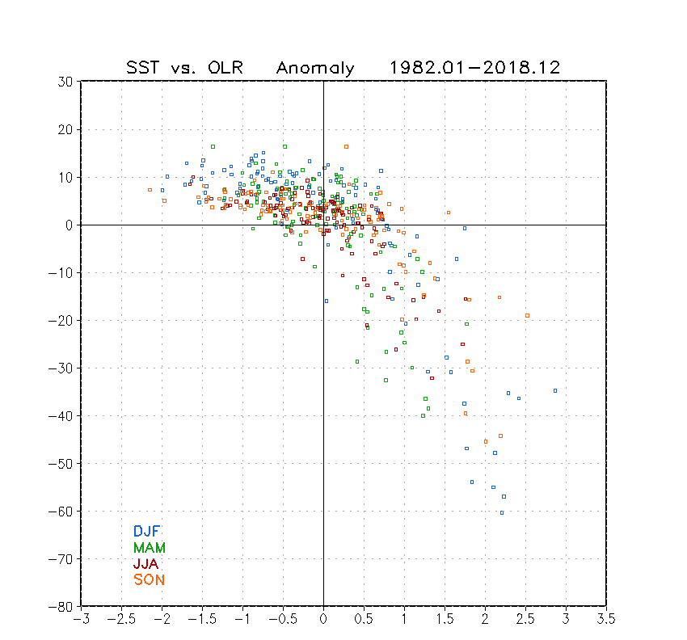
OBS: Seasonality
Anomaly
DJF: large amplitude
JJA, SON: small amplitude
DJF
SON
JJA
OLR (W m^{–2})
DJF
SST (ºC)

